Slide 1
Pin diode presentation
www.europeanspallationsource.se
17-06-28
Notes:
Only a quick presentation lost of stuff that I don’t know
Try to remove every equations and formula (as I know that we forget them)
Sorry for the quality of the picture did not spend time on it

Slide 2
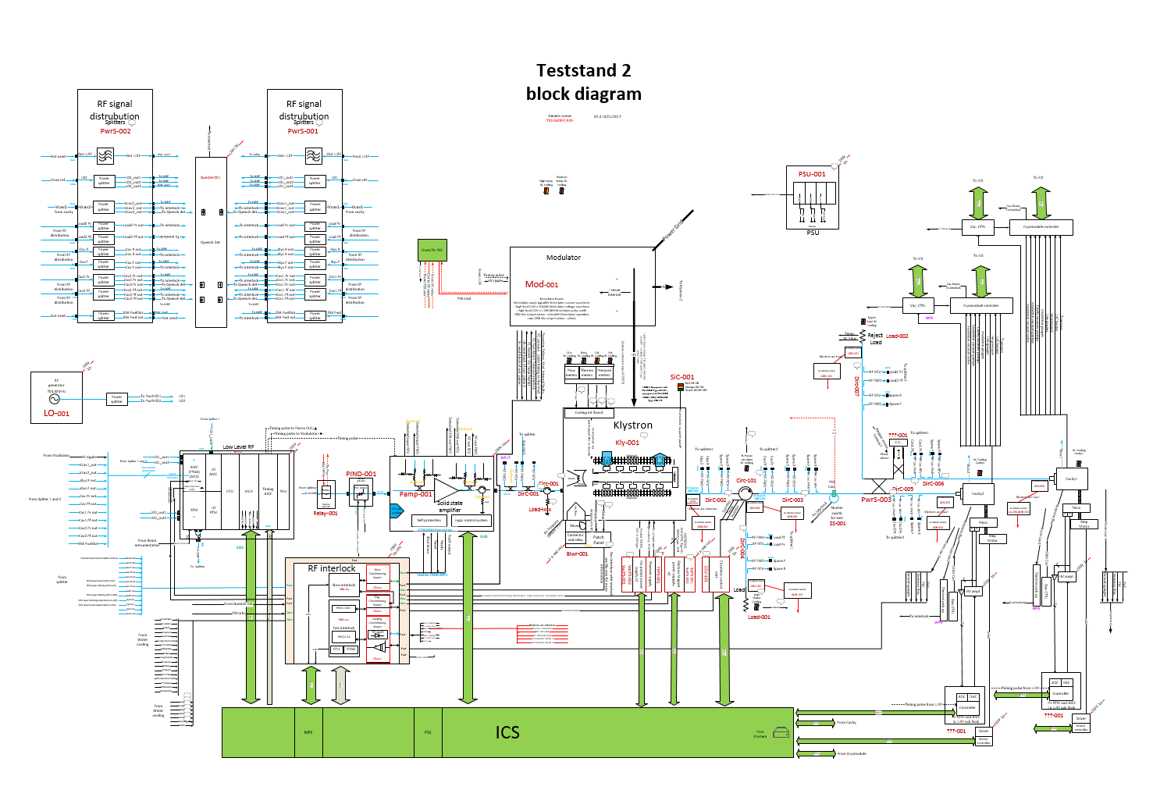
Two small boards in RF system (but key part of interlock)
Pin diode: to stop RF in less than 100ns

Slide 3
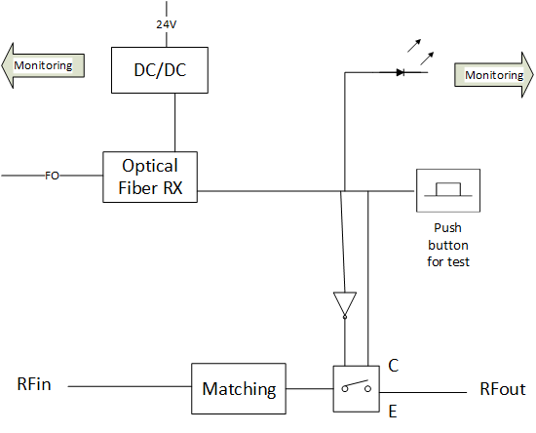
RF PIN diode with RX optical fiber receiver (1/2)
Block diagram
 | Description | Value |  |  | Unit
 |  | Min | Typ | Max
Frequency | input Frequency |  | 352/704 |  | MHz
switching time |  |  |  | 20 | ns
IL | Isertion Loss |  |  | 2 | dB
isolation | open state | 30 |  |  | dB
Isolation w/o | silation when VCC=0V | 30 |  |  | dB
VSWR in | On state |  |  | 1.3
VSWR out | On state |  |  | 1.3
VSWR in | Off state |  |  | 1.3
VSWR out | Off state |  |  | 1.3
command | TTL |  | 5 |  | V
IP1dB | 1dB compression point | 12 |  |  | dBm
Input power |  |  | 0 | 20 | dBm
power supply |  |  | 5 |  | V
consumption |  |  | 10 |  | mA
Specification
Interfaces:
RF in / RF out: interface with RF path
Fiber in: control of the PIN diode (from LPS)
Power supply (24V)
Ethernet connection (RJ45) monitoring to ICS

Slide 4
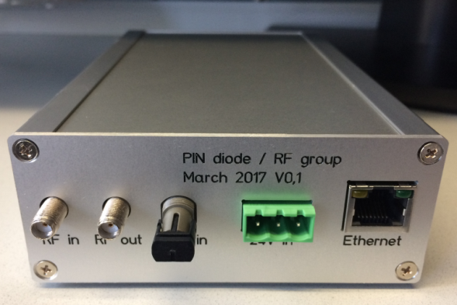
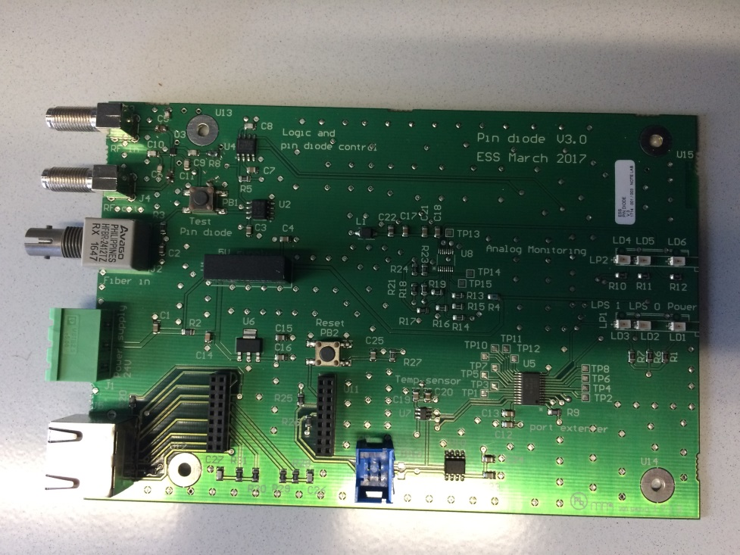
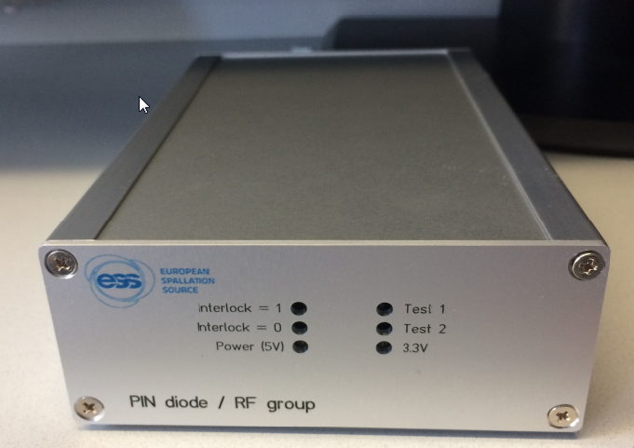
RF PIN diode with RX optical fiber receiver (2/2)
Design done for TS2
Design and manufacturing of the box for TS2 done
Back
Front

