Slide 1
RF Local Protection System
Critical Design review
Rafael Montaño
www.europeanspallationsource.se
17-06-28

Slide 2
Concepts
Machine State
Interfaces
Notes:
There is a brief summarize about the total system to be installed at ESS

Slide 3
FPGA Machine State
HV Enable (inhibit Modulator): Requires ion-pump digital set-point interlock, Modulator current/voltage high level interlock, Modulator ready signal, HV enable PLC command interlocks ok.
RF Enable: (pin-diode): Requires arc-detectors, Klystron output, circulator power detectors are not out of limits (signal latched whether the value has reached the threshold levels). RF enable PLC command interlock ok.
After the FPGA achieves the HV/RF enable status, there is required a signals processing to calculate the Modulator pulse width and repetition rate from the Modulator voltage waveform regarding HV enable. RF power average and RF pulse width interlocks for RF enable.
Note: for all statuses the PLC/FPGA will continue monitoring the interlocks according to the threshold defined by the user or digital interlocks where is required. It would be defined into the supervision conditions.
For more details see: \Collaboration Area\RF Systems\RF Local Protection System\MachineState and Interlock logic
→ ToshibaStateMachine_FIM.xlsx

Slide 4
RF and HV Enable
RF Enable: The RF Drive must be removed within less to 10 us under any of conditions listed below:
Input | Description
Arc detector | The RF drive must be removed if any arc is detected
Power detector | Max power forward/reflecting exceeds the maximum limits defined by the user
Klystron RF input - pulse width (RF power detector) | RF pulse width exceeds the maximum width parameter defined by the user
Klystron RF output - power average (RF power detector) | Power average measured by the FIM exceeds the limits defined by the user according to the HV amplifier type.
PLC RF enable | PLC RF stop command detected
HV Enable: The HV Modulator permissions must be removed within less to 10 us under any of conditions listed below:
Input | Description
Modulator current/voltage waveform | Current/voltage waveform exceed the maximum limits defined by the user.
HV pulse repetition rate (voltage waveform) | HV voltage repetition rate should be measured from the voltage waveform analogue input. The pulse specification should be defined according to the amplifier type (default value 14Hz)
HV pulse width (voltage waveform) | HV voltage pulse width exceeds the maximum limits defined by the user (default value 3.2 ms)
Solenoid current deviates | Solenoid current deviates more than +/-5% from the value given by the user
Ion-pump | Ion pump interlock
PLC HV enable | PLC HV stop command detected

Slide 5
FPGA Machine State
HVON = 0
RFON = 0
HVON = 1
RFON = 0
HVON = 1
RFON = 0
HVON = 1
RFON = 1
HVON = 1
RFON = 1
Wait for nominal values
HvSupCond
Wait for nominal values
RfSupCond AND
HvSupCond
HvCmd AND
HvPreCond
RfCmd AND
RfPreCond
Idle
HVON Pre-arm
HVON
RFON
Pre-arm
RFON
Not HvCmd OR
HvSupCond
Not RfCmd OR
RfSupCond
HV fault
RF fault
IF NOT INTERLOCK1 AND
NOT INTERLOCK2 AND
NOT INTERLOCK3 THEN
  HvPreCond = 1
ELSE
  HvPreCond = 0
END_IF;
HVON = 0
RFON = 0
HVON = 1
RFON = 0

Slide 6
Concepts
Interfaces
Notes:
There is a brief summarize about the total system to be installed at ESS

Slide 7
What is covered by the LPS?
RF Power
Detector
RF Power
Detector
Coupler
Arc
Detector
Arc
Detector
Arc
Detector
Modulator Fast abort

Slide 8
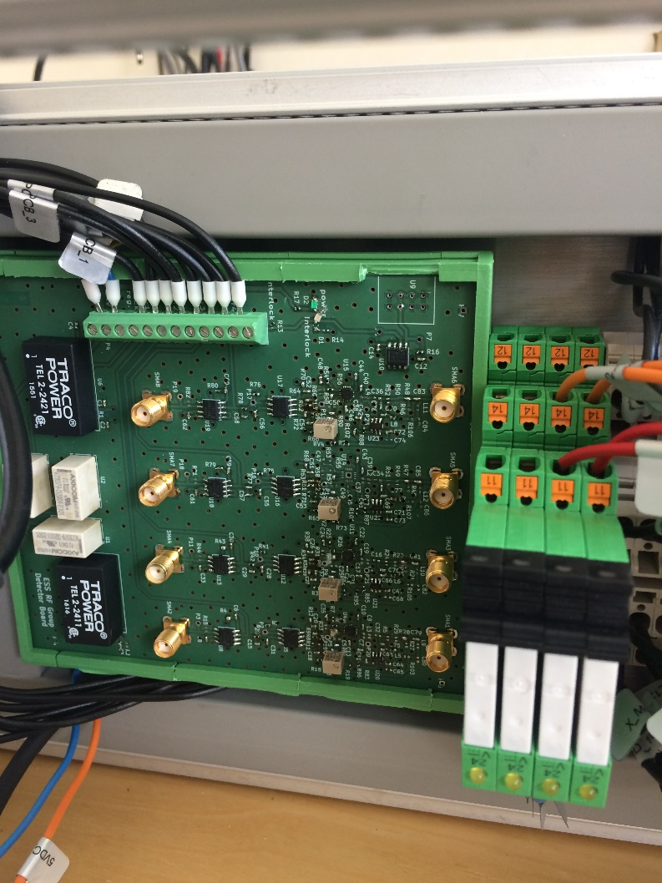
FIM – RF-DC converter based on LTC5530

Slide 9
Piecewise calibration – measured data
Input [mV] | Output [dBm] | Output [W] | Slope | Diff with next | Est from prev | Est err |  | Input [V] | Output [W] | Slope
-0.428 | -40 | 38.01893963 | 41103.75191 | 0.002 |  |  |  | -0.42800000000000 | 38.0189396320561000 | 41103.75191484260000
-0.426 | -35 | 120.2264435 | 259962.9529 | 0.001 |  |  |  | -0.42600000000000 | 120.2264434617410000 | 259962.95285882000000
-0.425 | -30 | 380.1893963 | 378388.1787 | 0.001 |  |  |  | -0.42500000000000 | 380.1893963205620000 | 378388.17870862200000
-0.424 | -27 | 758.577575 | 443686.8596 | 0.001 |  |  |  | -0.42400000000000 | 758.5775750291840000 | 443686.85958823100000
-0.423 | -25 | 1202.264435 | 351598.1417 | 0.002 |  |  |  | -0.42300000000000 | 1202.2644346174200000 | 351598.14167291600000
-0.421 | -23 | 1905.460718 | 371497.0008 | 0.003 |  |  |  | -0.42100000000000 | 1905.4607179632500000 | 371497.00081292300000
-0.418 | -21 | 3019.95172 | 260647.4143 | 0.003 |  |  |  | -0.41800000000000 | 3019.9517204020200000 | 260647.41426786600000
-0.415 | -20 | 3801.893963 | 328135.6533 | 0.003 |  |  |  | -0.41500000000000 | 3801.8939632056200000 | 328135.65334025600000
-0.412 | -19 | 4786.300923 | 619647.4688 | 0.002 |  |  |  | -0.41200000000000 | 4786.3009232263800000 | 619647.46875859400000
-0.41 | -18 | 6025.595861 | 312035.9779 | 0.005 |  |  |  | -0.41000000000000 | 6025.5958607435700000 | 312035.97790965900000
-0.405 | -17 | 7585.77575 | 491037.5275 | 0.004 |  |  |  | -0.40500000000000 | 7585.7757502918500000 | 491037.52748062900000
-0.401 | -16 | 9549.92586 | 412119.7477 | 0.006 |  |  |  | -0.40100000000000 | 9549.9258602143700000 | 412119.74765996700000
-0.395 | -15 | 12022.64435 | 622593.6276 | 0.005 |  |  |  | -0.39500000000000 | 12022.6443461742000000 | 622593.62763759000000
-0.39 | -14 | 15135.61248 | 489874.3369 | 0.008 |  |  |  | -0.39000000000000 | 15135.6124843621000000 | 489874.33690879700000
-0.382 | -13 | 19054.60718 | 704817.4301 | 0.007 |  |  |  | -0.38200000000000 | 19054.6071796325000000 | 704817.43008034500000
-0.375 | -12 | 23988.32919 | 690132.0015 | 0.009 |  |  |  | -0.37500000000000 | 23988.3291901949000000 | 690132.00153613600000
-0.366 | -11 | 30199.5172 | 710856.5844 | 0.011 |  |  |  | -0.36600000000000 | 30199.5172040202000000 | 710856.58436691400000
-0.355 | -10 | 38018.93963 | 820339.1334 | 0.012 |  |  |  | -0.35500000000000 | 38018.9396320562000000 | 820339.13335064400000
-0.343 | -9 | 47863.00923 | 885210.6697 | 0.014 |  |  |  | -0.34300000000000 | 47863.0092322639000000 | 885210.66965513500000
-0.329 | -8 | 60255.95861 | 1040119.926 | 0.015 |  |  |  | -0.32900000000000 | 60255.9586074358000000 | 1040119.92636552000000
-0.314 | -7 | 75857.7575 | 1155382.418 | 0.017 |  |  |  | -0.31400000000000 | 75857.7575029186000000 | 1155382.41760148000000
-0.297 | -6 | 95499.2586 | 1177484.993 | 0.021 |  |  |  | -0.29700000000000 | 95499.2586021438000000 | 1177484.99331418000000
-0.276 | -5 | 120226.4435 | 1353464.408 | 0.023 |  |  |  | -0.27600000000000 | 120226.4434617410000000 | 1353464.40790780000000
-0.253 | -4 | 151356.1248 | 1507305.652 | 0.026 |  |  |  | -0.25300000000000 | 151356.1248436210000000 | 1507305.65202707000000
-0.227 | -3 | 190546.0718 | 2055717.504 | 0.024 |  |  |  | -0.22700000000000 | 190546.0717963250000000 | 2055717.50440100000000
-0.203 | -2 | 239883.2919 | 1826820.004 | 0.034 |  |  |  | -0.20300000000000 | 239883.2919019490000000 | 1826820.00406630000000
-0.169 | -1 | 301995.172 | 2172061.786 | 0.036 |  |  |  | -0.16900000000000 | 301995.1720402030000000 | 2172061.78556554000000
-0.133 | 0 | 380189.3963 | 2343826.095 | 0.042 |  |  |  | -0.13300000000000 | 380189.3963205620000000 | 2343826.09528755000000
-0.091 | 1 | 478630.0923 | 2636797.739 | 0.047 |  |  |  | -0.09100000000000 | 478630.0923226390000000 | 2636797.73939828000000
-0.044 | 2 | 602559.5861 | 2943735.641 | 0.053 |  |  |  | -0.04400000000000 | 602559.5860743590000000 | 2943735.64065709000000
0.009 | 3 | 758577.575 | 3273583.517 | 0.060 |  |  |  | 0.00900000000000 | 758577.5750291840000000 | 3273583.51653758000000
0.069 | 4 | 954992.586 | 3746543.161 | 0.066 |  |  |  | 0.06900000000000 | 954992.5860214390000000 | 3746543.16054510000000
0.135 | 5 | 1202264.435 | 4206713.7 | 0.074 |  |  |  | 0.13500000000000 | 1202264.4346174200000000 | 4206713.70025398000000
0.209 | 6 | 1513561.248 | 4610581.994 | 0.085 |  |  |  | 0.20900000000000 | 1513561.2484362100000000 | 4610581.99443574000000
0.294 | 7 | 1905460.718 | 5305077.431 | 0.093 |  |  |  | 0.29400000000000 | 1905460.7179632500000000 | 5305077.43071227000000
0.387 | 8 | 2398832.919 | 18821781.86 | 0.033 |  |  |  | 0.38700000000000 | 2398832.9190194900000000 | 18821781.86007680000000
0.42 | 9 | 3019951.72 | #REF! | #REF! |  |  |  | 0.42000000000000 | 3019951.7204020200000000 | #REF!

Slide 10
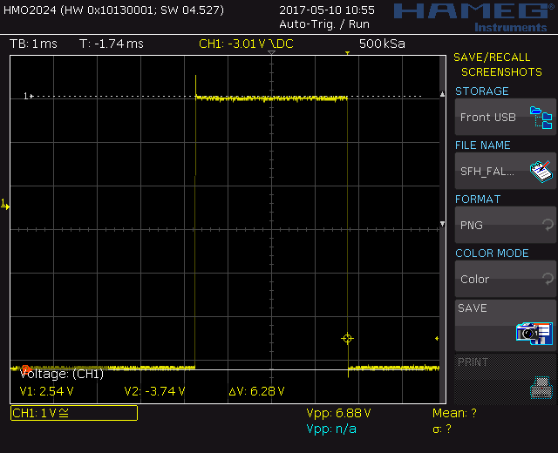
RF Power - Pulse Monitoring

Slide 11
RF Detector calibration

Slide 12
CERN Arc detector configuration

Slide 13
AFT Arc detector configuration
Light
detection
To FIM

Slide 14
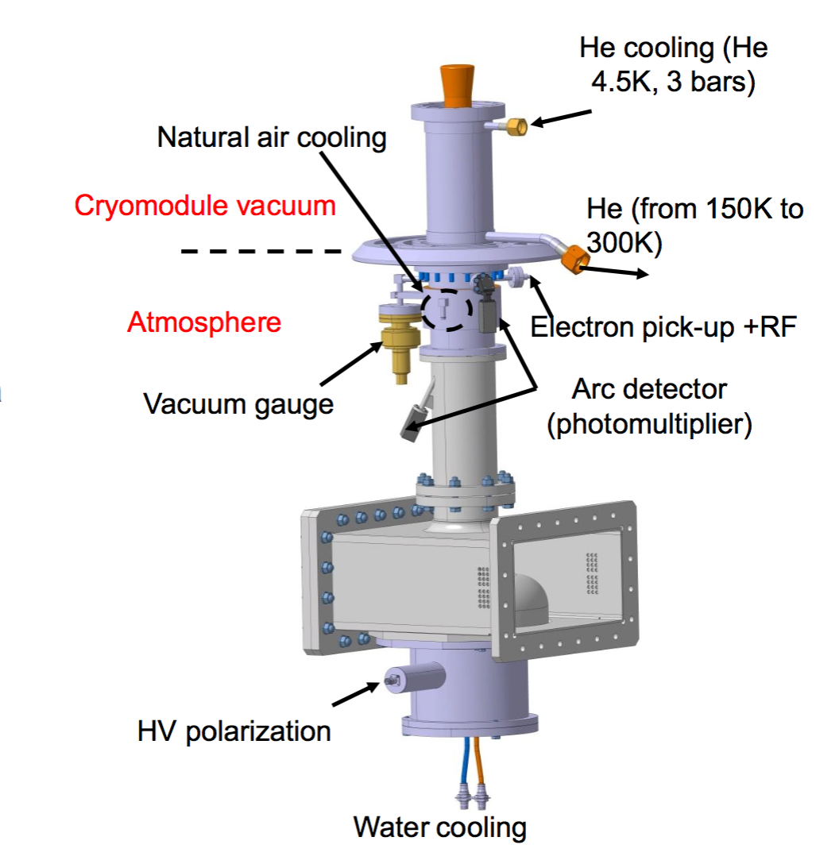
RFLPS FIM – Cavity Interface
The RF drive must be removed within less to 10 us under any of the conditions listed below:
Vacuum arc-detector
Atmosphere arc-detector
Vacuum controller interlock (digital interlock)
Quench detector
e pick-up (antenna)
Cavity ready chain

Slide 15
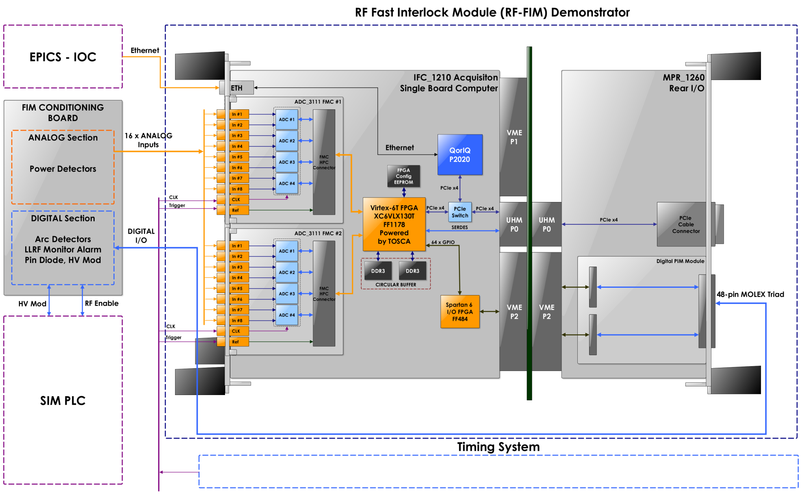
Fast Interlock Module prototype overview

Slide 16

Thanks!

