Slide 1
E-Pick up presentation
www.europeanspallationsource.se
17-06-20

Slide 2
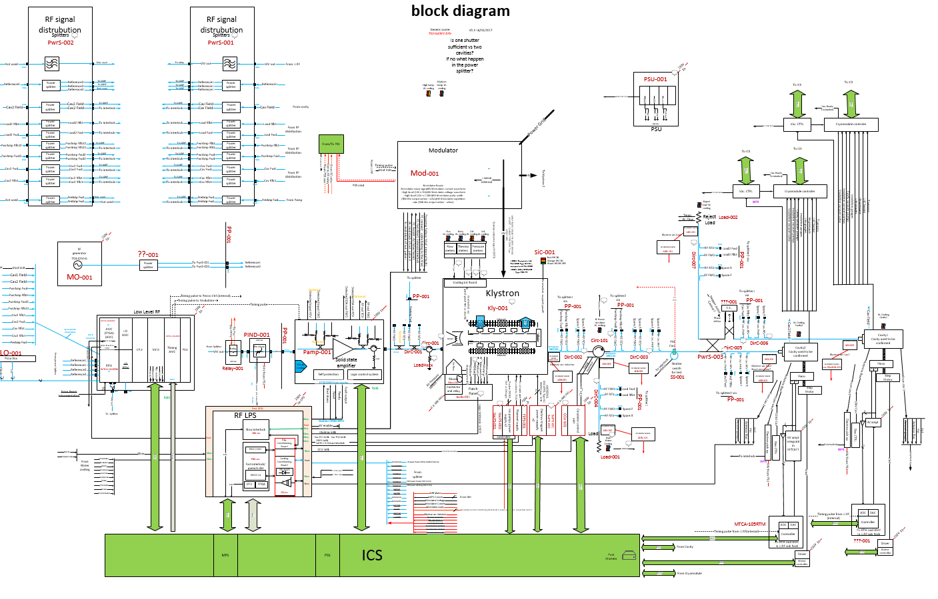
Block diagram
E- Pick Up: protect the coupler of the cavity

Slide 3
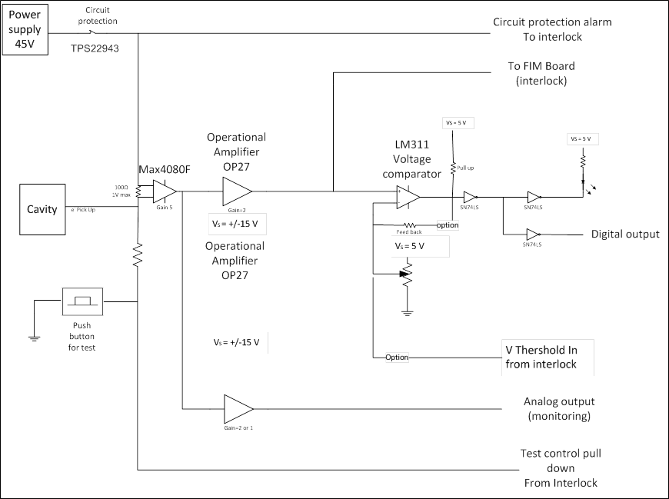
Specification
Name | value | Unit | Comments
Biasing | 48 | V | Why this value?
Current detector | Max4080 | used in CEA | What version is used some alternatives (see below) exist some have better performance but a compromise need to be done
current protection to be added
Gain needed | 5+2 | V/V | AOP if needed
Output | 0-10 | V
connector for the E pick Up | SMA | at CEA
Gain accuracy | 0.1 | % | typ. given by MAx4080 datasheet only
Vin Max | 1 | V | for 10 mA the resistor should be 100 Ω
Current we want to detect | 0 to several 10mA |  | TBC
Max current | 10 | mA
Min curent to detect | 2.5 | mA | typ
test |  |  | Manual and remote
Do we use a comparator or to ADC
speed | 10 | us Max | 5us Measured from CEA 0-5V
hysteresis |  |  | Don't need keep it as an option
Test |  |  | Push button and remote
Design done
Specification
Interfaces
Power supply 24V
Cavity input (current leakage to measure)
Analog output to LPS
Fiber in from LPS (for Test)
Ethernet (RJ45) for monitoring (ICS)

Slide 4
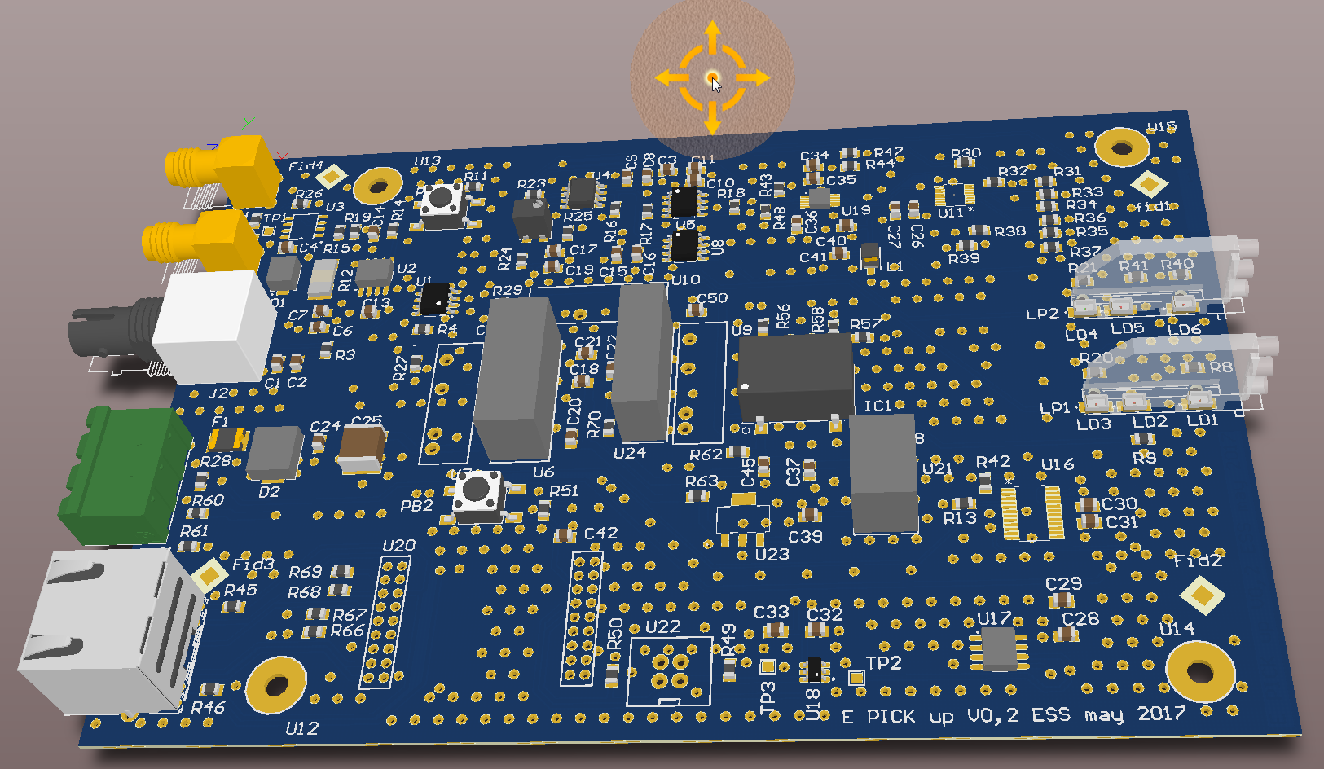
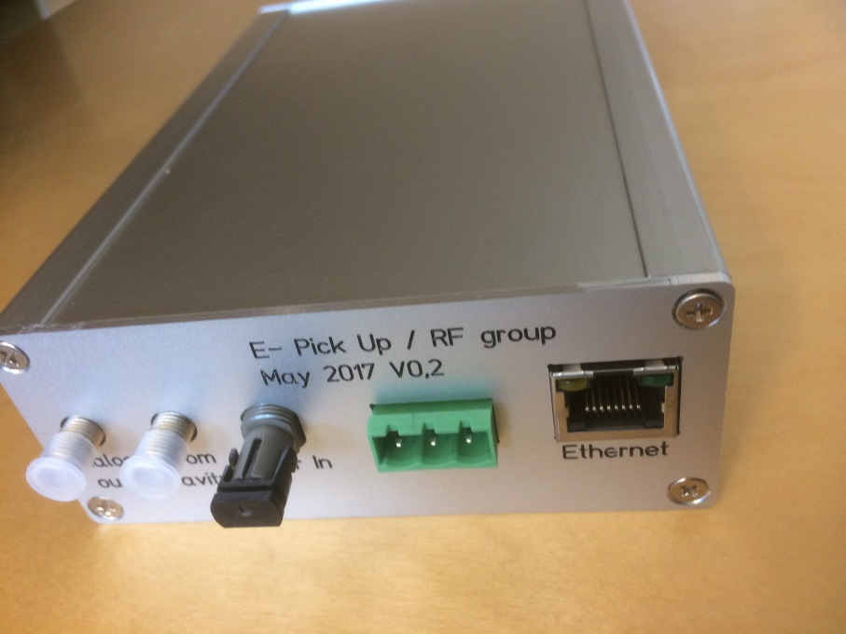
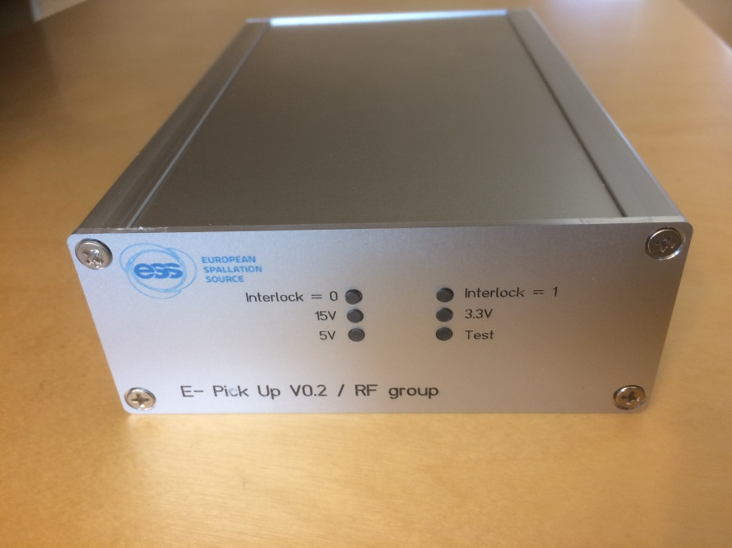
Electron pick up (2/3)

