Slide 1
RF detector
www.europeanspallationsource.se
17-06-21
Notes:
Only a quick presentation lost of stuff that I don’t know
Try to remove every equations and formula (as I know that we forget them)
Sorry for the quality of the picture did not spend time on it

Slide 2
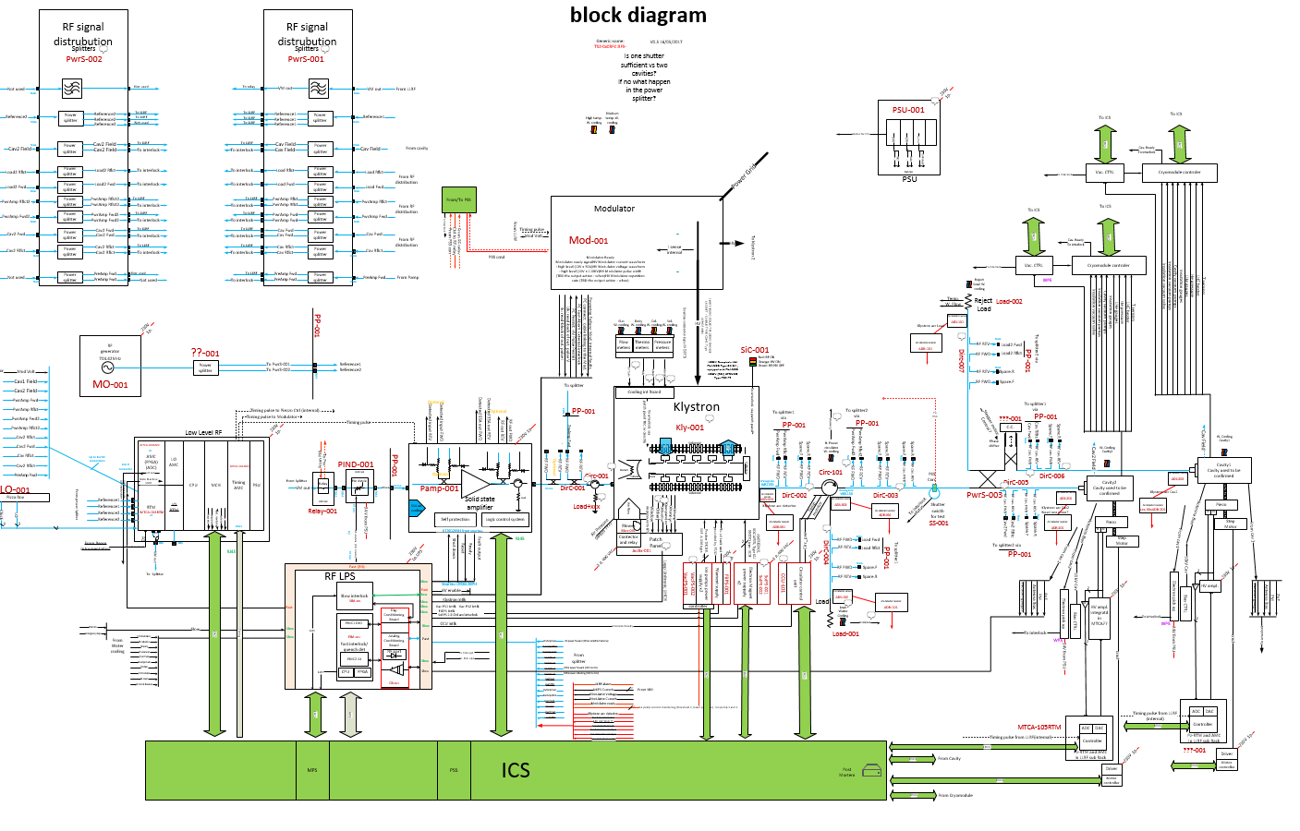
Block diagram
RF detector: measure the RF power at different stages

Slide 3
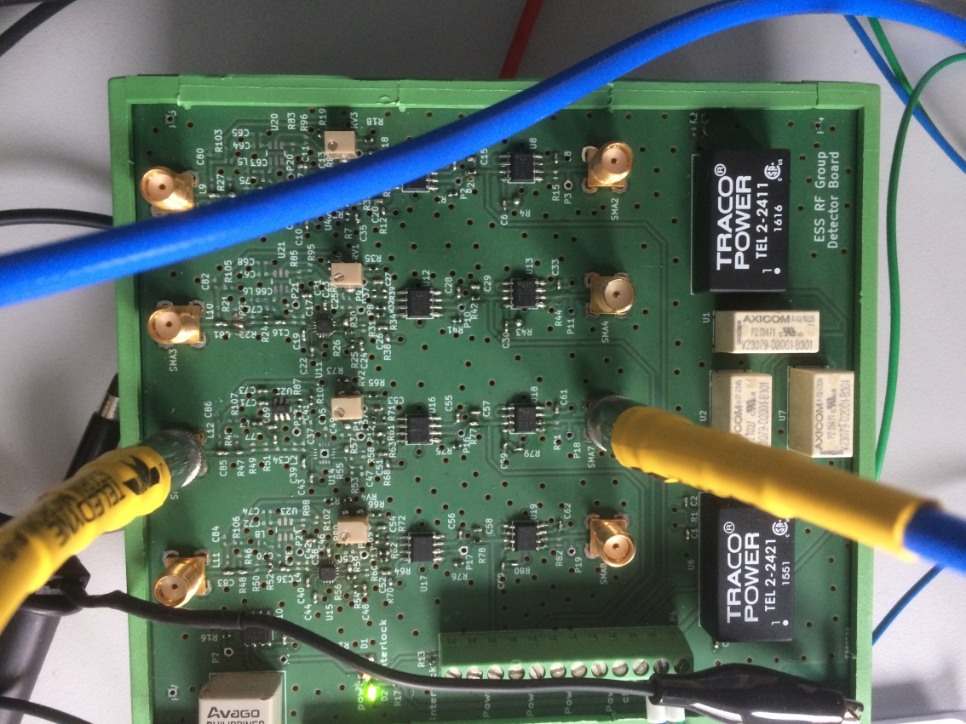
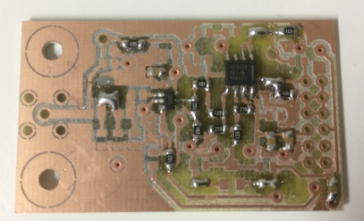
RF detector
Design done
Specification
Name | Description | Value | Unit | Comments
Frequency | Input Frequency | 704 | MHz | It will be possible to use it also at 352 MHZ if we don't use the input flter C7 and L3, or be retuning it
Pulse width |  | 3.5 | ms | ms
Pulse frequency |  | 14 | Hz | Hz
Pin |  | 7 to -40 | dBm | can be lower using the attenuator R27 R28 R29
Vout |  | -4 to 4V | V
Vout in case of failure |  | -5 to -4.5 | V | voltage if the detector is KO and OPA still operational.
rise time | time to detect an over power | 1 | us
Dynamic range |  | 30 | dB
Error over 20 dB dynamic |  | 0.1 | dB | for detector only waiting for feed back for measurements
Band width |  | 3 | GHz | or smaler
Operation Conditions | Description | Value | Unit | Unit
 |  | Min
Temperature |  | 25 | °C | °C
Humidity |  |  | % | %
Weight |  |  | Kg | Kg
Supply voltage |  | 24 | V | V
Size |  | 124x108 | mm | mm

