Slide 1
Hardware and Firmware for Fast Interlock Module
Timo Korhonen
ICS Chief Engineer
www.europeanspallationsource.se
27 June 2017

Slide 2
Overview
FIM Module overview
IOxOS IFC1410 digital platform
  ADC3117, Digital I/O interfaces
Signal processing
Machine State
EPICS communication
BIS interface
Summary

Slide 3
Fast Interlock Module
Component of the RF Local Protection System
Defined and specified by the RF Group
  Rafael Montano in particular
Implemented on ICS standard hardware platform
  IFC_1410 MTCA.4 board
  Prototype on IFC_1210 (predecessor of 1410, VME)
    Proof-of-principle but implements all functions
ICS has supported implementation
  FPGA programming (IOxOS SA)
  EPICS integration (ESS Lund)
  Machine Protection System integration
This talk concentrates on the final MTCA.4 implementation.

Slide 4
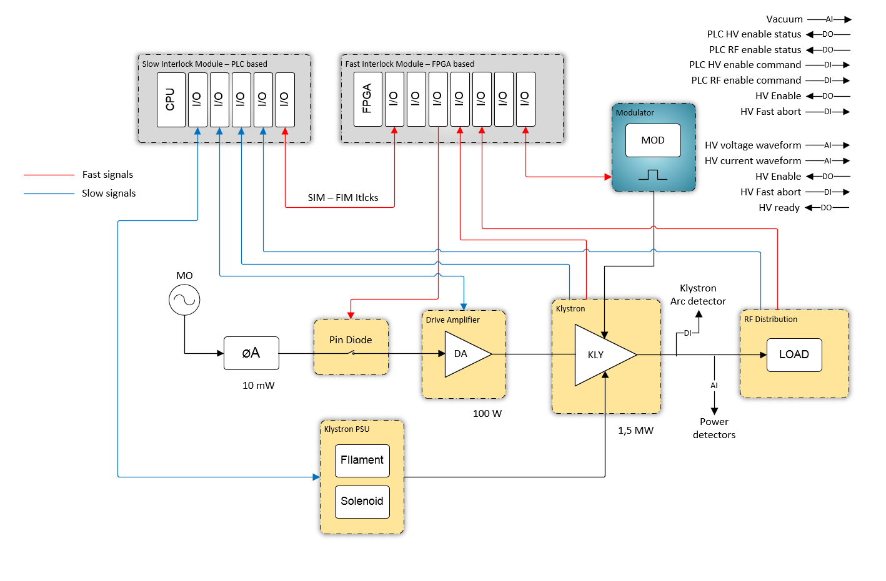
Fast Interlock Module (FIM)
FIM
Basic requirements:
React in microseconds range
Process analog and digital signals
  16-bit ADC, running at 1 MSPS
  Digital I/O sampled at 1 MHz
Point-to-point link to the Slow Interlock Module (SIM)
Interfaces to
  Pin diode
  Modulator
  Klystron
  RF load

Slide 5
IFC1410
A FMC carrier board with two (HPC) FMC slots
  FMC = FPGA Mezzanine Card, VITA-57 industrial standard
    Defines connections from an add-on board to a FPGA
  Fairly new but widely spread standard.
Latest (at the moment) generation FPGA
  Xilinx Kintex Ultrascale KU040
    RAM attached to the FPGA
On-board CPU to run EPICS control system
  4-core Hyperthreaded (8 virtual cores) 64-bit CPU
  Autonomous operation
TOSCA-III Firmware framework
  “operating system” of the FPGA
  Based on PCI Express (Network on Chip)
  Full source code available

Slide 6
IFC_1410 board without FMC modules

Slide 7
IFC1410 overview
BIS interface could also be implemented on a Rear Transition Module
FMC slot #1
BIS special
Mezzanine
(backside mounted)
CPU
FPGA
Xilinx
KU040
FMC slot #2

Slide 8
Digital platform support
IFC1410
  ICS-supported platform
    Primary long-term choice
  Support from PSI (in-kind)
    1 FPGA engineer, 1 SW engineer full time, 2 more will be employed
    Part-time support of 7 more people (controls, LLRF, instrumentation)
    Frees up ESS internal staff for integration tasks
  Hardware also contributed in-kind
    Issued “free-of-charge” to users

Slide 9
I/O Modules (FMC format)
ADC_3117
  FMC add-on card for analog signal inputs
  More on next slide
DIO FMC (name TBD)
  16 Ch digital in, 16 Ch digital out
    A simple board, can be modified easily if need be.
    Basically a FMC of an existing card
  Has been ordered, waiting for first batch

Slide 10
ADC 3117
Twenty(20) channels ADC 16-bit 5 Msps
  Latest generation Linear Technology LT2323-16/14
  Dual channel ADC
Differential Inputs with SW selectable range:
  +/- 10V, +/- 5V, +/- 2.5V Differential
Two Analog outputs driven from 16-bit DAC8563T
  0 .. +/-10V output range
Two(2) 3M Shrunk Delta Ribbon (SDR) Right Angle Connectors
  20 ADC inputs (Signal + GND) or Signal+/Signal-)
  2 DAC outputs
  2 x External Clock Reference / Trigger Input/Output
Maximum 6 [W] power dissipation

Slide 11
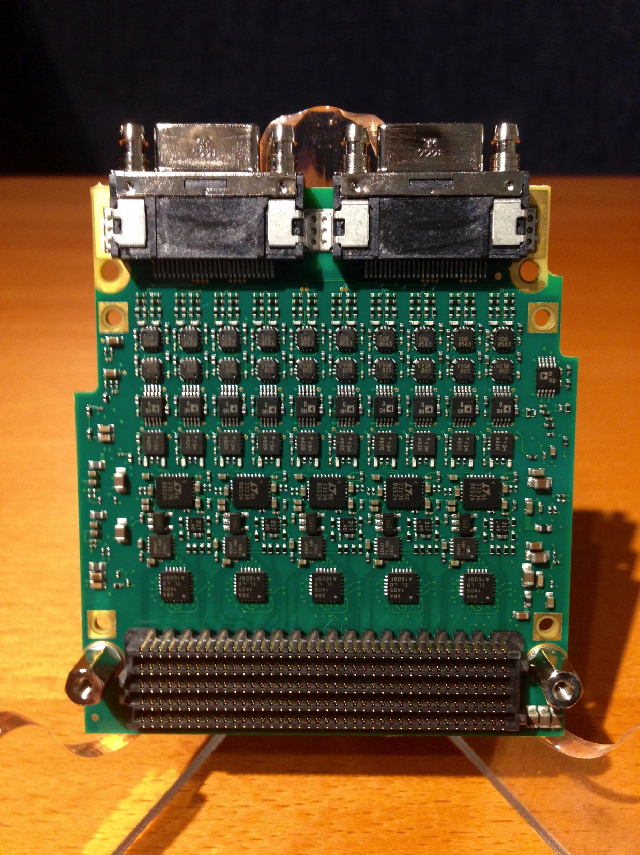
ADC_3117
3M connectors
Preamp section
ADCs
FMC connector

Slide 12
Signal flow
ADC_3117
MPS/BIS connection either via Rear Transition Module or add-on on IFC1410.
DIO_xxx

Slide 13
Signal (pre)processing
All analog and digital input signals can be used for steering the FIM state machine
  Digital signal processing is rather straightforward
  Analog signals have more options for monitoring
    Next slide
  State of the signals after processing is fed to registers that steer the state machine

Slide 14
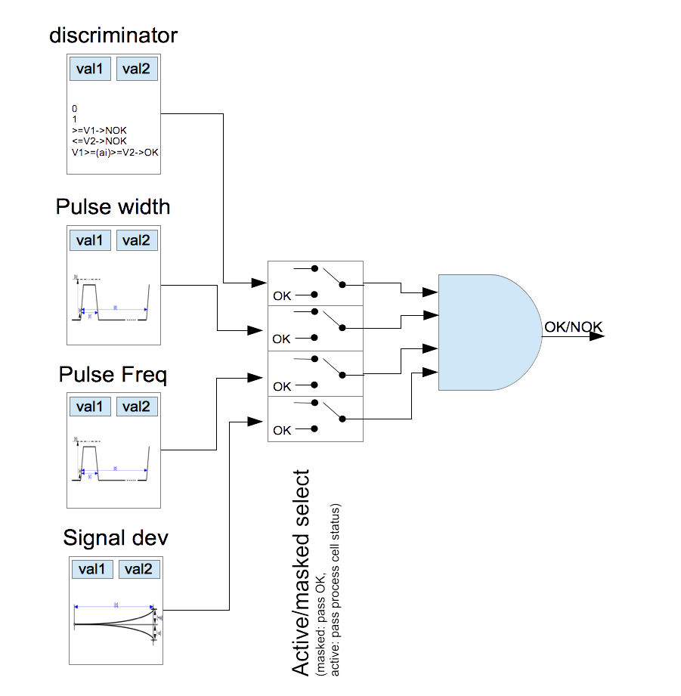
Analog pre-processing #1 (single input)
Any input can be configured for the pre-processing functions:
Discriminator: signal higher/lower/outside a range
Pulse width: signal above threshold for more than defined time
Pulse frequency: pulse repeats more often than defined minimum time
Signal deviation: signal within x% of defined value

Slide 15
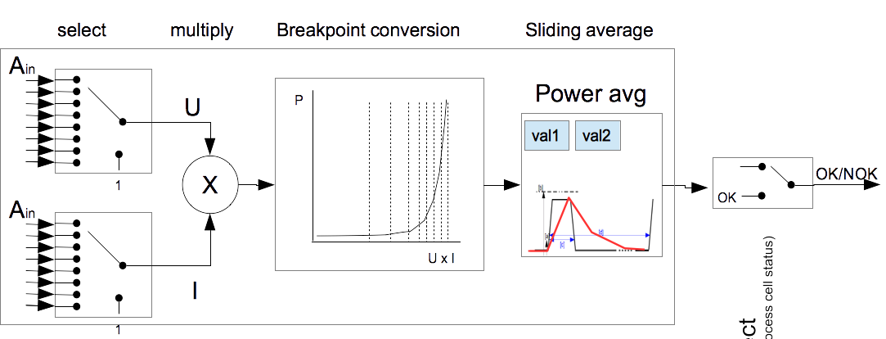
Analog pre-processing #2 (dual input)
Any two analog input signals can be selected for processing:
Multiply two values
Breakpoint conversion with a look-up table (linearization)
Sliding average with a configurable window
Activate, or send permanent OK (or NOK)

Slide 16
Digital pre-processing
Simple compared to analog processing
  Permanent OK or NOK (1 or 0)
  Follow input state (OK->OK, NOK->NOK)
  Invert input state (OK->NOK, NOK->OK)
    Can be very useful - sometimes OK for one state can be bad for another state
All inputs can be configured like this.

Slide 17
Combination of (processed) input states
All preprocessed signals go to a condition matching register
  Conditions drive the FIM state machine (next slide)
  As long as conditions for a state are valid, the state is maintained
  If condition is not valid (e.g., pulse length exceeded), state machine moves to a safe state (ABORT).
  To move to a “higher” operational state, a command is required in addition to fulfilling all conditions.

Slide 18
FIM State machine

Slide 19
State machine outputs (permits)
FSM | IDLE | PRE | RUN | ABO
RF_Enable | '0' | '0' | '1' | '0'
RF_Enable (Spare) | '0' | '0' | '0' | '0'
HV_Enable | '0' | '1' | '1' | '0'
HV_Enable_N (Spare) | '0' | '0' | '0' | '0'
RF_Enable_ST-PLC | '0' | '0' | '1' | '0'
HV_Enable_ST-PLC | '0' | '1' | '1' | '0'
LLRF_Enable | '0' | '0' | '1' | '0'
To interpret this: for instance, LLRF is enabled only in RUN-state. In IDLE and ABO states nothing is enabled.
(0-disabled, 1-enabled)

Slide 20
Configuration management
Pre-processing functions can be configured
  “live” during commissioning of the RF station
    Requires a permit to be set before values can be manipulated
    Can be accessed and manipulated via EPICS
  “permanently”, by storing the configuration in a flash memory which FPGA reads on power-on
    Exact details to be defined (how to store the configurations, etc.)
  Values can (and will) be cross-checked by software
    Important after e.g. replacement of the digital board.
    A new board from stock has to be configured before operating

Slide 21
Status recording, history buffer
All input values (analog, digital) are continuously recorded in a circular buffer
  Including pre-processor states (OK/NOK)
  Up to 1 Gbyte in total (64-byte frames @ 1 MHz provide 16 seconds recording)
    In practice probably less will be used.
  Possibility for dual-buffering (continuous data stream)
History buffer is available for EPICS to read out
Recording stops when
  Interlock condition happens (drop to ABO state).
  External post-mortem request event (from timing) comes

Slide 22
EPICS interfacing
The local CPU on the IFC_1410 board runs EPICS
  Independent unit, not affected by other processing (in a central, shared CPU)
  CPU has read access to
    the circular buffer
    ADC raw values (for display)
    Digital input and output values
  Protected write access to pre-processing function parameters
    Required in commissioning
CPU activity does not impact FPGA operation
  Even if CPU stops/crashes/…, protection remains active
EPICS interfacing has been done
  Requires updating to accommodate the latest FIM firmware
    New state handling
Same EPICS IOC can also talk to SIM
  Status monitoring, etc.
  Single, self-contained unit of FIM+SIM

Slide 23
Machine Protection System interface
Interfacing to MPS/BIS (Beam Interlock System)
  ICS provide a standard interface
  Also a firmware interface (FIM-> BIS)
Hardware interface consists of
  Discrete lines for fast switch-off
    OK/NOK, disconnect (“3-wire”)
  Ethernet link (UDP)
    Operating mode checking, heartbeat, online testing
    Timing system becomes “control only” – no strict protection requirements (responsibility transferred to BIS)
Beam permit “OK” when in “RF On” state
  May be masked in BIS, or ignored based on beam destination
    Details on MPS level to be defined.

Slide 24
Summary
Fast interlock module is a component of the RF Local Protection System
Implemented on ICS standard hardware
  Full EPICS integration
  Full MPS integration, with post-mortem capabilities
ICS has provided some help in implementation
  But this is still a RF Group system
  ICS will also help in providing the deployment and operating infrastructure (configuration management)
Final system implementation partially started
  But still waiting for final testing of the FIM prototype
  To be sure that the right thing will be implemented

