Slide 1
RF Local Protection System
Slow Interlock Module. Hardware Design
Iñigo De la fuente
www.europeanspallationsource.se
17-06-27

Slide 2
Electrical design
ESS Rules for electrical design ESS-0015433
CF Handbook for Electrical Design ESS-0044938
Eplan
Push buttons colours
Cable ducts
Separated terminal strips
Wires inside enclosure 0,5 mm²
Wire colours
Labelling and marking: Cables, wires, devices, terminals…
20% Spare

Slide 3
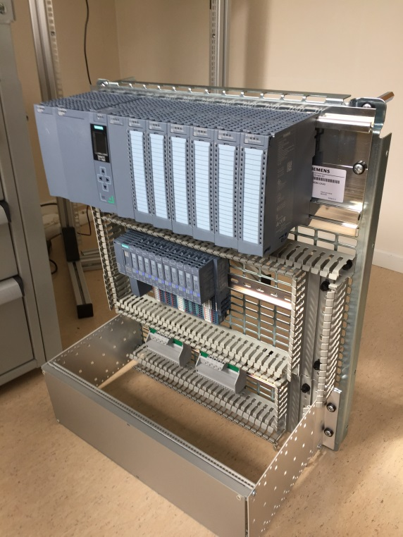
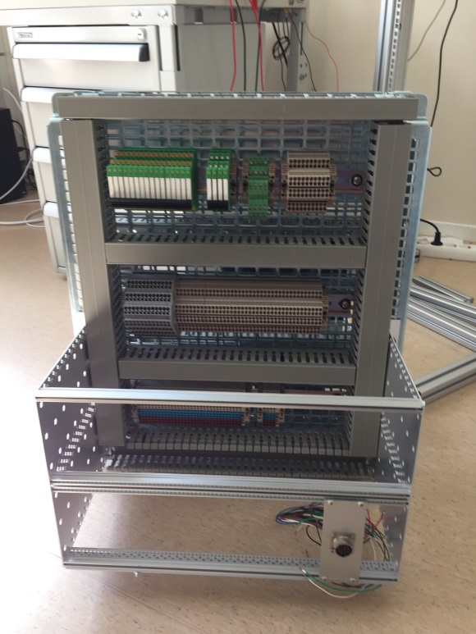
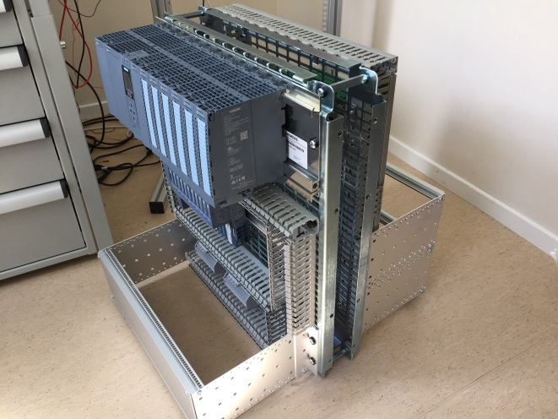
Enclosure
Two mounting panels (Front and rear)
Front subrack for pushbuttons
Rear subrack for connectors
Modular and upgradeable
Easy access for work and maintenance
LEDs of the components (PLC, relays) visible

Slide 4
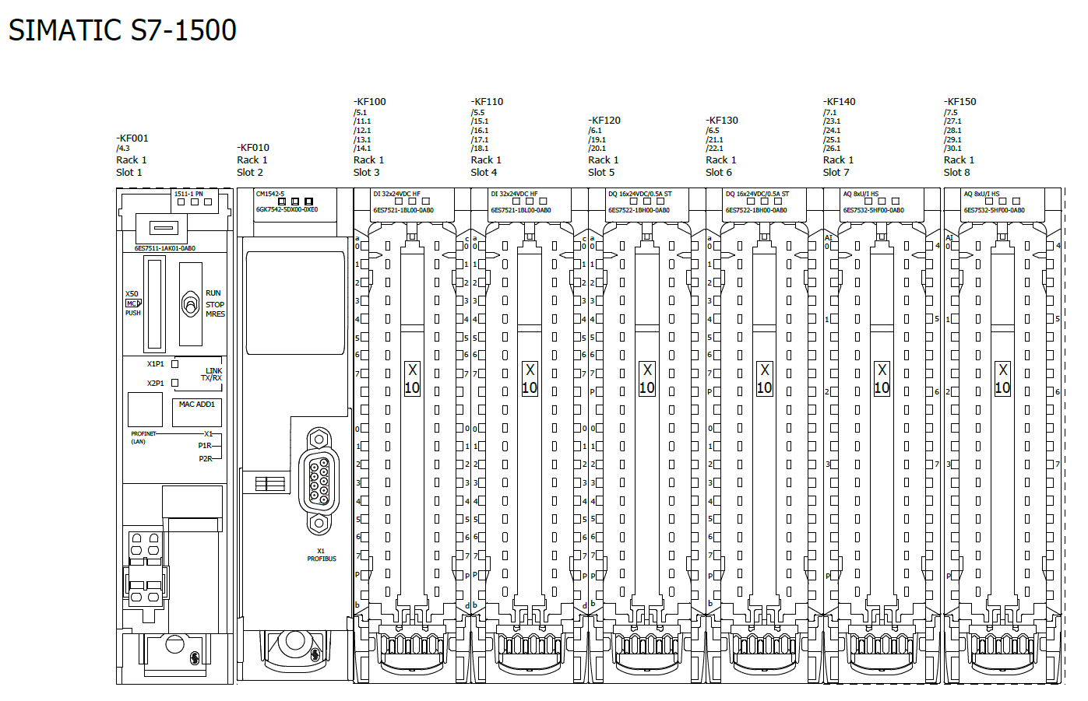
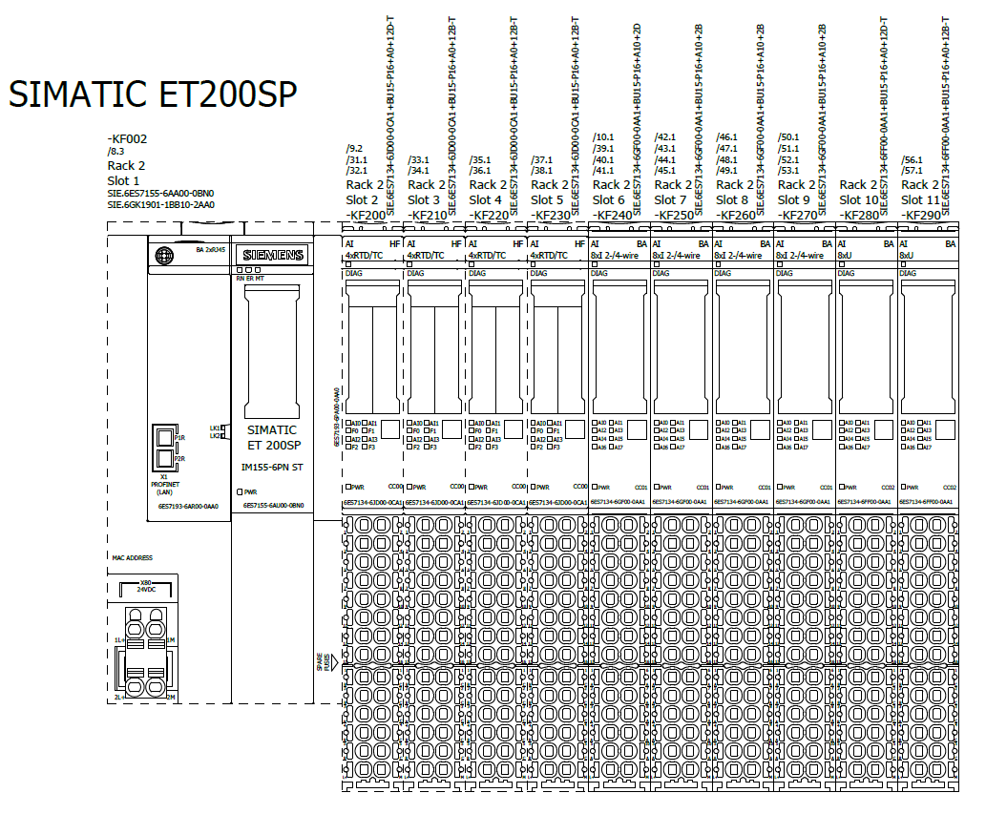
PLC
Siemens PLC S71500 & Simatic ET200SP with all I/O modules required, connected via Profinet

Slide 5
Power Supplies
Two Different Power Supplies:
  Power supply for the PLC, pushbuttons, relays…
  Power supply for external signals: Flowmeters, digital thermometers, arc detectors…
  Each power supply connected to a supply distributor (16 signals)
  In case of failure from external signal PLC does not go down
Notes:
There is a brief summarize about the total system to be installed at ESS

Slide 6
Interfaces
Connect to the PLC the signals needed with slow time-response requirements through connectors in the rear panel
Filament
Solenoids
Vacuum pumps
Klystron
Pre-amplifier
Arc detectors
Water patch panel
FIM

Slide 7
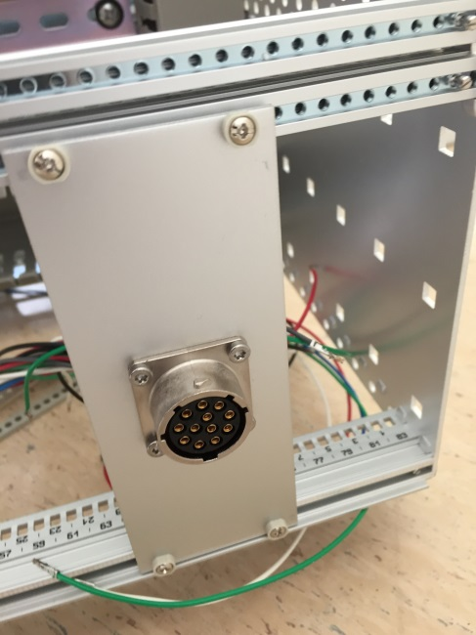
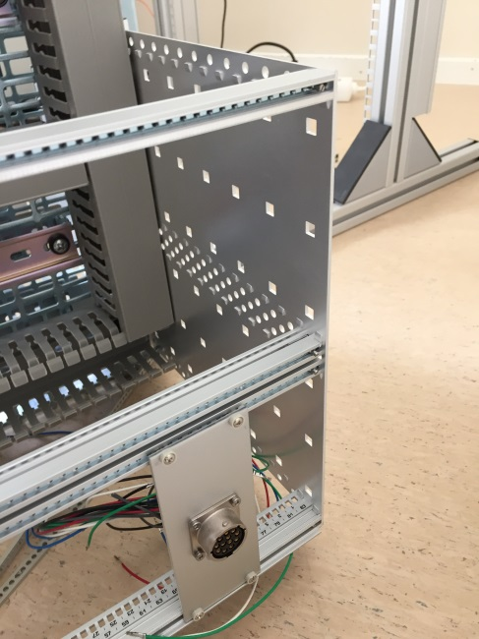
Connectors
Souriau Circular Connector, Trim Trio UT0 Series, Wall Mount Receptacle
Installed in 3U metal plate
Modular. Possibility of adding more metal plates and connectors in the subracks
230VAC Connector
RJ45 Connector for Ethernet

Slide 8
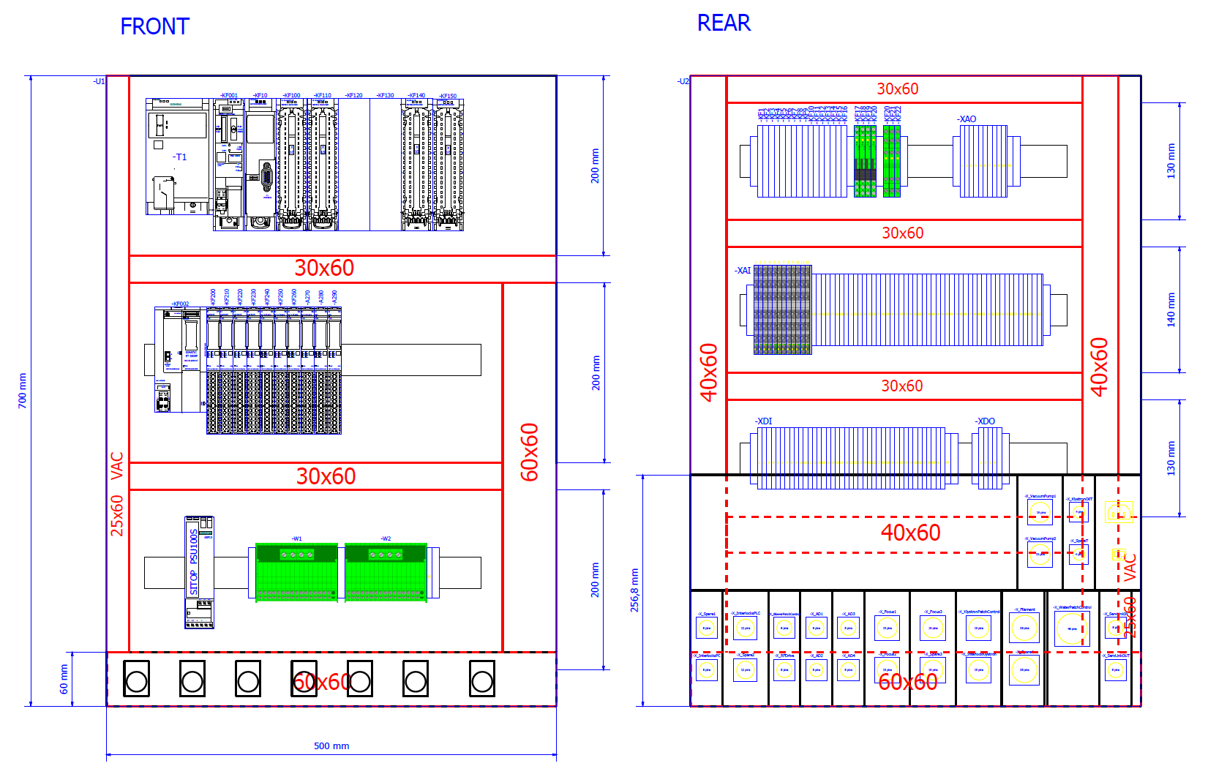
Layout
Notes:
There is a brief summarize about the total system to be installed at ESS

Slide 9
Schematics
Eplan Electric P8 Version 2.5
ESS-0028698 Using EPLAN at ESS
ESS project template
ESS automatic reports
90% done
Includes information about electrical installation, wiring and parts
G:\Collaboration Area\eplan\Projects\ESS\ACCELERATOR\SLOW INTERLOCK MODULE-TESTSTAND2.zw1
G:\Collaboration Area\RF Systems\RF Local Protection System\Electrical documentation\SLOW INTERLOCK MODULE-TESTSTAND2.pdf

Slide 10
Eplan
Circuit diagram pages
Power supply
PLC Overview
PLC Supply
PLC Signal Modules:
    Digital inputs
    Digital outputs
    Analogue inputs
    Analogue output
Relays
Connectors
Potential distribution
Layouts
Reports

Slide 11
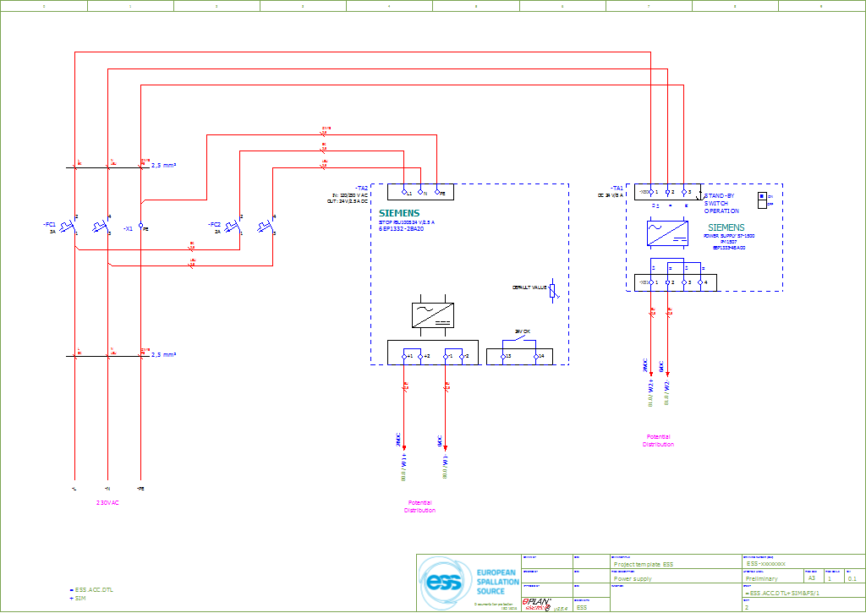
Eplan Power Supply

Slide 12
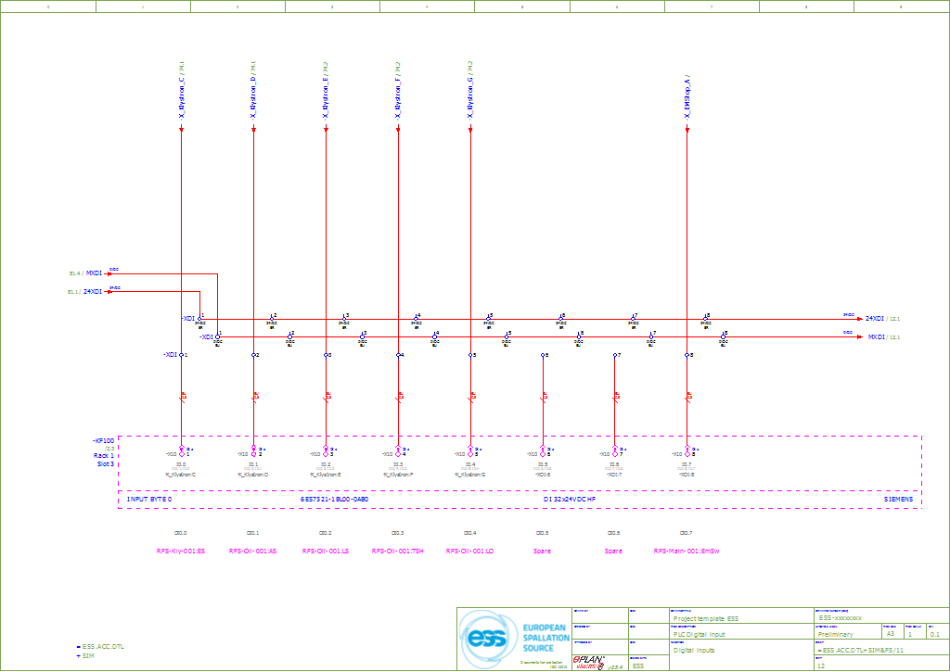
Eplan PLC Signals

Slide 13
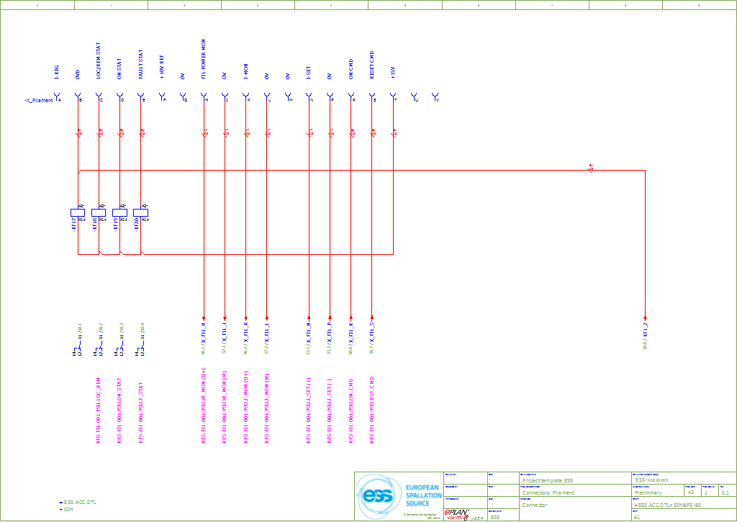
Eplan Connectors

Slide 14
Thanks
Questions

