Slide 1
RF Local Protection System
RF-LPS Preliminary Design Review
Rafael Montaño
www.europeanspallationsource.se
17-06-26

Slide 2
Concepts
SIM Hardware design
  System hardware layout
  Electrical documentation
Notes:
There is a brief summarize about the total system to be installed at ESS

Slide 3
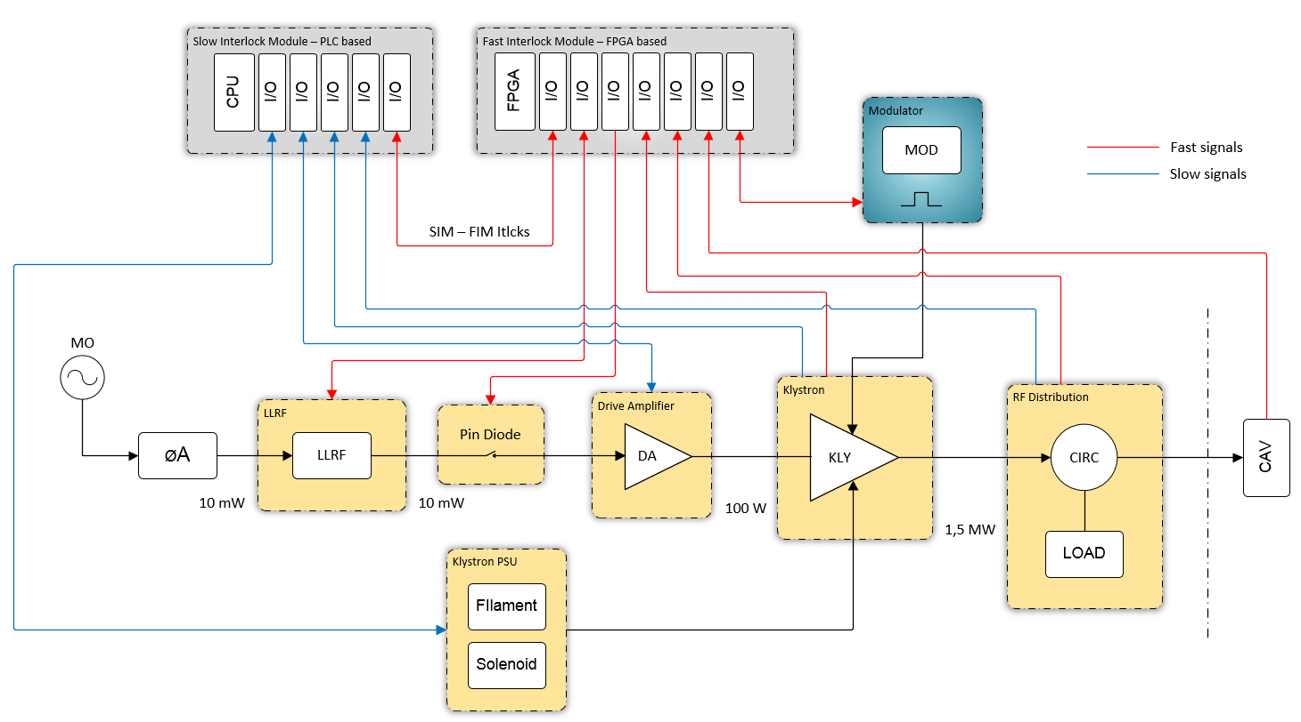
RF overall system diagram
SIM
Siemens PLC
CPU 1511-1 PN
FIM
IOxOS IFC_1410

Slide 4
RFLPS Hardware overview
EPICS
SIM
FIM

Slide 5
RF-LPS SIM – PLC HW configuration
The current configuration consists on a Siemens PLC S71500, with all I/O modules required according to the signal list defined so far.
The PLC and all its components shall be assembled into a 19 inch sub-rack enclosure. Here also are included the terminal connectors, AI transducers, digital output isolation and I/O connectors.

Slide 6

Thanks!!!
Questions

