Slide 1
Machine protection Risk analysis for the RF system (Medium Beta)
Enric Bargallo
Lead Analyst for Machine Protection and Dependability
www.europeanspallationsource.se
27 June 2017

Slide 2
MP Risk analyses for the RF System
The analysis is still undergoing
What we have now is enough to define the needs for the common elements (logic and actuation)
Cavity protection is still not clear (signals, criticality…)

Slide 3
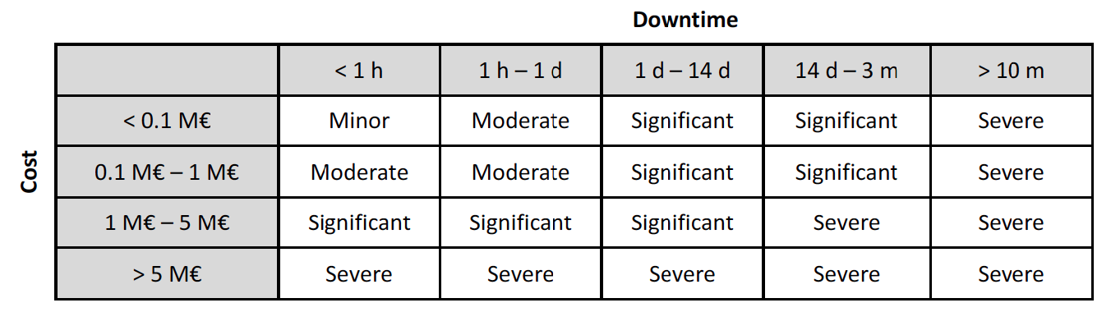
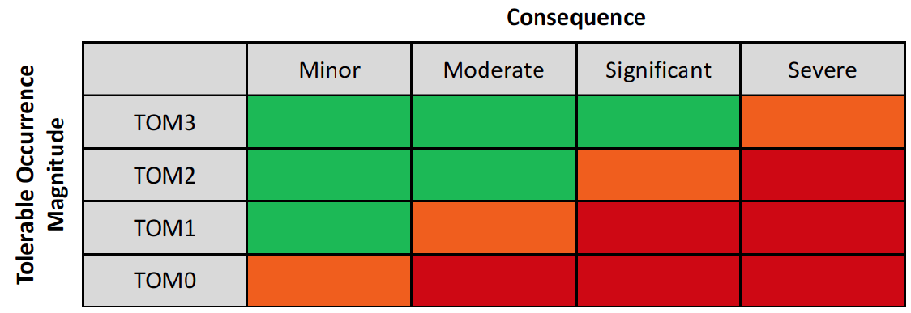
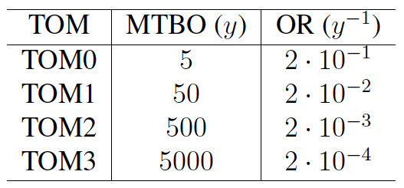
The Risk Matrix for MP
No-beam duration | Maximum occurrence
1 second - 6 seconds | 24000 per year
6 seconds - 1 minute | 8000 per year
1 minute - 6 minutes | 1000 per year
6 minutes - 20 minutes | 350 per year
20 minutes - 1 hour | 100 per year
1 hour - 3 hours | 33 per year
3 hours - 8 hours | 17 per year
8 hours - 1 day | 6 per year
1 day - 3 days | 2 per year
3 days - 14 days | 1 per year
14 days - 3 months | 1 in 5 years
3 months - 10 months | 1 in 100 years
more than 10 months | 1 in 500 years

Slide 4
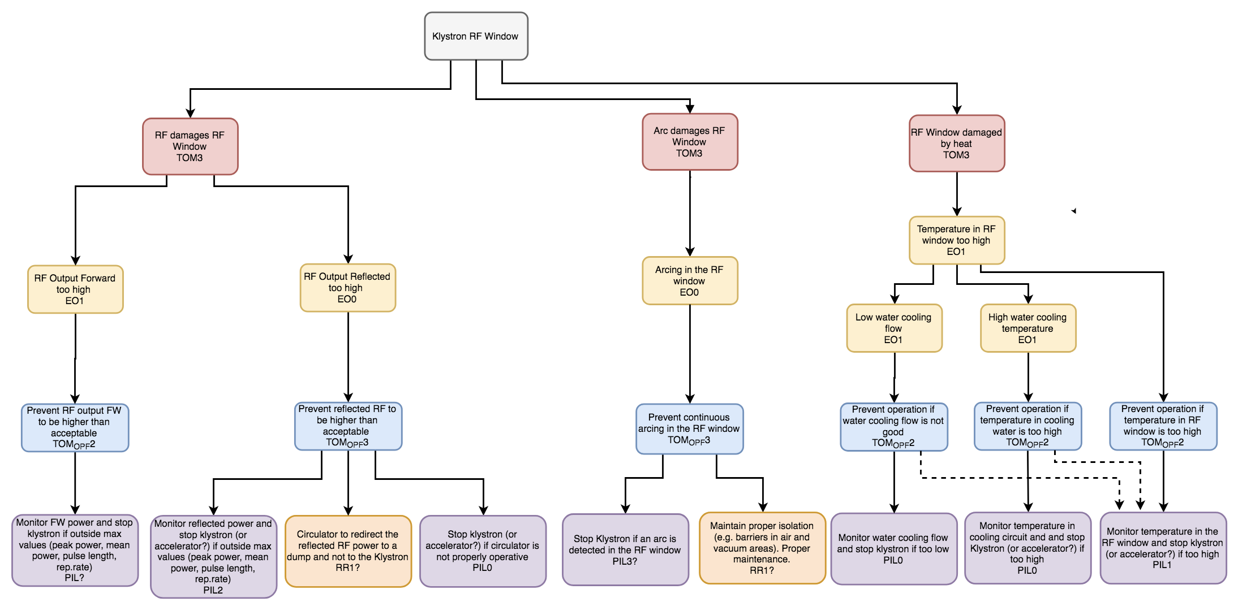
Example of the analysis: Klystron RF window

Slide 5
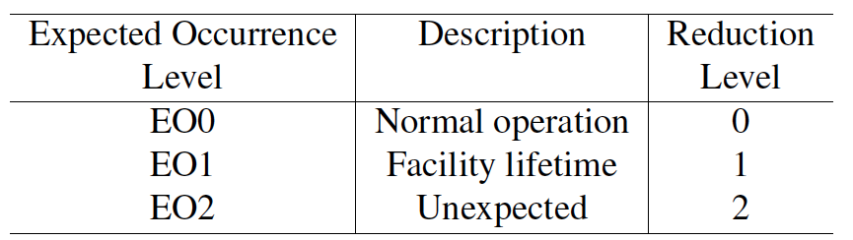
Maximum PIL in the RF cell
Breaking a coupler window (complete rupture)
 |  | Downtime
 |  | < 1h | 1h – 1d | 1d – 14d | 14d – 3m | > 3m
Cost | < 100 k€ | Minor | Moderate | Significant | Significant | Severe
 | 100 k€ – 1 M€ | Moderate | Moderate | Significant | Significant | Severe
 | 1 M€ – 5 M€ | Significant | Significant | Significant | Severe | Severe
 | > 5 M€ | Severe | Severe | Severe | Severe | Severe
This shows the we should have had some redesign of the coupler (e.g. two windows)
This is undesirable, but at least we require a PIL 3 PF
But PIL 3 is very tough and could lead to extra cost, redesign and spurious trips. A lower one could be discussed accepting the risk.

Slide 6
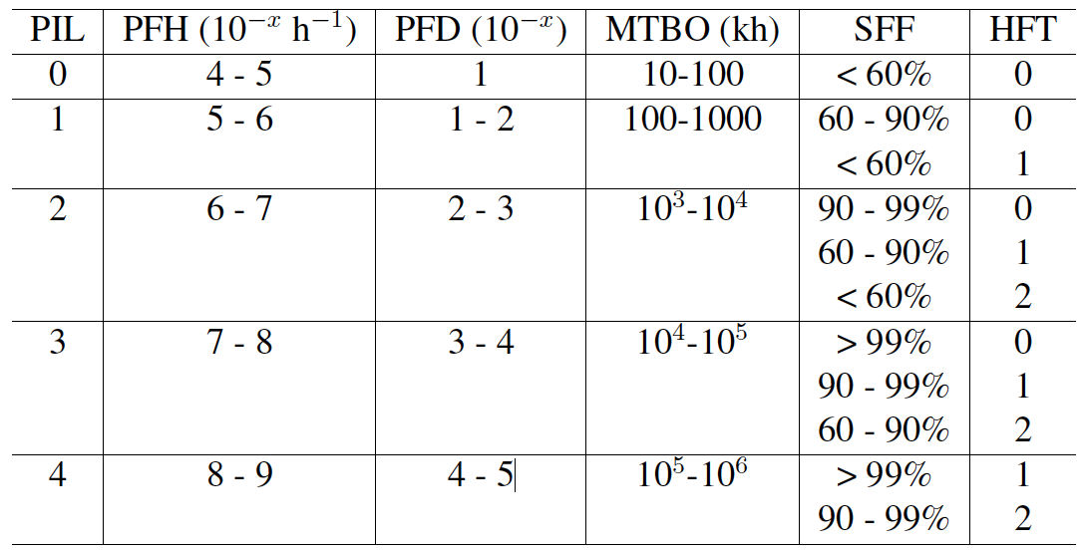
PIL 2 requirements
To reach PIL 2, the system must be very well though trough with either redundancies (Hardware Fault Tolerance) or extremely reliable components (Safe Fail Fraction) or both
Protection function (PF) with PIL 2
Sensor
Logic
Actuator
PIL 2
PIL 2
PIL 2
Part of the system analyzed

Slide 7
RF LPS PF blocks for Vacuum Window
Logic
Actuators
Reaction time ≈ ms
SIM
DA
Fast enough?
Sensor
Reaction time < 10us
FIM
Pin Diode
HFT=0 in fast PF
Reaction time < 10us
Not a protection system!
LLRF
HFT=0 in fast PF

Slide 8
Summary and conclusions
High PIL has to be reached in the logic and actuation part:
  FIM and Pin Diode must be analyzed and optimized to reach high PIL
  Consider redundancies and similar strategies in case these two elements are not as reliable as expected
Further analysis will help identifying weak points on the sensors side:
  E.g. arc detectors and RF power detector should also be analyzed and optimized
To be seen if there is a need for an extra signal to kill the beam

Slide 9
Extra slides

Slide 10

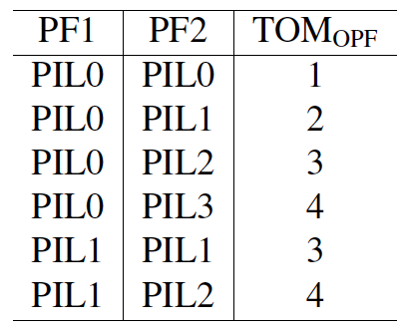
The MP Risk Analysis

Slide 11
Signal exchange in the LPS RF
When we have an interlock from RF enable the RF LPS sends the following:
  FIM:
    Pin diode (stop RF, fast)
    RF enable status to SIM (fast)
    BIS (stop Beam)
    LLRF (?)
  SIM:
    Driver Amplifier (stop RF, slow)
In the FPGA we can have two blocks, but we should have two inputs also! These inputs should be inversed and then the logic in the FPGA could be different also

