Slide 1
RF Local Protection System
RF-LPS Critical Design Review
Rafael Montaño
www.europeanspallationsource.se
17-06-27

Slide 2
Concepts
  Interfaces
  Series units
Notes:
There is a brief summarize about the total system to be installed at ESS

Slide 3
SIM interfaces
All interfaces related to the interlock signals of the SIM are defined by a hardwired connection. The connectors in the back-plain can also be defined for a specific interface from any of the I/O types of the PLC.
The PLC enclosure design allows the upgradability of the system by adding connectors as required. These connectors then can be connected to the terminal blocks of the PLC A I/O modules.
PLC patch panel connectors
Notes:
There is a brief summarize about the total system to be installed at ESS

Slide 4
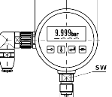
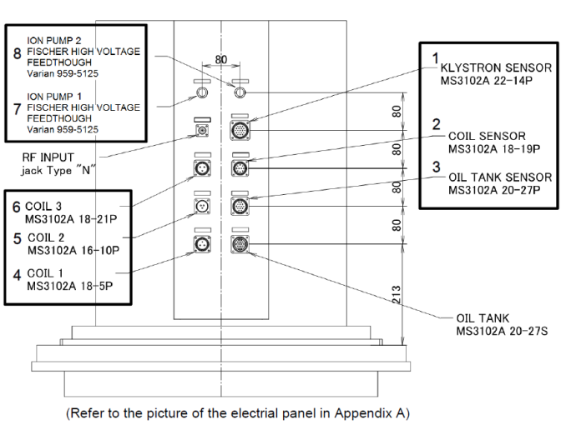
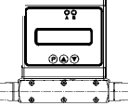
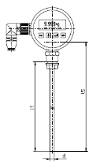


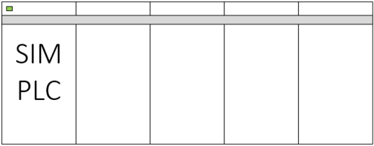
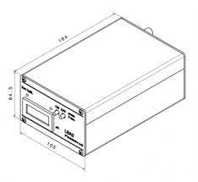

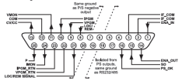
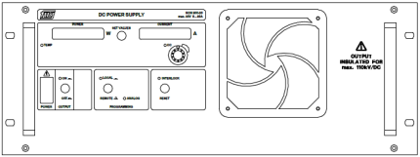
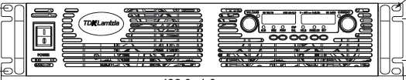
SIM interfaces
Temp, flow rate, Pressure, etc.
Klystron sensor connectors
IOC
Ion-pump
Filament PSU
Solenoid PSU
Notes:
There is a brief summarize about the total system to be installed at ESS

Slide 5
PLC Interfaces and I/O protection
The sensors and I/O signals where is required an external power supply (PS) can be powered from a secondary PS, then the CPU and the I/O modules are protected against an external short circuit.
Interface | Type of isolation / cable detection
PLC – PSUs | Dry-contacts
PLC – FPGA | Dry-contacts
PLC – Cooling | Secondary power supply
PSUs – PLC | Dry-contacts
Conn. Box – PS-2 | 500 mA fuses
PSUs – PLC | Cable detection
PLC – Sensors | Pull-up/down signals when no sensor connected
PLC – Arc-detector (CERN) | Test arc-detector from a PLC command

Slide 6
Series units
Timeline of the series units and system validation
Connects the system
to the test bench
System testing and
logic validation
Automatic
logic validation
Acceptance test
System report
System
received
Notes:
There is a brief summarize about the total system to be installed at ESS

Slide 7

Thanks!!!
Questions

