Slide 1
RF Local Protection System
RF-LPS Critical Design Review
Rafael Montaño
www.europeanspallationsource.se
17-06-27

Slide 2
Concepts
Slow Interlock Module design
  Signal processing
  Power Supply Units and control and interlock
  Machine State
  EPICS communication (PLC)
  Test stand integration and SIM commissioning
Notes:
There is a brief summarize about the total system to be installed at ESS

Slide 3
PLC program overall layout
The user commands of the MS are handled by the CPU DB.
Then, the “State Machine” block processes the permissions.
EPICS communication functions
Data-blocks to store the variables
Get measurement from the I/O modules
Machine State
EPICS communication is not allowed
Signal processing
Notes:
There is a brief summarize about the total system to be installed at ESS

Slide 4
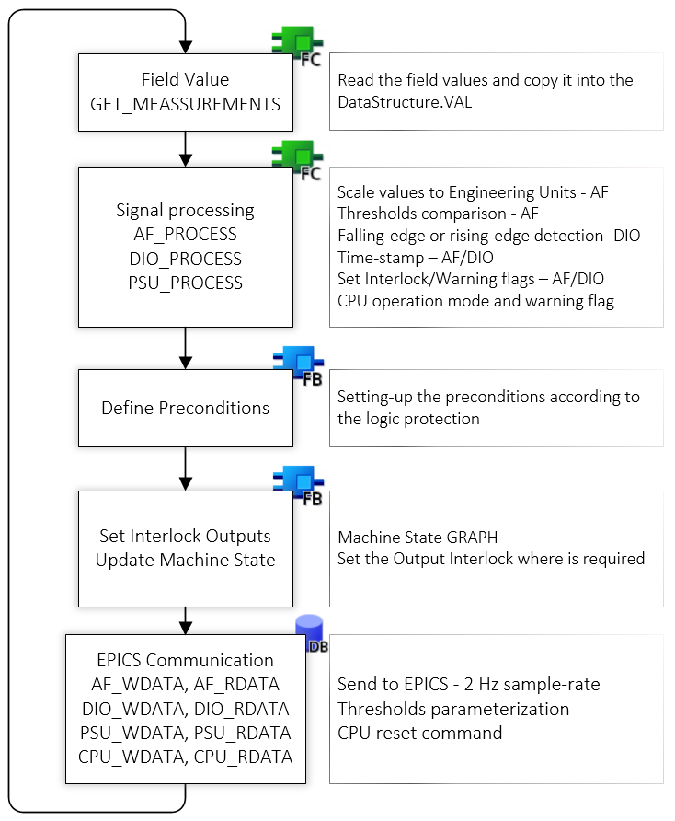
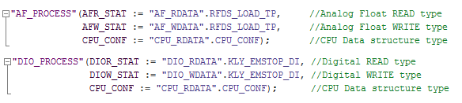
RF-LPS SIM – SIM SW design
The program gets the RAW values from the I/O modules, these can be an integer or Boolean values to be processed by the “Signal Processing” functions according to the type of variable.
Once the variables are processed, the Machine State takes the status of the interlock and update the output actuators.
The CPU structure handles the user commands such reset, latched and operation modes and bring the amplifier to the desire status.

Slide 5
RF-LPS SIM - Internal diagnostic and process data
The PLC program measures the field values as an integer and scale it to engineering units (EGU). The value then will be compared to the threshold levels defined by the user through EPICS. This feature allows the user to define the operation window of the sensor described in green in the following figure.
The reestablish mode of the interlocks would be defined by the CPU “latched” bit, which means the PLC will keep the interlock until reset is applied.
The PLC also include a diagnostic system to detect the time-stamp when an interlock is detected.
ALARM / INTERLOCK
WARNING
WARNING
ALARM / INTERLOCK
AF_PROCESS

Slide 6
Concepts
Slow Interlock Module design
  Signal processing
  Power Supply Units and control and interlock
  Machine State
  EPICS communication (PLC)
  Test stand integration and SIM commissioning
Notes:
There is a brief summarize about the total system to be installed at ESS

Slide 7
Compatible PSUs to LPS
The Slow Interlock Module (SIM) is capable to handle two types of power suppliers, TDK-Lambda Genesys GEN300-17 for the Solenoids and NCN 900 – 30 MOD Fug for the Filament. These are units connected to the PLC by a hardwired interface to the PLC.
The PSU functions include several parameters to parametrize the units, however most of them are defined by default to predefined values, and the user can also change it from EPICS is required. Some of the main functions are described below:
  Maximum current/power of the units
  Set-points for cold and warm operations
  Ramp or step operation mode
The functions do not allow to set the threshold upper than the maximum levels defined by the supplier, so by hardcode the absolute maximum levels are set into the PSU functions.

Slide 8
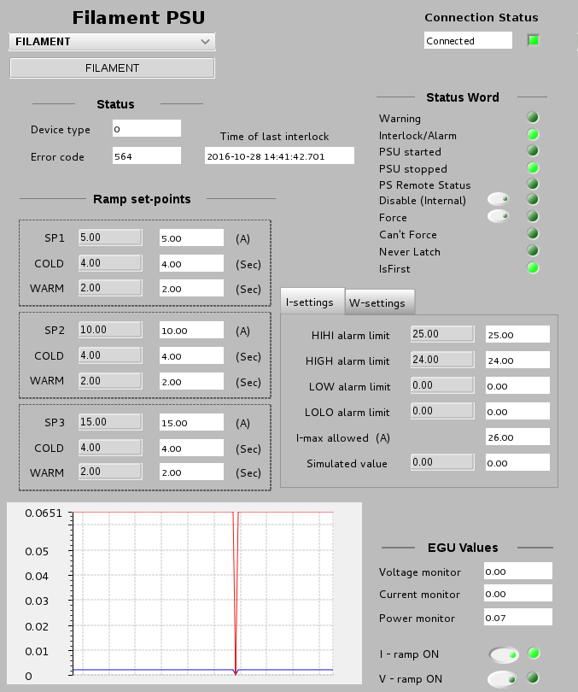
SIM FILAMENT PSU
Filament PSU control
and protection function
+/- I, read back monitor: The function monitors whether the I-setting will the same that the PLC is reading from the I-monitor.

Slide 9
Concepts
Slow Interlock Module design
  Signal processing
  Power Supply Units and control and interlock
  Machine State
  EPICS communication (PLC)
  Test stand integration and SIM commissioning
Notes:
There is a brief summarize about the total system to be installed at ESS

Slide 10
PLC Machine State overview
OFF (Initial status): Shutdown and revoke all permissions of the RF transmitter.
  HV Enable (OFF) - RF Enable (OFF) - PSUs (OFF) - MPS (OFF) - LLRF (OFF)
AUX (Ion-pump ON): Requires the Ion-pump is ON to meet this status, the PLC does not have any control on the ion-pump switch on/off commands.
Filament (Filament power on and current ramp): Requires oil tank cooling and temperature interlocks are ok to allow the user power on and ramp the Filament PS.
Stand-by (Solenoid power on and current set-point): This status requires the window, solenoid and collector cooling/temperature interlocks are ok to allow the user power on the solenoid PS.
HV Enable (inhibit Modulator through the FPGA): Requires Ion pump lower pressure interlock. Here is also include two variable calculation by the PLC: Collector and Body dissipation. Those threshold levels can be defined by the user.
RF Enable: (pin-diode through the FPGA and inform to MPS): Requires Ion-pump high pressure, DA ready, circulator and load cooling and temperature interlocks
Note: for all statuses the PLC/FPGA will continue monitoring the interlocks according to the threshold defined by the user or digital interlocks where is required. It would be defined into the supervision conditions.
For more details see: \Collaboration Area\RF Systems\RF Local Protection System\MachineState and Interlock logic
→ ToshibaStateMachine_SIM.xlsx

Slide 11
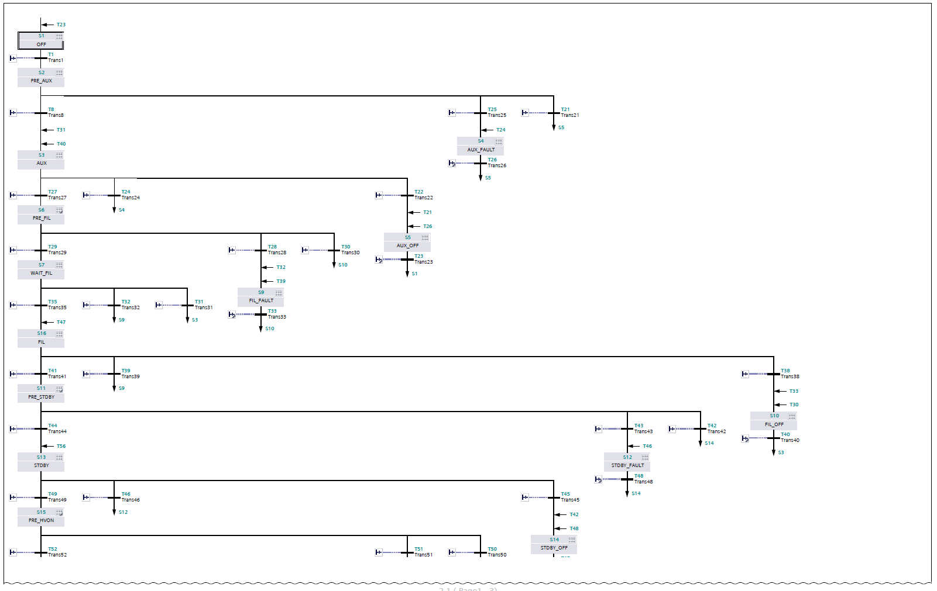

RF-LPS SIM – Machine State and SIM Interlock logic
S7-GRAPH (IEC 61131-3, DIN EN 61131).

Slide 12
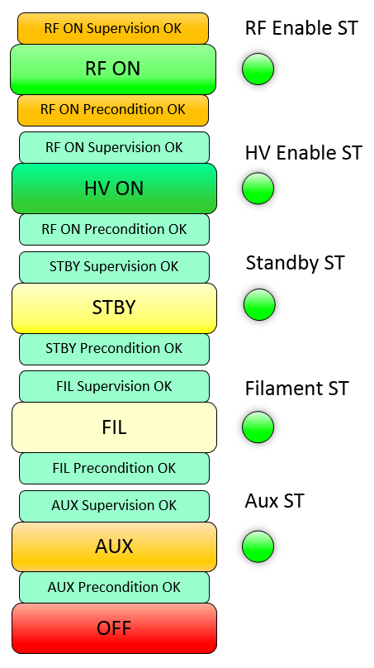
LPS Machine State
Five pre-conditions and three interlocks distributed on the following way:
(PC1) OFF AUX (PLC)
(PC2) AUX FIL (PLC)
(PC3) FIL STBY(PLC)
(PC4) STBY HVON (PLC)
(PC5) HVON RFON (PLC)
The connections between the PLC and FPGA must be through hardwire, the fieldbus would be used only for diagnostics purposes.
ITLCK_HV (FIM) HV Modulator
ITLCK_RF (FIM) Pin Diode
ITLCK_MPS_ST (FIM) Report status
The PLC also will handle the operation modes, and it shall be grouped to the Machine State:
NORMAL_OP Normal Operation
RF_COND_MODE Conditioning Mode
TEST_MODE Test Mode
WIRE_TEST Wire Test
Notes:
There are some conditions about the Klystron protective interlocks.

Slide 13
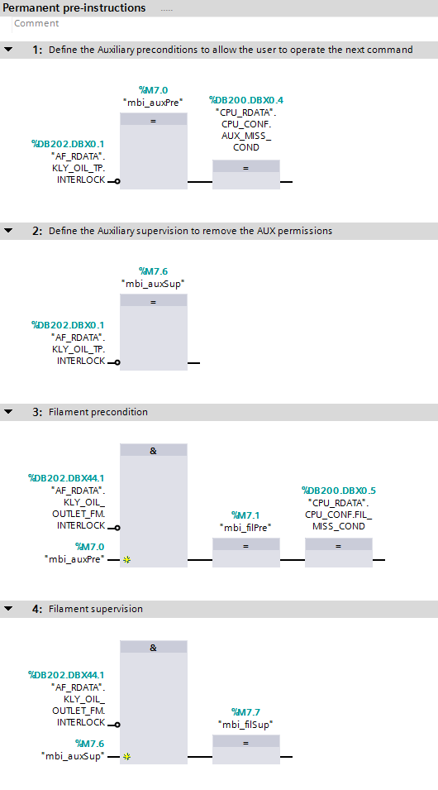

RF-LPS SIM – Pre-instructions
Preconditions and Supervisions
Before call the Machine State the preconditions and supervisions should be defined. All interlocks required to operate should be included here.
The Machine State also include a supervision conditions which means the PLC should wait a predefined time in order to get the nominal conditions before achieve the requested status by the user. i.e. Filament PSU or Solenoid PSU.
NOT Collector Flow Intlck
NOT Body Temp Intlck
PreCond OK

Slide 14

RF-LPS SIM – Machine Status and Interlock logic
S1
OFF
Command =
AuxPreCond =
AUX
True
OFF
False
T9
AUX
False
AUX Command
AuxPreCond
&
T1
NOT AuxSupCond
NOT AuxPreCond && timer
>1
T3
T7
OFF Command
S2
PRE AUX
AUX Switch ON
i.e. Ion Pump
T4
S3
AUX FAULT
State Faults
Update command request
S5
Delay SUP time
SUP Timer ON
T2
S4
AUX
T5
S5
FIL Command
FilPreCond
&
OFF Command
T6
NOT AuxSupCond
T8
T4
SUP Interlock
T7
S3
PRE FIL
S3
S5
AUX OFF
AUX Switch OFF
i.e. Ion Pump
T9
S1

Slide 15
Concepts
Slow Interlock Module design
  Signal processing
  Power Supply Units and control and interlock
  Machine State
  EPICS communication (PLC)
  Test stand integration and SIM commissioning
Notes:
There is a brief summarize about the total system to be installed at ESS

Slide 16
System overview
“Send and Receive” protocol
S7plc EPICS driver (PSI)
Variables on PLC is transparently reflected as PVs

Slide 17
Introduction
Communication over Ethernet and TCP
No logic implemented on the Control-box IOC
Data-blocks on PLC is directly mapped to PVs

Slide 18
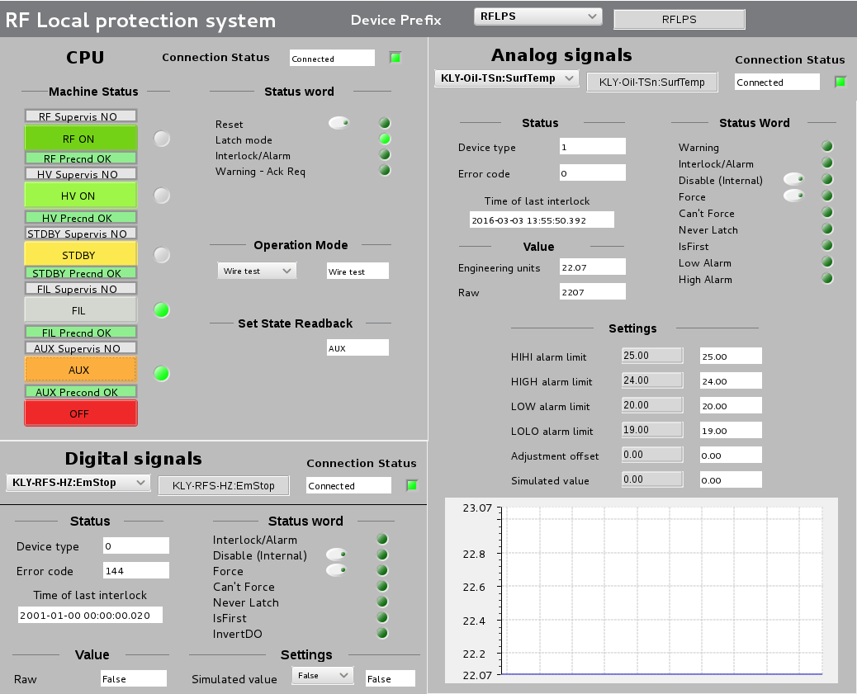
EPICS GUI – expert UI
CPU Status and
Machine State
Commands and CPU configuration
DIO type
Commands and
parametrization
Analog Input type
Commands and parameterization

Slide 19
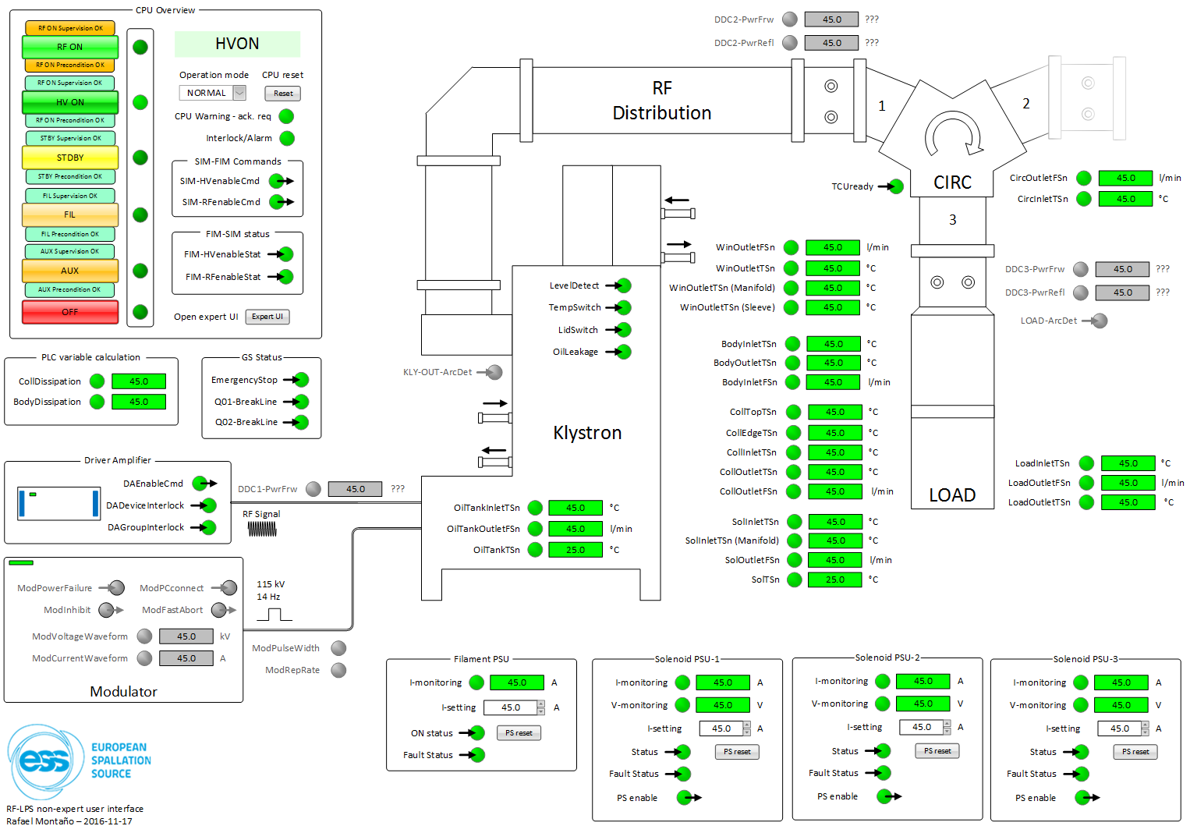
RF System UI

Slide 20
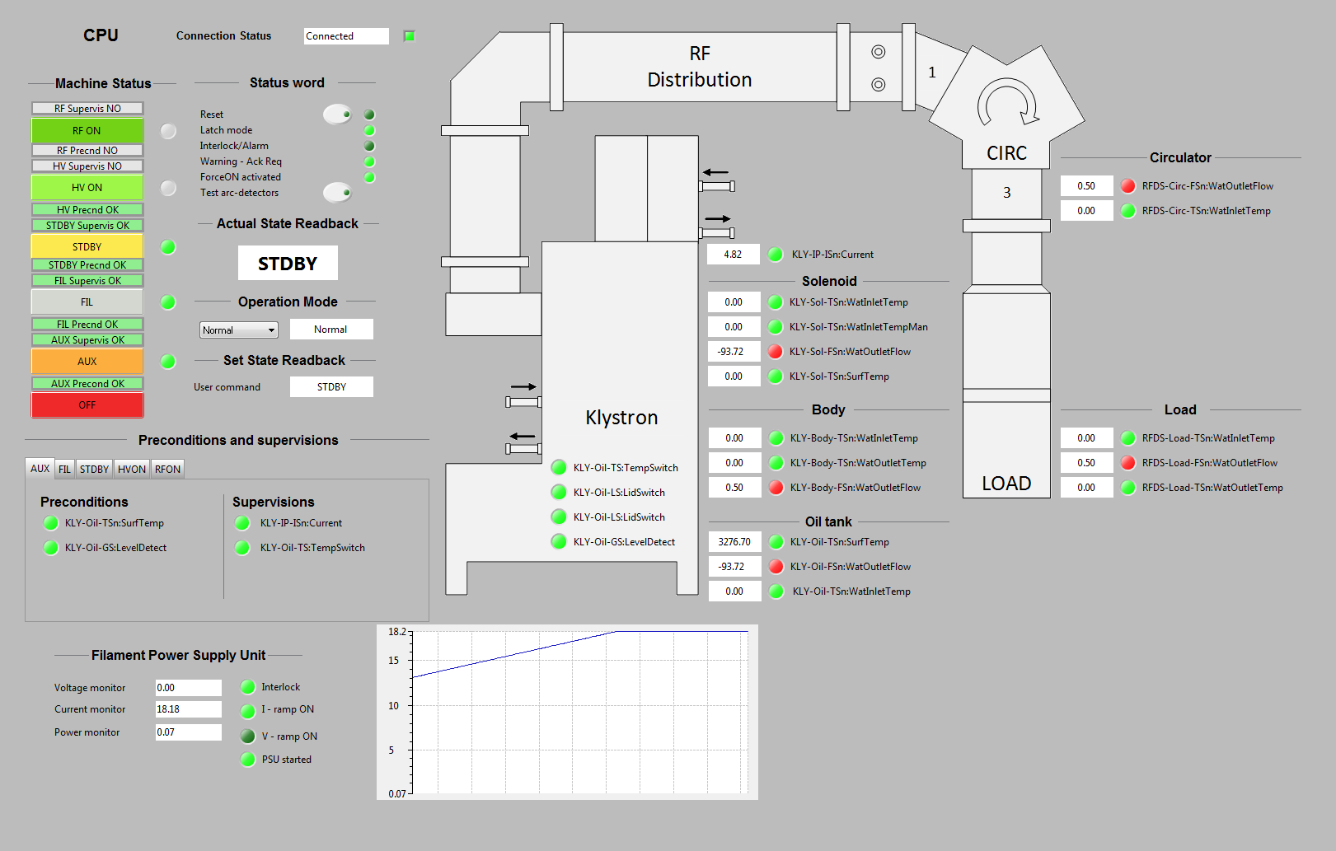
EPICS - non-expert User Interface

Slide 21
Concepts
Slow Interlock Module design
  Signal processing
  Power Supply Units and control and interlock
  Machine State
  EPICS communication (PLC)
  Test stand integration and system commissioning
Notes:
There is a brief summarize about the total system to be installed at ESS

Slide 22
System testing and commissioning
Timeline of the project development and system commissioning
LTH prototype
deployment
System
development
SW
deployment
System test
simulated
System
commissioning
Low-scale
prototype
Full scale
prototype
System
Ready
Notes:
There is a brief summarize about the total system to be installed at ESS

Slide 23
System simulation and logic validation
The system has been deployed in the technical lab, simulated and tested the interface connections. This test bench allows to simulate almost all statutes of the Machine State and the power supplies control such as ramp, max limits, etc.
Through the expert mode EPICS also allow to test the system behavior by creating a script about the predefined configuration and system setup, which means the system can be tested to check whether all parameters are properly setup.
EPICS
SIM
(Slow Interlock Module)
Simulation Box
PLC enclosure
Notes:
There is a brief summarize about the total system to be installed at ESS

Slide 24
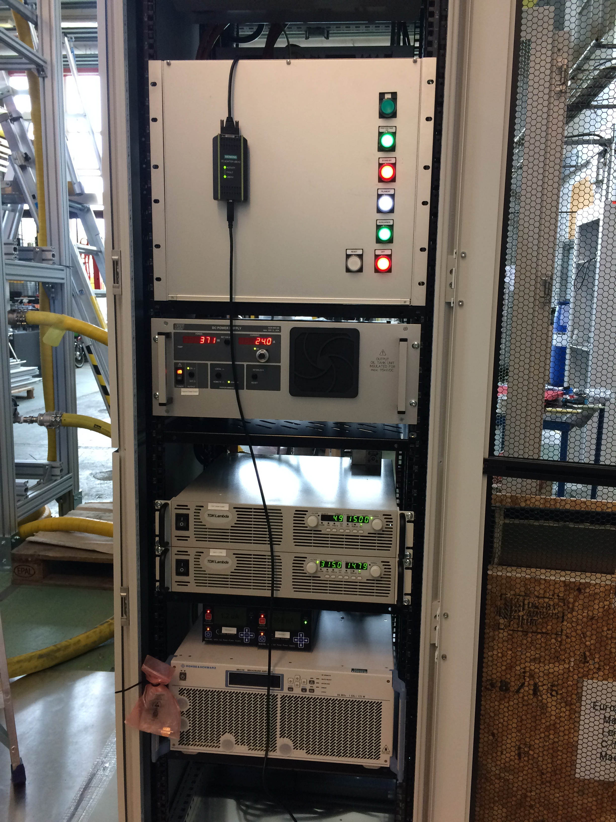
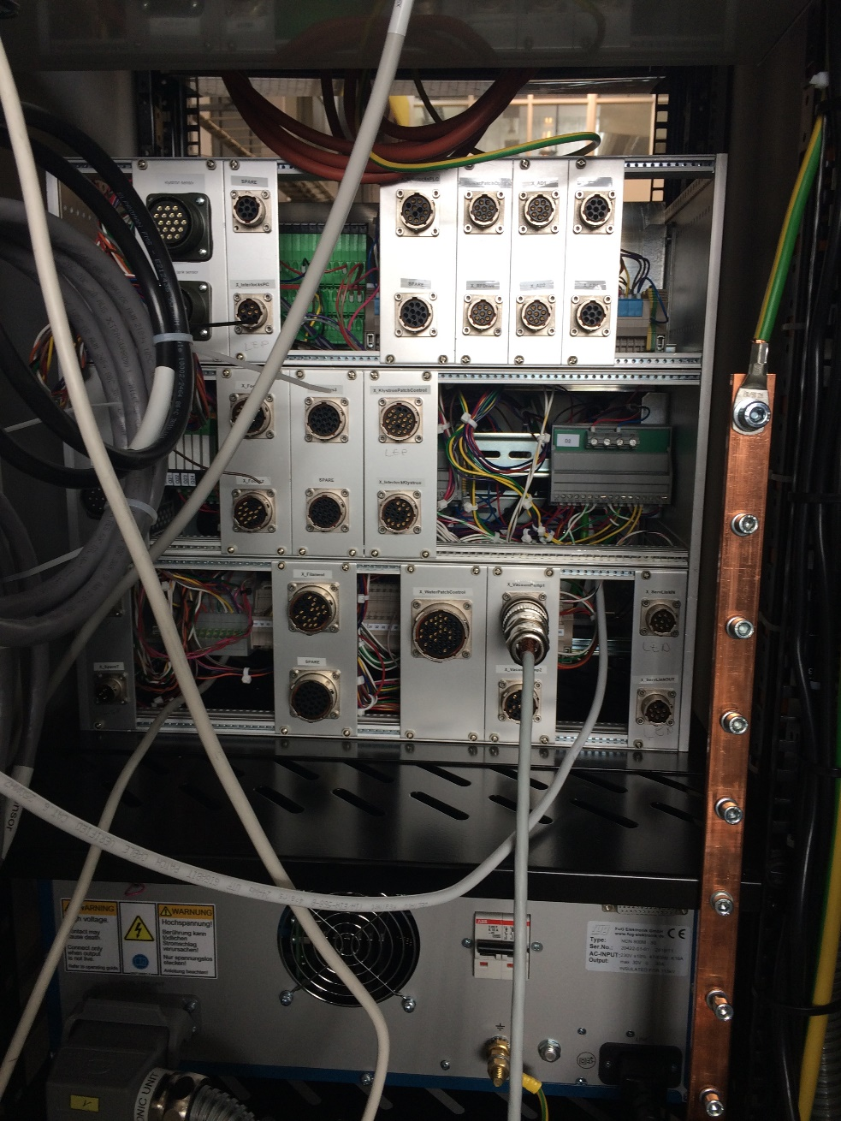
Toshiba Klystron commissioning

Slide 25
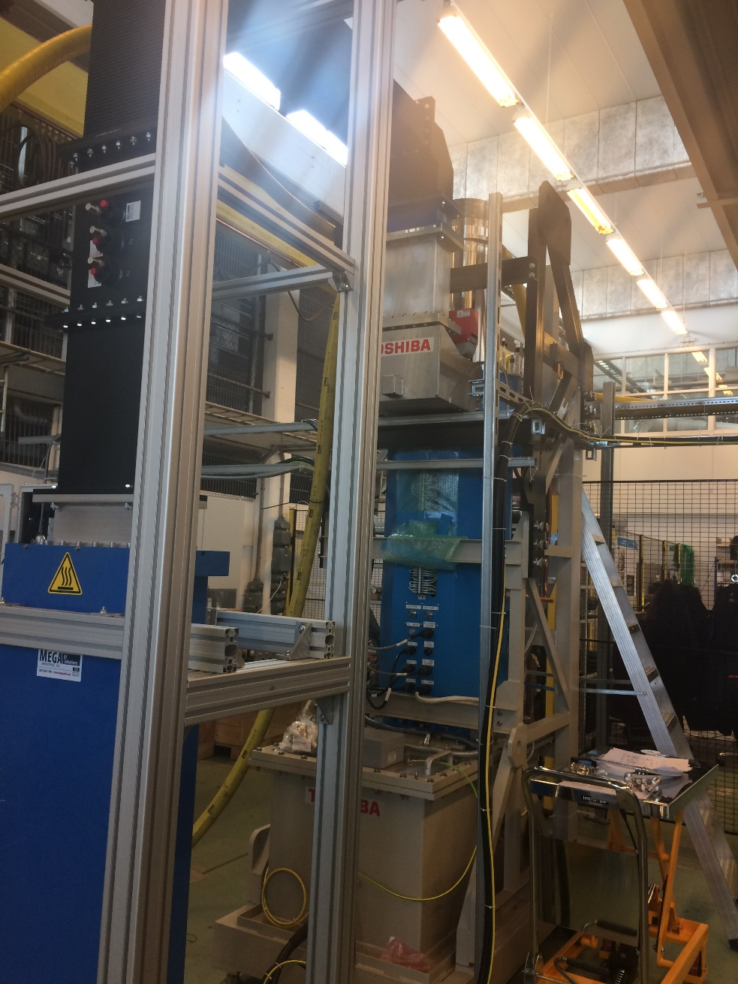
Toshiba Klystron commissioning

Slide 26
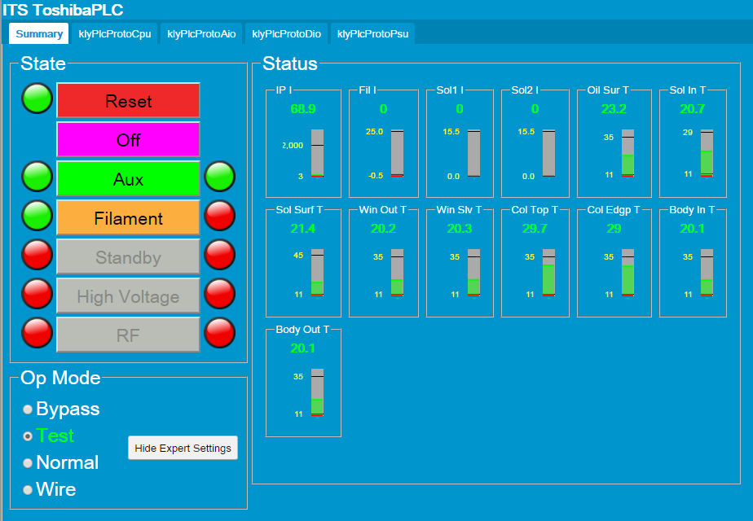
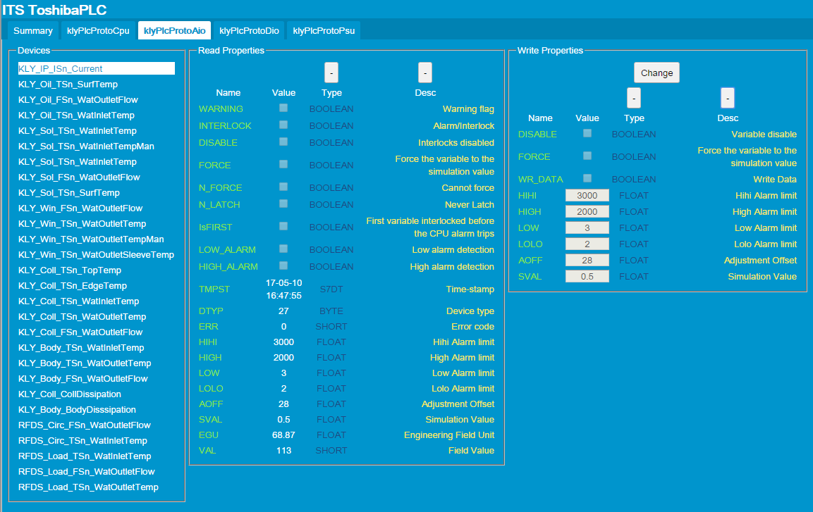
Test stand integration

Slide 27

Thanks!!!
Questions

