Slide 1

In-Kind Contribution
Radiofrequency Local Protection System (RF-LPS)
AIK 8.4
Signal Conditioning Boards
for RF-LPS of Medium Beta Linac
József Molnár, MTA Atomki
www.europeanspallationsource.se

Slide 2
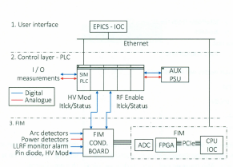
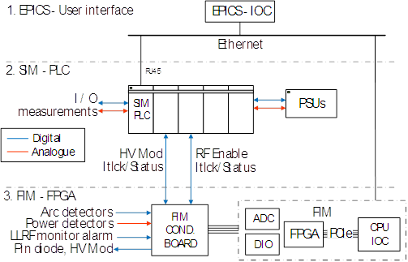
General Architecture of RF-LPS
Baseline documentation
2015-12-01
Recent version
2017-06-28

Slide 3
Role of Signal Conditioning Boards
Based on the specifications of the field devices to convert, filter-out, translate both analogue and logical signals in a way which will result correct matching of the signals between the inputs and outputs of the systems connected in chain.
The grounding policy is one of the most important issues in such an environment which is characterized by electromagnetic noise generated with high frequency and electrically harsh enough due to the power.
The electronics of the CBs should be robust and immune against the electromagnetic noise coming from the environment. The ground loops are avoidable by using de-couplers, optical isolators.
The logic implemented in the CBs must be always simple and reliable in this way guarantee the requested safety.

Slide 4
Initial Parameters and Instructions
Typically the signals to be processed in the conditioning are identified as fast response and its requirements have been defined from the Fast Interlock Module signal list
altogether DI: 14, DO: 8, AI: 17 channels.
Annex 01 FIM conditioning board requirements
Newest version: Signal_list_and_Machine_State.xlsx

Slide 5
Technical Aspects of the Design
The interlock systems can be implemented in different ways:
One of the possible solutions of the electronics for the klystron amplifier and related field units where the necessary hardware is implemented on printed circuit boards. Indeed, the timing specifications and the need of a reliable system forbid any software solution, including real-time platforms. The system flexibility built into this kind of solutions is minimal, and not even satisfying when the technical parameters of the field devices have been changed slightly.
A novel method applied in construction of interlock systems where the electronics is implemented in real-time based fast computer like MicroTCA.4 system. The system is equipped with all resources which can cover any demands aimed by the field devices. A benefit that can be mentioned is the excellent flexibility of the platform in terms of hot reconfiguration capability of the system in case of any changing in the technical parameters.

Slide 6
Digital Signal Conditioning Board
The Digital Conditioning Board involves:
16-channel LVTTL inputs equipped with protection circuits against sparks, overvoltage, electromagnetic noise
1-channel LVDS input for interconnection to LLRF unit
10-channel opto-isolated output with TTL driver
4-channel opto-isolated output with transistor driver
2-channel driver for fibre optic transmission
1-channel LVDS output for interconnection to LLRF unit
For detailed schematics of the Digital Conditioning Board, see:
Annex 18 Digital Conditioning Board
Annex 19 16 Ch LVTTL Input
Annex 20 14 Ch LVTTL Output & 2 Ch Fiber

Slide 7
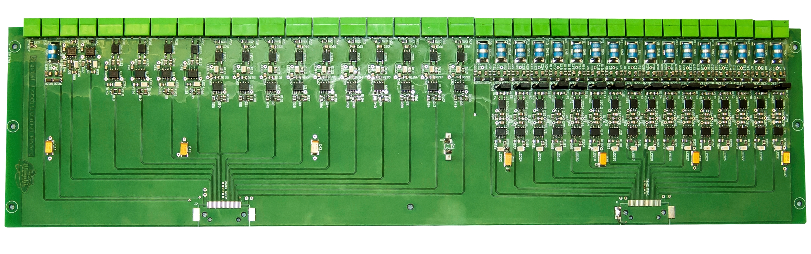
Digital Signal Conditioning Board
Assembled PCB of Digital Conditioning Board

Slide 8
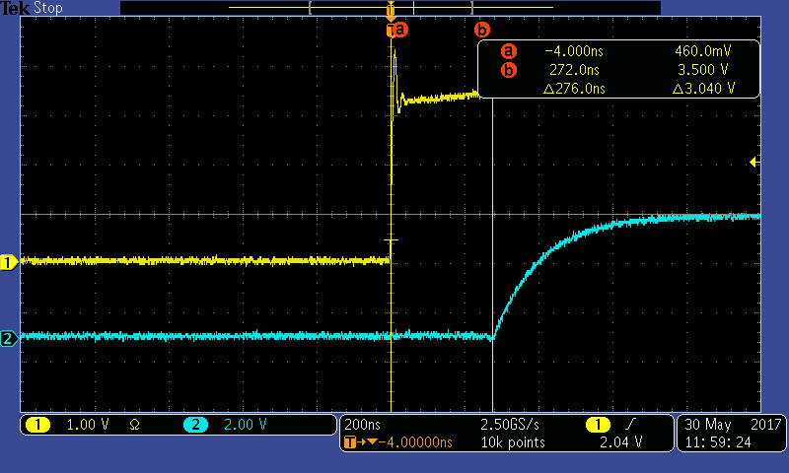
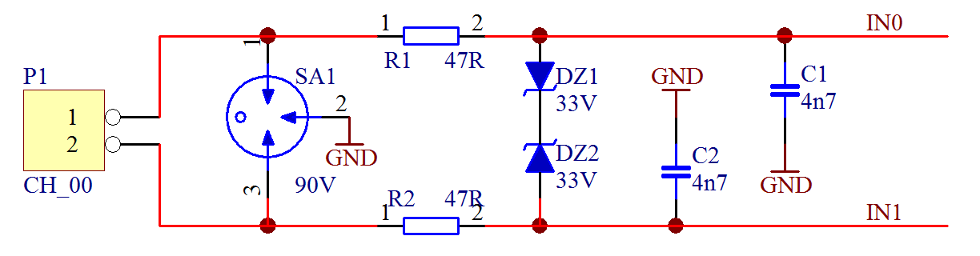
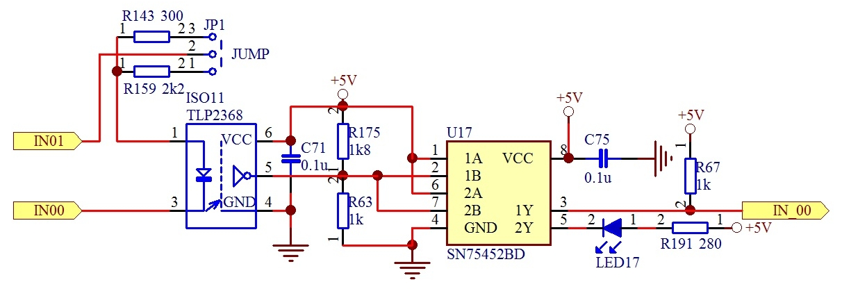
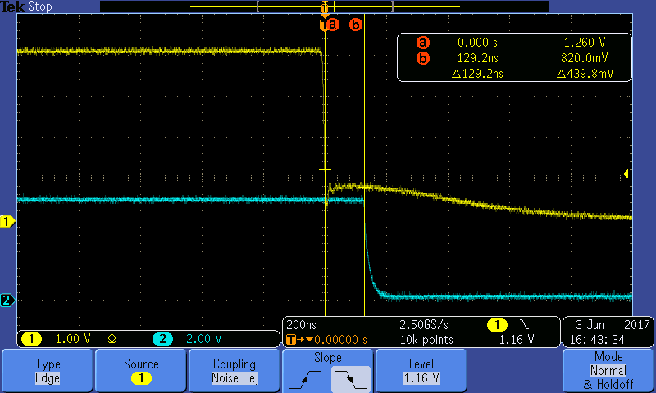
Digital Signal Conditioning Board
First stage of digital input cannels equipped with overvoltage protection and low pass filtering for attenuation of RF noises
Circuit of an open collector output stage on input channels with LED based opto-coupler for isolation
-------------------------
Oscillogram presenting 276 ns propagation delay of digital input channel at Low to High transient. The yellow curve represents the input and the blue is the output signal
Oscillogram presenting 129 ns propagation delay of digital input channel at High to Low transient. The yellow curve represents the input and the blue is the output signal

Slide 9
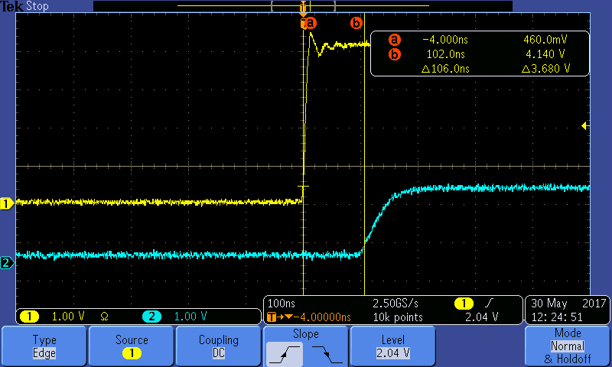
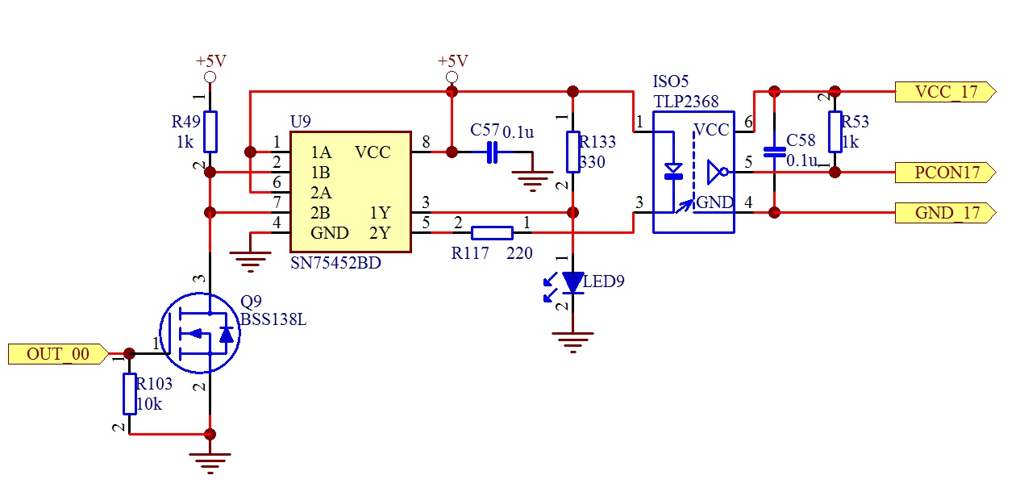
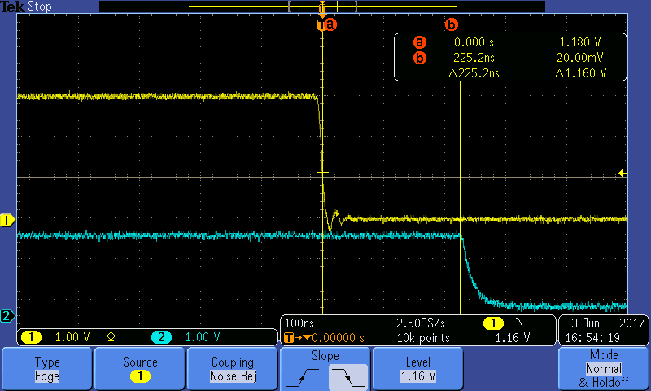
Digital Signal Conditioning Board
Typical schematics of output channels having optically isolated open collector outputs
-------------------------
Oscillogram presenting 106 ns propagation delay at Low to High transient of output channel
Propagation delay 225 ns observed at High to Low transient of output channel

Slide 10
Analogue Signal Conditioning Board
Analogue Conditioning Board involves:
10-channel mother board with isolated units including programmable instrumentation amplifier, high precision isolation amplifier and output drivers for monitoring purpose
10 pieces of protection daughter card including transient suppressor, low pass filter, protection diodes against overvoltage
10 pieces of RF power detector including high precision RF demodulator plus level shifter operational amplifier, resettable peak detector and output driver
For detailed schematics of the Analogue Conditioning Board, see:
Annex 21 Digital Filter Wall Board - RF daughter
Annex 22 Digital Filter Wall Board - RF mother
Annex 23 Digital Filter Wall Board - Analogue daughter

Slide 11
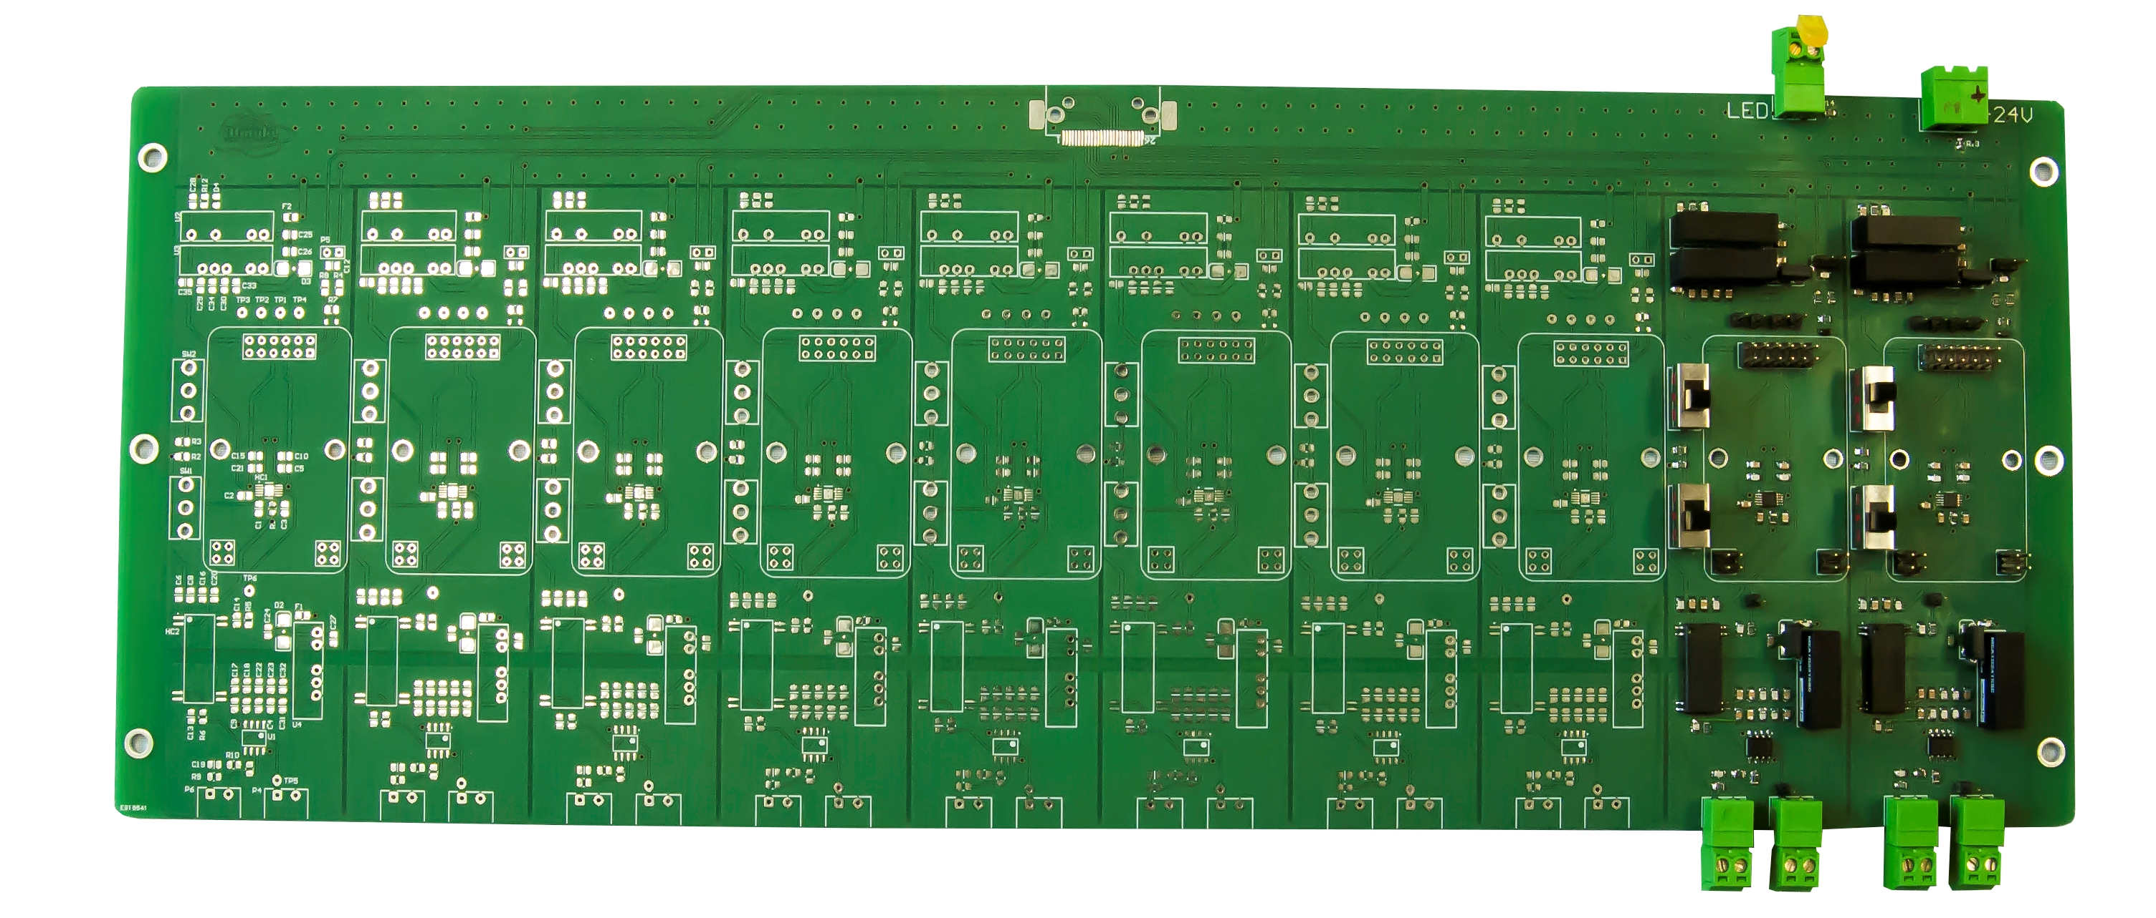
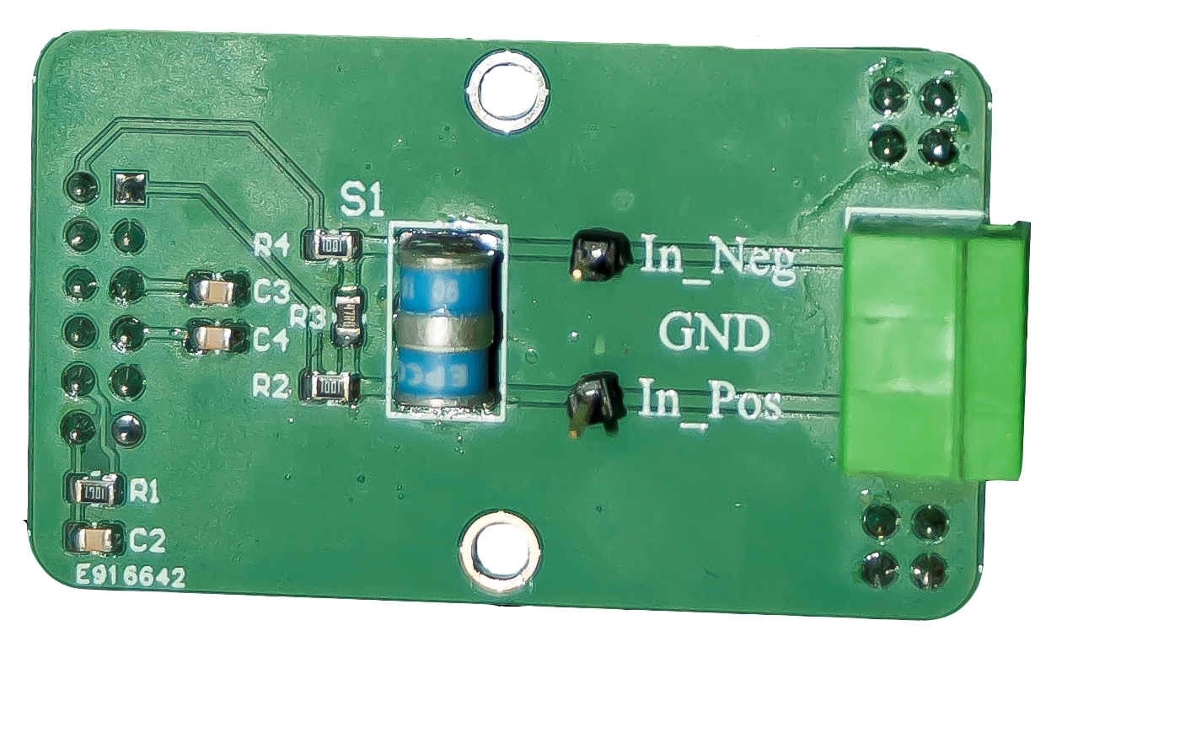
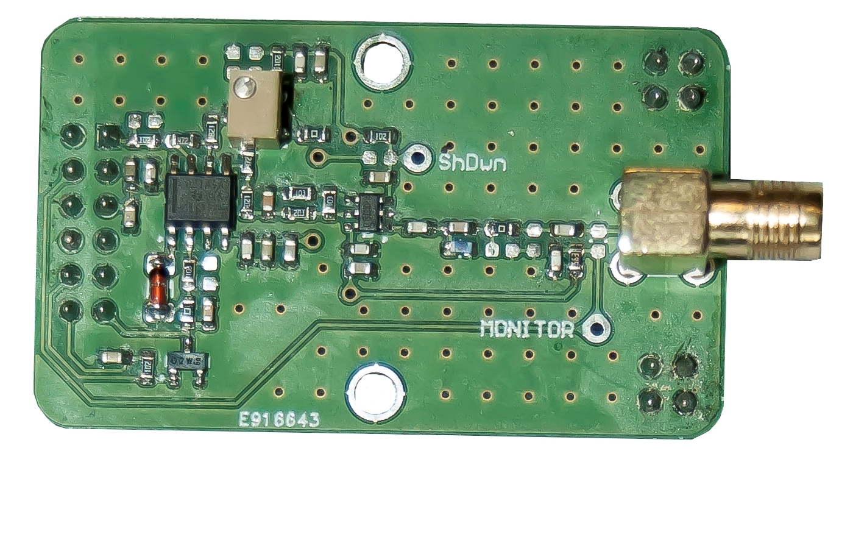
Analogue Signal Conditioning Board
Analogue Conditioning Board with 10 channels
Typical daughter cards
(protection and RF power detector) for Analogue Conditioning Board

Slide 12
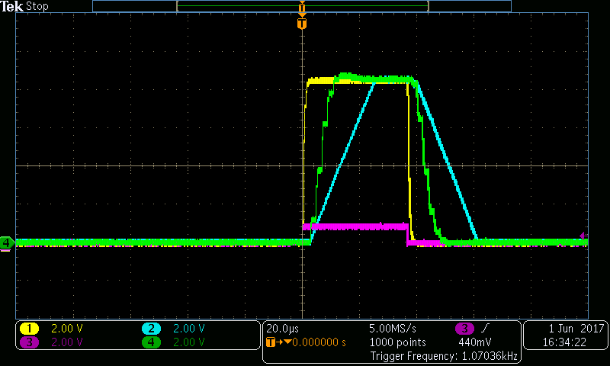
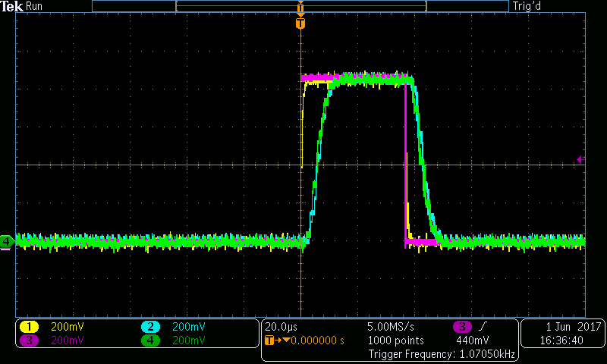
Analogue Signal Conditioning Board
Typical signals extracted from
one of the analogue channels
at 10 amplification factor
Typical signals extracted from
one of the analogue channels
at 1 amplification unit

Slide 13
Technical Parameters of SCBox
The mechanical dimensions of the Conditioning Box:
standard 19” rack mounted box with 4U height,
housing all of the necessary connectors required by the field devices like klystron, PLC, modulator, RF forward and reflected power detectors, fibre connectors for the pin diodes and the LLRF LVDS connectors.
Both digital and analogue signal conditioning circuits are included.
The Conditioning Box involves:
1 piece of Digital Conditioning Board
2 pieces of Analogue Conditioning Board
+24 V and +5 V switch-mode power supply
with low noise, low ripple and high efficiency

Slide 14
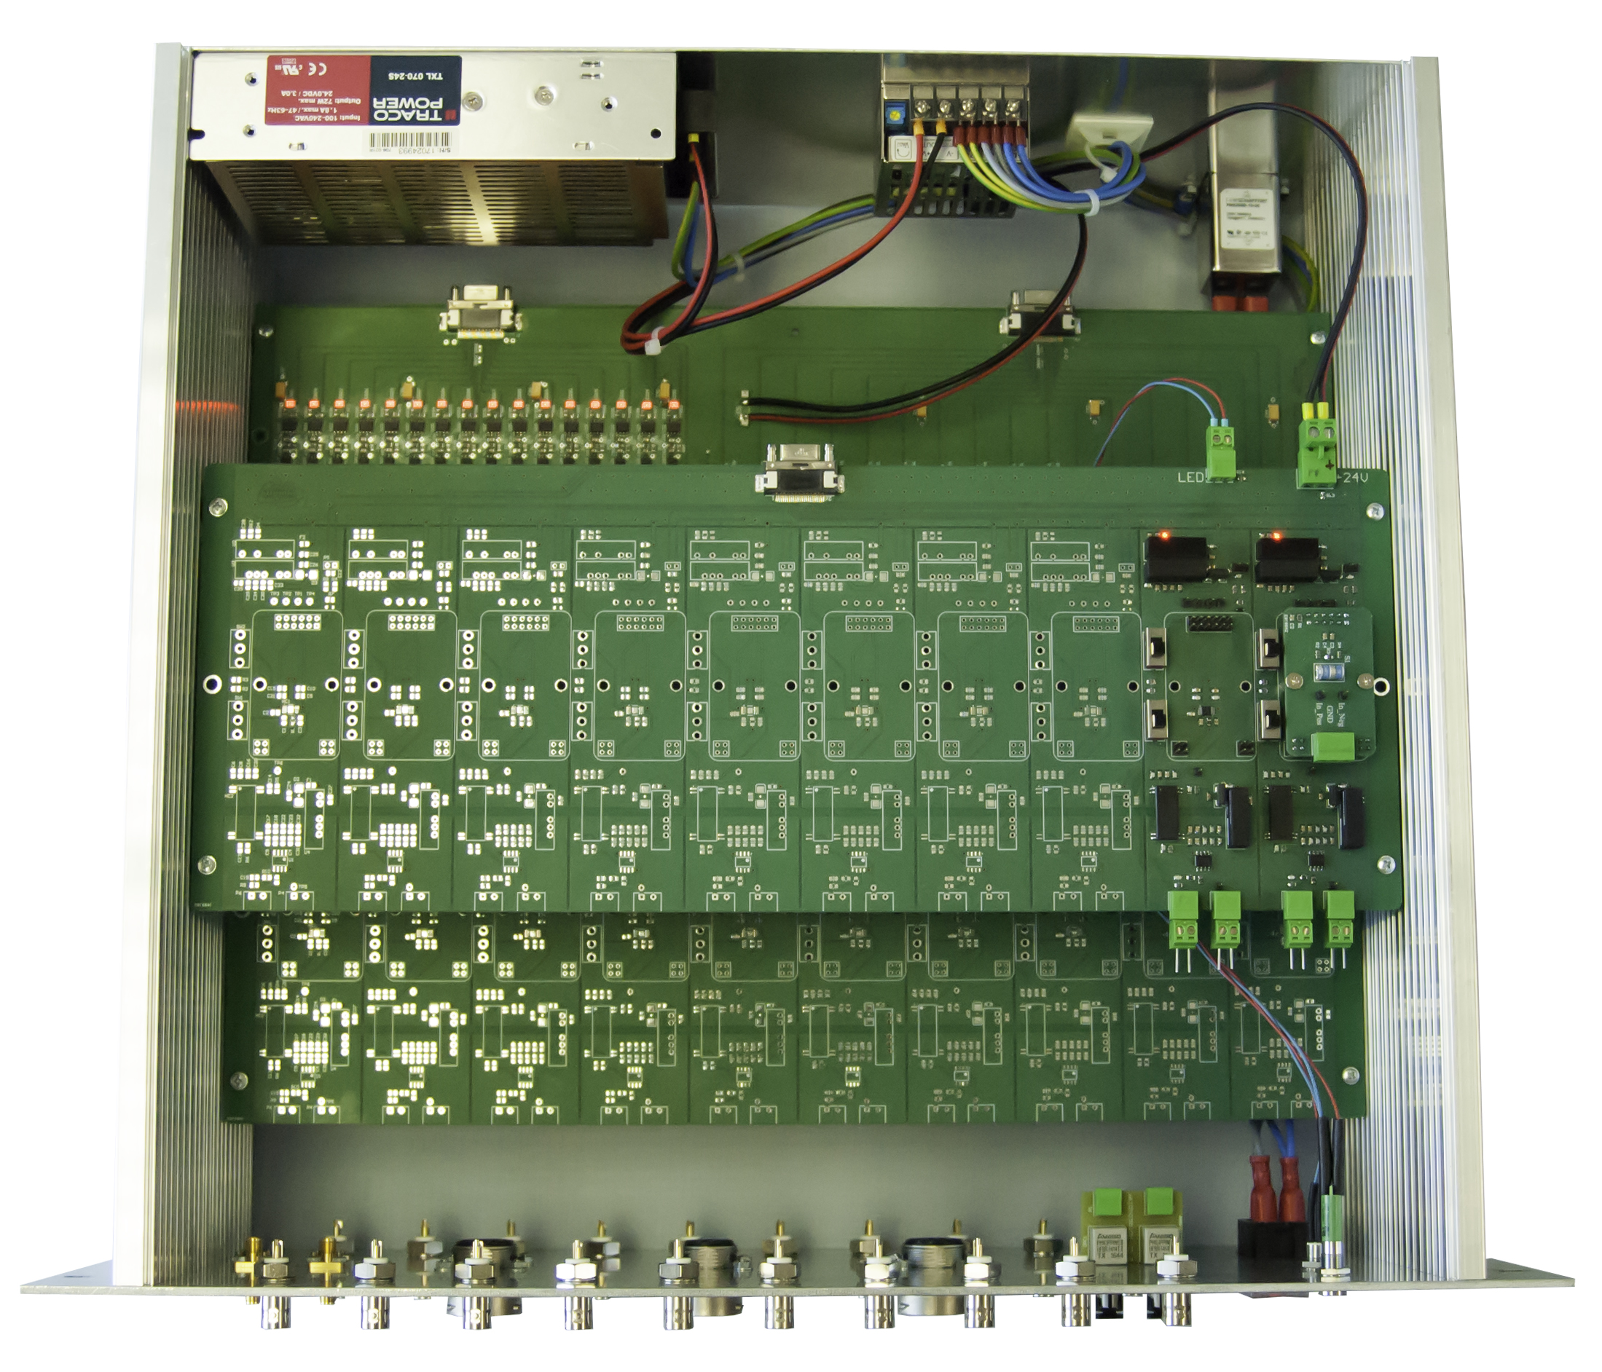
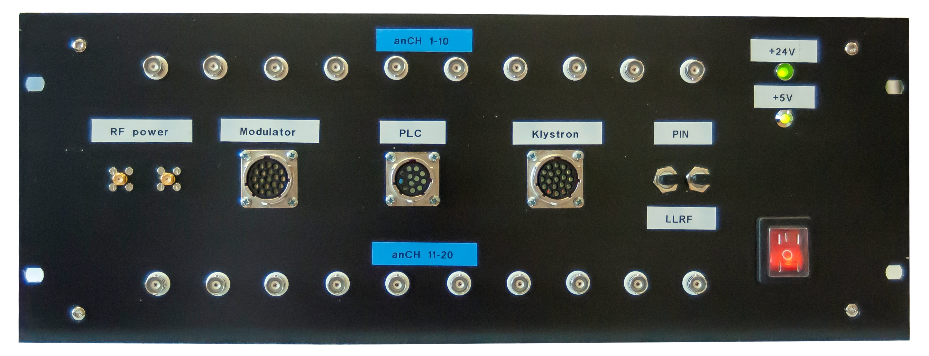
Signal Conditioning Box
Internal view of the
Conditioning Box
Front panel of the
Conditioning Box
with connectors

Slide 15
Concluding Remarks
The Signal Conditioning Box is used for proper matching of the analogue/digital signals between the inputs/outputs of the LINAC field devices and Interlock Systems.
SIM part of the Interlock System is constructed based on Siemens Automation Standard PLC platform, while the FIM part uses MicroTCA.4 standard. These standards represent excellent environment and flexibility for establish the platforms used for realization of processing power both the slow and the fast signals. However, any modificitations of the platforms can create impacts on the Signal Conditioning systems.
The real field devices should be specified in terms of signal lists, definition of the connectors, pin assignments of cables, timing and logic of the signals connecting in or out. In case of missing data, timing information describing the operation of the field devices can strongly impact on the Conditioning Boards, both analogue and digital.

