Slide 1
Proposed Installation Process
Marcus Green
RF Gallery Installation Supervisor
www.europeanspallationsource.se
8 May, 2017

Slide 2
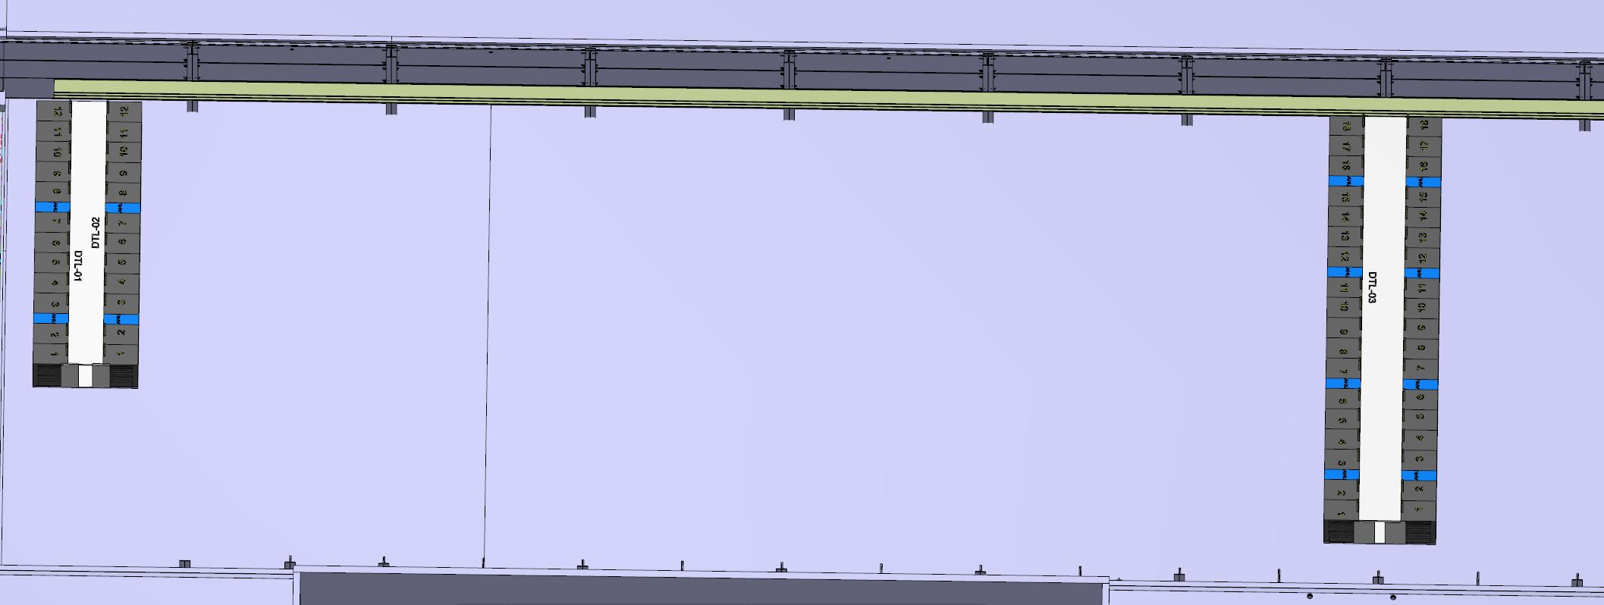
Defining the installation area
To prevent creeping along the gallery, it is important to fix and contain the installation area for each RF Cell. Therefore the location of the RACK on either side of the RF Cell shall be aligned and marked out first. These will then act as blockers and can be used for lateral reference points for marking out. The north wall will also be used as a reference point for marking out.

Slide 3
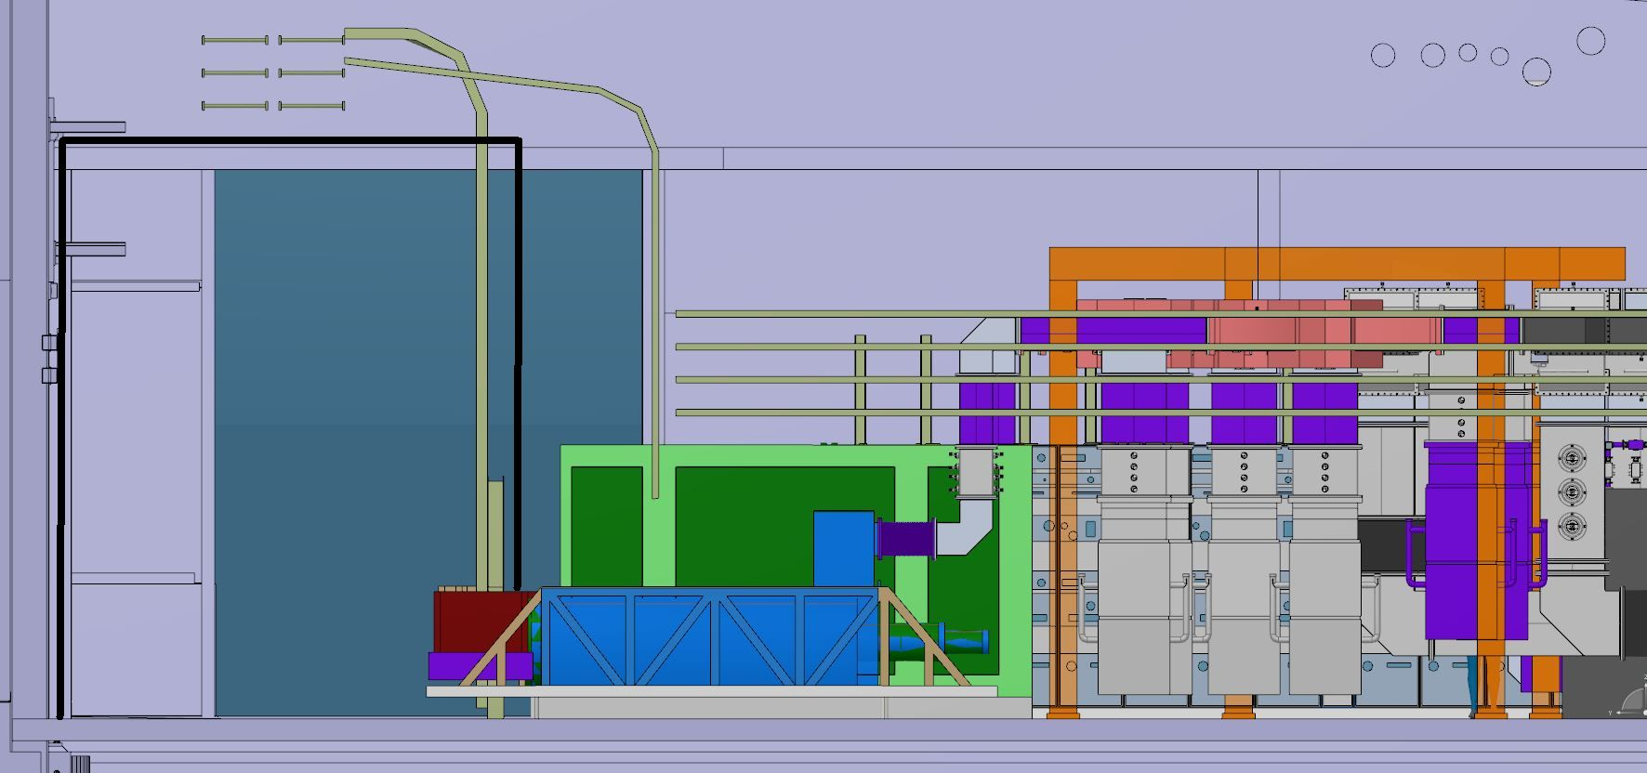
Keeping the transport corridor clear
Scaffolding at high level for cable installation, allowing free movement of the transport corridor

Slide 4
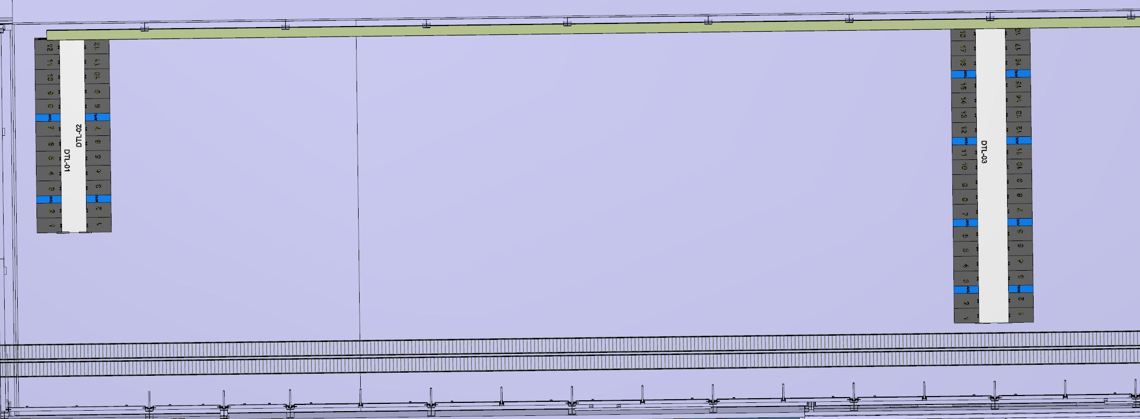
High level Cable tray and piping
High level cable tray installation can commence before or after the scaffolding has been installed. This decision will be based on the procurement of the electrical contractor. High level cooling pipe installation could also commence at this stage.

Slide 5
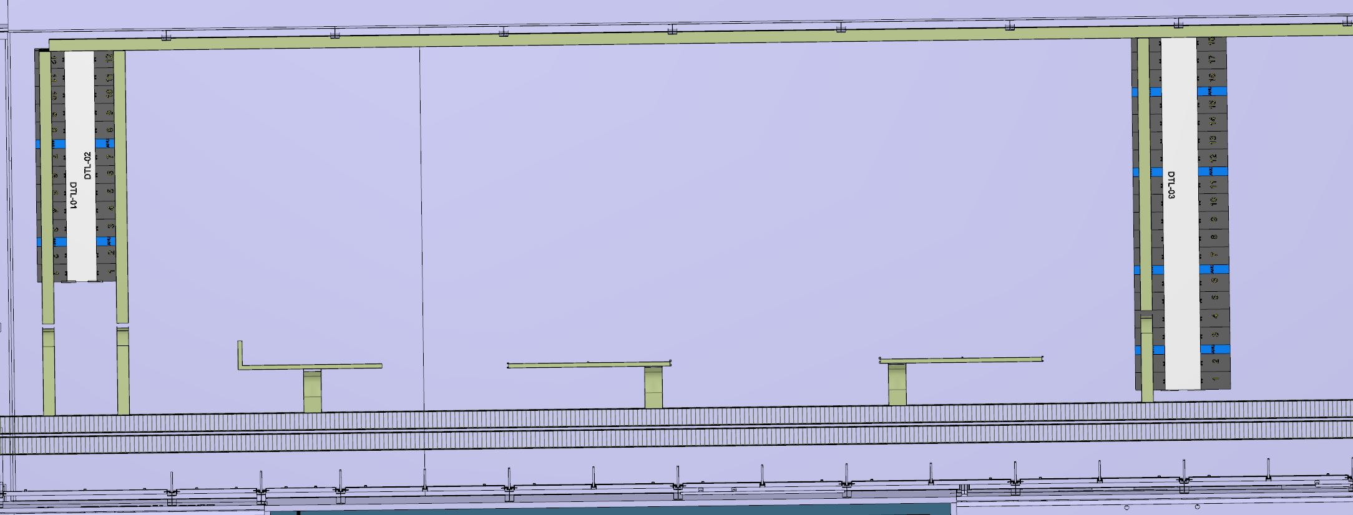
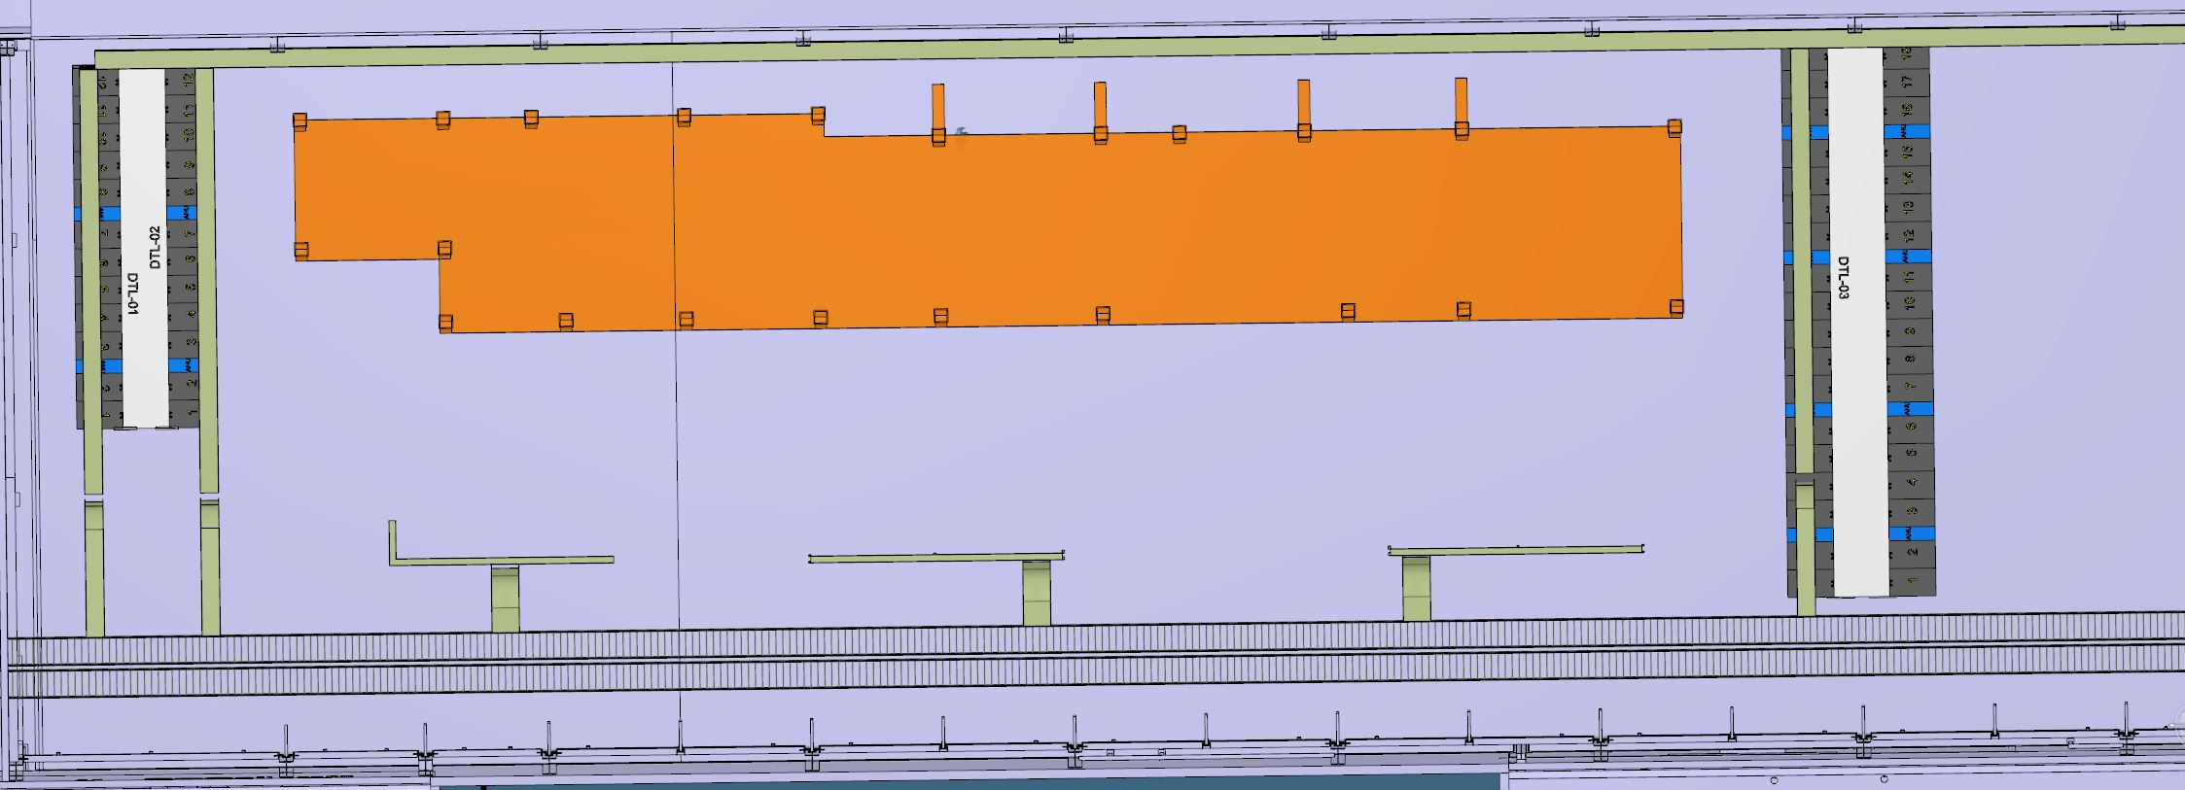
RF support structure and distribution cable tray
The cable tray distribution shall commence once the RACKs start to be positioned.
The cable installation can commence once their infrastructure installation permits.
The filling of the RACKs can then begin
RF supports can also commence once the RACKs have been marked out

Slide 6
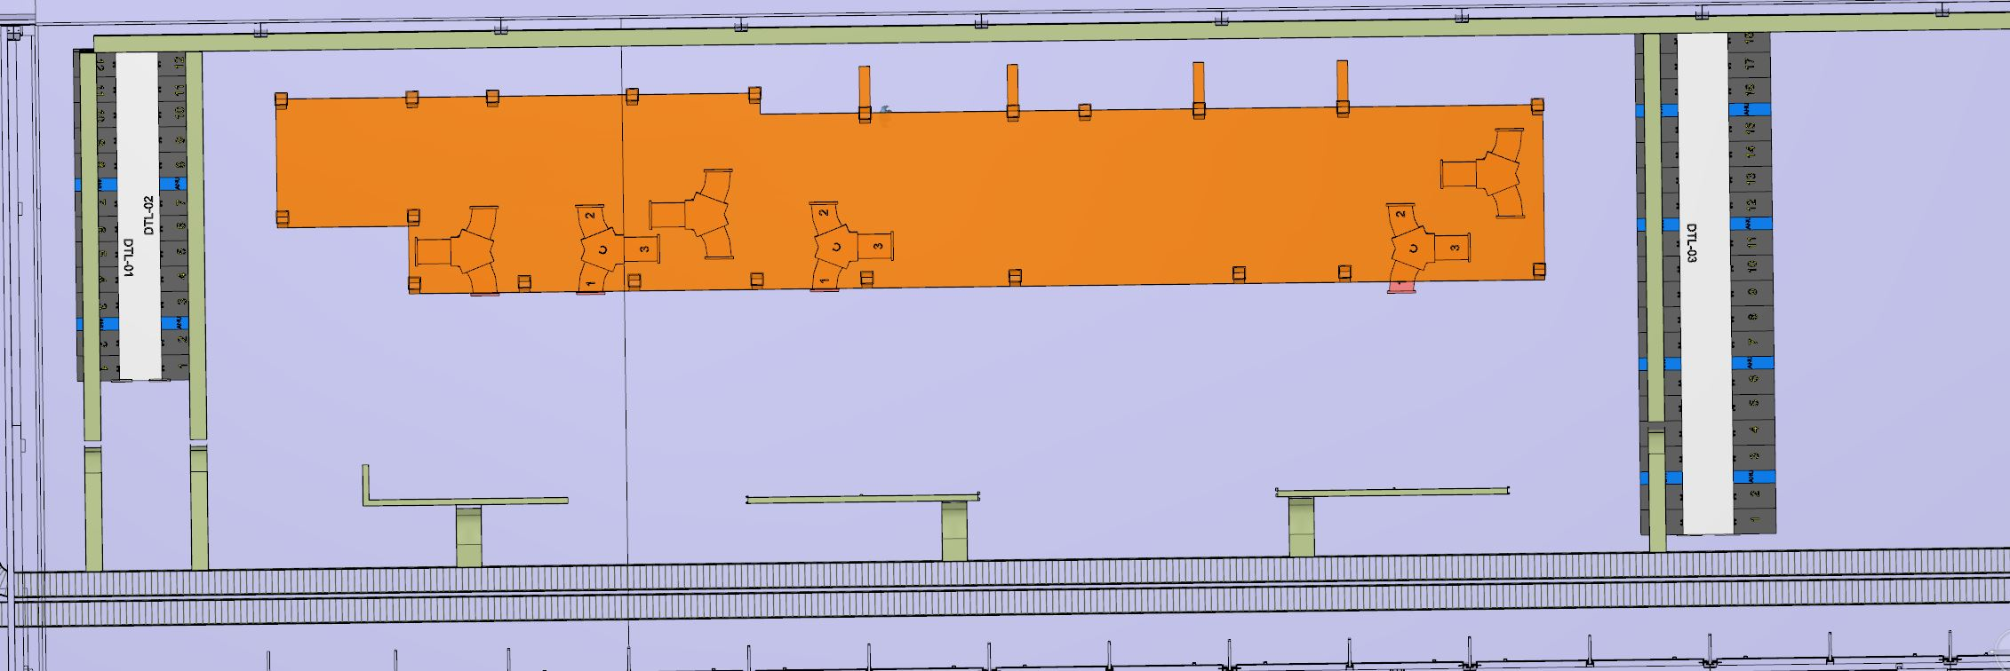
RF Circulator installation
The circulators will be lifted into place and aligned before being fixed in their final position. This will allow the waveguides to be installed independently of the stub installation and delivery of Klystrons.

Slide 7
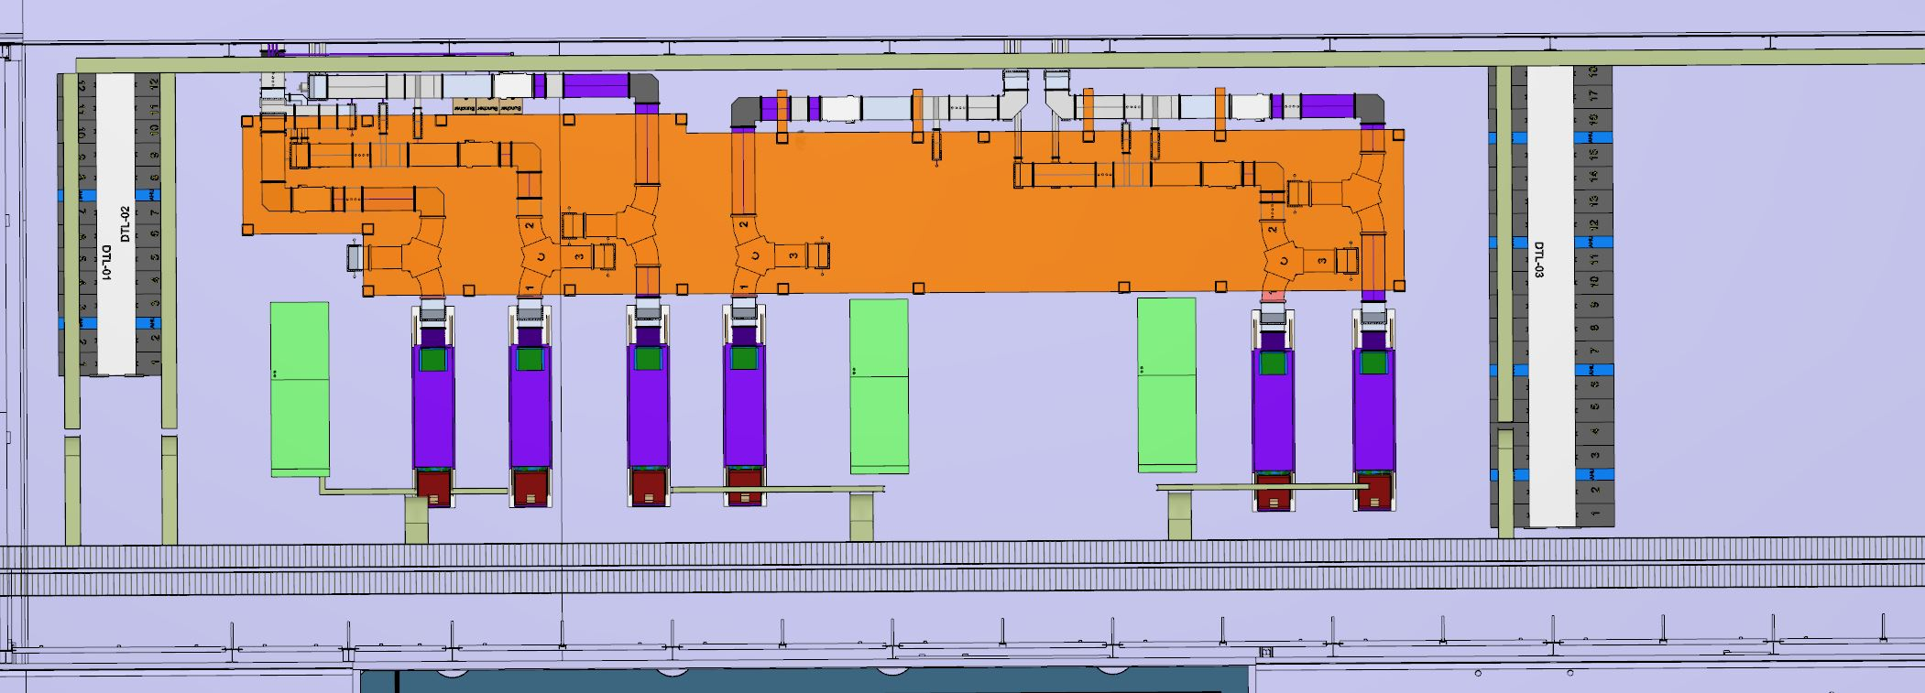
Waveguide, Klystrons & Modulators
The waveguide installation can commence once the circulators have been fixed into location.
The klystrons and modulators can be positioned into place as they arrive during this phase. With final piping and cable termination thereafter.

Slide 8
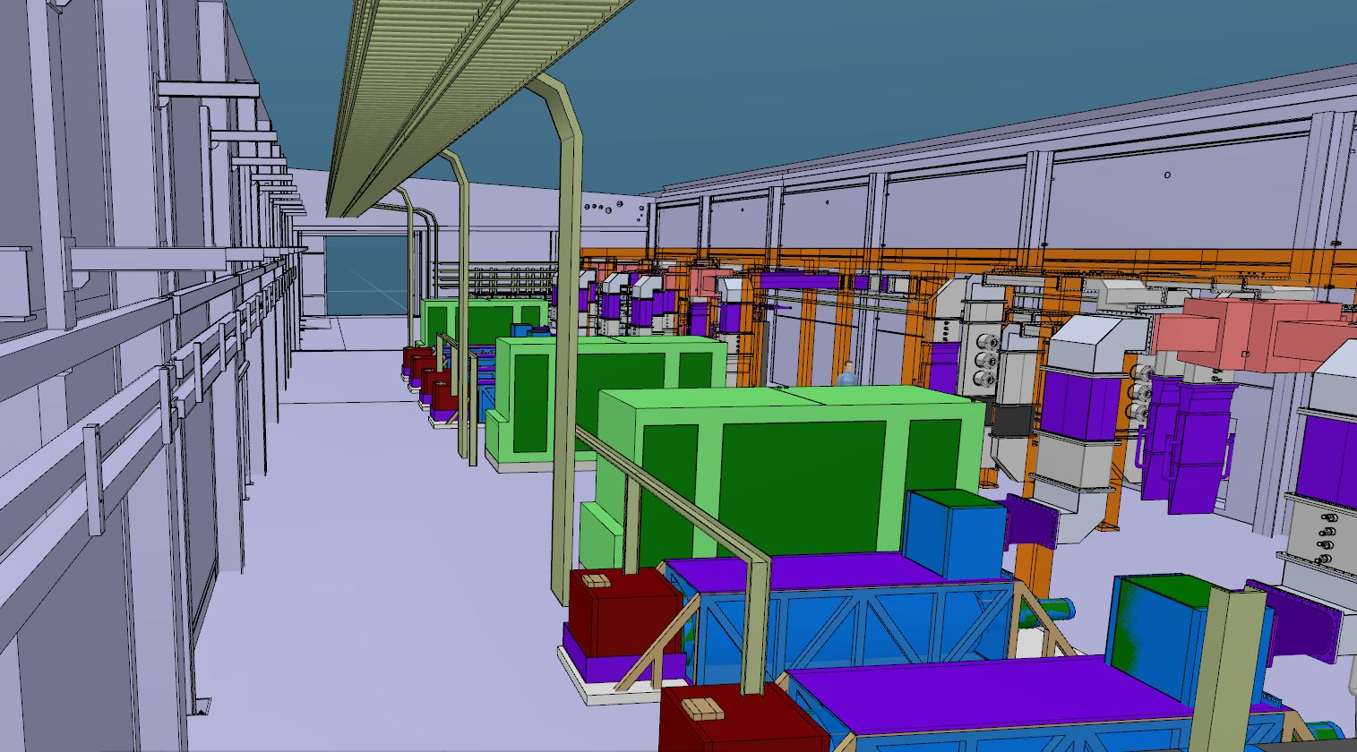
Over to test & commissioning

