Slide 1
WP 15 RF cell Review
Evangelia Vaena
Electrical Engineer
www.europeanspallationsource.se
11 May 2017

Slide 2
OVERVIEW
Definition of scope of electrical support (WP15)
Main Interfaces with other RF cell systems
Description of Normal Power Distribution and UPS
Rack Design (mechanical, space allocation, cooling)
Cable Management, Cable Tray design and Layout
Installation Sequence
Ongoing Actions and Current Status

Slide 3
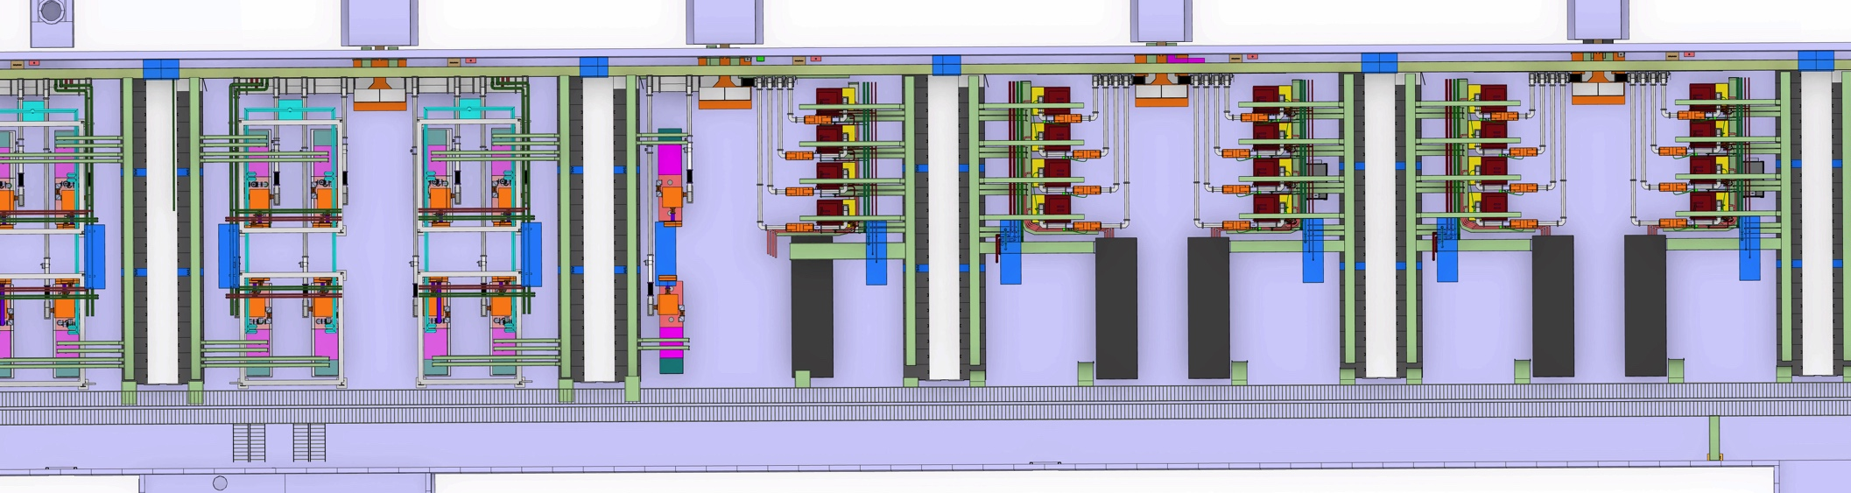
Description of WP15’s (electrical support) scope
Power to Modulators, Tetrodes and Racks
UPS power to rack mounted equipment
Integration, supply and installation of the rack cabinets
Cable tray design and installation
Earthing System design and grounding installation
Notes:
Power includes cable dimensioning, cable routing definition, installation and termination of cables at switchgear side and rack side
UPS design based on load requirements by accelerator systems

Slide 4
Interfaces RF cell-Electrical
WP15
Electrical support
CF substations ESS-0042523, ESS-0042880, CF documentation
Water Cooling- ESS-0085695
ICS-ESS-0085695& space reservation in 3D model
Accelerator Systems ESS-0085695& ESS-0082662
ESS-0085695: Rack Technical Specification
ESS-0042523: Interface description between Accelerator and site infrastructure regarding electrical in building G02 Gallery Building
ESS-0042880: Requirements on the Electrical system in G02 Gallery Building
ESS-0082662: Technical Specification for gallery electrical installation
Notes:
ICS interfaces: cooling monitoring, circuit breaker status switchgear side monitoring, space reservation in racks, space reservation in the cable trays, UPS power

Slide 5
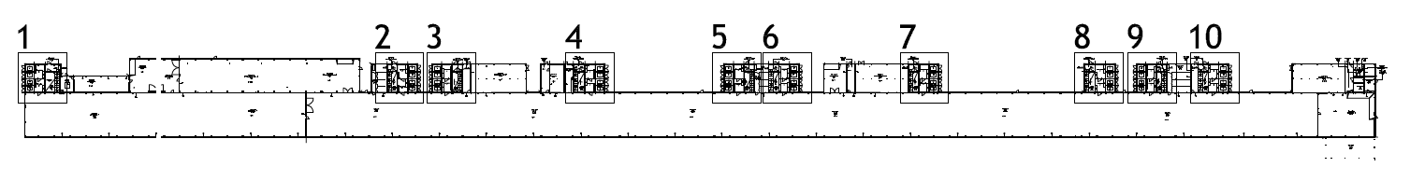
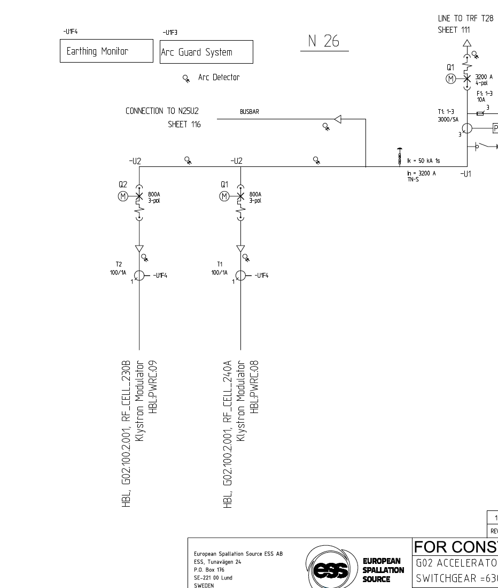
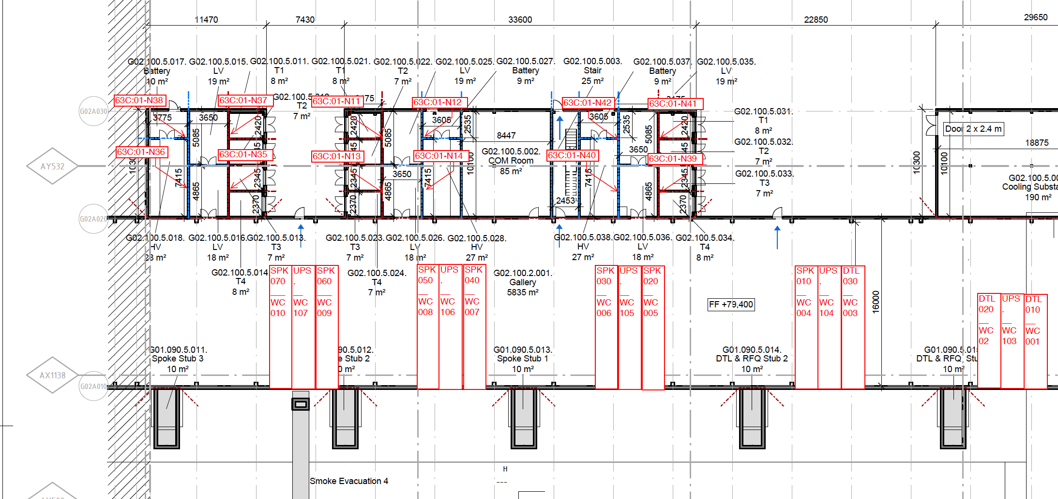
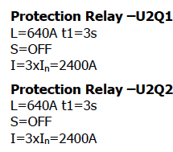
How is the RF Cell Powered?
Normal Power Description
10 Substations, 5 at 600V
Interface point: the circuit breaker on CF switchgear side.
Notes:
RF cells powered from 10 s/s in parallel to the gallery building
Documentation: Switchgear single line diagrams, Switchgear settings and short current calculations, cable lists from breakers to racks and modulators

Slide 6
RF-Cell power Installations (slide by F.Jensen)
Power Cables, 400 V
Trunking
CF/SI
Cable Trays, Corridor
Cable Trays, Racks
CB, (LOTO)
Tap-Off unit
PDU (LOTO)
LVSG
19”
19”
19”
19”
Power Cables, 600 V
Cable Trays, Corridor
Each tap-off unit supply 3 racks, 1 spare socket per tap-off.
Modulator is 3x single-core cable with PE (No Neutral)
Power cable dimensioning has been verified by external expert.
WP 8
CB, (LOTO) provided by HPRF
LVSG
HPRF

Slide 7
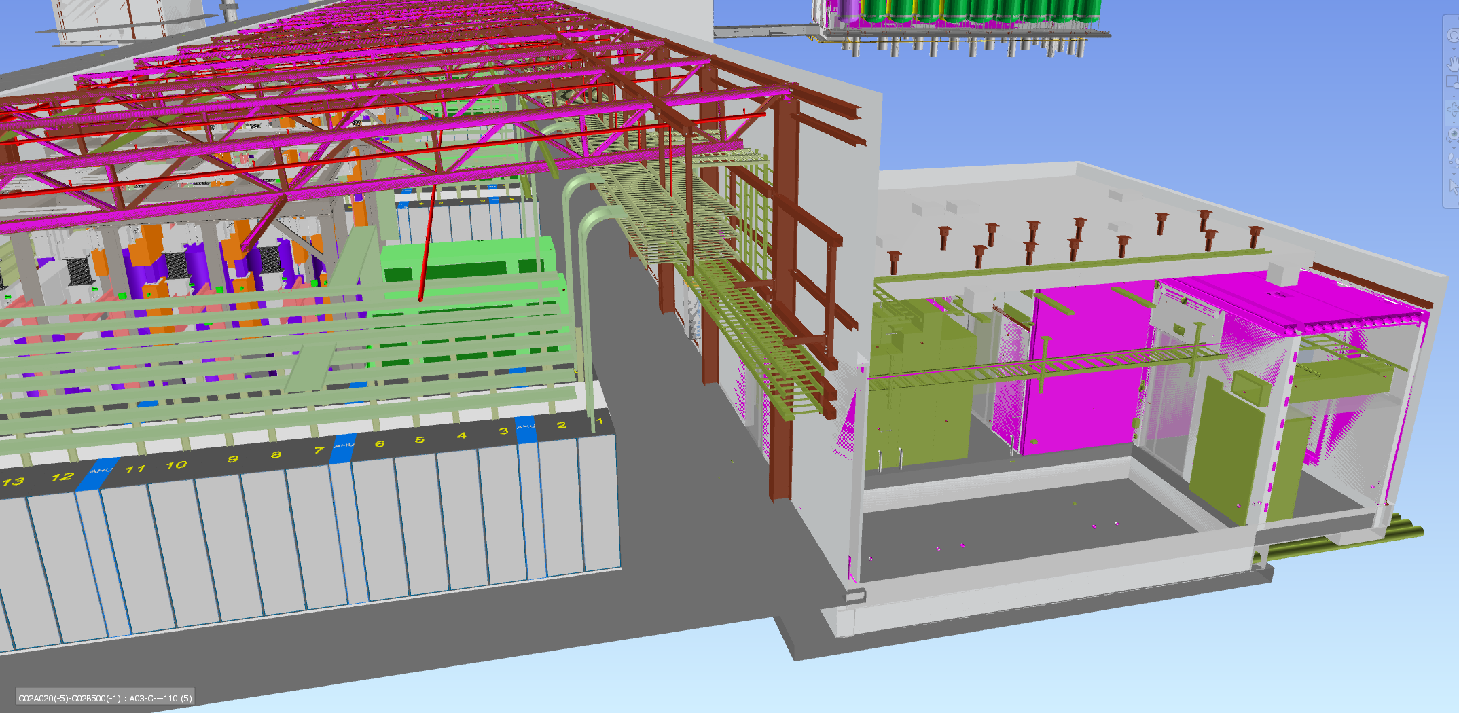
Layout- Power Distribution

Slide 8
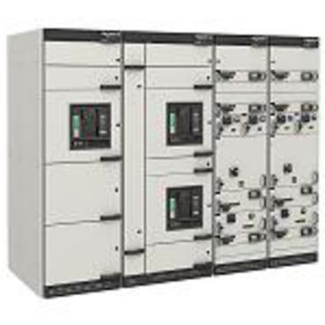
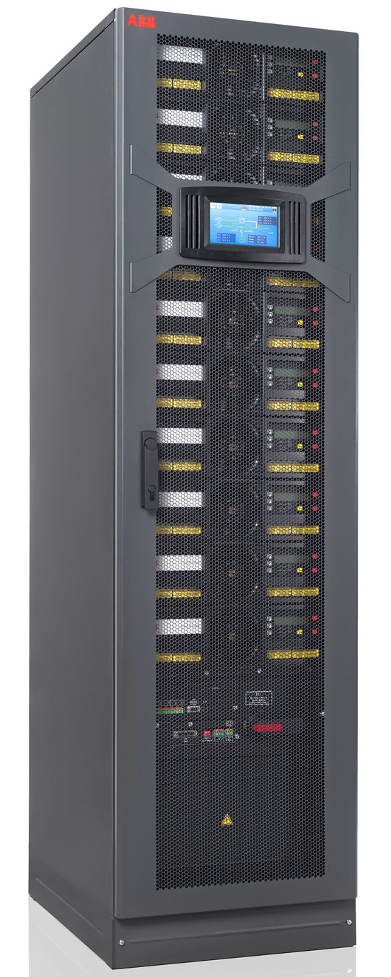
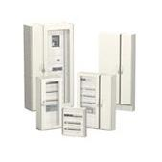
UPS Power distribution, Components(slide by F.Jensen)
Bus-bar trunking system
Distribution Panel
Low Voltage Switch-Gear
Tap-off units.
CB, (LOTO)
Modular UPS
Bypass
    Power distribution for UPS, the current plan is to distribute UPS for racks via a bus-bar trunking system due to long distances and uncertain requirements (low voltage drop, flexibility). PSS, VAC, CRYO-racks primarily, will all have “Central” UPS. ICS has estimated an additional 2 kW per RF Cell for some controls, Beam Instrumentation is T.B.D.
ODH and RAD monitor supplies have dedicated cabling.
Racks

Slide 9
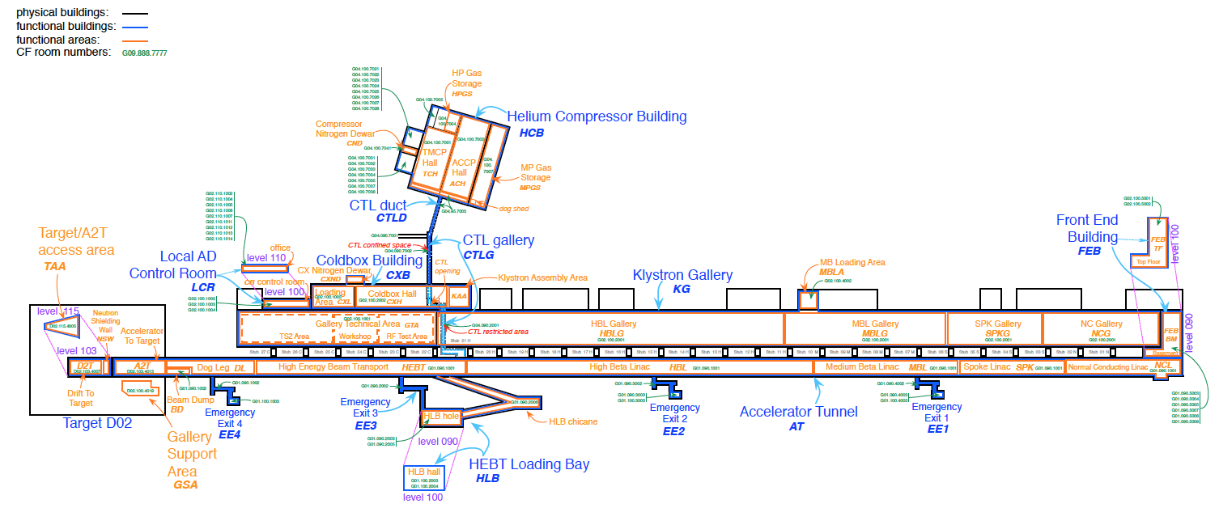
Location of UPS Loads(slide by F.Jensen)
PSS: 1.5 kW
ODH: 0.6 kW
CRYO: 25 kW
UPS distribution
PSS:
ODH:
RAD:
VAC:
PSS: 1.5 kW
ODH: 0.5 kW
CRYO: 15 kW
PSS: 18 kW
ODH: 0.3 kW?
RAD: 0.1 kW?
VAC: 1.5 kW
PSS: 3
RAD:
A2T:
Notes:
I it possible that we will only have 2 power distributions, one from either side of the gallery.
There are 50 radiation monitors dotted along the gallery, probably at the stubs, tunnel wall.
Decide if UPS go on the level 090 or level 100 – not to do like Fukushima.

Slide 10
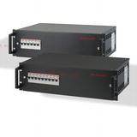
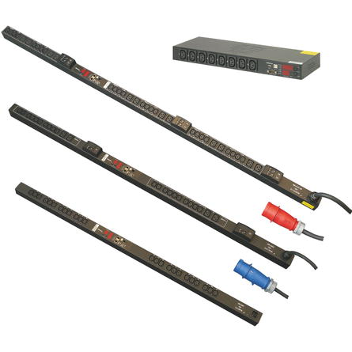
Power distribution in Racks (PDU’s) (slide by F.Jensen)
Lockable CB
Normal Supply
UPS Supply
PDU’s
Socket strips
Power distribution for racks, the accelerator is somewhat special because part of the equipment uses 3-phase power feeds. This drives a need for PDU’s.
Socket for crates or socket strips.
Notes:
Each Rack need an incoming Circuit Breaker that can be locked so that a rack can be isolated on a LOTO procedure.
If UPS is fed to the rack, the UPS incoming feed need a separate isolation switch / circuit breaker so that LOTO can be applied to the UPS supply also.
The racks are supplied with 400 V, 3 Phase power. Single-Phase loads are distributed onto phases in the PDU or in the socket strips, depending of the design of the rack.
Socket strips are less complicated, need to “normalise” the PDU’s to have few types – variants are always more expensive and error prone in production.

Slide 11
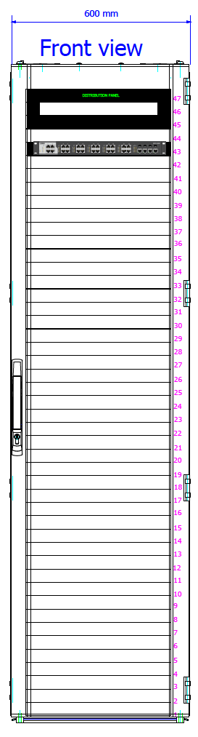
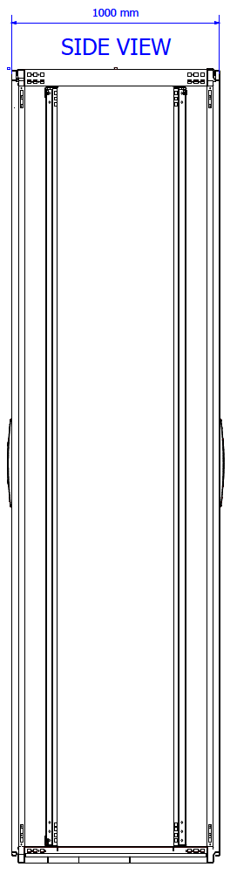
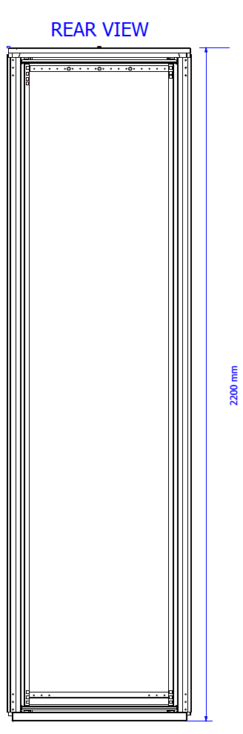
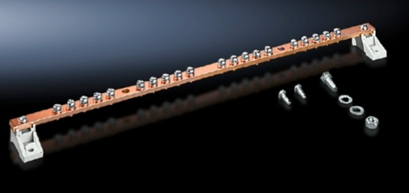
Rack Cabinet Mechanical Configuration
ONE rack size for all
Size 2200 mm high (47U), 1000 mm deep and 600 mm wide (19”), colour RAL 7035
Glass Front Door, rear door is in one-piece steel plate, fully perforated to optimize airflow
Front and back mounting rails. The rack units (U) of the rack are defined by the pre-threaded holes
The protection class IP20
Preinstalled earthing bars
Cable entries : top of the cabinet, sealing of the cable openings will be brush type sealants

Slide 12
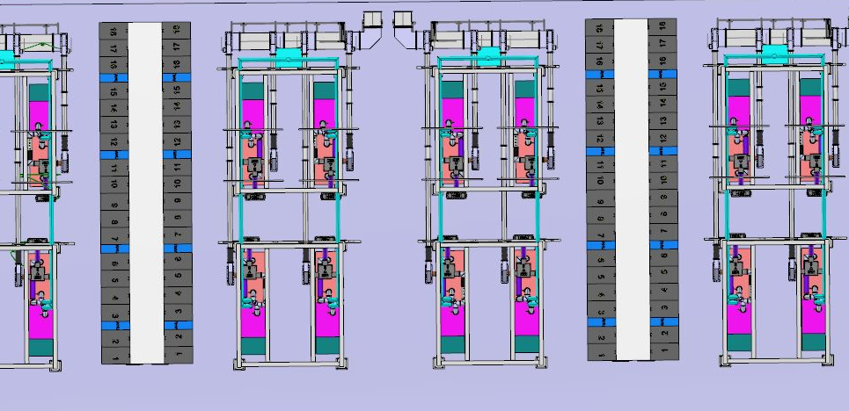
Racks per RF cell
3 RF racks per klystron, 2 per tetrode
2 Vacuum racks
1 power supply rack
2-3 BI racks
2 MPS racks
2 cryomodule &CDS controls
1 Network Distribution rack (ICS)
2 rows per cell- 18 racks per row
Position allocation for each system optimized to fit both gallery and tunnel needs
Notes:
Rack names and positioning defined in the rack spreadsheet ESS-0085695

Slide 13
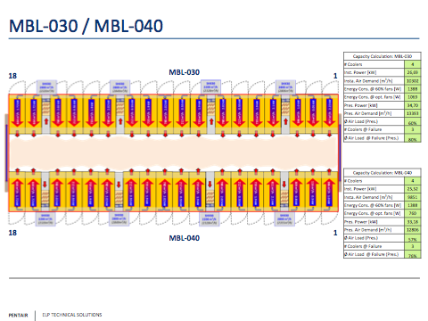
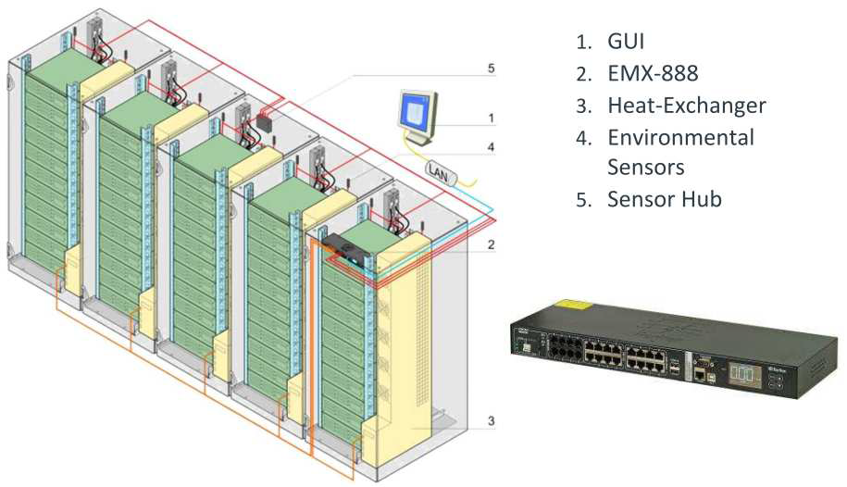
Rack Cooling- Interface with Water Cooling

Slide 14
Rack Cooling- Interface with ICS
The control device is connected to the cooling units. This integration provides a solution for remote monitoring and parametrization of the heat exchanger and control of fan speed.
Temperature and humidity can be measured and monitored remotely

Slide 15
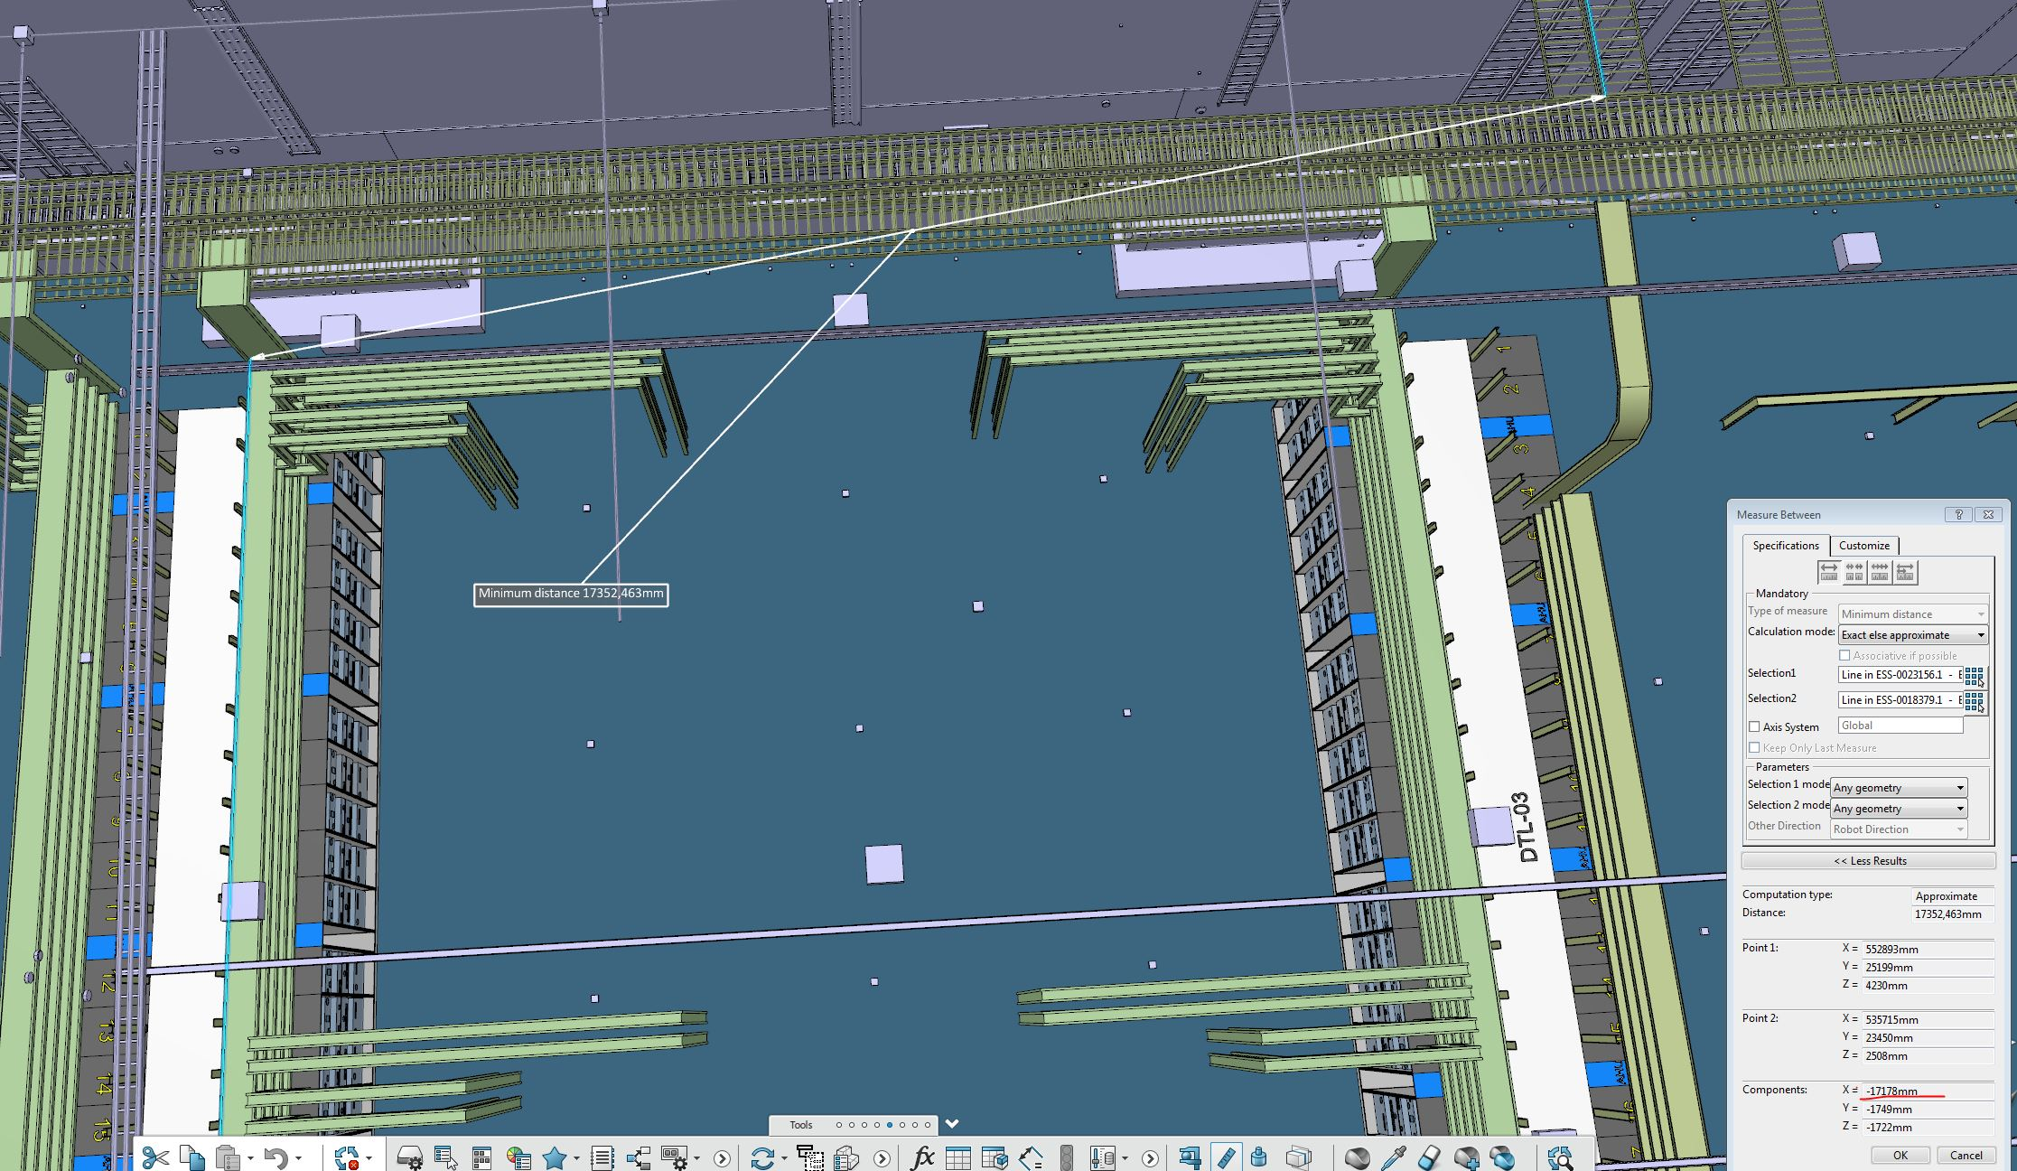
Cable Trays
600mm wide ladders fixed on the truss beams
Lowest layer of ladder at 5,5m
Smaller trays to RF equipment –could be fixed from roof or RF distribution supporting structure
400mm wide mounted on the racks

Slide 16
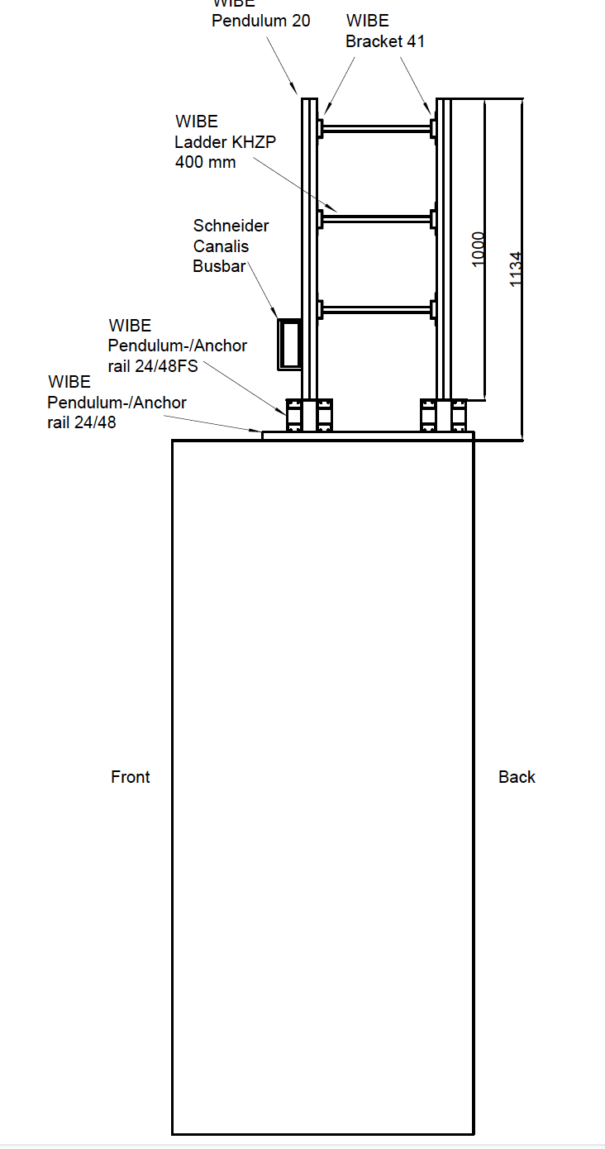
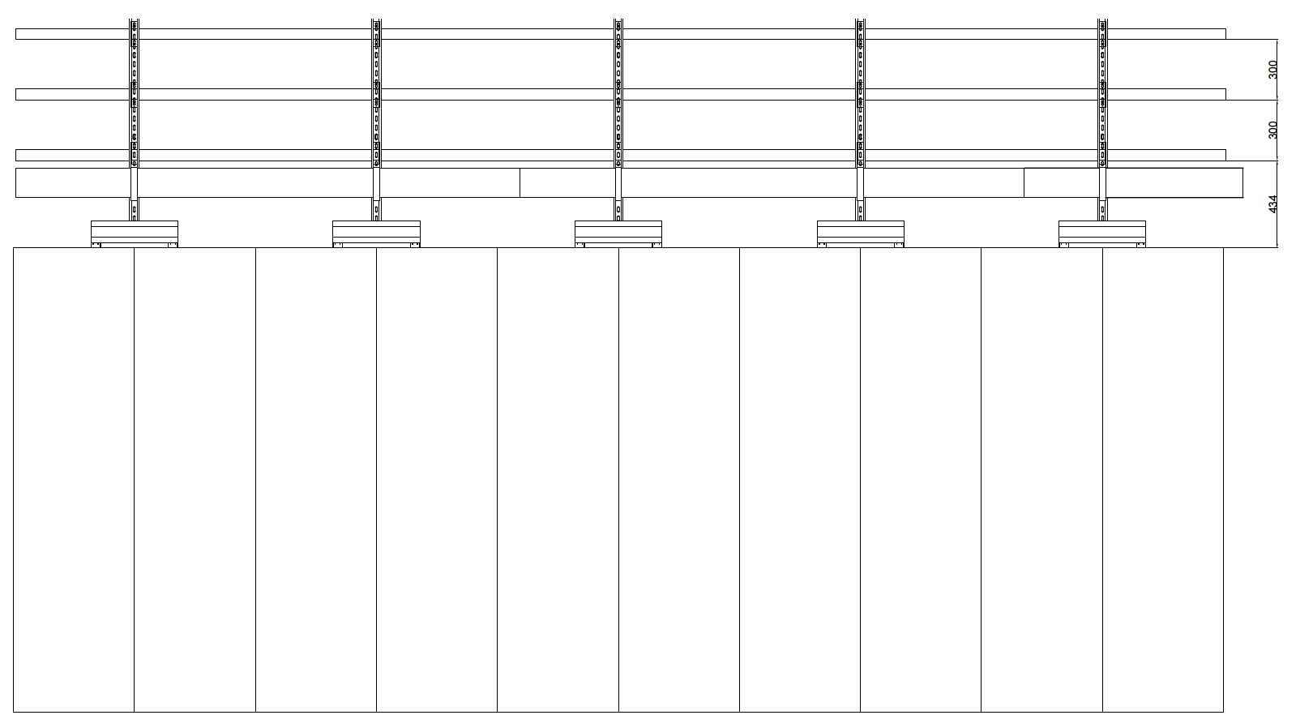
Cable Trays- rack mounted
4 layers of cable ladders
Segregated according to cable classification
Use of tray instead of ladder for very low level signal cabling is considered
Notes:
Trays shall be segregated according to classification

Slide 17
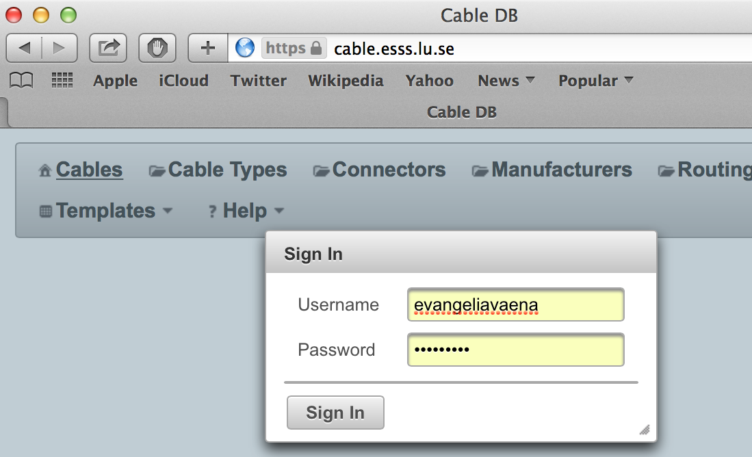

Cable management
The management of the cable plant will be done through the ICS cable database :(https://cable.esss.lu.se/)
The cables shall be low smoke, halogen free following the ESS safety rules.
The Cable Database (CDB) supports the tracking, configuration and naming of cables in all phases of the ESS project (design, installation, operation, shut downs). It is interconnected to the other two main ICS applications (e.g. CCDB and naming tool) to enable these to successfully perform their domain specific businesses.
Schematics, termination diagrams and connector information can also be included
Notes:
Same approach for gallery cables

Slide 18
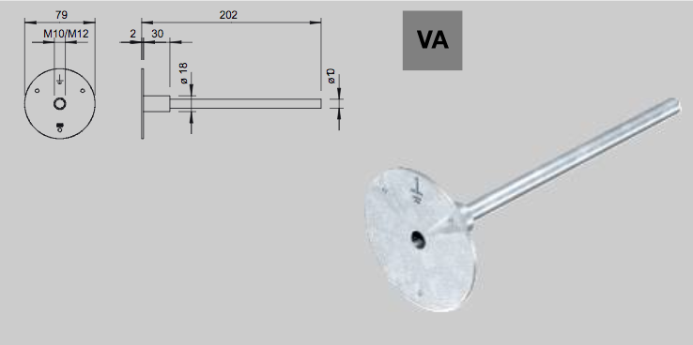
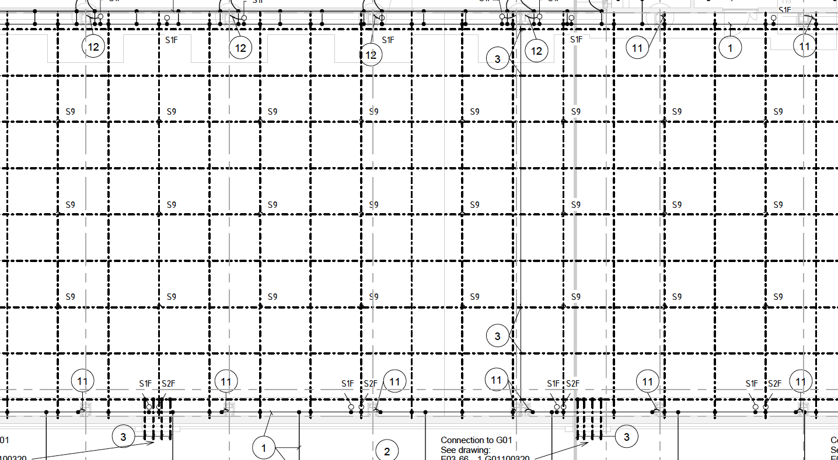
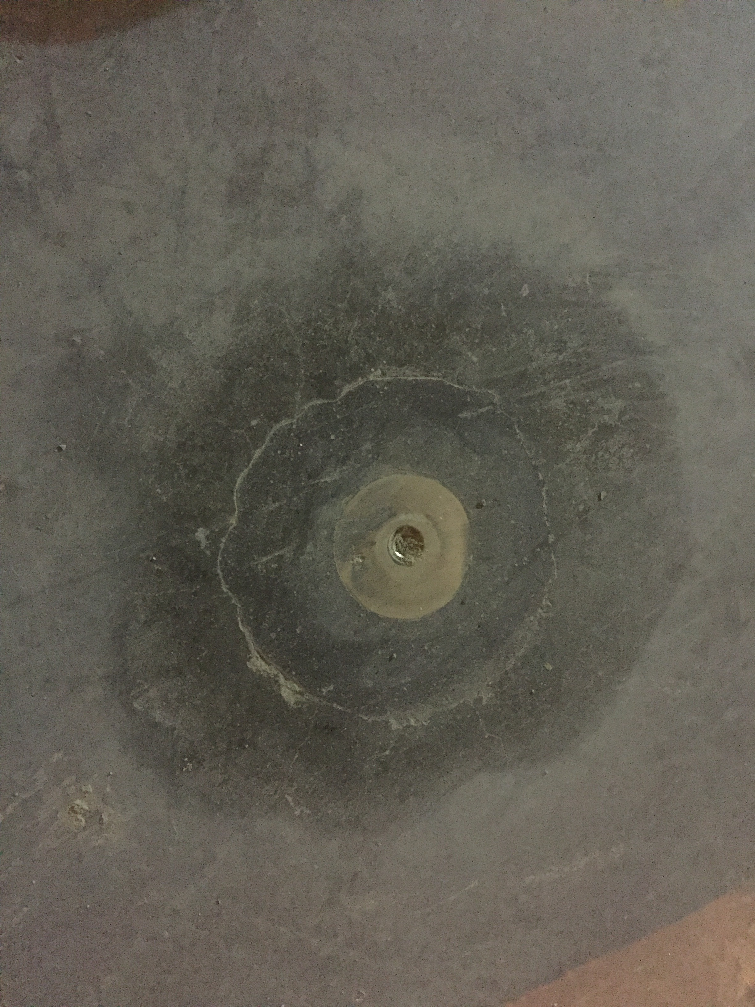
Grounding
Notes:
Pads on the floor – connected to EMC grid (3,5- 5cm below finished flood)
Bus Bars on the walls

Slide 19
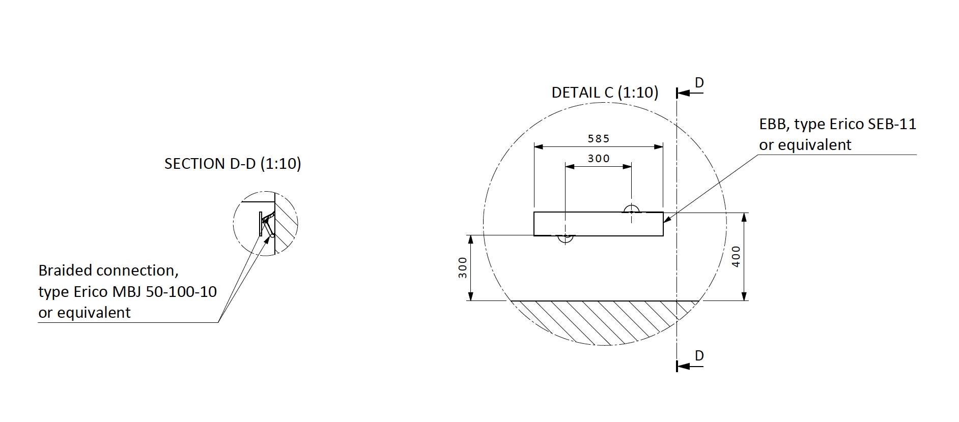
Grounding
One Bus bar every 8m, mounted on the wall

Slide 20
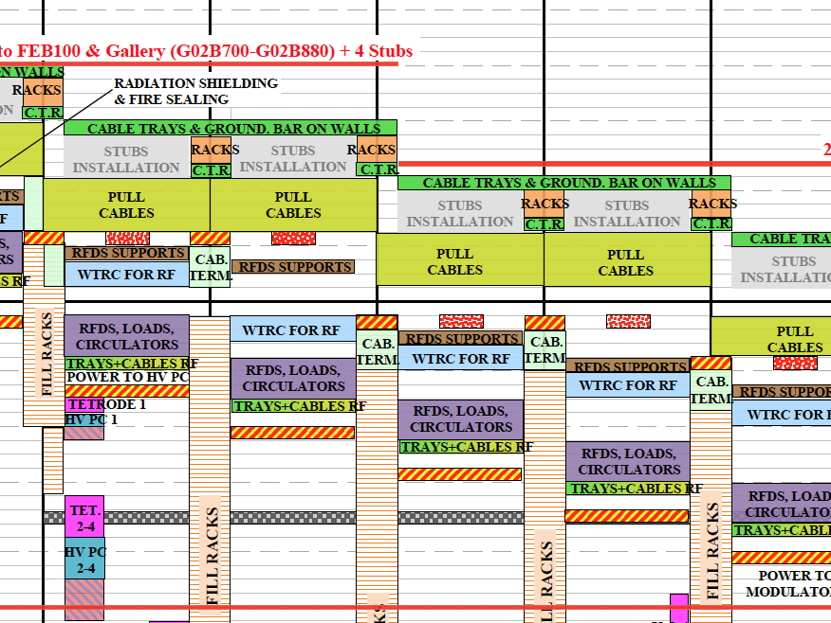
Installation Sequence- only for RF cell components
Main power cable ladders, grounding- By main electrical contractor
Rack Installation – By rack supplier’s contractor
Cable trays on top of the racks and installation of Bus bar trunking system
By main electrical contractor
Installation of power cables from s/s to rf cell -By main electrical contractor
Cable trays and cable installation to RF equipment (RF scope)

Slide 21
Conclusion, future actions and TBDs
Completed
Normal Power Distribution Design
Rack Procurement
Grounding design
Future Plans
Tender for gallery electrical installation
Rack IRR
Update installation plan with more details
Participation in switchgear testing and commissioning
Ongoing and TBD
UPS design
Rack internal power distribution configuration
Finalization of cable tray design
Rack Population
Do we want emergency stops on each rack row bus bar trunking system?

Slide 22
The end
Questions please?

Slide 23
Status, UPS (slide by F.Jensen)- back up slide
Present status of UPS work
  Prune / Update requirements
    PSS, VAC, ODH, RAD. primarily, will all have “Central” UPS, ICS has estimated an additional 2 kW per RF Cell for some controls, Beam Instrumentation is T.B.D.
    The PSS and ODH racks have Local UPS (24 V DC Batteries, with a 6 hour capacity), Central UPS will installed for these systems when available.
    CRYO-racks may need UPS for controls also (about 300 W per PLC).
  Procurement of UPS
    Complete the detailed design of distribution system, based on best estimates of needs to move installation contract procurement forward.
    Might be better to not order UPS systems now and use “normal power” for a while, until the UPS / and better requirements arrive. Temporary UPS and Local UPS power can be used for very critical loads.
  Distribution network
    Estimate UPS loads and add margin to allow dimensioning of UPS distribution systems and space reservations for UPS systems.
    Locate and Reserve physical space to install the UPS systems in, G04 should have space.

Slide 24
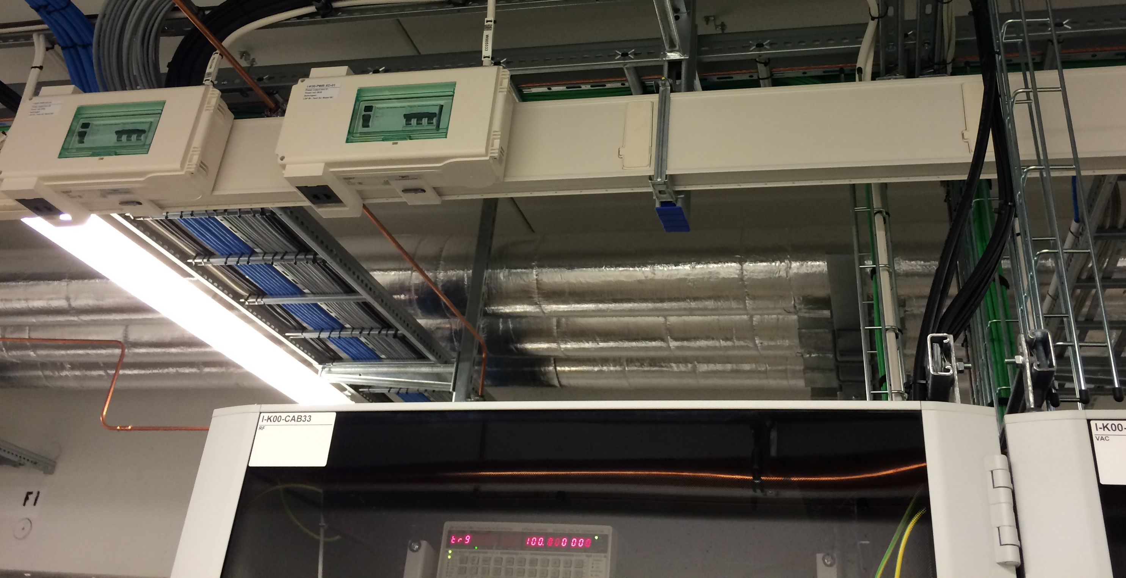
General Rack Design
All racks are supplied by a 400 V AC, 3-phase, mains supply.

Slide 25
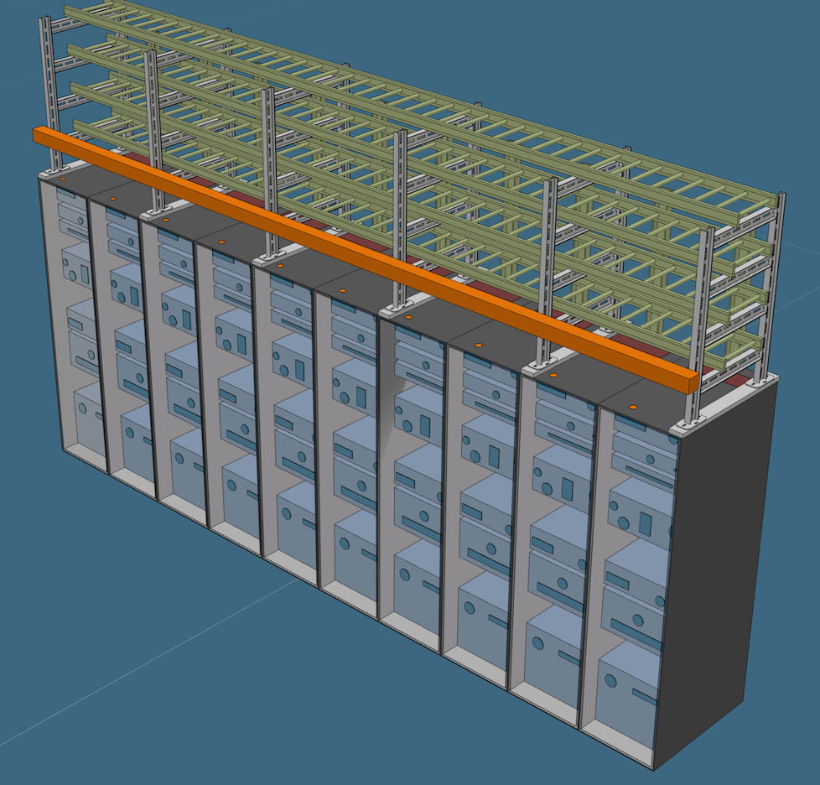
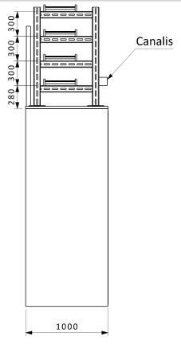
Rack Rows
The vast majority of the racks fitted together side-to-side forming rows.
The rack row will also carry a frame structure that holds all the cable trays and the power distribution bus bar trunking system.

Slide 26
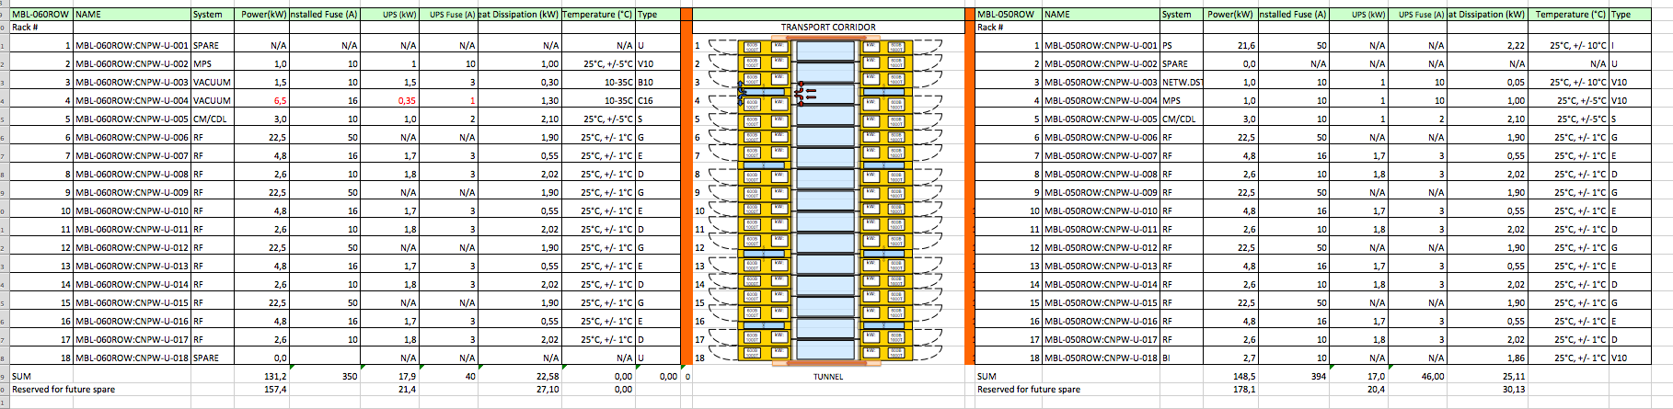
rack spreadsheet
rack space allocation per system
Rack row and rack naming
conventional power, UPS and dissipated heat per rack

Slide 27
Review Questions
Associated Racks, Cables and Cable Trays
Preliminary Installation Plans
Mechanical design at a sufficient detail to answer interface, performance, alignment and installation questions below.
Electrical design including: single line drawings, instrumentation lists, cable designs and connector pin outs, calibrations etc.
Are the interfaces between the various components and subsystems that compose this system completed defined in terms of: a) physical connection – location and type of mating flanges, location and type of power and cable connections, support stands etc. and b) physical parameters (flows, pressure, temperatures, current, voltage, data acquisition formats and rates etc.)

Slide 28
Have all interfaces between this system and other systems been completely defined and agreed. Are all the connections on the ESS site in place? This applies to physical connections, physical parameters (flows, pressure, temperatures, current, voltage, UPS requirements) and data exchange.
Is the preliminary installation plan for the system adequate? Have all tools, including cranes, movement devices, stands, alignment fixtures etc. been defined. Has the staff for this work been identified? Is the installation sequence consistent with the overall installation plan?

