Slide 1
LLRF for RF review
11-12 May 2017
Anders J Johansson
Lund University
v.1.1

Slide 2
LLRF functionality
The algorithms and functions should
  Control the cavity field during the pulses
  Tune the cavity by the slow tuners
  Control the fast tuners
  Support the procedures developed with the necessary functionality.

Slide 3
Cavity field regulation accuracy
 | Frequency (MHz) | Phase accuracy (RMS) | Amplitude accuracy (RMS)
RFQ | 352.21 | 0.2 deg | 0.2 %
Buncher | 352.21 | 0.2 deg | 0.2 %
DTL Static dynamic | 352.21 | 0.2 deg | 0.2 %
Spoke | 352.21 | 0.1 deg | 0.1 %
Medium-Beta | 704.42 | 0.1 deg | 0.1 %
High-Beta | 704.42 | 0.1 deg | 0.1 %
RMS values for time duration of beam, excluding the initial 10 us. In addition, the permissible drift of the phase between two adjacent cavities is 0.1 degrees, with a maximum of 1 degree between any two cavities along the accelerator.

Slide 4
LLRF system : General view
Klystron HV
Beam current

Slide 5
High level LLRF architecture
Procedures
  Schemes that involves longer times and multiple pulses.
Algorithms
  Updates that takes place between pulses (68 ms).
Functions
  Real-time control within a pulse (3.5 ms).
CPU
Procedures
Scripts
EPICS
CPU
Algorithms
Software
LLRF
PCIe
FPGA
Functions
Firmware

Slide 6
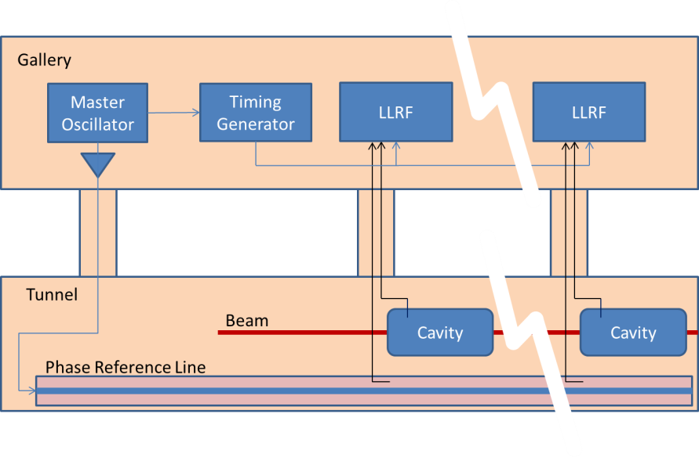
Timing and Phase Reference
MRF timing system in gallery distributes triggers.
Phase reference line in tunnel.

Slide 7
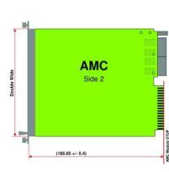
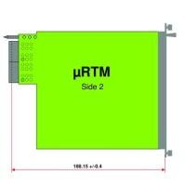
352.21 MHz MTCA.4 example - Spoke
CPU
CB control on backplane
Timing triggers
MCH supervision
External I/O
Ethernet on backplane
LO-generation
Phase referense
Cavity Pickup
VM out
PreAmp Out
PowerAmp out
PowerAmp Refl
Cavity In
Cavity Refl
Phase referense
Cavity Pickup
VM out
PreAmp Out
PowerAmp out
PowerAmp Refl
Cavity In
Cavity Refl
Phase referense
Cavity Pickup
VM out
PreAmp Out
PowerAmp out
PowerAmp Refl
Cavity In
Cavity Refl
Timing
In-Kind
LO/REF
Timing
Updated
RF/VM
352 MHz
FPGA/ADC
Interlock
Updated
Modulator voltage
Spare
Vectormodulator out
FPGA
PZ
Piezo 1
In-Kind
In-Kind
Piezo 2
Monitor
MCH
Fan Tray x 2
EPICS, Supervision
PSU x 2
230 V AC

Slide 8
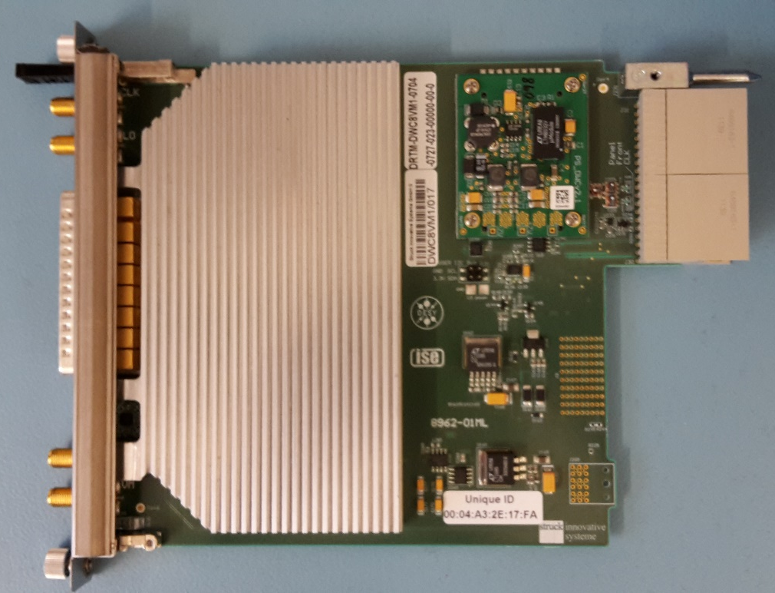
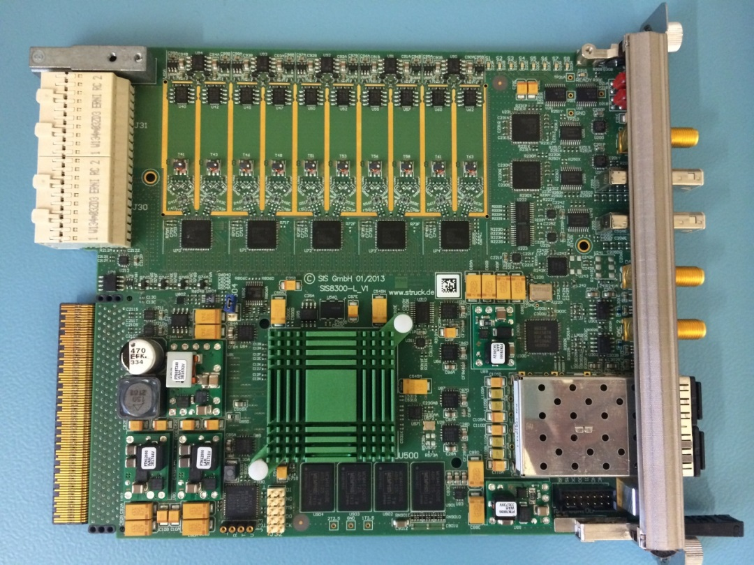
HW: RTM-Digitizer
8*AC-signal
input
2*DC-signal
input
Zone3
connector
5*2 ADCs
DAC
Vector
modulator
output
Attenuators
downconverters
Vector modulator
Backplane
connector
Kintex
Ultrascale
FPGA
Optical
interface
2GB DDR3

Slide 9
Slow tuner control
The slow tuner control will be done with the ESS standard motion controller: a Beckhoff solution controlled over EPICS by EtherCat.

Slide 10
ESS LLRF WU
ESS Eric and Lund University
  Responsible for overall LLRF system design and performance.
  Develop control algorithms and functions for cavity field control, fast and slow tuning.
  Implement these in the firmware (FPGA) and software (CPU).
  Monitor the activities of the in-kind partners.
  Owner of the LLRF system during operations (ESS Eric).

Slide 11
In-kind contributions
PEG
  Develop LO-generator MTCA board
  Develop Pz-control MTCA board
  Develop RTM carrier MTCA board
  Develop cavity simulator for test and commissioning
  Assemble, configure, test and deliver LLRF systems for
  the 704 MHz Linac.
ESS Bilbao
  Develop LO generator for 352 MHz linac.
  Adopt the LLRF firmware for multiple pickups at DTLs.
  Adopt the LLRF firmware for the multiple pickups at RFQ.
  Procure, assemble, configure, test and deliver LLRF systems for the 352 MHz Linac.

Slide 12
LLRF control within a pulse. (Baseband model)
Modulator
HV
Cavity
BCM
Feed-forward table
Ripple Model
Ripple Model
PID
PID
-
+
Setpoint
FPGA

Slide 13
Functions (Firmware in FPGA)
Operation Mode | Usage
PI-driven loop | Output is driven by the PI-control and the feed-forward table is added as a delta signal.
FF-driven loop | Output is driven by the feed-forward table and the PI-control is used to control the remaining error.
IQ signal generator | Open loop mode, where the set-point and feed-forward tables are used to create an output wave form, specified in IQ-points.
Magnitude-phase signal generator | Open loop mode, where the set-point and feed-forward tables are used to create an output wave form, specified in magnitude and phase.
Frequency-offset | Open loop mode, where magnitude is fixed and phase is increasing or decreasing. This creates an output with a frequency that is above or below the nominal RF frequency of 352.21 or 704.42 MHz

Slide 14
Control room displays
Control room controls
CPU
PVs
Reference settings
Detuning calculation
(Iterative Learning Algorithm)
Iterative Learning Algorithm
LLRF
Feed-forward table
Piezo Feedforward table
Tuning adjustment
Cavity field, Pfwd, Prefl
LLRF FPGA
Piezo FPGA
Stepper motor controller
LLRF control between pulses.
EPICS

Slide 15
Algorithms (In CPU)
Algortihm | Description
PI-tuning | Performs a search for optimal PI controller parameters.
Ripple filter tuning | Performs a search for optimal ripple filter parameters.
Notch filter tuning | Performs a search for optimal notch filter parameters.
Feedforward table update (iterative learning control - ILC) | Updates the feedforward correction table based on the measurements on the previous pulses.
Piezo waveform update | Computes a new piezo excitation waveform based on the measurements from the cavity.*
Piezo relaxation | Adjusts the static (DC) component of the piezo waveform by tuning the cavity by the slow tuner.*
Cavity tune calculation | Calculates the Q and tune of the cavity using measurements from the last pulse.

Slide 16
Control room displays
Control room controls
CPU
Detuning calculation
PVs
PI-tuning
Ripple/Notch filter tuning
System identification
Tuning adjustment
Cavity field, Pfwd, Prefl
Reference settings
LLRF FPGA
Piezo FPGA
Stepper motor controller
LLRF control setup.
EPICS

Slide 17
Overview RTM-Digitizer
AMC: Digitizer
FPGA
CUSTOM LOGIC

Slide 18
Custom logic
Custom logic:
Data path
Custom logic:
Memory, parameters
and ctrl

Slide 19
Closed loop amplifier linearization tests
Amplifier technology | Frequency | Site | Date
Mockup model | 352 MHz | Lund University | Q3-17
Mockup model | 704 MHz | Lund University | Q3-17
Tetrode | 352 MHz | Freia, Uppsala | Q4-17
Klystron | 704 MHz | Test stand 2, ESS | Q3-17
Klystron | 704 MHz | Freia, Uppsala | Q4-17
IOT | 704 MHz | TBD | TBD

Slide 20
Closed loop LLRF tests and verification
Cavity | Frequency | Site | Date (V1/V2)
Pill box | 352 MHz | Lund University | Done/Q3-17
Pill box | 704 MHz | Lund University | Done/Q3-17
Spoke | 352 MHz | Freia, Uppsala | Q4-17
Elliptical | 704 MHz | Saclay, Paris | Q4-17
Elliptical | 704 MHz | Test stand 2, ESS | TBD
Buncher | 352 MHz | Bilbao | Q3-17
RFQ | 352 MHz | ESS On-site | TBD
DTL | 352 MHz | ESS On-site | TBD

Slide 21
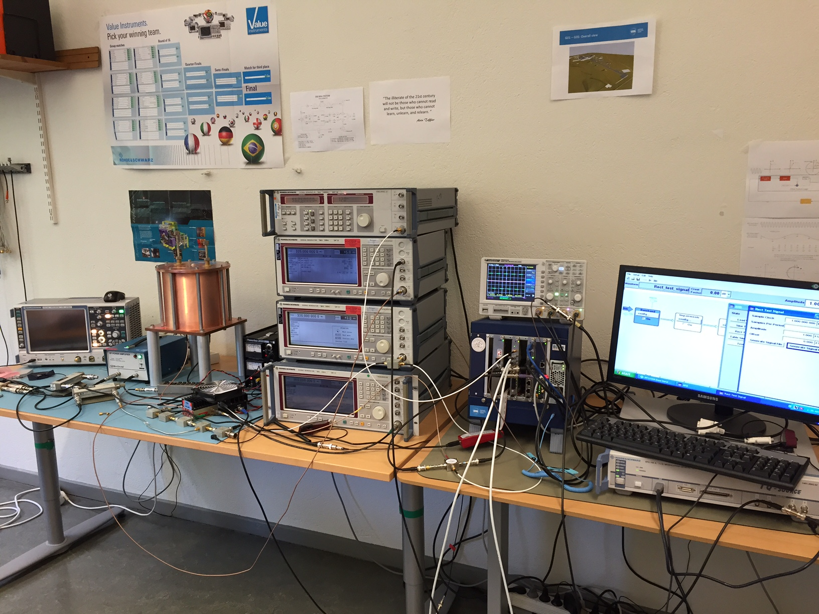
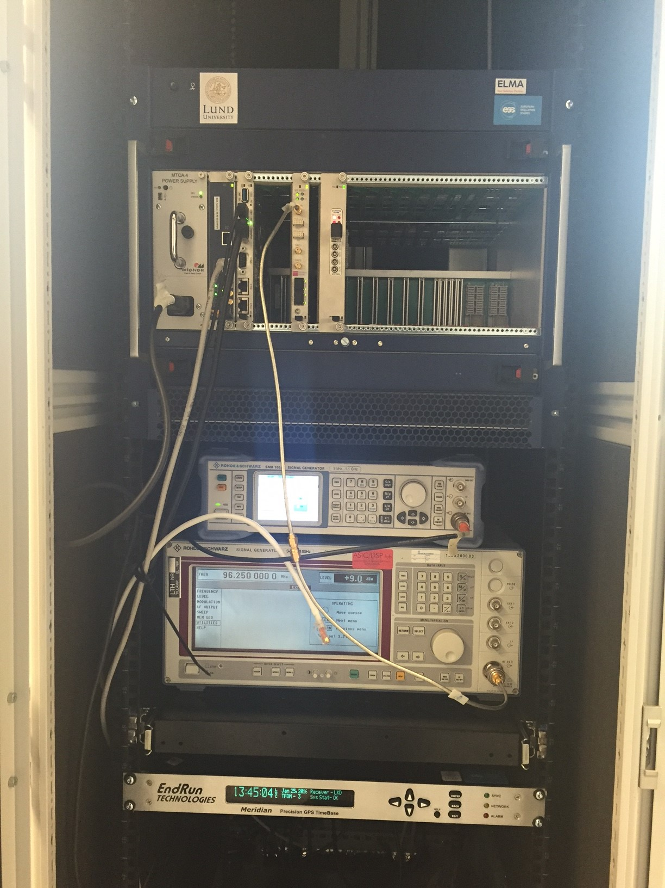
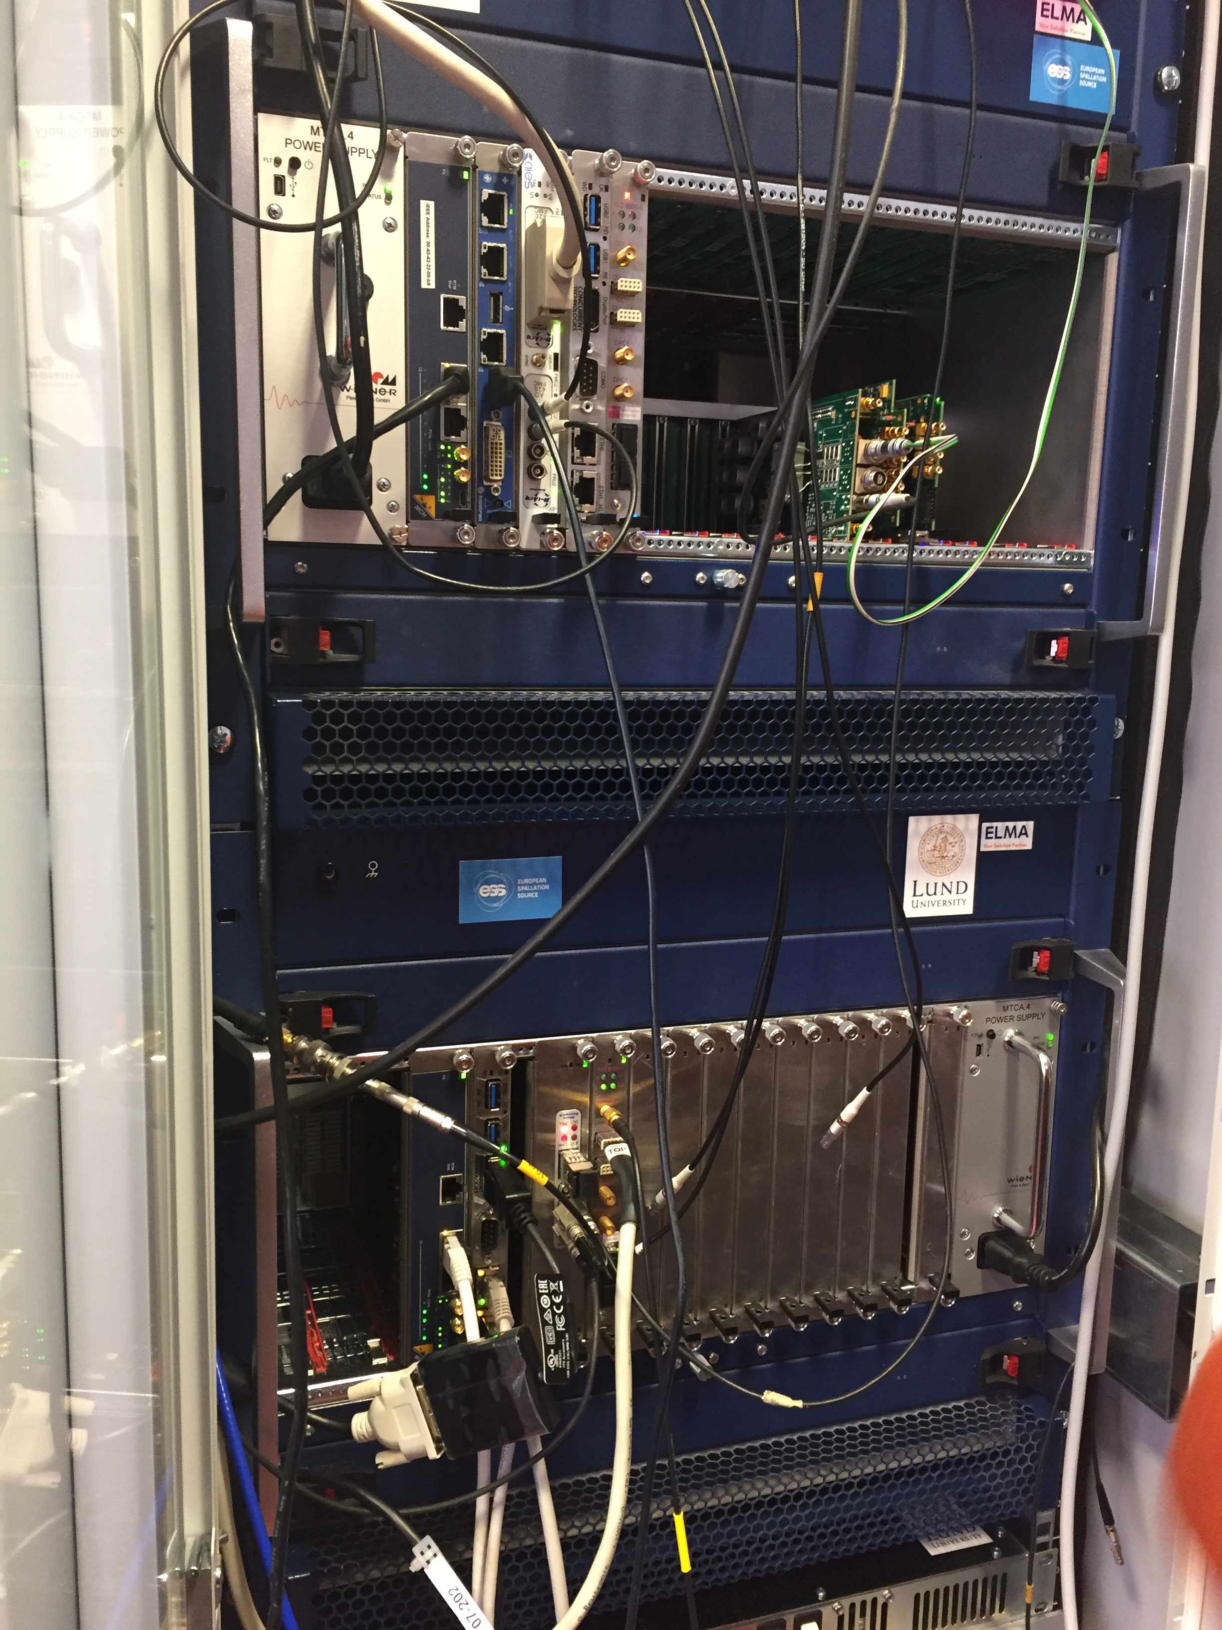
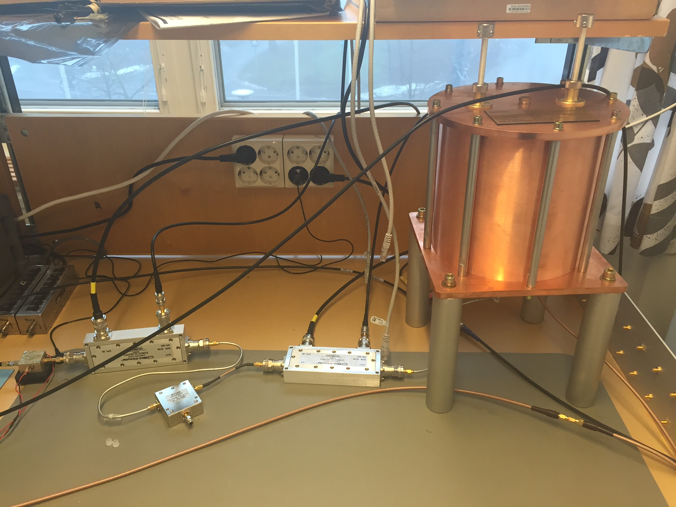
Three (four) LLRF systems running today.
352 MHz LLRF test bench
Lund University
Additional test stands under
development:
NCBJ – Swierk, Poland
DMCS – Lodz, Poland
ISE – Warsaw, Poland
ESS Bilbao - Spain
Test stand 2 – ESS, Lund
352 MHz LLRF system
Freia test hall
Uppsala University
704 MHz LLRF test bench
Lund University
(Under revision)

Slide 22
LLRF CDR
CDR passed 27 January 2016
Following is the recommendations related to LLRF that were recommended by the committee, and the status of each activity.

Slide 23
LLRF CDR recommendations
Create a detailed design report that fully describes the LLRF system.
  In progress, delayed due to changes brought by project variations.
Reduce the loading of the FPGA boards to below 50% prior to start of production.
  New FPGA board is developed and available.
For production, move to the new FPGA family (Kintex Ultrascale) supporting the VIVADO tools
  See above.

Slide 24
LLRF CDR recommendations (cont.)
Carefully review the choice of multiple LOs by discussing the implications of this with both the ESS reliability engineer and the RF group.
  Review done and changes implemented.
The handling of the cavity tuners should be clarified. There is high risk in the option of developing from scratch a RTM module for the piezo-actuators, when there are solutions off the shelf. A standard solution for both 352 and 704 Mhz would be more convenient.
  Handling is clarified by interacting with relevant WUs.
  No off-the shelf unit identified for Pz-control, in-house development in progress.
  Standard solutions for ESS will be used where applicable.

Slide 25
LLRF CDR recommendations (cont.)
The requirements for data flow and storage should be discussed with ICS and transformed into requirements.
  Discussions with ICS is ongoing.
LU shall work with the ESS reliability expert to update the reliability and availability analysis
  Done regarding LO. New revision of complete analysis needed after PDRs of in-kind contributions.

Slide 26
LLRF CDR recommendations (cont.)
Additional CDRs (that include a higher level of written documentation) with the In Kind Partners shall be held prior to start of procurement and production
  Planned both PDRs and CDRs of in-kind contributions.
ESS should consider if it wishes to allow multiple cavities to be controlled by the same LLRF crate with resulting cost savings.
  Investigated and ruled against.
Appropriately detailed QA and QC plans shall be presented by each of the In Kind Partners at the final preproduction CDRs
  Will be part of PDRs and CDRs.

