Slide 1
PSS Interfaces with RF Systems
Stuart Birch
Senior Engineer Personnel Safety systems
www.europeanspallationsource.se
11th May 2017

Slide 2
Introduction
Hazard
PSS/RF System Modes
PSS interfaces with RF systems:
    DTL RF Cell
    MEBT RF Cell
    Spoke RF Cell
    Medium Beta RF Cell
    High Beta RF Cell
Quantities
Snapshot of where we are!

Slide 3
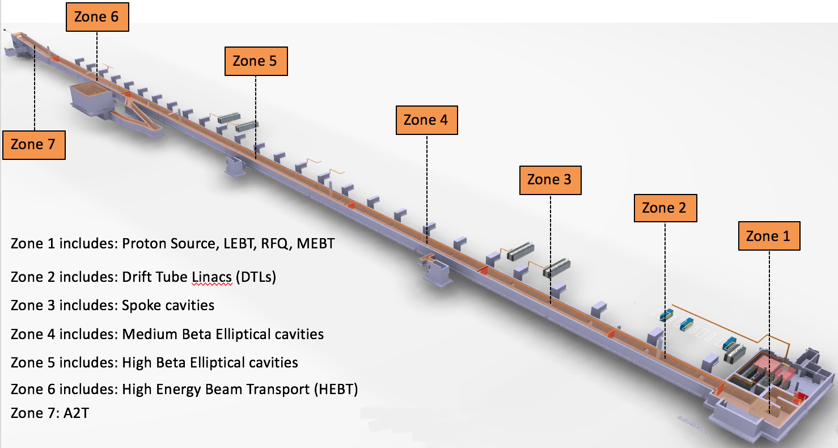
RF Hazards in PSS Controlled Areas
Hazard
X-Rays from Cavities within the Accelerator controlled area.

Slide 4
PSS/RF Modes/Operational Scenarios
Mode | Accelerator Controlled Area Status | Beam Operation | RF System Operation | RF Shutter Switch | RF System Waveguide
1 | Closed | Beam on | Normal Operation | Open | Complete Waveguide system
2 | Closed | Beam on | Amplifier Test Operation | Closed | Waveguide Removal
3 | Open Access | Beam off | Amplifier Test Operation | Closed | Waveguide Removal

Slide 5
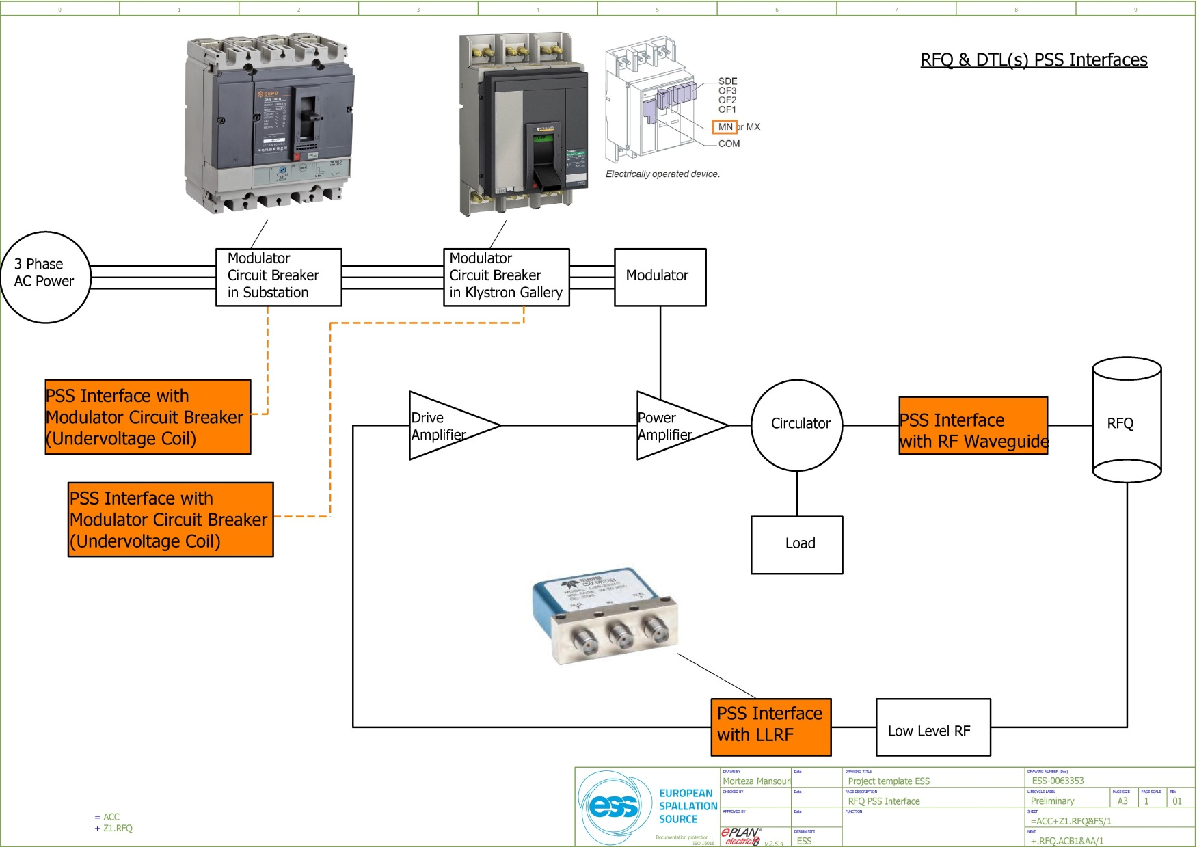
PSS Interfaces: RF Systems
In case of access to tunnel by personnel, the RF modules test can only be performed after a piece of waveguide has been removed and sealed properly in the Klystron Gallery.
PSS will use failsafe, 24 VDC RF switches with indicator mirror contacts to interface with Low level Radio Frequency systems (LLRF) in RF cells such as MEBT bunchers, RFQ, DTL(s), spoke cavities, etc.
Instantaneous under voltage release coil in Moulded case circuit breakers (MCCB). As an example, to be used in case of PSS interface with RF modulators in accelerator.
The under voltage release coil instantaneously opens the circuit breaker when its supply voltage drops to a value between 35 % and 70 % of its rated voltage. If there is no supply on the release, it is impossible to close the circuit breaker, either manually or electrically. Any attempt to close the circuit breaker has no effect on the main contacts. Circuit breaker closing is enabled again when the supply voltage of the release returns to 85 % of its rated value.
The control signal for the under voltage coil passes through the two PSS contactor relays.
Notes:
Accelerator PSS will interface four subsystems of RFQ.
RFQ Modulator air circuit breaker (ACB) in substation.
RFQ Modulator air circuit breaker (ACB) in klystron gallery.
RFQ LLRF.
RFQ Waveguide.

Slide 6
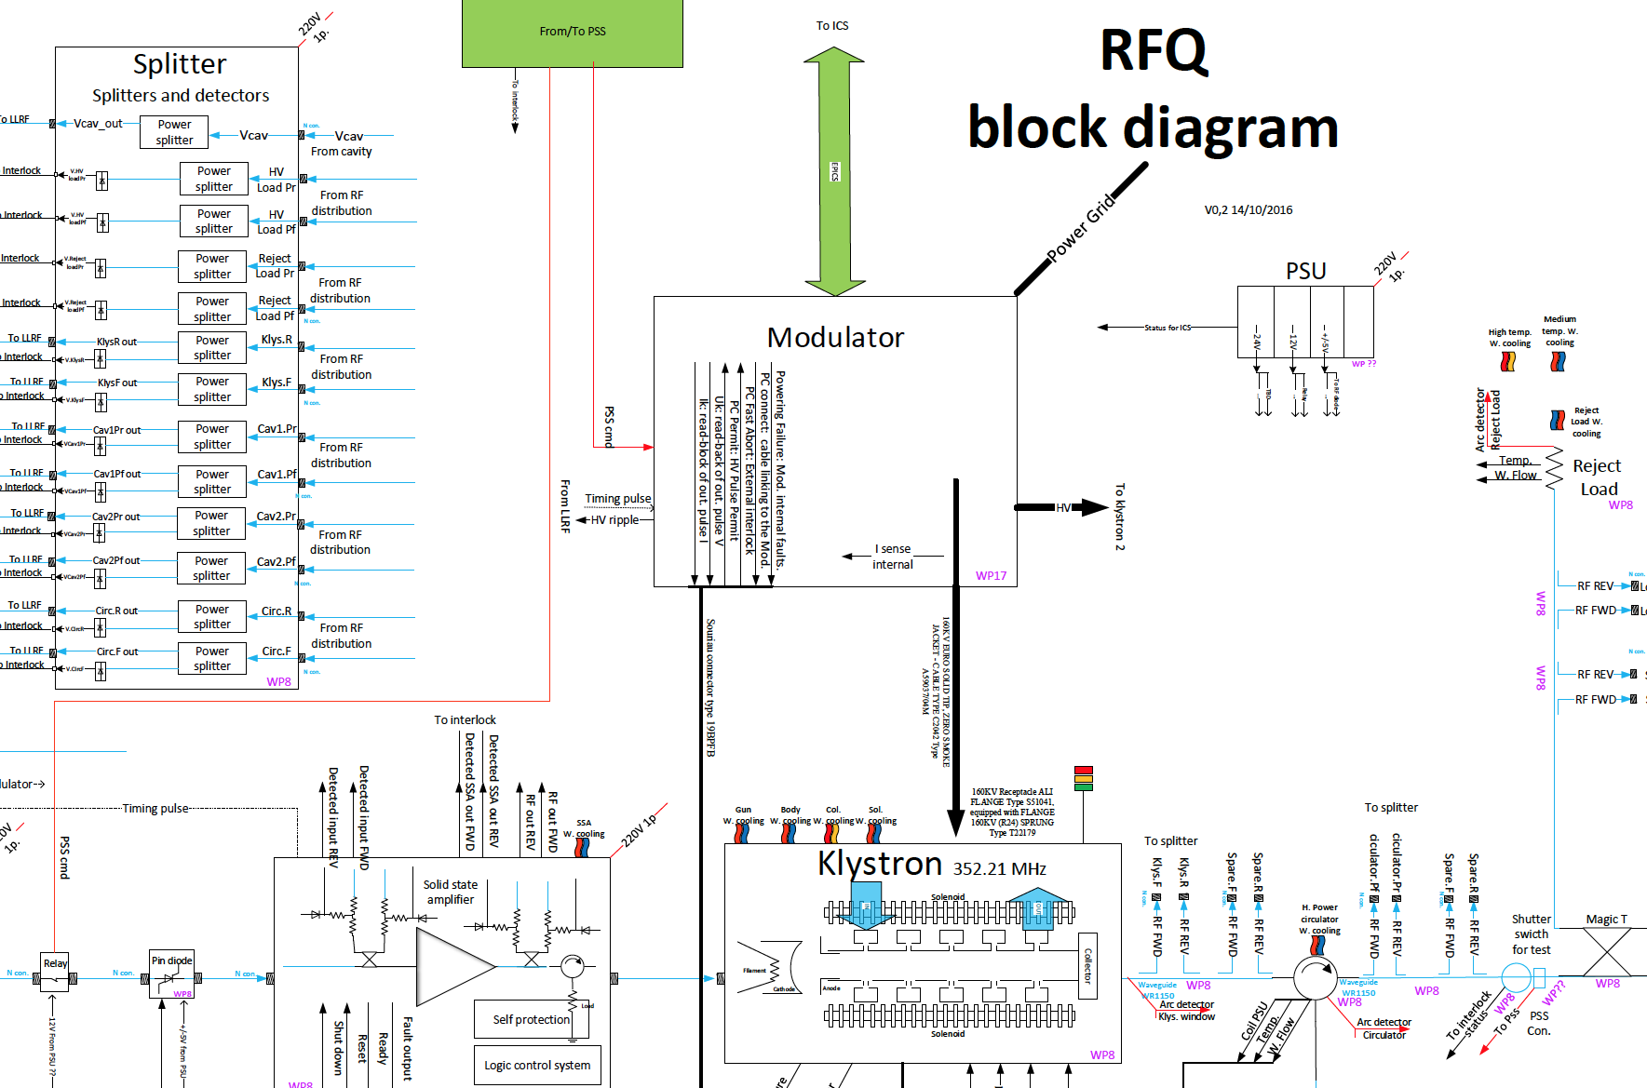
DTL Cavity PSS Interface
Incoming Power
Interface
Wave Guide
Interface
RF Switch
Interface

Slide 7
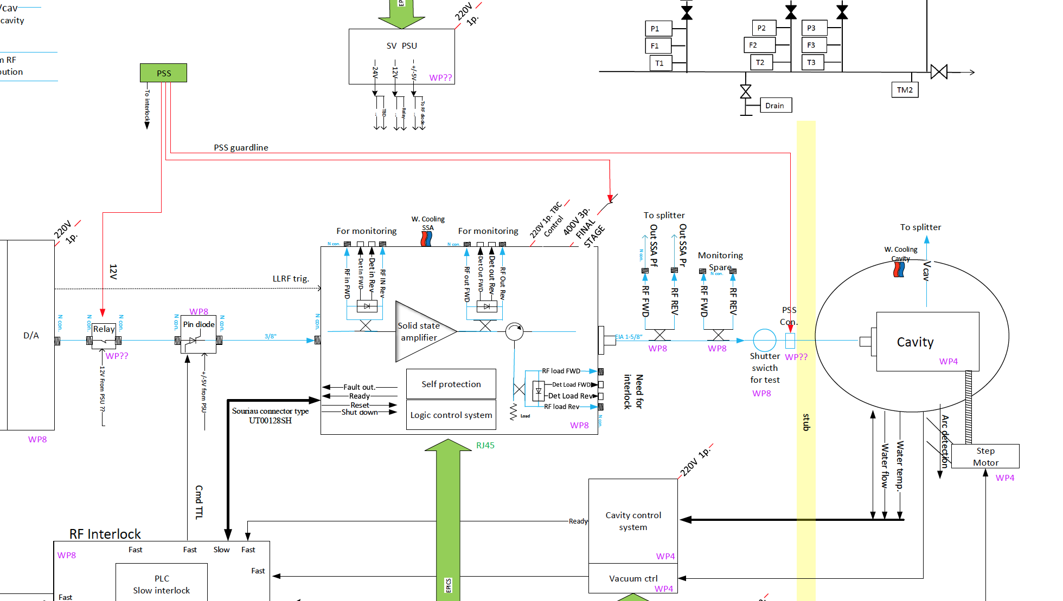
MEBT Buncher PSS Interface
Incoming Power
Interface
RF Switch
Interface
Coax Cable
Interface

Slide 8
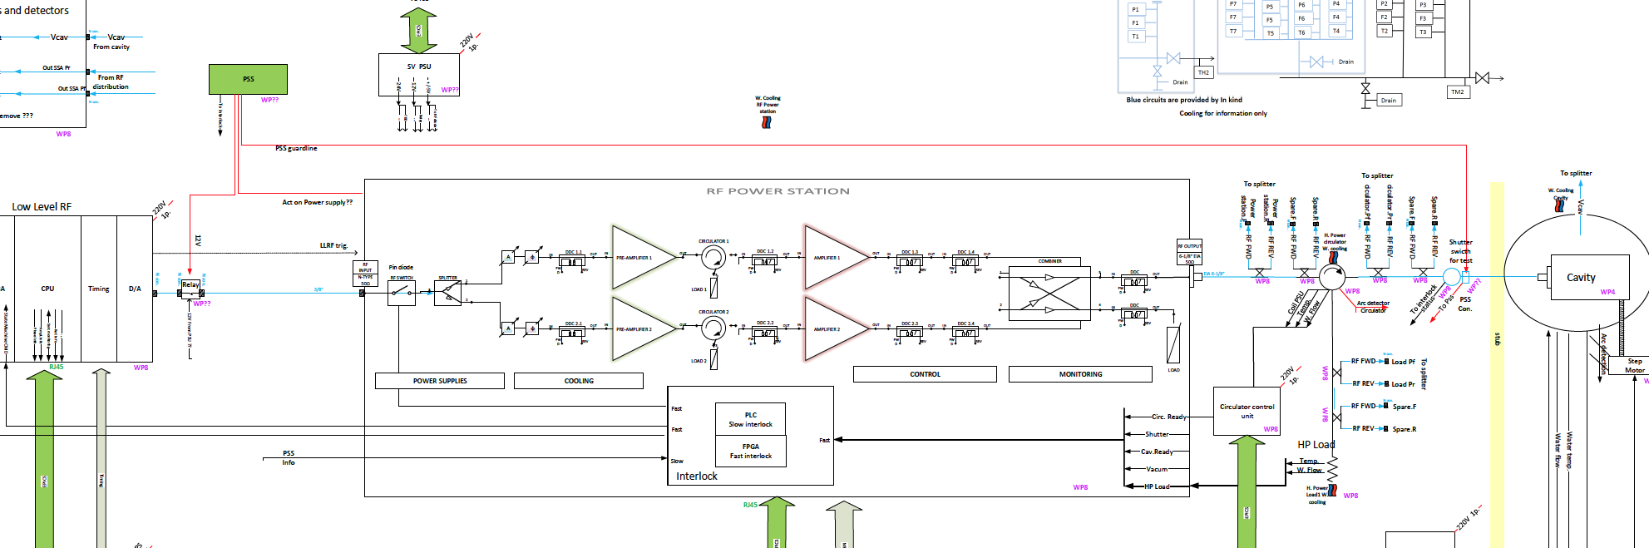
Spoke Cavity PSS Interface
Incoming Power
Interface
RF Switch
Interface
Wave Guide
Interface

Slide 9
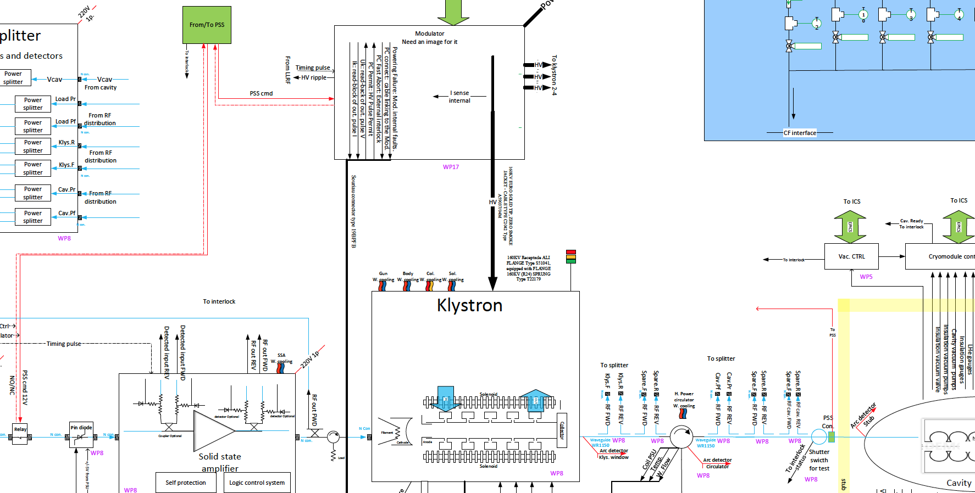
Medium Beta Cavity PSS Interface
Incoming Power
Interface
Wave Guide
Interface
RF Switch
Interface

Slide 10
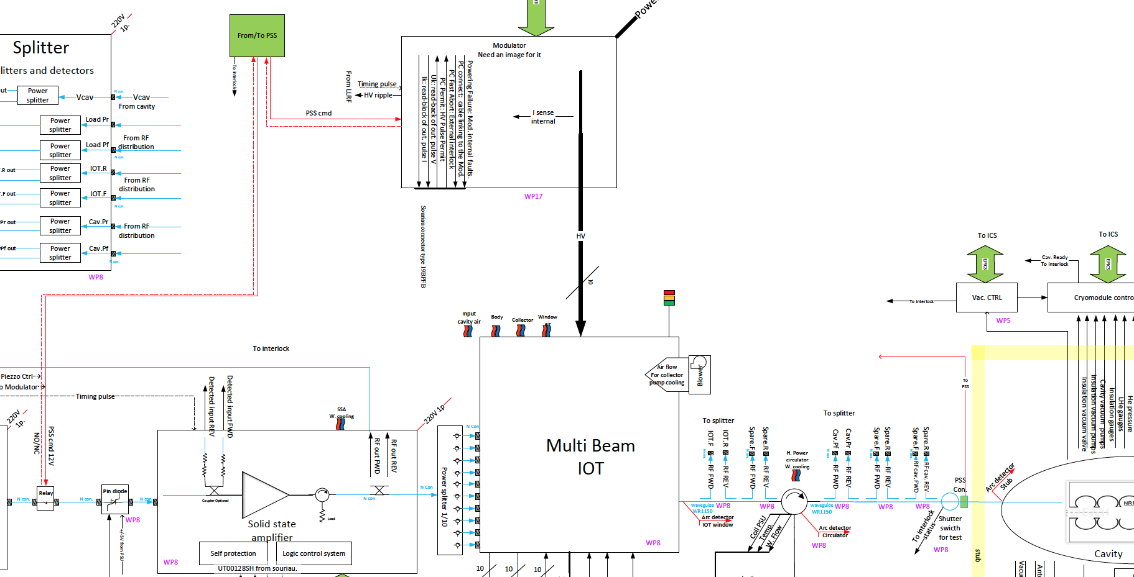
High Beta Cavity PSS Interface
Incoming Power
Interface
Wave Guide
Interface
RF Switch
Interface

Slide 11
Numbers
PSS will interface with the following systems
RFQ, DTL RF Cell - 3
MEBT Buncher RF Cell - 3
Spoke Cavities RF Cell - 26
Medium Beta RF Cell - 9
High Beta RF Cell - 21

Slide 12
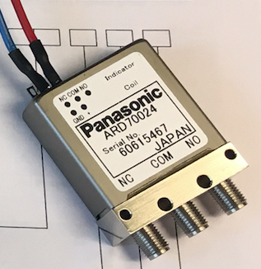
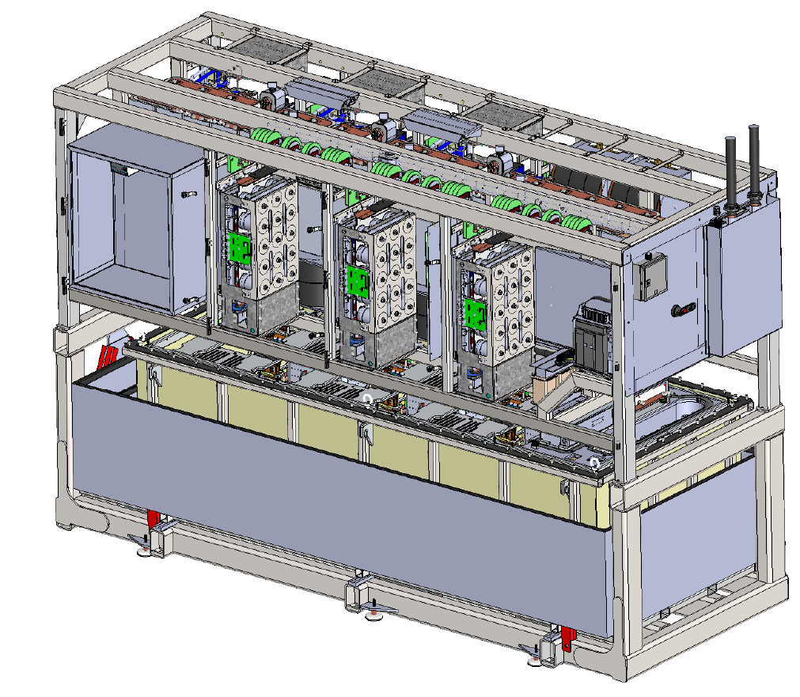
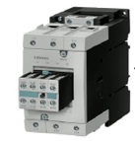
Where are We!
Coaxial Switch
Coaxial RF switch has been tested by Bruno. PSS team are currently testing the switch.
PSS contactor box
Modulator System
Modulator system PSS interface agreed and incorporated into current designs.
Solid State Power RF Cell PSS Contactors
The 400V three phase contactor box design is still in early design.

Slide 13
Where are We!
Wave Guide
Our baseline design will be on a standard removable piece of waveguide. The PSS team will design a suitable switch system.
(as soon as we know direction on sliding waveguide design) We have already provided switches for this system.
RF Coaxial Cable RF
Coaxial Cable (cable to the buncher cavities) ongoing discussions on the PSS interface.
Interface Control Documents
The PSS team have started the ICD’s for each of the systems. These need to be completed and approved by both divisions (ICS & AD) as soon as possible. They will be required for SSM applications.

Slide 14
Thank You
Questions?

