Slide 1
WP8 Schedule Summary
Morten Jensen
RF Section Leader, WP8 manager
www.europeanspallationsource.se
9 May, 2017

Slide 2
P6
The P6 plan has been extensively updated
All signed IK agreements have been aligned with the IK milestones now in P6
All signed IK agreement budgets have been reconciled
ESS Bilbao – currently in the process of being signed
Covers RFQ and DTLs
MEBT – in WP3 but with significant WP8 contribution
P6 plan to be updated – significant delays to be resolved
  Will be resolved in the next period subject to TA agreements
UK Contribution – Some paperwork still to be signed
Activities in P6 were largely based on procurement in three tenders
  Currently 8 tenders are included.
  P6 plan will be updated to reflect the actual tenders
  Delivery expectations largely aligned with the Installation Plan
    Some tenders (stub installation, arc detectors) are becoming more critical

Slide 3
New section in P6 to cover ESS Procurements
Will ensure design and procurements are planned and executed to support partners and for direct procurements
Main activities include:
  MO design and procurement
  LLRF Procurement (for MB and HB)
  Klystron procurement
  Filament, solenoid, ion pump controllers, blowers

Slide 4
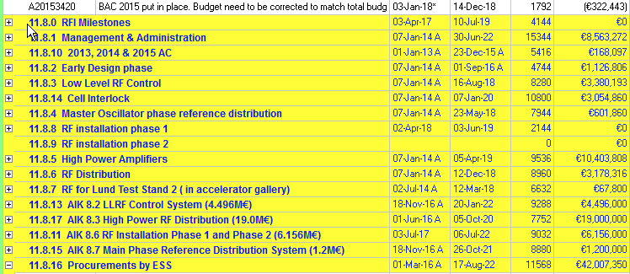
P6 Extract
In kind Contracts
Budget mostly to cover RFQ, DTLs, MEBT plus Spoke LLRF

Slide 5
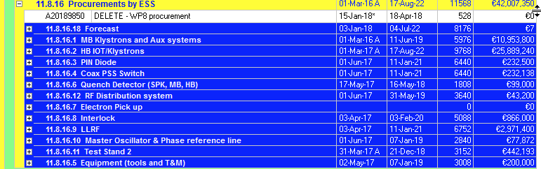
ESS (WP8) Procurements in P6
Procurements to be done by ESS for own supply or free issue

Slide 6
ESS Procurements
Test Stand 2 – majority of hardware on order
Item | Procurement | RFI Estimate
MB Klystrons | Tender awarded by 12 May | 2 klystrons in 12 months Remaining 34 in months 12 - 24
Filament Supplies | Tender for Frame work in May | RFI - three months before klystron delivery
Solenoid Supplies | Tender for Frame work in May | RFI - three months before klystron delivery
Ion Pump Controller | Frame work in place | RFI - three months before klystron delivery
Klystron blowers | Tender for Frame work in September | RFI - three months before klystron delivery
Drive amplifier | Tender for Frame work in May | RFI - three months before klystron delivery

Slide 7
ESS Procurements
Item | Procurement | RFI Estimate
Pin Diode | Prototype in progress: Transfer to IKC | RFI - three months before klystron delivery
Coax PSS Switch | Prototype in progress: Transfer to IKC | RFI - three months before klystron delivery
Quench Detector | Design not started. Concept proposed | RFI - three months before cryo module delivery
Electron Pickup | Prototype in progress: Transfer to IKC | RFI - three months before cryo module delivery
Interlock Fast Modules | CDR June. Procurement being investigated with ICS | RFI - three months before klystron delivery
LLRF (WP8 and ICS) | Specifications being drafted | Currently uncertain – Target three months before klystron delivery

Slide 8
ESS Procurements
Item | Procurement | RFI Estimate
Master Oscillator | PDR complete | Ready end of 2018. Not considered critical for initial operations
Phase Reference line and associated | PDR complete CDR June Installation July (August)

Slide 9
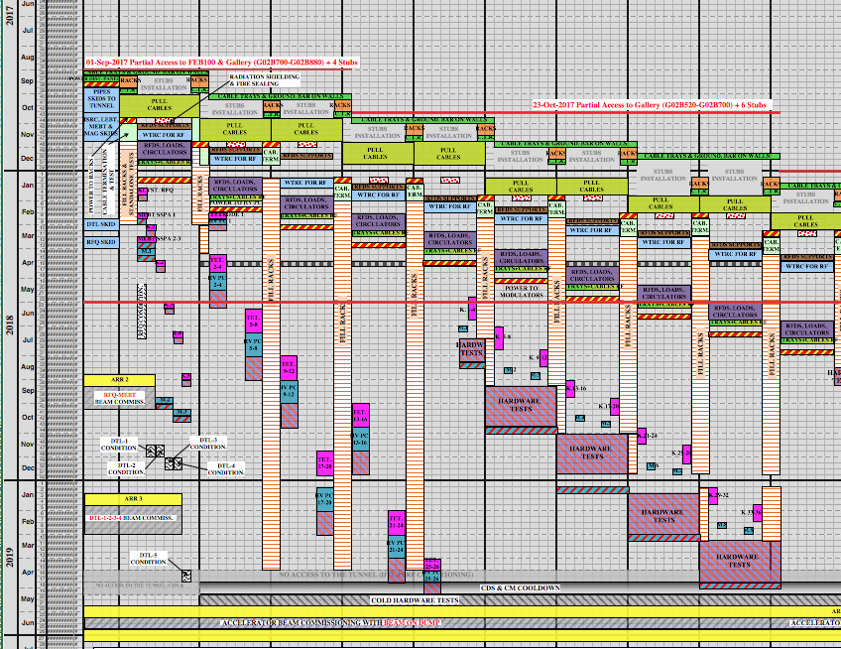
Installation Plan
Target RFI dates are being produced to comply with the existing installation plan
It is understood that this is under review

Slide 10
Detailing underway
RFI dates from Installation plan
Some discrepancy between installation plan and signed TAs
  Currently being evaluated.
ESS Procurements being scheduled to match the RFI dates with rack equipment to be delivered 90 days before installation date (as a guide)
  Orphan items being incorporated but not yet fully staffed.
Monthly meeting (since April) with all WU leaders and system owners to align planning, procurement, site preparations, installation and installation effort.
  Started in April, intention is to meet 2nd Thursday every month

Slide 11
Main Schedule Risks
RFQ and DTL delivery and installation
MEBT delivery and installation
Procurement of LLRF components (in association with ICS)
Any delays of installation of racks and trays will delay WP8 installation
Any delays of installation of electrical utilities will delay WP8 installation
Any delays of installation of pipework and water cooling instrumentation will delay WP8 installation
Any delays of other critical systems (modulator, ICS controls, timing…) will delay or prevent commissioning of systems post installation.
Stub installation trial has been delayed – until complete this is considered a risk
Generally time for procurement is impact schedule and effort
  Very high value procurement OK
  Medium value: Some delays
  Low value procurement: Procurement is generally quite fast but for installation we often need next day delivery
No spares budget
  Failure or damage of critical components with long lead time could be serious

Slide 12
The End

