Slide 1



Modulators, RFPS’s and LWU Magnet Power Converters:
- Integration within RF cell
Carlos A. Martins
ESS – Accelerator Division - RF Electrical Power Systems
www.europeanspallationsource.se

Slide 2
Types and Quantities of Equipment under WP17 Responsibility
RFQ & DTL:
  3 x modulators rated 115kV/100A, 3.5ms/14Hz (660kVA) – SML topology;
Spokes:
  26 x RF Power Stations, rated 400kWrf, 3.5ms/14Hz (60kVA) – Tetrode based;
  26 x Power converters for LWU quadrupole magnets, rated 200A/30V DC – type PCQ5;
  26 x Power converters for LWU corrector magnets, rated ±16A/ ±24V – type PCC5;
Medium Beta:
  9 x modulators rated 115kV/100A, 3.5ms/14Hz (660kVA) – SML topology;
  18 x Power converters for LWU quadrupole magnets, rated 200A/30V DC – type PCQ6;
  18 x Power converters for LWU corrector magnets, rated ±16A/ ±24V – type PCC6;
High Beta I (i.e. following VE):
  11 x modulators either Klystrons or IOT’s (660kVA) – topology not defined if IOT’s;
  42 x Power converters for LWU quadrupole magnets, rated 200A/30V DC – type PCQ6;
  42 x Power converters for LWU corrector magnets, rated ±16A/ ±24V – type PCC6;

Slide 3
Types and Quantities of Equipment under WP17 Responsibility
High Beta II (completion to 5MW beam):
  11 x modulators either Klystrons or IOT’s (660kVA) – topology not defined if IOT’s;
HEBT:
  32 x Power converters for LWU quadrupole magnets, rated 200A/30V DC – type PCQ6;
  32 x Power converters for LWU corrector magnets, rated ±16A/ ±24V – type PCC6;
  1 x Power converter for vertical dipole, rated ??/?? – type PCD1;
Dump Line:
  3 x Power converters for LWU quadrupole magnets, rated 200A/30V DC – type PCQ6;
  6 x Power converters for LWU corrector magnets, rated ±16A/ ±24V – type PCC6;
A2T:
  12 x Power converters for LWU quadrupole magnets, rated 200A/30V DC – type PCQ7;
  12 x Power converters for LWU corrector magnets, rated ±16A/ ±24V – type PCC6;
  6 x Power converters for LWU quadrupole magnets, rated 200A/30V DC – type PCQ8;
  8 x Power converters for LWU corrector magnets, rated ±16A/ ±24V – type PCC8;

Slide 4
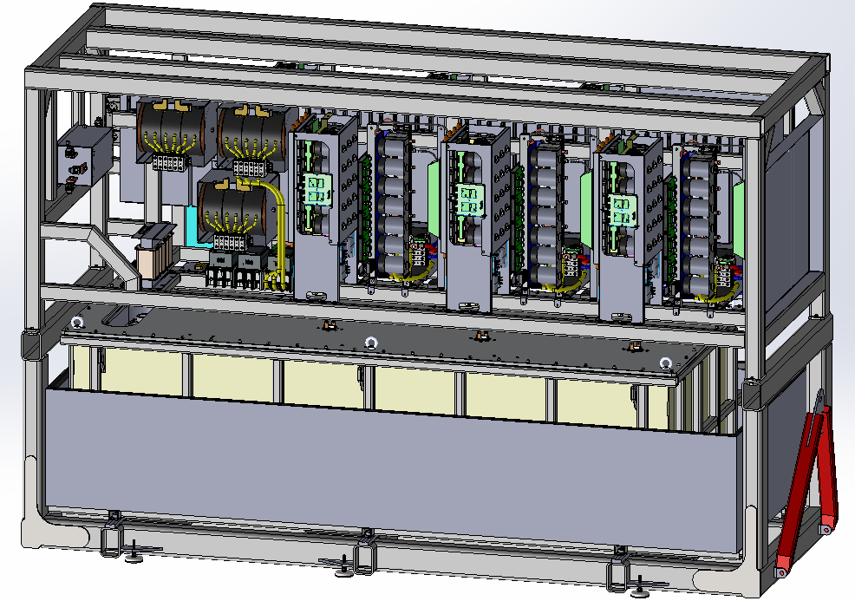
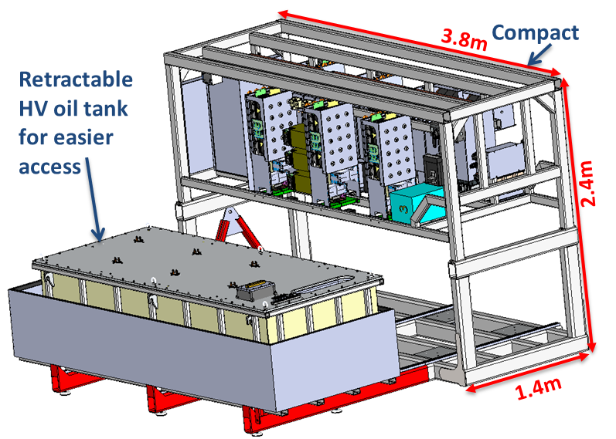
Klystron Modulators – SUMMARY & STATUS
AC/DC+DC/DC
H-bridge (DC/AC)
LV power converter stage
RFQ & DTL modulators:
  3 units, IKC from ESS Bilbao;
  call for tenders launched end Dec. 2016;
  3 offers received on 3rd March 2017;
  1 offer pre-selected; evaluation undergoing
  Placement of contract: July 2017;
  Delivery 1st unit: July 2018;
  Delivery units 2 & 3: Jan. 2019;
HV oil tank assembly
Oil spill retention bin
Medium Beta modulators:
  9 units, Not IKC, in charge by ESS Lund;
  call for tenders launched 2nd Apr. 2017;
  offers received on 8th May 2017;
  Evaluation and selection by 30th May 2017
  Placement of contract: June 2017;
  Delivery 1st unit: June 2018;
  Delivery units 2 to 9: until June 2019;

Slide 5
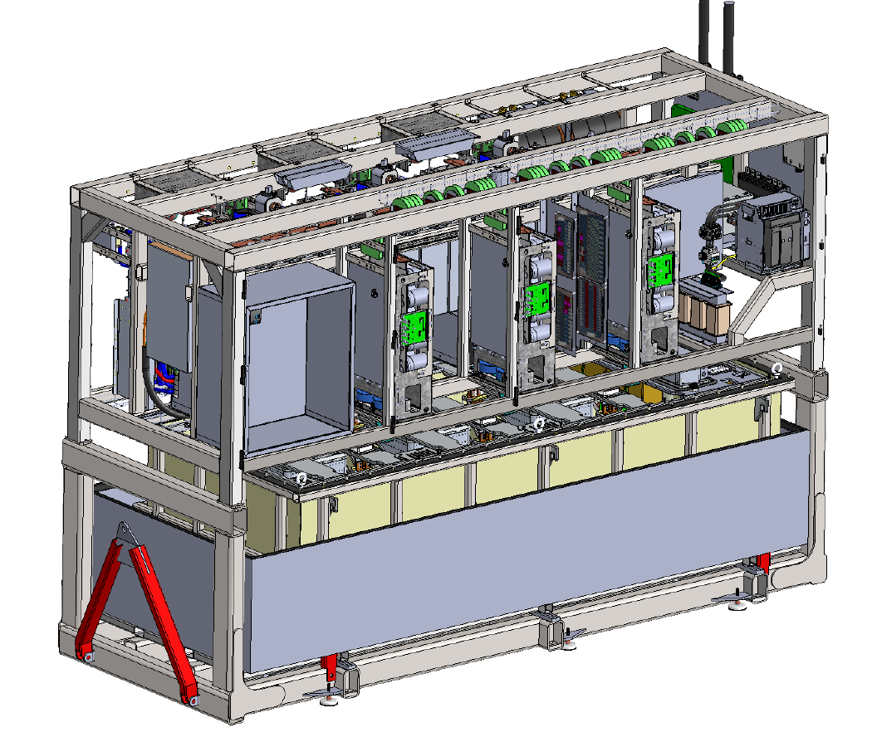
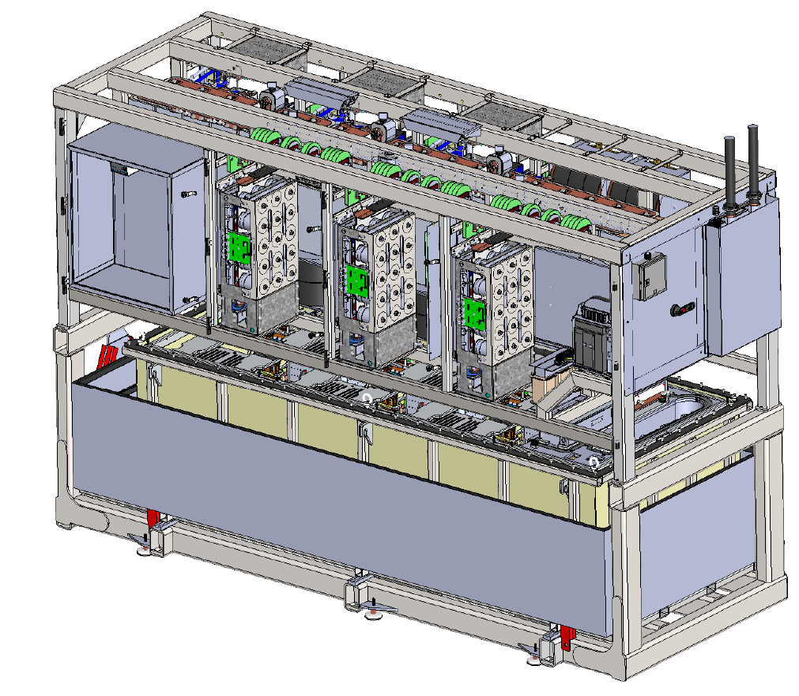
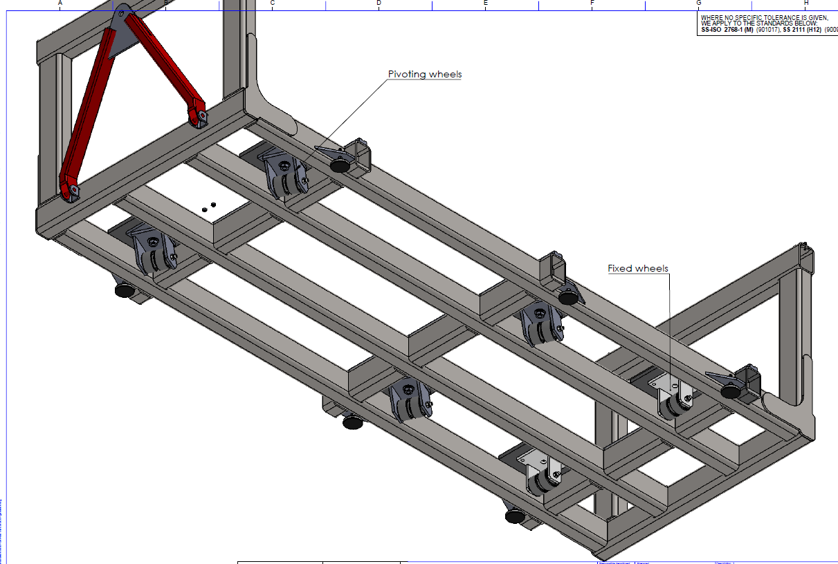
660 kVA modulator main features
AC power input terminal box
PSS contactor box
Controller crate
LV power electronic stage
Water manifold (not shown)
HV oil tank assembly stage
HV oil tank
Grounding switch
Oil pump & heat exchanger (not shown)
Oil retention bin
Pulling handle
HV output sockets (4x)
foot
Total weight: ~7.5 ton (with oil);
Qty of oil: 2200 litres;
Pivoting wheels
Fixed wheels

Slide 6
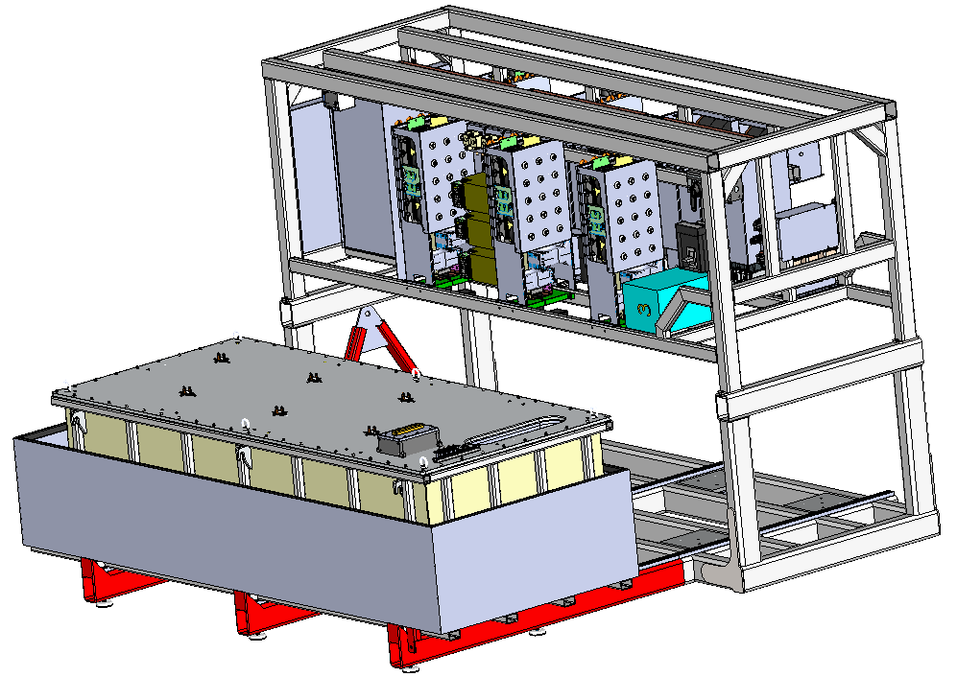
660 kVA modulator main features
Withdrawable oil tank for easy maintenance & test
Add on sliding rails

Slide 7
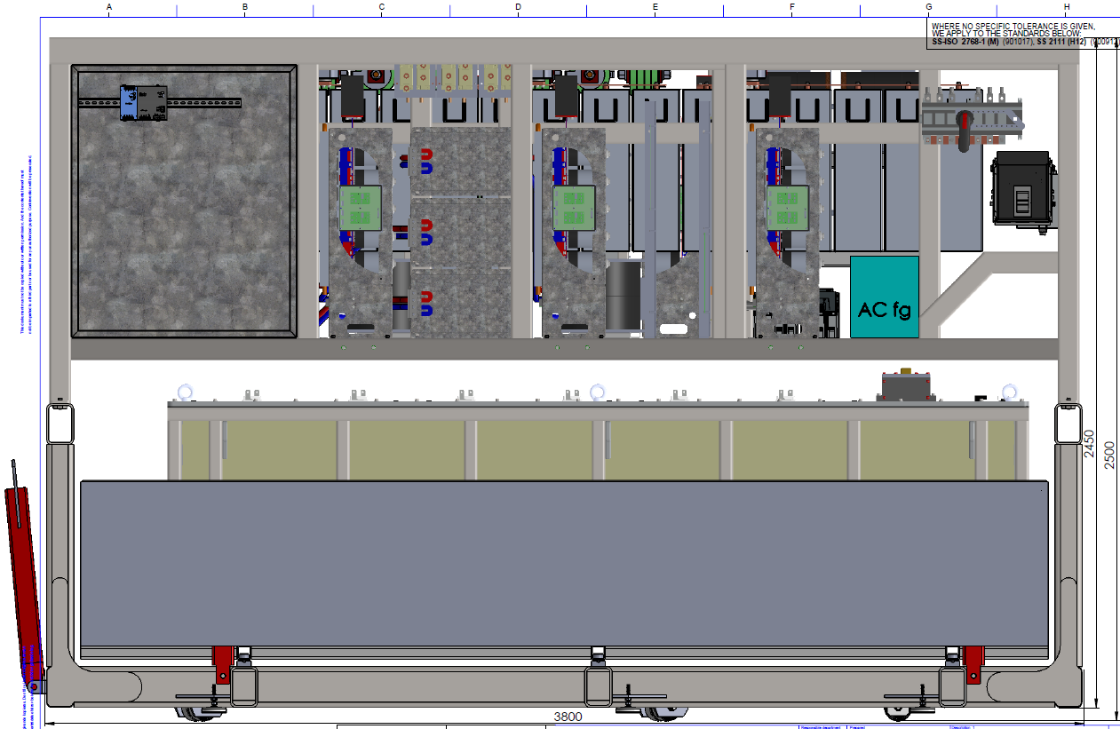
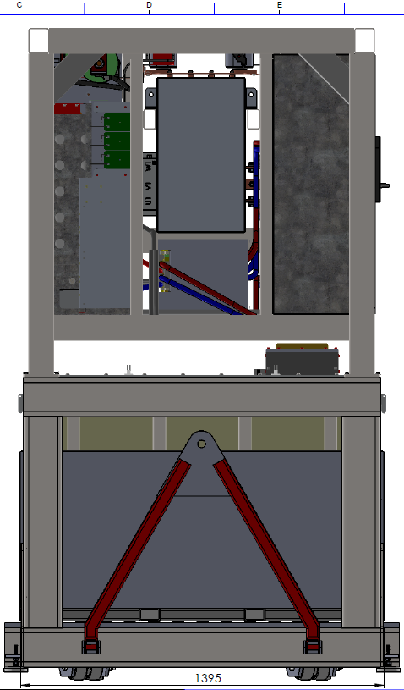
660 kVA modulator external dimensions
Controller crate
Front view
Left side view

Slide 8
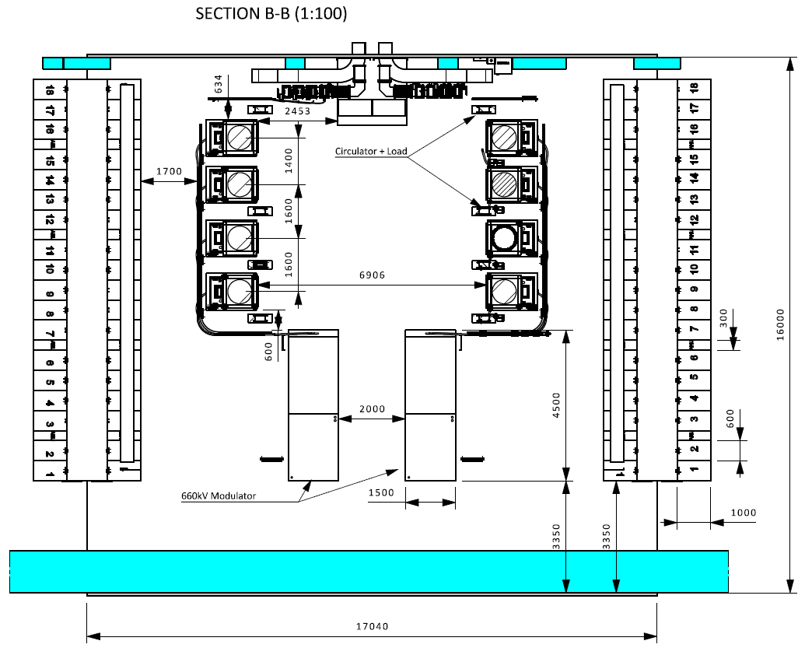
Positioning of the 660kVA modulators in G02 Gallery:
- Example of Medium Beta RF cell
HV output sockets
Controller crate

Slide 9
Positioning of the 660kVA modulators in G02 Gallery:
- Location of interface points
Controller crate
Controller crate
ICS:
1- Ethernet remote fieldbus cable;
2- Ethernet remote digital streaming cable;
3- External pulse trigger cable;

Slide 10
Positioning of the 660kVA modulators in G02 Gallery:
- Location of interface points
Controller crate
Controller crate
RF - LPS:
1- Remote hard control cable;

Slide 11
Positioning of the 660kVA modulators in G02 Gallery:
- Location of interface points
PSS contactor box
PSS:
1- PSS control cable;
PSS contactorbox

Slide 12
Positioning of the 660kVA modulators in G02 Gallery:
- Location of interface points
Water manifold
Water manifold
Water:
1- Inlet/outlet manifold;

Slide 13
Positioning of the 660kVA modulators in G02 Gallery:
- Location of interface points
AC power input terminal box
AC power input terminal box
Conventional power:
1- AC power cables, power port;
2- AC power cable, control port (from UPS);

Slide 14
Positioning of the 660kVA modulators in G02 Gallery:
- Location of interface points
HV output sockets (4x)
RF amplifiers:
1- HV output cables (4x);
HV output sockets (4x)

Slide 15
RF Power Stations for Spokes – SUMMARY & STATUS
Spokes:
  26 units, IKC from Elettra;
  Writing technical specification in view of tendering almost finished;
  IKC agreement not signed, VAT and cash flow issues;
  Procurement starts in July 2017;
  Placement of contract: Feb 2018;
  Delivery 1st unit: Nov 2018;
  Delivery units 2 to 26: until Oct. 2019;

Slide 16
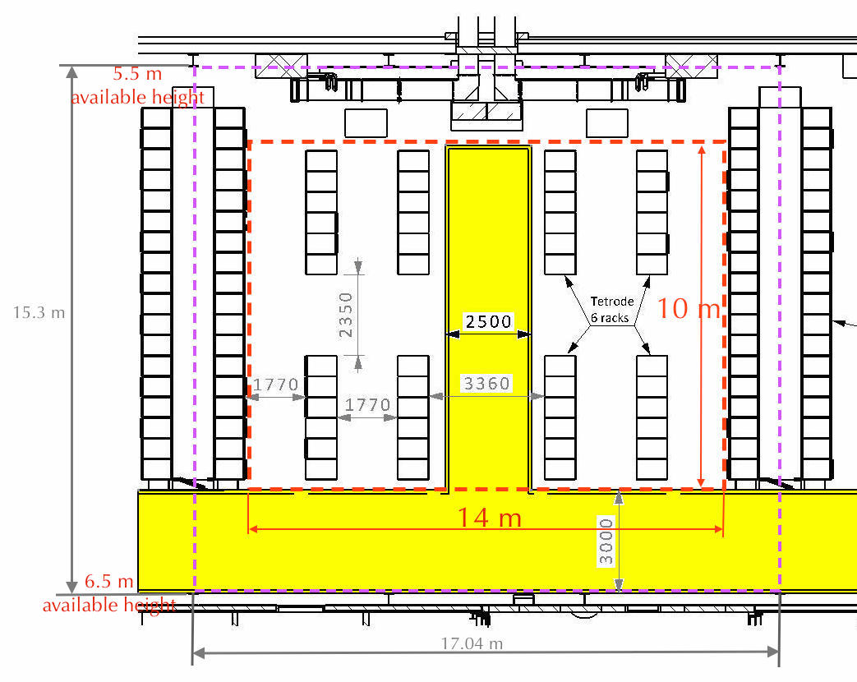
Positioning of the RFPS for spokes in G02 Gallery

Slide 17
Positioning of the RFPS for spokes in G02 Gallery:
- Location of interface points
The only interface position points defined today are:
Flange of output RF;
Missing are:
ICS (Ethernet cable, trigger cable);
PSS (control cable);
MPS (RFPS status cable);
RFDS (RFDS interlock cables);
LLRF (LLRF input RF cable);
Conventional power (AC power cable power port & control port (UPS);
Water (Inlet/outlet water manifold connection points);

Slide 18
Klystron/IOT Modulators for High Beta – SUMMARY & STATUS
High Beta I (i.e. upon VE exercise):
  11 units;
  In case of decision for KLYSTRONS: same topology/design (SML) as for the Medium Beta;
  In case of decision for IOT’s: new topology to be identified;
  Decision klystrons or IOT’s is supposed to be taken by Nov. 2017

Slide 19
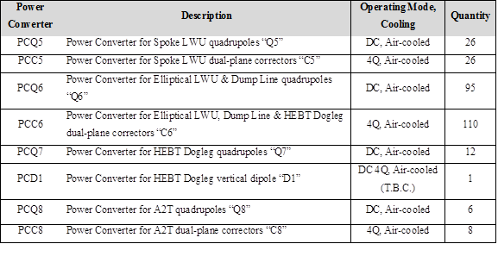
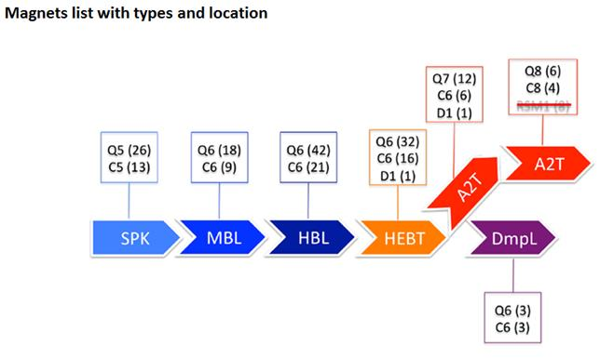
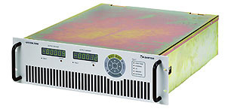
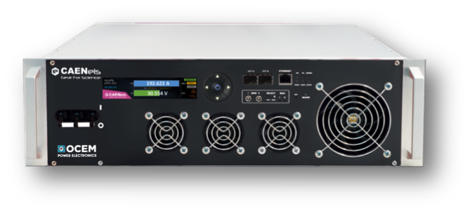
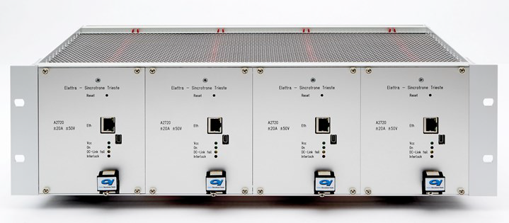
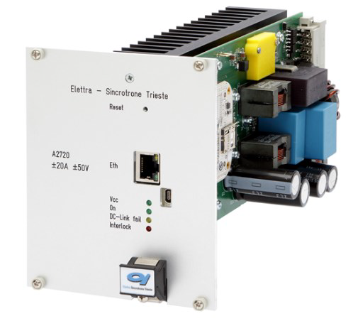
LWU Magnet Power Converters – SUMMARY & STATUS
For harmonization:
Types: PCQ5 = PCQ6 = PCQ7 = PCQ567;
Types: PCC5 = PCC6 = PCC8 = PCC568;
- PCQ567: 133 units rated 200A/30V, DC
- PCC568: 144 units rated ±16A/ ±24V, DC
- PCD1: 1 unit rated ??A/ ??V, DC
- PCQ8: 6 units rated ??A/ ??V, DC
Note: 4 units into 1 crate 3”

Slide 20
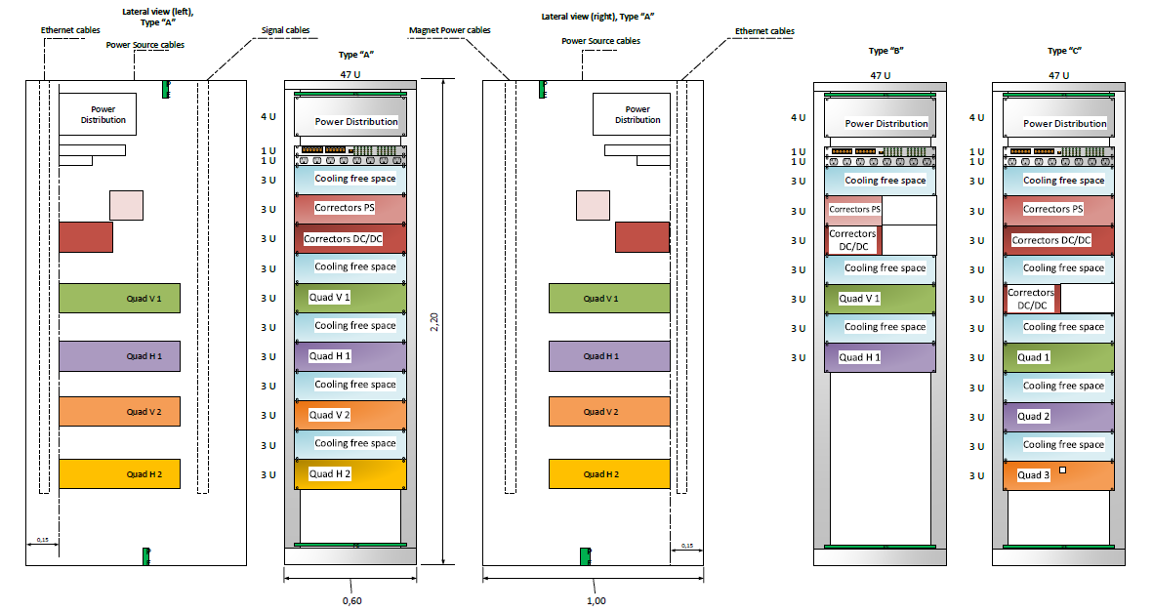
LWU Magnet Power Converters
- Rack internal layout (except PCD1)
3 types of Rack layout for the whole machine:
Type “A” can feed 2 LWU’s; Type “B” can feed 1 LWU; Type “C” can feed

Slide 21
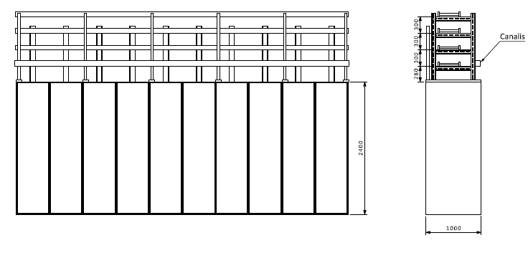
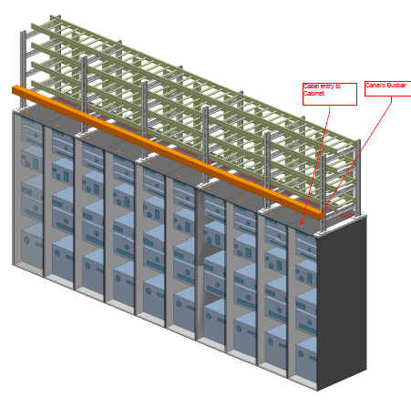
LWU Magnets Powering Configuration:
- Rack raws

Slide 22
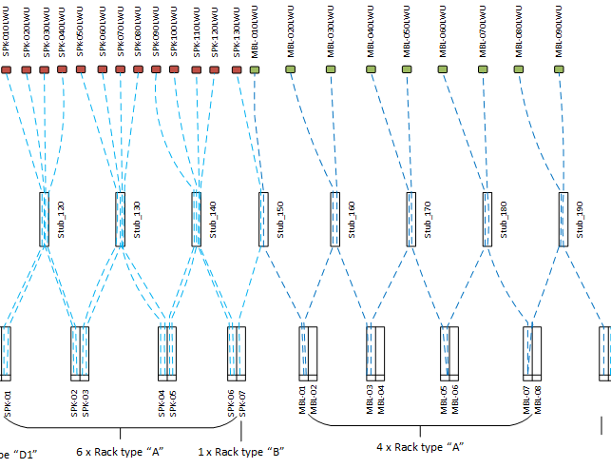
LWU Magnets Powering Configuration:
- Rack / stub / LWU
Spoke;
Medium Beta;
1 x Rack type “B”

Slide 23
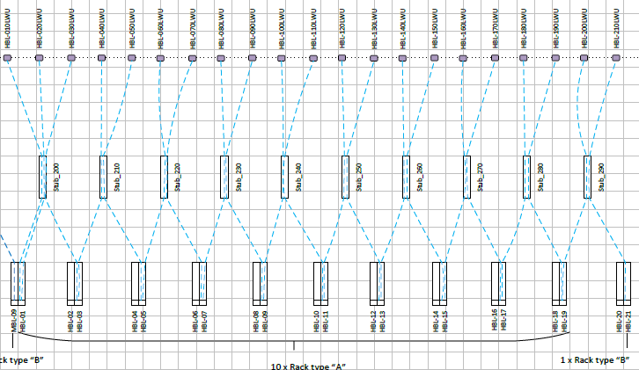
LWU Magnets Powering Configuration:
- Rack / stub / LWU
High Beta;

Slide 24
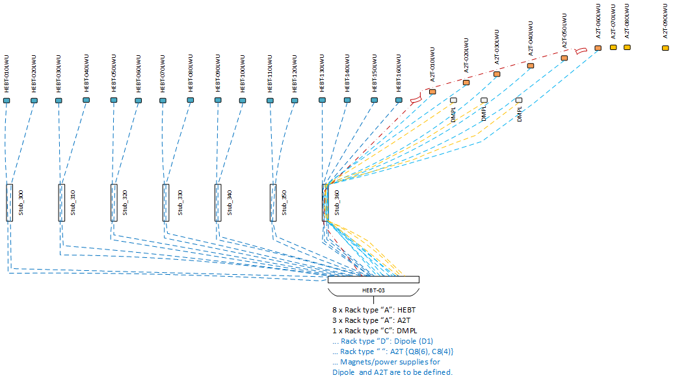
LWU Magnets Powering Configuration:
- Rack / stub / LWU
HEBT;
A2T;
Dump Line;

