Slide 1
RF cell
Anders Sunesson RF group leader
(assistance from the RF group kindly acknowledged)
www.europeanspallationsource.se
RF cell review, May 11, 2017

Slide 2

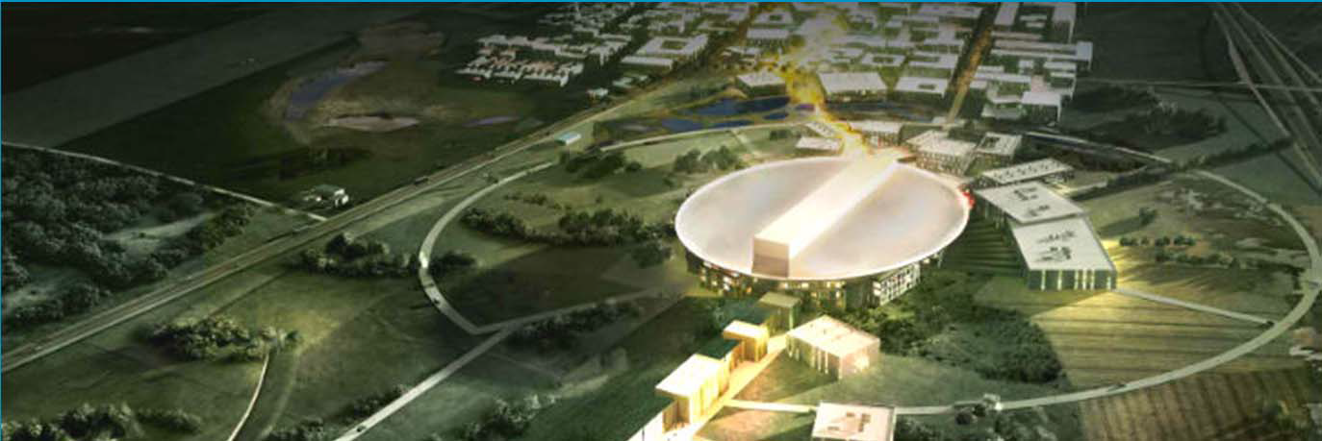


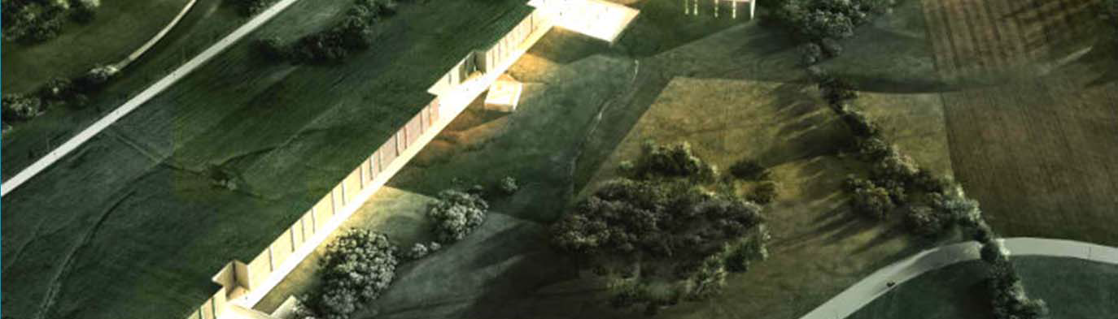
An artists impression of ESS

Slide 3
Overview
What is the RF cell?
Design status
Subsystems:
    HV modulators
    RF sources
    RF distribution systems
    Phase reference, master oscillator
    RF local protection system
    LLRF system
Installation
Next steps

Slide 4
Types: RFQ, MEBT, DTL, Spoke, M/H beta
352.21 MHz
704.42 MHz
2.4 m
4.5 m
3.6 m
40 m
54 m
75 m
174 m
Target
Source
LEBT
RFQ
MEBT
DTL
Spokes
Medium β
High β
HEBT & Contingency
75 keV
3.6 MeV
90 MeV
220 MeV
570 MeV
2000 MeV
 | Energy (MeV) | Frequency /MHz | No. of Cavities | βg | Temp / K | RF power /kW
Source | 0.075 | - | 0 | – | ~300 | –
LEBT | 0.075 | - | 0 | – | ~300 | –
RFQ | 3.6 | 352.21 | 1 | – | ~300 | 1600
MEBT | 3.6 | 352.21 | 3 | – | ~300 | 15
DTL | 90 | 352.21 | 5 | – | ~300 | 2200
Spoke | 220 | 352.21 | 26 (2/CM) | 0.5 βopt | ~2 | 330
Medium β | 570 | 704.42 | 36 (4/CM) | 0.67 | ~2 | 870
High β | 2000 | 704.42 | 84 (4/CM) | 0.86 | ~2 | 1100
HEBT | 2000 | – | 0 | – | ~300 | –

Slide 5
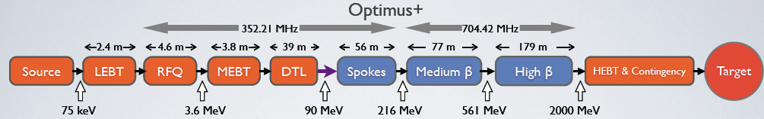
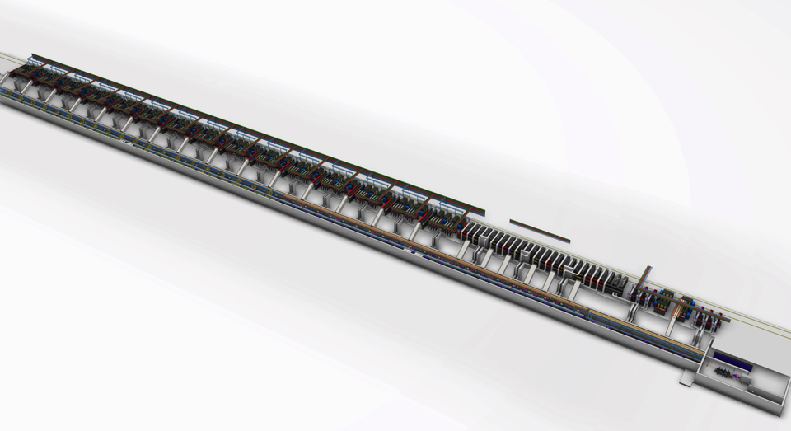
ESS Linac Layout
High beta RF
DTL RF
Medium beta RF
Low Energy Front end
Spoke RF
High beta cryomodules
Medium beta cryomodules
Spoke cryo-modules
DTL tanks

Slide 6
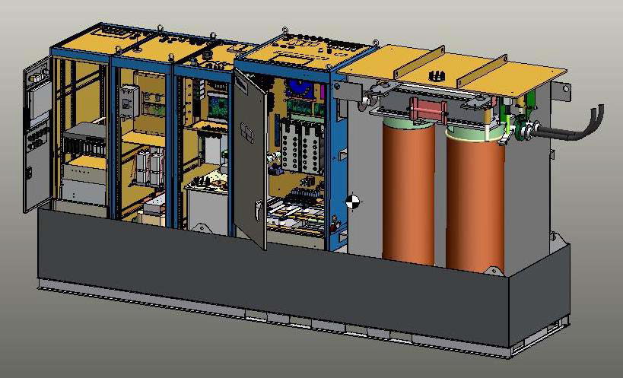
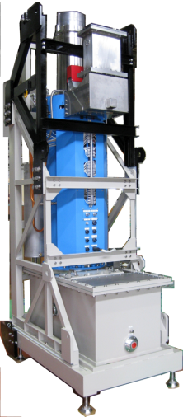
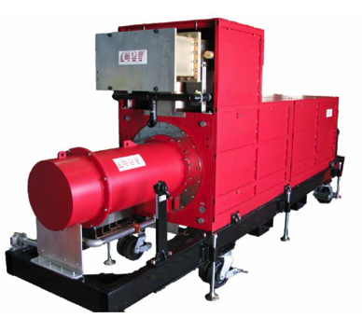
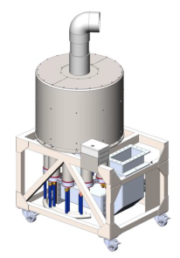
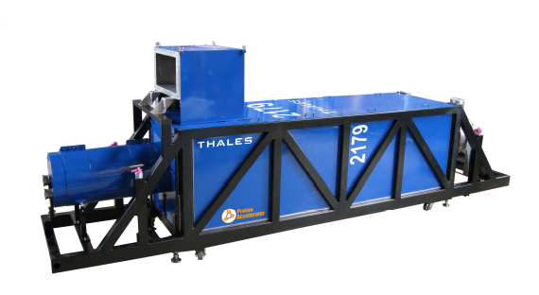
RF systems: the power to accelerate
Many, bulky, costly (~450 k€ per meter cavity length)
Consumes vast amounts of power and needs cooling
Many interfaces

Slide 7
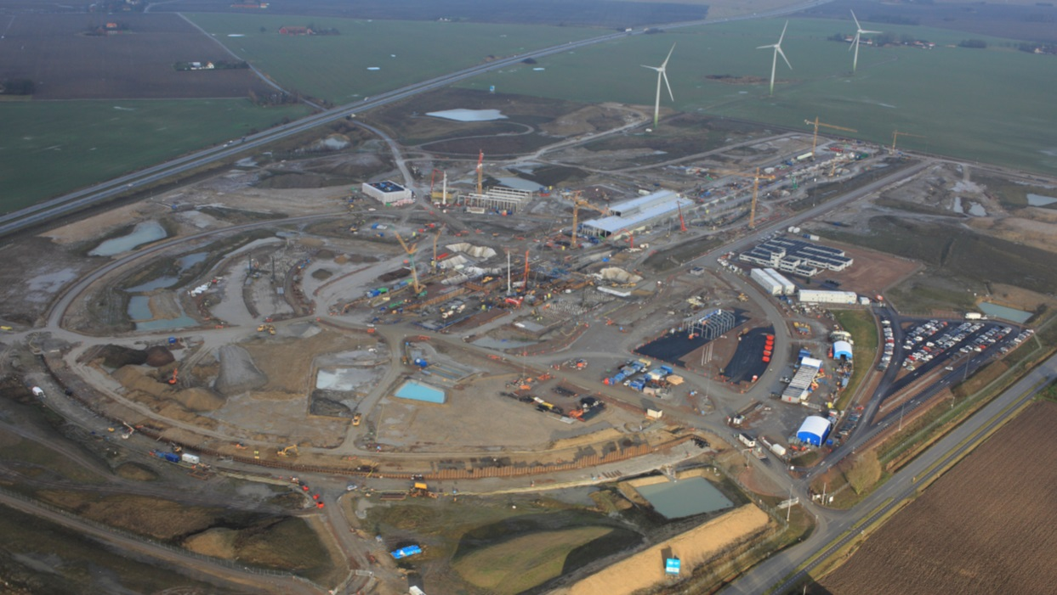
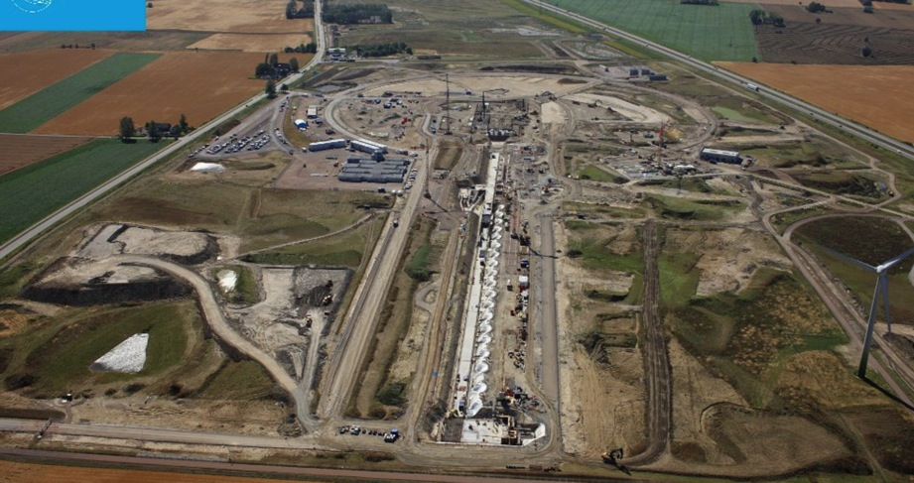
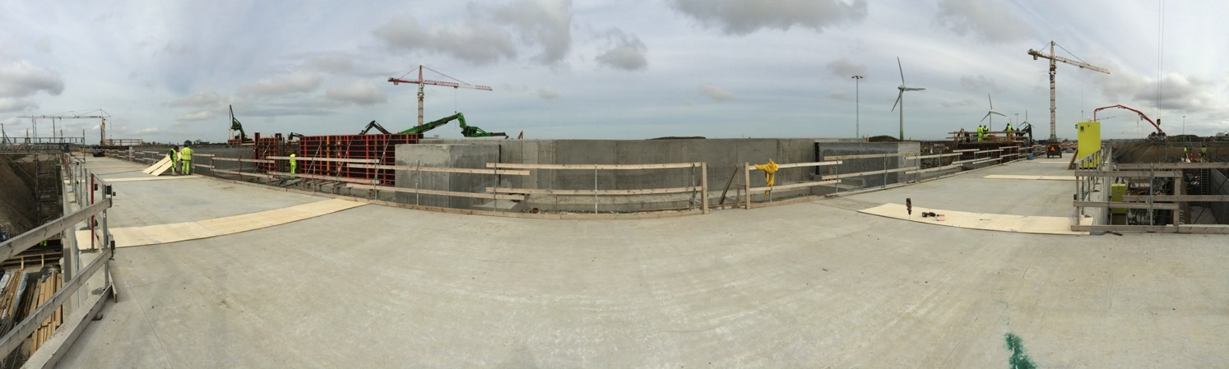
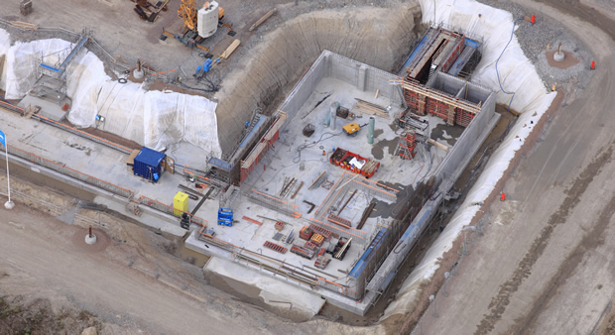
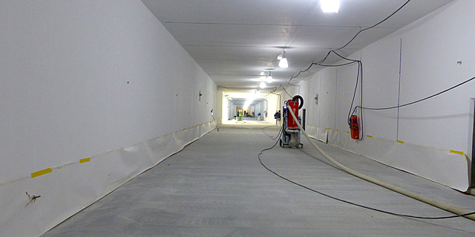
Site construction work

Slide 8
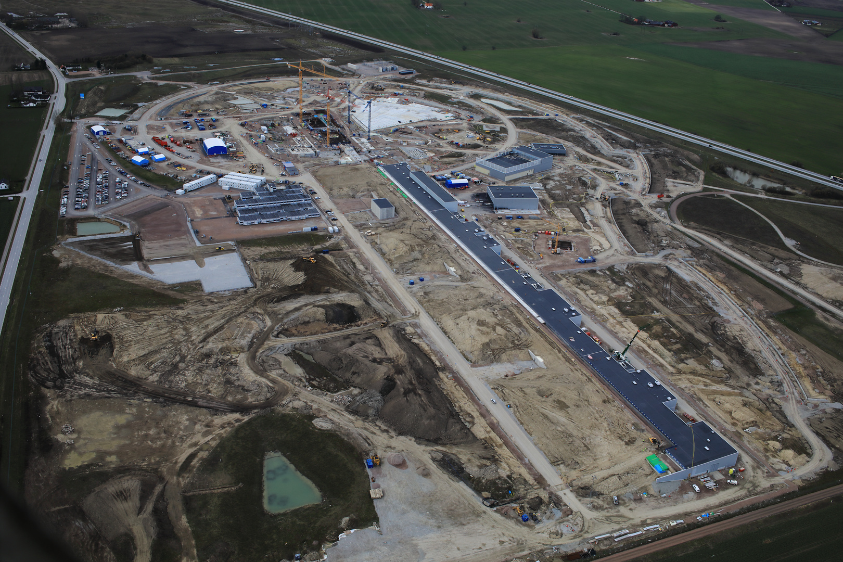
Gallery April 2017

Slide 9
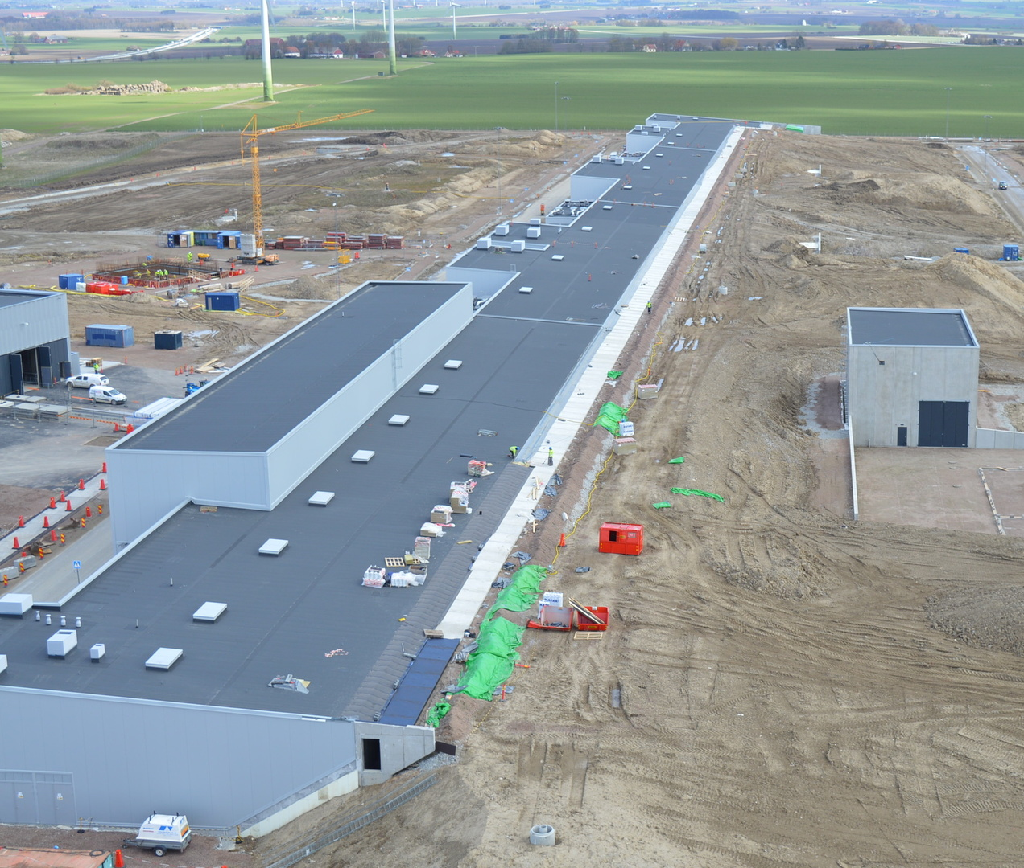
Gallery and tunnel berm April 2017

Slide 10
RF systems
Power to 155 cavities, one RF station/cavity
  High Voltage new development: SML modulator topology
  High Power RF Amplifier new development: MB-IOT amplifier (targeted for high beta)
A large part of the RF systems is provided in collaboration with partners
      RF NC linac (Spain) (complete RF systems)
      Spoke RF stations (Italy) (RF transmitters + interlocks)
      LLRF (Spain and Poland) (both NC and SC)
      RF high power distribution (UK) (SC linac)
      Phase ref distribution (Poland) (the whole linac)
      Installation (Poland)
Collaboration Lund Univ Uppsala Univ(FREIA facility)

Slide 11
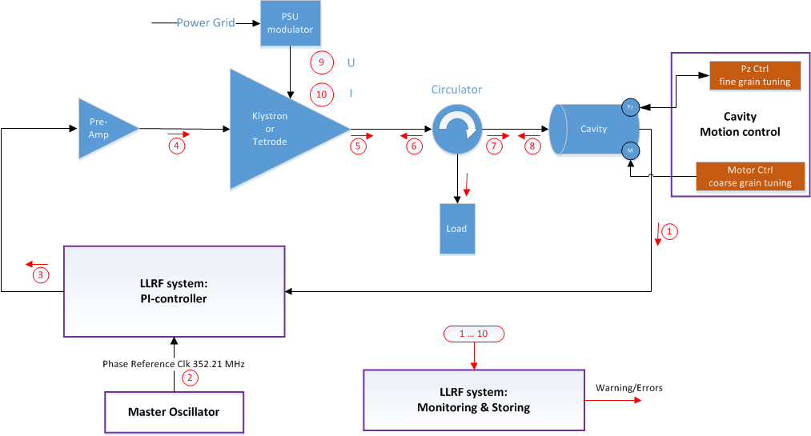
RF Cell
Interlock
Basic building block for RF systems is the RF cell:
High Voltage
Amplifiers
Regulation (LLRF)
Protection – Interlock
Waveguides

Slide 12
CELL Design and Status
Set of schematic produced for each linac section
Schematics to assist communication between external and internal interfaces
Includes communications channels, signal lists, all sub systems, utilities (water and power), MPS, PSS, and cryo-modules.
Owners and providers at sub system level identified
All ‘external’ interfaces should have been captured
  If it is not on the schematic, it is probably missing

Slide 13
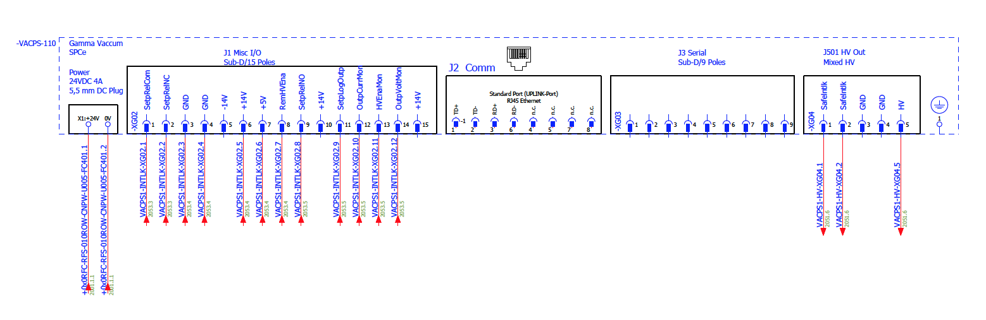
Design status
Cable Database Preparation
155 Systems
Approx. 120 external cables per system
18000 WP8 cables
55 unique devices per system
Detailed electrical diagrams (E-plan)
  TS2 95% done as a trial
    Cable procurement
    Connector procurement
    Cable schedules
    Installation optimisation
    Working with cable database (WP16)
  Currently being extended to MB
  Sample sent to ESS Bilbao for RFQ, DTL and MEBT
  Based on schematics but now with full pin-to-pin connectivity
    All devices named
    All cables and pin-to-pin specified
    All connectors defined
    Etc
  Rack layout complete and power requirements documented
Electrical schematics at system level

Slide 14
Design status
Selection of Top Requirements
  MPS functionality agreed (WP8 – ICS)
  PSS functionality agreed (WP8 – ICS)
  Water parameters (temperature, flow, pressure, pressure drop, filtration and quality etc) agreed (WP8 – WP15)
  Electrical parameters (rack power and HV agreed) (WP8 – WP16)
    UPS decision still somewhat unclear
  Modulator electrical interfaces and requirements agreed (WP8 – WP17)
  Water instrumentation requirements agreed (WP8-WP16)
  Gallery and tunnel environment agreed (WP8 – Building)
  Rack space and location agreed (WP8 – WP15)

Slide 15
Design status
Selection of Top Requirements
  Interface to cryomodules agreed (size, location and orientation) (WP8 – EMR)
  RF power to beam agreed (WP8-WP3)
  Cavity field stability (via LLRF) agreed (WP8-WP3)
  Phase reference outputs, connectors, power levels agreed (WP8-WP3, WP8-WP7)
  MO performance agreed (WP8-WP3, WP8-WP7)
  Local Protection System
    Only intended to protect RF CELL except
    Selection of fast cavity interlocks included

Slide 16
Design status
Selection of Top Requirements
  Quench Detector (was orphan item) (WP8-EMR)
    Requirement not fully defined, however fast digital concept proposed and detailed design being started
  Electron Pick (was orphan item) (WP8-EMR)
    Requirement agreed, first design complete and prototyping under way
  Safety and Installation
    WSCPs under production
    RA and MS documentation under production
    Activities being coordinated with Area Manager
  QA/QC
    TA include relevant references
    QA/QC invited to PDRs and CDRs
    QA/QC invited to comment on procurement specifications prior to tender
    CE marking where possible and applicable

Slide 17
RF cell medium beta

Slide 18
High Voltage
Needed to power RF amplifiers
Voltages to >100 kV
Currents 20-80 A
Pulsed or cw
Large and $$$

Slide 19
Development strategy ESS
Prototyping 330 kVA, 1 contract
Internal development: SML topology
Validated and used for RFQ/DTL/MB, 660 kVA
Provided in-kind for RFQ/DTL by ESS Bilbao (3 pcs)
Provided by ESS for Medium beta (9 pcs)
Spoke – RF integrated transmitter, provided in-kind by Elettra
High beta: start prototype work during 2018 for IOT modulator, discussing possible in-kind
Interfaces with High power amplifiers, controls, interlock

Slide 20
High power amplifiers
Amplifiers:
Generate High power RF
Power up to several MW
Typical example klystron
Large, $$$

Slide 21
Amplifiers
Solid state amplifiers
Tube amplifiers
Interfaces with LLRF, HV modulator, controls, cooling systems

Slide 22
High power amplifiers ESS linac
Section | Power /kW | Baseline design | Strategy | Status
Normal conducting RFQ and DTL | 2800 | Klystron | Exist commercially | In kind: recondition + buy
Normal conducting bunchers | 30 | Solid State | Tender from market | In kind: ready for tender
Spoke linac | 400 | Tetrode | Tender from market | In kind: design and tender
Medium beta linac | 1500 | Klystron | 3 prototypes, tender 2 suppl | Tender awarded
High beta linac | 1500/1200 Klystron/IOT | MB-IOT (decision end 2017) | Finance development 2 prototypes | Prototypes under test

Slide 23
RF distribution system
Transport RF to cavity:
Waveguides
Circulator (protect amp)
Load (reflected power)
Couplers for measurements
Arc detectors for protection

Slide 24
RF distribution system
Layout in gallery, stub, tunnel very critical
Coexist with shielding and cables in stubs
Coexist with cooling piping, cable trays, RF equipment in gallery
Coexist with cable trays, cavities, cryo lines, piping in tunnel
Interfaces with RF amplifiers, cavities, interlock, LLRF, cooling systems, controls

Slide 25
Phase reference, Master Oscillator
Phase reference:
What is the right phase?
LLRF regulates to that
Given by phase ref
All along the linac

Slide 26
Interlock
Protection:
Amplifier
Waveguides
Cavity
LLRF
Fast (μs) and slow (ms)

Slide 27
Interlock
Handles protection of the RF cell
Strategic decision to have interlock handle ALL protection functions
This leads to splitting of RF signals between LLRF and interlock
LLRF handles NO protection functions
Interfaces with control systems
Interfaces with MPS, PSS
Provided in-kind from MTA Atomki, Debrecen
Interfaces with all RF cell systems that have an interlock

Slide 28
LLRF
LLRF regulates cavity amplitude and field:
PI-control
Adaptive feedforward
Inner klystron loop
Beam current variation
compensation

Slide 29
LLRF
Design based on STRUCK-hardware (DESY)
MTCA 4 standard
ESS manages algorithms
  Challenge regulation limits
Provided in-kind from
  ESS Bilbao for RFQ/MEBT/DTL/Spoke
  Polish Electronic Group for medium/high beta
Interfaces to phase reference line, amplifiers, cavity, controls, distribution system

Slide 30
Installation
Installation manpower provided in-kind from IFJ PAN Krakow for most RF systems
Installation starts summer/autumn 2017 (phase ref)
Requires very precise planning and great flexibility
Installation plan v 3 for ACCSYS is being drafted

Slide 31
Next Steps RF cell
Order NC and MB modulators
Order MB klystrons
Follow up of the in-kind contracts
Installation
Commissioning
Starting operation 2019
Full installation in 2022

Slide 32
Thank you

