Slide 1
RF distribution system
Anders Sunesson RF group leader
Design work done by Rutambhara Yogi
www.europeanspallationsource.se
RF cell review, May 11, 2017

Slide 2
RF distribution system
Transport RF to cavity:
Waveguides
Circulator (protect amp)
Load (reflected power)
Couplers for measurements
Arc detectors for protection

Slide 3
RF distribution system
Layout in gallery, stub, tunnel very critical
Coexist with shielding and cables in stubs
Coexist with cooling piping, cable trays, RF equipment in gallery
Coexist with cable trays, cavities, cryo lines, piping in tunnel
Interfaces with RF amplifiers, cavities, interlock, LLRF, cooling systems, controls

Slide 4
Parts of distribution system
Waveguides/coaxes – standard design
Directional couplers – used by LLRF and interlocks
Flexible section – standard design
Circulator – power handling, stability, losses
Load – as high absorption as possible required, temperature handling (hot cooling water, >50 deg C)
Arc detectors – two basic designs to choose from, depends on environment and timing response

Slide 5
Parts continued
In the gallery, the stubs, and the tunnel, support systems are required
These must carry load of waveguide, circulators, loads, etc (very heavy), at a height of 4 to 5 m

Slide 6
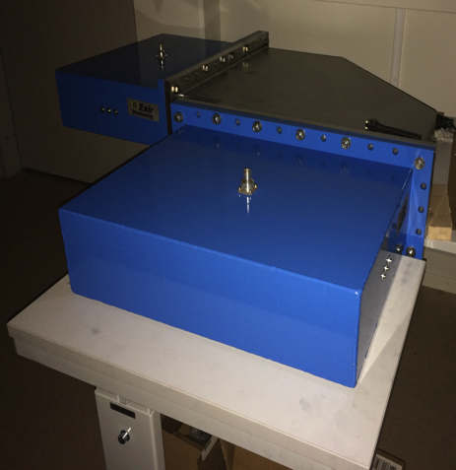
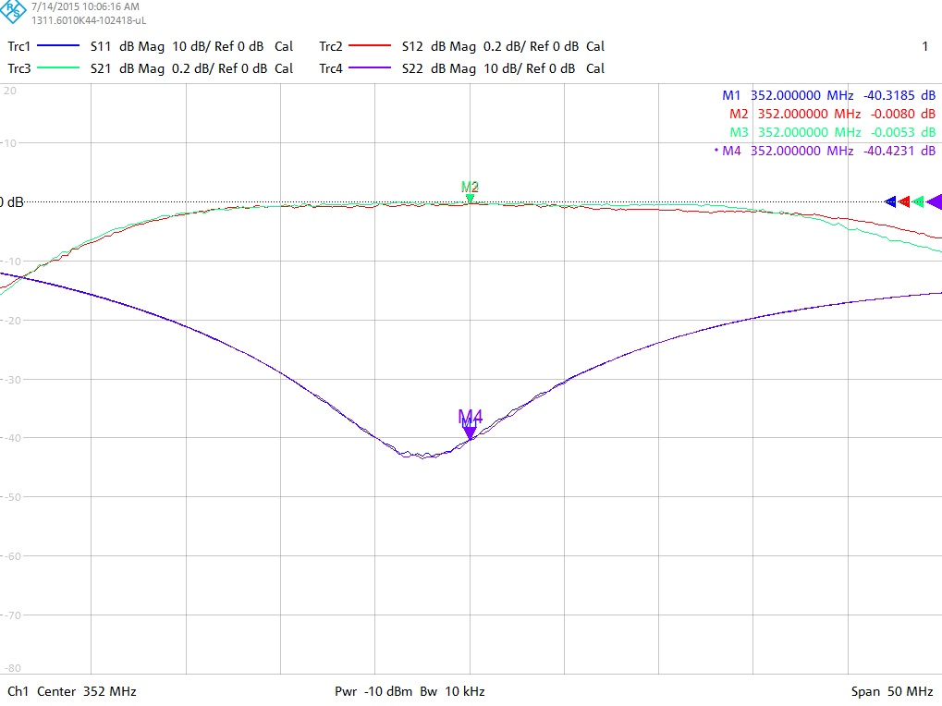
Distribution: Waveguide, coax, circulators and RF loads
ESS needs several kilometers of waveguide and thousands of elbows
Prototypes for 704 MHz circulators and loads
  Circulators: AFT, FMT and MEGA
  Loads: AFT, Thales and MEGA
Failed in visual inspection
H-Elbow
Coax-waveguide
Adapters
Supplied in-kind
ESS Bilbao for NC linac
Huddersfield University for SC linac
S11 > 30 dB
S21 < 0.05 dB
Courtesy of R Yogi

Slide 7
Prototypes circulators / loads
Three circulator prototypes were ordered from AFT, MEGA, and FMT
Delivered 2016
FAT results available
Three load prototypes were ordered from AFT, MEGA, Thales
Delivered 2016
FAT results available
No power tests made yet

Slide 8
Example FAT result circulator

Slide 9
Example FAT result load

Slide 10
Arc detectors
Either AFT or Micro-step design
AFT can be used for cavity coupler arc detectors
AFT faster time response
Micro-step cost-effective
Both systems used extensively in existing accelerators

Slide 11
RF distribution system delivery
NC linac, In-Kind contribution from ESS Bilbao
  All designs are done
  Layouts ready (still some question marks stubs)
  Circulator/load ready for tender (waits for approval)
  Support structures are being designed

Slide 12
RF distribution system delivery II
SC linac, in-kind contribution from UK
  All designs ready
  Waveguides ordered
  Couplers, flexible sections ordered
  Circulators/loads awarded
  Arc detectors ongoing
  Support structures ready to tender
  Very tricky to get waveguides into the stubs

Slide 13
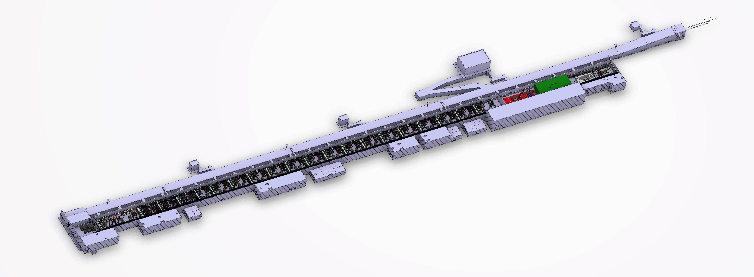
Whole gallery

Slide 14
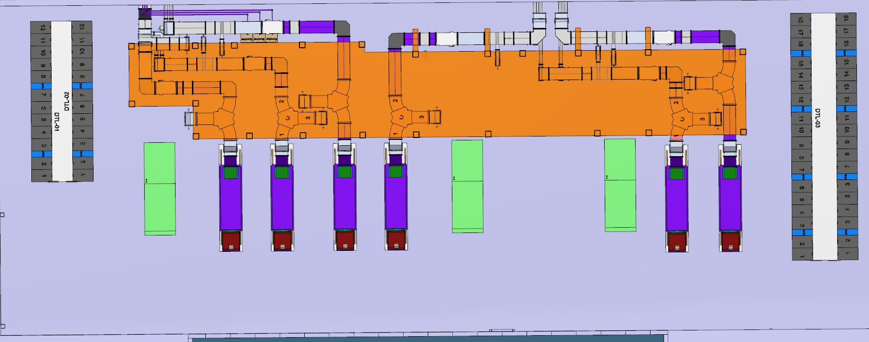
Layout NC gallery, top

Slide 15
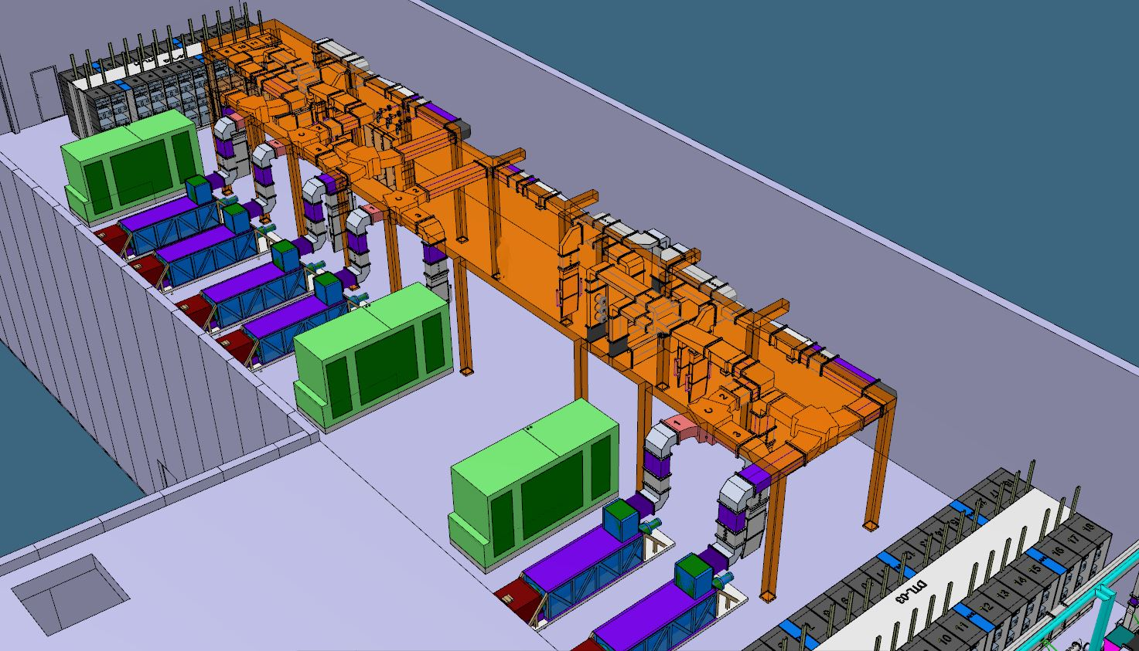
NC gallery, side view

Slide 16
NC layout stubs and tunnel

Slide 17
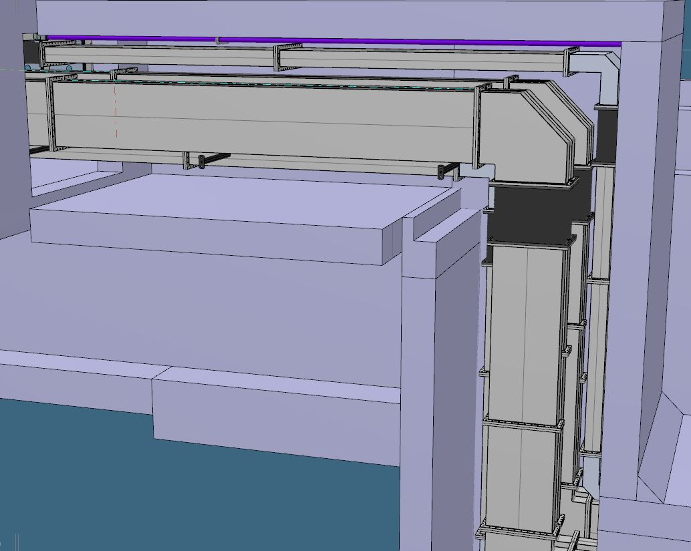
RFQ/MEBT/DTL 1-2 stub

Slide 18
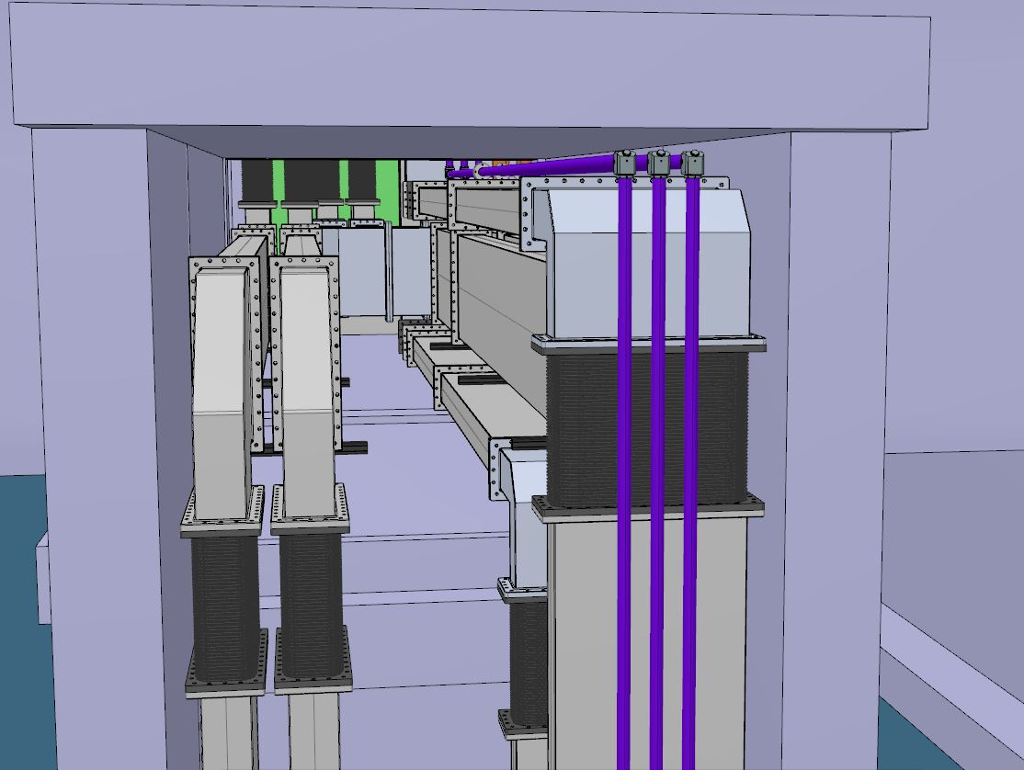
RFQ/MEBT/DTL 1-2 stub

Slide 19
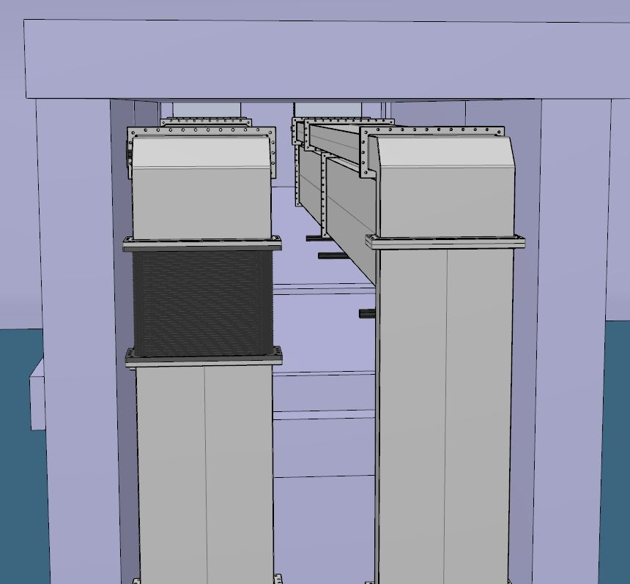
DTL 3-5 stub

Slide 20
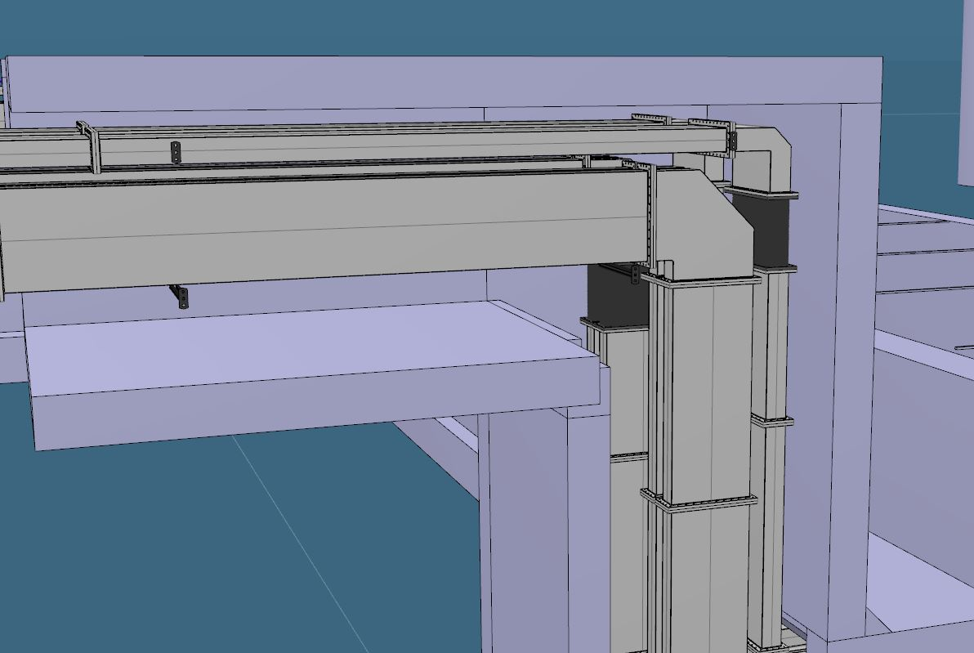
DTL 3-5 stub

Slide 21
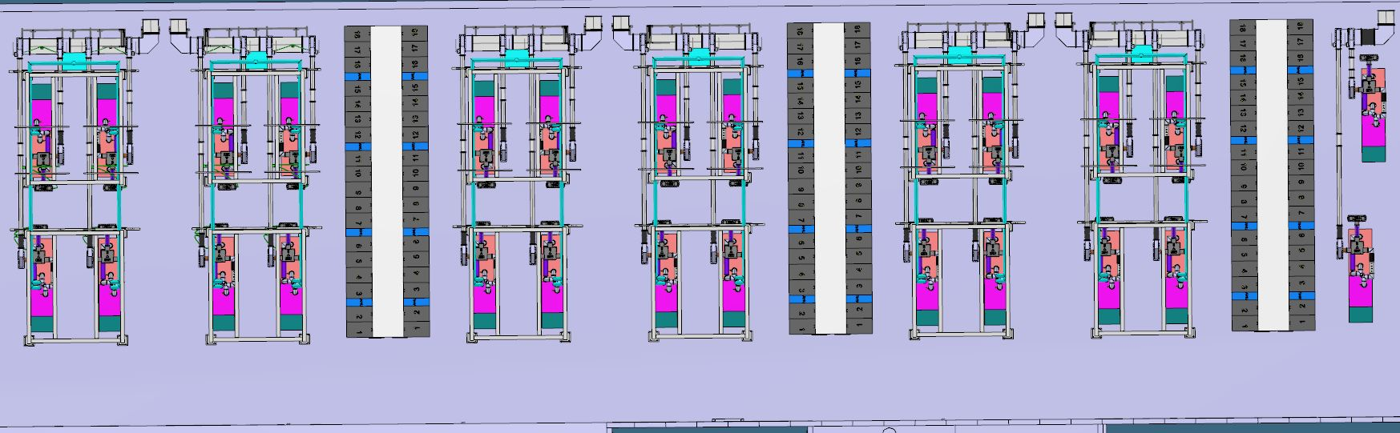
Spoke gallery layout, top view

Slide 22
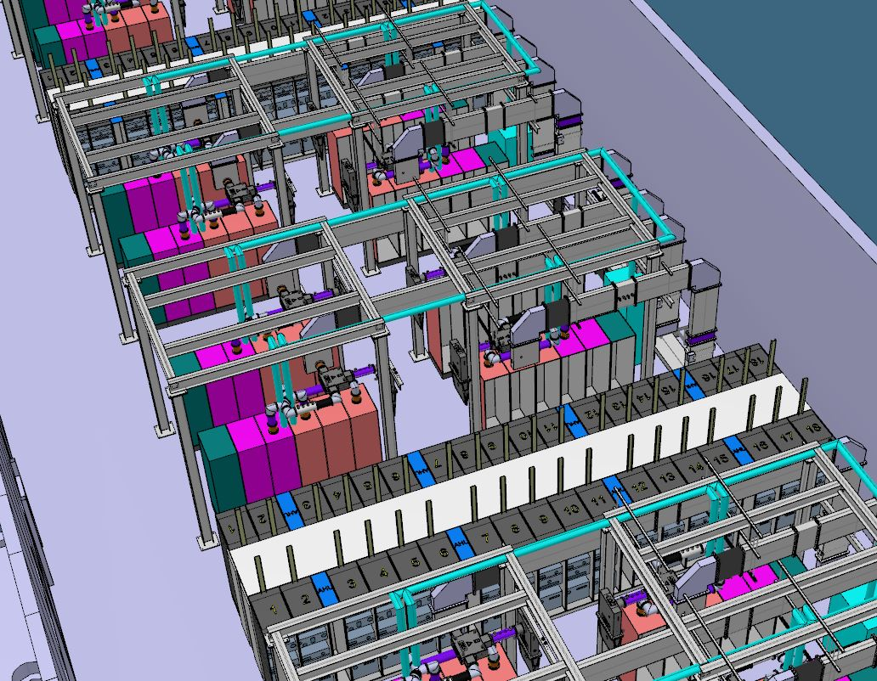
Spoke gallery, side view

Slide 23
Spoke stub and tunnel

Slide 24
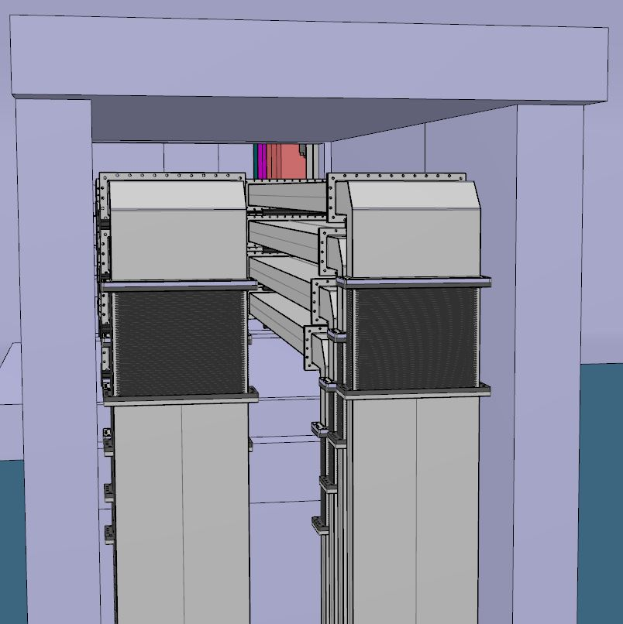
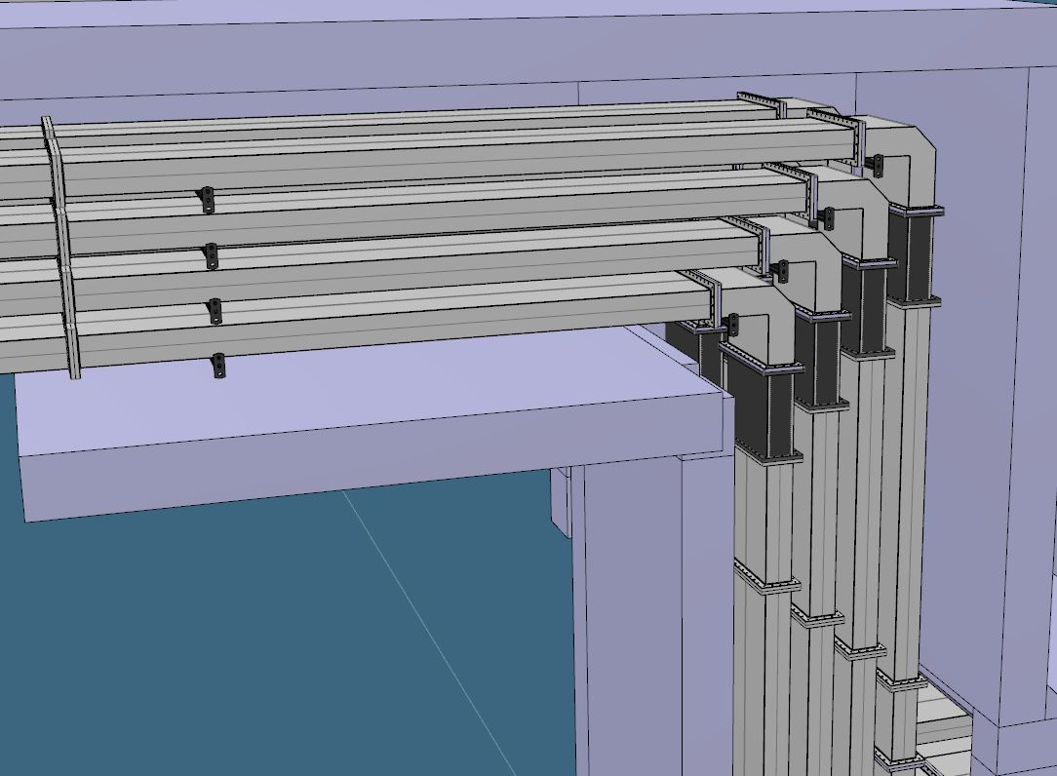
Spoke stub

Slide 25
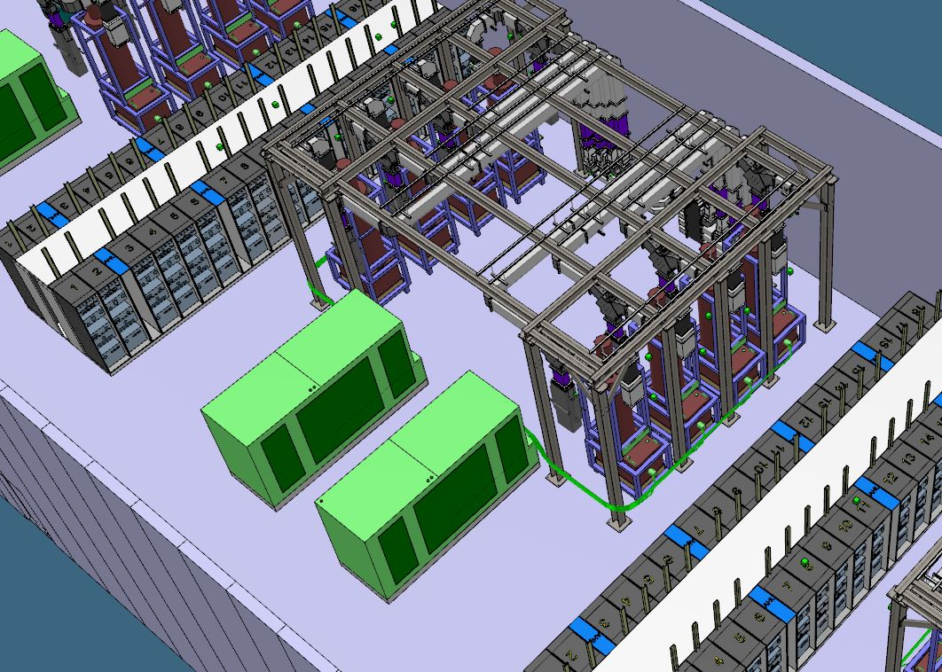
Medium/high beta gallery

Slide 26
Medium/high beta stub and tunnel

Slide 27
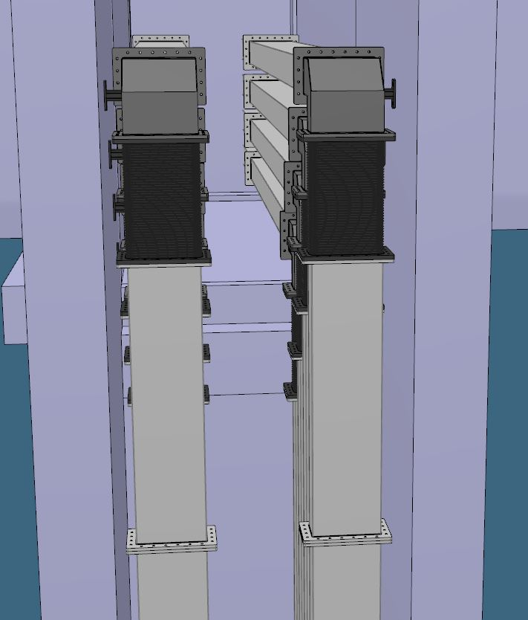
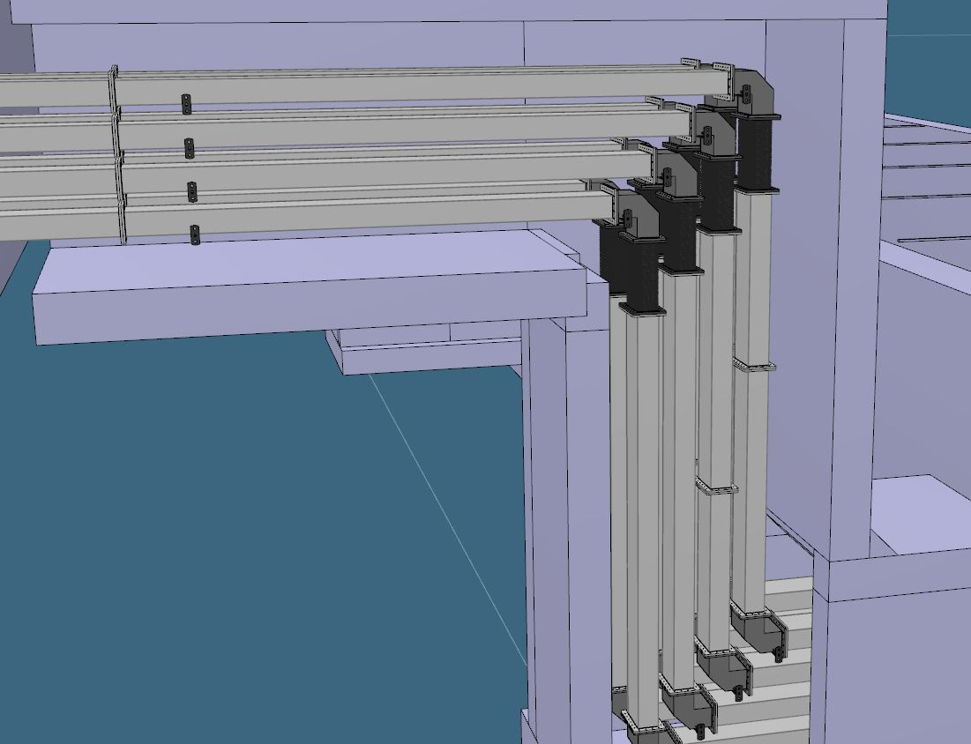
Medium/high beta stub

Slide 28
Next Steps RF distribution system
Mockup stub installation to ensure waveguides will go in
Prepare for installation in stubs (Q3/4 2017)
Finalise and tender support structures (HU and ESS Bilbao)
Place tenders circulators/loads 352 (ESS Bilbao)
Tender arc detectors
Tender shutter switches

Slide 29
Thank you

