Slide 1
RF Sources
Morten Jensen
RF Section Leader; WP8 Manager
www.europeanspallationsource.se
10 May, 2017

Slide 2
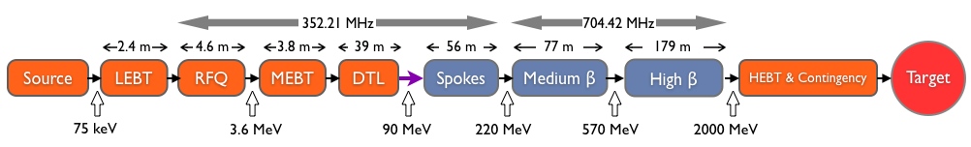
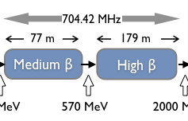
RF Power Requirements
Design Drivers:
Average Beam Power 5 MW
Peak Beam Power 125 MW
High Availability
Key parameters:
    -2.86 ms pulses
    -2 GeV
    -62.5 mA peak
    -14 Hz
    -Minimize energy use
    -Flexible design for mitigation and future upgrades
30 kW Solid State Amplifiers
3 MW Klystrons
200 kW Tetrodes
1.5 MW Klystrons
1.2 MW IOTs

Slide 3
RF Technical performances
352.21 MHz
704.42 MHz
2.4 m
4.5 m
3.6 m
40 m
54 m
75 m
174 m
Target
Source
LEBT
RFQ
MEBT
DTL
Spokes
Medium β
High β
HEBT & Contingency
75 keV
3.6 MeV
90 MeV
220 MeV
570 MeV
2000 MeV
 | Frequency /MHz | No. of Cavities | HP RF Technology | RF power to beam /kW
RFQ | 352.21 | 1 | Klystron | 1600
MEBT | 352.21 | 3 | SSA | 20
DTL | 352.21 | 5 | Klystron | 2200
Spoke | 352.21 | 26 | Tetrode | 330
Medium β | 704.42 | 36 | Klystron | 870
High β | 704.42 | Total: 84 Part 1: 44 Part 2: 40 | MB-IOT (Klystron backup) | 1100

Slide 4
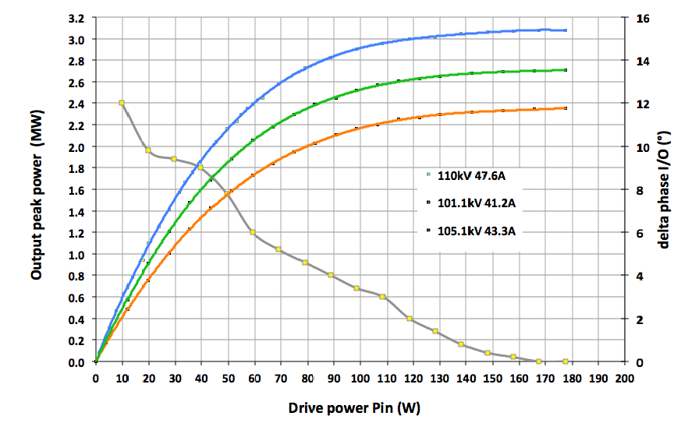
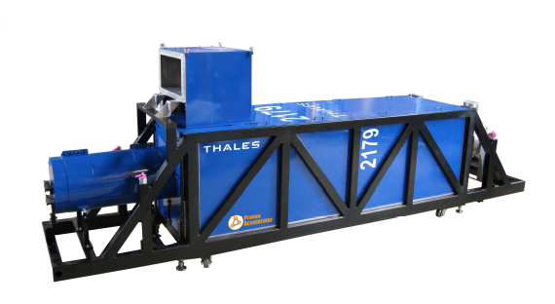
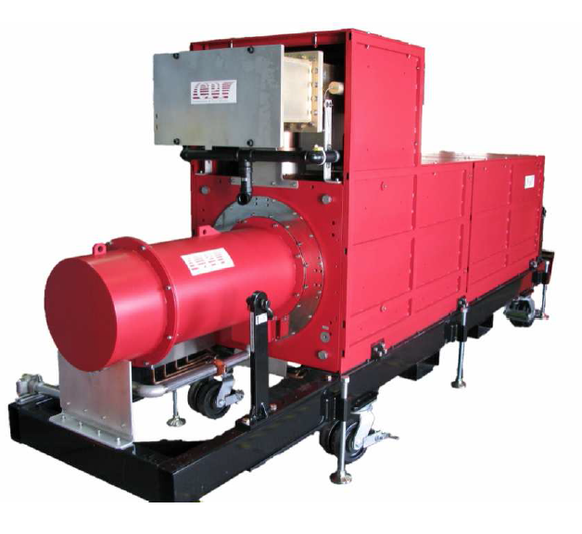
RFQ and DTLs
‘Turn Key’ from ESS Bilbao
Output vs Voltage
Frequency | 352 MHz
RF Power | 3 MW peak
High voltage | to 115 kV
Current | to 50 A
Repetition Rate | 14 Hz
Pulse width | 3.5 ms
3 MW
In-kind from ESS Bilbao
Phase
Courtesy of Thales ED
Two klystrons per modulator
Thales TH2179
CPI VKP-8352A

Slide 5
RFQ/DTL
Horizontal Klystrons

Slide 6
MEBT SSAs
Frequency | 352.21 MHz
Nominal Output Power | 30 kW pulsed power including transmission losses and overhead for regulation
Input connector | N-type
Output connector | EIA 1-5/8”
Number of units | 3
Statement of work has been reviewed by ESS Bilbao and ESS
Emphasis on reliability – Loss of any buncher cavity will drop the beam
Initially one SSA will be procured for test followed by two further units
Full Technical and Procurement Specification available

Slide 7
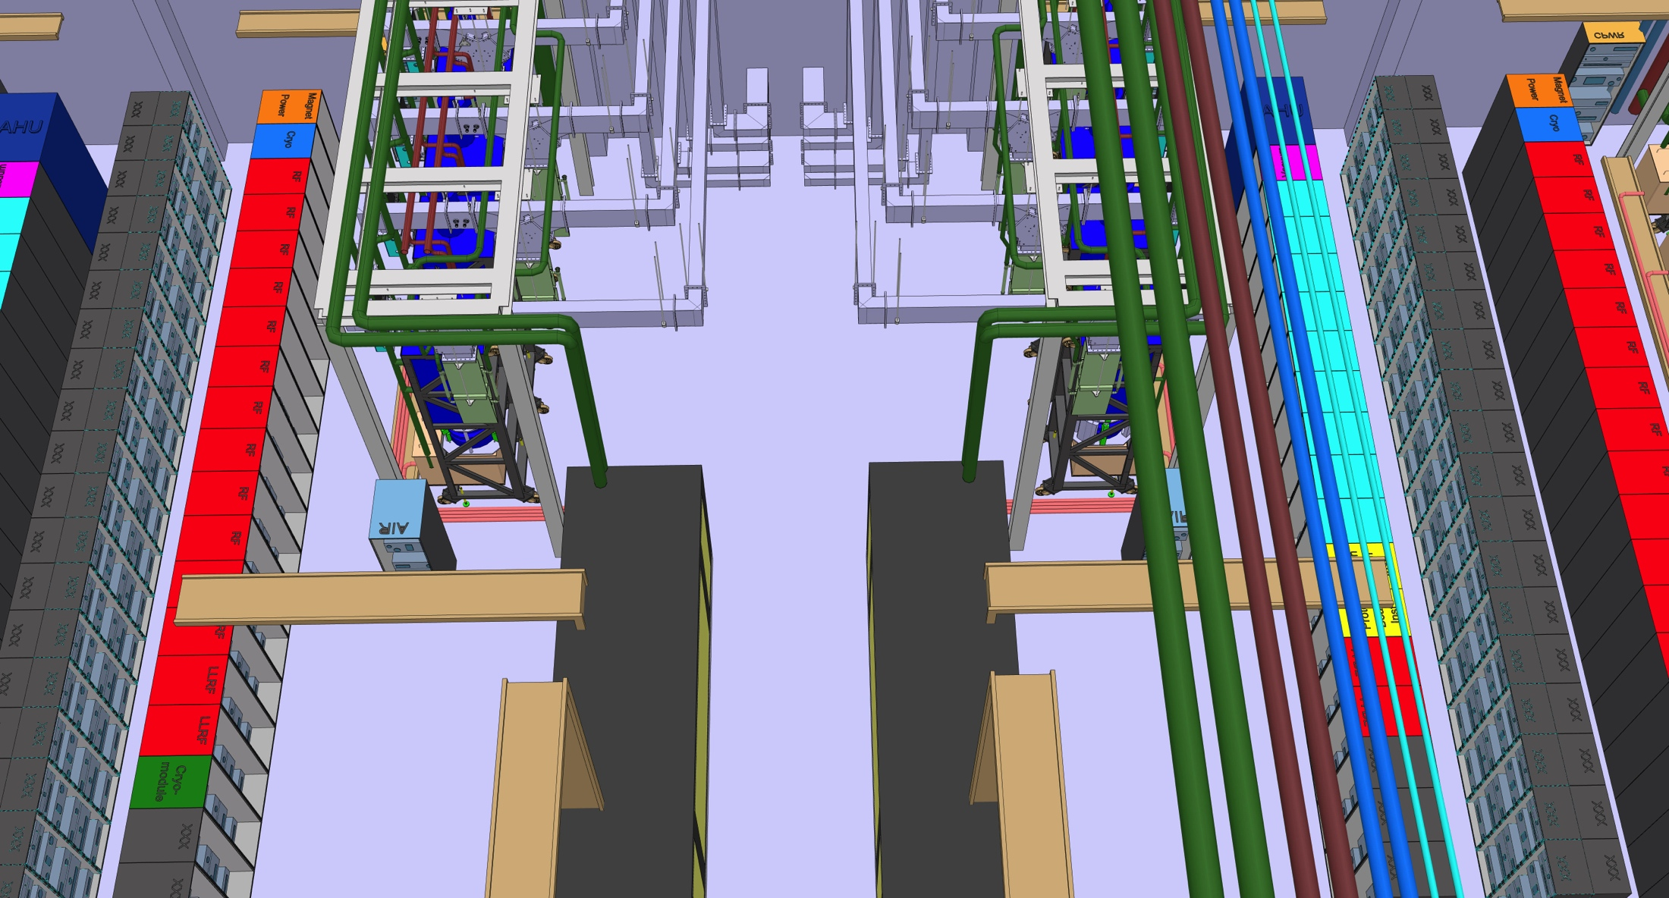
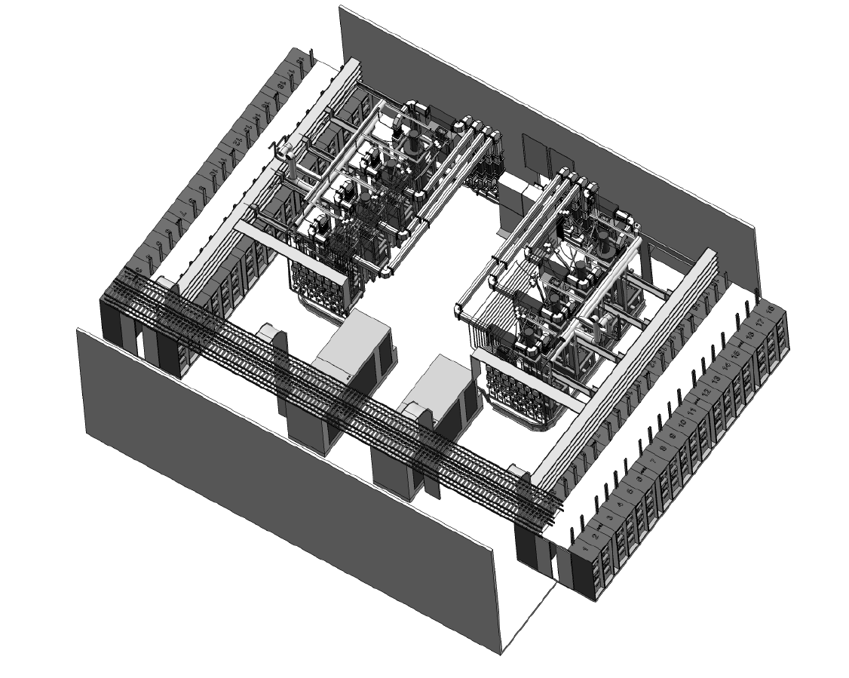
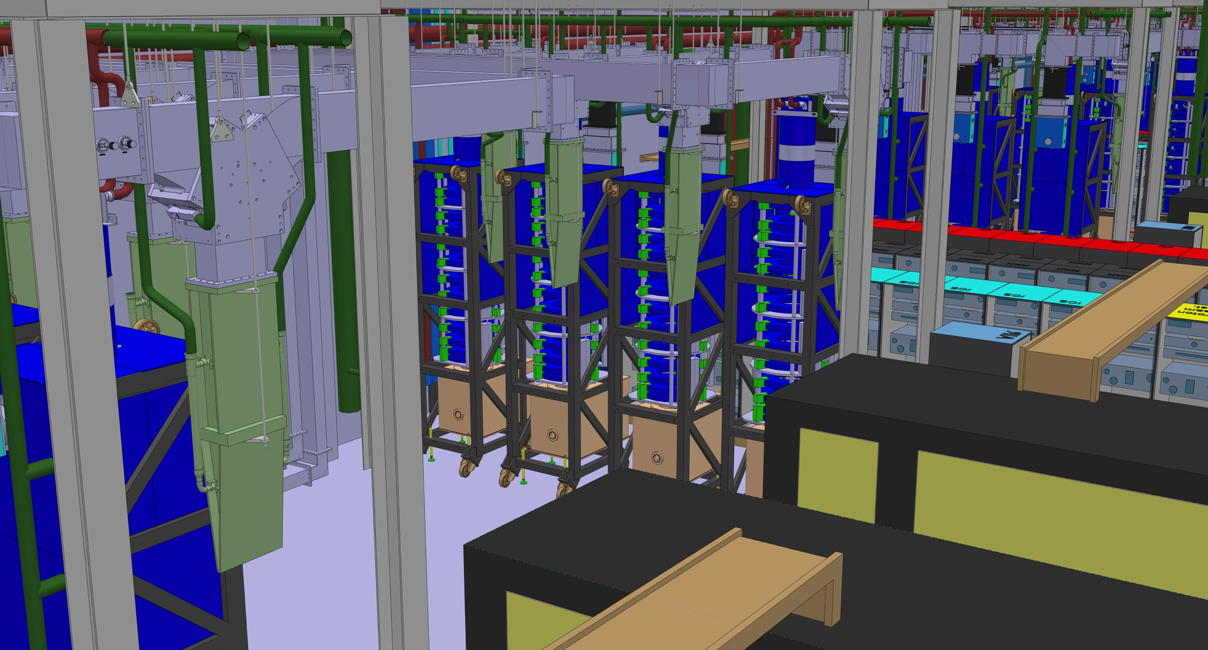
Medium Beta klystrons
PDR for series and summary of prototype performance held in December 2016 (https://indico.esss.lu.se/event/731/)
One 660 kVA modulator will power 4 klystrons
4.5 Cells of 8 klystrons for Medium Beta
10.5 Cells of 8 MBIOTs or klystrons for High Beta
Cooling manifold
Racks and Controls
Klystrons
WR1150 Distribution
Modulators
Klystrons will be operated vertically to save space
7

Slide 8
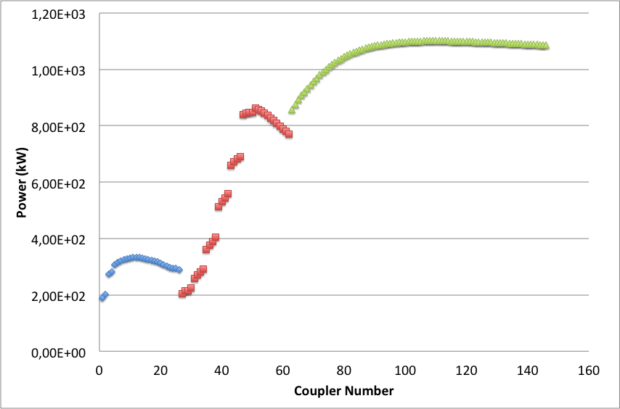
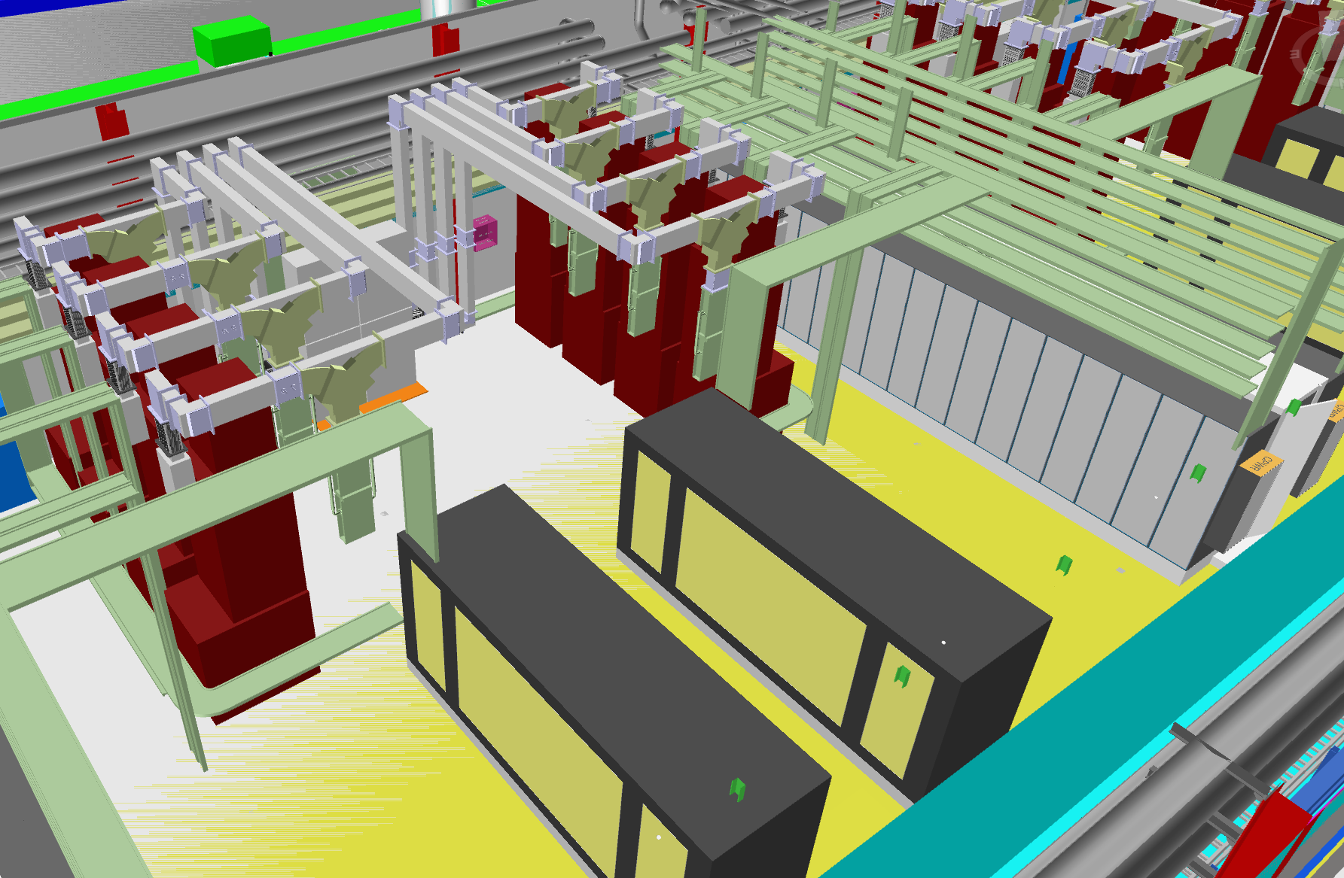
Medium beta linac
Frequency | 704 MHz
Power | 1.5 MW peak
High voltage | to 115 kV
Current | To 25 A
Repetition Rate | 14 Hz
Pulse width | 3.5 ms
866 kW
200 kW
Vertical orientation to fit in the gallery
High Power Density: 12 MW of RF in approx. 10 x 13 m
Four klystrons per modulator
Klystrons
Modulators

Slide 9
Medium Beta Klystrons
Contracts signed for three klystron prototypes
  Toshiba
  CPI
  Thales
All three klystrons have been tested in the factory and delivered
First klystron (Toshiba) about to be tested at ESS
Decision was to proceed with the tender for the MB series based on the factory tests only.
  Increased risk, but necessary to maintain schedule
  Interfaces have been confirmed or consolidated in the series SoW to ensure electrical and mechanical compatibility between vendors
  Hopefully, the klystrons will have been installed and SAT tested (but not soak tested), before the contractual design review

Slide 10
Scope of Series Klystron Tender
Items included in the supply:
36 Klystrons in batches of 6, including electromagnet, magnetic frame, cooling jackets, gun tank
Design, construction and integration of the oil tank. This includes the integration in the oil tank of the heater power supply (supplied by ESS together with the connectors) and the current limiting resistors (supplied by ESS)
Oil tank sensors/switches
Body sensors, if required from the Supplier
Window sensors/switches, as required from the Supplier
Oil drip tray and oil leak detector
Coax to waveguide transition (where required), or transition to WR1150
Mechanical support
X-rays Shielding
Factory acceptance test
Delivery at ESS Lund
Technical documentation
Optional Items
Additional klystrons (not in batches)
Spare parts (to be agreed with ESS, and to be quoted separately: ex: electromagnet)
Output mismatch for operation at low beam voltage

Slide 11
Items NOT included in the klystron tender:
Filament power supply
  Specification complete; tender about to be released (Framework agreement)
Current limiting resistors
  Procurement to start
Electromagnet power supply and connectors
  Specification complete; tender about to be released (Framework agreement)
Ion pump power supply and connectors + interconnecting cables
  Framework agreement for controllers in place
  50% of required cables and connectors delivered
Drive Amplifiers
  Tender prepared, currently with Procurement
HV cable and socket
  Provided by WP17
External water cooling
  Instrumentation provided by WP16

Slide 12
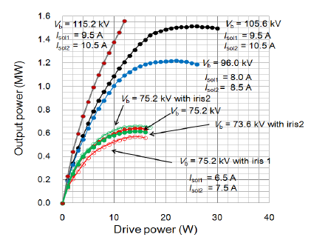
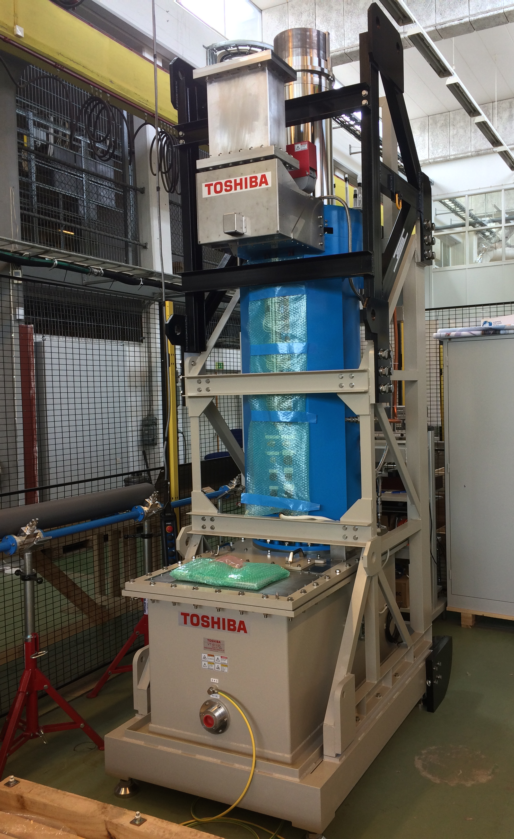
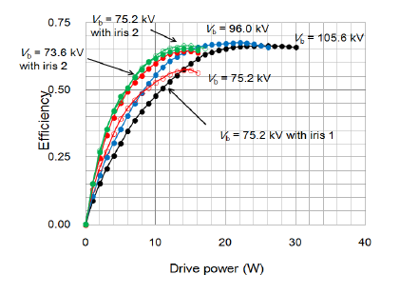
Toshiba klystron E37504 prototype
Some results from the Factory Acceptance Test (February 2016):
1.5 MW
Performance at 115 kV
> 60% efficiency even at 600 kW

Slide 13
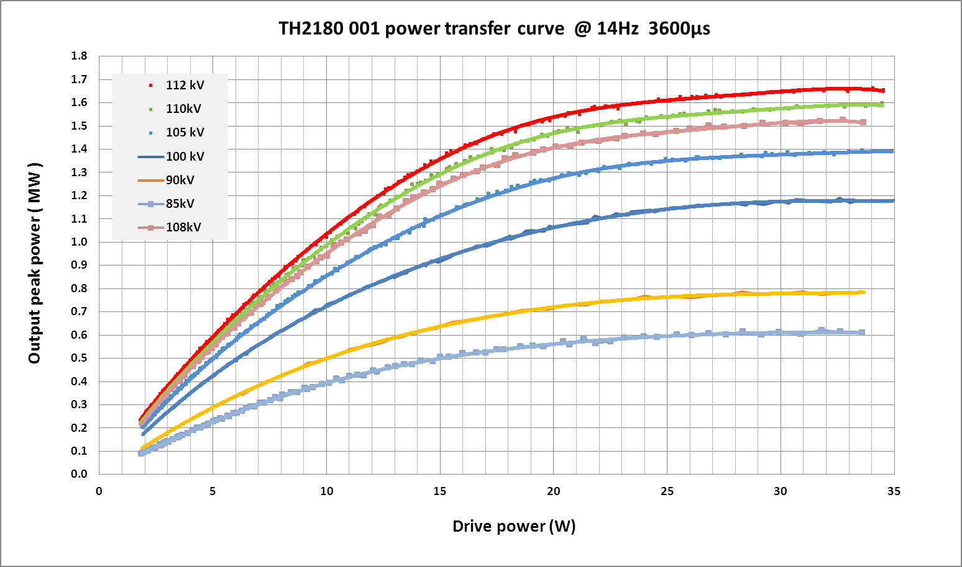
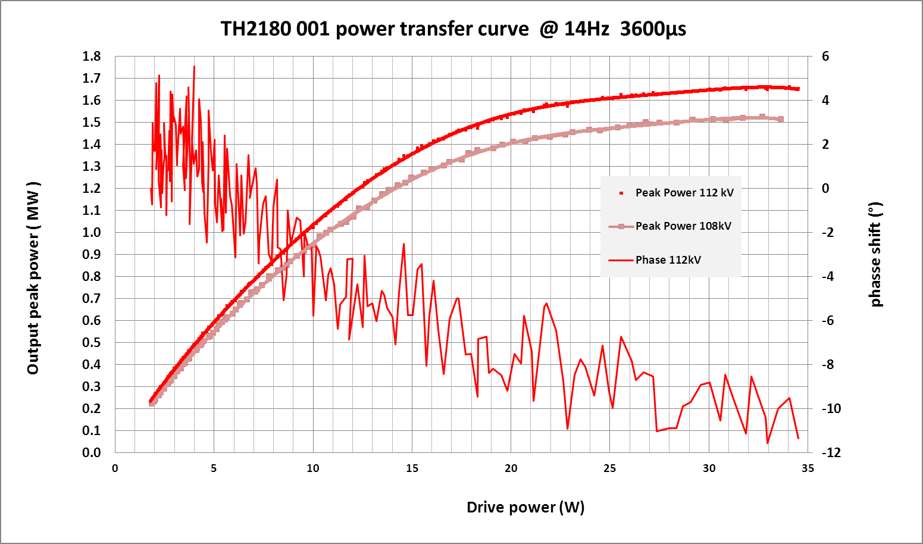
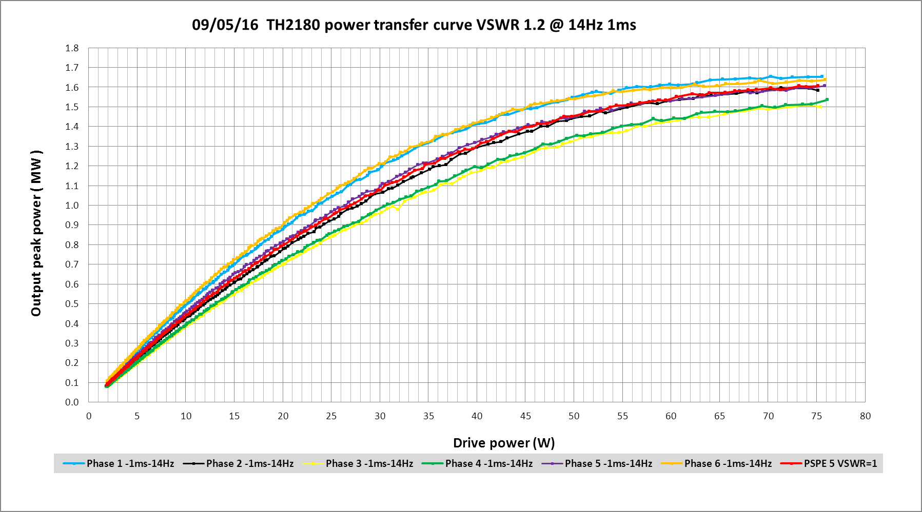
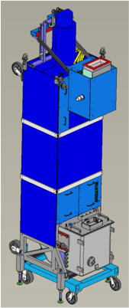
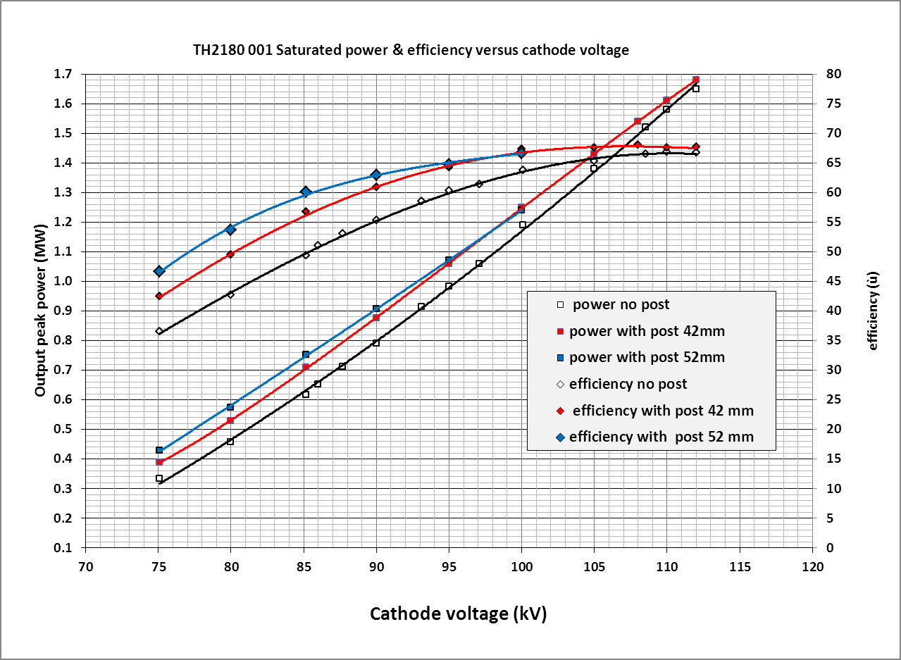
Thales klystron prototype TH2180
Results of factory tests in May 2016.
Saturated efficiency 66%.
1.5 MW at 108 kV
1.5 MW
65%
Efficiency
600 kW
55%
80 kV
Power

Slide 14
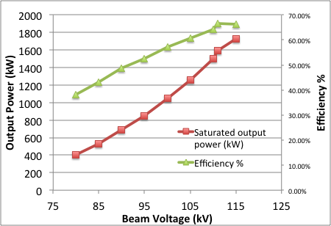
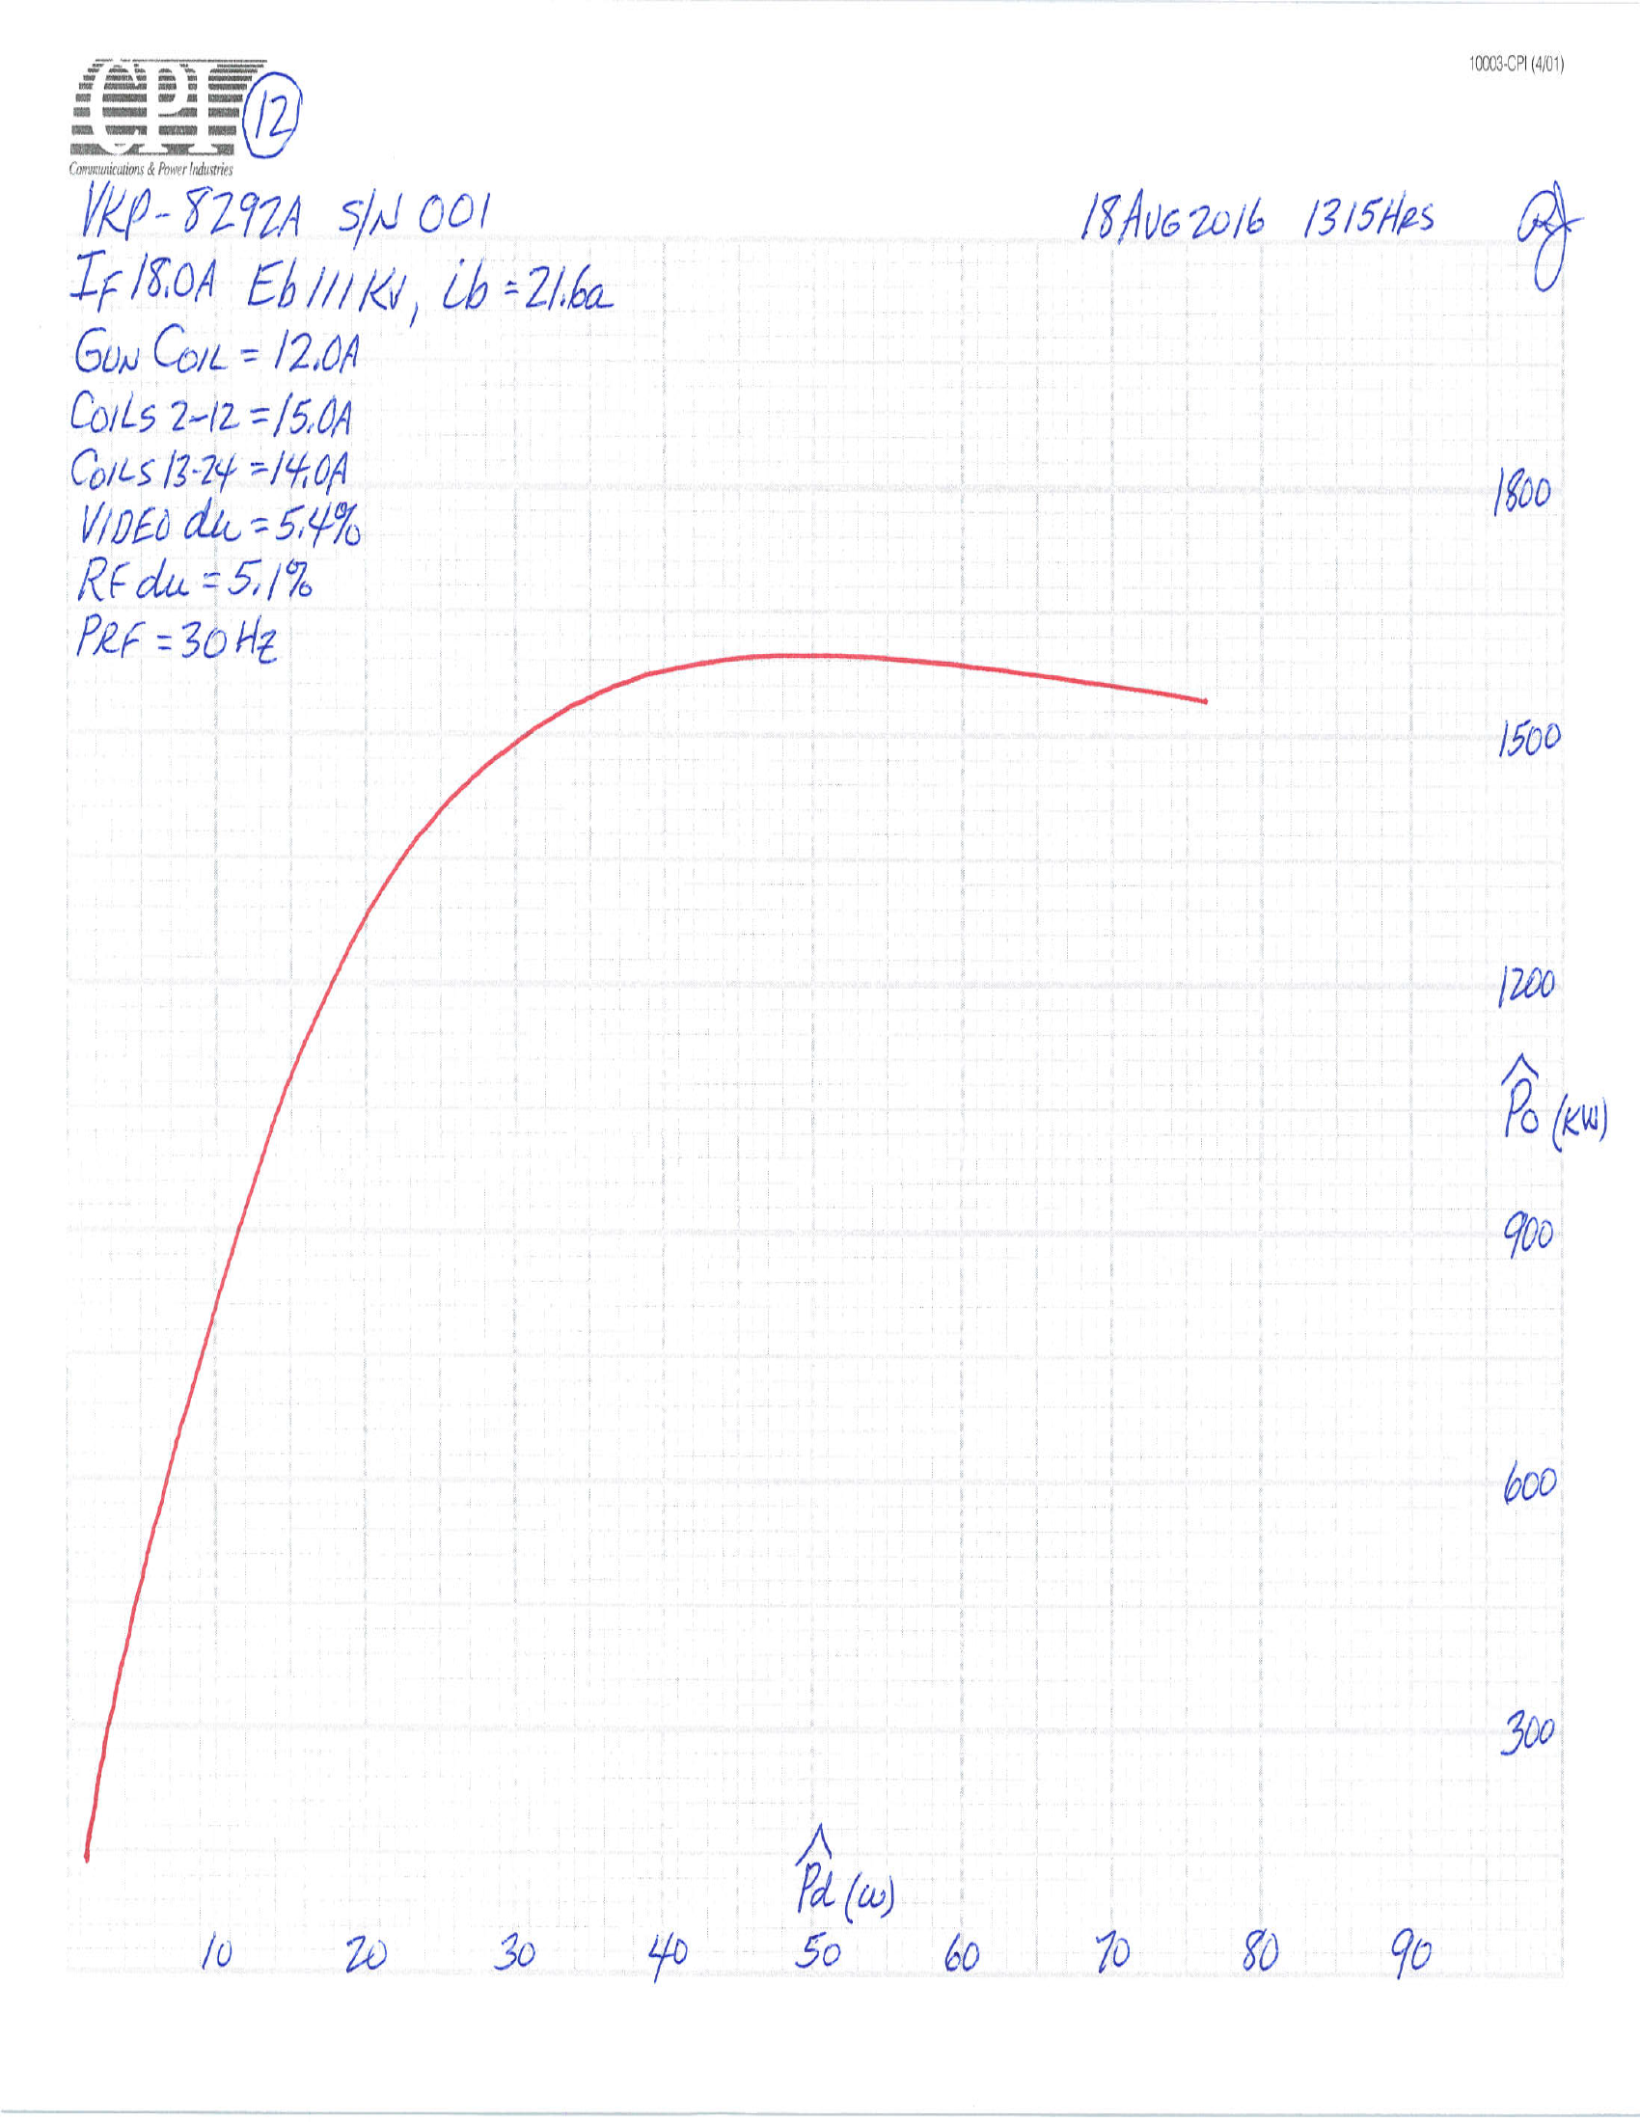
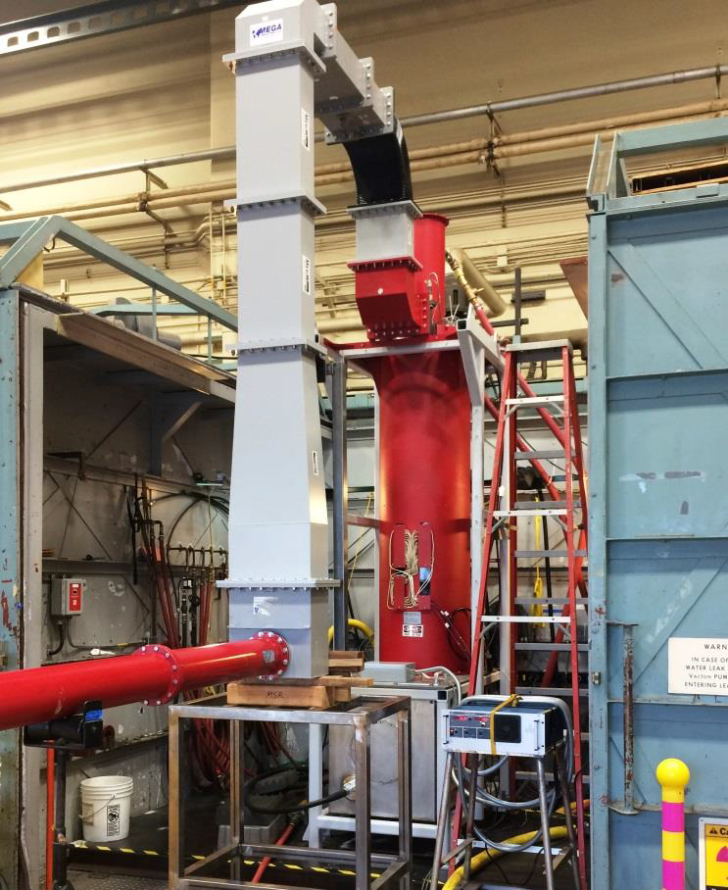
CPI Klystron prototype VKP-8292A
Results of factory tests in August 2016.
1.6 MW
Specification 1.5 MW
Output power and Efficiency
vs Beam voltage
Transfer curve at nominal 111 kV

Slide 15
Main Technical Klystron Specifications (for series (1/2)
OPEN CALL FOR TENDER
OCT-2017-110800001-001
Nominal output power | 1.5 MW: during flat-top at saturation, when klystron operated on VSWR=1.05.
Operation mode | Pulsed
Frequency | 704.42 MHz
BW | ≥ +/- 1 MHz at -1 dB point.
RF Pulse width | ≤ 3.5 ms (RF drive will not be applied until the high voltage is within 10% of the flat top voltage. )
Repetition rate | 14 Hz
VSWR | Up to 1.2, any phase: The output power shall exceed 85% of full rated power when operated into a 1.2:1 mismatch of any phase.
Maximum beam current | ≤ 25 A
Maximum HV | 115 kV: Although the nominal RF power may be achieved at a high voltage below 115 kV subject to the actual Perveance and efficiency, it shall be possible to operate the klystron at up to 115 kV, provided that the RF output power does not exceed the nominal value.

Slide 16
Main Technical specifications (for series (2/2)
Beam perveance | 0.6*10⁻⁶ ± 10%
Efficiency | RF >= 60%; 63-65% expected. The efficiency shall be calculated from the beam voltage, beam current and output power during the pulse. The efficiency will be demonstrated operating at saturation at maximum power operating into a load with a VSWR ≤1.1
Harmonic spectral content | ≤ -30 dBc (2nd and 3rd harm). Measured with spectrum analyzer and standard dir. coupler
Spurious spectral content | ≤ -60 dBc from 50% to full nominal power at saturation
Klystron current variation | ≤ +2/-3% : Klystron peak current variation at constant peak cathode voltage and cathode emissivity ± 5% change in filament power.
Collector dissipation | The collector shall be capable of withstanding indefinitely full beam power at 115 kV without RF for a 4 ms pulse at 14 Hz

Slide 17
Main Technical specifications (LLRF and drive amplifier)
Power gain | ≥ 43 dB
Differential Gain | >0 between 0 and saturation
Phase continuity | Monotonous between 20% of output power and full nominal power at saturation
Phase sensitivity to cathode voltage | ≤ 15 deg/kV At nominal voltage correspondent to 1.5 MW saturated output power. Measured at constant drive at -1.5 dB below saturated output power.
Pout sensitivity to cathode voltage | ≤ 0.2 dB/kV At nominal voltage correspondent to 1.5 MW saturated output power. Measured at constant drive at -1.5 dB below saturated output power.
Group Delay | ≤ 250 ns
RF input connection | N type, 50 ohm, female

Slide 18
Power needed at the output of the SSA
 | Power | Unit
Output power from Klystron | 1.5 | MW
 | 61.76 | dB
Gain of the Klystron | 43 | dB | Minimum gain of the klystron
Input power of the klystron | 18.76 | dB | 75.17 | Watt
Insertion loss in the distribution | 3.9 | dB IL in cable + circulator + coupler
Output power for the SSA | 22.66 | dB | 184.5 | Watt
Tender will be for 200 W driver

Slide 19
Technical Specifications: High Voltage
Please refer to Modulator Presentation
HV pulse width | Up to 4 ms: measured from the time when the high voltage is above 10% of the flat top voltage between the rise and falling edges.
Operating voltage | 85-115 kV for operation. Lower voltage may be required for conditioning (without beam) ESS intends to adjust the high voltage of the klystron to increase efficiency for low power operation. It shall not be necessary to re-tune any cavities. If beneficial, the solenoid currents can be adjusted and the output matching can be optimised .
Voltage rise/fall times | ≤ 300 μs
Maximum reverse voltage | ≥ 23 kV (20% of HV)
HV standoff | 120% of nominal HV
HV connectors (WP17) | 160KV Receptacle ALI FLANGE Type S51041, equipped with FLANGE 160KV (R24) SPRUNG Type T22179 (ESSEX)
HV cable (WP17) | 160KV EURO SOLID TIP, ZERO SMOKE JACKET - CABLE TYPE C2042 Type A59037/04M (ESSEX)
Maximum DC Arc Energy | 20 J (including energy stored in the cables)
Oil | Synthetic Ester, MIDEL 7131; maximum oil temperature: 60°C

Slide 20
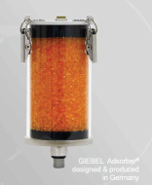
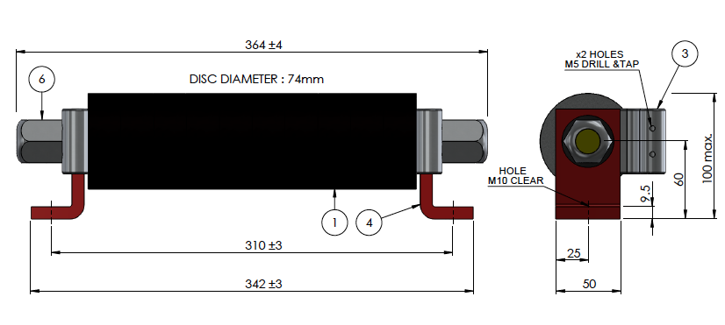
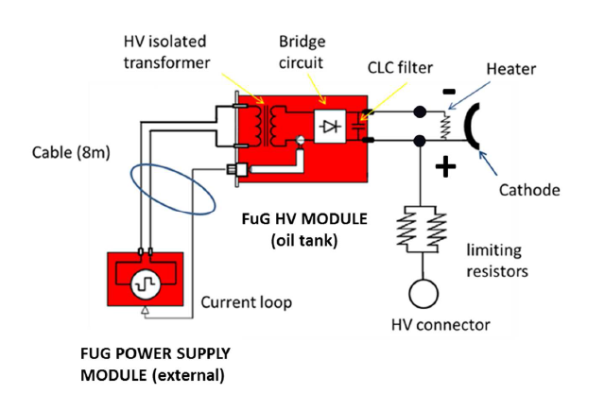
Oil tank
The gun oil tank shall be made of steel or aluminium.
Oil tank sealed with breather and fitting for desiccator (provided by ESS: Giebel Varo-Vent 130-PA with valve; fitting G 3/8” )
The oil tank shall be able to accommodate the filament power supply provided by ESS, plus two additional current limiting resistors in parallel
Filament power supply (based on a rectified high frequency transformer (20 kHz) in the oil tank; provided by ESS
Energy limiting series resistors (provided by ESS):
HVR CD3C10T10R0K695 - 10 Ohm/50 KJ (two in parallel)
Example from Thales prototype
Courtesy of Thales

Slide 21
High Level: Technical specifications for the auxiliary supplies
Please refer to the Detailed specifications for full details
Cathode heater voltage | ≤ 30 V DC; The nominal operating voltage shall be specified by the manufacturer.
Cathode heater current | ≤ 30 A DC
Solenoid supplies | ≤3; 2 preferred. Provided by ESS: 300 V, 15 A.
Solenoid supply connector | Amphenol Socapex, type SL/EM25D (TBD)
Ion pump supplies | 2 units, 8 l/s : an alternative can be proposed
Ion pump voltage | ≤ 5kV
Ion pump connector | FISCHER, type D105A036-7 ; provided by ESS

Slide 22
Klystron Technical specifications: mechanical
Klystron height | ≤ 4.5 m from the floor to the highest point
Klystron output waveguide height | ≤ 3940 mm. It includes the optional mismatch section. Lower lengths can be accommodated from RFDS.
Klystron height adjustment | > 100 mm (+/- 50 mm)
Nominal distance between the base of the frame and the floor | 250 mm (+/- 50 mm)
Klystron footprint | 1100 mm x 1500 mm.
Waveguide output | WR1150; Orientation defined
Output circuit | Coaxial to waveguide output transition or a direct waveguide output to standard WR1150). Output transition demountable and accessible for inspection.
Location of electrical interfaces defined.

Slide 23
Air and water Cooling
Air cooling of window as required – WP8 provides blowers
Water cooling
medium temperature circuit: inlet temperature of 25 °C; body, gun tank, electromagnet and window (where required). The total available medium temperature flow per klystron will be 44 l/min.
hot temperature circuit: inlet temperature >= 50 °C and outlet temperature regulated at 60 °C for collector. The available flow per klystron will be 250 l/min.
Operating inlet pressure: 7 barg max; Max pressure drop 3 bars.
Flanges and fittings agreed with WP16
Cooling requirements discussed extensively and documented in ESS-0021791

Slide 24

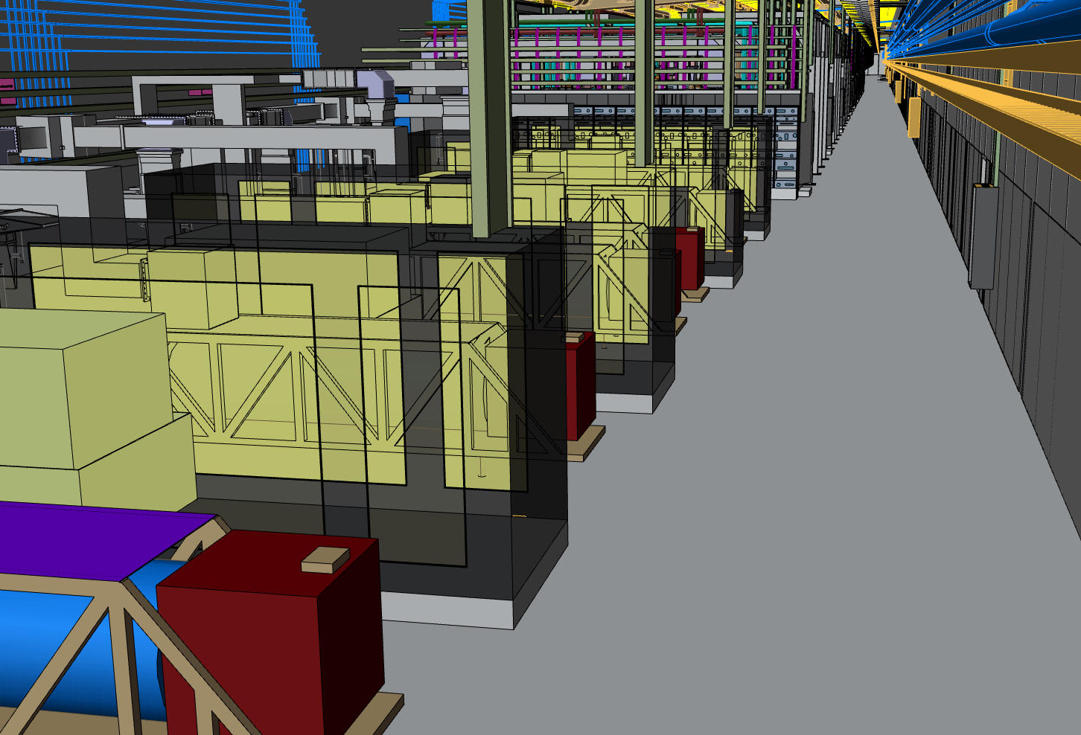
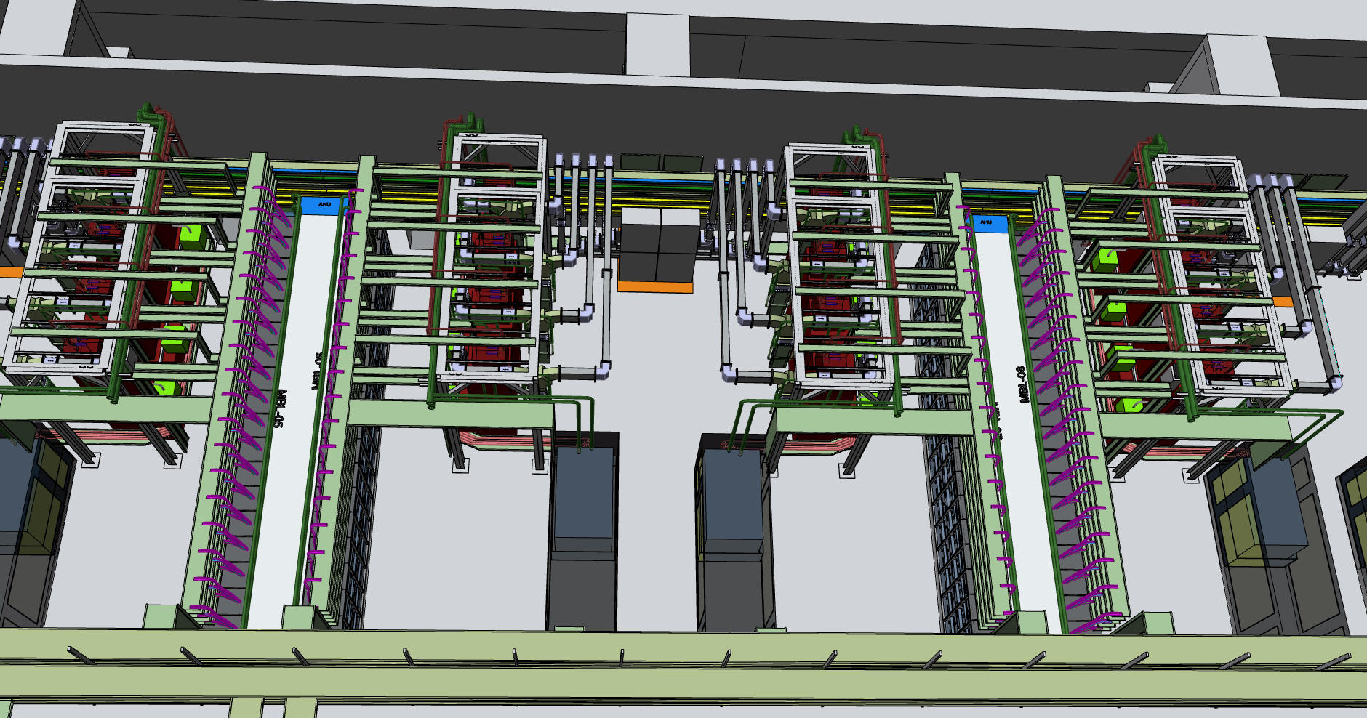
Installation and Handling
‘Klystron moving truck’
Klystron and equipment Delivery Access:
Two 5x5 m doors in cold box building with overhead crane
5x5 m door between cold box building and RF Gallery
3x5 m door between Klystron assembly area and RF gallery
3 m stay-clear along Gallery for transport
Additional ‘spare 3x5 m door halfway along the RF Gallery
Klystron removal without the need to rotate in-situ
Space for ‘heavy’ equipment (forklift, pallet truck, scissor lifts etc)
Order placed for dedicated truck for safe maneuvering, aligning and height adjustment.
Delivery expected in June 2017

Slide 25
Safety and Hazards
High voltage
Protected to an IP3X class (according to EN 60529) to prevent direct and indirect contact (EN 60204-1:2006 clause 6.1).
All high voltage points, cables and access points shall be labelled with standard type labels. Where appropriate, HV access points shall be protected with interlocks to detect removal of covers, cables etc.
Non-Ionising radiation
ESS will adopt the Swedish guidelines.
The microwave power leakage from any RF system shall not exceed 35 mW/cm² (3.5 W/m²) average power measured at any accessible point .
Ionising Radiation (X-Radiation)
The effective dose rate from ionising radiation (in this case x-rays) shall not exceed 1.0 μSv/h at point of contact anywhere on the klystron.
Removable shielding to be under configuration control:
Magnetic Field
The magnetic field measured @ 1 m from the klystron axis ≤ 0.5 mT.
Preliminary Risk Assessment carried out prior to tender.
Specific Risk Assessment for the oil tank: ESS-0029924

Slide 26
Testing
Klystrons to be Factory Tested prior to delivery
  Site acceptance testing not contracted
Discussions underway relating to possible auxiliary supplies soak testing prior to placed in the field eg:
  Solenoid supplies
  Filament supplies
  Ion Pump controllers
  Drive amplifiers

Slide 27
High Beta
Baseline is to use MB-IOTs
Klystrons to the MB specification suitable as a backup

Slide 28
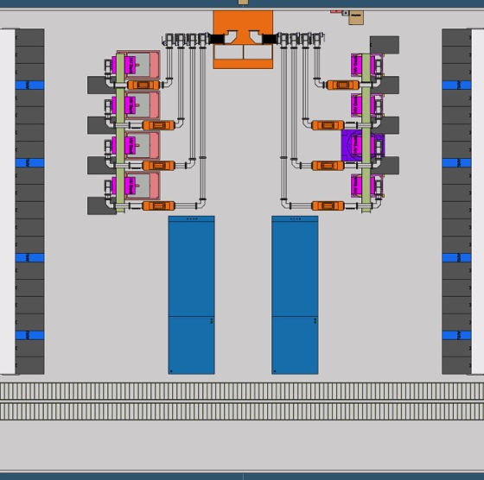
MBIOT - Possible Gallery Layout (for HB)
Layout compatible with Klystron layout
(Important for utilities and building constraints)
Gallery design compatible with both MB-IOT designs
4 Tubes per HV supply
One driver rack per MB-IOT
HV-Deck for Filament and Grid supplies placed above the tube (Details will depend on final filament/grid requirements)

Slide 29
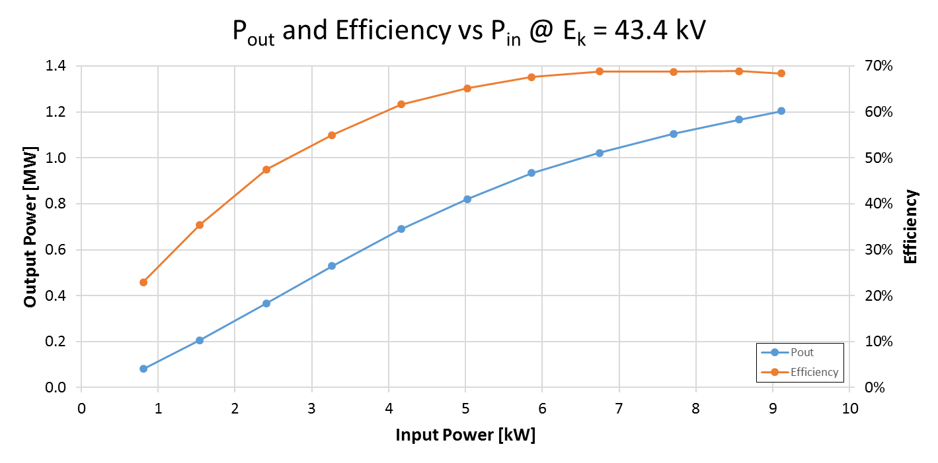
L3 MBIOT
Efficiency ≥ 60% from 600 kW to 1.2 MW
(HV efficiency only)
Rated output power of 1.2 MW
was achieved at 43.4 kV – the highest level available from the L-3 HV power supply
Efficiency is maintained above 60% from ~ 650 kW to 1.2 MW
Maximum efficiency 68.8%

Slide 30
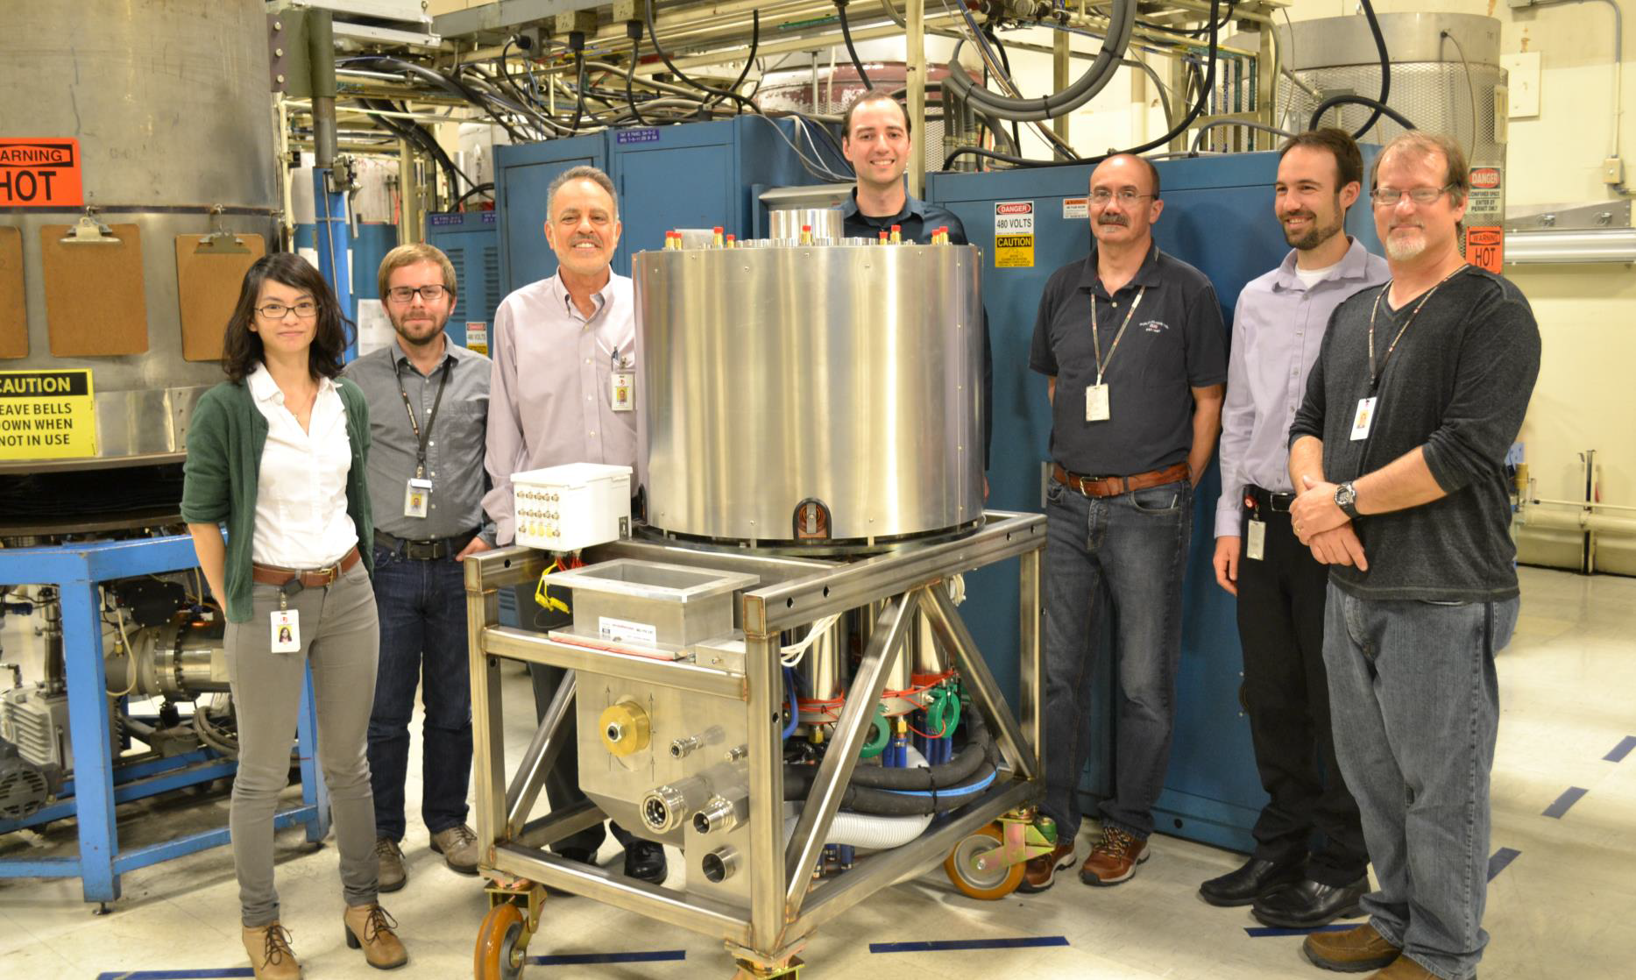
L3 MBIOT

Slide 31
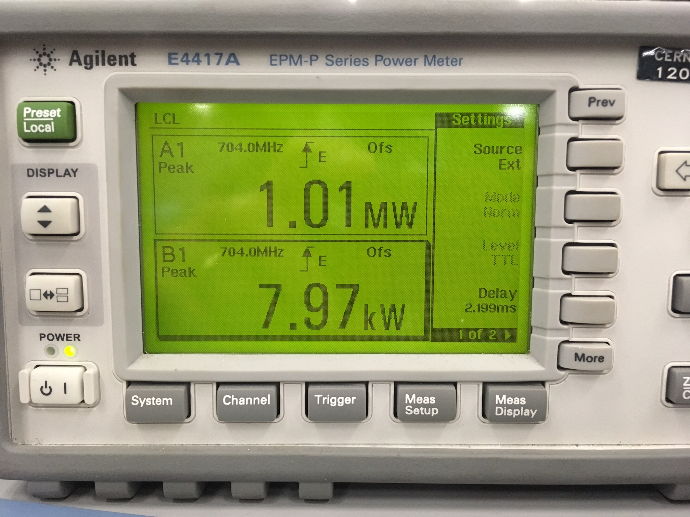
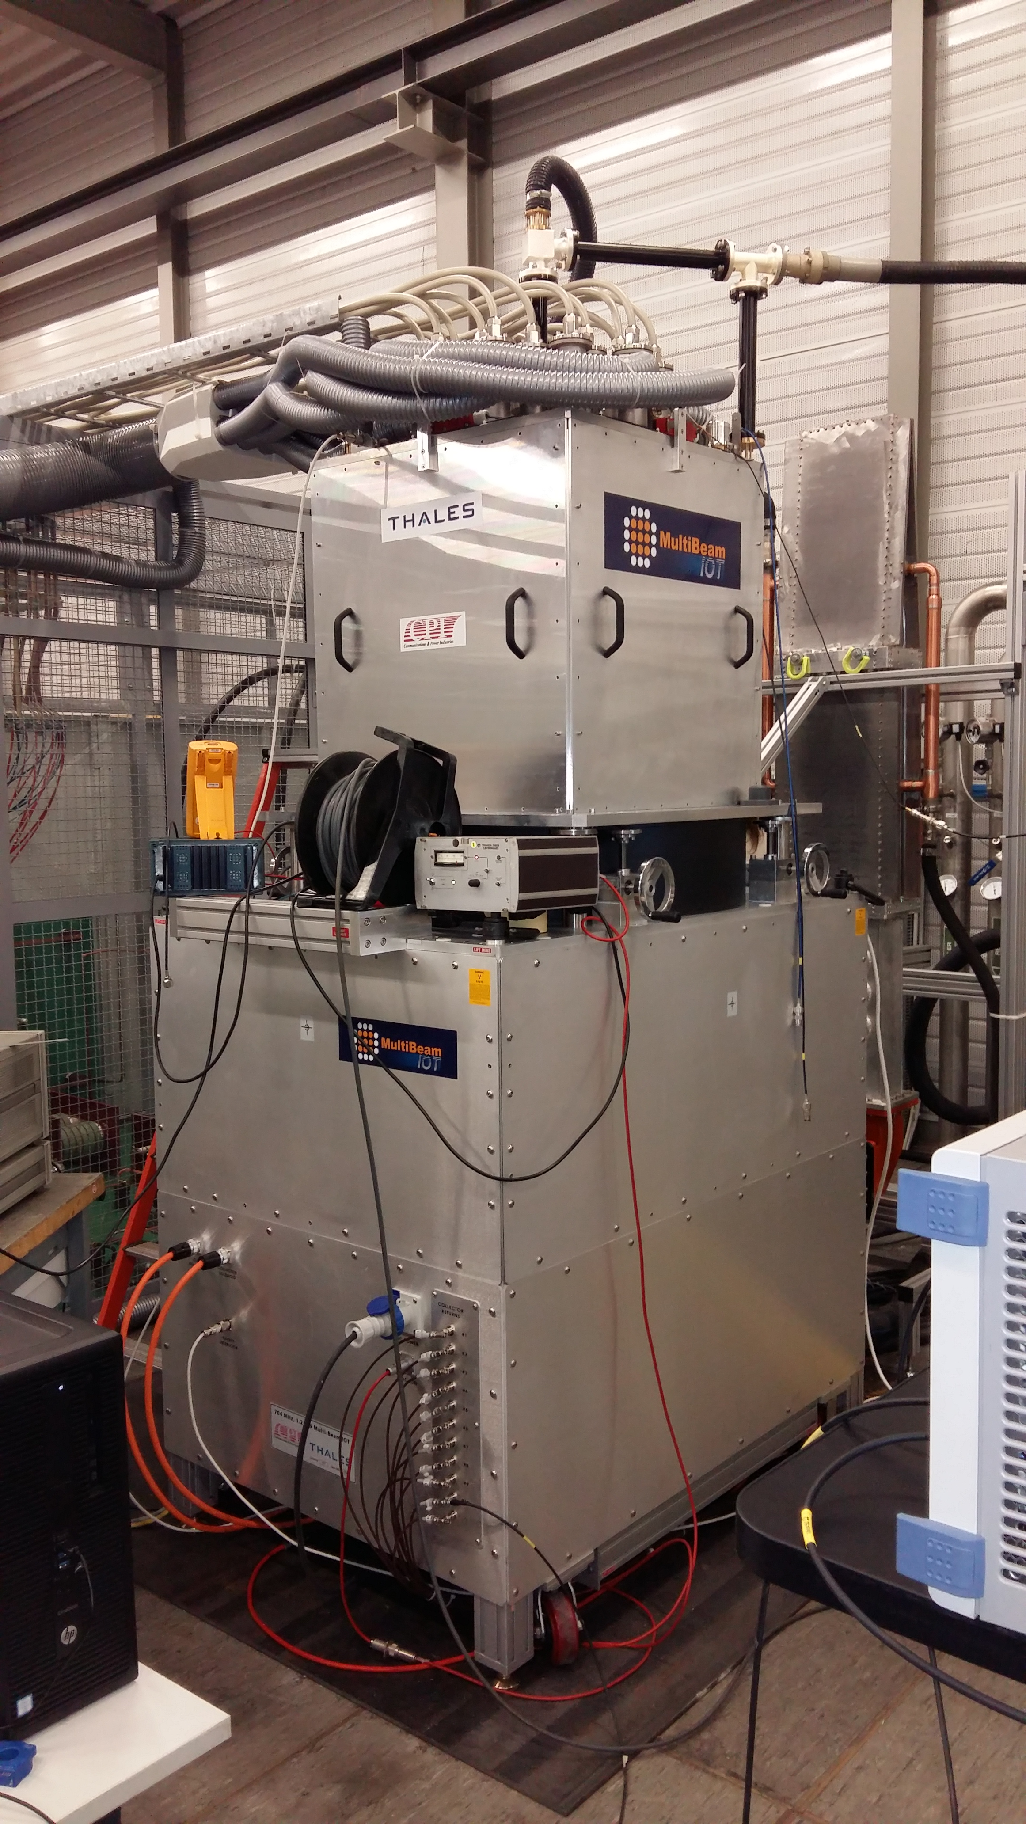
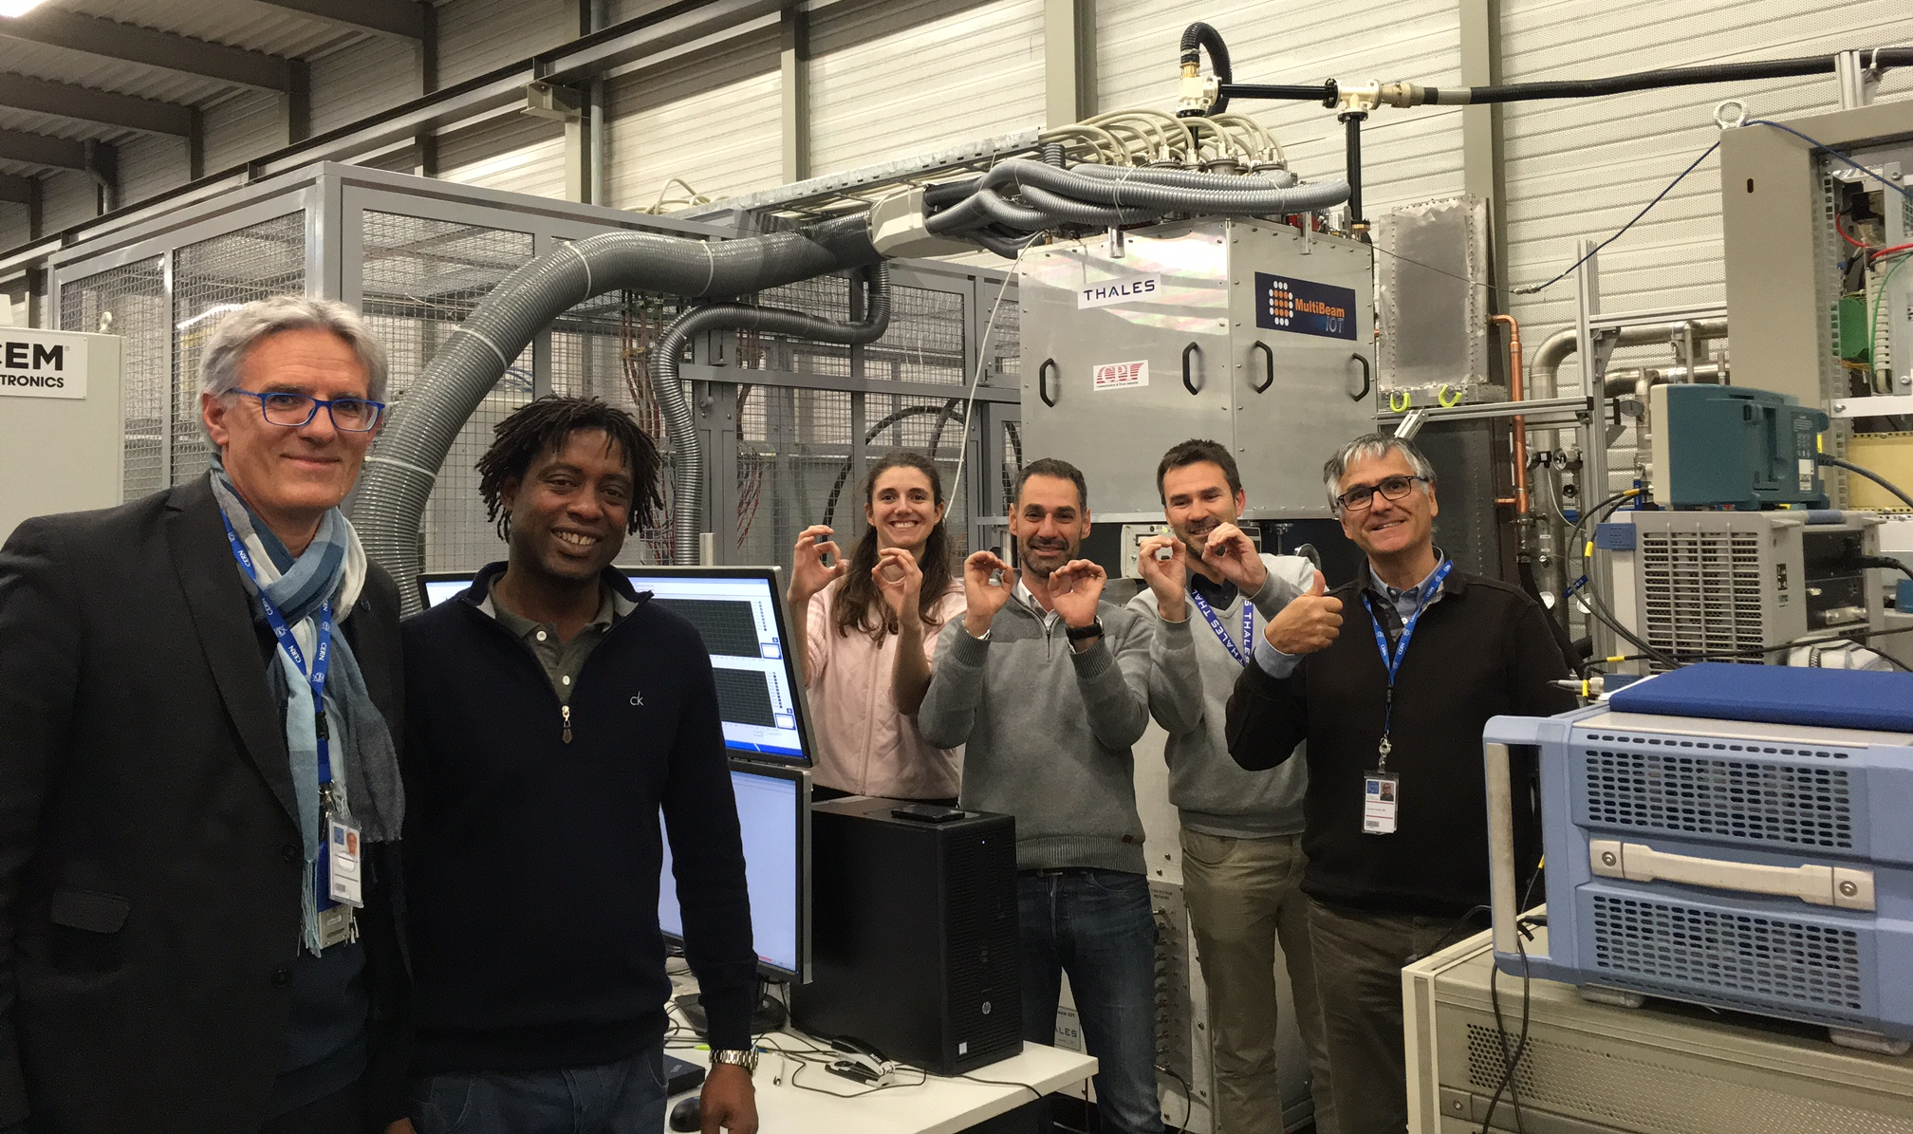
Thales/CPI MBIOT
MBIOT on test at CERN

Slide 32
The End

