Slide 1
RF Local Protection System
RF Cell review
Rafael Montaño
www.europeanspallationsource.se
17-05-11

Slide 2
Concepts
Project scope and system overview
SIM signal processing and Machine State
FIM signal processing and Machine State
EPICS integration
Test stand integration and SIM commissioning
Notes:
There is a brief summarize about the total system to be installed at ESS

Slide 3
LPS project scope
The project scope includes the interlock system to the RF stations.
704.42 MHz - cavities
36 – Medium β
84 – High β
352.21 MHz – cavities
1 – RFQ
5 – DTL
The following cavities types will be provided by Elettra and ESS Bilbao according to the prototype design architecture.
26 – Spokes *
3 – MEBT
Notes:
Remember to mention the Spokes and MEBT interlock plans.

Slide 4
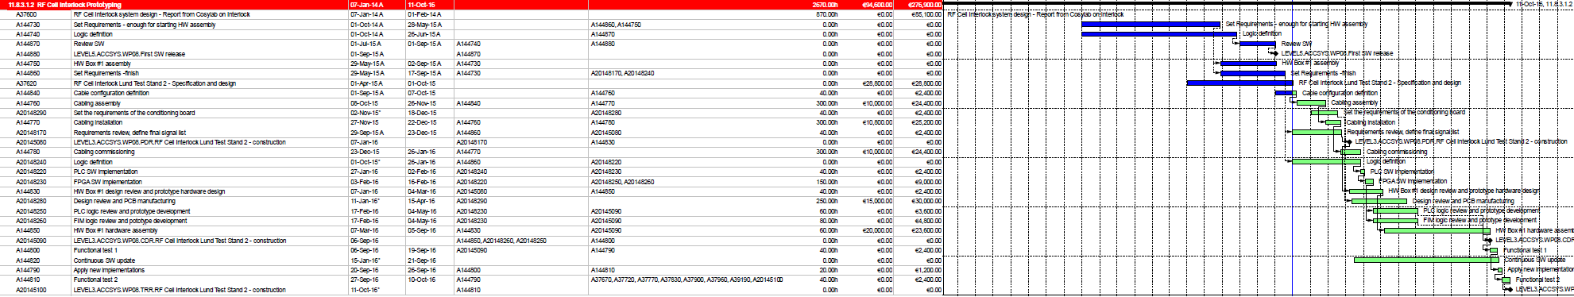
Planning
Primavera plan
The in-kind partner would provide support on the development and series unit assembling.
Atomki MTA | ESS Bilbao | Elettra
36 – Medium β 84 – High β | 1 – RFQ 5 – DTL 3 - MEBT | 26 - Spokes
Notes:
There is a brief summarize about the total system to be installed at ESS

Slide 5
RF overall system diagram
SIM
FIM

Slide 6
RF system diagram

Slide 7
Concepts
Project scope and system overview
SIM signal processing and Machine State
FIM signal processing and Machine State
EPICS integration
Test stand integration and SIM commissioning
Notes:
There is a brief summarize about the total system to be installed at ESS

Slide 8
RF-LPS SIM - Internal diagnostic and process data
The PLC program measures the field values as an integer and scale it to engineering units (EGU). The value then will be compared to the threshold levels defined by the user through EPICS. This feature allows the user to define the window of operation of the sensor described in green in the following figure.
The reestablish mode of the interlocks would be defined by the CPU “latched” bit, which means the PLC will keep the interlock until reset is applied.
The PLC also include a diagnostic system to detect the time-stamp when an interlock is detected.
ALARM / INTERLOCK
WARNING
WARNING
ALARM / INTERLOCK

Slide 9
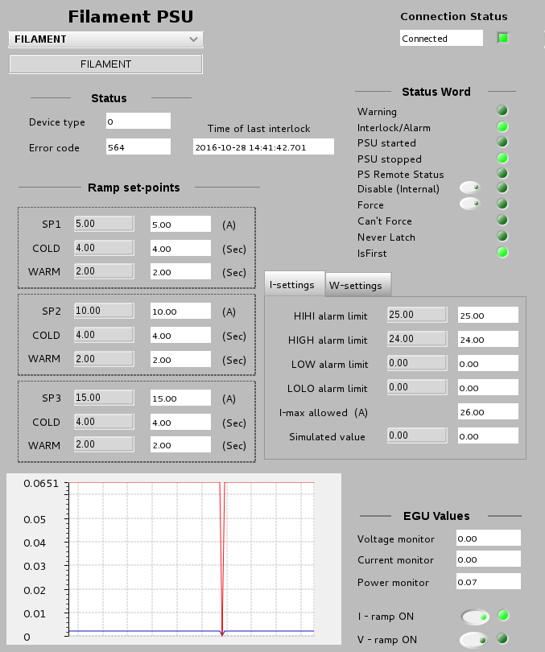
SIM FILAMENT PSU
Filament PSU control
and protection function
+/- I, read back monitor: The function monitors whether the I-setting will the same that the PLC is reading from the I-monitor.

Slide 10
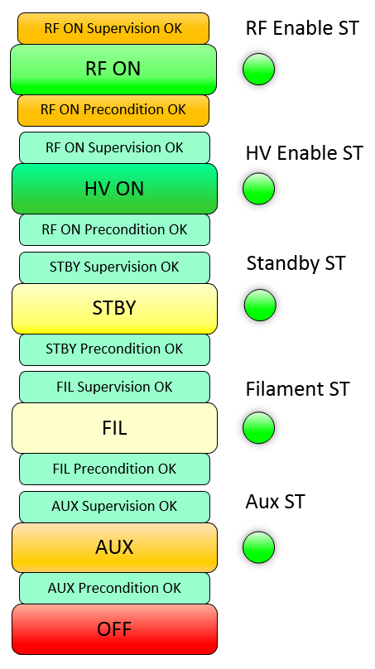
LPS Machine State
Five pre-conditions and three interlocks distributed on the following way:
(PC1) OFF AUX (PLC)
(PC2) AUX FIL (PLC)
(PC3) FIL STBY(PLC)
(PC4) STBY HVON (PLC)
(PC5) HVON RFON (PLC)
The connections between the PLC and FPGA must be through hardwire, the fieldbus would be used only for diagnostics purposes.
ITLCK_HV (FIM) HV Modulator (HV Enable)
ITLCK_RF (FIM) Pin Diode (RF Enable)
ITLCK_MPS_ST (FIM) Report status (No RF output on the amplifier)
The PLC also will handle the operation modes, and it shall be grouped to the Machine State:
NORMAL_OP Normal Operation
RF_COND_MODE Conditioning Mode
TEST_MODE Test Mode
WIRE_TEST Wire Test
Notes:
There are some conditions about the Klystron protective interlocks.

Slide 11
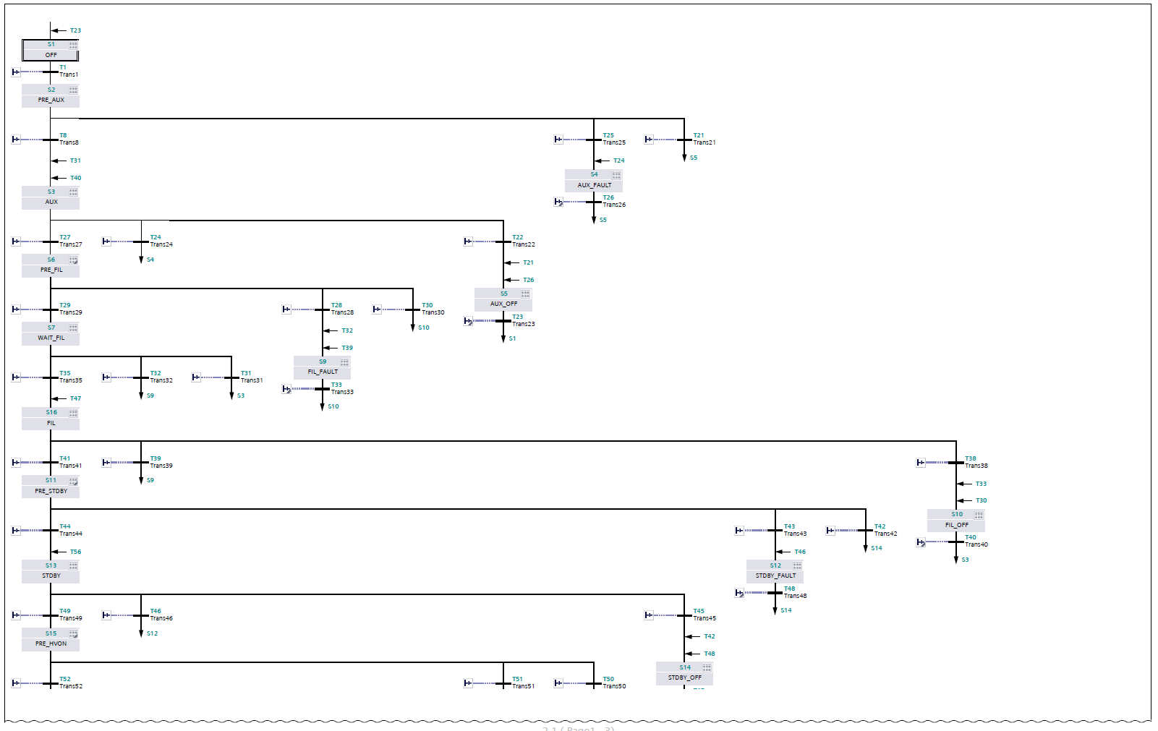

RF-LPS SIM – Machine State and SIM Interlock logic
S7-GRAPH (IEC 61131-3, DIN EN 61131).

Slide 12
PLC Machine State
Switch OFF
PRE : Preconditions
SUP : Supervisions
CMD : Command
StateFault()

Slide 13
PLC Machine State
OFF (Initial status): Shutdown and revoke all permissions of the RF transmitter.
  HV Enable (OFF) - RF Enable (OFF) - PSUs (OFF) - MPS (OFF) - LLRF (OFF)
AUX (Ion-pump ON): Requires the Ion-pump is ON to meet this status, the PLC does not have any control on the ion-pump switch on/off commands.
Filament (Filament power on and current ramp): Requires oil tank cooling and temperature interlocks are ok to allow the user power on and ramp the Filament PS.
Stand-by (Solenoid power on and current set-point): This status requires the window, solenoid and collector cooling/temperature interlocks are ok to allow the user power on the solenoid PS.
HV Enable (inhibit Modulator through the FPGA): Requires Ion pump lower pressure interlock. Here is also include two variable calculation by the PLC: Collector and Body dissipation. Those threshold levels can be defined by the user.
RF Enable: (pin-diode through the FPGA and inform to MPS): Requires Ion-pump high pressure, DA ready, circulator and load cooling and temperature interlocks
Note: for all statuses the PLC/FPGA will continue monitoring the interlocks according to the threshold defined by the user or digital interlocks where is required. It would be defined into the supervision conditions.
For more details see: \Collaboration Area\RF Systems\RF Local Protection System\MachineState and Interlock logic
→ ToshibaStateMachine_SIM.xlsx

Slide 14
System simulation and logic validation
The system has been deployed in the technical lab, simulated and tested the interface connections. This test bench allows to simulate almost all statutes of the Machine State and the power supplies control such as ramp, max limits, etc.
Through the expert mode EPICS also allow to test the system behavior by creating a script about the predefined configuration and system setup, which means the system can be tested to check whether all parameters are properly setup.
EPICS
SIM
(Slow Interlock Module)
Simulation Box
PLC enclosure
Notes:
There is a brief summarize about the total system to be installed at ESS

Slide 15
PLC hardware layout

Slide 16
Concepts
Project scope and system overview
SIM signal processing and Machine State
FIM signal processing and Machine State
EPICS integration
Test stand integration and SIM commissioning
Notes:
There is a brief summarize about the total system to be installed at ESS

Slide 17
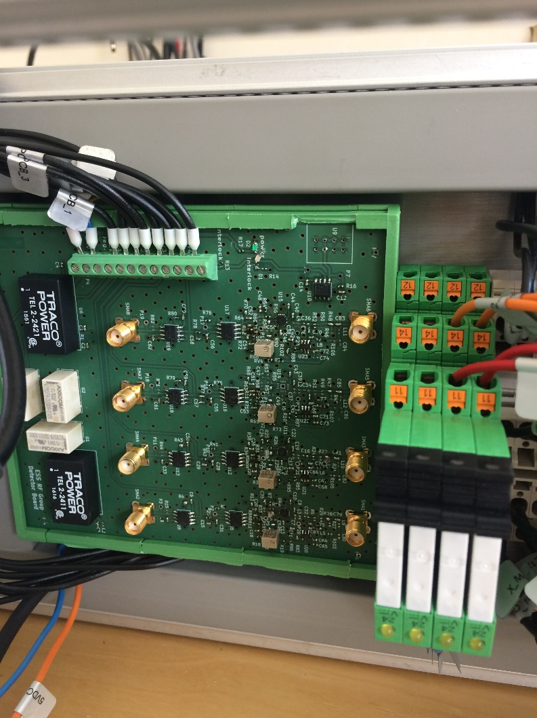
FIM – RF-DC converter based on LTC5530

Slide 18
Piecewise calibration – measured data
Input [mV] | Output [dBm] | Output [W] | Slope | Diff with next | Est from prev | Est err |  | Input [V] | Output [W] | Slope
-0.428 | -40 | 38.01893963 | 41103.75191 | 0.002 |  |  |  | -0.42800000000000 | 38.0189396320561000 | 41103.75191484260000
-0.426 | -35 | 120.2264435 | 259962.9529 | 0.001 |  |  |  | -0.42600000000000 | 120.2264434617410000 | 259962.95285882000000
-0.425 | -30 | 380.1893963 | 378388.1787 | 0.001 |  |  |  | -0.42500000000000 | 380.1893963205620000 | 378388.17870862200000
-0.424 | -27 | 758.577575 | 443686.8596 | 0.001 |  |  |  | -0.42400000000000 | 758.5775750291840000 | 443686.85958823100000
-0.423 | -25 | 1202.264435 | 351598.1417 | 0.002 |  |  |  | -0.42300000000000 | 1202.2644346174200000 | 351598.14167291600000
-0.421 | -23 | 1905.460718 | 371497.0008 | 0.003 |  |  |  | -0.42100000000000 | 1905.4607179632500000 | 371497.00081292300000
-0.418 | -21 | 3019.95172 | 260647.4143 | 0.003 |  |  |  | -0.41800000000000 | 3019.9517204020200000 | 260647.41426786600000
-0.415 | -20 | 3801.893963 | 328135.6533 | 0.003 |  |  |  | -0.41500000000000 | 3801.8939632056200000 | 328135.65334025600000
-0.412 | -19 | 4786.300923 | 619647.4688 | 0.002 |  |  |  | -0.41200000000000 | 4786.3009232263800000 | 619647.46875859400000
-0.41 | -18 | 6025.595861 | 312035.9779 | 0.005 |  |  |  | -0.41000000000000 | 6025.5958607435700000 | 312035.97790965900000
-0.405 | -17 | 7585.77575 | 491037.5275 | 0.004 |  |  |  | -0.40500000000000 | 7585.7757502918500000 | 491037.52748062900000
-0.401 | -16 | 9549.92586 | 412119.7477 | 0.006 |  |  |  | -0.40100000000000 | 9549.9258602143700000 | 412119.74765996700000
-0.395 | -15 | 12022.64435 | 622593.6276 | 0.005 |  |  |  | -0.39500000000000 | 12022.6443461742000000 | 622593.62763759000000
-0.39 | -14 | 15135.61248 | 489874.3369 | 0.008 |  |  |  | -0.39000000000000 | 15135.6124843621000000 | 489874.33690879700000
-0.382 | -13 | 19054.60718 | 704817.4301 | 0.007 |  |  |  | -0.38200000000000 | 19054.6071796325000000 | 704817.43008034500000
-0.375 | -12 | 23988.32919 | 690132.0015 | 0.009 |  |  |  | -0.37500000000000 | 23988.3291901949000000 | 690132.00153613600000
-0.366 | -11 | 30199.5172 | 710856.5844 | 0.011 |  |  |  | -0.36600000000000 | 30199.5172040202000000 | 710856.58436691400000
-0.355 | -10 | 38018.93963 | 820339.1334 | 0.012 |  |  |  | -0.35500000000000 | 38018.9396320562000000 | 820339.13335064400000
-0.343 | -9 | 47863.00923 | 885210.6697 | 0.014 |  |  |  | -0.34300000000000 | 47863.0092322639000000 | 885210.66965513500000
-0.329 | -8 | 60255.95861 | 1040119.926 | 0.015 |  |  |  | -0.32900000000000 | 60255.9586074358000000 | 1040119.92636552000000
-0.314 | -7 | 75857.7575 | 1155382.418 | 0.017 |  |  |  | -0.31400000000000 | 75857.7575029186000000 | 1155382.41760148000000
-0.297 | -6 | 95499.2586 | 1177484.993 | 0.021 |  |  |  | -0.29700000000000 | 95499.2586021438000000 | 1177484.99331418000000
-0.276 | -5 | 120226.4435 | 1353464.408 | 0.023 |  |  |  | -0.27600000000000 | 120226.4434617410000000 | 1353464.40790780000000
-0.253 | -4 | 151356.1248 | 1507305.652 | 0.026 |  |  |  | -0.25300000000000 | 151356.1248436210000000 | 1507305.65202707000000
-0.227 | -3 | 190546.0718 | 2055717.504 | 0.024 |  |  |  | -0.22700000000000 | 190546.0717963250000000 | 2055717.50440100000000
-0.203 | -2 | 239883.2919 | 1826820.004 | 0.034 |  |  |  | -0.20300000000000 | 239883.2919019490000000 | 1826820.00406630000000
-0.169 | -1 | 301995.172 | 2172061.786 | 0.036 |  |  |  | -0.16900000000000 | 301995.1720402030000000 | 2172061.78556554000000
-0.133 | 0 | 380189.3963 | 2343826.095 | 0.042 |  |  |  | -0.13300000000000 | 380189.3963205620000000 | 2343826.09528755000000
-0.091 | 1 | 478630.0923 | 2636797.739 | 0.047 |  |  |  | -0.09100000000000 | 478630.0923226390000000 | 2636797.73939828000000
-0.044 | 2 | 602559.5861 | 2943735.641 | 0.053 |  |  |  | -0.04400000000000 | 602559.5860743590000000 | 2943735.64065709000000
0.009 | 3 | 758577.575 | 3273583.517 | 0.060 |  |  |  | 0.00900000000000 | 758577.5750291840000000 | 3273583.51653758000000
0.069 | 4 | 954992.586 | 3746543.161 | 0.066 |  |  |  | 0.06900000000000 | 954992.5860214390000000 | 3746543.16054510000000
0.135 | 5 | 1202264.435 | 4206713.7 | 0.074 |  |  |  | 0.13500000000000 | 1202264.4346174200000000 | 4206713.70025398000000
0.209 | 6 | 1513561.248 | 4610581.994 | 0.085 |  |  |  | 0.20900000000000 | 1513561.2484362100000000 | 4610581.99443574000000
0.294 | 7 | 1905460.718 | 5305077.431 | 0.093 |  |  |  | 0.29400000000000 | 1905460.7179632500000000 | 5305077.43071227000000
0.387 | 8 | 2398832.919 | 18821781.86 | 0.033 |  |  |  | 0.38700000000000 | 2398832.9190194900000000 | 18821781.86007680000000
0.42 | 9 | 3019951.72 | #REF! | #REF! |  |  |  | 0.42000000000000 | 3019951.7204020200000000 | #REF!

Slide 19
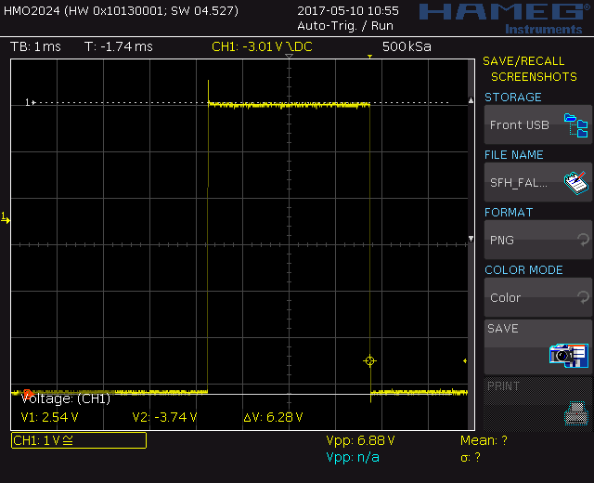
RF Power - Pulse Monitoring

Slide 20
RF Detector calibration

Slide 21
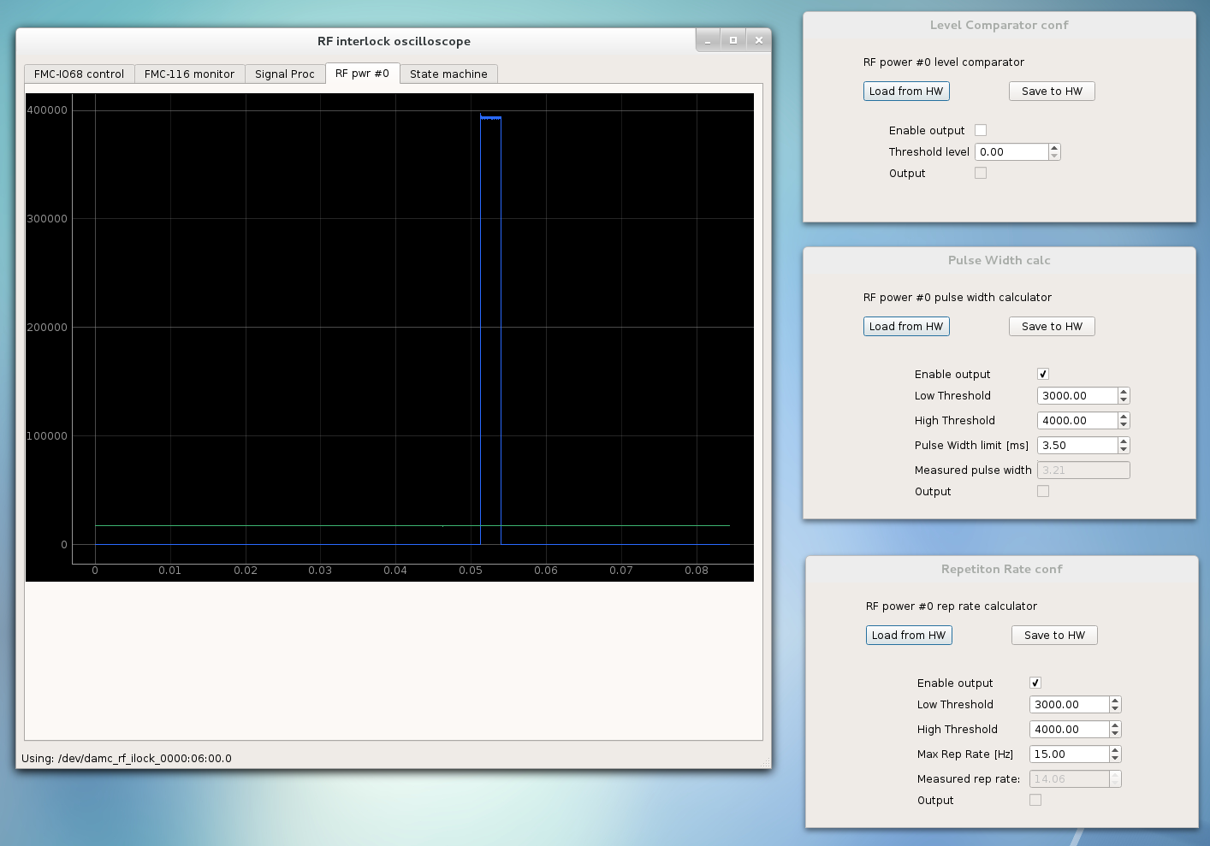
RF Power - Pulse Monitoring (CAENels setup)

Slide 22
FPGA Machine State

Slide 23
FPGA Machine State
HVON = 0
RFON = 0
HVON = 1
RFON = 0
HVON = 1
RFON = 0
HVON = 1
RFON = 1
HVON = 1
RFON = 1
Wait for nominal values
HvSupCond
Wait for nominal values
RfSupCond AND
HvSupCond
HvCmd AND
HvPreCond
RfCmd AND
RfPreCond
Idle
HVON Pre-arm
HVON
RFON
Pre-arm
RFON
Not HvCmd OR
HvSupCond
Not RfCmd OR
RfSupCond
HV fault
RF fault
IF NOT INTERLOCK1 AND
NOT INTERLOCK2 AND
NOT INTERLOCK3 THEN
  HvPreCond = 1
ELSE
  HvPreCond = 0
END_IF;
HVON = 0
RFON = 0
HVON = 1
RFON = 0

Slide 24
FPGA Machine State
HV Enable (inhibit Modulator): Requires ion-pump digital set-point interlock, Modulator current/voltage high level interlock, Modulator ready signal, HV enable PLC command interlocks ok.
RF Enable: (pin-diode): Requires arc-detectors, Klystron output, circulator power detectors are not out of limits (signal latched whether the value has reached the threshold levels). RF enable PLC command interlock ok.
After the FPGA achieves the HV/RF enable status, there is required a signals processing to calculate the Modulator pulse width and repetition rate from the Modulator voltage waveform regarding HV enable. RF power average and RF pulse width interlocks for RF enable.
Note: for all statuses the PLC/FPGA will continue monitoring the interlocks according to the threshold defined by the user or digital interlocks where is required. It would be defined into the supervision conditions.
For more details see: \Collaboration Area\RF Systems\RF Local Protection System\MachineState and Interlock logic
→ ToshibaStateMachine_FIM.xlsx

Slide 25
RF and HV Enable
RF Enable: The RF Drive must be removed within less to 10 us under any of conditions listed below:
Input | Description
Arc detector | The RF drive must be removed if any arc is detected
Power detector | Max power forward/reflecting exceeds the maximum limits defined by the user
Klystron RF input - pulse width (RF power detector) | RF pulse width exceeds the maximum width parameter defined by the user
Klystron RF output - power average (RF power detector) | Power average measured by the FIM exceeds the limits defined by the user according to the HV amplifier type.
PLC RF enable | PLC RF stop command detected
HV Enable: The HV Modulator permissions must be removed within less to 10 us under any of conditions listed below:
Input | Description
Modulator current/voltage waveform | Current/voltage waveform exceed the maximum limits defined by the user.
HV pulse repetition rate (voltage waveform) | HV voltage repetition rate should be measured from the voltage waveform analogue input. The pulse specification should be defined according to the amplifier type (default value 14Hz)
HV pulse width (voltage waveform) | HV voltage pulse width exceeds the maximum limits defined by the user (default value 3.2 ms)
Solenoid current deviates | Solenoid current deviates more than +/-5% from the value given by the user
Ion-pump | Ion pump interlock
PLC HV enable | PLC HV stop command detected
For more details see: \Collaboration Area\RF Systems\RF Local Protection System
→ RF-LPS FIM prototype.docx

Slide 26
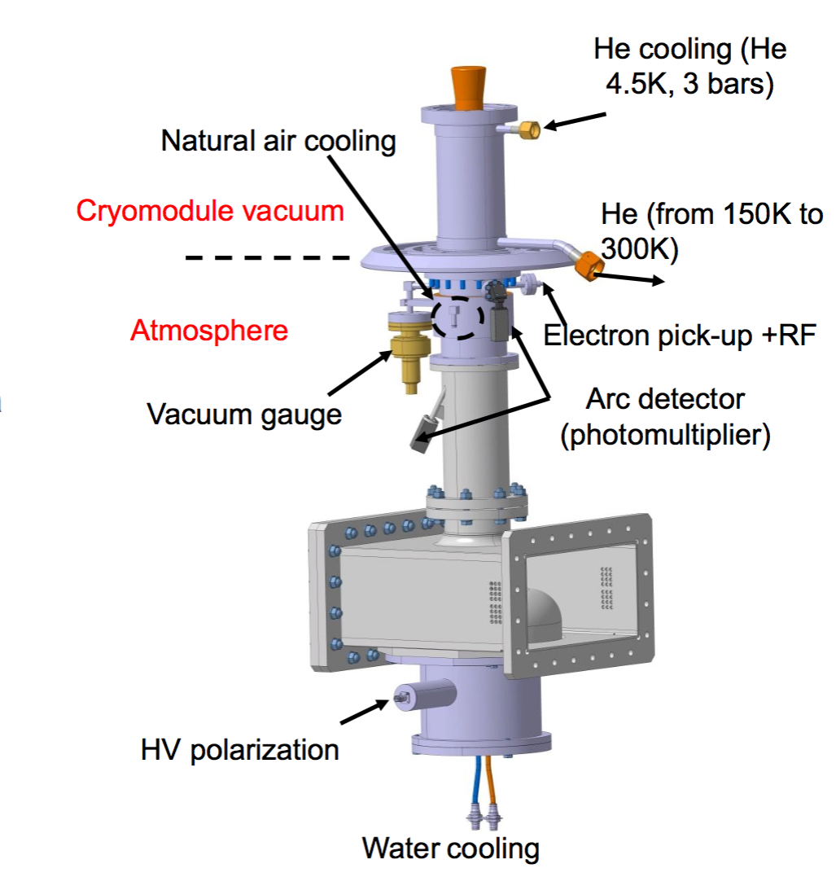
RFLPS FIM – Cavity Interface
The RF drive must be removed within less to 10 us under any of the conditions listed below:
Vacuum arc-detector
Atmosphere arc-detector
Vacuum controller interlock (digital interlock)
Quench detector
e pick-up (antenna)
Cavity ready chain

Slide 27
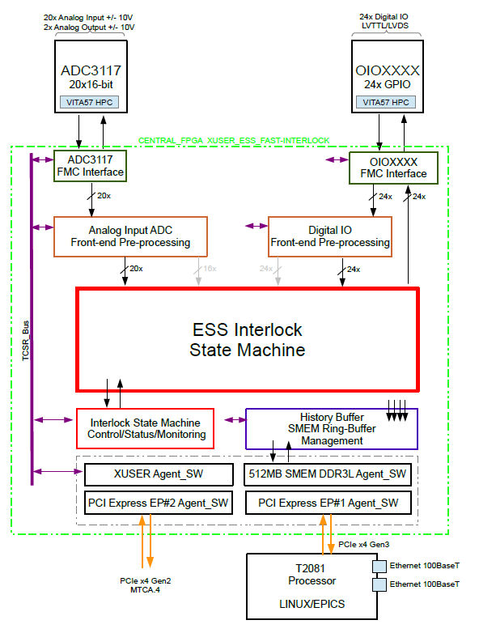
RF-LPS FIM – ICS supported
IFC_1210
VME Based

Slide 28
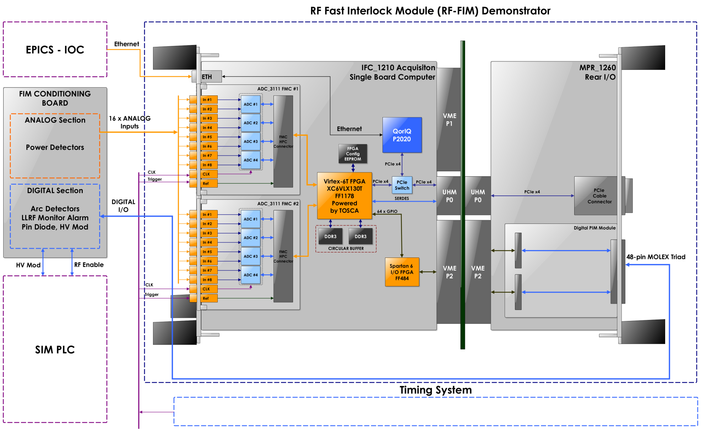
RF-LPS FIM – ICS supported

Slide 29
Concepts
Project scope and system overview
SIM signal processing and Machine State
FIM signal processing and Machine State
EPICS integration
Test stand integration and SIM commissioning
Notes:
There is a brief summarize about the total system to be installed at ESS

Slide 30
Communication overview
“Send and Receive” protocol - PLC
S7plc EPICS driver (PSI) - IOC
Variables on PLC is transparently reflected as PVs

Slide 31
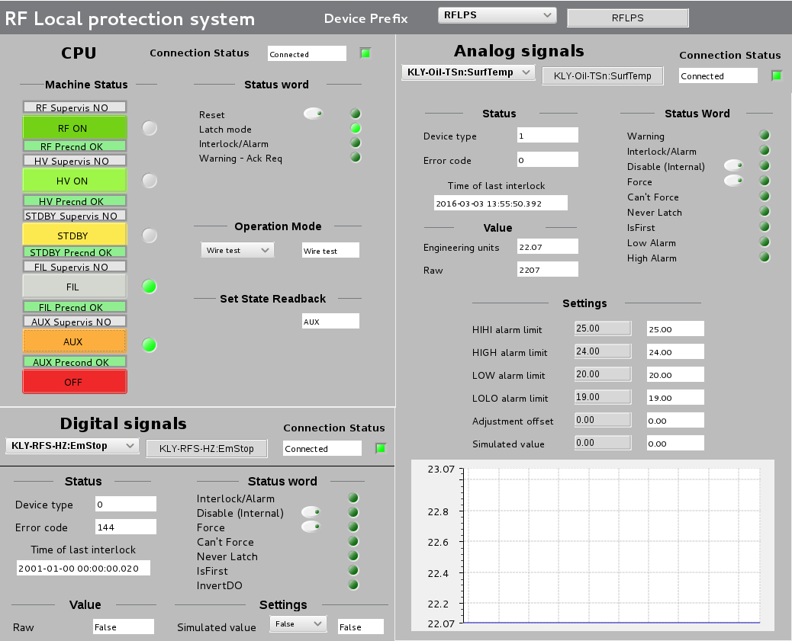
EPICS - Expert User Interface

Slide 32
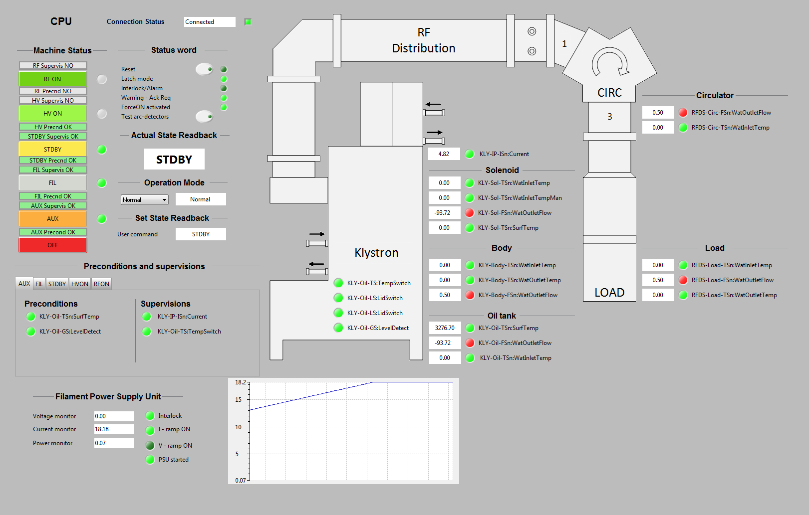
EPICS - non-expert User Interface

Slide 33
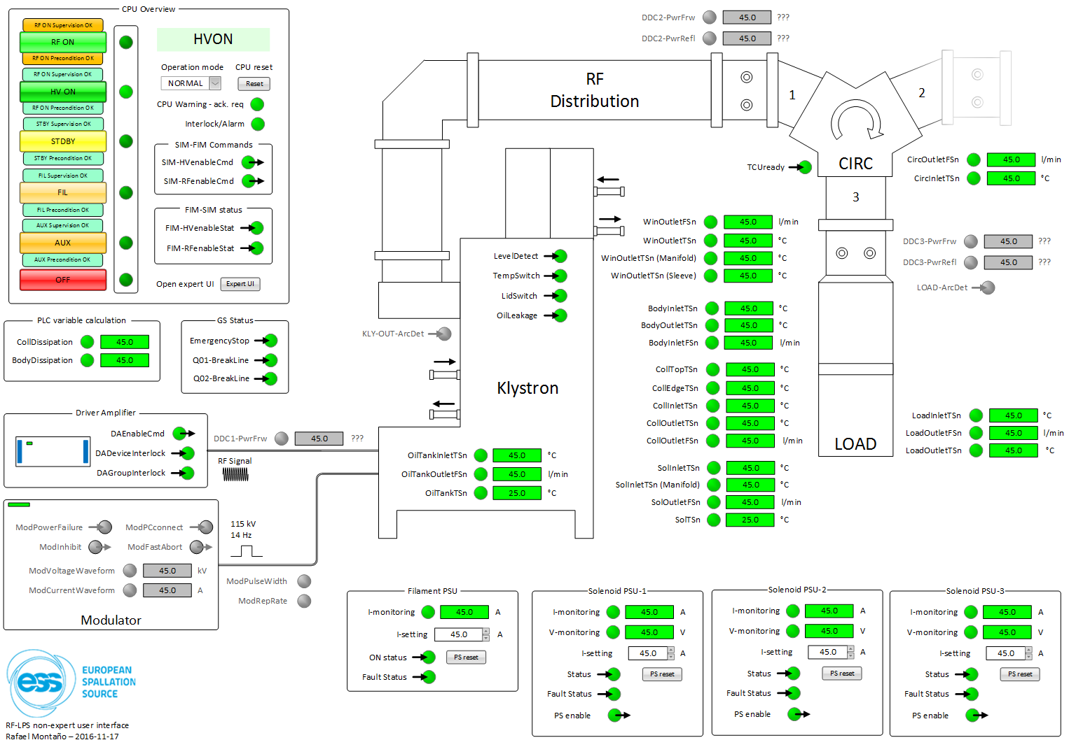
RF System UI

Slide 34
Concepts
Project scope and system overview
SIM signal processing and Machine State
FIM signal processing and Machine State
EPICS integration
Test stand integration and SIM commissioning
Notes:
There is a brief summarize about the total system to be installed at ESS

Slide 35
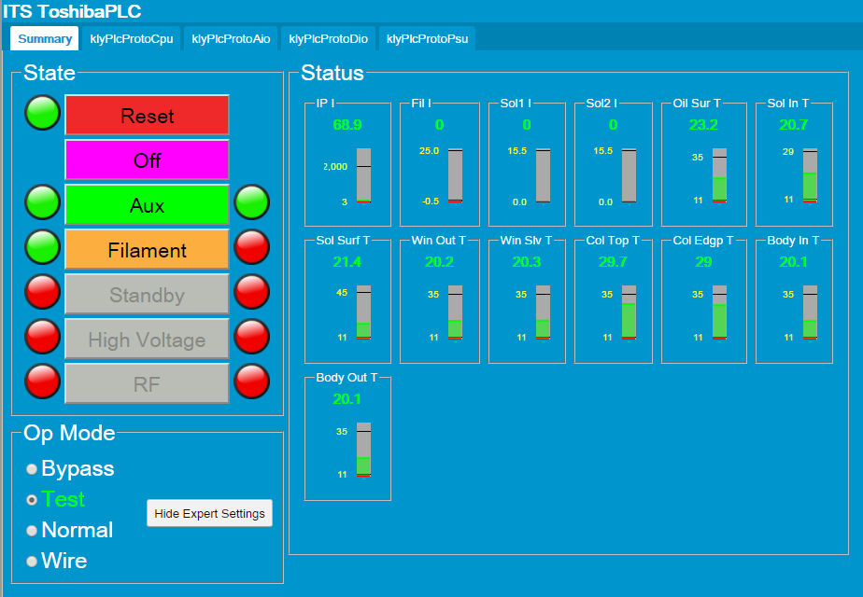
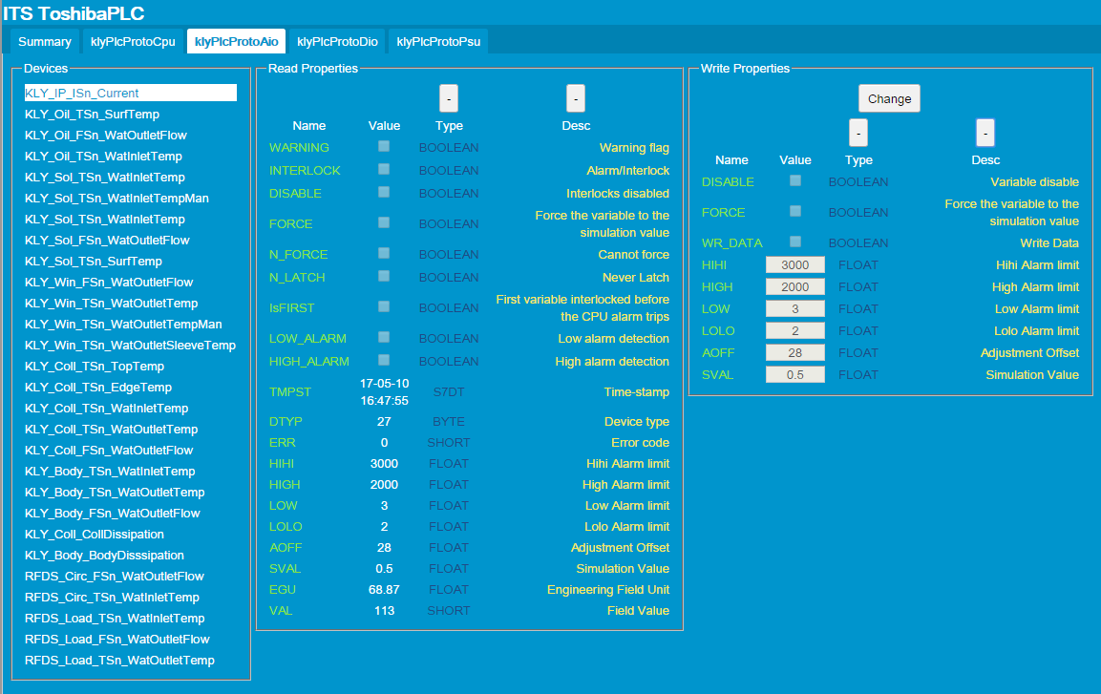
Test stand integration

Slide 36
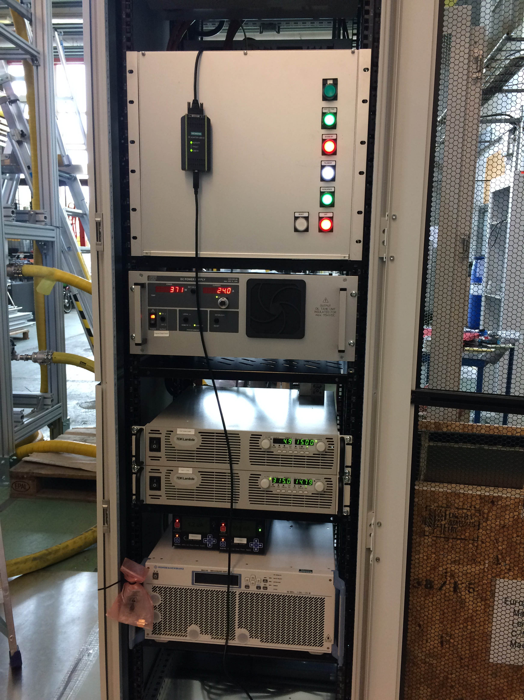
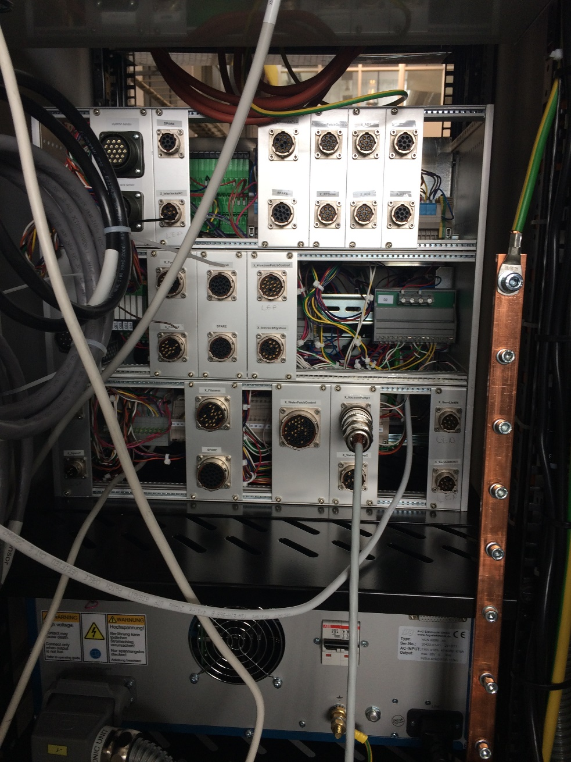
Toshiba Klystron commissioning

Slide 37
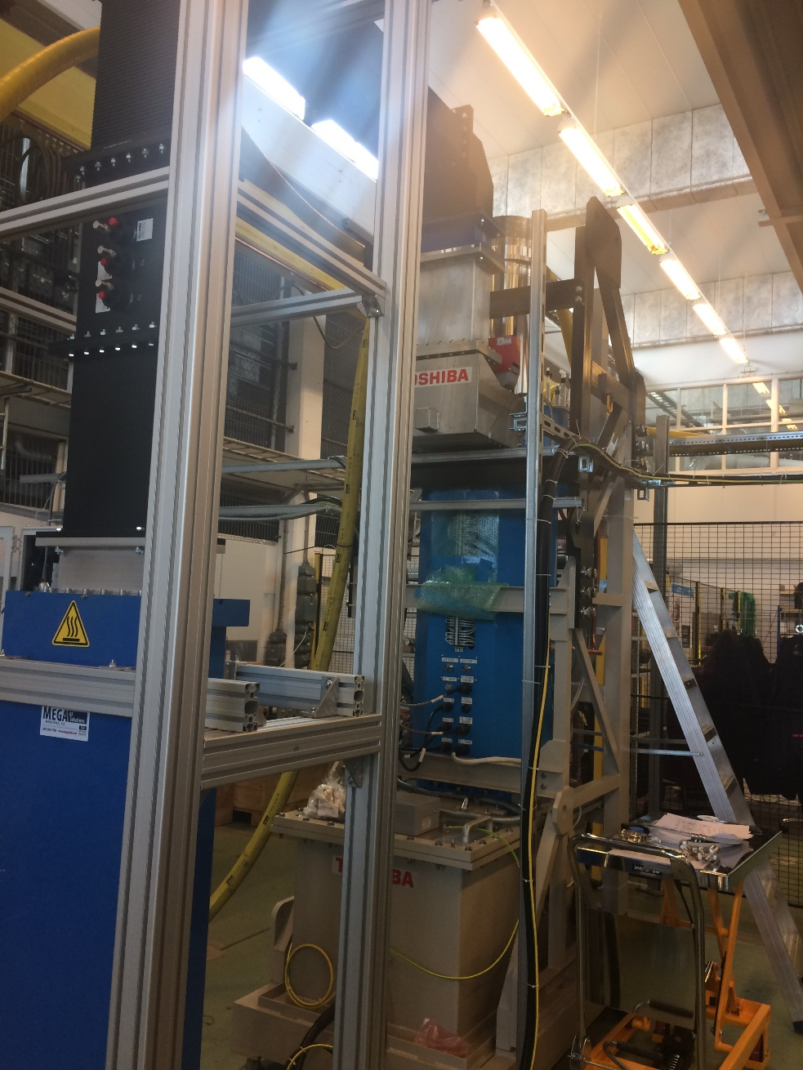
Toshiba Klystron commissioning

Slide 38
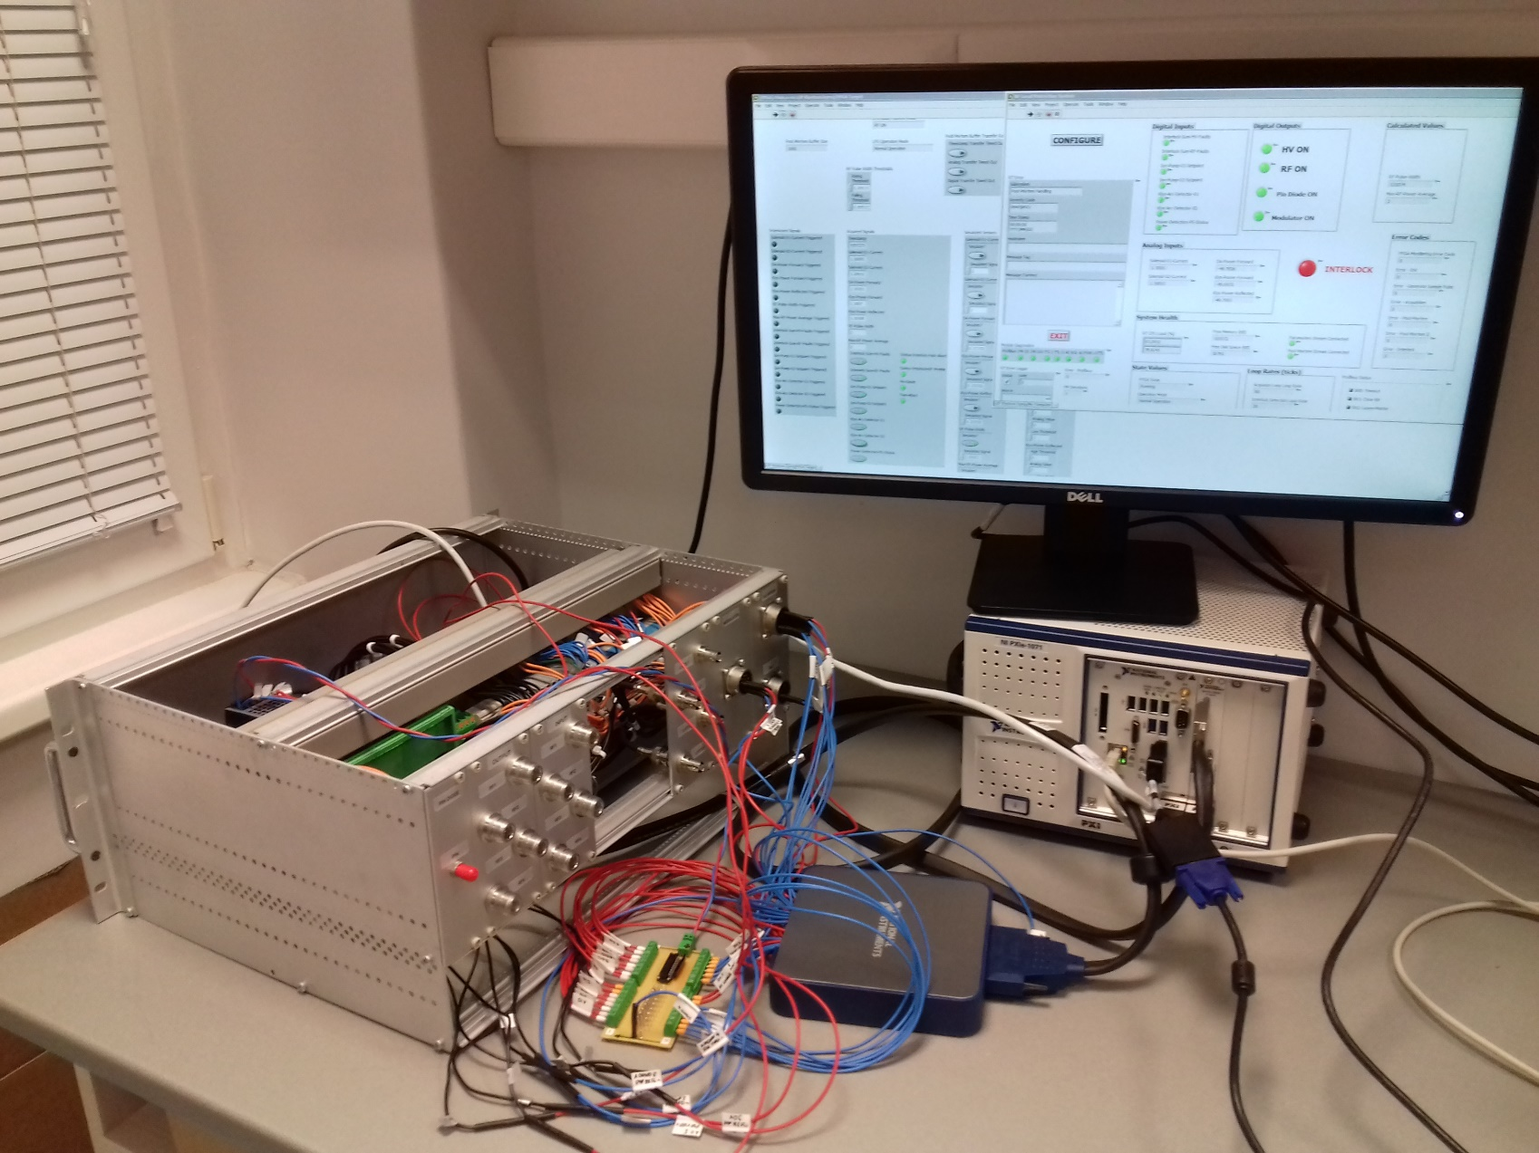
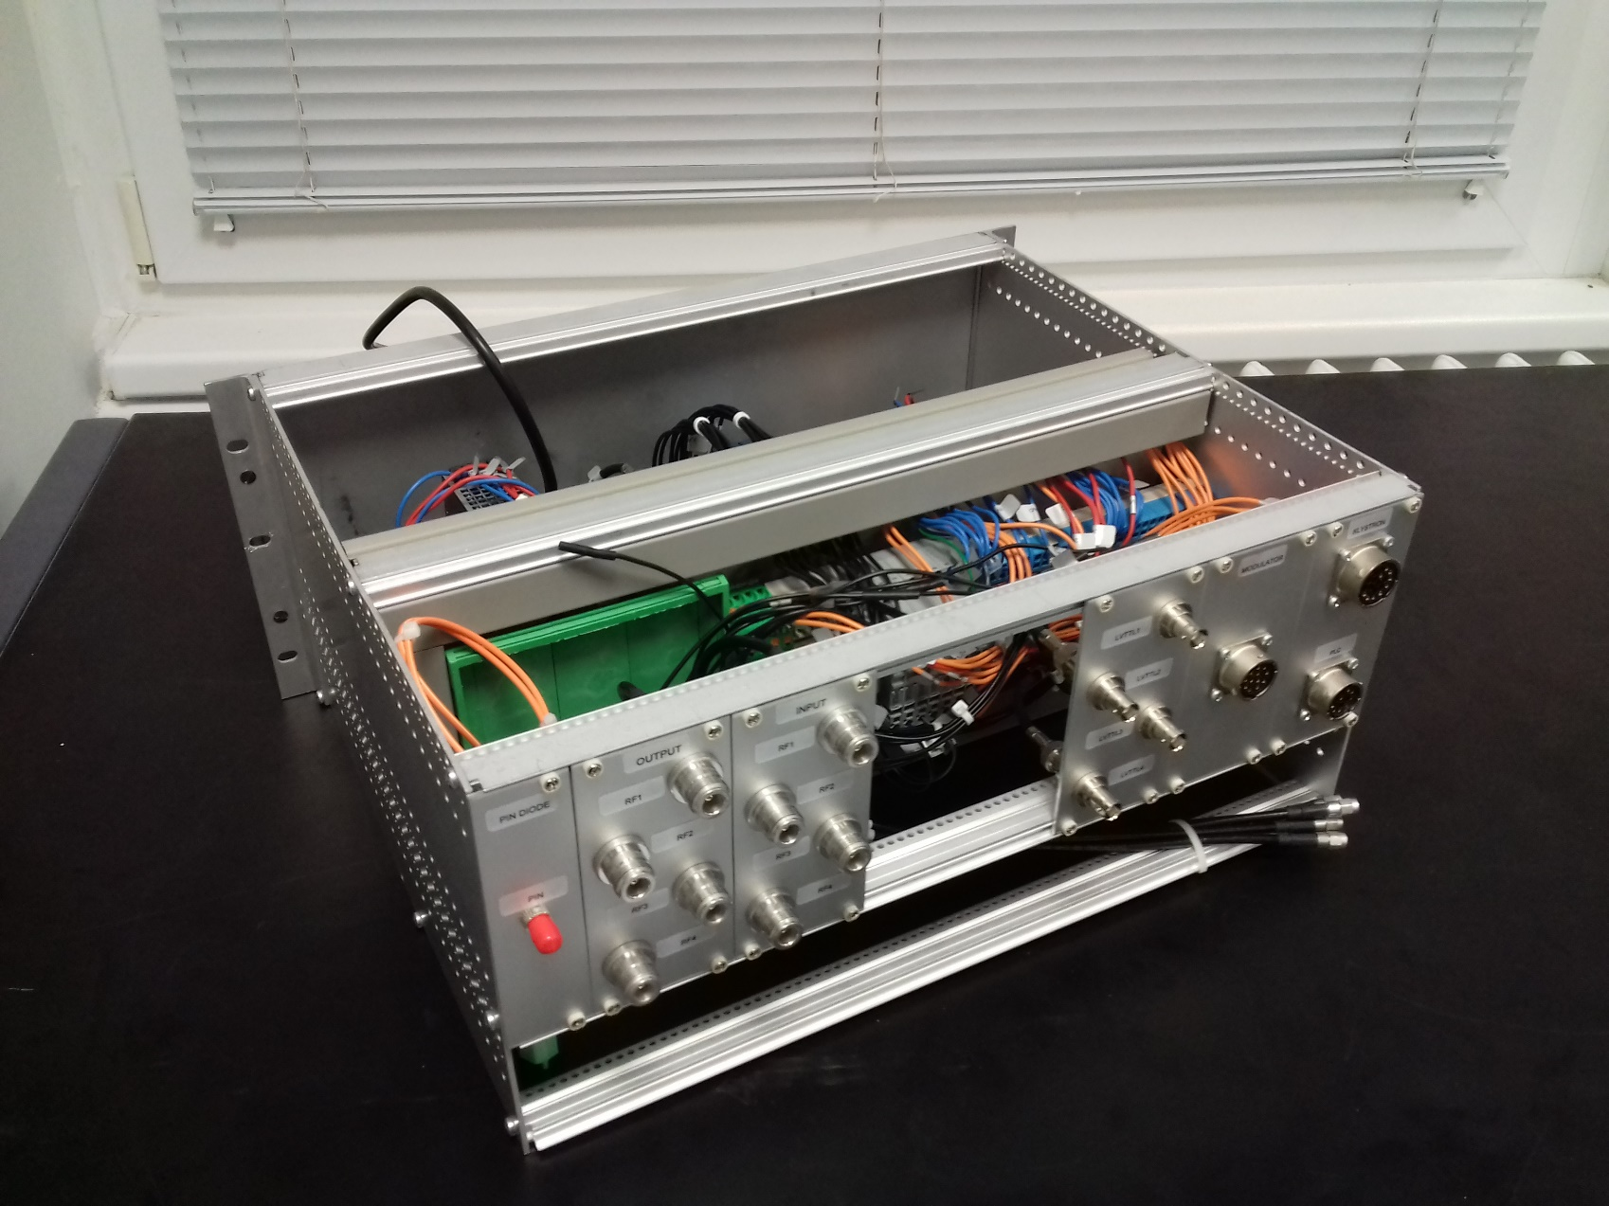
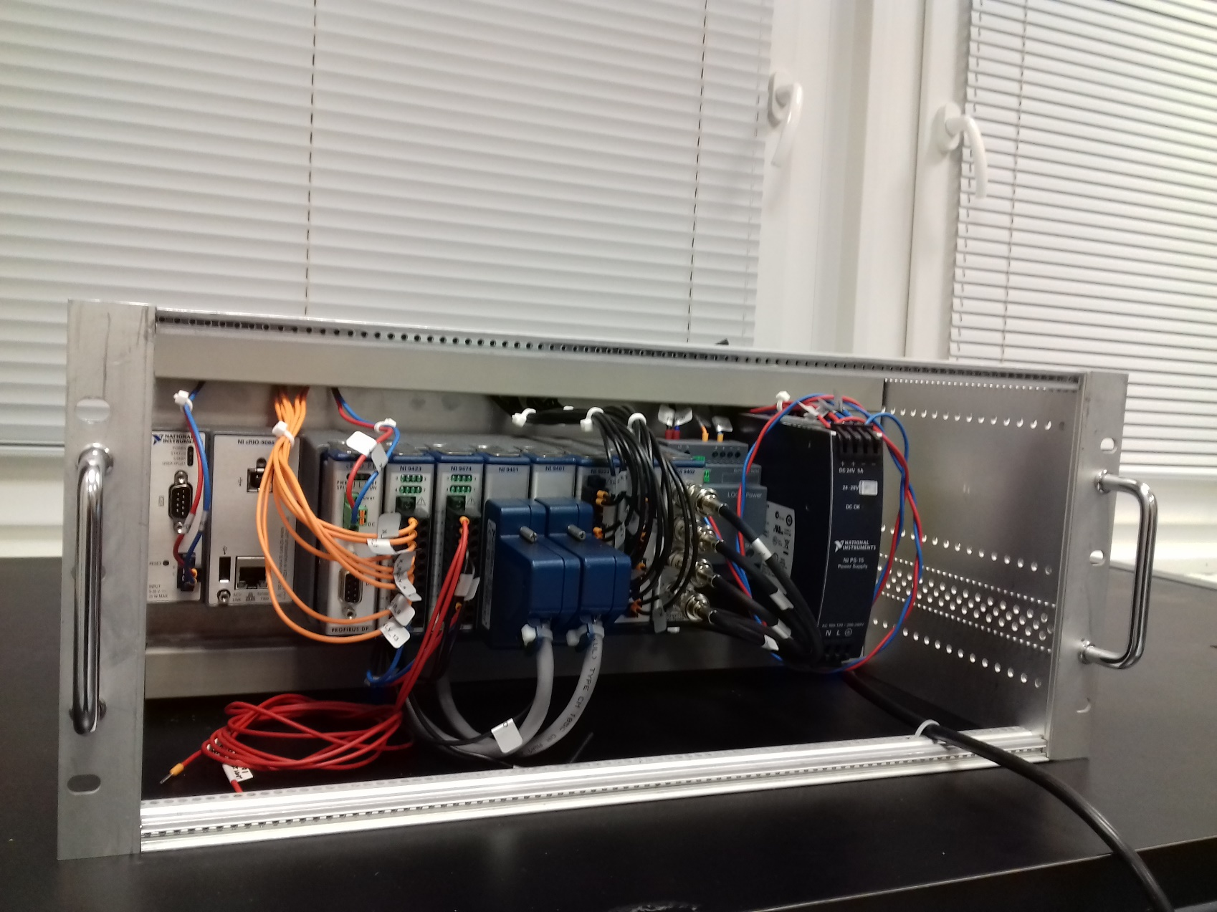
RF-LPS FIM – NI cRIO

Slide 39
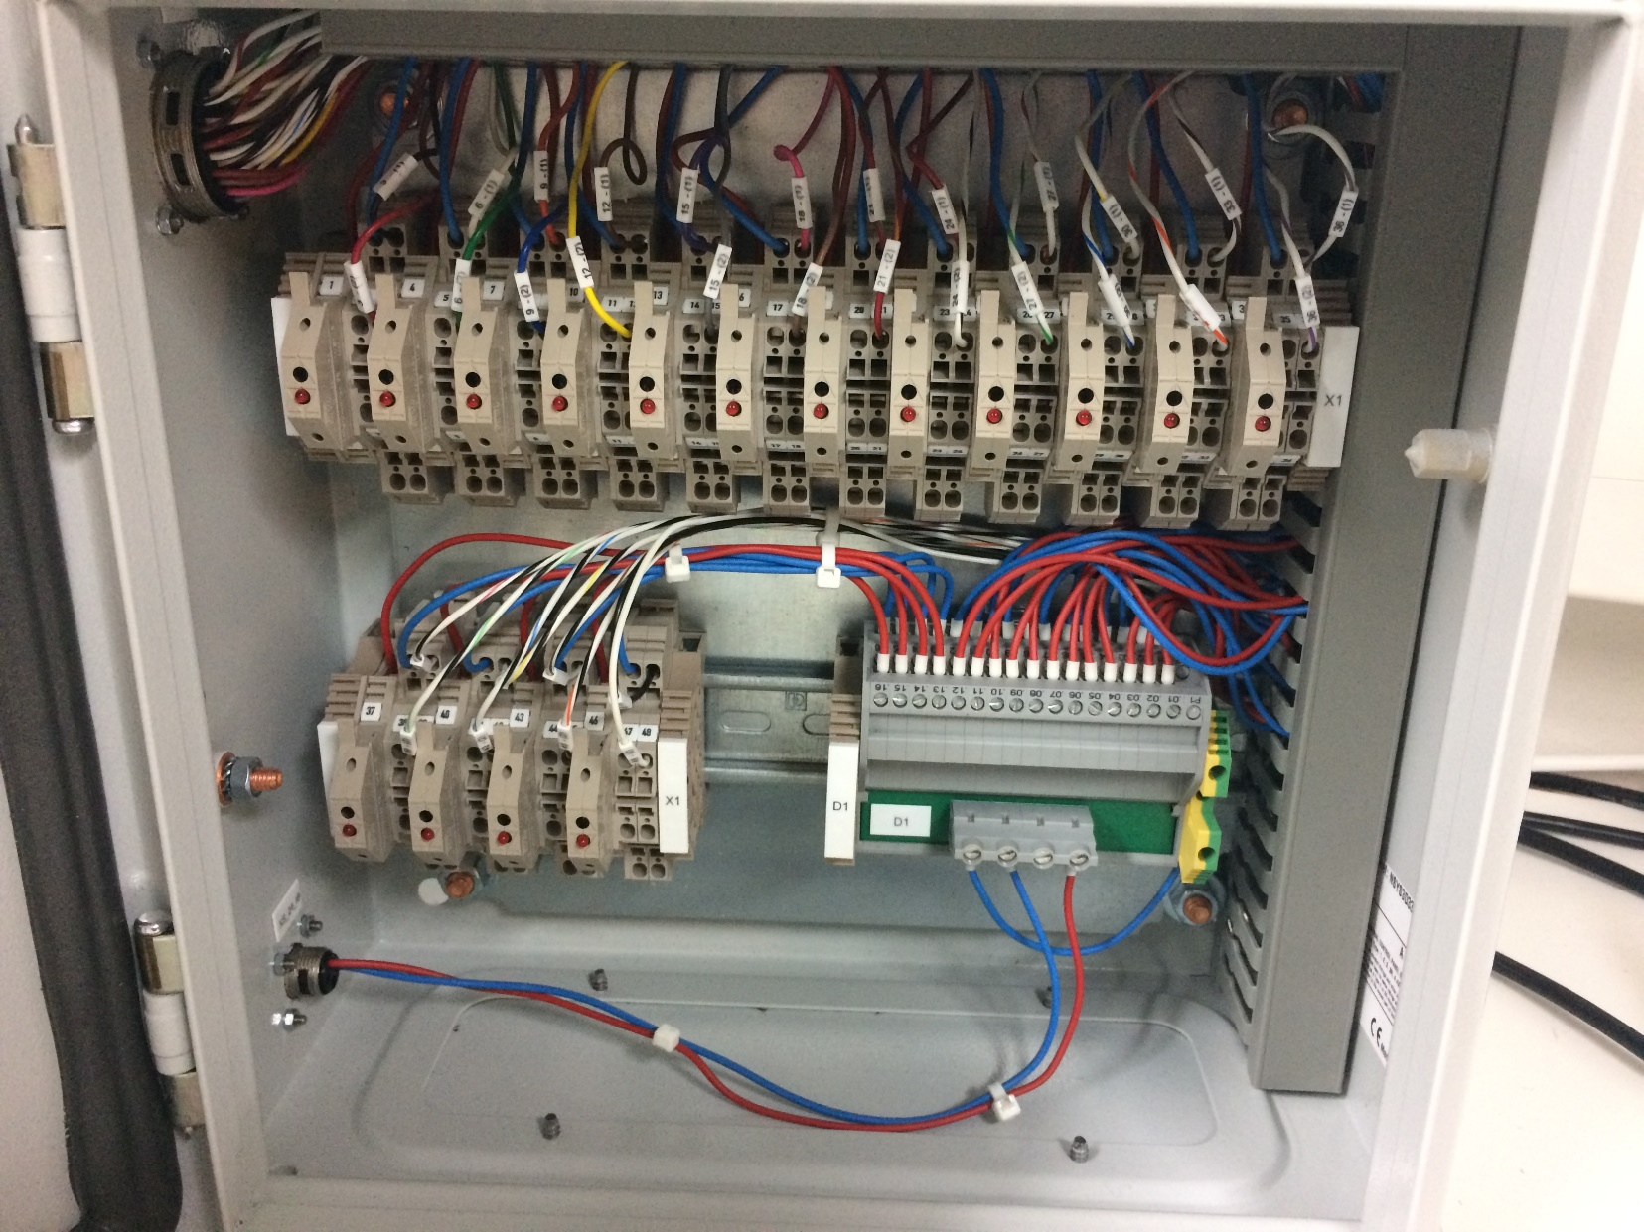
Intermediate box for cooling cabling
For more details see: \Collaboration Area\RF Systems\RF Local Protection System\Electrical documentation → INTERMEDIATE BOX_v2.pdf

Slide 40
PLC Interfaces and I/O protection
The sensors are powered by a secondary power supply (PS), in order to isolate the PLC PS from the sensors and actuators.
Interface | Type of isolation / cable detection
PLC – PSUs | Dry-contacts
PLC – FPGA | Dry-contacts
PLC – Cooling | Secondary power supply
PSUs – PLC | Dry-contacts
Conn. Box – PS-2 | 500 mA fuses
PSUs – PLC | Cable detection
PLC – Sensors | Pull-up/down signals when no sensor connected
PLC – Arc-detector (CERN) | Test arc-detector from a PLC command

Slide 41
Electrical documentation
The follow links show the electrical documentation created on ePLAN, which shows the internal cabling connections of each system.
Slow Interlock Module
Fast Interlock Module
ESS cooling connection box
CERN cooling connection box
For more details see: \Collaboration Area\RF Systems confidential\RF Local Protection System\Electrical documentation

Slide 42

Thanks!

