Slide 1
Phase Reference Distribution System
Rihua Zeng
RF Cell Review
2017-May-11

Slide 2
Outline
System Design and In-Kind
Prototype
Installation soon in August

Slide 3
Signal Parameter Requirements
Along the whole 600m tunnel, provide around 200 reference signals for LLRF, BPM and BSM with required power level, phase noise, and phase drift
Power levels:
  input power level:
    10 dBm from MO
  output power levels:
    BPM/BSM:+15 dBm (±2 dB), i.e. +13 dBm…17 dBm.
    LLRF: +17dBm(±2dB)
Harmonics: less than -60 dBc
Phase noise:
  Less than 100fs over 100 Hz – 1M Hz (more detailed specification in separated document) at 704.42MHz
Phase stability requirements:
  phase drift between neighboring outputs: 0.1°
  phase drifts between any PRL outputs: 2.0°
  short-term (during one RF pulse: ~3.5 ms): 0.1°
→ Electrical length change of whole line (600 meters) should be:
  ΔL(T, P) < ±2 mm

Slide 4
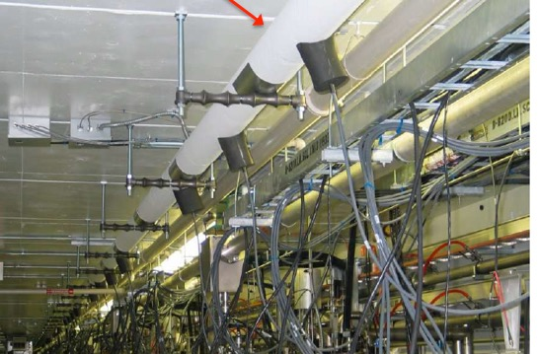
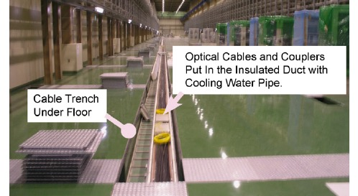
Starting Point
What other facilities are using:
SNS:
Rigid line/Coaxial cable for LLRF
Optical fiber for BPM
Distribution in Tunnel
Temperature control by heating
JPARC:
Rigid line/Coaxial cable for BPM
Optical fiber for LLRF
Distribution in Klystron Gallery
Temperature control by cooling

Slide 5
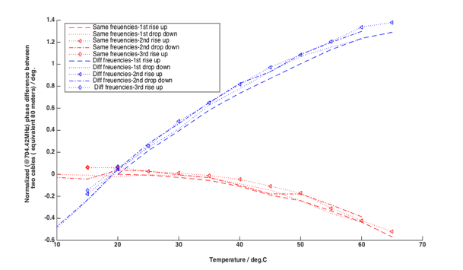
Design Context at ESS
Start from SNS and JPARC experience
Strongly recommended to synchronize RF and BI reference signals (from the same source)
Successfully integrate PID feedback loop in EPICS in LTH prototype
Thoroughly phase drift characterization of RF cables, RF components, and Rigid line.

Slide 6
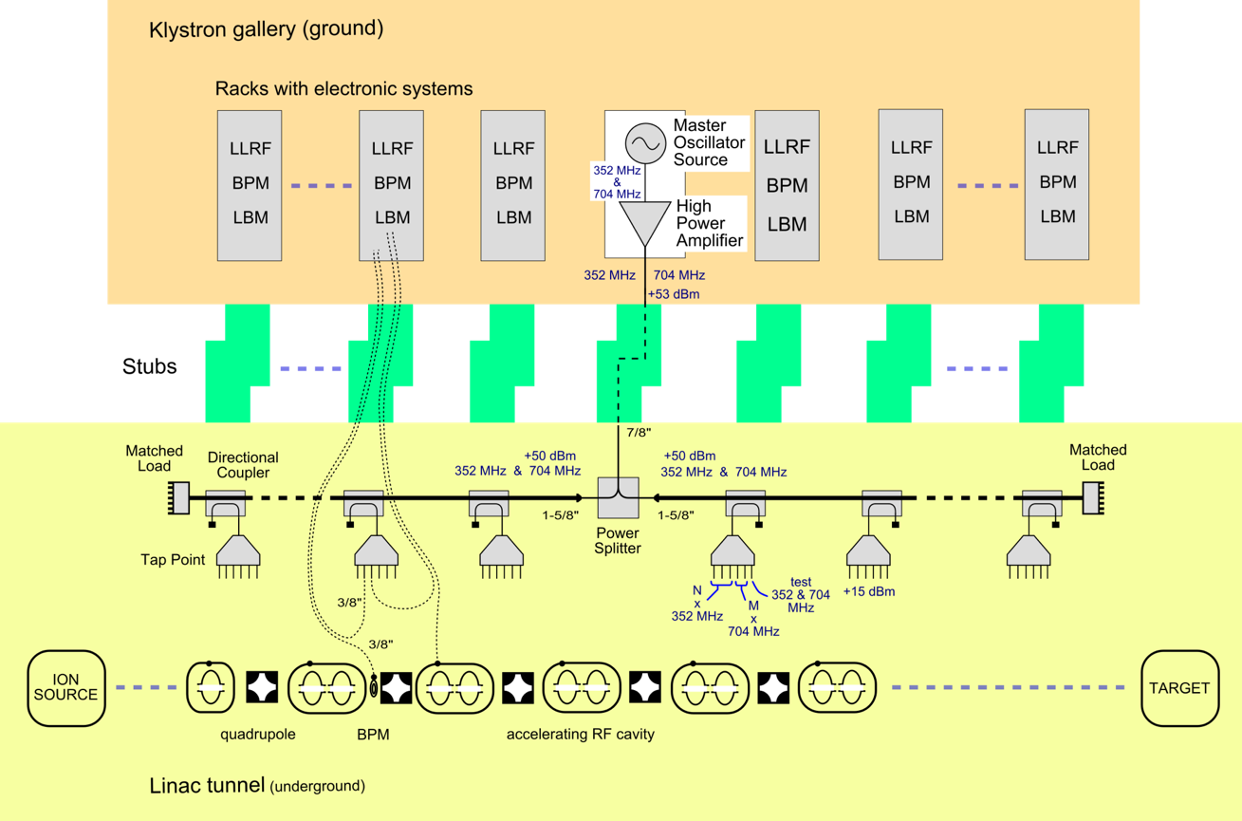

System Layout

Slide 7
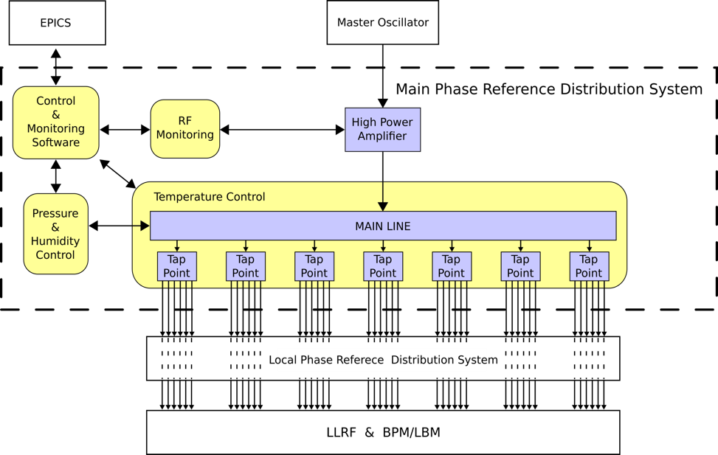
System Functions
Two RF Frequencies(352.21MHz&704.42MHz) running in the same rigid line along the tunnel
The whole system divided into around 70 zones, each zone is controlled individually by PID loop in EPICS
56 taps offers LLRF/BPM/BSM reference signals (current 198 reference signals) at 15~18dBm power level
ICS Interface
Interface to MO
…
Interface to Local PRDS
M. Zukocinski, WUT

Slide 8
Scope of InKind
ESS, LTH
InKind (2016 Oct ~2018 Dec)
ESS
Conceptual design /Prototype
Detailed Design/Prototype/Installation/Commission
System Integration to RF/Operation

Slide 9
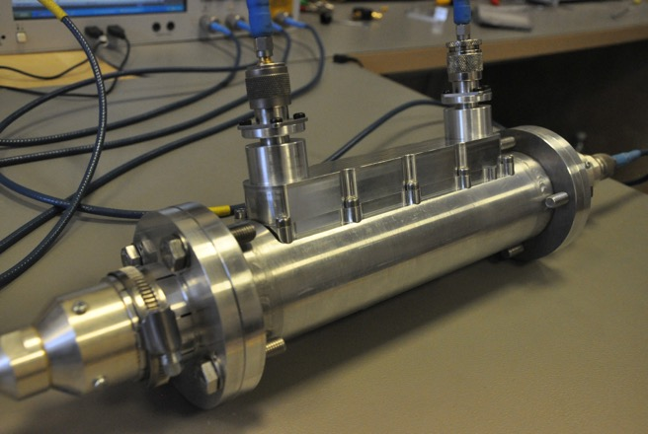
Prototype in Test

Slide 10
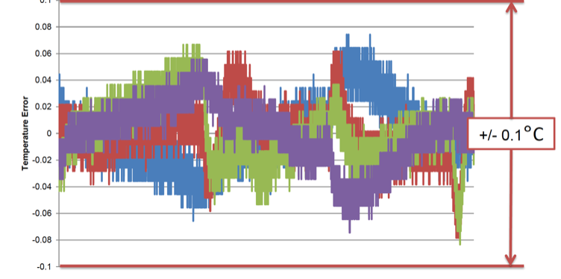
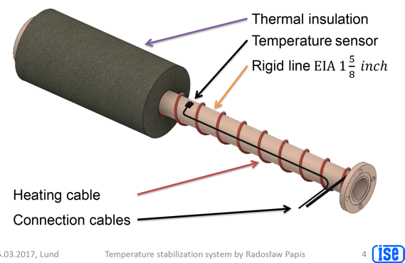
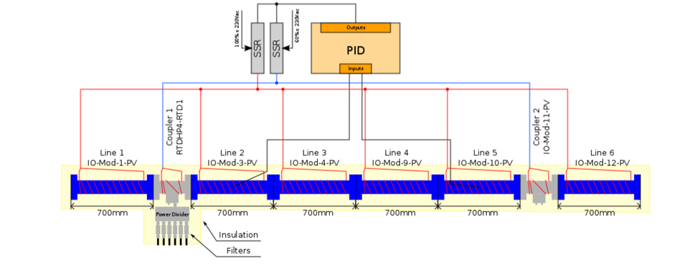
Prototype in Test(Temperature Control)

Slide 11
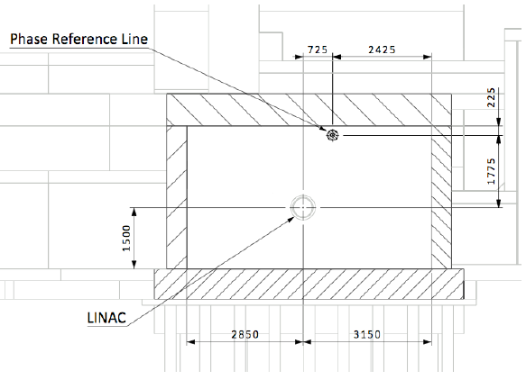
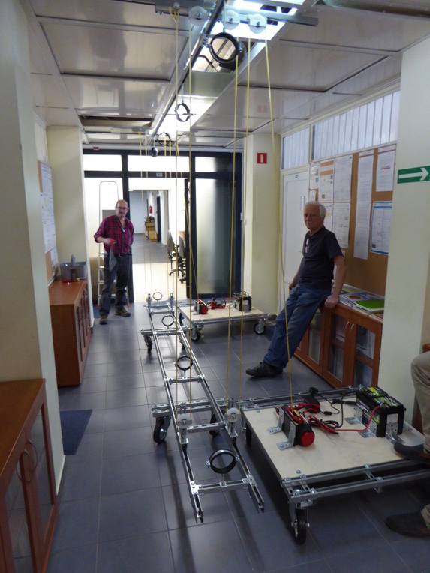
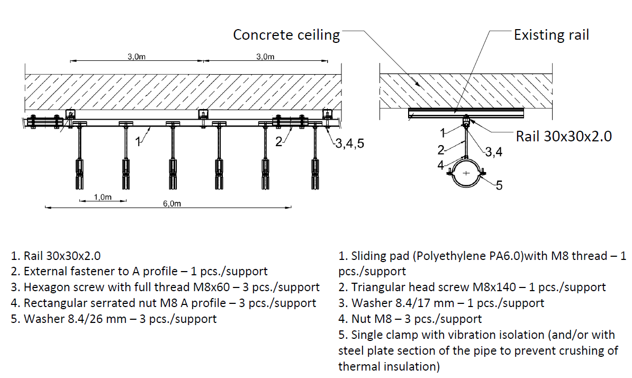
Prototye in Test (Installation)

Slide 12
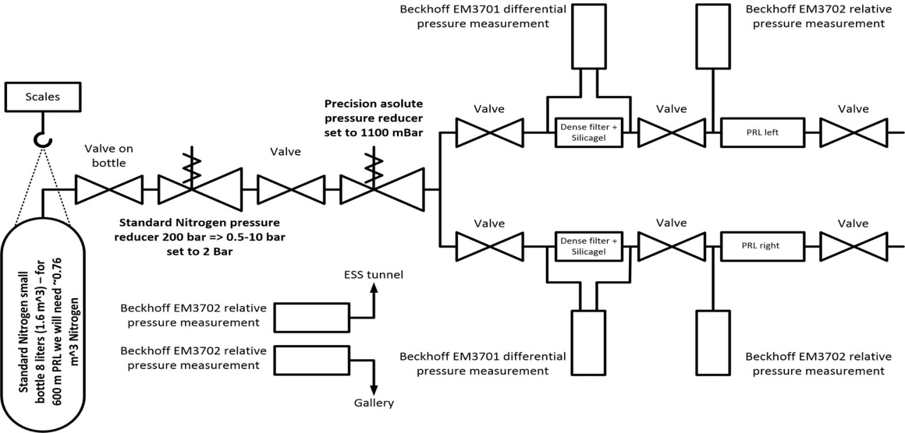
Air Pressure and Humidity Control
The pressure of Nitrogen will be reduced to ~2 Bar.
Precision absolute pressure reducer will provide gas pressure set to 1100 mBar.

Slide 13
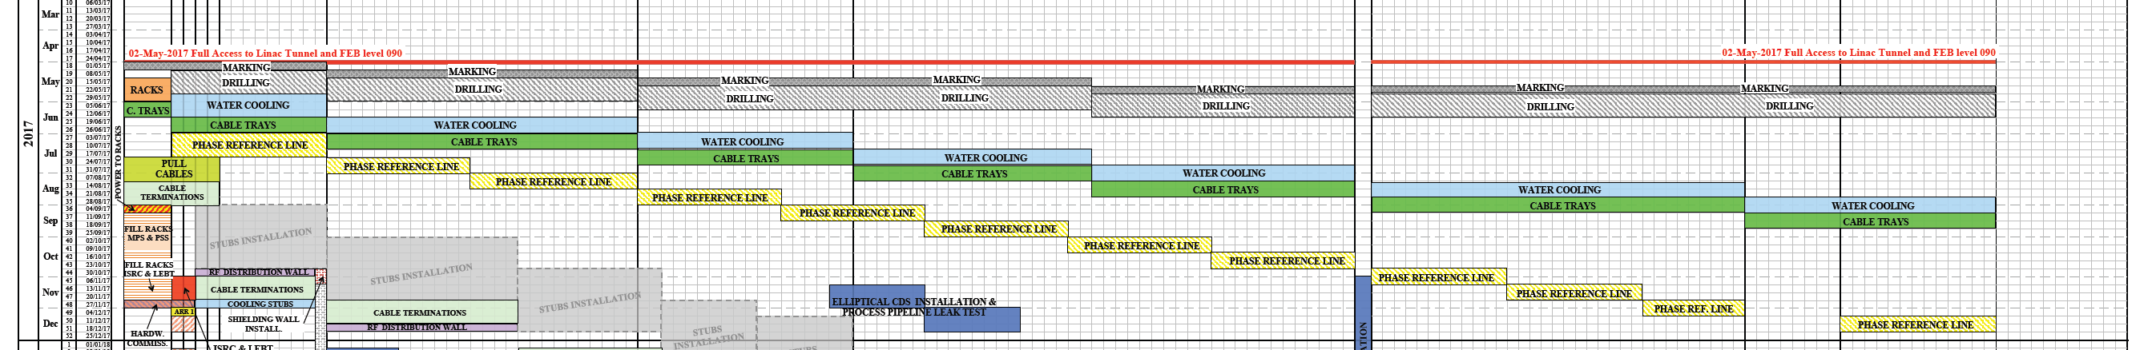
Schedule Update for 2017
No. | Activity | Dates | Who | Comments | Q1 |  |  | Q2 |  |  | Q3 |  |  | Q4
12 | Installations | August – December + cont. in 2018 | All + installation team | Plan to hire additional persons for installation work

Slide 14
Installation Preparation in June, July
Safety Training for Partners
Tunnel measurement and marker
Trial of installation for one section in Front End Building(or somewhere else)
  Familiar with environment
  Test logistic and inventory
  Test the transport sequence
  Test installation sequence
  Develop ‘routine’ for daily work-flow
  Build collaboration-coordination with work area managers
  ….

Slide 15
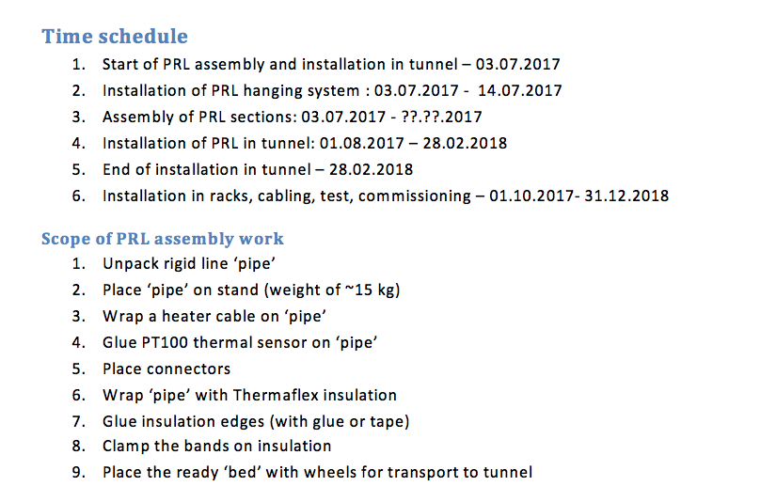
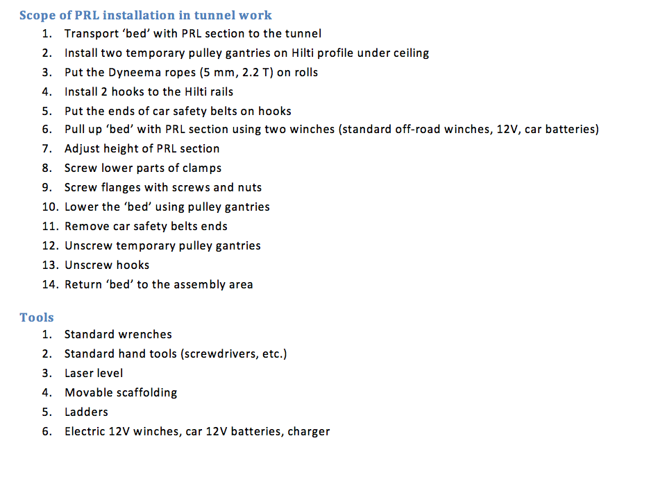
WSCP to be done this month

Slide 16
Thanks!

