Slide 1
ACCSYS WP16 Cooling Support
Anton Lundmark
Cooling System Engineer
www.europeanspallationsource.se
11 May 2017

Slide 2
Outline
WP16 scope
Input documents
Status
Some ongoing activities/open issues
Schedule

Slide 3
WP16
Anton Lundmark – WP leader
Akif Coku – Lead Engineer
Fredrik Persson – Piping design Engineer – ACC tunnel
Roy Montheli – Piping design Engineer – RF gallery
2 x Technicians TBD
Support from other groups:
  Piero Valente (EIS) – system design, E3D and FBS support, leading process and plant standardization group
  Anders Olsson (EIS) – Structural analyses
  Martin Hansson (CF) – Process design and interfaces with CF

Slide 4
Design documents
ESS-0027146 - WP16 water cooling systems
ESS-0021791 - Water cooling requirements for the ESS RF system
ESS-0094205 - structural loads for STFC
ESS-0094585 – structural loads for SPK waveguide supports
  Cleanup of document required
  Working on developing structural loads for RFQ/DTL cells
“Water cooling devices” – requirement specification regarding instrumentation
  Not in CHESS
P&ID:s
  TS2 – done; will be used as basis for rest of gallery
  RFQ/DTL/MEBT/SPK/MBL/HBL – preliminary; should be updated with recent minor changes
CF prerequisites:
  Design pressure 10 bar(g)
  CWL, 8 °C
  CWM, 25 °C
  CWH, 50 °C
  Water quality

Slide 5
Status
DTL/RFQ/MEBT
  P&ID; need minor updates based on new input from TS2 work
  No details about RFDS support structures
Spoke
  P&ID; preliminary but main features are known (power station includes required instrumentation and valves)
  Enough details exist regarding RFDS supports
  Preliminary pipe routing
MBL/HBL
  P&ID; need minor updates due to input from TS2 work
  Enough details exist regarding RFDS supports
  Ongoing detail design

Slide 6
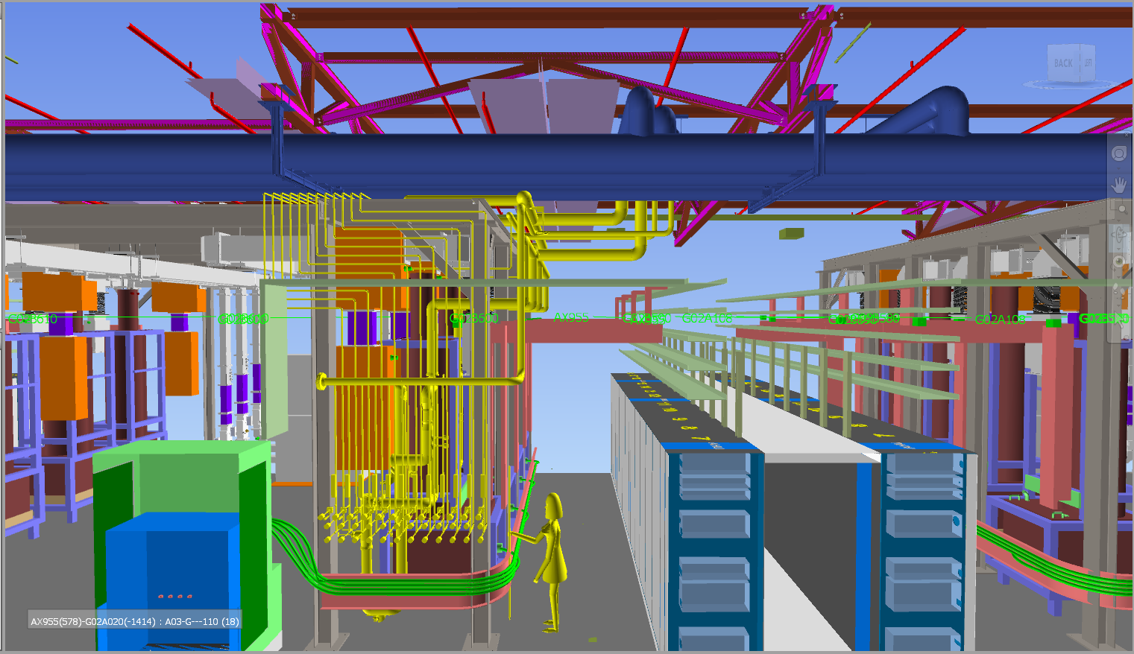
Status

Slide 7
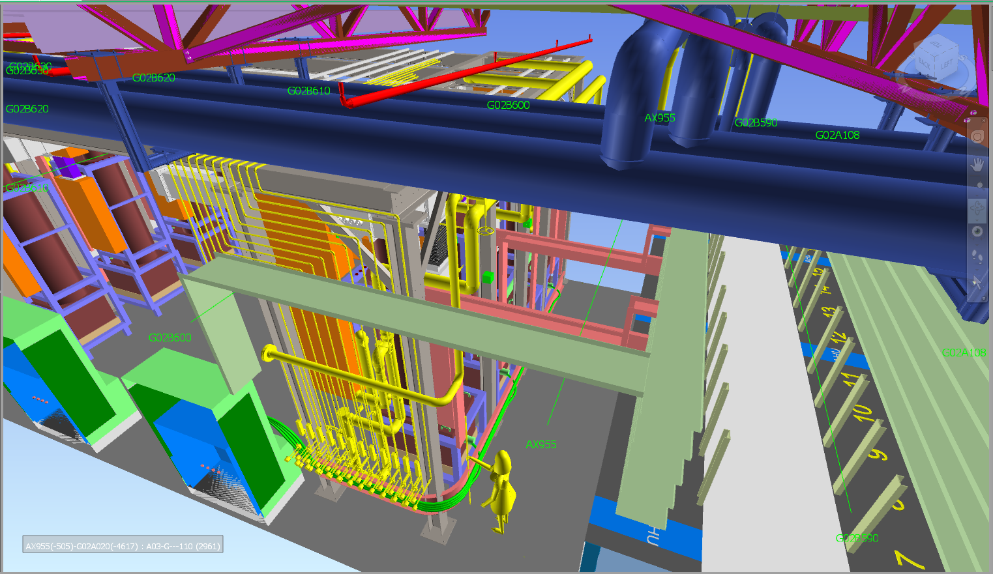
Status

Slide 8
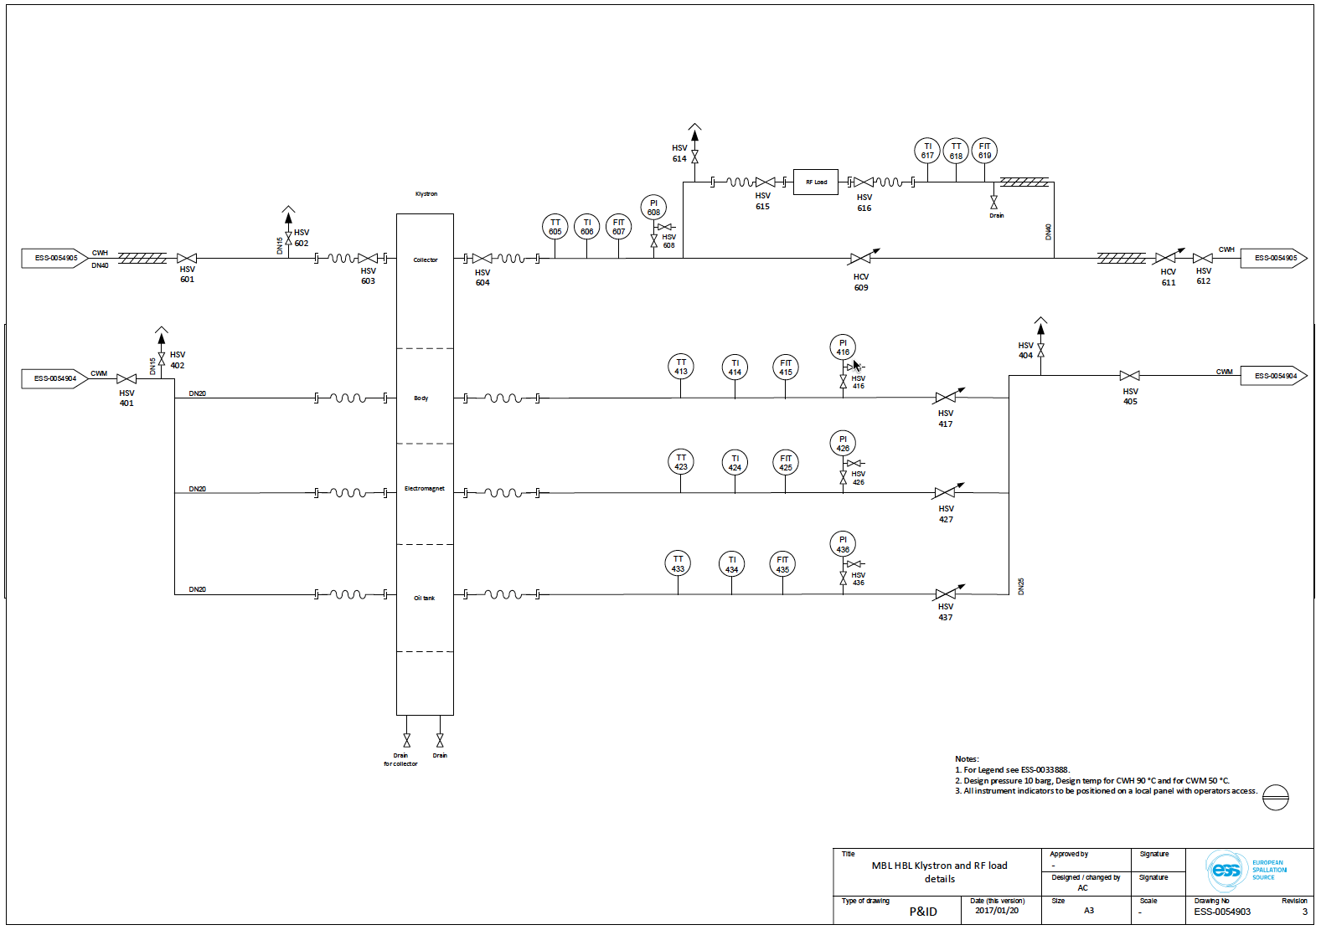
P&ID MBL/HBL klystron

Slide 9
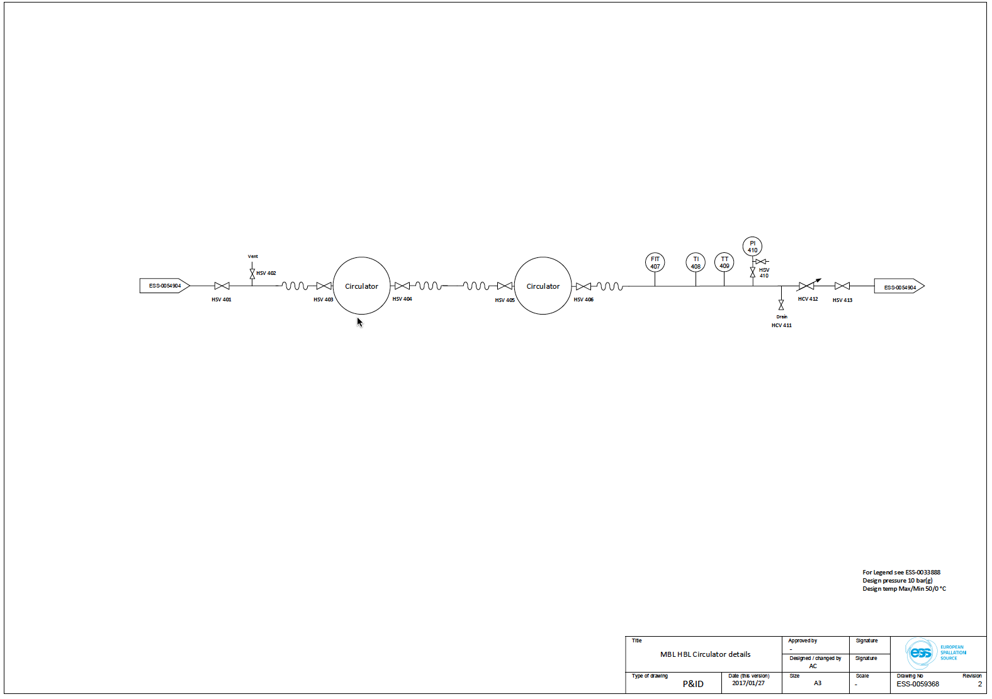
P&ID MBL/HBL Circulators

Slide 10
Ongoing activities/issues
Collisions in roof with beams – solved via CFRFI on confluence
Difficult finding space for filter
Lack of space in-between klystrons for valves and instruments for load circuit
Have defined connector types for klystrons, loads, circulators and modulators
Want to avoid welding so we may go for tubing, i.e. need to set up tubing specification together with EIS
Initiated effort to set up framework agreements for piping installations together with procurement, EIS, and quality
Received quotes for instrumentation for TS2 manifold, thus detailed design for water instrumentation for the rest of the gallery is progressing
FBS structure for gallery cooling is in place (WP16 parts, not CF parts)
  Some issues exists how to connect to P&IDs since these follow ESS (ICS) naming and not FBS (RDS) tagging
Met several times with Skanska/SEC and discussed commissioning of the G02 temporary utilities
  Included ICS in last meeting
Updating TS2 WSCP to include entire G02
Most focus regarding piping design has been on MBL/HBL; RFQ/DTL have to progress since this is the first installation
Spoke is fairly “easy” since all instrumentation and controls are included in the power stations. Thus, spoke is mainly pipe routing.

Slide 11
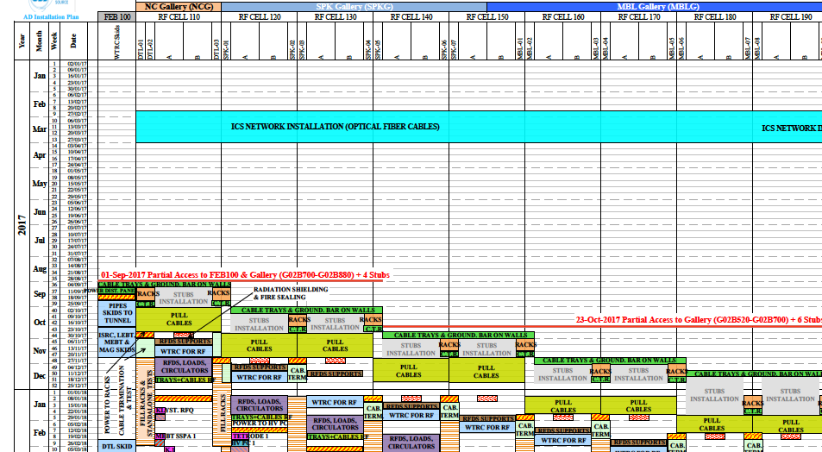
Schedule
Installation of first skid
Installation of cooling system for RF

