Slide 1
RF Systems and Machine Protection
Annika Nordt
Group Leader for Machine Protection and Personnel Safety Systems/ICS/ESS
www.europeanspallationsource.se
2017-05-11

Slide 2
Overview
RF and Machine Protection put in context
Interfaces between RF and Beam Interlock System
Analysis of RF systems related to Machine Protection
Status overview
Questions and Answers

Slide 3
MP-Strategy for RF Systems (Simplified)
Clear split of responsibilities:
AD is in charge of the design, procurement, installation, operation of the RF Local Protection System (RF LPS):
  The RF LPS protects all the RF equipment (1 RF LPS per RF cell)
  The RF LPS informs the Beam Interlock System (BIS) in case beam operation should be interrupted.
ICS/WP14.5 is in charge:
  Of providing support for the analysis of the RF systems related to MP/RAMI,
  For documentation of MP/RAMI-related requirements and
  For integration into overall ESS MP/RAMI Strategy and to Beam Interlock System.

Slide 4
Machine Protection: How Does it Work?
Beam Interlock System
EPICS,
Timing System
Beam
Monitoring
Systems
Local Protection Systems
Accelerator
Local Protection Systems
Target
Local Protection Systems
NSS
PSS
and
TSS
Remove RF from ISRC
Magnetron
Remove power on ISRC HVPS
Activate HV
of LEBT
Chopper
Activate HV
of MEBT
Chopper
Allow Timing
System to Send
Trigger Events
Input Systems: Local Protection Systems (LPS), Beam Monitoring Systems, etc.
Logic: Beam Interlock System
Output/Actuation Systems: Ion Source, LEBT chopper, Timing System

Slide 5
RF-Machine Protection: How Does it Work?
Beam Interlock System
From an MP point of view we see the RF LPS as part of LPSs for Accelerator:
EPICS,
Timing System
Beam
Monitoring
Systems
155 RF
Local Protection Systems
Local Protection Systems
Target
Local Protection Systems
NSS
PSS
and
TSS
Remove RF from ISRC
Magnetron
Remove power on ISRC HVPS
Activate HV
of LEBT
Chopper
Activate HV
of MEBT
Chopper
Allow Timing
System to Send
Trigger Events
Input Systems: Local Protection Systems (LPS), Beam Monitoring Systems, etc.
Logic: Beam Interlock System
Output/Actuation Systems: Ion Source, LEBT chopper, Timing System

Slide 6
MP-Strategy for RF Systems (Simplified)
ICS
AD
Beam
Interlock System
Beam Permit OK/NOK
RF LPS
RF Systems for 1 RF cell
The RF LPS takes fully care of protecting the different RF systems and related equipment. There is 1 RF LPS per RF cell.
In case an RF cell is locally ready for beam operation then the BEAM PERMIT = OK is sent from the RF LPS to the BIS.
In case an RF cell is locally NOT ready for beam operation then the BEAM PERMIT = NOK is sent from the RF LPS to the BIS and the BIS will not allow beam operation
There is no other interface between RF systems and the BIS!

Slide 7
General Rules for BIS Behaviour:
Global Beam Permit == OK, IF
Beam Interlock System: IF ∀OK and Consistent → Global Beam Permit == OK
Destination
Information LPSID, LPS-A2T
BI Mode configuration information
(RF) LPS
Local Beam Permit == OK
Beam Presence
Information
from BI, ISRC
Beam Monitoring Systems == OK
Operational Status & Health== OK
Mode and event information from Timing System
ISRC Magnetron
System ==OK
ISRC HVPS
System==OK,
HV Status
LEBT Chopper
System == OK,
HV Status
MEBT Chopper
System == OK,
HV Status
PSS,TSS
Beam Permit
== OK
Global Beam Permit==OK
Timing System
is permitted to send around
Trigger Events

Slide 8
If Something Goes Wrong in Between Pulses: Beam Inhibit
Beam Interlock System: NOK in between pulses→ Global Beam Permit == NOK
Destination
Information LPSID, LPS-A2T
BI Mode configuration information
LPS RF RFQ
Beam Permit
== NOK
Beam Presence
Information
from BI, ISRC
Beam Monitoring Systems == OK
Operational Status & Health== OK
Mode and event information from Timing System
ISRC Magnetron
System ==OK
ISRC HVPS
System==OK,
HV Status
LEBT Chopper
System == OK,
HV Status
MEBT Chopper
System == OK,
HV Status
PSS,TSS
Beam Permit
== OK
Global Beam Permit==NOK
Timing System
is NOT permitted to send around
Trigger Events for the next pulse
When the BIS detects an unexpected situation in between pulses, then it performs a “BEAM INHIBIT”
Actuation of HV for
LEBT and MEBT choppers

Slide 9
If Something Goes Wrong in the Middle of a Pulse: Regular Beam Interlock
Beam Interlock System: NOK in the middle of a pulse→ Global Beam Permit == NOK
Destination
Information LPSID, LPS-A2T
BI Mode configuration information
LPS RF RFQ
Beam Permit
== NOK
Beam Presence
Information
from BI, ISRC
Beam Monitoring Systems == OK
Operational Status & Health== OK
Mode and event information from Timing System
ISRC Magnetron
System ==OK
ISRC HVPS
System==OK,
HV Status
LEBT Chopper
System == OK,
HV Status
MEBT Chopper
System == OK,
HV Status
PSS,TSS
Beam Permit
== OK
Timing System
is NOT permitted to send around
Trigger Events for the next pulse
Global Beam Permit==NOK
When the BIS detects an unexpected situation in the middle of a pulse,
a “REGULAR BEAM INTERLOCK” is being performed.
Deflect beam to absorbers, by actuating of HV for
LEBT and MEBT choppers
Actuation of ISRC Magnetron

Slide 10
BIS Behaviour – Escalation
BIS checks if Beam Inhibit/ Regular Beam Interlock was successful:
  Based on beam presence information from BI systems,
  Based on status feedback from Actuation Systems.
If not successful then the BIS can escalate:
  Beam Inhibit→ Regular Beam Interlock→ Emergency Beam Interlock.
BIS informs Timing System about beam interlocks such that timing can send post mortem freeze triggers to all systems.
BIS can act in two ways:
  Automatic resumption of operation,
  Resumption to operation after external reset.

Slide 11
Example: If Nothing Works
Emergency Beam Interlock
Beam Interlock System: NOK in the middle of a pulse→ Global Beam Permit == NOK
Destination
Information LPSID, LPS-A2T
BI Mode configuration information
RF LPS
Beam Permit == OK
Beam Presence
Information
from BI, ISRC
Beam Monitoring Systems == OK
Operational Status & Health== OK
Mode and event information from Timing System
ISRC Magnetron
System ==OK
ISRC HVPS
System==OK,
HV Status
LEBT Chopper
System failure during Regular Beam Interlock
MEBT Chopper
System == OK,
HV Status
PSS,TSS
Beam Permit
== OK
Global Beam Permit==NOK
In case a “REGULAR BEAM INTERLOCK” could not be executed successfully, an “EMERGENCY BEAM INTERLOCK” is being initiated.
Switch off HVPS of ISRC
Actuation of ISRC Magnetron

Slide 12
Interfaces

Slide 13
BIS - RF LPS Interface – Requirements I
Primary Functional Requirement
  Transmit boolean BEAM-PERMIT signal [OK/NOK]
Primary Performance Requirements
  Optimize for speed
  PIL 2 capability (Protection Integrity Level 2)
  Minimize “spurious trip” probability

Slide 14
BIS - RF LPS Interface – Requirements II
Additional Requirements according to IEC 61508-2:2010:
  Mode Confusion: input systems assume wrong mode, wrong reference values for failure detection: Loss of protection
  →Send «mode» information to BIS
  Input system “dies” with stuck-at OK: Loss of Protection
  → Send a regular «heartbeat» signal to the BIS
    can be timestamp, incrementing counter.

Slide 15
BIS - RF LPS Interface – Requirements III
The interface to the BIS must allow detection of the following link faults:
  Stuck-At OK → Loss of Protection Function
  Stuck-At NOK, Glitches → Loss of Availability (Spurious Trips)
  Degraded Connection, Connection Loss → Both Consequences possible
From Facility Operations point of view:
  System shall allow to detect disconnected or degraded links directly and explicitly.
  Rationale: allow for efficient system test, fast problem diagnostics and troubleshooting.
→ Link to BIS needs to support direct detection of connection loss and degraded connection.

Slide 16
BIS - RF LPS Interface - Satisfy all Requirements – Current Proposal
Discrete, static link for BEAM-PERMIT transmission
  Minimize Latency
  Support «high-density» logic
Additional data-link
  Transmission of «mode» information
  Transmission of «heartbeat»
  Redundant and diverse transmission
  of BEAM-PERMIT states
  Bonus: full Handshake Capability
Primary Requirement: Speed
Mode Confusion Check
Sensor «Alive» Check
Allows Input comparison/voting (Table A.7 IEC 61508-2)

Slide 17
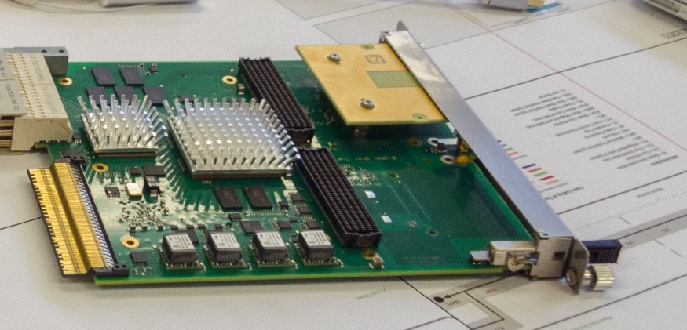
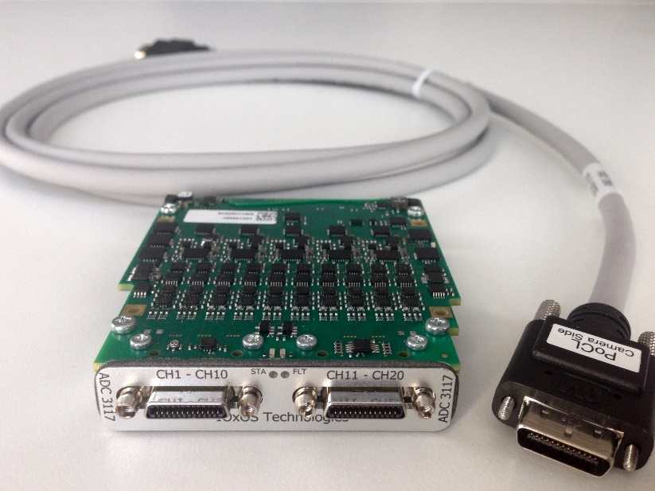
Realization Options for ICS standard
IFC 14x0 based boards - Connectivity
Three connection options
  Dedicated Interlock Piggy-Back (top picture shows mock-up)
  Dedicated Interlock FMC Card
  Interlock Connectivity on uRTM
Connector options under investigation
  3M-SDR 26 pin
    mixed data-link and multiple discrete signal connection (bottom picture shows connector example; courtesy of Ioxos)
    Support for redundant interface
  3M-SDR for discrete signals and RJ-45 for data link

Slide 18
Realization Options for ICS standard
IFC 14x0 based boards - Firmware
Direct Integration of interlock interface management into TOSCA framework:
  User does not need to cope with data-link protocol details or concrete discrete link implementation
Include «heartbeat» generation into protection function processing

Slide 19
MP-Analysis for RF Systems
  Analysis underway (we plan to be ready for the CDR of the RF LPS taking place on 2017-06-01)

Slide 20
Example of Results from Beam-Induced Damage Workshops: RF in the RFQ
Failure mode (event) | Consequences on the device | Consequences on the beam | Possible beam induced damage | Preventive function | Mitigation function
No RF (e.g. Failure in RF generation) | No RF into the cavity. RF decays in some time | Beam is partially or totally lost in the RFQ. Simulation 1 needed to define loss maps (time dependent). | Beam lost anywhere in the LINAC (to be simulated in 1). When RF is low enough, the beam is lost in the first part of the RFQ (75Kev). | RF LPS to stop the beam before cavity field is too low | BLM and BCM to detect losses
RF too high | Possible damage to the coupler. Possible increase of Kilpatrick limit which leads to higher spark rate | No immidiate consequence |  | Reflected power too high: RF LPS to stop the beam
RF too Low | Lower RF field | Beam is partially or totally lost in the RFQ. Simulation 1 needed to define loss maps (time dependent). Maybe slower than previous. | Beam lost anywhere in the LINAC (to be simulated in 1). When RF is low enough, the beam is lost in the first part of the RFQ (75Kev). |  | BLM and BCM to detect losses
Wrong RF (phase) | No effect | Wrong phase of the exit beam | Beam lost partially or totally in the rest of the linac |  | BLM and BCM to detect losses
Wrong timing of the RF (RF comes before the pulse) | Possibility of having beam and no RF in the RFQ | No acceleration, focusing or bunching for part of the pulse | Beam is first lost in the whole linac and after some time is totally lost in the RFQ (simulation 1) |  | BLM and BCM to detect losses
Wrong timing of the RF (RF comes after the pulse) | Possibility of having beam and no RF in the RFQ | No acceleration, focusing or bunching for part of the pulse | Beam is first lost in the RFQ and after some time (when RF starts) is lost in the whole LINAC (simulation 1) |  | BLM and BCM to detect losses
Courtesy of E. Bargallo, A. Ponton, M. Eshraqi, et al.

Slide 21
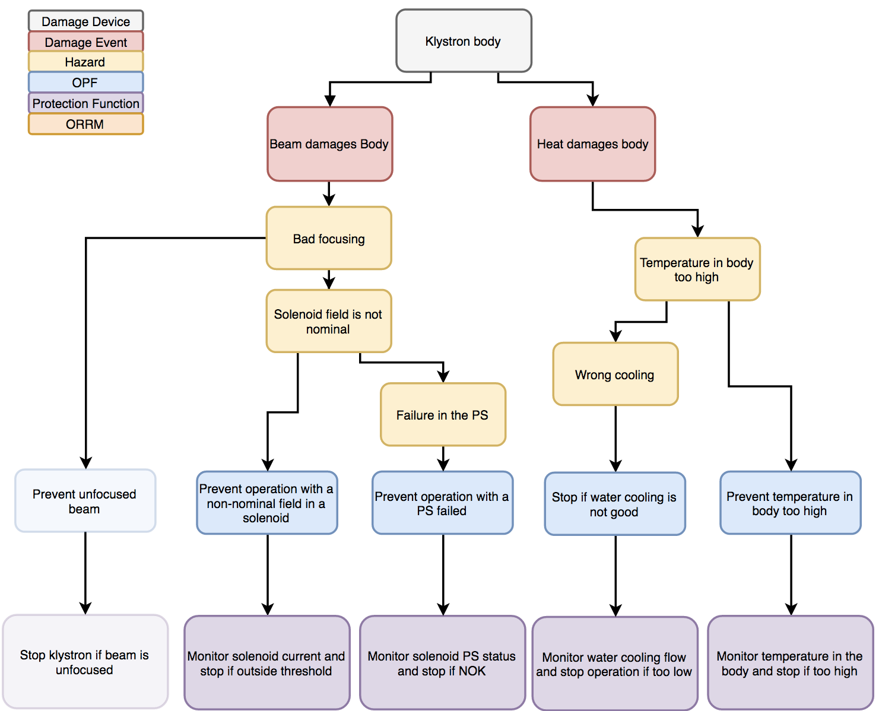
Preliminary analysis of an RF Cell
Courtesy of E. Bargallo, R. Montano

Slide 22
Very Very Useful for an Analysis, especially a gap analysis! THANKS!
Courtesy of M. Jensen

Slide 23
Status: Gaps
Quench Detection (was orphan item) (now in WP8-EMR)
Requirements for quench detection not fully defined, however fast digital concept proposed and detailed design being started
Electron Pick Up (was orphan item) (now in WP8-EMR)
Requirement agreed, first design complete and prototyping under way
Interface between LLRF and BCMs
  No information at the moment, will be addressed

Slide 24
Global Status Overview
Analysis for RF systems (focus on MP/RAMI):
  Good base existing, detailed analysis ongoing (results stored in insight)
  Plan is to be ready by 2017-06-01 for the CDR of the RF LPS.
Functional interfaces between RF systems and Beam Interlock System:
  Established and communicated. Some more workshops needed. Not critical.
Hw and sw interfaces between RF systems and Beam Interlock System:
  Agreement between both teams exists and ICS standard platform will be used for RF, hence integration in BIS is straight forward.
  Real implementation and testing ongoing (RF test stand is an option for testing)
Post Mortem Integration:
  No progress: this shall be addressed with higher priority!
Documentation of Machine Protection requirements for RF:
  Ongoing, Will be tough to have all ready for the CDR, but we focus.
Collaboration between the different teams/WPs:
  Is very good and we would like to thank the team for RF, in particular Morten, Rafael, and Anders
  It is really efficient that the RF team has 1 full time responsible for the RF LPS since the beginning.

Slide 25
Back Up Slides

Slide 26
General Rules for BIS Behaviour:
Global Beam Permit == OK, IF
The BIS allows for beam operation based on:
  BEAM-PERMIT signals.
  Operational status and health status.
  Operational mode of accelerator, target, NSS.
  “Beam Mode and Destination” configuration of relevant systems.
  “Beam Presence” information.
  Positions of interceptive devices. Status of Bending Magnets.

Slide 27
HOW?
In order to understand better the concept of operations for the BIS, we go quickly through an example
Selected example: We want to start beam operation after some days of stopping and we send beam only to DTL Faraday Cup 4.
HOW?

Slide 28

Example HOW:
Start of Beam Operation after Long Stop
0) PSS must be ready and allow for beam operation.
The operator must select in a special “Operations GUI”:
  The beam destination (DTL4-FC).
  The beam mode (probe beam).
Beam Destination
Beam Mode
LEBT-FC
MEBT-FC
DTL4-FC
Tuning Dump
Target
No Beam
Probe Beam
Slow Tuning Beam
Fast Tuning Beam
Full Power Beam

Slide 29
Example HOW:
Start of Beam Operation after Long Stop
The Timing System will broadcast this information to every system.
Beam Destination
Beam Mode
Timing Receiver
System 1
LEBT-FC
MEBT-FC
DTL4-FC
Tuning Dump
Target
No Beam
Probe Beam
Slow Tuning Beam
Fast Tuning Beam
Full Power Beam
Timing Receiver
System 2
…..
EPICS
Timing Receiver
System n
Timing Network
Timing System (EVG)
….............
5μs, 6mA, 1 Hz
DTL4-FC

Slide 30
Example HOW:
Start of Beam Operation after Long Stop
Every system will start to configure itself accordingly, for example:
  LPSID reads out position switches from IDs and detects that the DTL4-FC is set as destination already (DTL4-FC is IN and all other IDs are OUT).
  LPSVAC will check whether all sector gate valves up to DTL4-FC are open and if the vacuum levels are all OK.
  BCMs will prepare to check for beam with 5μs, 6mA, 1 Hz (probe beam).
  LPS-A2T and TSS input is not required, as we send beam only to DTL4-FC.
  The BIS expects RF to be ready up to DTL tank 4. RF LPS BEAM PERMITS must be OK.
  Etc.
  The BIS will wait until all relevant systems are ready and then derive the Global Beam Permit, telling the timing system to send triggers to the Ion Source.

Slide 31
Example HOW:
Start of Beam Operation after Long Stop
4) The BIS derives the GLOBAL BEAM PERMIT == OK, IF the following is true:
    Beam Permit == OK from LPSs: Vacuum, Magnets, Interceptive Devices, ISRC, RF,
    Beam Permit == OK from Beam Monitoring Systems:
    BCMs,
    Beam Permit == OK from Actuation Systems: LEBT chopper, MEBT chopper, ISRC Magnetron, ISRC HVPS,
    BCM configuration == probe beam == timing system configuration,
    Beam destination detected by LPSID == DTL4-FC == timing system configuration,
    Position of interceptive devices detected by LPSID == OK according to beam destination and beam mode,
    Operational status and health status == OK for all relevant systems,
    Beam Presence information from BI systems, ISRC == information sent by timing system (event trigger information).
If the GLOBAL BEAM PERMIT == OK, then the Timing System is permitted to send around trigger events, and the ISRC will start beam operation

Slide 32
BIS Behaviour - Assumptions
Assumptions:
BIS knows when beam is expected/not expected (from Timing System).
BIS receives dependable information whether beam is present (from BI):
  Directly downstream of beam destinations.
  At the Proton Source.
BIS receives dependable information about current state of Actuation Systems:
  Whether beam is extracted or not (from Proton Source).
  Whether high-voltage is applied or not to LEBT/MEBT Choppers.

Slide 33
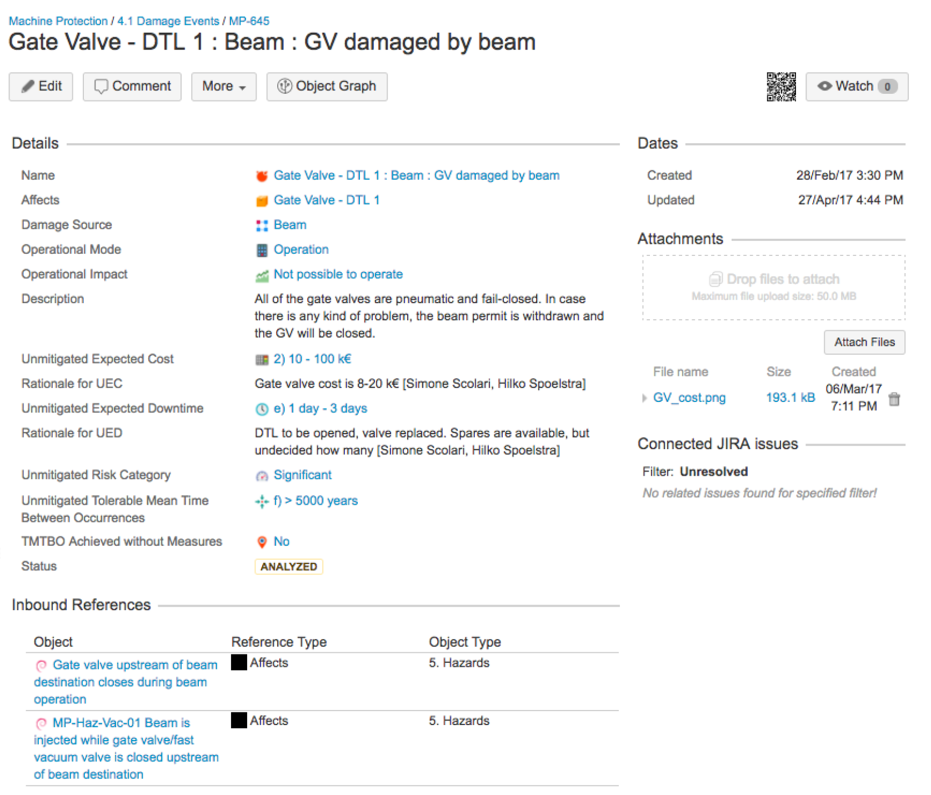
Storing Analysis Results in InSight

Slide 34
Some Important Definitions
Functional Safety Term | Functional Protection Term | Definition
Overall safety function | Overall protection function (OPF) | Generic function that protects from a hazard
Safety function | Protection function (PF) | Technology specific function that is part in fulfilling an OPF, containing a sensor, logic, actuator, timing and protection integrity requirement
Safety Integrity | Protection Integrity | Average probability for satisfactorily performing the required PF under the stated conditions
Safety Integrity Level (SIL) | Protection Integrity Level (PIL) | Discrete level for the Protection Integrity Level requirements of the PF.
Term | Definition
Risk | Combination of the frequency of occurrence of damage and the severity of that damage
Risk category | A discrete category specifying the level of Risk for a certain damage event
Damage | A device being affected by external factors in such a way that it (partly or entirely) cannot perform its intended task
Failure | A device being affected by internal factors in such a way that it (partly or entirely) cannot perform its intended task
Hazard | Potential source of damage
Protection | State of being protected against damage
Damage Event | A specific event that damages a device, including the source of damage and the risk category

Slide 35
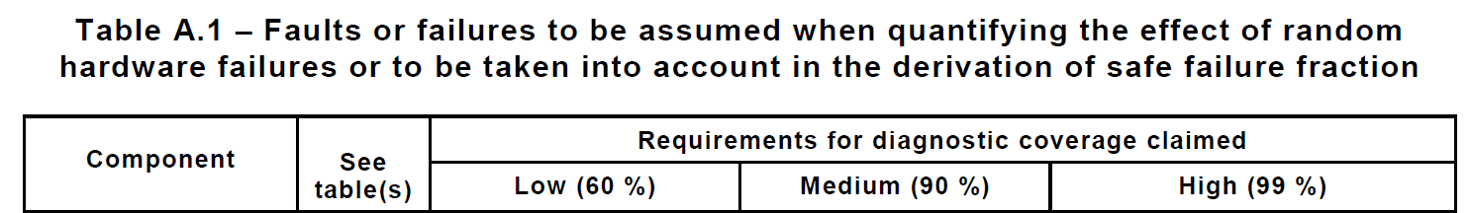

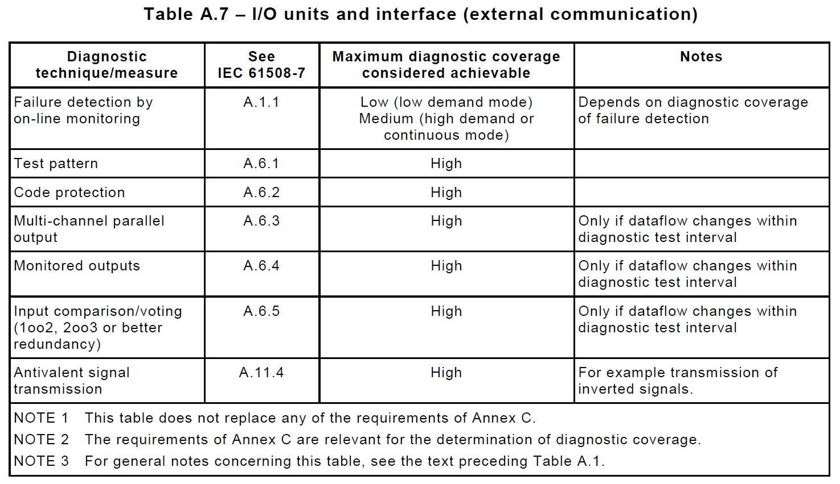
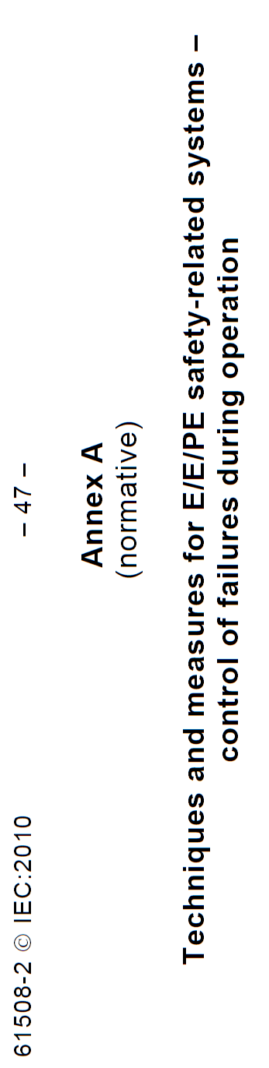
BIS Interface - Sensor Side
Requirements Analysis – Link Faults
Options given in IEC 61508 for Diagnostic Measures

