Slide 1
NMX Macromolecular Diffractometer – Current Status
NMX Phase 2 Review
Lund 2017-06-22
Esko Oksanen
Scientific Project Leader

Slide 2
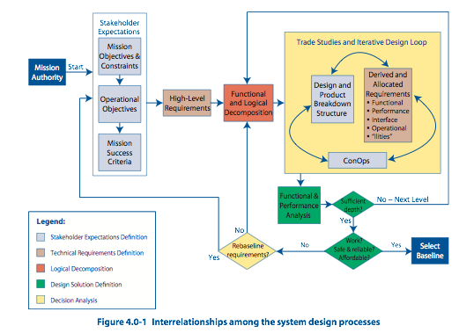
System design – Where are we?
Work package specification
ESS-0115131
What does the instrument look like?
Preliminary System Design Description
ESS-0115021
System Requirements Specification
ESS-0115018
What does the instrument need to do?
How are the experiments done?
Concepts of Operations
ESS-0057133
Initial operations & staging plan
ESS-0115027

Slide 3
Review Questions
Do the high-level system requirements match the science case for NSS approved scope?
Is the proposed engineering design expected to meet the functional and performance requirements, and are interfaces properly identified and defined?
Have appropriate options and alternatives been considered in selecting the design approach? Are there further value engineering opportunities that should be considered?
Is the project schedule reasonable and are the cost estimates in line with the cost book value?
Have major project risks and safety hazards been identified, characterized, and mitigated where appropriate?

Slide 4
Outline
Esko
Why build NMX?
What are the requirements?
What will we build?
How will it perform?
How does it look in detail?
How will we manage the construction?
Question 1
Question 2.1
Question 2.2
Question 3
Question 4
Question 5
Giuseppe

Slide 5
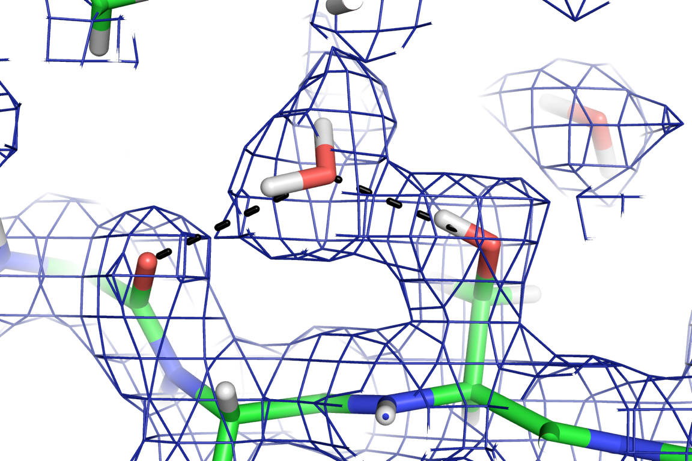
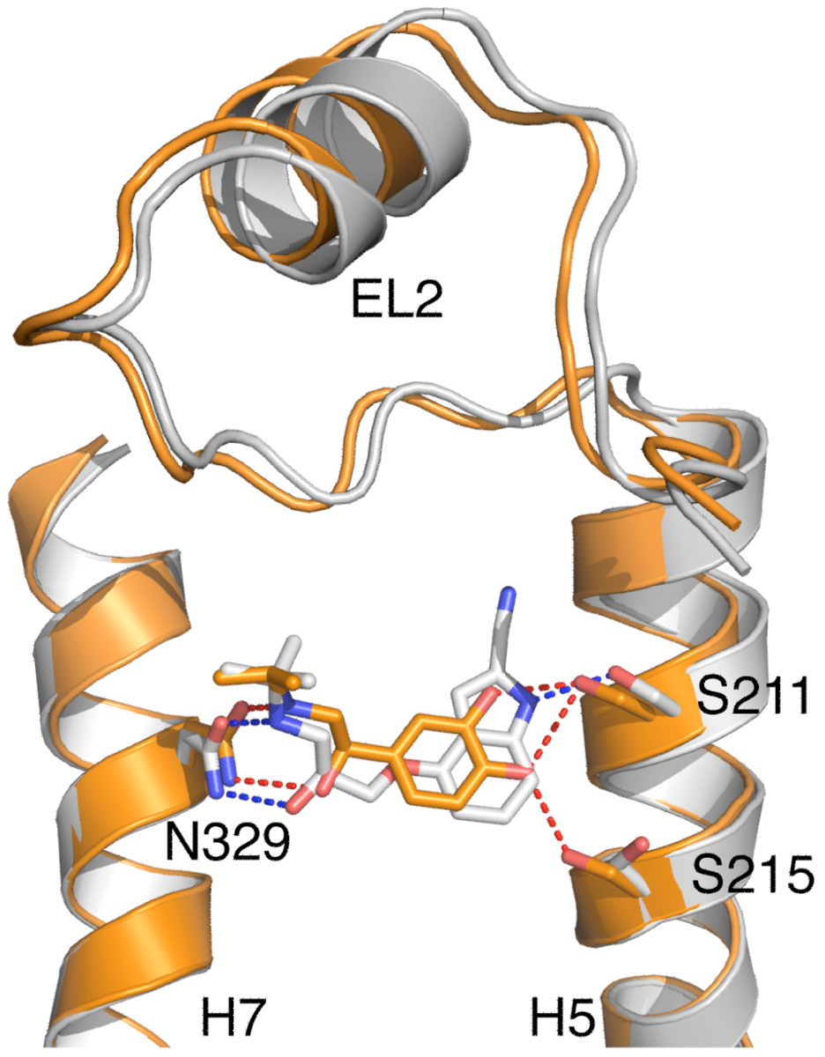
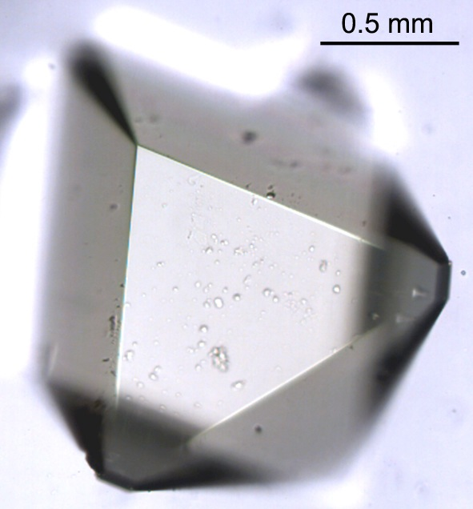
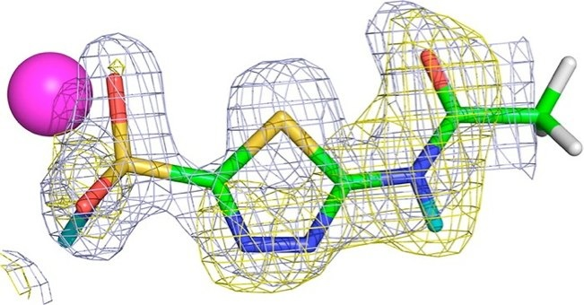
Why Neutron Macromolecular Crystallography?
Where are hydrogens important?
☺Hydrogens are visible
☺No radiation damage
☹Large crystals needed
☹Data collection takes weeks
☹Few instruments available
Enzyme mechanisms
Protein-ligand interactions
Proton transport across membranes
Acetazolamide in HCAII
Hydrogens
not seen!
Fisher SZ et al. JACS 2012;134:14726-14729
Oksanen, E et al. J. R. Soc. Interface 2009, 6 Suppl 5, S599-610.
Notes:
β1AR-m23 bound to either cyanopindolol (antagonist, grey) or isoprenaline (agonist, orange)

Slide 6
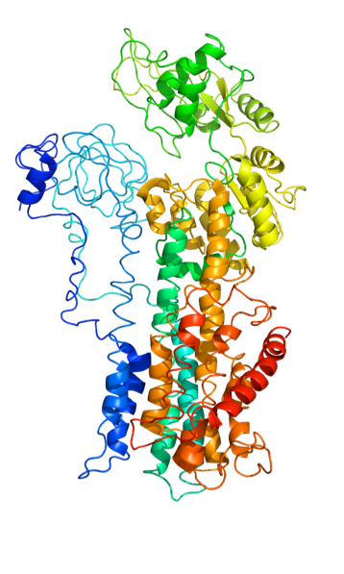





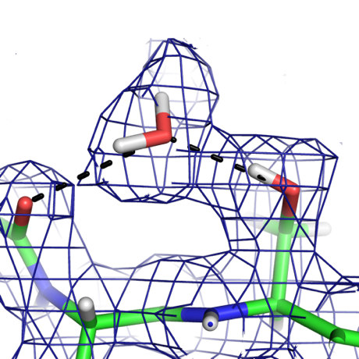
Scientific drivers - Locating hydrogens in bio-macromolecules
Key goals for the NMX Macromolecular Diffractometer
Smaller crystals needed (200 µm vs. 1 mm)
Data collection faster (days vs. weeks)
Larger unit cells possible (300 Å vs. 150 Å)
“Hydrogens represent nearly half of the atoms in biomolecules. Hydrogen bonding and proton transfer play a critical role in biological structure and in catalytic mechanisms.” V. Ramakrishnan, University of Cambridge
“-One of our first questions using the ESS MX beamline will be to understand the protonation states of the reactive site aspartate acids, which will help us understand the mechanism and so lead to novel drug molecules. This, given the size of the protein, is impossible with any current technology.” A. Goldman, University of Leeds
“There is no alternative to neutron crystallography in order to uniquely identify the location of protons, which is of particular importance when dealing with proton translocating proteins” H. Michel, MPI of Biophysics
Notes:
Hydrogen atoms are of fundamental importance for biological function, but neutron crystallography has been too hard for the most interesting systems. The ESS can change this. The structural biology community is large, generates high impact and is interested as letters of support show.

Slide 7
High-level Requirements – starting point
A typical system to be studied would be a 30-40 kDa protein
Unit cell edges 100-150 Å, up to 300 Å
Realistic dmin ~1.8 Å, rarely < 1 Å
Crystal size ~0.01-0.1 mm³
Data set in one day

Slide 8
High-level Scientific Requirements
1. The instrument shall allow data collection from crystals with unit cell repeats > 300 Å.
2. The instrument shall allow data to be collected to a dmin of 1.5 Å.
3. The instrument shall match the size of the neutron beam to the size of the sample.
4. The instrument shall match the divergence of the neutron beam to the mosaicity of the sample.
5. The instrument should maximise the signal-to-background (S/B) ratio of the Bragg reflections.
6. The instrument should allow data collection from crystals of < 0.01 mm³ volume
Unchanged from TG2

Slide 9
Subsystem Requirements - example
1. Wavelength resolution
1.1. The BTS shall transport from the moderator a beam of neutrons to the sample at a distance that leads to a maximal wavelength uncertainty of 5% (∆λ/λ) for the detected neutrons using the full ESS pulse
1.2. Rationale: A moderate wavelength resolution allows the full pulse to be used while conserving the advantage of TOF for the S/B (see 13.6.4 (5))
1.3. Verification: Measurement of the pulse length at sample
2. Beam size
2.1. The BTS shall transport from the moderator to the sample a beam of neutrons with maximum size (full width half maximum) of 5 ± 0.1 mm and minimum size of 0.2 ± 0.02 mm.
2.2. Rationale: Matching the beam size to the sample size maximises the S/B (see 13.6.4 (3,5-6))
2.3. Verification: Measurement of the beam intensity profile at sample
Reference to high-level requirements
Unchanged from TG2

Slide 10
Do the high-level system requirements match the science case for NSS approved scope?
👍

Slide 11
Instrument length and wavelength band
How to resolve reflections with a long pulse?
By time-of-flight
On the detector plane
☺Lower spatial resolution needed on the detector → can use existing technology
☺Can accept more divergence
☺Wider wavelength band
☹Need to chop the pulse → ~90 % loss in flux + cost of chopper (~1 M€)
☺Can use full pulse
☺No need for high timing resolution (~1 ms is OK)
☹Detector technology does not exist yet (can be expensive)
☹Narrower wavelength band
Limits harmonic overlap
Notes:
For 28 m instrument 40% @ 1 Å, 20% @ 2Å

Slide 12
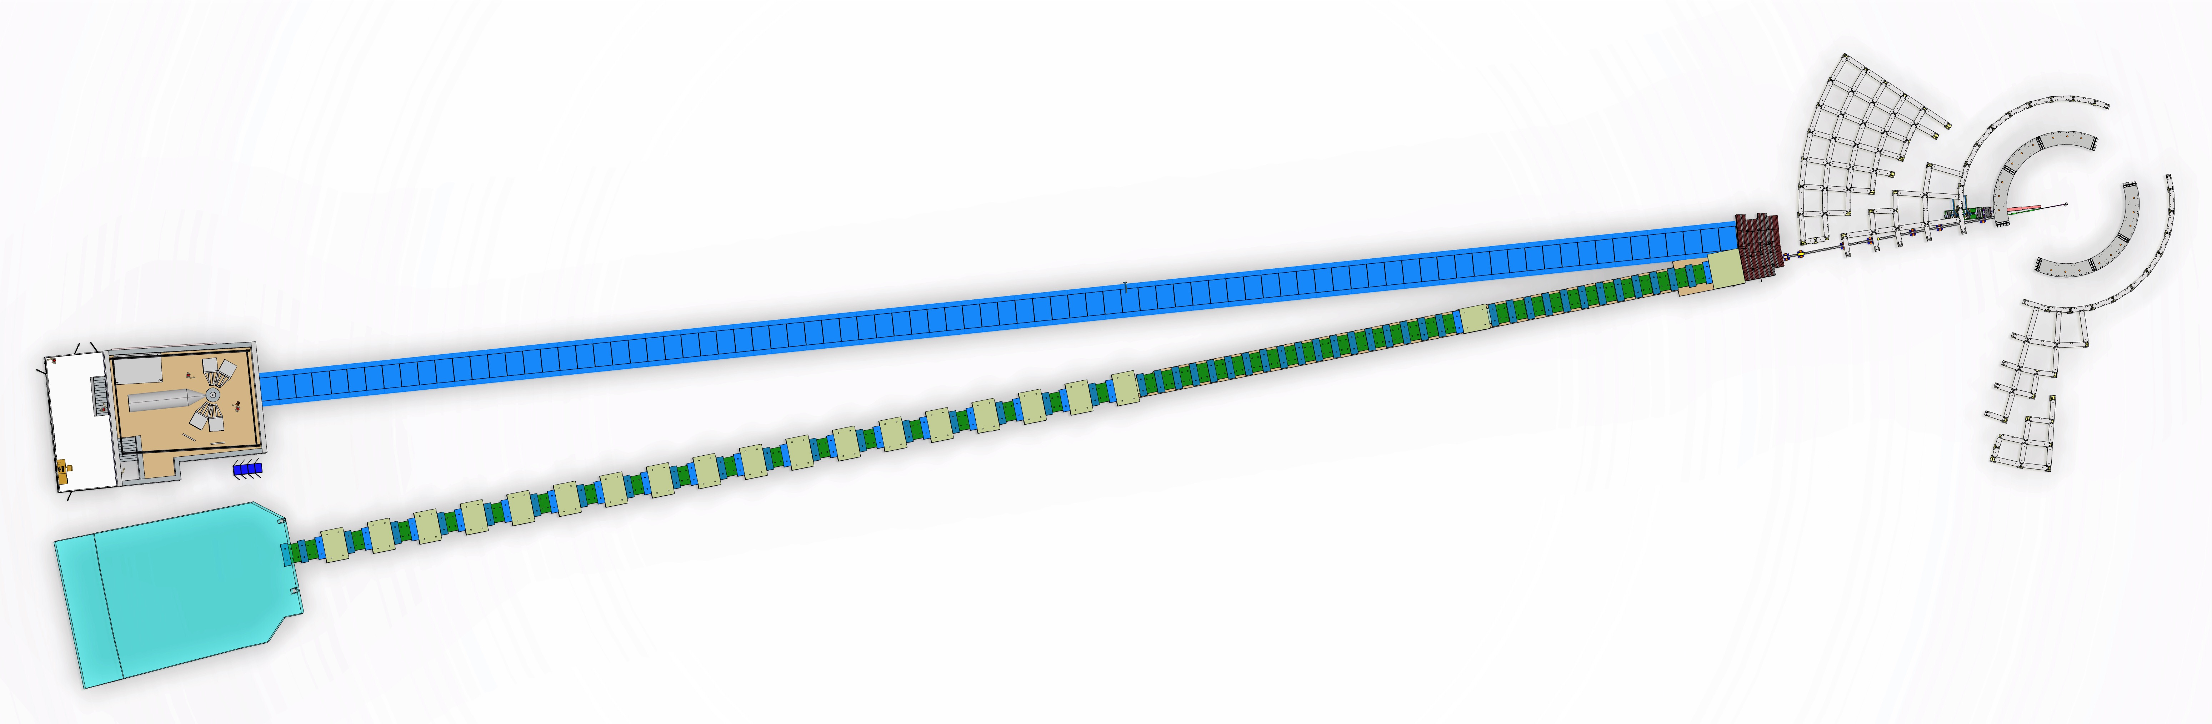
NMX overview
Quasi-Laue TOF diffractometer
Uses full pulse
Moderator-sample distance 157.6 m
~1.75 Å wavelength band (1.8-3.55 Å)
Moderator
Choppers
BEER
Straight guide
Curved guide
Beam extraction
NMX
Detector with high spatial resolution (~0.2 mm)
Variable sample-detector distance (0.2-1.0 m)
Variable 2θ angle (0-165°)
Experimental cave

Slide 13
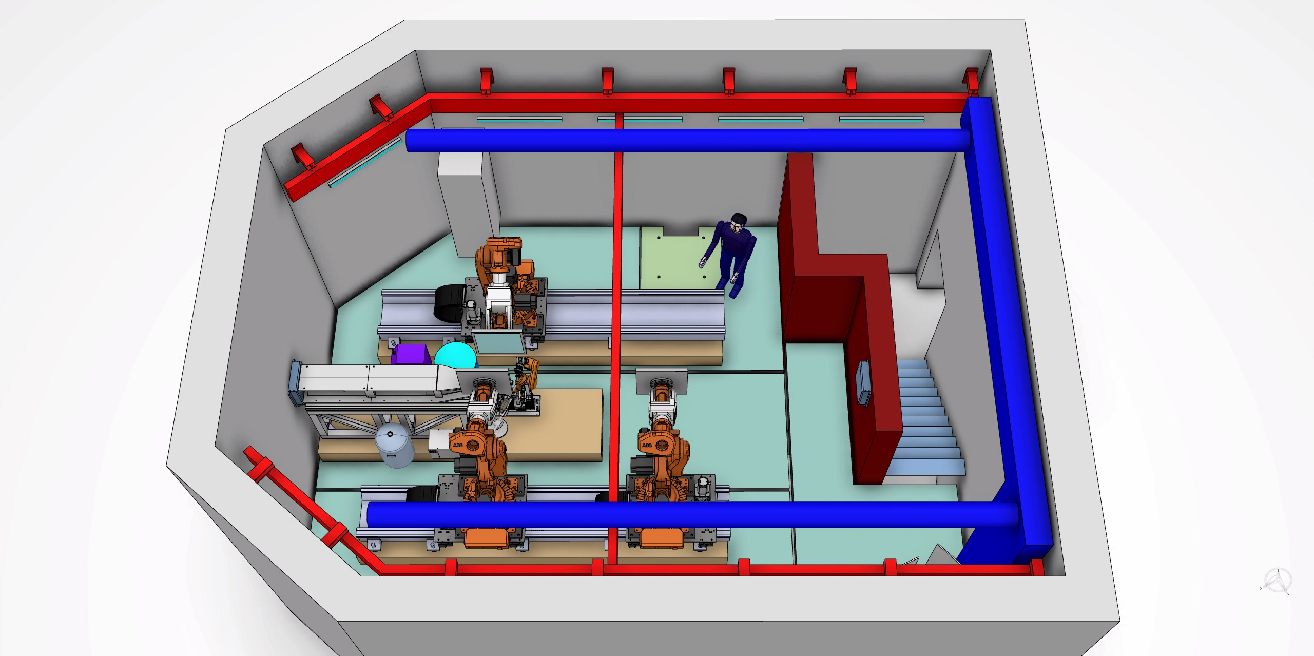
NMX Experimental cave
Detector positioners
Collimation system
Choppers
Sample positioner
Detectors

Slide 14
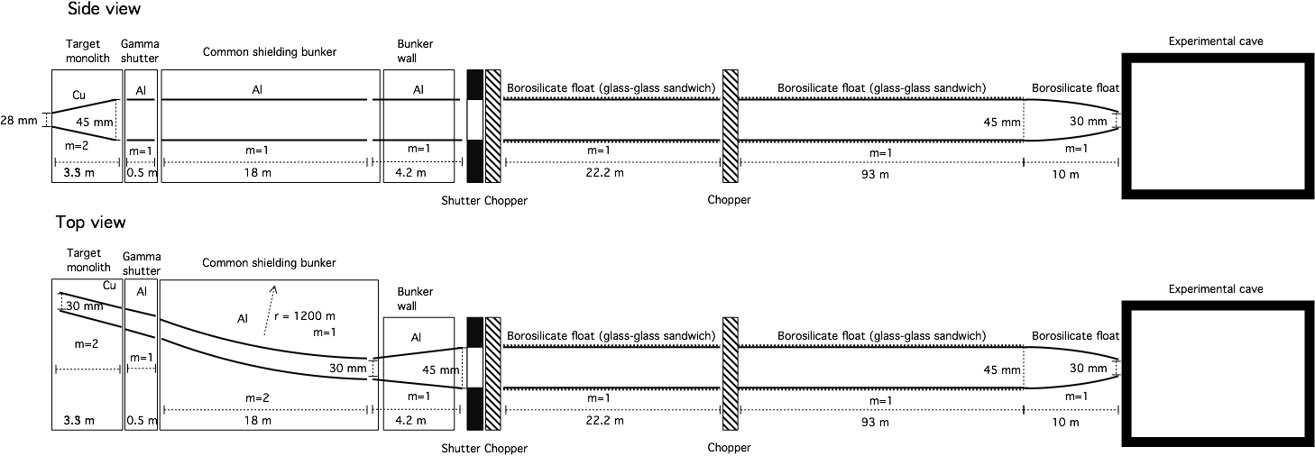
NMX optics
Optics concept was updated from TG2 to match new bunker design & increased robustness
Substrate still under discussion
The instrument should maximise the signal-to-background (S/B) ratio of the Bragg reflections.
Higher flux → Higher signal
Nikolaos Tsapatsaris
Márton Markó

Slide 15
Flux at sample – time averaged
By Monte Carlo simulation 2 x 10⁹ n/s/cm² at ±0.2° divergence
LADI-III 5 x 10⁷ n/s/cm², divergence unclear
PCS 9.7 x 10⁶ n/s/cm² at ±0.1° divergence
Factor 40
Factor 200
NMX makes full use of the long pulse and high-brilliance moderators
Signal/background gain from TOF is difficult to quantify – depends on crystal
The instrument should allow data collection from crystals of < 0.01 mm3 volume
Should be realistic to collect 0.1 mm³ crystal in < 1 day

Slide 16
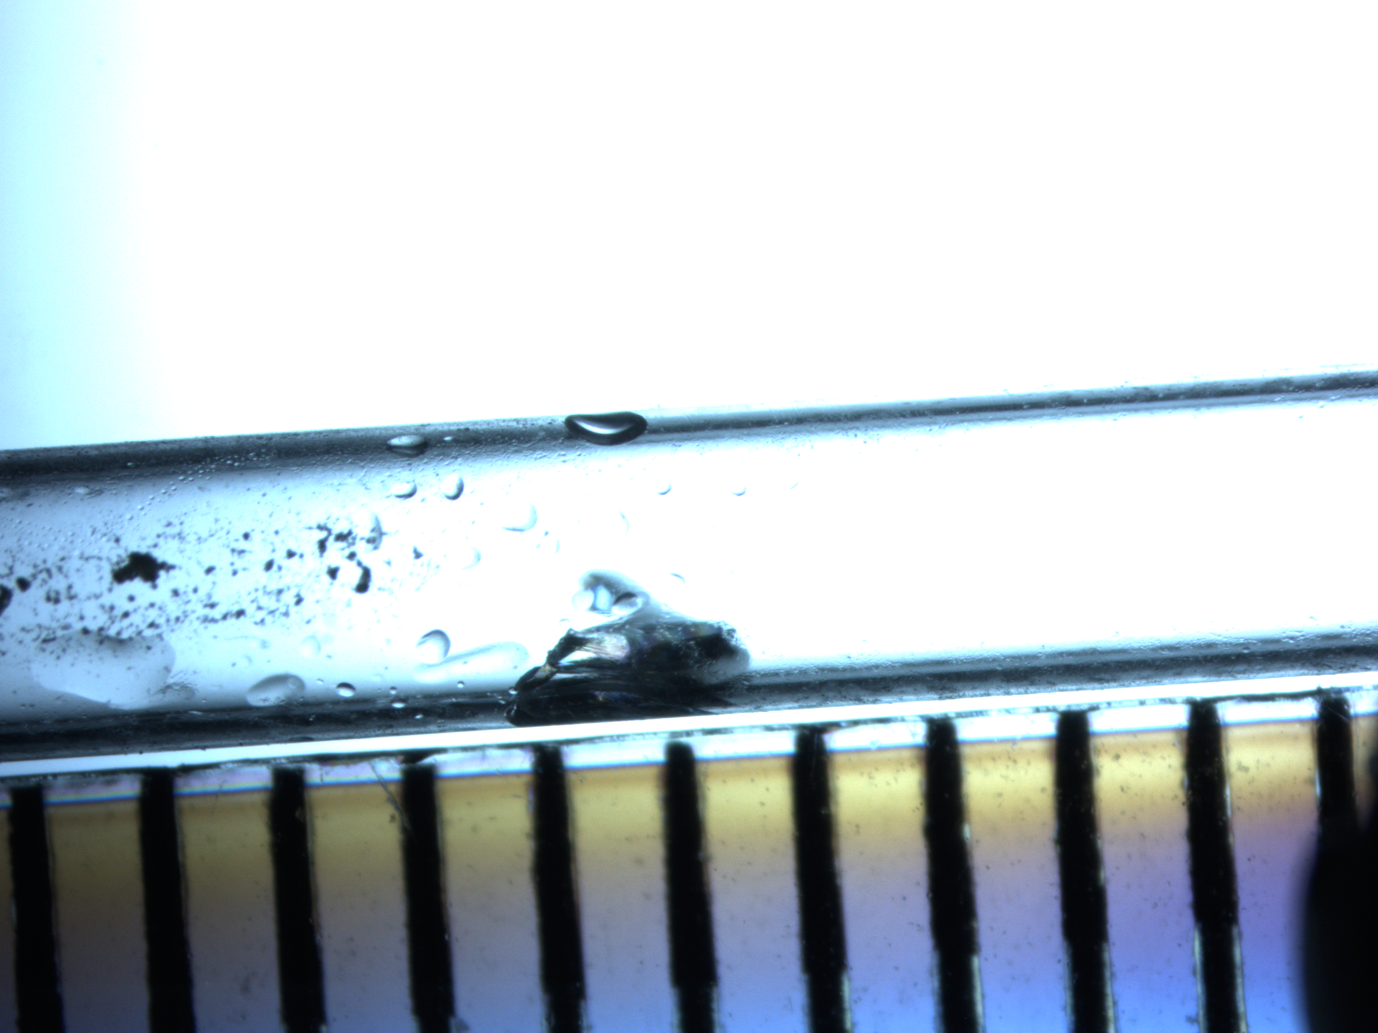
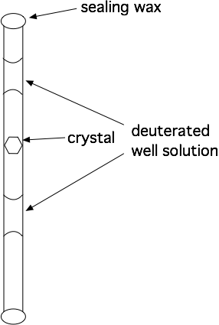
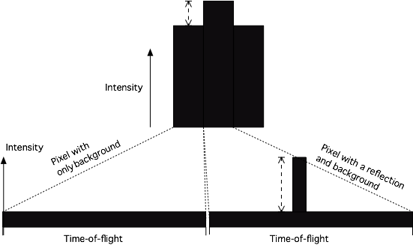
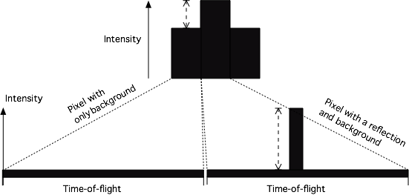
Spreading background over time-of-flight
Background arises mostly from liquid in & around the sample
The instrument shall match the size of the neutron beam to the size of the sample.
The instrument should maximise the signal-to-background (S/B) ratio of the Bragg reflections.

Slide 17
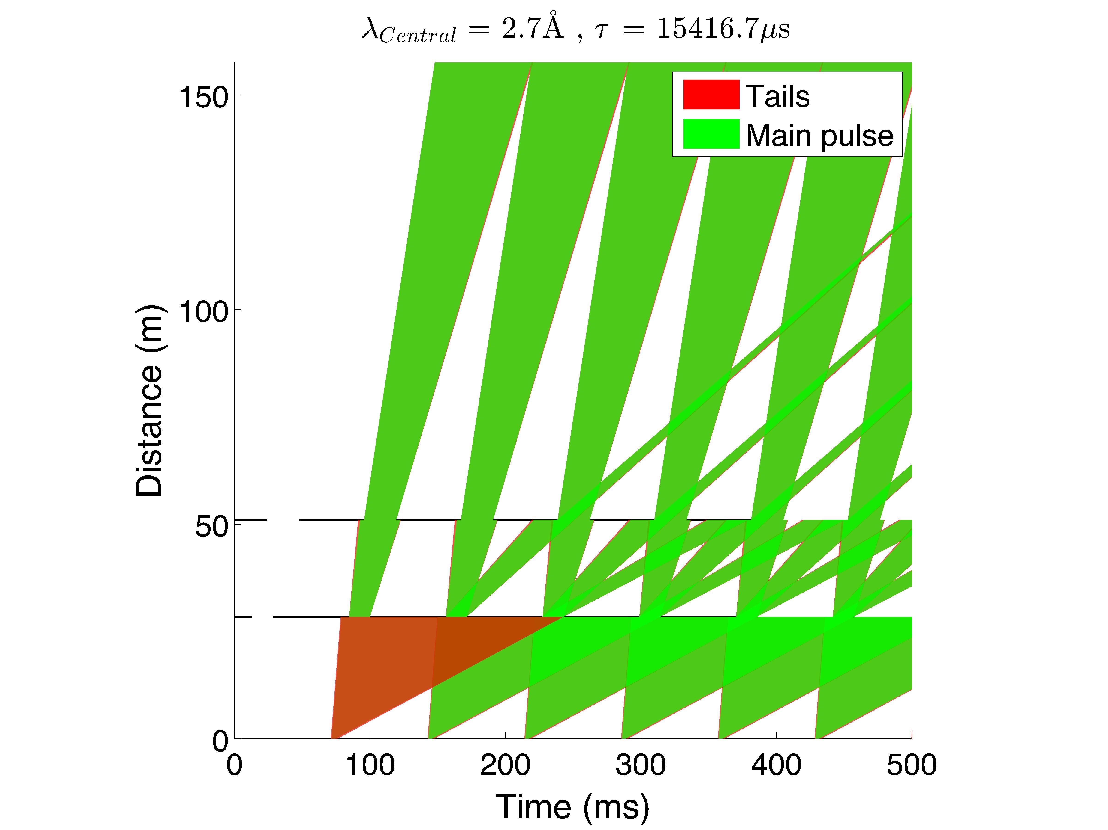
Choppers – selecting wavelengths
Always 14Hz
    Choppers are for wavelength selection
    Single disc chopper at 28.6 m, co-rotating double disc chopper at 51 m
    Transmission has priority
    No choppers in common bunker
Control bandwidth by change of phase and variable openings
Nikolaos Tsapatsaris
Markus Olsson
￼

Slide 18
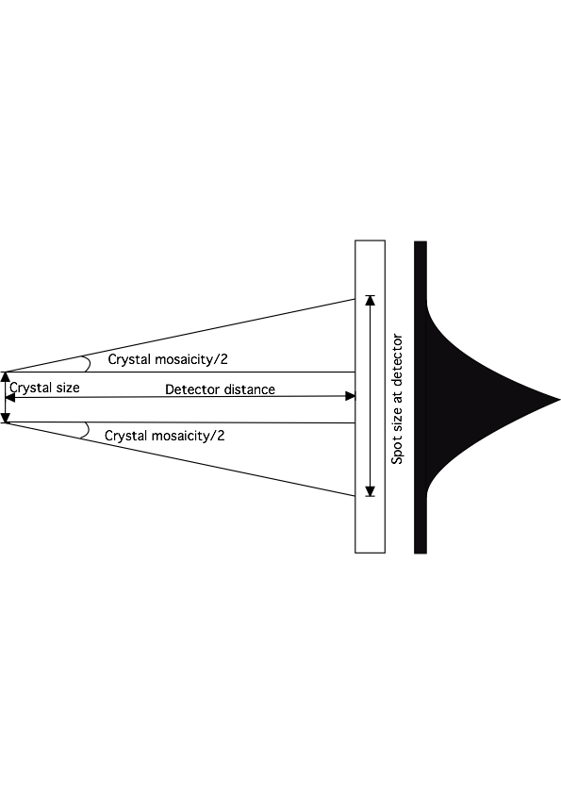
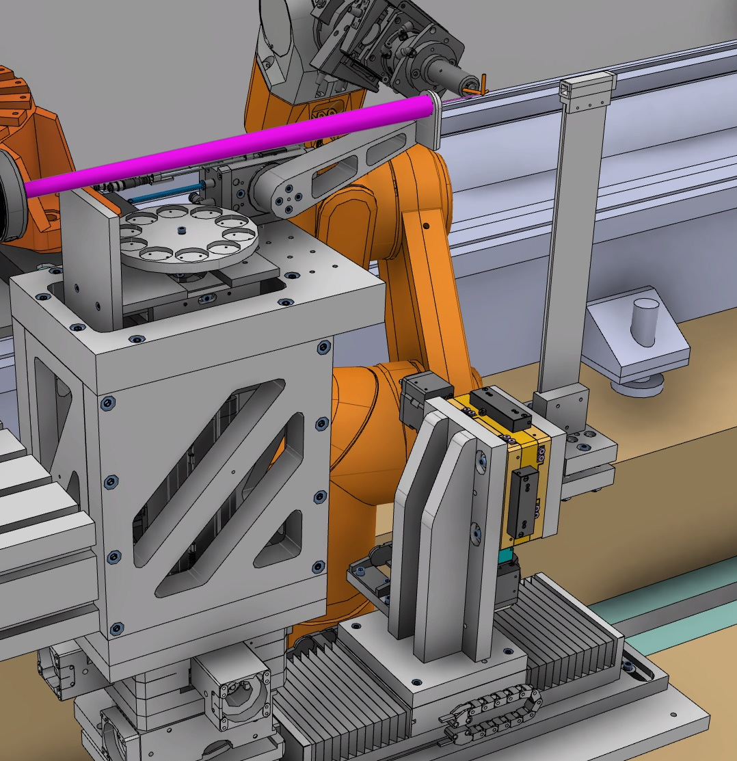
Collimation – matching divergence & beam size
The instrument shall match the size of the neutron beam to the size of the sample.
The instrument shall match the divergence of the neutron beam to the mosaicity of the sample.
Slit 1 – select divergence
Slit 2 – coarse size selection
Selectable pinhole
Sample

Slide 19
What wavelength to use?
Vcrystλ⁴
2Vcell²sin²θ
Ipk =tφ(λ)ε(λ)κ
TDW⟨∣Fhkl∣²⟩
^{I}pk = integrated intensity for an average Bragg peak (n) = duration of measurement (s),
t = duration of measurement (s)
φ(λ)= incident spectral flux at sample (n.cm⁻².s⁻¹.Å⁻¹)
ε(λ) = detector efficiency
κ = conversion factor 1×10²⁴ (cm².bn⁻¹)
Ns = no. of unit cells in sample,
2θ = Bragg angle for reflection,
^{V}cell = unit cell volume (Å³)
^{V}cryst = crystal volume (Å³)
^{T}DW = temperature factor
^{|F}hkl^{|2} = structure factor modulus of reflection hkl squared (bn)
Air absorption is not a problem → Go for long wavelengths!

Slide 20
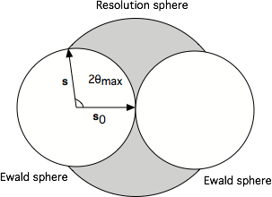
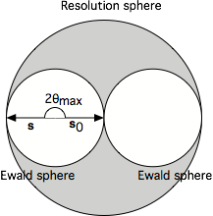
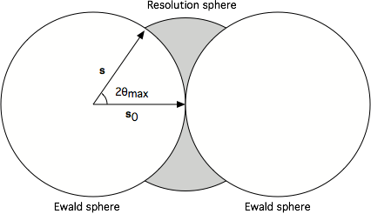
Crystallography with long wavelengths
Scattering power increases with wavelength
Air scattering/absorption is not a problem with neutrons
Long wavelengths require large 2θ
Blind zone gets large
Blind zone
|s| = |s0| = λ⁻¹
Multi-axis goniometry
Large solid angle detectors
The instrument shall allow data to be collected to a dmin of 1.5 Å

Slide 21


Detector geometry
Robotic goniometer allows choice of sample rotation axis direction
Three 50 x 50 cm detectors with 0.2 mm spatial resolution
Sample-detector distance (0.2-1.0 m) and 2θ angle (0-165°) variable by robotic positioning
Solid angle coverage can be traded for unit cell size
Large unit cells will take longer to collect

Slide 22

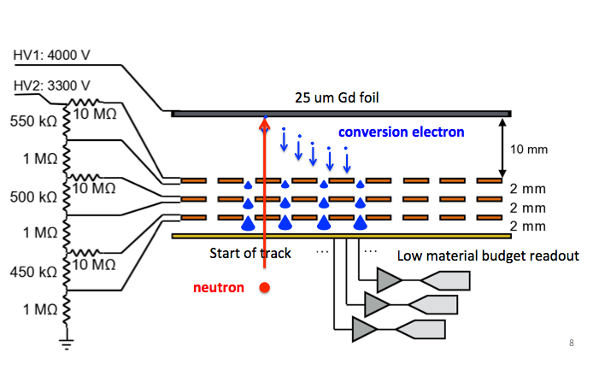
Gd-GEM detectors
Dorothea Pfeiffer

Slide 23
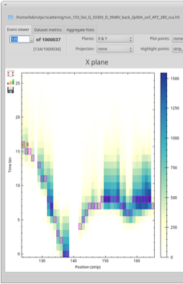
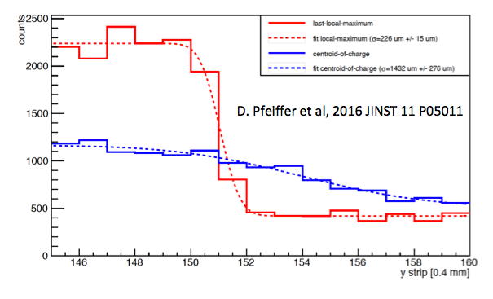
μTPC method gives resolution
Dorothea Pfeiffer, Martin Shetty
Position resolution σ <300 μm reached with Triple GEM, APV-25
Due to scattering, detection efficiency < 12 % at normal incidence of thermal neutrons

Slide 24
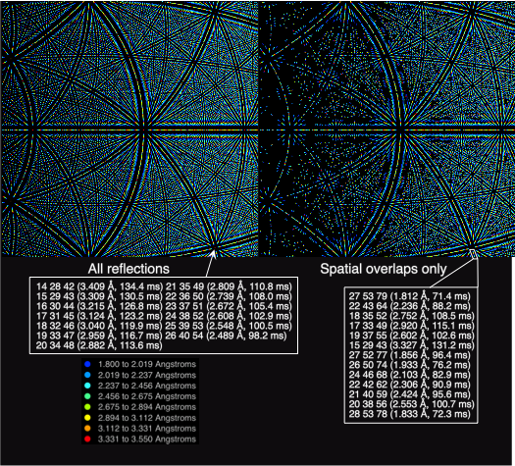
Bovine heart
cytochrome c oxidase
P212121
a = 182.59 Å
b = 205.40 Å
c = 178.25 A
Detector distance 1 m
Generated using the Daresbury Laue Suite
Campbell et al. J. Appl. Cryst. (1998). 31, 496-502
Artz et al. J. Appl. Cryst. (1999). 32, 554-562
Helliwell, J.R. et al. J. Appl. Cryst. (1989) 22, 483−497

Slide 25
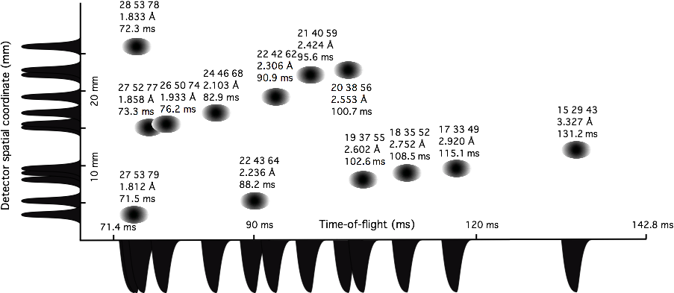
Overlap separation with TOF
The instrument shall allow data collection from crystals with unit cell repeats > 300 Å

Slide 26
Is the proposed engineering design expected to meet the functional and performance requirements?
👍

