Slide 1
NMX – Phase 2 Design Iupdate Review
NSS status and meeting objectives
Shane Kennedy
NSS Project Leader
European Spallation Source ERIC
www.europeanspallationsource.se
22nd June 2017

Slide 2
The 15 NSS Project Instruments
All are funded to be world leading in 2023
Instrument Class | Instrument | Costbook Value (M€) | Performance targets (@ 2MW)
Large Scale Structures | LOKI (Broad band SANS) | 12.19 | 5 x D22 & 20 x SANS2D
 | SKADI (General Purpose SANS) (+SONDE funds) | 11.50 | 4 x D22
 | ESTIA (Focusing Reflectometer) | 11.80 | Conventional mode: ~ 100 x D17 High intensity mode: 1cm² samples = seconds
 | FREIA (Liquids Reflectometer) | 13.2 | 30 x FIGARO, INTER
Diffraction | DREAM (Bispectral powder diffractometer) | 13.66 | > 10 x POWGEN or WISH
 | HEIMDAL (Hybrid diffractometer) | 13.55 | ~ 50 x GEM, ~ 8 x new POLARIS
 | MAGIC (magnetism single crystal diffractometer) | 13.10 | Cold: > 100 x worlds best, Thermal: 1mm³ crystals = 10 min
 | NMX (Macromolecular crystallography) | 11.67 | > 10 x LADI & Biodiff
Engineering & Industrial | BEER (Engineering diffractometer) | 14.99 | world leading in strain scanning, unique flexibility
 | ODIN (multi-purpose imaging) | 11.60 | world leading for high resolution, > 10 x best for TOF methods
Spectroscopy | BIFROST (extreme environment spectrometer) | 13.45 | > 10 x THALES & MACS
 | C-SPEC (cold chopper spectrometer) | 16.50 | 100 x IN5 (w RRM)
 | T-REX (bispectral chopper spectrometer) | 16.85 | 3 x 4-SEASONS, 3 x IN5
 | VESPA (vibrational spectroscopy) | 12.0 | 10 x VISION (ΔE = 130 meV)
 | MIRACLES (backscattering spectrometer) | 13.53 | 2 x BASIS and DNA
Total cost book value |  | 199.59
With a further ~ 53 M€ investment ESS will more than double the performance of these instruments

Slide 3

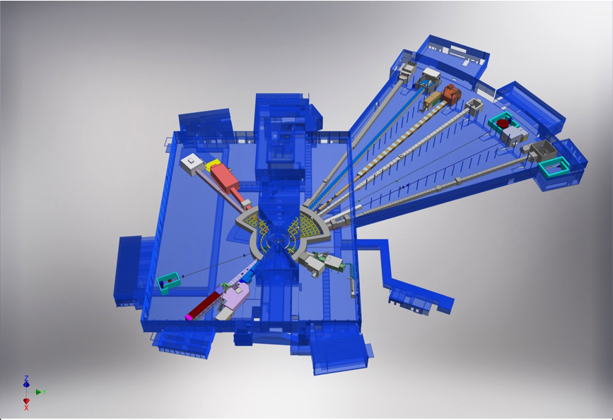











NSS Neutron Instrument positions:
December 2016
ESS Lead Partners for instrument construction
+
Nuclear Physics Institute
NMX
BEER
+
C-SPEC
BIFROST
MIRACLES
MAGIC
ODIN
T-REX
DREAM
HEIMDAL
LoKI
VESPA
FREIA
SKADI
ESTIA
+
ESS In-Kind Partners also collaborate on sample environment, data management systems etc.
ESS Instrument Layout (December 2016)

Slide 4
Neutron Instruments: Phase 1 schedule
2016-17 | Jul | Aug | Sep | Oct | Nov | Dec | Jan | Feb | Mar | Apr | May | Jun
LOKI (P2)
SKADI
ESTIA
FREIA
NMX (P2)
MAGIC
HEIMDAL
DREAM
BEER
ODIN
C-SPEC
BIFROST
MIRACLES
T-REX
VESPA
29
10
20
29
17
19
31
31
13
8
14
STAP
scope-setting
TG2
14
7
5
24
12-13/9
7
3
12
24
21
28
8
27
IKON11
ICB
SAC
COUNCIL
IKON12
ICB
SAC
COUNCIL

Slide 5
NSS Project; Neutron Instrument project phases
Proposal and Planning
Design and Construction
Installation and Commissioning
Instrument Proposal
Phase 0
Preparation for Design
Phase 1
Preliminary Design
Phase 2
Detailed Design
Phase 3
Manufacturing and Procurement
Phase 4
Installation and Integration
Phase 5
Hot Commissioning
Deliverables
Science case covering scientific relevance, impact and usage
Conceptual design with credible estimates of performance
Preliminary costing.
Deliverables
Conceptual design updates
Prototyping
Definition of facility requirements and interfaces
Clarification of institutional responsibilities
Resource planning
Deliverables
Scientific and technical requirements
Technical design concept
Delivery plan for all phases (including hot commissioning)
Delivery Schedule covering all phases
Resource plan
Staging plan for later enhancements
Budget with contingency at 10% of cost to complete
Deliverables
Complete definition of all major technical components
Completion of detailed plan for Phase 3
Refined plan for phase 4
Refined Resource plan
Refined delivery schedule, with critical path items and dependencies
Refined budget with contingency at 10% of cost to complete
Deliverables
Procurement and manufacture of all major technical components
Completion of detailed plan for phase 4
Site preparation
Refined plans for phase 5 and for staging
Refined Resource plan
Refine instrument delivery schedule
Maintain budget with contingency at 10% of cost to complete
Deliverables
Construction of physical infrastructure on site.
Assembly and installation of technical components
Integration and testing of technical components
Installation, integration and testing of Personnel Safety System
Submission of application for approval to hot commission
Formal project completion
Deliverables
Verification of performance of Personnel Safety System
Proof of compliance with radiation dose limits
Critical performance demonstration of basic functionality
Scientific performance demonstration
Friendly user experiments
Completion of technical and user manuals
Tollgate 1
STAP review
SAC recommendation
NSS recommendation
STC approval
Tollgate 2 (PDR)
Preliminary Design Review
STAP review
NSS
scope review
assign cost book value
Approval by SD
Tollgate 3 (CDR)
Critical Design Review
STAP review
ICB review
NSS approval
Tollgate 4 (IRR)
Installation Readiness Review
ICB review
NSS approval
Tollgate 5 (SAR)
Safety systems acceptance review
NSS approval
Tollgate 6 (ORR)
Operations readiness review
NSS approval

Slide 6
Planned order of commencement of operation of first 8 instruments (August 2023)
Matching early success in delivery of scientific outputs with the capacity of Lead In-Kind partners to deliver on schedule (ISIS, PSI, FZJ, LLB, HZG/NPI, TUM/PSI, TUM/LLB & DTU lead consortium).
Instrument Class | Sub-class | Candidates
Large Scale Structures | Small Angle Scattering | LOKI (ISIS) or SKADI (FZJ)
 | Reflectometry | ESTIA (PSI) or FREIA (ISIS)
Diffraction | Powder Diffraction | DREAM (FZJ) or HEIMDAL (ÅU)
 | Single crystal diffraction | MAGIC (LLB) or NMX (ESS)
Engineering | Strain scanning | BEER (HZG/NPI)
 | Imaging and tomography | ODIN (TUM/PSI)
Spectroscopy | Direct Geometry | C-SPEC (TUM) or T-REX (FZJ)
 | Indirect Geometry | BIFROST (DTU), MIRACLES (Bilbao), VESPA (CNR)
Instruments in bold type to be operational by Aug 2023
Italic:
backups in case of delays

Slide 7
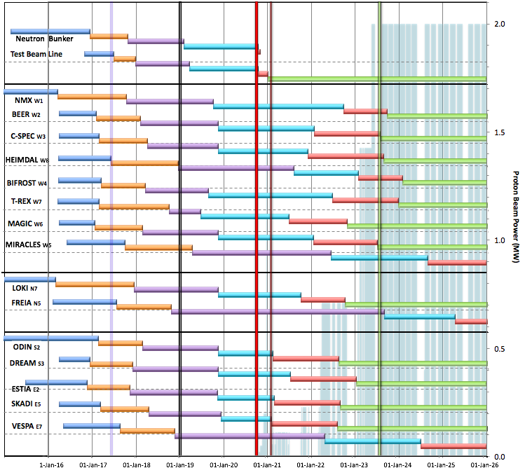

Internal* Neutron Beam Instrument Schedule
Draft for Discussion V3.3, 10th June 2017
Current date
First access to NSS areas
Hot Commission
instruments
Start User Program
* still under discussion with ESS-ERIC Council
Beam on Target
NOTES:
Assumes 2MW maximum power until end 2025
Phases aligned with TG2 reviews on 1st 9 NBIs
Installation & Integration (TG4) + Hot Commissioning (TG5) for first 8 NBIs aligned with draft BOT plan (schedule match typically within 1 month)
West sector
North sector
East and South sectors
Preliminary Design
Detailed Design
Manufacturing & Procurement
Installation & Integration
Hot Commissioning/Early science
Operation
2016 2017 2018 2019 2020 2021 2022 2023 2024 2025
Installation for most instruments begins in Q2/2019 with in-monolith optics
Access to other “instrument construction areas” will be later

Slide 8
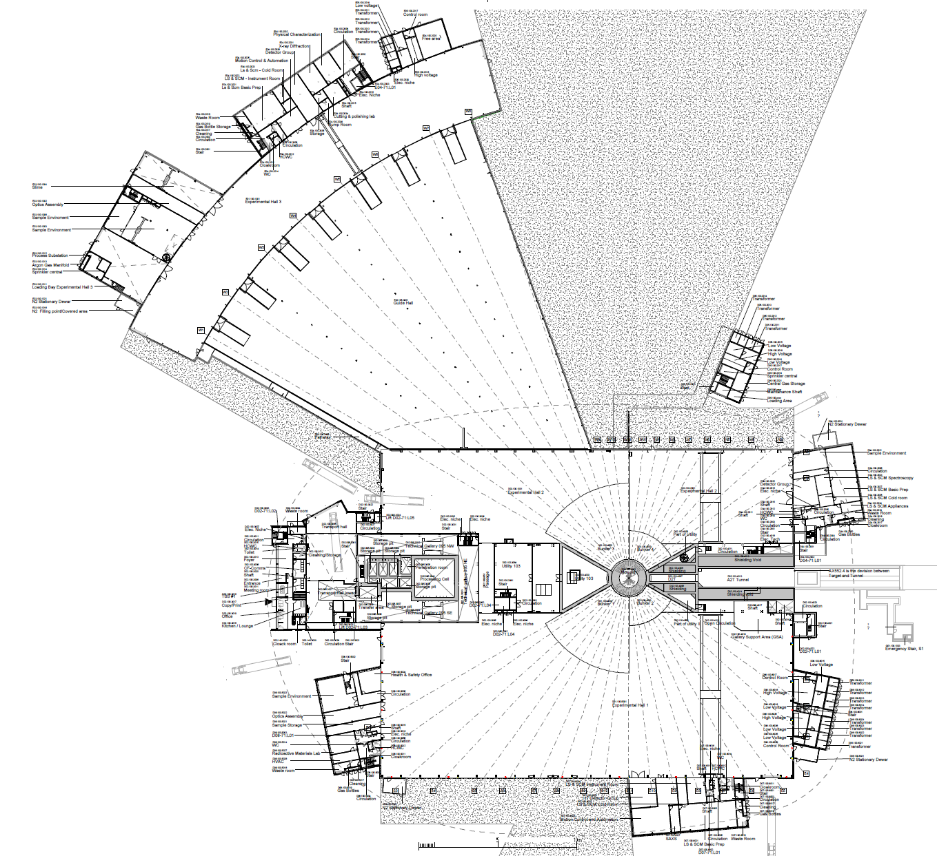
2019/2020: NSS Proposed Access Dates (Excludes Full Access Dates)
1
D08 RML Lab – Early Access 10-Jan-19 (Level 1b MS)
E05
2a
E01 – Full Access 27-Apr-19 (Level 1 MS)
E04
2b
E02 Area 1 – Partial Access 27-Apr-19 (Level 1 MS)
3
D03 Bunker – * Early Access 03-Jun-19 (Level 1 MS)
E01
2a
4
D01 Bunker – * Early Access 14-Aug-19 (Level 1 MS)
E03
2b
5
E02 Area 2 – Partial Access 15-Oct-19 (Level 1b MS)
6
D03 Main Hall – Partial Access 01-Nov-19 (Level 1b MS)
E02
7
D01 Main Hall Ph 1 – Partial Access 06-Jan-20 (Level 1b MS)
Exact Location of Final De-Lineation Point TBC
5
8
D01 Main Hall Ph 2 – Partial Access 02-Mar-20 (Level 1b MS)
D05
D04
Additional Area Made Available for Storage of Blocks (D03) for NSS: 01-Sep-19
6
3
D03 Cranes Operational: 13-Aug-19
4
D06
D08
8
Additional Area Made Available for Storage of Blocks (D01) for NSS: 01-Oct-19
1
7
D01 Cranes Operational: 28-Oct-19
Area Under Review for Possibilities of Early Access for NSS
D07

Slide 9
NSS Floor loading limits:
Reduced in D01 & D03 in February 17
E05
E04
Under the bunker (D02 & inner parts of D01 & D03); 30 t/m²
In the rest of D01 & D03
      In general (under guides & instrument caves); 14 t/m²
      Around perimeter (3 metres from wall); 10 t/m²
      Staging areas (near truck access doors); 20 t/m²
In E01 & E02 (long instruments in west sector); 20 t/m²
E03
D04
D06
D08
D07

Slide 10
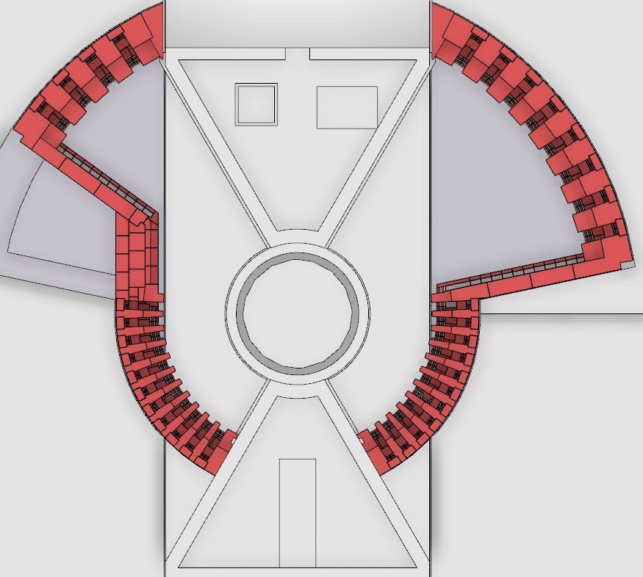
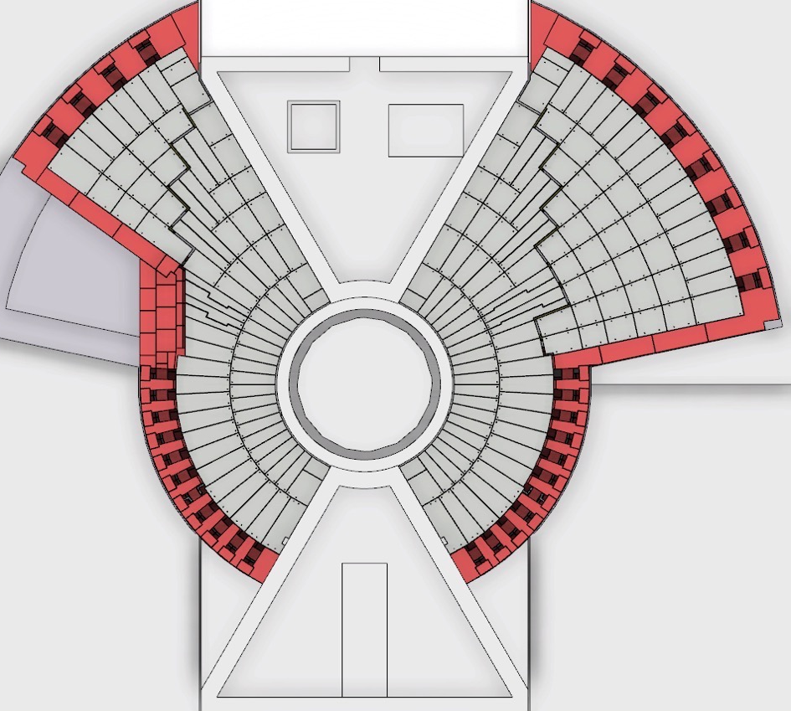
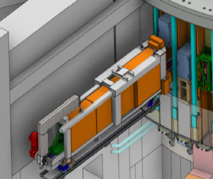
Preparing for BOT and first BOI:
In bunker activities
NMX
First installations in bunker:
(Feb – Sept 2019)
Neutron Beam Optics in monolith & light shutters
ODIN
BEER
DREAM
C-SPEC
BIFROST
MIRACLES
MAGIC
T-REX
HEIMDAL
S2
W1
S3
W2
W8
Next installations in bunker:
(from Nov 2019 – May 2020)
Bunker Optics for first 4 – 8 Neutron Beam Instruments
W11
Test Beamline
E5
N7
E3
N5
E2
LoKI
VESPA
FREIA
Bunker roof completed:
(from Jun – Aug 2020)
Bunker Optics for first 4 – 8 Neutron Beam Instruments
SKADI
ESTIA

Slide 11
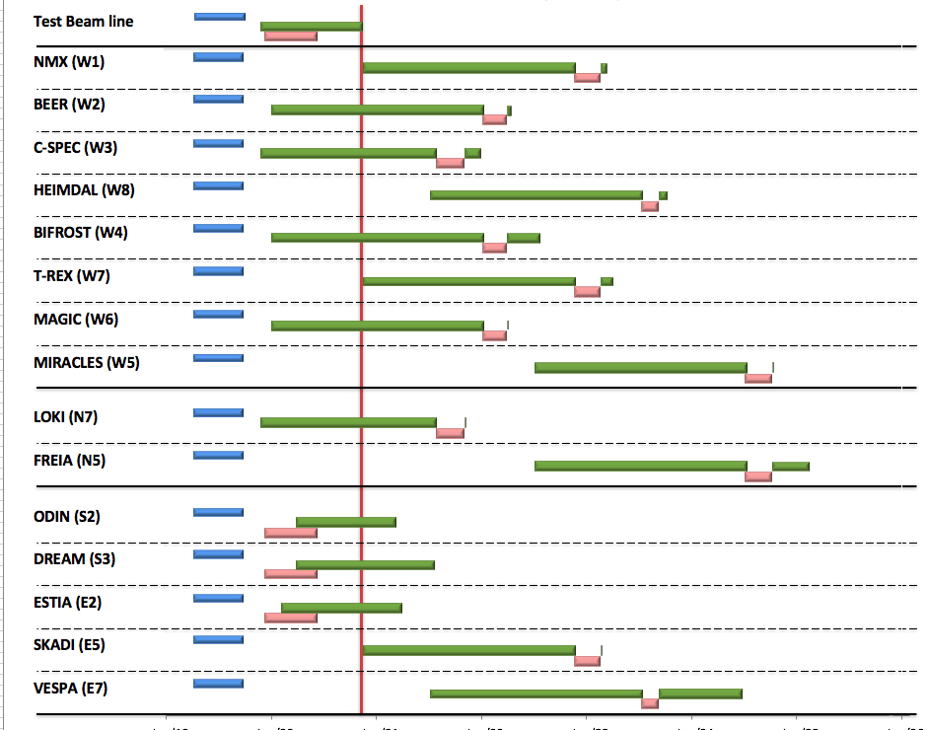
Internal* NBI Installation Schedule (TG4 –> TG5)
Draft for Discussion (from V3.3, 10th June 2017)
* BOT still under discussion with ESS-ERIC Council
Hot Commission
instruments
Start User Program
Beam on Target
NOTES:
Plan aligned with access dates to D & E buildings
TG4 (Installation & Integration) according to on-site resource plan & aligned with first 8 NBI schedules (schedule match typically within 1 month)
Alignment with TG5 for NBI 9-15 not yet complete
On-site Resource plan under development
In monolith complete
In bunker complete
Out of bunker
TG5 (Hot Commission)
12 – 18 months
2019 2020 2021 2022 2023 2024 2025

Slide 12
Neutron Instrument Hot Commissioning and Early Science (prior to User Program)
PHASE 5 -Neutron Instrument Hot Commissioning
Safety systems commissioning
  Personnel safety systems confirmed to be operational.
  Radiation dose levels verified to comply with operational requirements.
  Where necessary, corrective measures bring radiation dose levels into compliance.
Critical performance verification
  Critical performance requirements verified by measurement.
  Any critical performance shortfalls rectified before moving into operations.
Scientific Performance Demonstration
  Standard ‘benchmark’ measurements to satisfy expectations of scientific quality.
  Friendly user experiments test the instrument capabilities, with scientists who have been involved construction. – Any technical problems encountered should be solved.
  Measurements selected on their potential to produce exciting scientific results.
Tollgate 6 – Neutron Instrument Operations Readiness Review
All operational documents (technical reports, drawings, user manuals, safety procedures)
Changes and modifications made during the beam testing phase
Neutron Instrument operation and maintenance plans.

Slide 13
ESS Proton Production Schedule
DRAFT FOR DISCUSSION
Start User program: Aug. 2023 (Level 0 MS)
Production 200 days/yr @ 2 MW
BOI#9, #10 & #11
BOI#6, #7 & #8
BOI#4 & #5
<- (BOI#12 -15) ->
Commission
Accel/Target
BOI#1
(L1-MS)
BOI#2 & #3
Ready for BOT (L1-MS)
Ref: NSS MS V3.3

Slide 14
NSS Project management
Director for Science
Andreas Schreyer
ESS Technical Board
Chair: Roland Garoby
Project Leader: Shane Kennedy
Deputy Project Leader: Oliver Kirstein
Instrument Collaboration Board
Chair: Andreas Schreyer
Safety and Licensing:
Lead: Arno Hiess
Neutron Instruments:
Lead Scientist: Ken Andersen
Lead Engineer: Gabor Laszlo
In-Kind Office:
Lead: Michela Del’Anno Boulton
Integration Activities:
Lead: Zvonko Lazic
Planning:
Lead: Sofie Ossowski
SSM application
Partner coordination
Neutron Bunker
Budgets & workflow
LOKI (ISIS)
ODIN (TUM/PSI)
Safety Systems analysis & design
Requirements & Standards
Schedule
SKADI (FRJ)
BEER (HZG/NPI)
Memoranda of Understanding
ESTIA (PSI)
Risk Management
Systems Engineering
Four Instrument Classes
Large scale structures
Engineering & imaging
Spectroscopy
Diffraction
C-SPEC (TUM)
Technical Annexes
FREIA (ISIS)
T-REX (FZJ)
In-Kind Collaboration Agreements
Conventional Facilities
DREAM (FRJ)
BIFROST (DTU)
Target Project
HEIMDAL (ÅU)
MIRACLES (ESS Bilbao)
Instrument Class Co-ordinator (scientist) assigned to each instrument
NMX (ESS)
VESPA(CNR)
MAGIC (LLB)

Slide 15
Interface Management & Support
Science Divisions:
DMSC, NID, NTD, SAD
Integrated Systems
Neutron Bunker
Beam inserts
Choppers
Transport optics
Vacuum systems
Electrical systems
Shutters
Shielding
Cranes
Penetrations
Grounding
Services
Controls & sensors
Remote handling
Safety systems
Integrated Processes
In-kind agreements
Installation planning
Installation co-ordination
Project Management
    Tollgates
    Schedule
    risk
Resource management
Safety management
Technical annexes
NSS Project Integration Team (12 roles)
TBA
Iain Sutton
Gabor Laszlo
Antonio Bianchi

Slide 16
Objectives for this meeting
This is not a tollgate 2 meeting, nor is a a tollgate 3 meeting
– but we hope that NMX is nearly ready for that.
This meeting should identify
how well NMX is progressing in Detailed Design,
what key issues are to be addressed before TG3,
What early procurements are needed, and
ensure NMX team is up to date on all related activities in the NSS project.
(ESS-0051706)

Slide 17
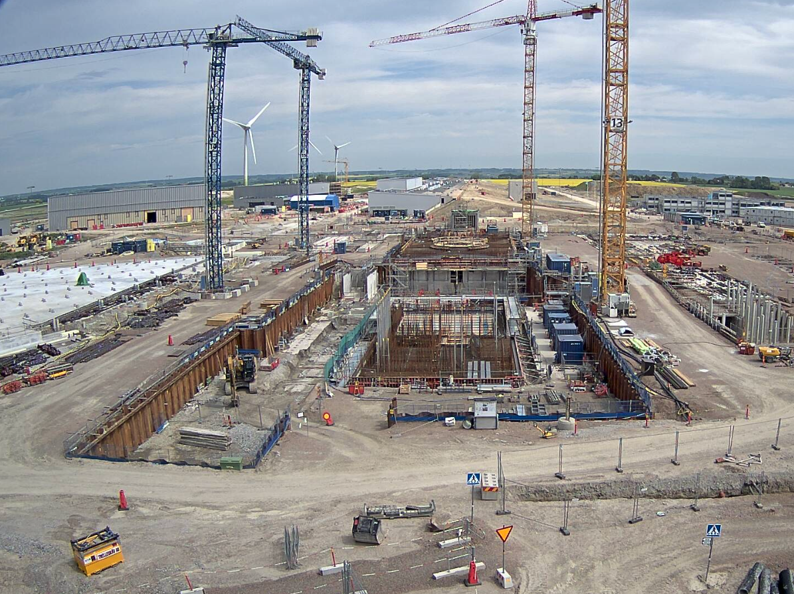
Central Utilities Building (CUB)
LINAC
Site
Offices
East sector Instruments
West sector (160 m) Instruments
Target
South sector Instruments
May 2017

Slide 18
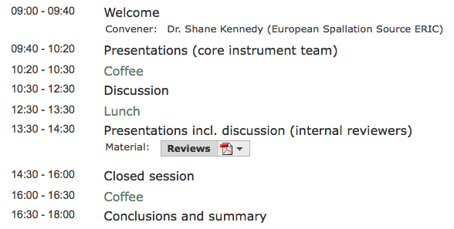
Agenda for NMX Phase 2 design Update
Thursday, 22nd June 2017
Dr. Shane Kennedy

Slide 19
Phase 2: detailed design (1/2)
Aim: To bring the design of the Neutron Instrument components to a state of readiness for Manufacturing and Procurement (M&P).
Essential achievements:
Complete detailed design of all major components coherently so as to minimize risk of incompatibilities and need for redesign work as the Project moves into Phase 3: M&P.
Detailed planning for M&P. Note Phase 2 does not include M&P.
Exception: where long lead-time procurements add considerable risk to project schedule.
Approval to begin early M&P: by NSS Project via Neutron Instruments Lead Engineer (Gabor Laszlo).
Detailed planning for Phase 4: Installation and Integration.
Technical Annexe for whole of project to be completed within 3 months of Phase 2
Template for the TA was distributed in March

Slide 20
Phase 2: detailed design (2/2)
Notes on Phase 2:
Careful scheduling of Phases 3 & 4 ensures resource planning for M&P processes (e.g. FAT & SAT), site preparation, installation and system integration, cold commissioning activities and licensing processes.
Critical dependencies should be identified and a critical path analysis should be performed in this phase.
The NSS Construction Engineer will develop and maintain an integrated installation plan that takes into account the procurement schedules for all Neutron Instruments, CF building schedules, and resource allocation.

Slide 21
Objectives for this meeting (1/2)
High level questions:
has adequate planning been done to move the project into Phase 2?
is the proposed budget consistent with the proposed scope?
does the preliminary design satisfy the requirements?
is the presented baseline technically sound?
has anything been forgotten or neglected?
where several In-kind partners are collaborating - are roles and responsibilities adequately defined and agreed?
(ESS-0043330)

Slide 22
Objectives for this meeting (2/2)
Low level questions:
have safety-related aspects been appropriately considered?
to what extent have appropriate connections been made with the critical project interfaces, such as software, data storage hardware and sample environment?
Has the instrument context been appropriately considered in terms of physical interfaces, such as bunker, beam extraction, ICS etc. ?
to what extent have available engineering standards been implemented appropriately?
are the cost and duration estimates reasonable?
to what extent has the team planned appropriately for the risks, both technical and otherwise?
to what extent have Reliability and Maintenance aspects been appropriately considered?
(ESS-0043330)

