Slide 1
BPM Electronics
Conceptual Design Review
BPM Test results
Rafael A. Baron
Lund - Sweden
2017 - May

Slide 2
BPM Electronics design
BPM electronics
BPM ADC raw data
BPM decimated phases and amplitudes
BPM Phase relative to reference line
BPM positions

Slide 3
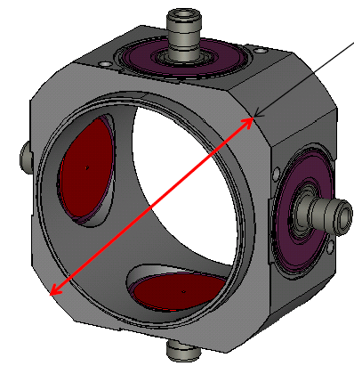
BPM system design
Phase Reference Line
Local
oscillator
Sampling
clock
LO generation / distribution
Standalone unit or MicroTCA.4 AMC
Ref
Position
Interlock
RF Front-End
MicroTCA.4 infra-structure
Calibration
AMC digitizer
(SIS8300-KU)
User interface
RF analog processing
Analog down conversion
ADC
FPGA - Digital signal Processing
Data management and data processing - CPU
Long Cables
RTM (DWC10LF)
Calibration trigger
Timing receiver
Power supply and crate management
Ethernet
MicroTCA.4 crate
BPM sensors
Timing system

Slide 4
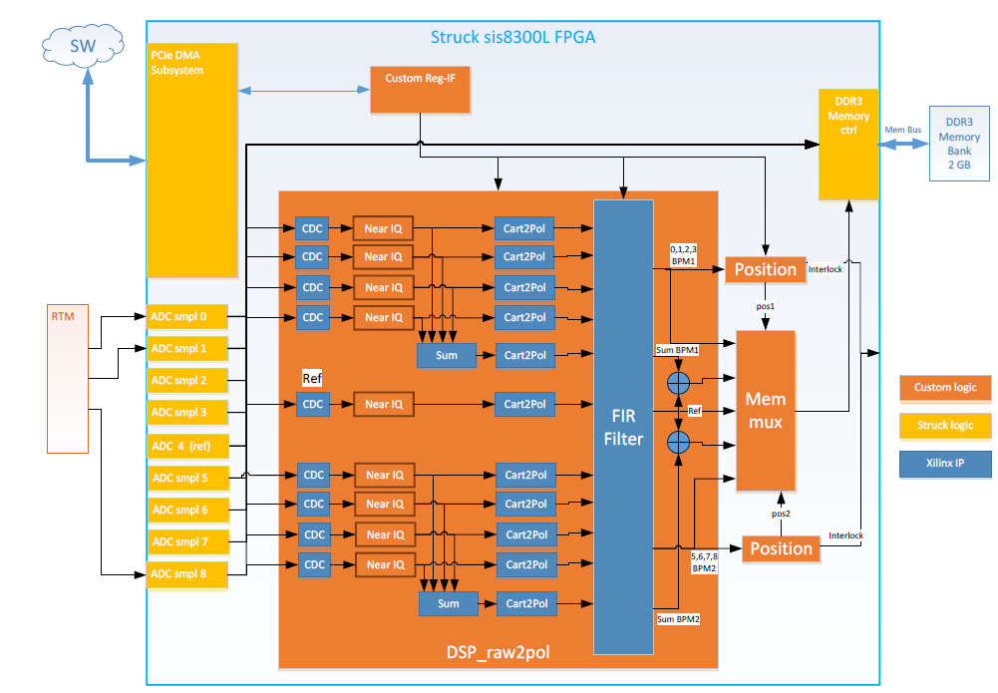
BPM Electronics
System architecture
Local
oscillator
Sampling
clock
Position
Interlock
Phase Reference Line
Timing System

Slide 5
BPM Electronics
Functionalities
ADC raw data at a rate of Fs (in general, ~88 MHz is used)
Data decimation: amplitudes and phases for all the BPM channels and reference
BPM Phase measurements relative to phase reference line
BPM Position measurements

Slide 6
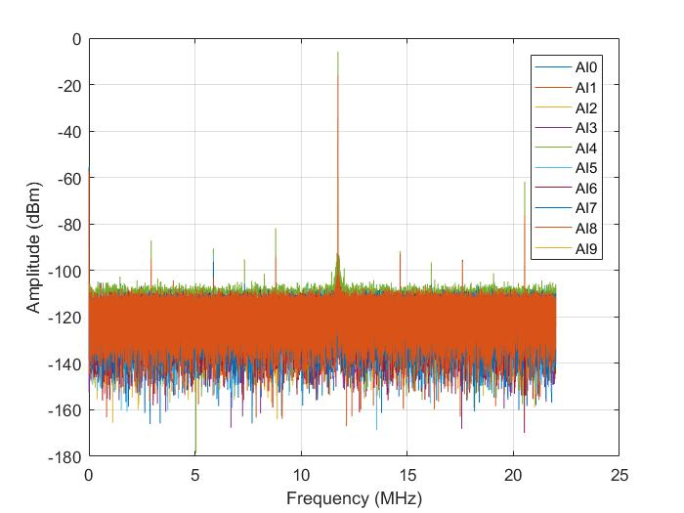
BPM Electronics
System architecture
ADC raw data
  Data at ~88 MHz with no digital processing

Slide 7
BPM Electronics
System architecture
Decimated single channel phases and amplitudes
  Data at ~5 MHz with digital processing
  ~2.5 MHz signal bandwidth

Slide 8
BPM Electronics
System architecture
Phase of each BPM relative to reference line
  Data at ~5 MHz with digital processing
  ~ 2.5 MHz input signal bandwidth

Slide 9
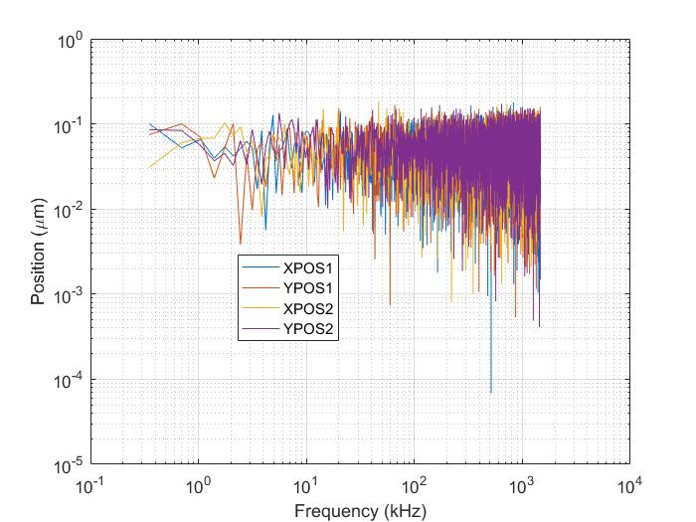
BPM Electronics
System architecture
Position X and Y of each BPM
  Data at ~5 MHz with digital processing
  ~ 2.5 MHz input signal bandwidth
  Position interlock capability

Slide 10
BPM Electronics
System architecture
Phase as function of input power
  Resolution and accuracy measurements for different beam conditions
Equivalent to a typical LWU BPM response for short pulse (5 us) and ~ 6 mA
Equivalent to a typical LWU BPM response for long pulse (2.86 ms) and ~ 63 mA

Slide 11
BPM Electronics
System architecture
Position as function of input power
  Resolution and accuracy measurements for different beam conditions
Equivalent to a typical LWU BPM response for short pulse (5 us) and ~ 6 mA
Equivalent to a typical LWU BPM response for long pulse (2.86 ms) and ~ 63 mA

Slide 12
Thanks!
Questions?

