Slide 1
LLRF for RF review
11-12 May 2017
Anders J Johansson
Lund University
v.1.1

Slide 2
LLRF system : General view
Klystron HV
Beam current

Slide 3
High level LLRF architecture
Procedures
  Schemes that involves longer times and multiple pulses.
Algorithms
  Updates that takes place between pulses (68 ms).
Functions
  Real-time control within a pulse (3.5 ms).
CPU
Procedures
Scripts
EPICS
CPU
Algorithms
Software
LLRF
PCIe
FPGA
Functions
Firmware

Slide 4
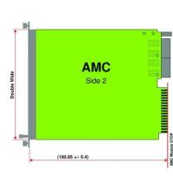
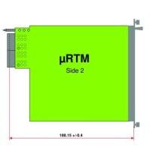
352.21 MHz MTCA.4 example - Spoke
CPU
CB control on backplane
Timing triggers
MCH supervision
External I/O
Ethernet on backplane
LO-generation
Phase referense
Cavity Pickup
VM out
PreAmp Out
PowerAmp out
PowerAmp Refl
Cavity In
Cavity Refl
Phase referense
Cavity Pickup
VM out
PreAmp Out
PowerAmp out
PowerAmp Refl
Cavity In
Cavity Refl
Phase referense
Cavity Pickup
VM out
PreAmp Out
PowerAmp out
PowerAmp Refl
Cavity In
Cavity Refl
Timing
In-Kind
LO/REF
Timing
Updated
RF/VM
352 MHz
FPGA/ADC
Interlock
Updated
Modulator voltage
Spare
Vectormodulator out
FPGA
PZ
Piezo 1
In-Kind
In-Kind
Piezo 2
Monitor
MCH
Fan Tray x 2
EPICS, Supervision
PSU x 2
230 V AC

Slide 5
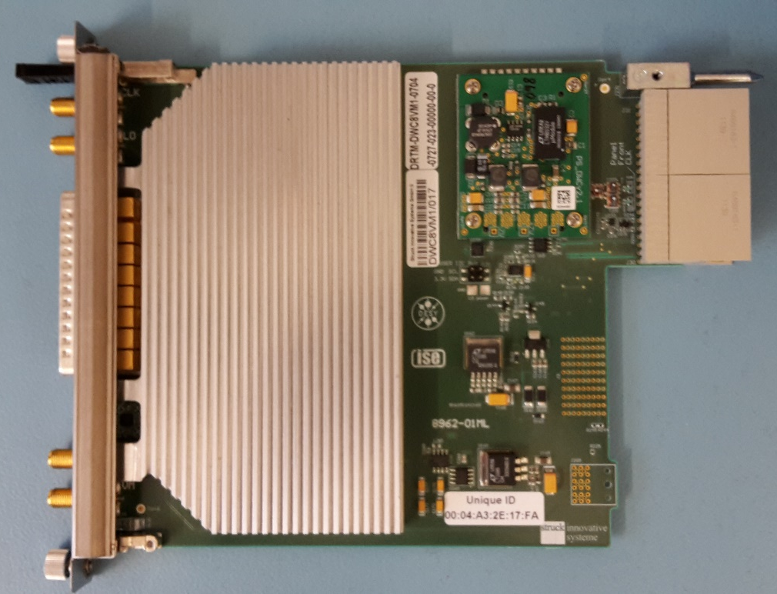
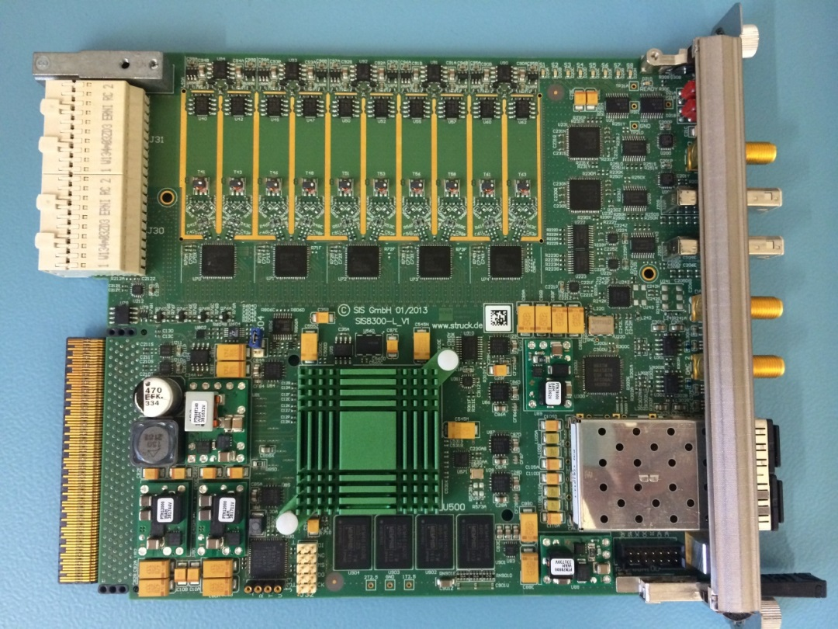
HW: RTM-Digitizer
8*AC-signal
input
2*DC-signal
input
Zone3
connector
5*2 ADCs
DAC
Vector
modulator
output
Attenuators
downconverters
Vector modulator
Backplane
connector
Kintex
Ultrascale
FPGA
Optical
interface
2GB DDR3

Slide 6
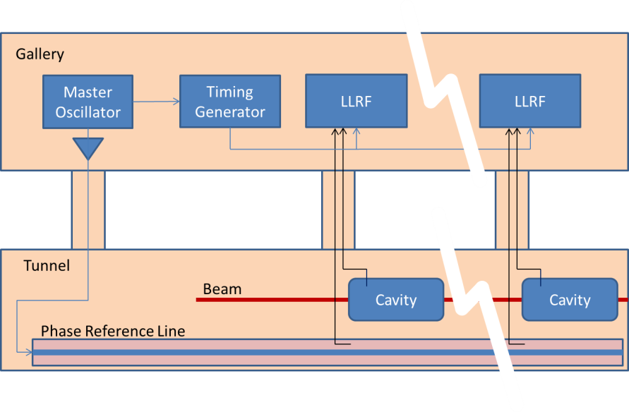
Timing and Phase Reference
MRF timing system in gallery distributes triggers.
Phase reference line in tunnel.

Slide 7
LLRF LO generation
LO and CLK signals generated from the phase reference.
Stand alone (pizza)-box for 352 MHz cavities.
  One for normal conducting, distributed in the gallery.
  One per four Spoke cavities, distributed in rack row.
MTCA-integrated for 704 MHz cavities
  One per cavity and LLRF system.

Slide 8
LO generation RTM
Functional specification
The LO RTM module should fulfill the following functional requirements:
the module must be compliant with the MTCA.4 RTM specification,
the module can be mid-size or full-size,
the module shall provide 4 LO outputs,
the module shall synthesis the LO signal using direct analog synthesis scheme,
the module shall provide 4 clock outputs,
the module shall provide 1 reference output,
the configuration of the module should be performed remotely by the AMC module,
a monitoring output for clock and LO signal shall be provided.

Slide 9
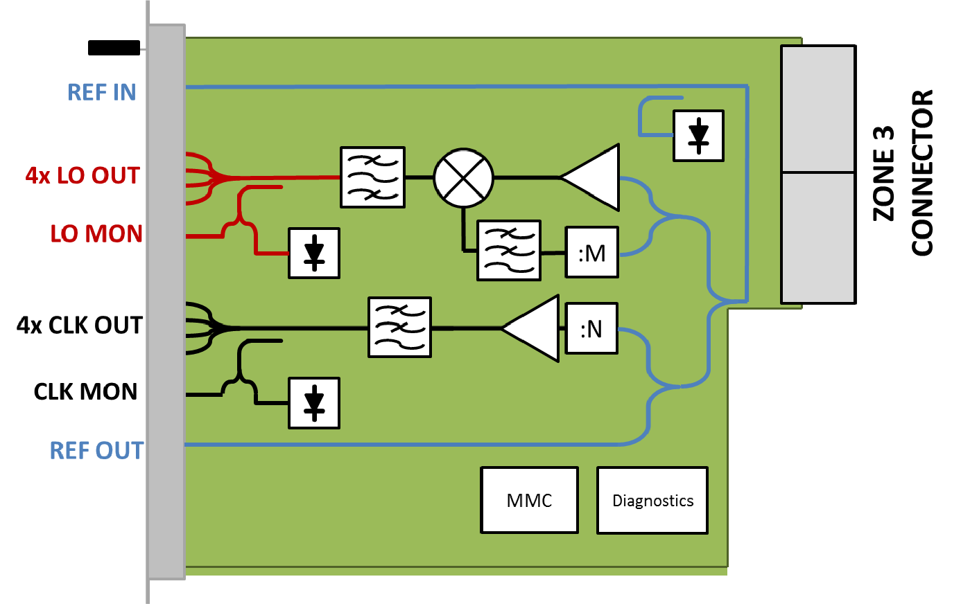
LO block diagram

Slide 10
LO RTM spec.
Table 4: LO signal absolute phase noise requirements
Table 5: CLK signal phase noise requirements

Slide 11
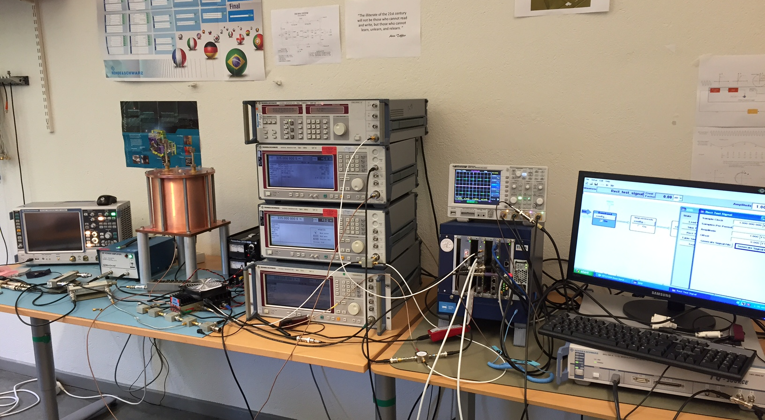
PDR of LO-RTM (etc.) 30-31 May

