Slide 1


ESS BPM Firmware
Status of BPM firmware
Notes:
<number>

Slide 2
ESS FPGA development framework
ESS platform
ESS DEVENV for IKCs
BPM Status

Slide 3
ESS FPGA development framework
ESS platform
ESS DEVENV for IKCs
BPM Status

Slide 4

Beam Diagnostics
The Beam Diagnostics work package includes the development of all beam instrumentation for the ESS linac:
BLM (Beam Loss Monitor)
BCM (Beam Current Monitor)
BPM (Beam Position Monitor)
FC (Faraday Cup)
WS (Wire Scanner)
NPM (Non-Invasive Profile Monitor)
EMU (Emittance Measurement Unit)
LBM (Longitudinal Bunch Profile Monitor)
etc…..
Integrated Control System (ICS)
The ESS Control System is a complex network of hardware, software and configuration databases that integrates the operations of all the various parts of the Accelerator, Target, Instrument and Conventional Facility infrastructures.
ESS has a large network of laboratories to exchange knowledge, personnel and experience with, and that in many cases will contribute directly to the project through In-Kind Contributions (IKCs)

Slide 5
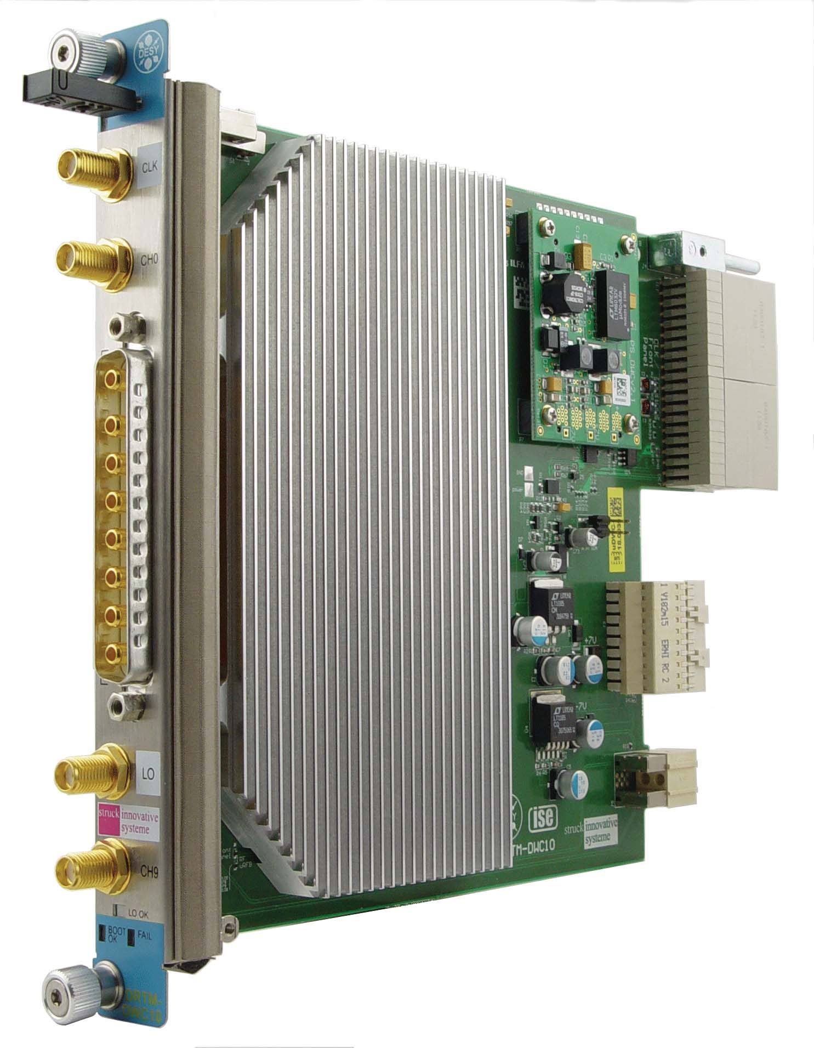
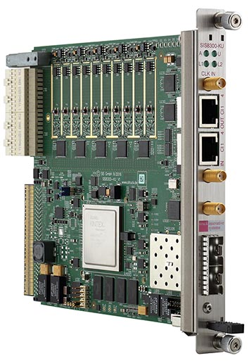
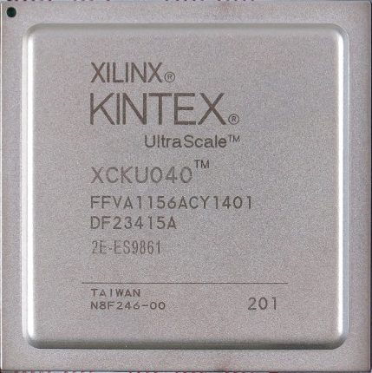
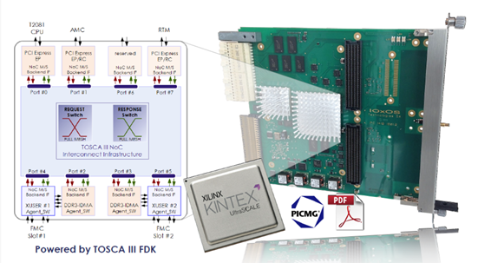

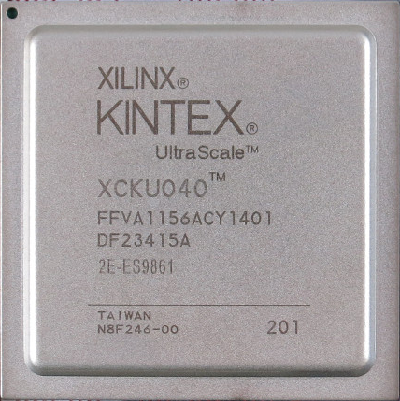
MTCA.4 AMC
BEAM DIAGNOSTIC
PLATFORM
STRUCK
SIS8300KU/L2
+
DWC8300
MIGRATION
ICS
PLATFORM
IOxOS
IFC1420 (??)

Slide 6
ESS FPGA development framework
ESS platform
ESS DEVENV for IKCs
BPM Status

Slide 7
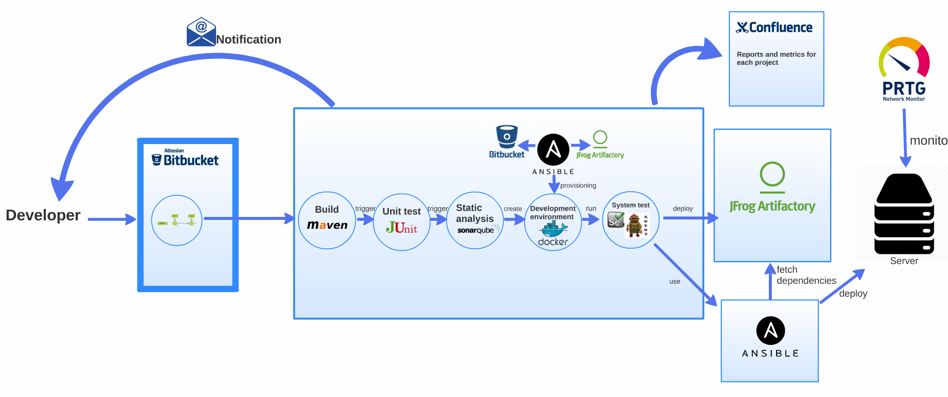
ICS Continuous Integration/Delivery
Courtesy of ICS
JAVA flow

Slide 8










FPGA design/delivery
Logs and
documentation
Notification
Bitstream
Repository
Development
Environment
Notes:
<number>

Slide 9
minor
feature
major
feature
Feature
branch
Master
branch
V1.0.0
V1.1.0
V1.1.1
V2.0.0
Production
branch
hotfix
branch
http://semver.org/
MAJOR.MINOR.PATCH
MAJOR version when you make incompatible API changes
MINOR version when you add functionality in a backwards-compatible manner
PATCH version when you make backwards-compatible bug fixes

Slide 10

Logs (Simulation, Synthesis, Mapping, Routing)
Documentation
Simulation results
Manual
acceptance
Folder
structure
Scripts
Patterns
Golden Model
Configuration
Constrains
AMC
Bitstream
V1.0.0
Production
Branch
commit
Simulate
FPGA Flow
Notification

Slide 11
Frameworks on bitbucket
STRUCK project contains different repository for FW and SW for the SIS8300L/L2/KU, each of it has 2 branch for the 2 RTM used:
    for BCM (SIS8900 RTM);
    for BPM (DWC8300 downconverter RTM);
IOxOS project contains the TOSCA III firmware for IFC1410 that support streaming of data from a ADC 3110/3111 - FMC Mezzanine Card

Slide 12
ESS FPGA development framework
ESS platform
ESS DEVENV for IKCs
BPM Status

Slide 13
BPM
What does it include?

Slide 14
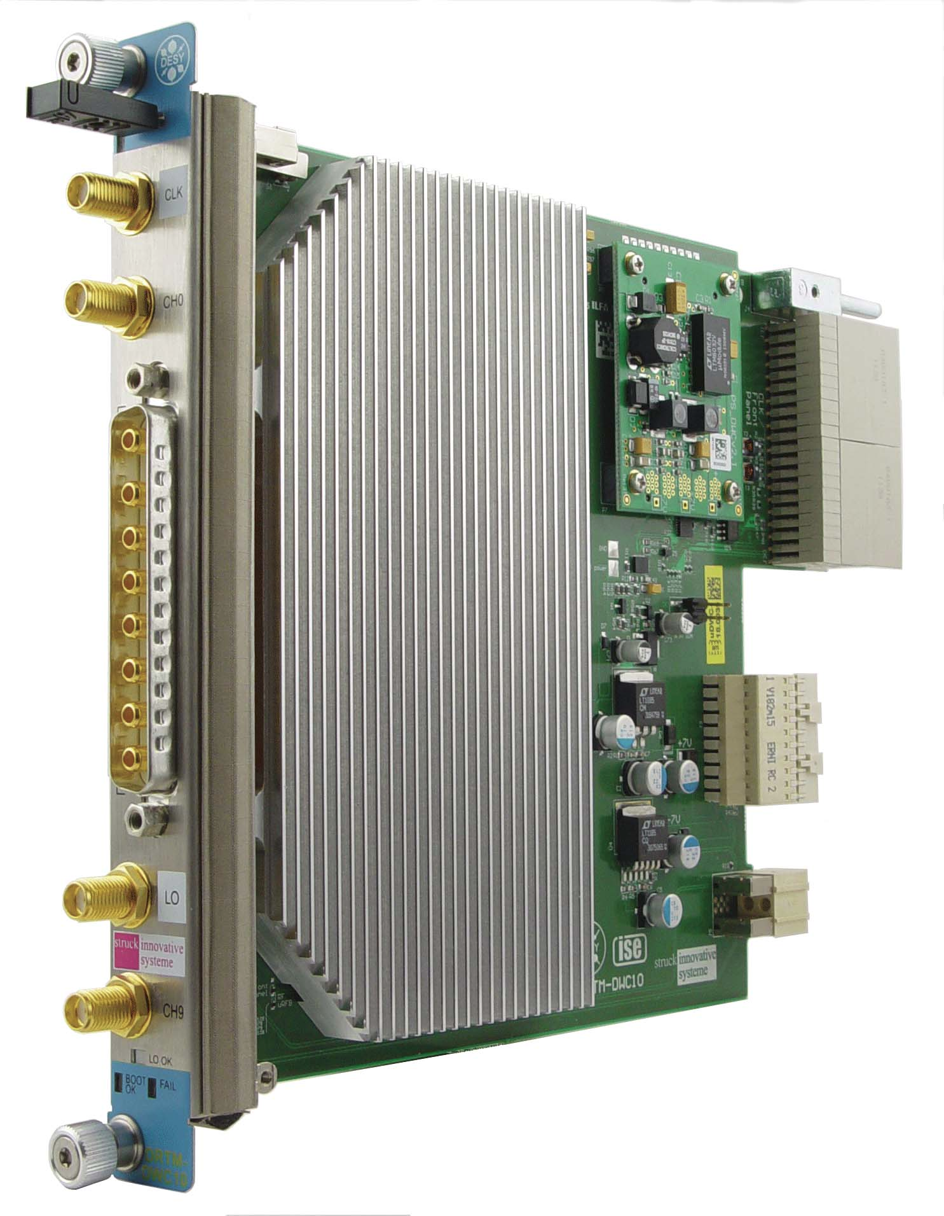
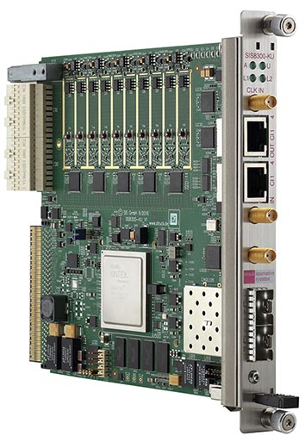
HW: RTM-Digitizer
8*AC-signal
input
2*DC-signal
input
Zone3
connector
5*2 ADCs
DACs
Kintex
Ultrascale
FPGA
Attenuators
downconverters
2GB DDR4
Optical
interface
Backplane
connector

Slide 15
Overview RTM-Digitizer

Slide 16
Overview RTM-Digitizer
PHASE

Slide 17
Supported FW functionality:
Supports both pulsed and CW operation;
Operation modes:
        ADC raw data
        Near-IQ sampling
        FIR filtering
        Single channel phases and amplitudes
        BPM phases relative to Phase reference line
        BPM positions calculations
        Self trigger
        Position interlock

Slide 18
Near or Non IQ Sampling
Less sensitive to:
  Nonlinearities
  DC-offset
  Noise
Will cost in delay

Slide 19
Operation
`

Slide 20
Operation
After PULSE_DONE IRQ is received, SW has access to:
From memory:
      Raw samples of all 9 input channels, plus one measurement channel or
      Raw samples from 1 BPM, plus all measurement channels.
From registers (for fast GUI displaying)
      Amplitude and phase of Phase-ref, position and antenna-sum at PULSE_END.

Slide 21
PDR’s implementation numbers
Utilization of FPGA: 75% slices
Max Clk period ~10 ns (100 MHz)
Delay: FW 97cc, ADC 13cc
Input to interlock delay ~1.1 us

Slide 22
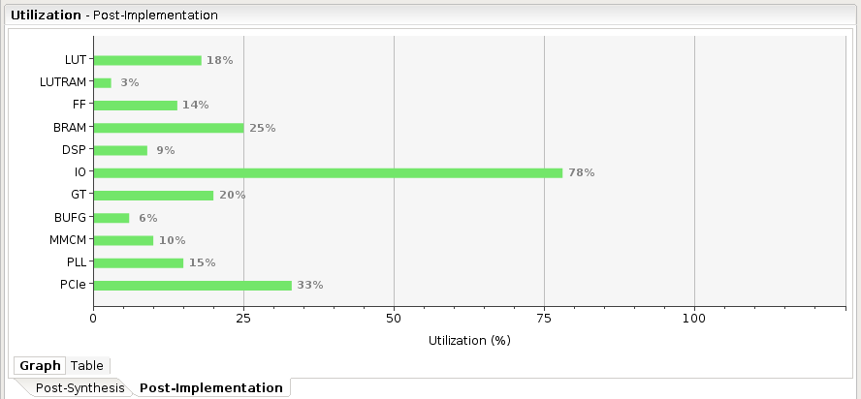
Today's implemetation number

Slide 23
PDR's Next step
Use and test the design as much as possible
Optimizations, if required.
Move to the next generation of digitizers
  Reduce latency.
  Get access to all internal data at all times.
  Get space to add new functionality.
Test
Test
And some more testing

Slide 24
Next step
Firmware has been tested on the STRUCK SIS8300L (Xilinx Virtex 6 FPGA) and successfully ported with same performance to STRUCK SIS8300KU (Xilinx Kintex Ultrascale);
We plan to migrate from the Struck framework (not AXI based) to a more reliable and maintainable AXI based framework;
When IOxOS IFC1420 (with same FPGA mounted) it will replace the SIS8300KU (we wish…) easily;

Slide 25




Questions
Notes:
<number>

Slide 26

Notes:
<number>

