Slide 1
Safety, reliability and maintainability
Hooman Hassanzadegan
ESS BI section
BCM CDR meeting, ESS-Lund
12-13 June 2017

Slide 2
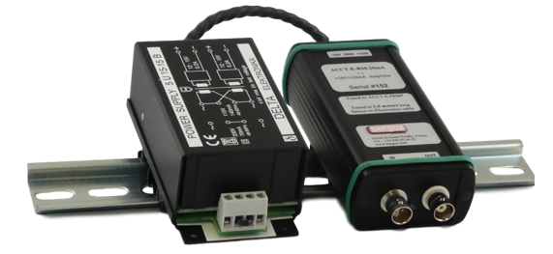
Safety
The ACCT system is in general not supposed to pose a risk to personnel safety.
Main considerations are:
ACCT cables will be fire-resistant and non-PVC.
A faulty flanged BCM after being replaced with a new one should be handled with special care due to radiation (same for any linac component that will be exposed to the beam).
ACCT front-end electronics uses a screw-terminal for the mains connection (230 V). The front-end will be mounted in a proper enclosure, preferably 3-4 m above the floor. This will then mitigate the risk of an electric shock.

Slide 3
Reliability 1
Main considerations:
An attempt has been made to prototype, test and verify all parts of the system including the sensor, cables, customized modules, readout electronics, firmware and software well in advance of final installation.
Significant amount of time has been given to new developments, test, trouble shooting and modifications. Design of the in-house-developed modules will be checked and verified (or modified if needed) once more by an external partner with significant experience in electronics.
Customized parts including FW, SW and HW need to successfully pass acceptance tests before an official delivery takes place. This includes both internal and external developments. Moreover, the complete system will be tested and verified before installation in the linac.
An attempt has been made to maximize synergy with other systems that have similar requirements. That includes the readout electronics and main cables that will be same/similar to those used in the BPM and LLRF systems.
Readout electronics have been tested and verified over the last 4 years. Troublesome modules have been replaced with other types.

Slide 4
Reliability 2
Main considerations :
New developments are being done in collaboration with some partners who have significant experience in this field.
Electronics sanity checks at different levels are foreseen before and during beam operation. This can be useful in detecting faulty parts.
Some parts of the system will be redundant. That includes the readout electronics in the warm linac and the ACCT-E / AIU power supplies.
The readout electronics will be based on uTCA.4 standard. This will provide extra features for system reliability including IPMI.
The aim is to have a fail-safe system.
BCM electronics will be installed out of the tunnel. Rad-hard sensors, cables and connectors will be installed in the tunnel.

Slide 5
Maintainability
Main considerations:
Care has been taken to have easy access to the sensors and the signal ports.
The use of patch panels near the toroid and on top of the BCM rack will facilitate maintenance.
The BCM electronics (FE, AIU, uTCA) are all modular. This will make it easy to replace a faulty part.
Sufficient spare parts are being foreseen for the electronics.
The BCM-specific FW is independent of the platform. It is foreseen to develop the next versions of the integration FW in-house. Also, it is planned to develop some new features (ex. the optical link) in-house.

