Slide 1
BCM-BIS Interface
Szandra Kövecses
Lead Integrator for Machine Protection
Protection and Safety Systems
Lund, 2017-06-12

Slide 2
Overview
MPS Purpose/BIS ConOps
BCM-BIS Interface (Hardware/Electrical)
  Spec. of discrete link
  Spec. of serial link
Required BCM Functions
Signal List
  Suggestion
  Alternative signal sets?

Slide 3
MPS Purpose/BIS ConOps

Slide 4
Architecture of Machine Protection System of Systems
Beam Interlock System
EPICS,
Timing System
Beam
Monitoring
Systems
MP-related Systems, LPS
Accelerator
MP-related Systems, LPS
Target
MP-related Systems, LPS
NSS
PSS
and
TSS
Remove RF from ISRC
Magnetron
Remove power on ISRC HVPS
Activate HV
of LEBT
Chopper
Activate HV
of MEBT
Chopper
Allow Timing
System to Send
Trigger Events
Input Systems: MP-related Systems, Beam Monitoring Systems, etc.
Logic: Beam Interlock System
Output/Actuation Systems: LEBT chopper, Timing System, etc.

Slide 5


BIS Functions- Allow Beam/Stop Beam
Allow Beam Extraction
  Checking that all relevant systems are ready for beam
Stop Beam Extraction (Interlock)
  When an off nominal state is detected

Slide 6
Allowing Beam Extraction
Beam may be extracted (Timing System is allowed to send triggers) when:
All systems are ready for beam
All systems have the same configuration:
  All subsystems should be configured according to the same Proton Beam Mode and Proton Beam Destination
Notes:
BCMs validate beam destination

Slide 7
Allowing Beam Extraction – All systems are ready for beam
Beam Interlock System: IF ∀OK and Consistent → Global Beam Permit == OK
LPSID, LPS-A2T
destination
information
BI Mode configuration information
MP-related systems Beam Permit == OK
Beam Presence
Information
from BI, ISRC
Beam Monitor.
Beam Permit == OK
Operational Status & Health
∀systems == OK
Mode and event information from Timing System
ISRC Magnetron
System ==OK
ISRC HVPS
System==OK,
HV Status
LEBT Chopper
System == OK,
HV Status
MEBT Chopper
System == OK,
HV Status
PSS,TSS
Beam Permit
== OK
Global Beam Permit==OK
Timing System
is permitted to send around
Trigger Events

Slide 8
Stopping Beam Extraction
Beam Inhibit (between pulses)
  Inhibit triggers from TS
  Activate LEBT and MEBT Chopper
Beam Interlock (during a pulse, as escalation from Beam Inhibit)
  Inhibit triggers from TS
  Activate LEBT and MEBT Chopper
  Remove RF of ISRC Magnetron
Emergency Beam Interlock (as escalation from Beam Interlock)
  Inhibit triggers from TS
  Activate LEBT and MEBT Chopper
  Remove RF of ISRC Magnetron
  Switch off HVPS of ISRC

Slide 9
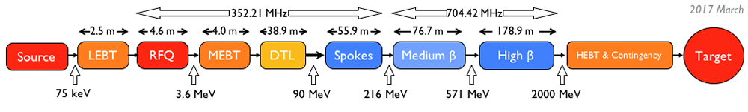
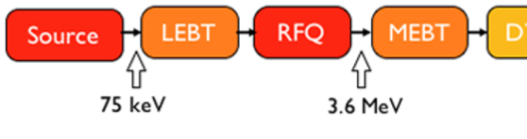
Escalation of Interlocks - Example
Remove RF of ISRC Magnetron
Inhibit triggers
Switch off HVPS of ISRC
Activate LEBT Chopper
Activate MEBT Chopper
Inhibit
Interlock
Emergency
Interlock
Timing System

Slide 10
Escalation of Interlocks
BIS checks if Beam Inhibit/ Beam Interlock was successful, by checking:
  BI systems: if beam is still detected
  Actuator Systems: status feedback, if the actuation is performed
If not successful then the BIS can escalate:
  Beam Inhibit→Regular Beam Interlock→ Emergency Beam Interlock.

Slide 11
Beam Interlock – consequence of failure
 | Beam Interlock | Success | TS Failure | LEBT Chopper Failure | TS and LEBT Chopper Failure
Timing System | Stop Triggers | No triggers | Triggers are sent to IS | No triggers | Triggers are sent to IS
Ion Source | Remove RF | Extraction for 100ms (decay) | Extraction | Extraction for 100ms (decay) | Extraction
LEBT Chopper | Deflect | Deflecting | Deflecting | No deflection | No deflection
LEBT BCM | - | No Beam | No Beam | Beam present | Beam present
MEBT Chopper | Deflect | Deflecting | Deflecting | Deflecting | Deflecting
MEBT BCM | - | No Beam | No Beam | No Beam | No Beam
 |  |  | No consequence | Beam will not be stopped as fast as expected | MEBT Chopper will melt

Slide 12
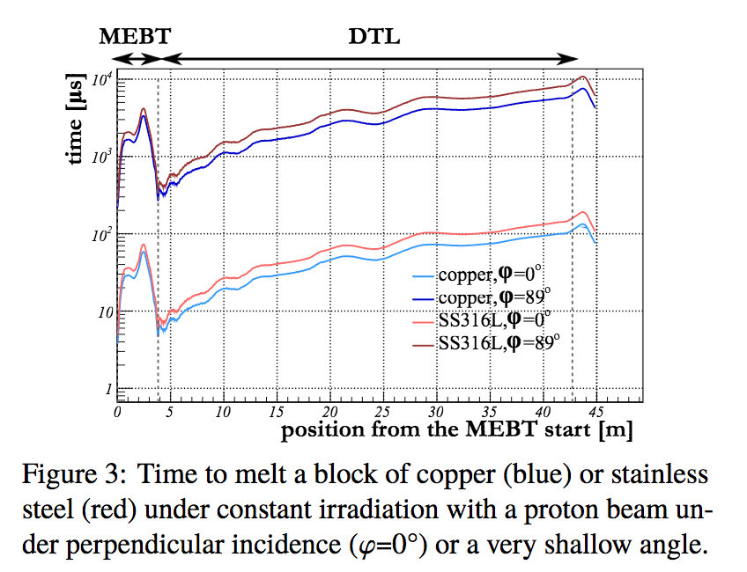
Why do We Need Fast Protection?
Simulations have shown that 90° beam impact is possible in the MEBT scrapers.
Fastest reaction time required to stop proton beam is 1-5μs to avoid melting.
This includes detecting, processing and actual stopping of the proton beam.
Courtesy of I. Kittelmann/ HB2016 THAM6Y01
Notes:
Slide 6: For me the PIL, the distribution and so on is not yet clear. To not make it more “safe” for the presentation, I would give the facts that they should know: Very reliable functions (PIL2), fast in some functions (4-5us). Then you can say that the BCMs play an important role in these fast and reliable functions.

Slide 13
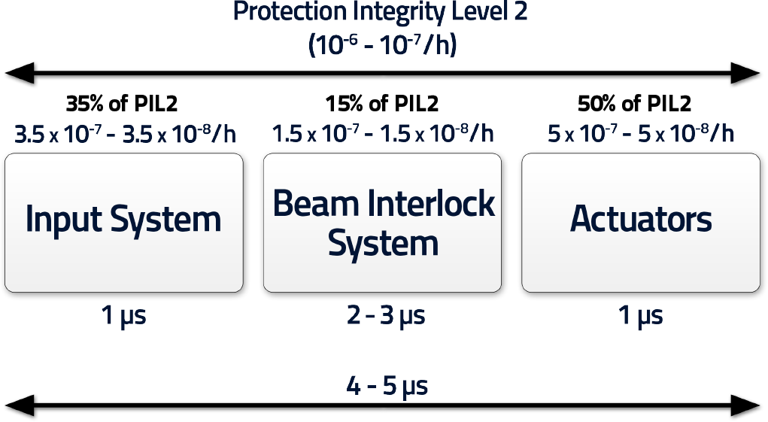
Top Level Requirements for the FBIS
Based on preliminary risk analysis (IEC61508, IEC61511)
Requirements at ESS
Notes:
- what I mean is that this picture shows the 'worst’ protection function, where the reaction time is the fastest / based on findings from slide 5, and where the PIL is highest, i.e. PIL 2./
- the pic in slide 6 shows the function that sets the tough requirements on BCMs and also the BIS, because of that one very nasty and fast and high PIL function, where we might start melting if beam is deflected badly/and we learned that this is NOT unlikely in the warm linac where melting starts within microseconds due to the low energy/which is the perfect energy to cut metal/, and also due to an aperture change in the DTL tanks we can assume that the likelihood of such an event is increased—> event is: beam is deflected by almost 90 degrees in a short time in the warm linac and hits the beam pipe and melting can start….
Summary: In the past we assumed that beam can hit perpendicularly e.g. A valve if its closed. And then melting starts in 1-10 micsec in the warm linac or in 400 micsecs in the cold linac. But we were told that this event is not likely to happen and hence we should not build such a fast BIS that can cope with very fast reaction times.
So we checked….and Irena could show (her plot on slide 5) that there are other events than closed valves, where beam might impact perpendicularly onto the beam pipe. And that is badly deflected beam in the DTL + the following DTL aperture change. This bad deflection can happen because steering magnets fail for example. And then this beam will hit the corner (perpendicularly) of the next DTL tank because the pipe size is smaller there than in the tank before (aka aperture change).
Slide 6 is the result of slide 5.
And we can use only BCMs when such a fast reaction time is required (i.e. For the function shown on slide 6, only the fast bis and the super BCMs + choppers are candidates).
The BLMs and BPMs are slower than that. The ion source switch off as well is slower than that.

Slide 14
Conditions for BIS functions:
BIS knows when beam is expected/not expected (from Timing System).
BIS receives information whether beam is present (from BI):
  Directly downstream of beam destinations.
  At the Proton Source.
BIS receives dependable information about current state of Actuation Systems:
  Whether beam is extracted or not (from Proton Source).
  Whether high-voltage is applied or not to LEBT/MEBT Choppers.
Notes:
has the functions we need from BCMs///you can point this out when talking through the slide

Slide 15
Required BCM Functions

Slide 16
BCM requirements from MPS
Function | Purpose | Status
BCM Configuration information | Prevent mode confusion | Implemented in firmware
BCM Internal Health information | Allow for beam | Implemented in firmware
Beam Loss Detection | Prevent damage and unnecessary activation of equipment due to losses | Implemented in firmware
Beam Charge Measurement | Prevent damage due to too high beam charge | Implemented in firmware
Beam Presence Detection | Validate interlock or escalate to emergency interlock Validate Beam Destination | Implemented in firmware
Notes:
Clarify what these signals are. You can’t put a table without if it is not super clear. Here you could be saying that these is what is there, or what we need… When you say 1/ACCT Processign boar, it would be easier to understand without saying ACCT I think… 1/processing board? No signals for beam loss or beam charge?

Slide 17
General MPS Requirements
Function | Purpose
ALGORITHM | the logic used to detect off nominal states Off nominal state: a state that can lead to damage or activation of the machine Example: It shall be possible to change beam loss thresholds and which BCM pairs to use for beam loss measurements. Can be done through EPICS.
LATCH MODE | If the LATCH MODE is YES, the signal shall stay in the NOK state until a RESET command is received. If the LATCH MODE is NO, the signal shall automatically transition from the NOK state to the OK state when no off nominal states are detected.
MP-DATALOG (Archiving) | The BCM System shall have a MP-DATALOG readable by external systems. The time and reason for all off nominal state transitions shall be stored in the MP-DATALOG
PROTECTION MODE | It shall be possible to set the BEAM CHARGE signal status according to ALG, OK or NOK. Where ALG corresponds to the off nominal state detection ALGORITHM, OK to “1” and NOK to “0”. This will be used for testing of the BIS, masking for commissioning or degraded states.
Requested Proton Beam Mode (from TS) | Additional protection against mode confusion

Slide 18
Interfaces are needed to implement the needed functions…

Slide 19
BCM-BIS Interface

Slide 20
Hardware Interface
BIS will connect to each ACCT Processing Board (SIS8900 µRTM Transition Board) through the RJ45 connection
4 In/out
Can be discrete or serial

Slide 21
Electrical Interface
LVDS
RS422
  Protocol: telegram frame with total 16 bytes
  Startbyte
  Lifesign
  Other information
  CRC Checksum
Pos. | Size | Variable
D0 | Byte | Startbyte (0xAA)
D1 | Byte | ACCT Lifesign
D2 | Byte | ACCT Alarm
D3 | Byte | ACCT Calibration (8 bits assigned to the 8 ACCTs)
D5 | Byte | Reserved
D6 | Byte | ACCT Beam Presence (8 bits assigned to the 8 ACCTs)
D7 | Byte | Reserved
D8 | Byte | ACCT Firmware version
D9 | Byte | ACCT Proton Beam Destination
D10 | Byte | ACCT Proton Beam Mode
D11 | Byte | Reserved
D12 | Byte | ACCT Health
D13 | Byte | Reserved
D14 | Byte | CRC
D15 | Byte
Protocol suggestion
Notes:
please add the info listed in the ICD (your presentation should be in synch with the 2 documents which we will deliver/MP requirements and ICD).

Slide 22
Logical Interface - Signals
Hardware interface is defined but not yet the signals

Slide 23
Signal list

Slide 24
Required information vs. number of signals
Required Functions
Beam Loss Detection BCM1 … BCM8
Beam Charge Measurement BCM1 … BCM8
BCM Internal Health information BCM1 … BCM8
Beam Presence Detection BCM1 … BCM8
BCM Proton Beam Mode BCM1 … BCM8
BCM Proton Beam Destination BCM1 … BCM8
Implemented Functions
Alarm (Beam Charge, Beam Loss) 1/ Processing Board
BCM Internal Health 1/ Processing Board
Beam Presence BCM1 … BCM8
Proton Beam Mode 1/ Processing Board
Proton Beam Destination 1/ Processing Board
Interface - Available signals
Alarm_1
Alarm_2
Beam Presence (serial transmission for the 8 ACCTs)
ACCT Serial Datalink (redundant alarms and other information)
Notes:
why 2 signals for health and configuration?
Beam charge clearly is part of beam loss
Why? Matthias is comparing the full pulse shape. That includes: pulse length, beam current, rep rate AND beam loss.
In case of differential measurements, he also has the loss as part of the alarm.
Hence these 2 functions (charge and loss) are combined into 1 signal that is generated by the firmware.
On top, we don’t want 1 alarm (charge+loss) per ACCT, but its totally ok,
that the alarm for each ACCT is combined with an OR and 1 alarm is generated per ACCT board.
meaning: if ACCT1 alarm is on, OR ACCT2 alarm is on, OR ACCT3 alarm is on, etc…then ACCT board alarm is on.
Beam presence is only any current above 3mA. Hence only beam current, not length or anything else.
1: ALARM (discrete): aggregated for all ACCTs per board
2: ALARM (discrete): aggregated for all ACCTs per board (redundant to 1)
3: Beam Presence ACCT1 (discrete)
4: Beam Presence ACCT2 (discrete)
5: Beam Presence ACCT3 (discrete)
6: Beam Presence ACCT4 (discrete)
7: Beam Presence ACCT5 (discrete)
8: Beam Presence ACCT6 (discrete)
9: Beam Presence ACCT7 (discrete)
10: Beam Presence ACCT8 (discrete)
11: Maybe Health (discrete but possible as serial as well/ depends on an analysis of the hardware interface [drivers, etc])
12: Beam Mode, Beam destination, Firmware version, ALARM, health, life sign, (serial link)
13: calibration for each ACCT (to be discussed) as serial link
Enric: Slide 18: Clarify what these signals are. You can’t put a table without if it is not super clear. Here you could be saying that these is what is there, or what we need… When you say 1/ACCT Processign boar, it would be easier to understand without saying ACCT I think… 1/processing board? No signals for beam loss or beam charge?

Slide 25
First suggestion
2 discrete links
  ACCT Alarm_1
  ACCT Alarm_2
2 serial RS422 links
  ACCT Beam Presence (serial transmission for the 8 ACCTs) (1 byte)
  ACCT Serial Datalink (redundant alarms and other information) (16 bytes)

Slide 26
Alternative suggestion
3 discrete links
  ACCT Alarm_1
  ACCT Alarm_2
  ACCT Beam Presence (1st ACCT of the Board)
1 serial RS422 link
  ACCT Serial Datalink (redundant alarms and other information) (16 bytes)
Notes:
Why is this preffered: motivate

Slide 27
Signal list might change
Need to analyze speed and reliability requirements of the different functions further

Slide 28
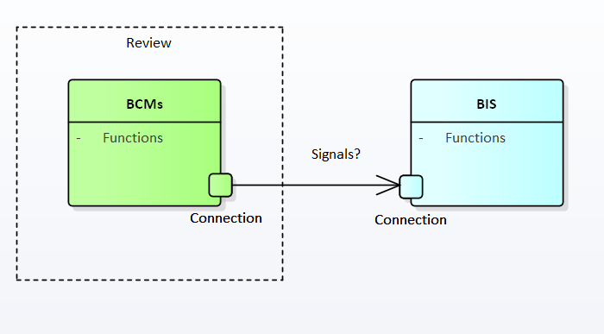
BIS-BCM Interface Status
BCM Functions – Implemented
BCM-BIS Interface – Implemented
Signals - ongoing
Notes:
Slides 21 and 22: It would be good to say that you think that this has no impact, no?

Slide 29
END
Questions?

