Slide 1
BCM electronics and cables
Hooman Hassanzadegan
ESS BI section
BCM CDR meeting, ESS-Lund
12-13 June 2017

Slide 2
BCM specifications
Parameter | Value | Comment
Current measurement range | 0 – 80 mA | Full-Scale current is 80 mA.
Pulse width range | 5 us – 6 ms
Pulse frequency range | 1/30 – 14 Hz
Absolute accuracy | +/-1% FS | Equivalent to +/-0.8 mA. This is valid in the whole measurement range.
Resolution | 1% (RMS) FS | This is valid for absolute current measurement with one toroid.
Differential resolution | 2% (RMS) FS | This is valid for differential current measurement with 2 toroids.
Measurement band-width | 1 MHz | This is valid with a toroid cable shorter than 20 m.
Overall latency | 2 us | This is the latency from beam through the toroid to digital signal on the AMC output port. This latency is valid with a toroid cable being shorter than 20 m.
‘Beam existence’ threshold | 3 mA | Below this threshold, the digital output signal will be set to ‘NO-BEAM’
ADC sampling frequency | 88.0525 MHz | Locked to RF frequency.

Slide 3
BCM sensor summary
Section | No. of sensors | type | Source | Status
LEBT | 1 ACCT | Bare toroid | ESS | Procured, installed at INFN- Catania
RFQ | 1 ACCT | Bare toroid | ESS | Awaiting specifications from CEA to start with procurement
MEBT | 1 ACCT 1 combined ACCT/FCT 1 current monitoring BPM | Bare toroid Flanged Welded | ESS-B IK | Held PDR in July 2016, ESS-Bilbao starts with the procurement process on June 15th 2017
DTL | 5 ACCTs | Toroid in epoxy-resin-filled enclosure | INFN-Legnaro IK | Requirements communicated with IK partner
MB | 1 ACCT | Flanged | STFC IK | Requirements communicated with IK partner
HB | 1 ACCT | Flanged | STFC IK | Requirements communicated with IK partner
HEBT | 2 ACCTs | Flanged | STFC IK | Requirements communicated with IK partner
A2T | 3 ACCTs | Flanged | STFC IK | Requirements communicated with IK partner
DmpL | 2 ACCTs | Flanged | STFC IK | Requirements communicated with IK partner

Slide 4
BCM electronics summary
ACCT
  Bergoz ACCT-E and its redundant power module: mostly in-kind
  ACCT Interface Unit: custom-designed
  uTCA electronics: commercial
Fast BCMs (i.e. FCT and BPM)
  Rack mount oscilloscope (or similar) commercial
As the BLMs cannot be used at low energies, the ESS MPS will mainly rely on the BCMs in the warm linac. In order to provide redundancy in these sections, it is planned to process the ACCT signal in parallel by two sets of readout electronics, whereas in the cold linac, the BLMs will serve as the primary system for measuring beam losses and the BCMs will provide some redundancy.

Slide 5
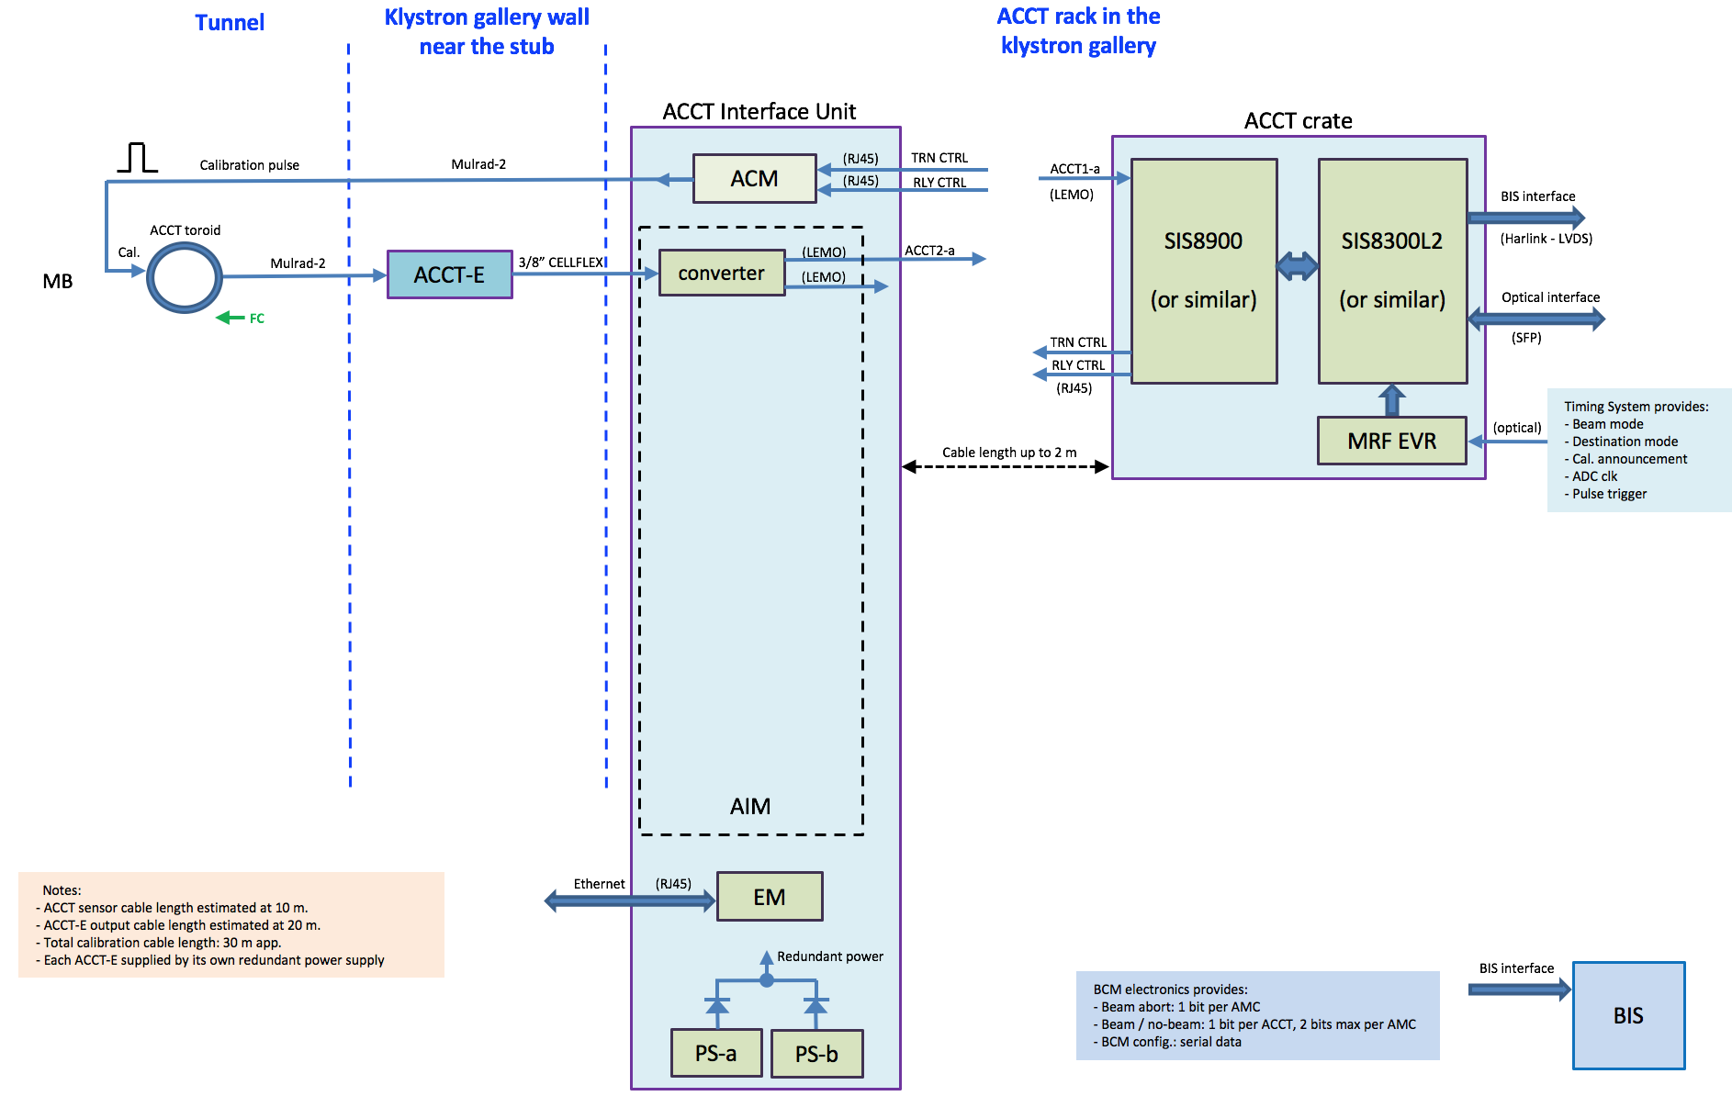
BCM electronics schematics – case 1
The schematics is subject to small changes.

Slide 6
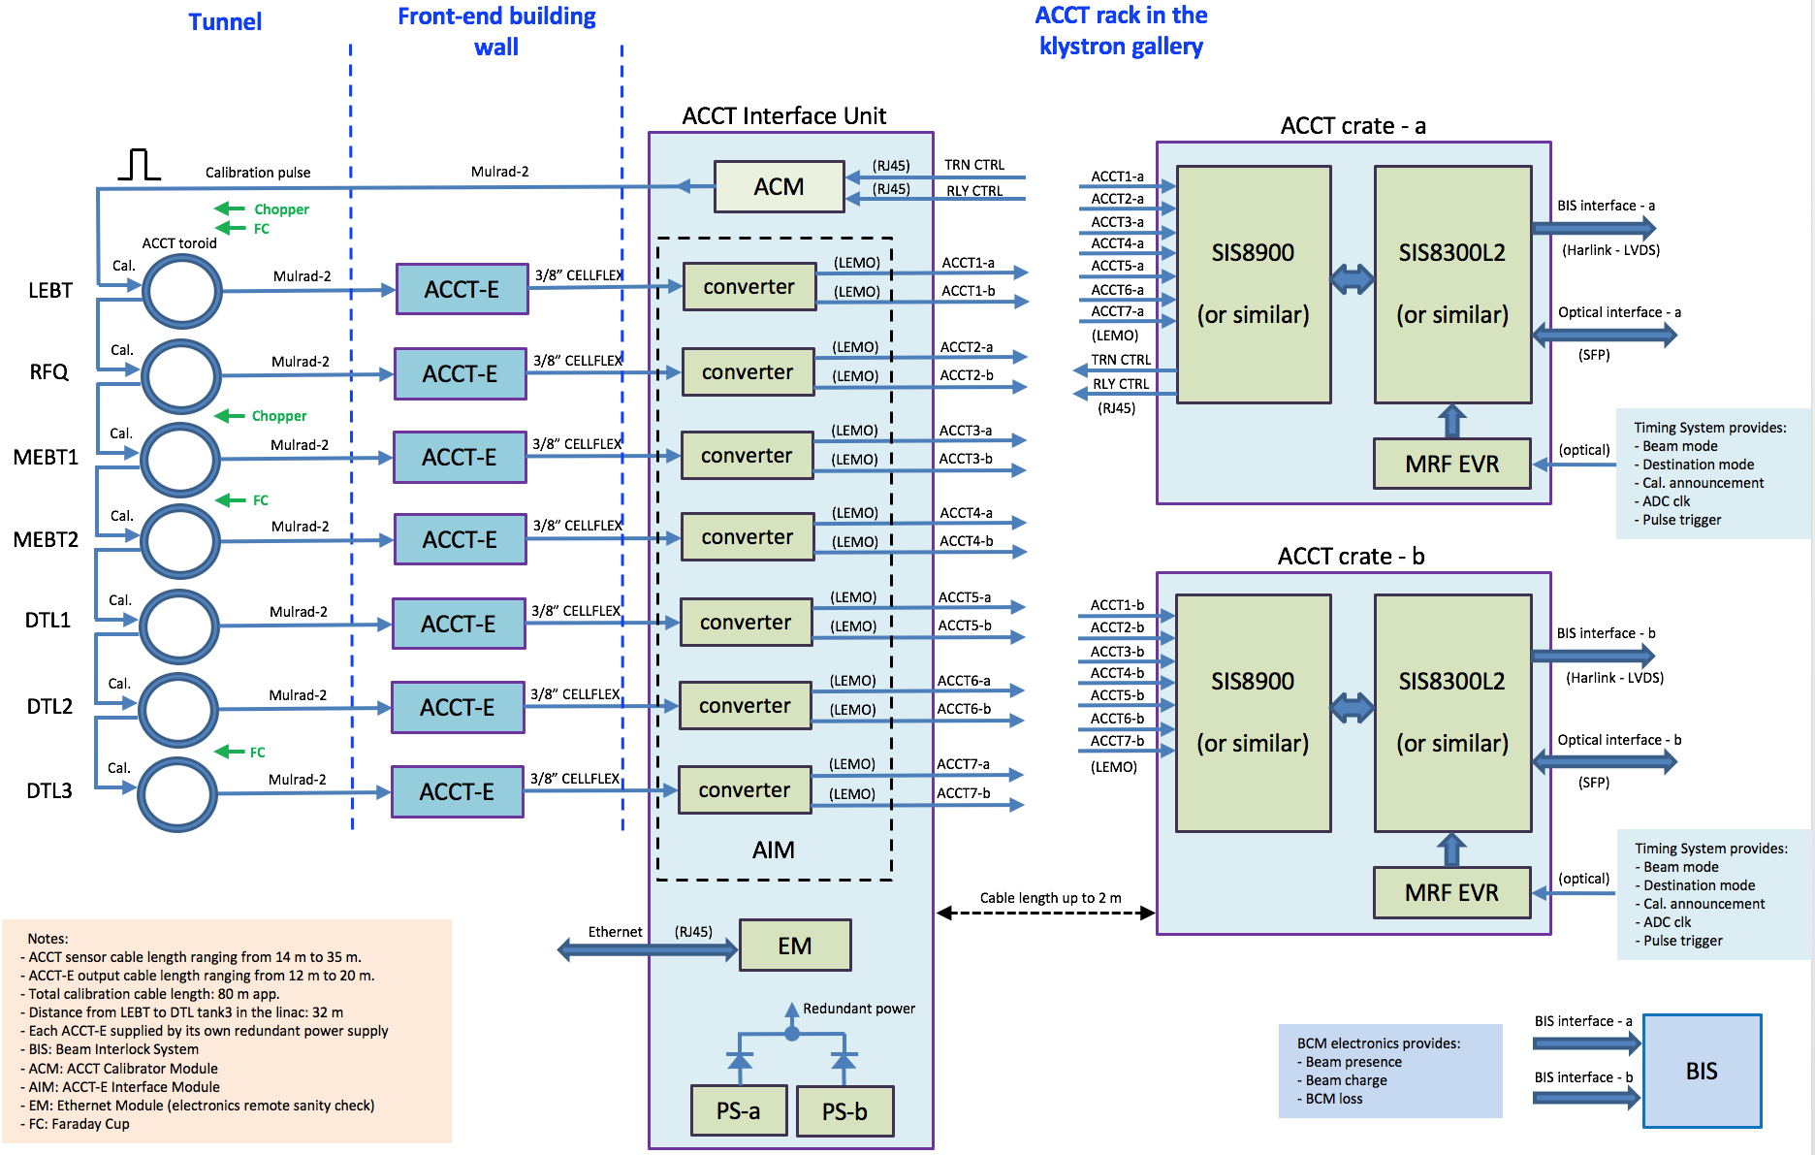
BCM electronics schematics – case 2

Slide 7
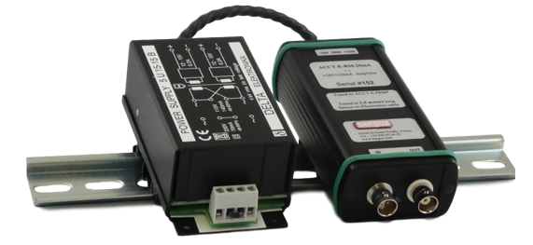
ACCT front-end
The output signal from each ACCT toroid will be fed into its ACCT-E.
It is planned to supply the ACCT-E by a redundant power source.
A prototype of the redundant power module has already been developed and successfully tested at ESS
The ACCT-E and its redundant power module will be installed in a proper enclosure and installed out of tunnel at a minimum cable distance to the toroid.
The ACCT-E needs to be calibrated based on the sensor cable length.
Specification | Value | Unit | Comments
ACCT-E output full scale | +/-10 | V
Lower cutoff (-3dB) | 3 | Hz
Upper cutoff (-3dB) | 1 | MHz | Only with toroid cable being shorter than 20 m.
Rise time | 350 | ns | Only with toroid cable being shorter than 20 m.
Droop | <2 | %/ms
Slew rate | 2 | V/us
Output offset | 0.2 0.5 | mV typ. mV max
Noise at 100 mA F.S. | <5 | uArms
Power Supply voltage | +/-15 | V DC
Power Supply output current | 200 | mA
Bergoz ACCT-E (right) and its power supply (left)

Slide 8
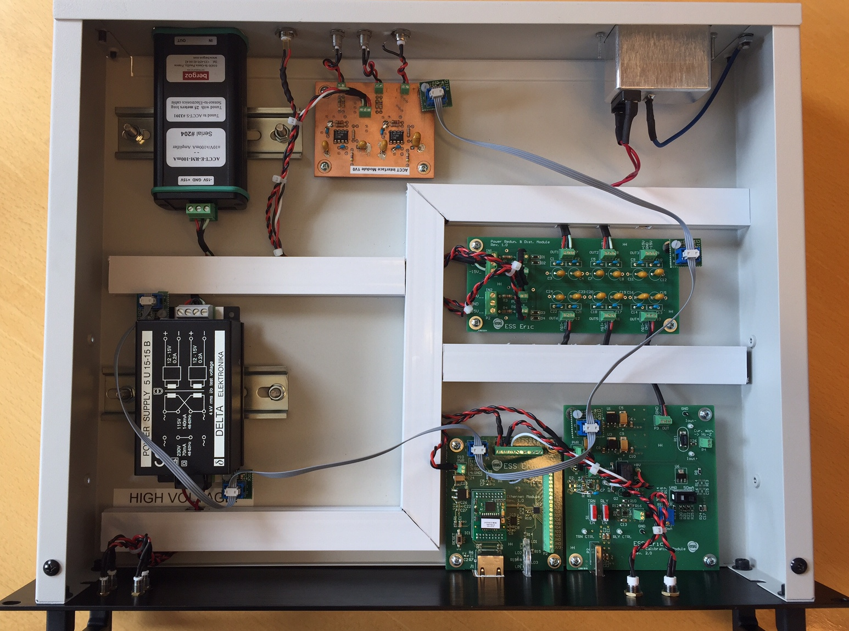
ACCT Interface Unit (AIU) prototyping
The AIU includes:
  ACCT-E Interface Module
  ACCT Calibrator Module
  Ethernet Module
  Redundant Power Supply
A prototype AIU has been designed, built and successfully tested in lab.
Discussions with external partners have started for possible design modifications and series production of final units.
Prototype AIU including Bergoz ACCT-E

Slide 9
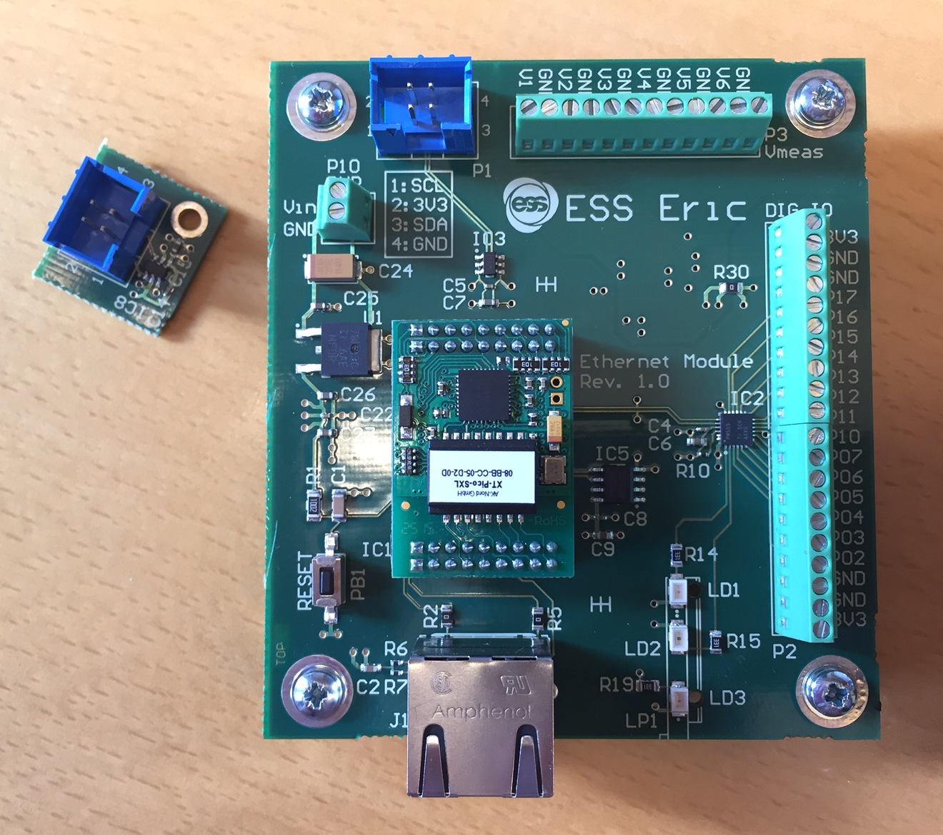
Electronics sanity check
Two ways are foreseen to do electronics sanity check:
  Sending a current pulse to the calibration winding and measuring/verifying the ACCT output signal before running the system with beam
  Remote monitoring of electronics voltage and temperature with an Ethernet Module
The Ethernet Module provides:
  Network connection (RJ45)
  1 on-board and 6 external temperature sensors
  Port expander including 14 general-purpose digital I/O
  2 on-board and 6 external analog voltage monitors
  500 kBIT EEPROM
  Connection to external devices through I2C bus
  LED displays

Slide 10
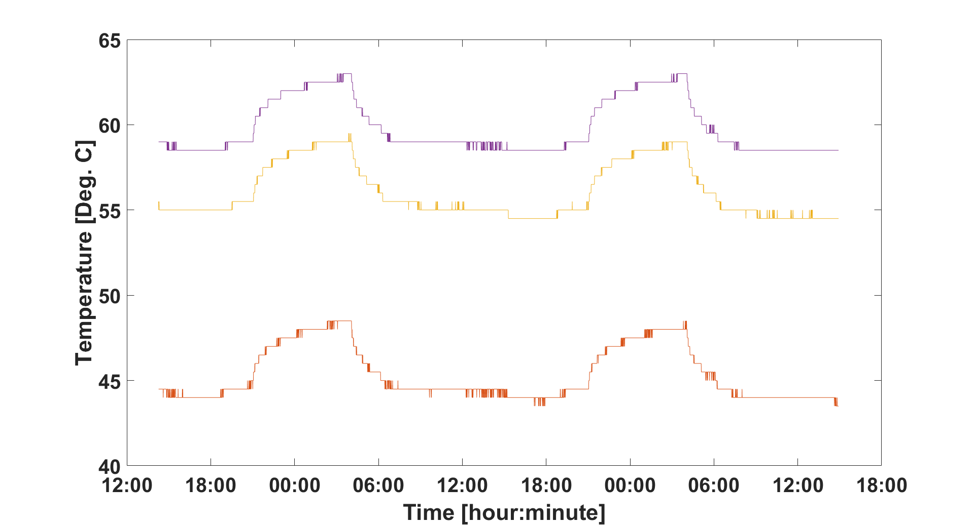
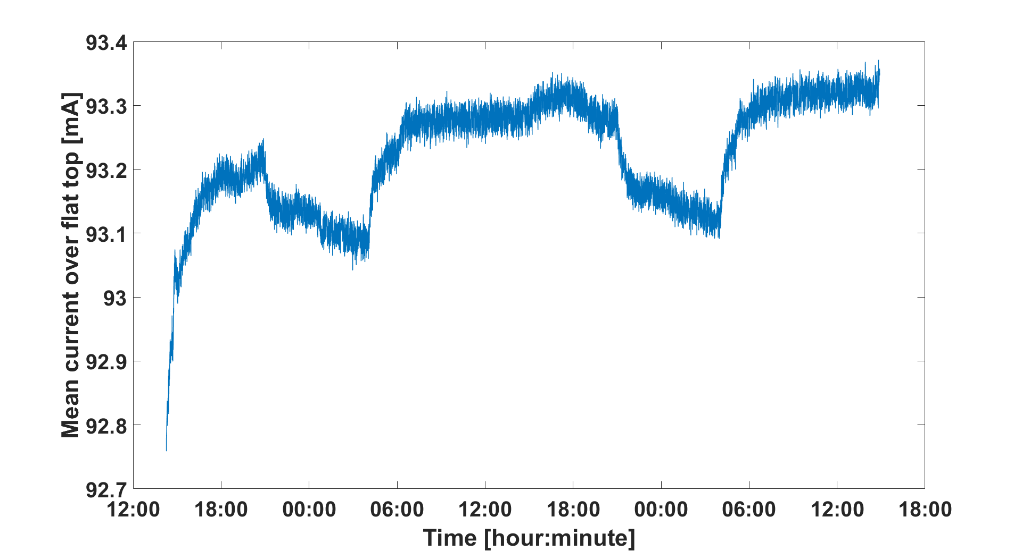
ACCT signal drifts with temperature
Long-term tests with an overall cable length of 85 m (25 m of toroid cable, plus 60 m of low-quality coaxial cable) from the toroid to the RTM shows a clear correlation between temperature variations and ACCT signal drifts.
The sharp variation of the ACCT signal at the start of the acquisition is due to the initial cable warm up (the coaxial cable was taken from a cold storage room)
Although the peak-to-peak variations are by a factor of 4 smaller than the required ACCT accuracy of +/-1%, it is foreseen to significantly reduce them using the very stable calibration pulse from the ACM.

Slide 11
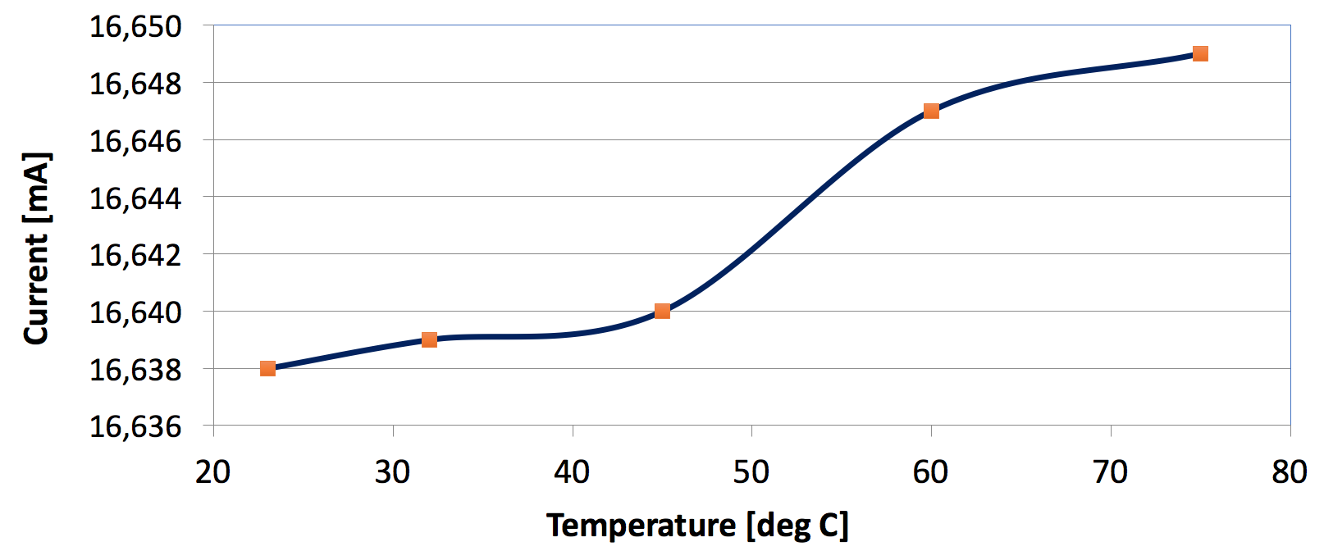
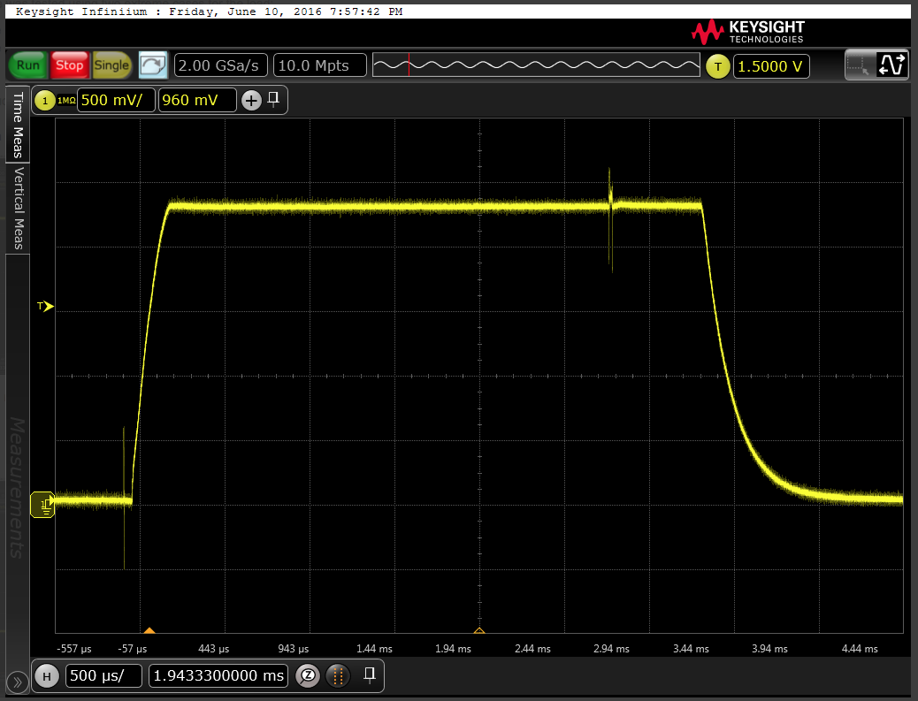
Tests with the prototype calibrator module
Calibrator design considerations:
Short rise time
Constant current over pulse flat top
Insensitive to temperature variations
Insensitive to cable length variations
Relay for disconnecting the calibrator from the toroid(s) when not operating in calibration mode
Calibrator control from digital port on the Struck board
Tolerant to more than 100 V of voltage difference on the cable shield
Fail-safe
Measured changes of the ACM output current is 0.07% with the temperature being increased from 23 to 75 deg.

Slide 12
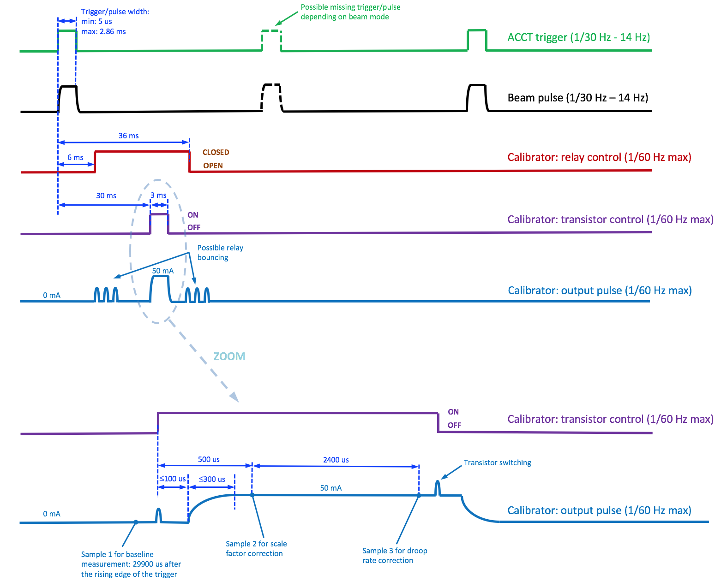
ACCT calibrator and its synchronization with the beam pulse (draft proposal)

Slide 13
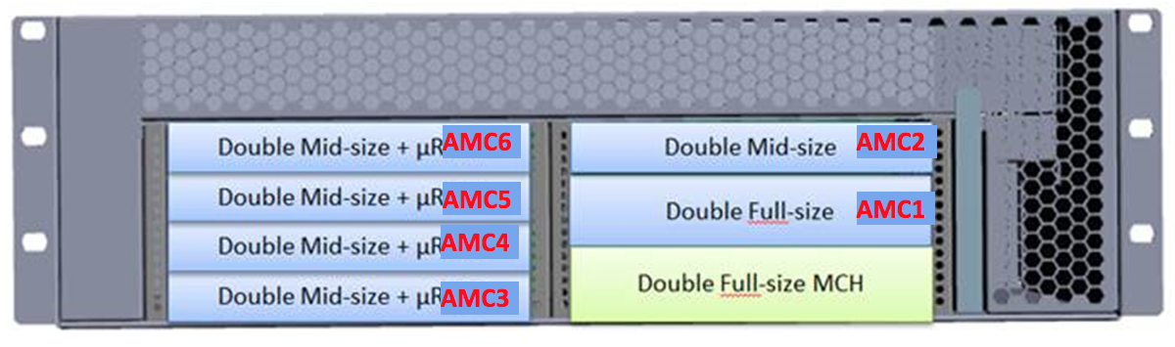
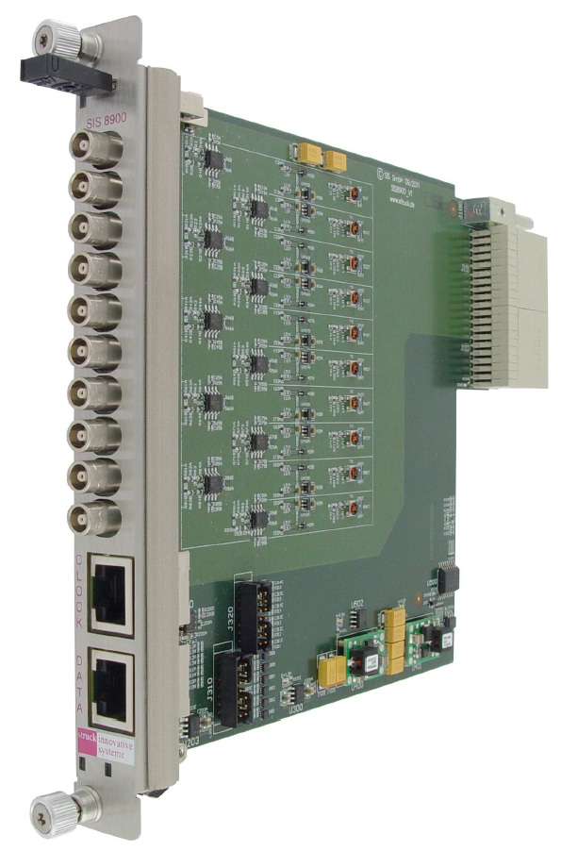
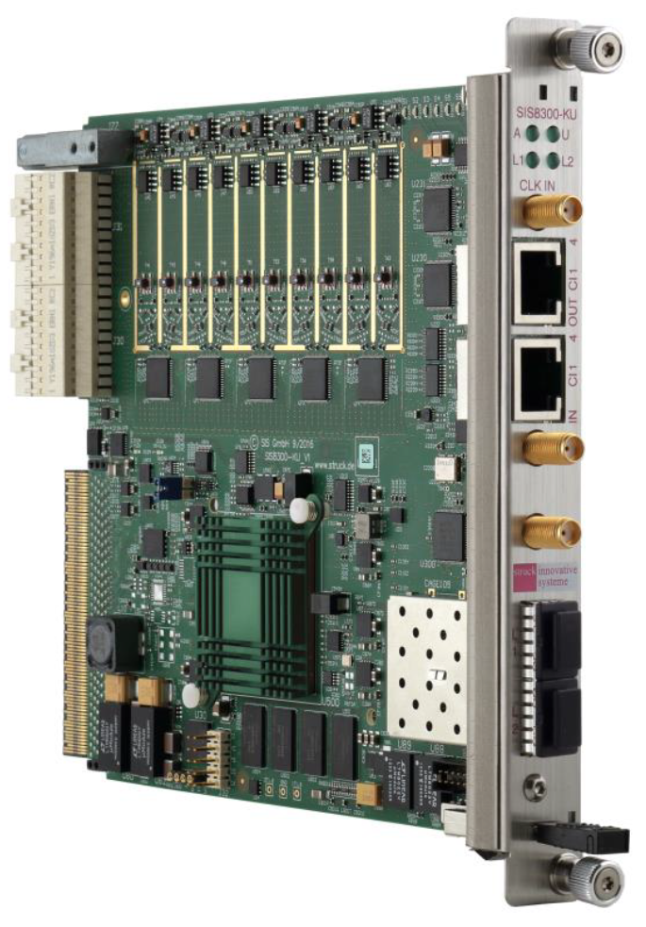
uTCA electronics
The required number of BCM crates (excluding fast BCMs and spares) is 9.
The chassis and the infrastructure modules (i.e. power supply, CPU, MCH, fan, EVR) are within the ICS scope.
The Struck RTM and AMC are within the BI scope.
The crate will consist of the following items (subject to small changes):
  Compact 3U chassis
  Struck SIS8300-KU AMC
  Struck SIS8900 RTM
  uTCA cooling unit
  uTCA EVR-300
  NAT MCH
  CONCURRENT TECHNOLOGIES CPU module
  NAT Power Supply AC600D

Slide 14
Procurement plan for the BCM electronics (hardware)
The ACCT-Es will be procured from Bergoz together with the toroids. This will be done either by ESS or by the IK partners. The ACCT-E and its redundant power supply will then be installed in a proper enclosure by an external partner.
An AIU prototype including all modules that will be installed in it has already been developed and successfully tested at ESS. It is planned to send the design and the test results to an external partner with extensive experience in electronics design and fabrication. This partner will then be responsible for design modifications as well as series-production of final AIUs.
The foreseen uTCA items are all commercial products. Procurement of the BCM AMC and RTM boards are within the scope of the ESS BI. Other items including the chassis and the infrastructure modules are within the scope of the ESS ICS.

Slide 15
Summary of ACCT firmware and software
A ‘demo’ ACCT FW was developed earlier in 2013 through a collaboration with COSYLAB. This FW has recently been used for the ACCT system that was delivered to INFN-Catania in May 2017.
New FW is divided into two parts:
  Custom FW including ACCT-specific DSP (collaboration with DESY)
  Integration FW based on the Struck SIS8300L2 FW performing clock multiplexing, register and memory maps, data decimation etc. (collaboration with Cosylab)
‘LEBT version’ of the ACCT FW with functionality covering warm linac (excluding optical interface) has already been received and tested in the ESS lab.
A revised version with extra functionality and for the Struck SIS8300-KU is foreseen as next step.
SW includes (more information in the afternoon talk by H. Kocevar):
  EPICS modules
  CSS application-specific panels
  ACCT post processing in software

Slide 16
From ADC
Baseline & droop
Scaler
Cross-bar-switch
Diff-Interlock
Permit handler
Check shape
From ADC
Baseline & droop
Scaler
Diff-Interlock
Check shape
From ADC
Baseline & droop
Scaler
Check shape
From ADC
Baseline & droop
Scaler
Check shape
Diff-Interlock
Test signals
From ADC
Baseline & droop
Scaler
Check shape
Diff-Interlock
BIS-Interface
BIS
From ADC
Baseline & droop
Scaler
Check shape
Diff-Interlock
provided by
ESS / MPS
From ADC
Baseline & droop
Scaler
Check shape
From ADC
Baseline & droop
Scaler
MEBT chopper protection
FPGA pins
Check shape
From ADC
Baseline & droop
Scaler
PERMIT
BIS Backbone
Check shape
From ADC
Baseline & droop
Scaler
Check shape
Trigger
Serial Timing data receiver (provided by ESS)
Manual calibration support
FPGA pins
Data interface to DDR memory
(provided by ESS)
16
16
Draft and simplified layout of the custom FW for the warm linac (M. Werner - DESY)

Slide 17
Strategy for FW development, maintenance and improvements
Previous versions of the BCM FW were done through external collaborations. This was mainly due to the rack of internal resources. On the other hand, this helped us benefit from the experience of some external experts.
The custom FW is platform independent. Therefore, it is not supposed to change if we switch later to another platform. It is planned to continue working with DESY for the development of the future revisions of the custom FW. On the other hand, it is preferred that an internal FPGA programmer knows how the code works. This will be useful for long-terms support and maintenance.
The integration FW depends on platform. We plan to use the internal resources for the integration, maintenance and possible modifications of the next revisions of the FW.
It is also planned to develop a fast optical link for crate-to-crate data transmission using internal resources (more information will be given in the afternoon talk by M. Donna). This link can then be used for differential current measurement over large distances.
Notes:
Internal

Slide 18
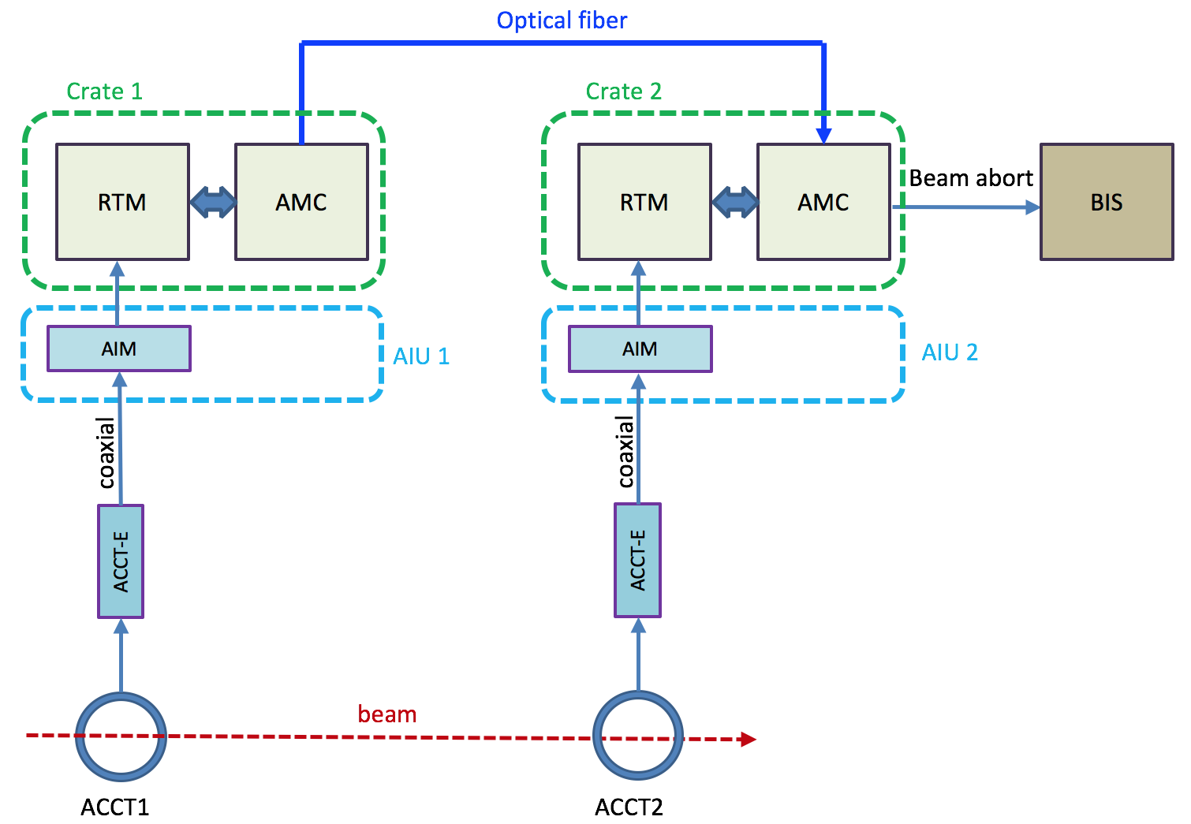
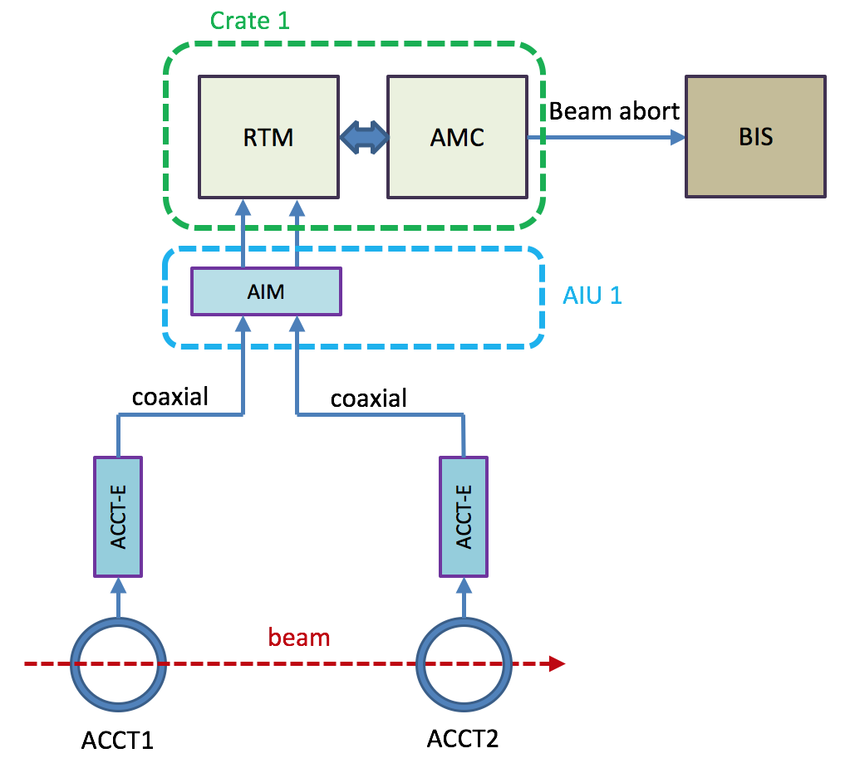
Differential current measurement with the BCMs
Case 1: differential current measurement with the 2 ACCTs connected to the same AMC
Case 2: differential current measurement with the 2 ACCTs connected to two AMCs in separate crates
The existing FW already provides differential current measurement without an optical link. The implementation of the optical link and the differential current measurement over large distances are planned as a next revision.

Slide 19
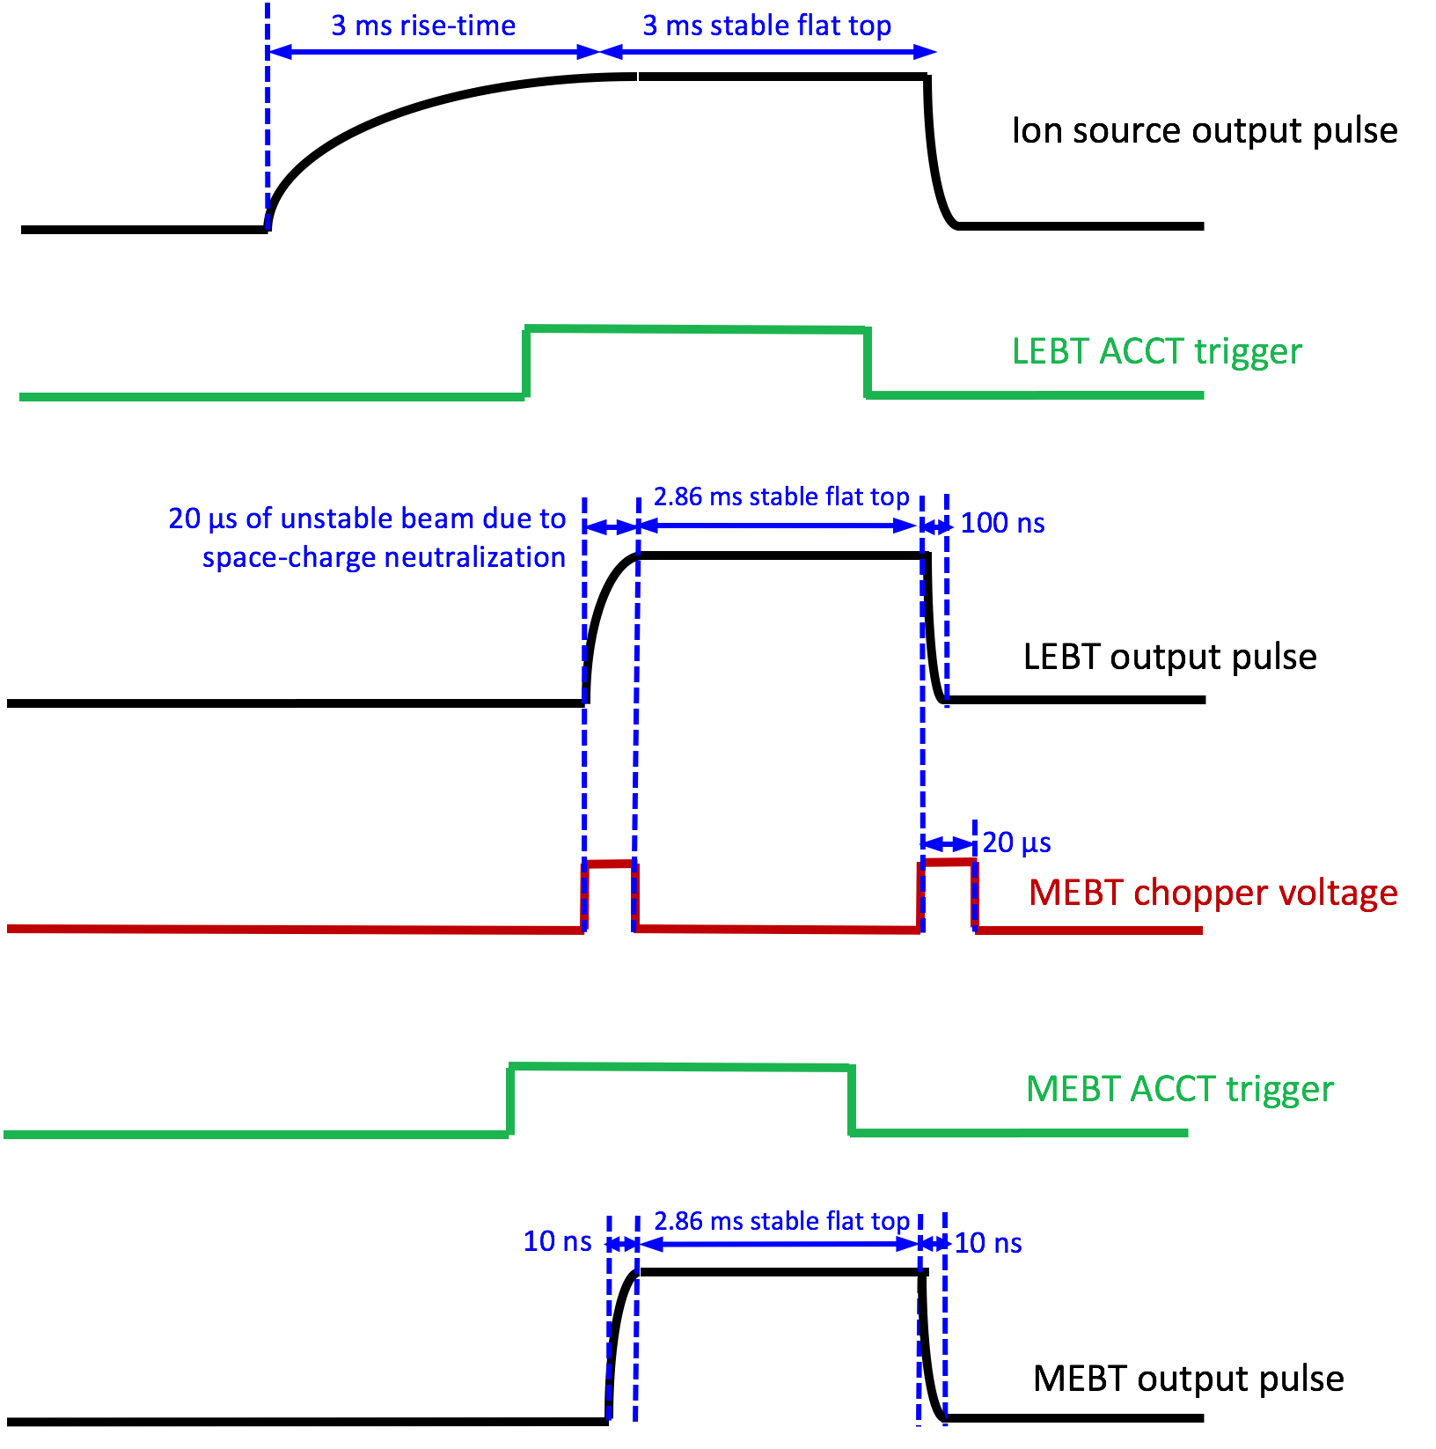
Normal losses in the RFQ and the MEBT chopper
Important considerations relevant to the differential current measurement:
Differences in the propagation delays of the differential pair should be precisely compensated.
Normal losses of the RFQ should be considered for all the ACCTs downstream of the RFQ.
The MEBT chopper will cut up to 20 us of unwanted beam from the start of the pulse
Special FW blocks are foreseen for the RFQ and the MEBT chopper. False beam aborts will be avoided by relaxing disabling some interlocks during short periods.

Slide 20
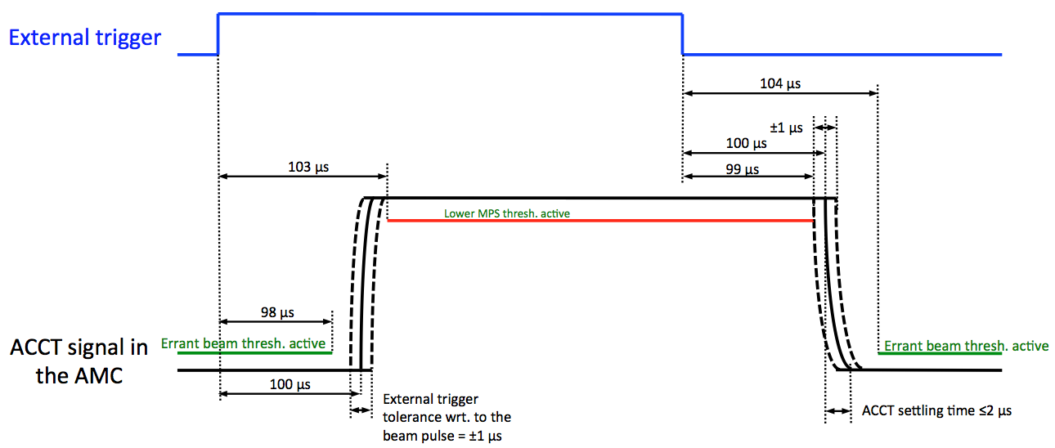
BCM timing requirements
ADC clock: 88.0525 MHz, locked to RF
Pulse trigger: same width and frequency as the real pulse, should be received by the BCM electronics at a well-defined time (typically 100 us) before the beam pulse.
Beam mode: information regarding pulse current, width and frequency
Destination mode: information regarding beam destination
Calibration announcement

Slide 21
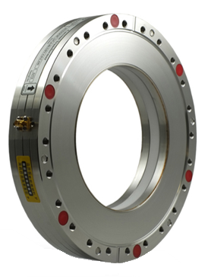
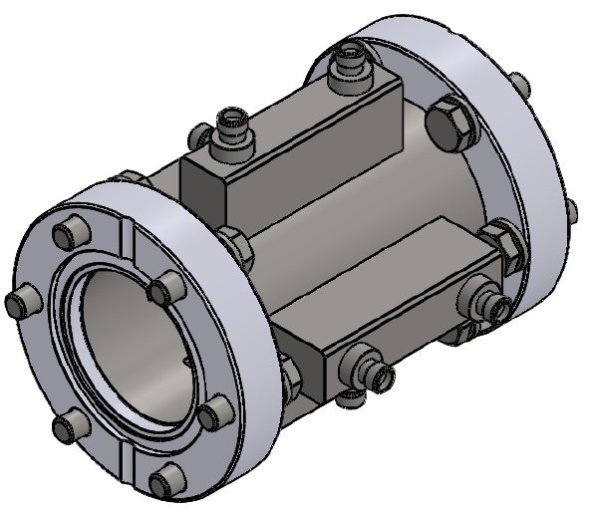
Fast BCMs
The fast BCMs of the ESS consist of a BPM and an FCT that will be both installed in the MEBT and used to the measure the pulse rise/fall times of ~10 ns downstream of the MEBT chopper.
Both of these sensors will provide a measurement bandwidth significantly larger than that of the ACCTs.
In both cases, it is foreseen to measure the sensor output signal directly using a rack-mount oscilloscope integrated into EPICS, or alternatively with an IOxOS AMC including a fast digitizer FMC.
In the BPM case, a simple front-end box including some RF adders is foreseen to merge the 4 stripline signals. This will then amplify the amplitude and minimize variations due to beam position changes.

Slide 22
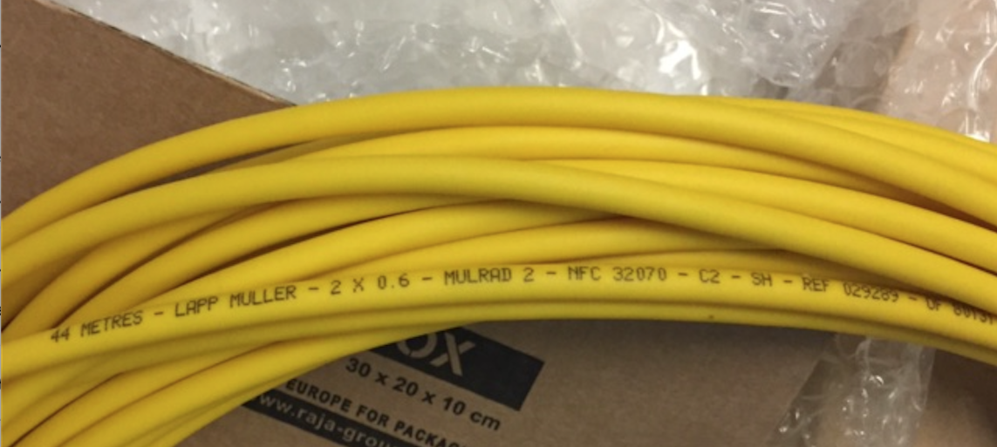
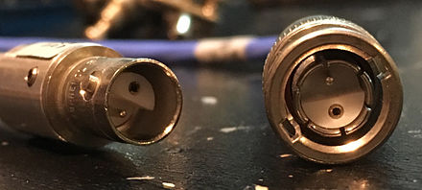
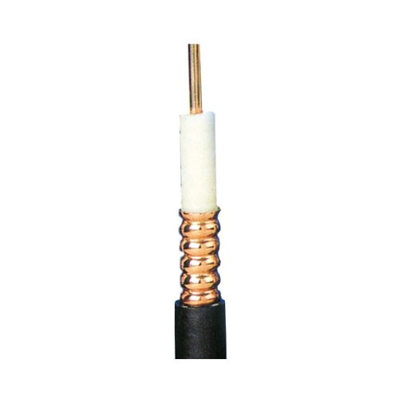
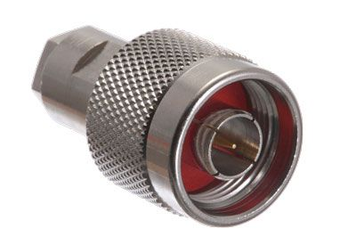
BCM cables and connectors
ACCT:
  Toroid: MULRAD 2 (Siltem) from Lapp-Muller
  Calibrator: MULRAD 2 (Siltem)
  ACCT-E: 3/8” CELLFLEX
FCT:
  3/8” CELLFLEX
Fast BPM:
  3/8” CELLFLEX
Connectors:
  BNO on the toroid cable
  ‘N-type’ on the ACCT-E cable
  Patch panels are planned near the toroid and on top of the BCM racks. These will then be used to change the connector type where needed.

Slide 23
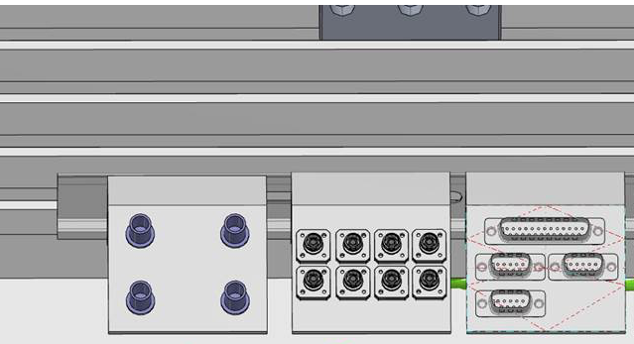
Routing of BCM cables from the tunnel to the rack
Tunnel
RF stub
Klystron gallery / FE building / Target building
toroid P.P.
toroid
Cal.
Mulrad-2
FE
3/8” CELLFLEX
toroid P.P.
toroid
Cal.
Mulrad-2
FE
3/8” CELLFLEX
rack P.P.
BCM rack
Patch Panels are planned near the toroid and on top of the BCM rack. These will then be used for series-connection of the calibration windings and/or conversion of cable/connector types.
Draft design of the toroid P.P. (left)

Slide 24
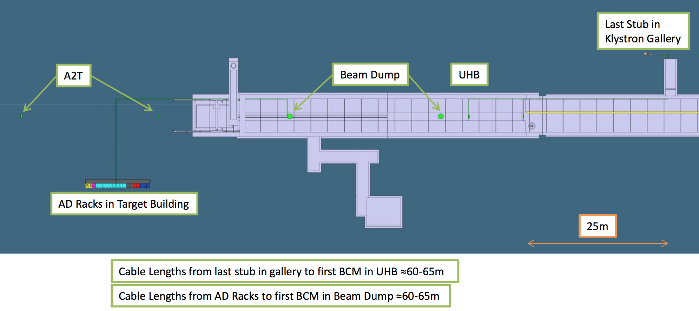
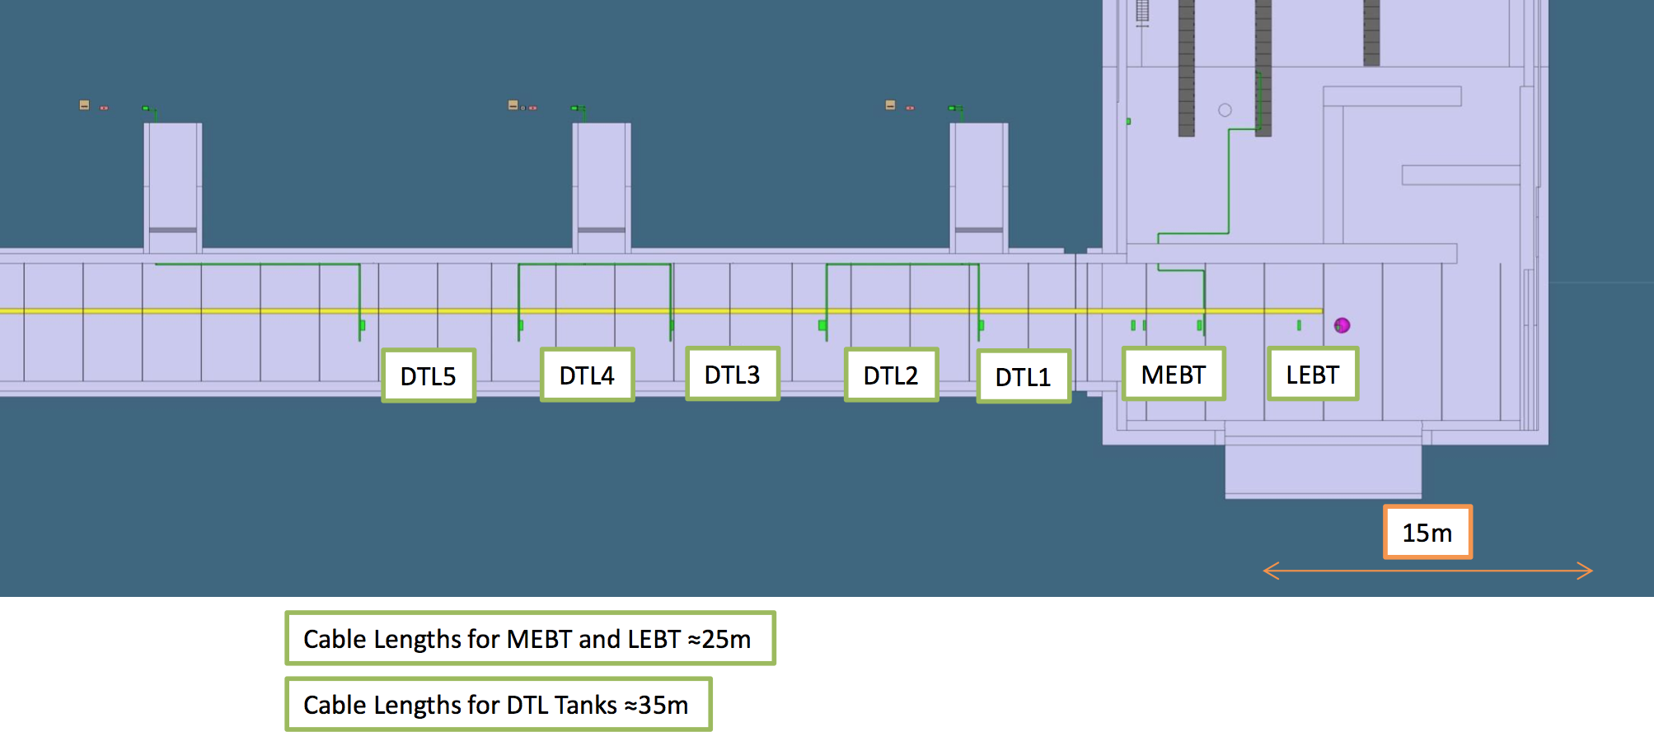
Preliminary estimation of the toroid cable length in different sections of the linac
The ACCT provides an analog BW of 1 MHz only if the toroid cable is shorter than 20 m. Longer cables results in overshoots/oscillations that should be removed through a re-calibration of the ACCT-E at the expense of increasing the settling time.
Toroid cable can be as long as ~80 m towards the end of the linac.
Notes:
Internal

Slide 25
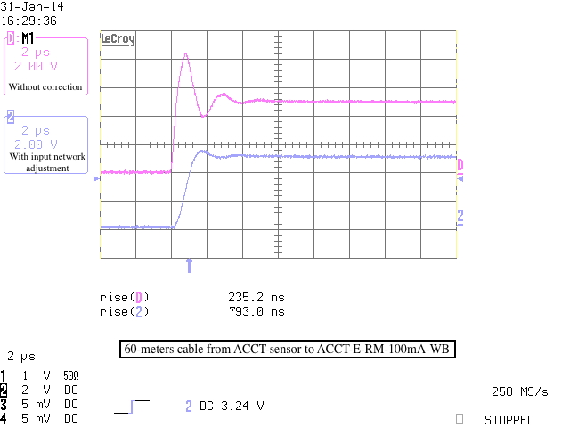
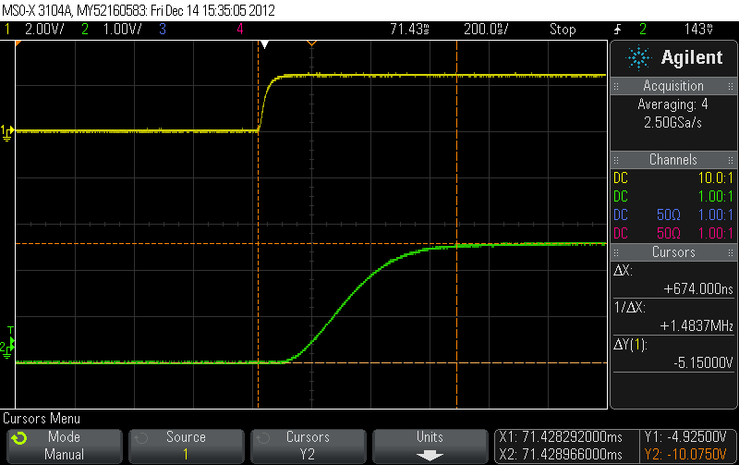
ACCT-E output signal dependency on toroid cable length
The ACCT provides an analog BW of 1 MHz only if the toroid cable is shorter than 20 m. Longer cables results in overshoots/oscillations that should be removed through a re-calibration of the ACCT-E at the expense of increasing the settling time. These differences in the settling time should be taken into account in the design of the BCM FW.
Top: rising edge of the toroid input pulse, Bottom: settling time of the ACCT-E output with a toroid cable length of 4 m measured at ~700 ns.
ACCT-E output signal with a toroid cable of 60 m, Top: without correction, Bottom: settling time increases to ~4 us with correction
Notes:
Internal

Slide 26
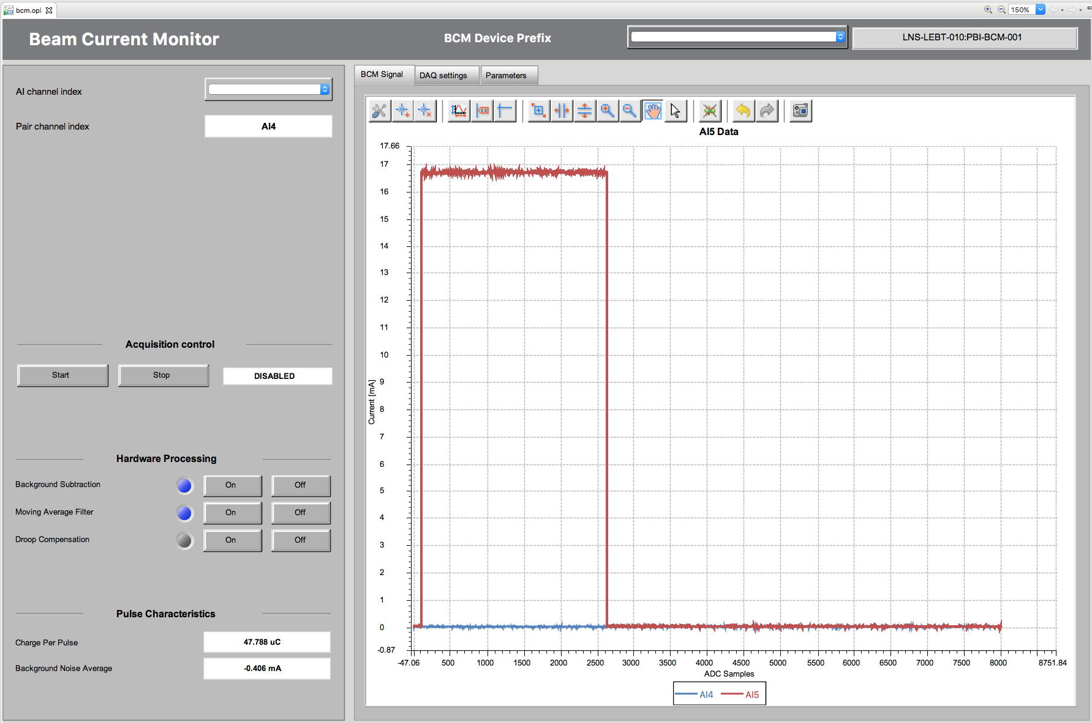
ACCT tests at the ESS lab.
A demo BCM FW was developed earlier in 2013 by COSYLAB. This FW is being used since May 2017 on the ESS ion-source at INFN-Catania.

Slide 27
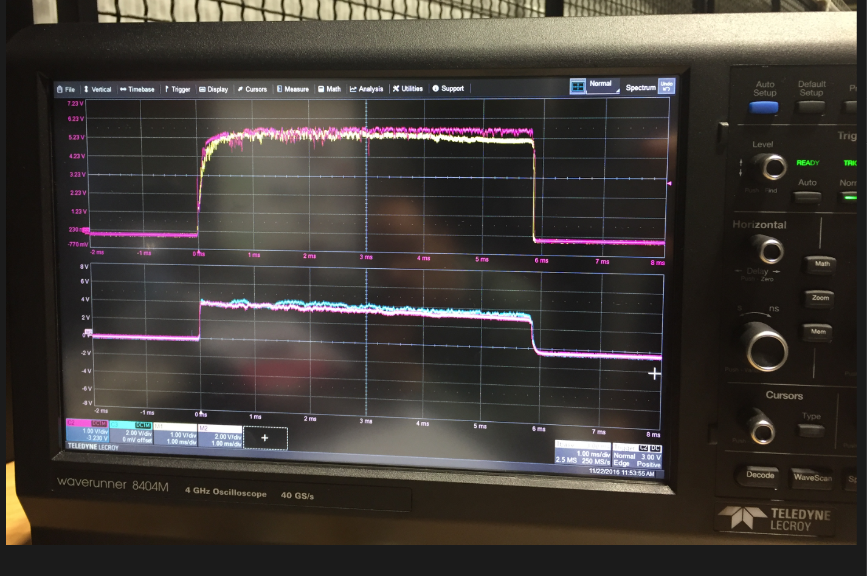
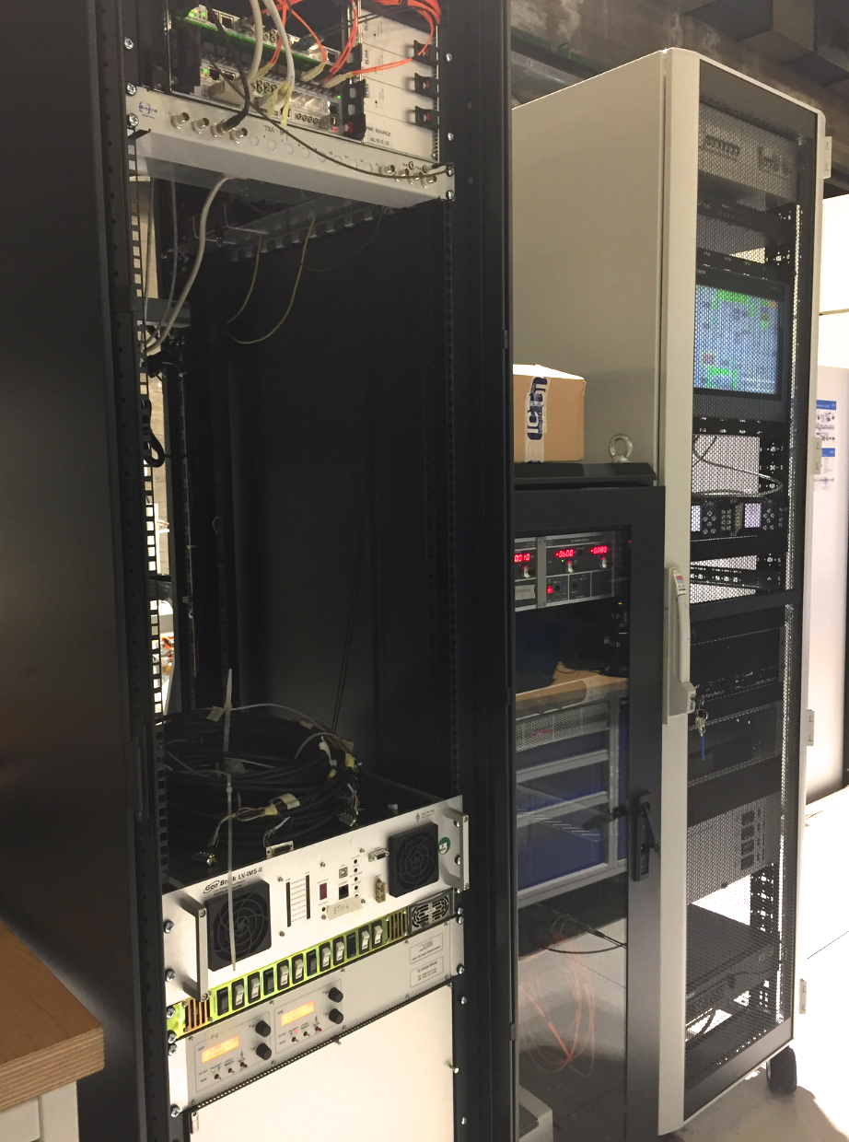
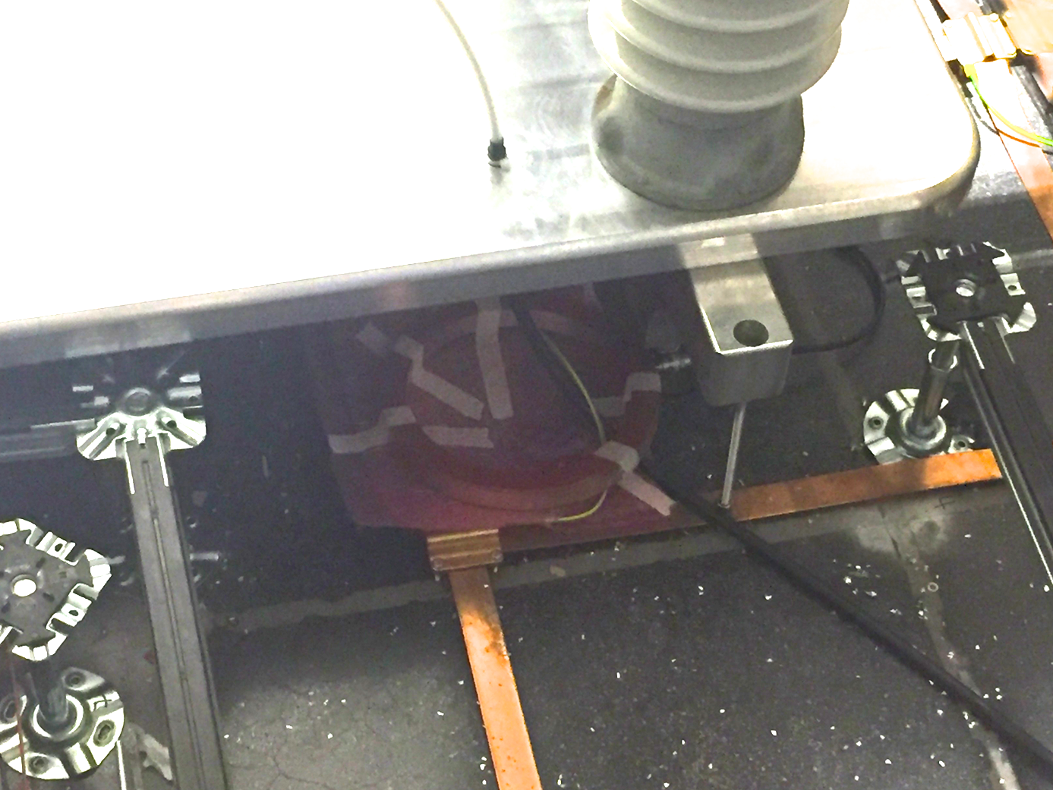
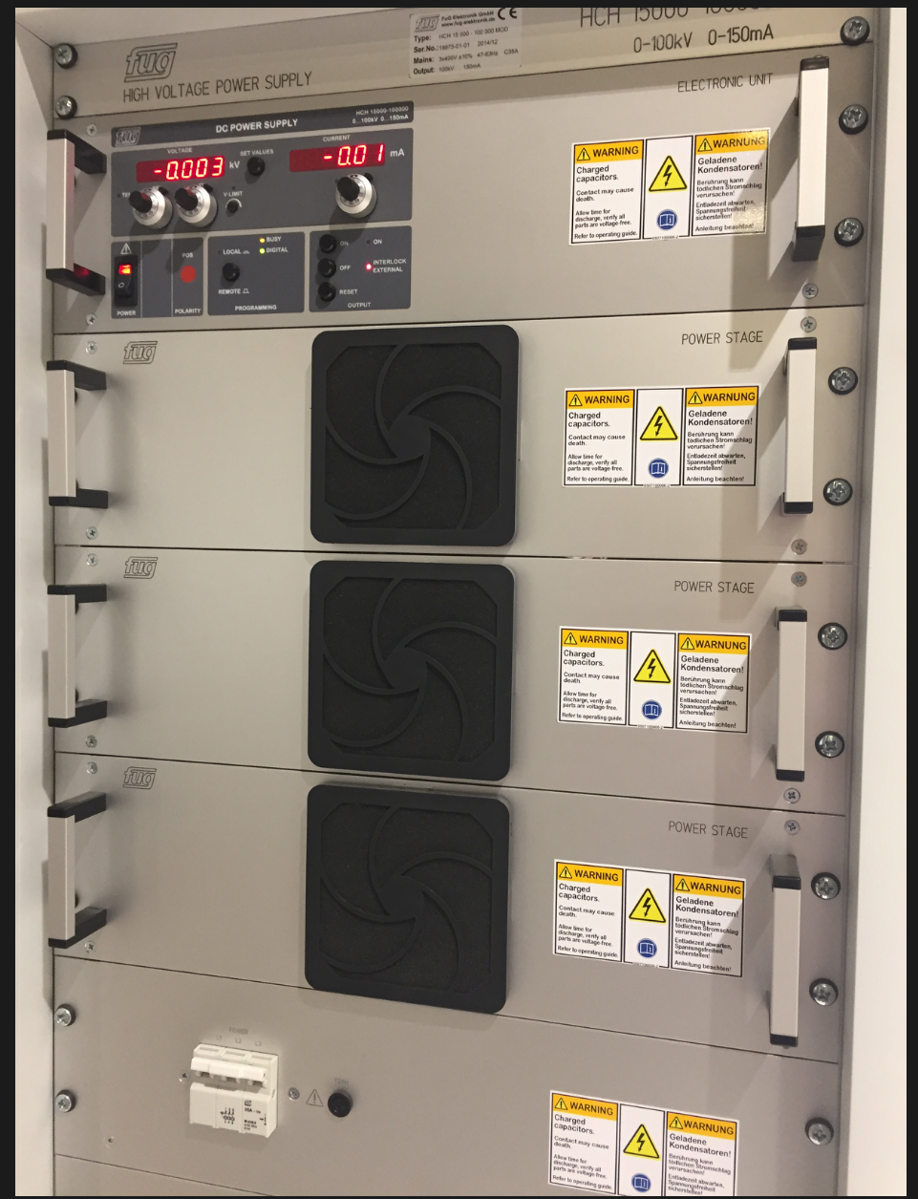
ACCT installation in Catania – Nov. 2016
FC (ion source exit)
ACCT (HVPS output)
HVPS cable to the platform
ACCT toroid

Slide 28
ACCT installation in Catania – May 2017
ACCT-measured pulse of the ion source HVPS
BCM readout electronics (uTCA)
FE box

Slide 29
Summary
A ‘demo’ ACCT system based on the Bergoz toroid, uTCA electronics and customized FW was developed earlier in 2013, and successfully tested under laboratory conditions and more recently on the ESS ion-source at INFN-Catania.
The BCM system has been improved over the course of the past four years. The improvement includes: up to 10 ACCTs per RTM/AMC, added monitoring and machine protection functionality, custom-designed interface unit including Ethernet and calibrator modules as well as improved timing, software and OPI.
A BCM FW that can be used in the warm has already been developed through collaborations with DESY and COSYLAB, and successfully tested under laboratory conditions. We only saw an issue with the external clock that we plan to fix in a future version.
Preliminary discussions have already started with some external partners for the possible design modifications and series-production of the ACCT Interface Units.
External cables to the BCM rack have been chosen with the aim of satisfying ESS regulations and maximizing synergy with the BPM and LLRF systems.

