Slide 1


ESS BCM Firmware
Notes:
1

Slide 2
ESS BCM FIRMWARE
ESS platform migration
BCM Optical link
ESS DEVENV for IKCs

Slide 3
ESS BCM FIRMWARE
ESS platform migration
BPM Optical link
ESS DEVENV for IKCs

Slide 4
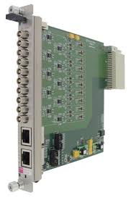
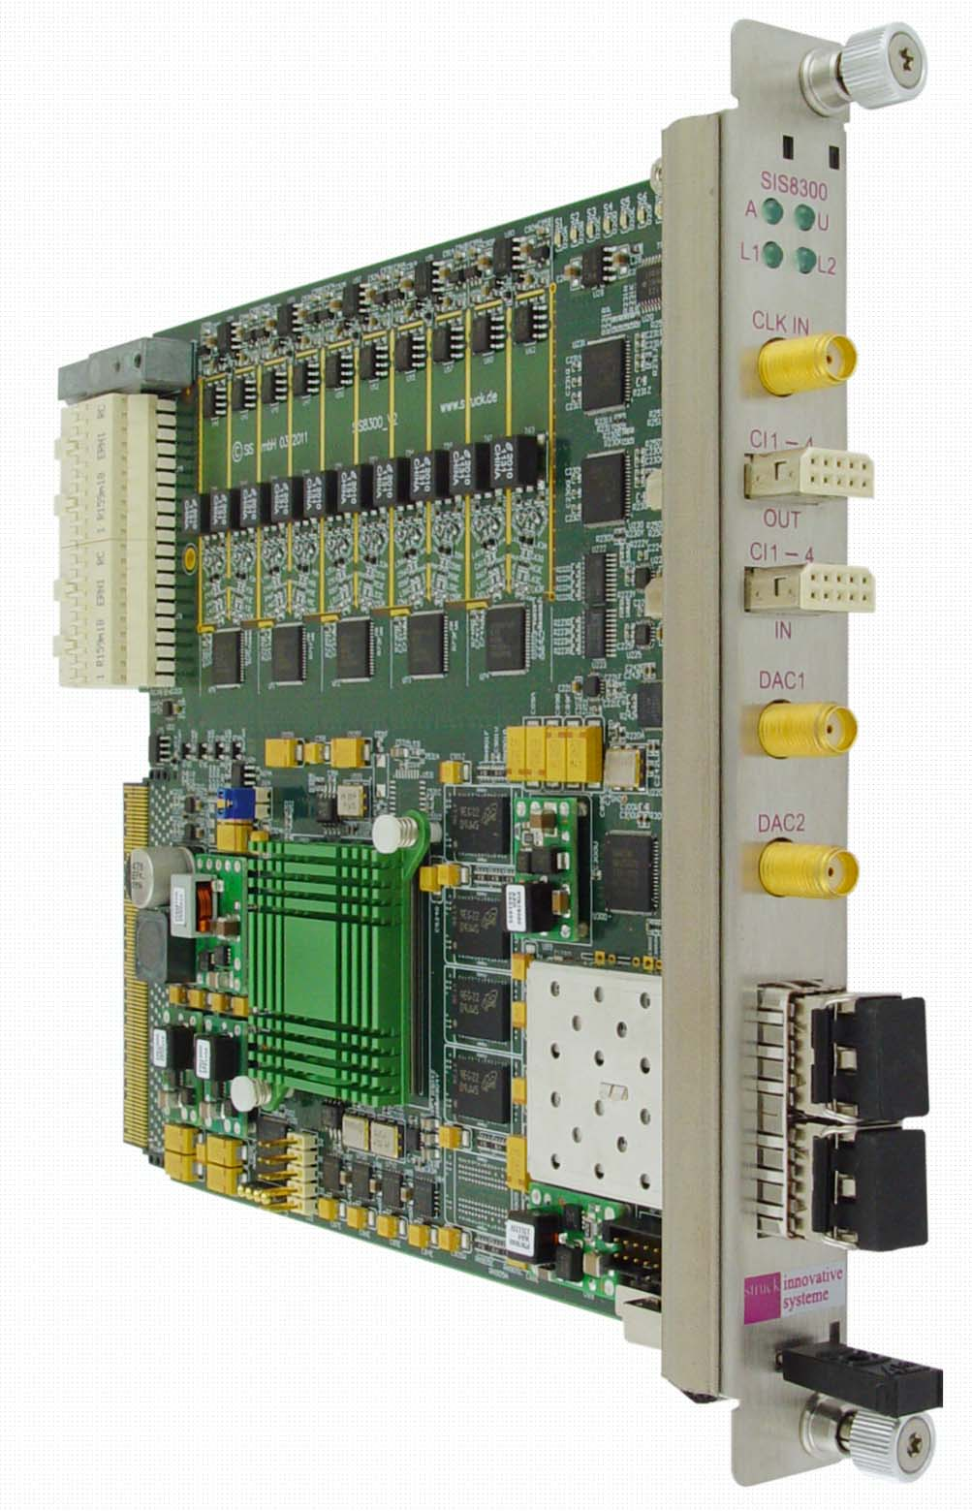
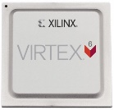

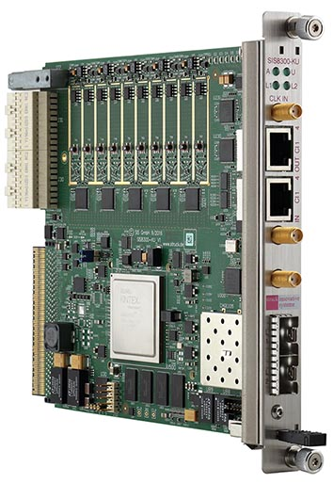
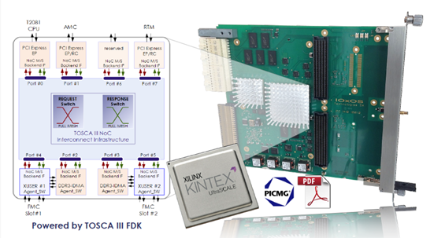
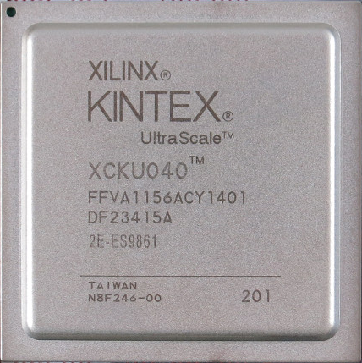
MTCA.4 AMC
BEAM DIAGNOSTIC
PLATFORM
STRUCK
SIS8300L2 + SIS8900
MIGRATION
ICS
PLATFORM
IOxOS
IFC1420 (??)
BEAM DIAGNOSTIC
PLATFORM
STRUCK
SIS8300KU + SIS8900

Slide 5
BCM AMC migration
Based on STRUCK MTCA.4 HW we will migrate the actual BCM design to the new AMC based on XILINX Kintex Ultrascale (KU):
  First migration: should be on the Struck native FPGA framework that is mostly similar to the Virtex6 (L2) framework (same proprietary interfaces, part of the design is not based on HDL file but netlist): according to BPM experience we expect the same performance ADC;
  All the mathematical core will need a wrapper because on the new technology are AXI based;
  Next step: working with LLRF we are developing a new framework based on AXI bus, so it will be necessary to rebuilt most of the HDL that was interfacing to the Struck proprietary framework, but it will make the design more maintainable and solve some issue related to the Struck native framework (missing arbiter betweene DDR – PCIe –ADC)

Slide 6
BCM AMC migration (2)
ICS platform is based instead on the IOxOS IFC 1420 AMC (FMC carrier) that mount the same XILINX Kintex Ultrascale of the Struck SIS8300KU AMC:
  This is a complete different framework, but it has in the TOSCA III crossbar an AXI interface to their proprietary protocol, so if we have already migrated the FW design to KU it will be much more easy to migrate to the ICS platform;
  There will be many difference on the memory management, shared memory area, access to the ADC, etc…. But there will be the ICS/PSI support to migrate the working design to the TOSCA III;
  Still there are no samples to make any test because the design phase it is still on PCB review!!!

Slide 7
ESS BCM FIRMWARE
ESS platform migration
BCM Optical Link
ESS DEVENV for IKCs

Slide 8
BCM L2 optical Link
The bidirectional optical link is needed to provide the current measurement, or the raw data, to
the next BCM that is (for logistic reason) implemented on an AMC that sit in a crate in a different rack;
To the LLRF cavity controller to use the information to improve the quality of the beam.

Slide 9
BCM based on Struck
Struck SIS8300 has 2 SFP cage available on the front panel:
Xilinx provide an easy to use fast serial protocol (AURORA) based on a proprietary frame/streaming interface, that include the GTX/GTH configuration using Core Generator: this mean that only a FIFO based interface to the actual design need to be designed;
Each ADC samples at 88 MSps, each sample is 16 bit, that means 1.5 Gbps, the aurora protocol has an overahed of 3% so:
  The L2 AMC mount a Virtex6 FPGA that has GTX transceiver up to 6.5 Gbps: so only 4/8 channel could transported on the link
  The KU AMC mount a Kintex Utrascale that has GTH transceiver up to 16 Gbps so all the 10 channels.

Slide 10
ESS BCM FIRMWARE
ESS platform migration
BPM Optical Link
ESS DEVENV for IKCs

Slide 11
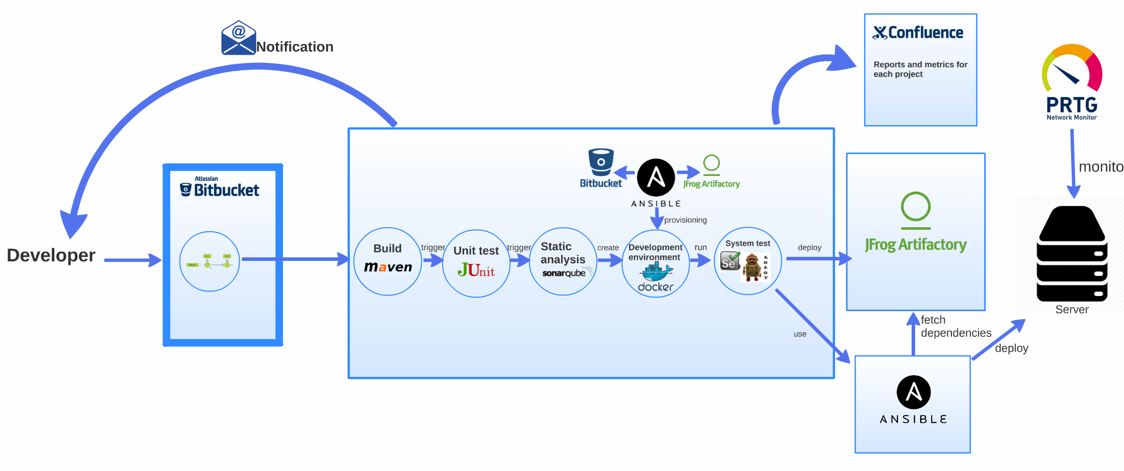
ICS Continuous Integration/Delivery
Courtesy of ICS
JAVA flow

Slide 12










FPGA design/delivery
Logs and
documentation
Notification
Bitstream
Repository
Development
Environment
Notes:
12

Slide 13
minor
feature
major
feature
Feature
branch
Master
branch
V1.0.0
V1.1.0
V1.1.1
V2.0.0
Production
branch
hotfix
branch
http://semver.org/
MAJOR.MINOR.PATCH
MAJOR version when you make incompatible API changes
MINOR version when you add functionality in a backwards-compatible manner
PATCH version when you make backwards-compatible bug fixes

Slide 14

Logs (Simulation, Synthesis, Mapping, Routing)
Documentation
Simulation results
Manual
acceptance
Folder
structure
Scripts
Patterns
Golden Model
Configuration
Constrains
AMC
Bitstream
V1.0.0
Production
Branch
commit
Simulate
FPGA Flow
Notification

Slide 15
Frameworks on bitbucket
STRUCK project contains different repository for FW and SW for the SIS8300L/L2/KU, each of it has 2 branch for the 2 RTM used:
    for BCM (SIS8900 RTM);
    for BPM (DWC8300 downconverter RTM);
IOxOS project contains the TOSCA III firmware for IFC1410 that support streaming of data from a ADC 3110/3111 - FMC Mezzanine Card

Slide 16




Questions
Notes:
16

Slide 17

Notes:
17

