Slide 1
BCM verification plan
Clement Derrez
Test Engineer
www.europeanspallationsource.se
10 June, 2017

Slide 2
Outline
Naming convention
Data management system: Insight
Acceptance tests workflow
BCM tests description
After-installation tests
Notes:
Walk through: workflow from acceptances tests to commissonning

Slide 3
Naming convention
Every Field Replaceable Unit (FRU) is named. A FRU can be a simple part or an assembly
  Ex: FEB-050ROW:PBI-PPC-002 for a cabinet cable
Naming convention:
Sec-Sub:Dis-Dev-Idx
  Two major areas of FRU installation slots are identified:
  tunnel: including stub, tunnel wall and gallery wall,
  support: front end building (FEB), klystron gallery, gallery support area (GSA) in A2T
→ System name is not misused!
Notes:
Naming: Section – subsection : Discipline – Device type - Index

Slide 4
Data management system
Data export / import with other software tools
Systems and subsystems tests results coming from different locations (ESS, IK Partner, Industry partners…)
We must be able to trace back acceptance tests results to laboratory measuring devices
We need to be able to prepare an installation batch when an installation slot is ready: need for a dynamic tool
  → Having a reliable Data management system is critical!
Notes:
Illustration: mention a possible issue happening if we want to find out what tests results are affected when a deviation is detected in a lab device calibration.
How can we make sure we’ll be able to store reliably all our systems docs? The answer is using insight.

Slide 5
Data management system: Insight
Ensures traceability between tests and production data, system components and laboratory devices.
Objects’ attributes store all FRU info: responsible, current status (procured, received, RFI…) etc.
Added value, current installation or production progress… can be automatically extracted for each system or FRU
Timeline is managed in Jira, tasks are linked to Insight.
We do not want to replace CHESS!
Insight: PBI shopping list
Component requirements
System FRUs list
Tests report
Test plan
Laboratory devices
Test Design document
JIRA: timeline
Notes:
Add a demo here using Insight??
We can get a quick overview of any project extracted from this system: % of all BPMs in “RFI” state for instance.
Stress that we do not replace CHESS when using Insight! This is a data management tool.

Slide 6
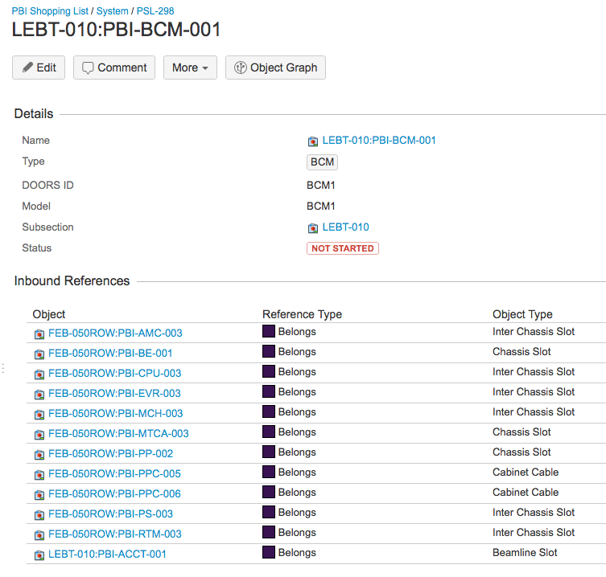
Data management system: Insight
Change of status are triggered when all required documents and conditions are met.
ICS database requirements are being defined. It will be automatically populated from Insight when available.

Slide 7
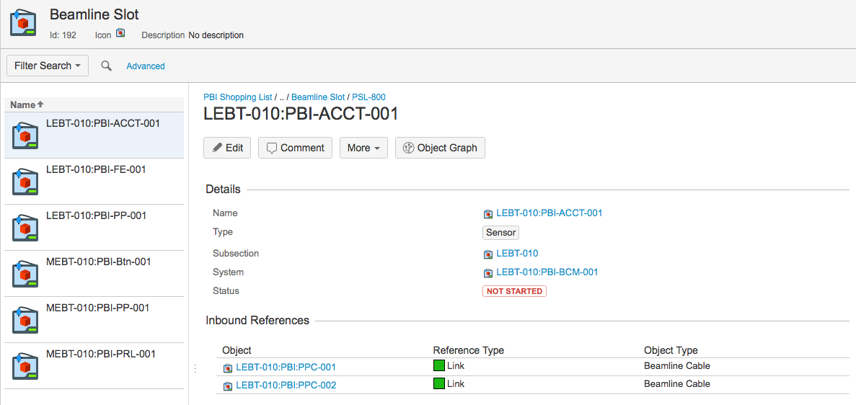
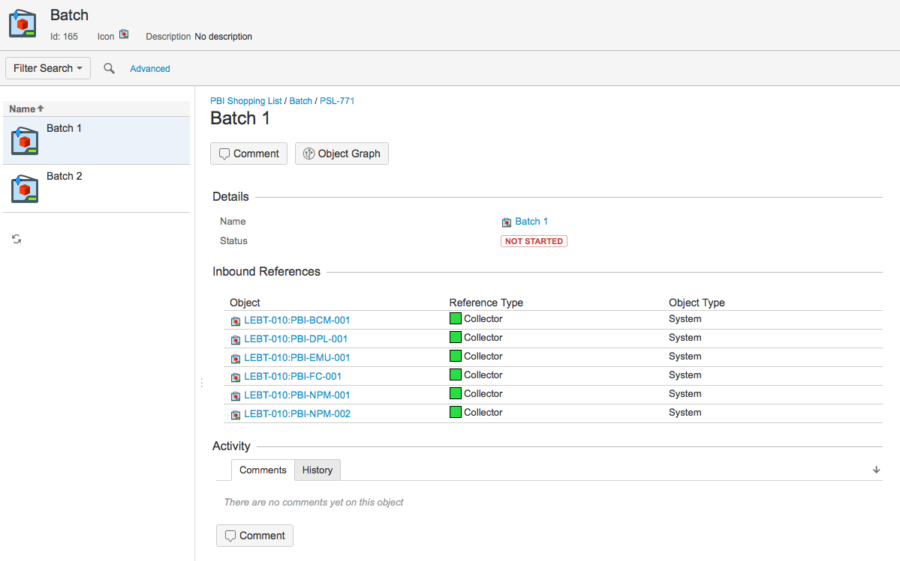
Data management system: Insight
No lost effort, as everything can be scripted to populate external tools and extract any needed information!
Installation batch: installation status easily verified and prepared
Data is uploaded by BD team. Training IK and industrial partners on that is possible.
Notes:
Main additional points to mention: When we prepare a system for installation, we can make sure all components are stored and tested by checking the corresponding installation batch status
Each object share a minimum set of mandatory attributes.
Screenshot: example of a BPM beam line element: a BPM button and its beam line cables are visible here… It is part of this system etc (we can go up to the mTCA objects easily)

Slide 8
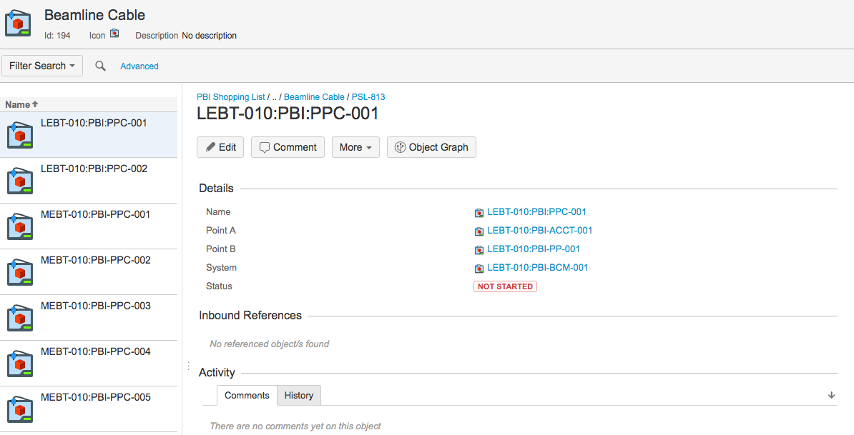
Data management system: Insight
Hierarchy goes down to systems cables and their status and properties
Example of a Beam line cable connecting an ACCT to a Patch Panel:

Slide 9
Measurements files format
Large amount of measurements parameters: Data logged in HDF5 and uploaded to Insight.
Data files produced at ESS follow a fixed format: Files, groups and datasets mandatory attributes are defined.
Existing data received from IK and industry partners is stored as is for now, adding the needed metadata. Re-formatting to HDF5 is planned for each test results.
Notes:
A few words on the measuremnts files format: We already have data from DESY and ESS bilbao in a shared drive. We’ll upload it as it is now, adding metadata to it.

Slide 10
Acceptance tests workflow
System tests requirements
Test plan
Test Design Document
testbench implementation
Tests requirements are defined for each subsystem
Design document is validated by system lead: we make sure test requirements are correctly translated
Test coverage is reviewed. Possible risk assessment if we do not reach 100% coverage
Test system implemented in python.
Describes subsystems' test setup and characterization procedures
Tests IDs defined for each measurements
When not COTS: test plan is prepared/discussed and agreed with IK partner
Run tests
Acceptance tests performed in RATS
Data logging in Insight

Slide 11
Where do we test our systems?
RATS preliminary layout
BI area
36 m
87 m

Slide 12
Acceptance tests workflow
RATS: Component received.
RATS: Component tested.
RATS: Component stored.
RATS: System assembly and test → RFI
RATS: System stored
Installation slot: System goes to ESS AT site.
  Guideline: Install and test as much as possible, as early as possible
  Learning curve will help us moving faster with installation work after the first systems are processed
Last step: commissioning
Notes:
We focus on having as much automation in our test and tuning stations!
This flow might change depending on if we score some area on site…

Slide 13
Tests description
When struck digitizer boards are received, acceptance tests are performed to characterize the ADC on all channels:
Parameter | Test description | Pass/Fail thresholds
ADC SNR | Using low noise & distortion Generator | 65 dBc
ADC SFDR | Using low noise & distortion Generator | 65 dBc
ADC SINAD | Using low noise & distortion Generator | 60 dBc
ADC ENOB | Using low noise & distortion Generator | 11.5 bits
RTM clock source | Test the ADC clock using the RTM input as source
Notes:
Specifications are based on “BCM electronics and cables” presentation. We will

Slide 14
Tests description
The next tests then include the complete system, from toroid +FE to digitizer card:
Parameter | Test description | Pass/Fail thresholds
Current measurement range | Measure non linearity on a full scale input waveform | Non linearity < 0.1 % FS
Pulse rise time | Measure pulse rise time, sweeping pulse amplitude until 80 mA. | < 300 ns (cable length < 20m)
latency | Measurement of response time from current through toroid to AMC/RTM digital output. | < 2 us (cable length < 20m)
Droop | Acquire a 6 ms pulse, measure droop value | < 2% per ms

Slide 15
Tests description
Parameter | Test description | Pass/Fail thresholds
Noise | Measure noise in lab conditions. Adjust threshold after first tests. | < 1% (RMS) FS
Temperature induced drift | Measure signal drift vs temperature over a range of xx degC | < +/- 1% FS
Bandwidth | Measure data acquisition system’s bandwidth: sweep sine input frequency until 3 MHz | > 1 MHz (cable length < 20m)
Overshoot | Sweep pulse amplitude until 80 mA, measure overshoot | Time and amplitude thresholds to define
Uploaded to database:
ACCT-E calibration data
Automated electronics tests results: output of the tests described in the table above.
Production tests results from manufacturer (Bergoz)
Notes:
Specifications are based on “BCM electronics and cables” presentation. We will adjust noise pass/fail threshold after the first systems’ tests

Slide 16
After-installation tests sequence
After-installation tests sequence:
  initial first-time commissioning: test_ID
  cold check-out: test_ID
  commissioning with beam: test_ID
  quick self-check: test_ID
Sequential testing is important (tests timestamps are checked automatically). Otherwise the statement: “the instrument is installed and working properly” has less confidence.
During debugging:
  Relevant tests in each architectural layer are repeated until satisfactory results are obtained.
  If the problem is identified and can be isolated within its layer, there is normally no need to repeat all of the tests which are sequentially following. Depending on the situation, some test might become mandatory nevertheless (for instance a software recompilation might entail a standard interface check, and a repaired connector might entail a signal transmission check).

Slide 17
After-installation tests sequence
Cold check out: Testing of the whole instrument on all architectural layers:
  monitor, front-end electronics, cables, mTCA-electronics, timing, data treatment, publishing, network transmission and machine protection interface.
Commissioning with beam: Aims at verifying the correctness of the integration for machine operations.
  Includes initial comparisons and cross-calibrations in order to gain confidence in the instrument. Performance limiting factors are identified.
Quick self test: The self-test procedure includes testing of calibration, machine protection and data transmission.

Slide 18
Thank you!
Questions ?

