Slide 1
Controls Infrastructure
Timo Korhonen
ICS Chief Engineer
www.europeanspallationsource.se
12 June 2017

Slide 2
Overview
Control system infrastructure components
MTCA base infrastructure
Timing system
Machine Protection System
Digital platforms, status and support
Procurement and Installation
Interface with Beam Instrumentation
Software services
Summary

Slide 3
Control system infrastructure components
MTCA.4
  Crates, MCH, Cooling Units, PSU
  Platform Management
  Crate variants: 12-slot and 6-slot
I/O and processing
  Digital platforms
Network and servers
  Network hardware in-kind contribution from Norway
Timing System
  EVG, EVR, Distribution System
EPICS and associated software
Configuration management tools

Slide 4
MTCA base infrastructure
Crates in two variants
12-slot, 9U crate
  For (LL)RF systems that can utilize many slots
  Has been in use, stable configuration
6-slot, 3U crate
  For smaller, more distributed systems (saves rack space)
  Backplane issues
    Vendors consider MTCA backplanes as “custom”
    Defined an “ESS-specific” backplane – follows layout of the bigger crate
  Cooling and airflow issues with prototype
    Added one fan to improve airflow
    Front-to-rear cooling is challenging due to small air inlet area
MCH (Micro Channel Hub) standardized on N.A.T.
Power supplies need final definition
  Wiener has good noise performance but issues with size

Slide 5
MTCA Crate variants
3U, 6-slot crate
4 slots with place for rear transition module
CPU, EVR in remaining slots
Primary candidate for the BCM systems
9U, 12-slot crate
12 slots with place for rear transition module
2 MCH slots (redundancy)
4 PSU slots (2 with double width, e.g. WIENER)

Slide 6
Timing system
MRF Event System
  Components defined
  Uses latest design with active delay compensation
    Higher frame rate possible
    Unlimited fan-out depth
    Etc.
  MTCA.4 version with backplane trigger and clock support
    Software support to be finalized
Details of interfacing to BI (and other) systems to be discussed and finalized
  A preliminary, incomplete definition exists (ESS-0088633)

Slide 7
Interaction of timing with BCM system
Clock and trigger signals transmitted via the backplane
  Beam pulse start and end timing (pulse length monitoring)
Beam mode, beam destination transferred as data, handled by the MTCA CPU and written into BCM module memory
  These actions do not depend on real-time response of the CPU. MPS/BIS sequences ensure that modes are checked properly before beam is allowed. Thus, “intended” mode.
  Having this “directly to the FPGA” would not give any extra benefit in terms of reliability.
  Nevertheless, the sequences can be fast when needed.

Slide 8
Accelerator sequences
14 Hz <-> 71.4 ms
71.4 ms
71.4 ms
71.4 ms
…
t
Beam Off, t=0+3395 us
Beam On,t=0+535 us
RF Pulse, t=0+530 us
DATA
Modulator, t=0+500 us
Transmit (well) before next cycle
Pre-programmed sequences repeat at 14 Hz
  Sequencer with a RF-synchronous 88 MHz clock (can be changed)
  “programming” can happen in less than a millisecond
“Data”, i.e., beam envelope mode, etc., transmitted in parallel
  Contains “plan” for the next cycle: envelope mode, beam/no beam, pulse counter, rep rate,…
  Mode changes require a handshake with BIS
    When mode change is transmitted, timing does not send beam before MPS/BIS gives OK

Slide 9
Machine Protection System
Interfacing to MPS
  System concept is ready and accepted
  Detail discussions are still underway
Interface defined, consisting of
  Discrete lines
    OK/NOK, disconnect (“3-wire”)
    For fast switch-off
  Ethernet link (UDP) (or serial RS-422 port?)
    Operating mode checking, heartbeat, online testing
    Removes dependency on timing system direct link for mode data transfer
  Use RJ-45 connector on the SIS8900 RTM when on SIS8900-KU
    For IFC1420, special interface card under design.

Slide 10
Digital platforms, status and support
Struck SIS8300-L2,KU
  Supported until final platform (IFC1420) at equivalent or better performance level
    The agreement as I have understood it.
    EPICS integration; drivers and IOC application (EPICS records)
  MPS (BIS) interface under design
    Use RJ-45 for I/O and serial links
    Firmware interface (programming resources to be found)
  Procurement etc. is BI responsibility

Slide 11
IFC1420
Consists of a FMC carrier (IFC1411) and a mezzanine ADC module (IFC1430) (can be replaced)
  10 Ch ADC (TI ADS42LB69, 250 MSPS, 16 bits)
  4 CH DAC (TI DAC38J84, 2.5 GSPS, 16 bits)
Two standard (HPC) FMC slots (one usually used for 1430)
In IFC1420 configuration, front plate space can still be used for a BIS (Beam Interlock System) mezzanine
  One FMC slot still remains free for use (SFP, additional ADCs, DI/O, …)
Other specifications like the already existing IFC1410, with minor changes
  Mostly due to digital vs. analog RTM interface
  Firmware, software essentially the same (some differences due to signal routing etc.)

Slide 12
IFC1420 layout overview
ADC Mezzanine (1430)
FMC slot #1
BIS special
mezzanine
FMC slot #2
Notes:
IFC1411 can be used with two FMCs! (i.e., both FMC slots are forward-facing)

Slide 13
Networks and servers
Network design done
  Technical (aka controls) network backbone
  State-of-the-art performance level
  Hardware in-kind contribution from Norway
  Installation, cabling is underway
    System-level connection details to be defined
Some EPICS IOCs already running on site
  CF systems with PLCs
Temporary control room being equipped
  As well as server infrastructure (also temporary until server room ready)

Slide 14
Procurement and Installation
3U Crate expected in June (new backplane, “custom”)
  No agreed “standard backplane” by the manufacturers (according to our discussions)
9U crate technically ready
Need to go through a tendering process (3U and 9U)
  Resulting in a framework agreement
  Final delivery timetable to be defined
Timing system components procurement in progress
  Backbone cabling design done, detail distribution TBD
IFC1420 prototypes expected end of June
  Firmware work could start immediately, software support may require some time to figure out RTM configuration, etc.

Slide 15
Software support from ICS
EPICS base infrastructure
  EEE (ESS EPICS Environment) is designed to support
    Distributed development
    Continuous integration, test procedures
    closed loop from development to deployment
  Scripting support (Python)
EPICS (7) services
  Archiving, alarm system, save&restore
  Channel Finder for (flat) namespace management
    Generate higher level abstraction(s) and grouping
Configuration management
  Databases
Data management tools
  Calibration data for various devices
  Storage and indexing of measurement results
  Under design, based on use of HDF5 file format

Slide 16

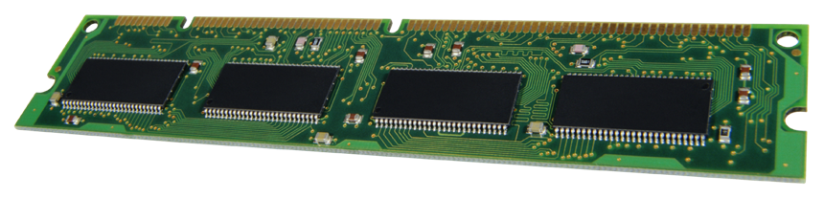
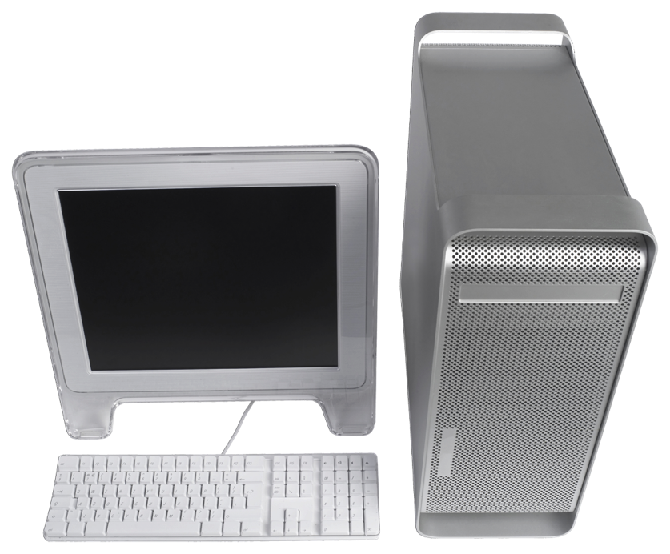
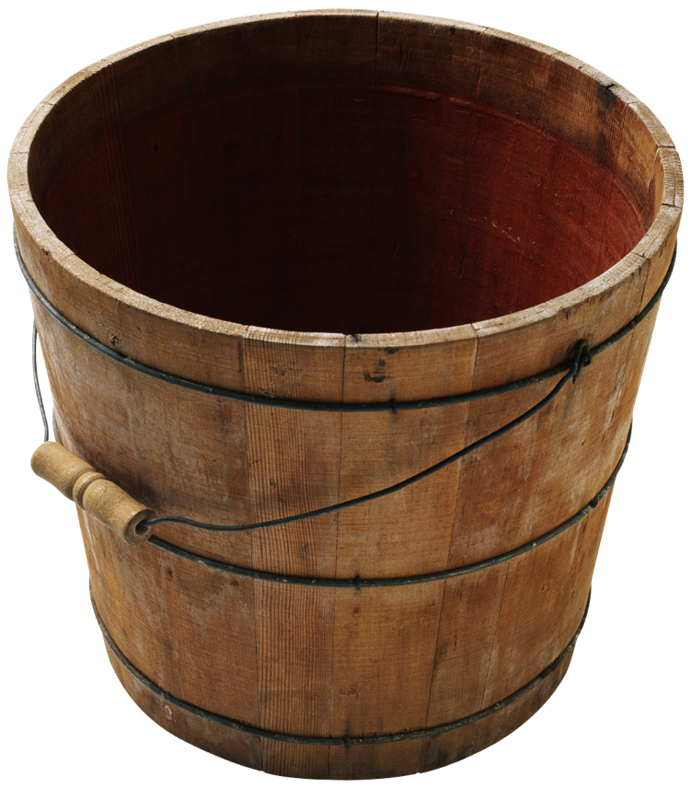

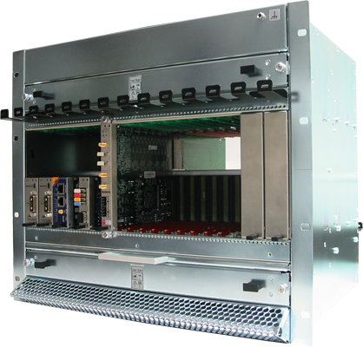
Deployment environment overview
EPICS Base
EPICS modules (community)
EPICS modules (ESS)
Community release
Community (various sources)
ESS internal or in-kind
Download, configure, test, etc.
Develop, configure, test, etc.
Download, configure, test, etc.
CCDB
Compilation, maintenance
Continuous integration, tests, etc.
EPICS core
EPICS modules
(RT)OS image
File system (NFS)
IOC Factory
File system (NFS)
rsync
st.cmd
Synchronization
System integration
Boot

Slide 17
Interface with Beam Instrumentation
From our latest ICD document (should be updated and finalized)
MPS/BIS interface to be finalized
Discussion on data interfaces (EPICS PVs, to beam physics, etc. to be done)
Work on defining requirements for archiving and other services necessary
Data management, calibration, operating procedures to be discussed in detail.

Slide 18
Summary
MTCA base infrastructure defined
  Work still required to verify performance and functionality
Timing system components defined
  Procurement process in preparation
Platform support defined
  Details still to be finalized
  Final platform development speeding up after a slow start
Control system services defined but more details to be discussed
  Definition of PVs for operation (waveforms, integrated values,…)
  Archiving requirements
  Beam-synchronous data handling
  Etc.

