Slide 1
WP07. PDR of nBLM + IC
July 10th & 11th 2017
nBLM based on Micromegas detectors: Introduction
Thomas Papaevangelou

Slide 2
Why a new BLM?
Challenges:
RF cavities emit γ-rays. Those γ’s may pose a problem to ionization chambers used as BLMs
In the case of high intensity but low energy regions of an accelerator charged particles and γ’s do not even exit the accelerator vessel
Continuous monitoring of small losses is needed
Signature of beam loss: fast neutrons
  Thermal neutrons can come from moderation inside the walls, so must to be rejected
  Gamma’s and X-rays present during normal operation, so the detector must be insensitive to them
The nBLM should be:
sensitive enough to monitor small losses
sensitive & fast enough to react on
“catastrophic event”
appropriate for high rates
radiation hard
The “nBLM for ESS” consept:
Micromegas equipped with combination of appropriate neutron convertors & moderators

Slide 3
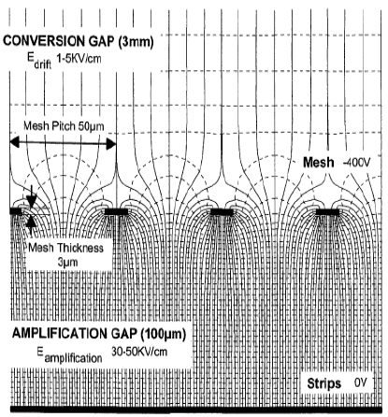
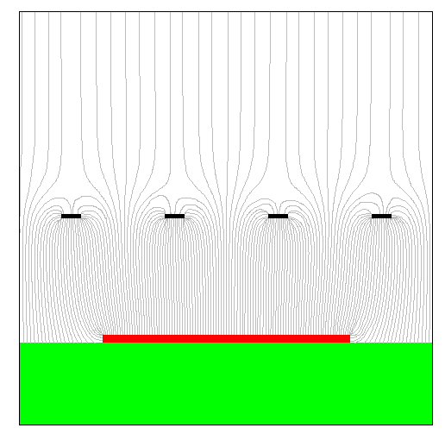
The Micromegas detector
Drift field
typical 10²⁻³ V/cm
γ
Two-region gaseous detector separated by a Micromesh :
Conversion region
  Primary ionization
  Charge drift towards A.R.
Amplification region
  Charge multiplication
  Readout layout
    Strips (1/2 D)
    Pixels
➔Very strong and uniform electric field
Amplification field
typical 10⁴⁻⁵ V/cm
Amplification
gap: 50-100 μm
MICROMEsh GAseous Structure
Giomataris, Charpak (1996)
Y. Giomataris et al., NIM A 376 (1996) 29
In 1st Micromegas
Fishing line spacers have been used
metallic micromesh (typical pitch 50μm)
sustained by 50-100 μm pillars
simplicity
high single stage of amplification
fast and natural ion collection
discharges non destructive
Mesh signal
Pixels / strips
signals

Slide 4
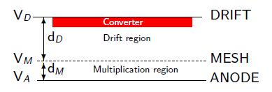
Neutron detection with Micromegas
Neutron detection ➔ neutron-to-charge converter
Solid converter: thin layers deposited on the drift or mesh electrode (¹⁰B, ¹⁰B₄C, ⁶Li, ⁶LiF, U, actinides…)
  Sample availability & handling
  Efficiency estimation
  Limitation on sample thickness from fragment range
  ⇒ limited efficiency
  Not easy to record all fragments
Detector gas (³He, BF₃…)
  Record all fragments
  No energy loss for fragments ⇒ reaction kinematics
  No limitation on the size ⇒ high efficiency
  Gas availability
  Handling (highly toxic or radioactive gasses)
Neutron elastic scattering
  gas (H, He)
  solid (paraffin etc.)
    Availability
    High energies
    Efficiency estimation & reaction kinematics

Slide 5
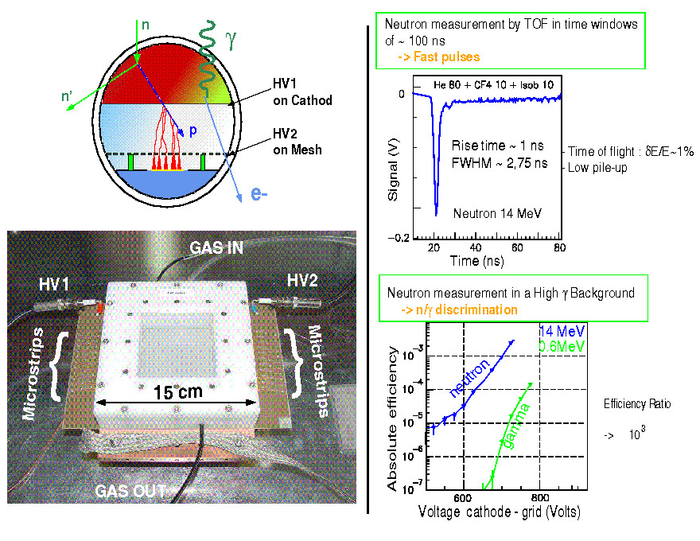
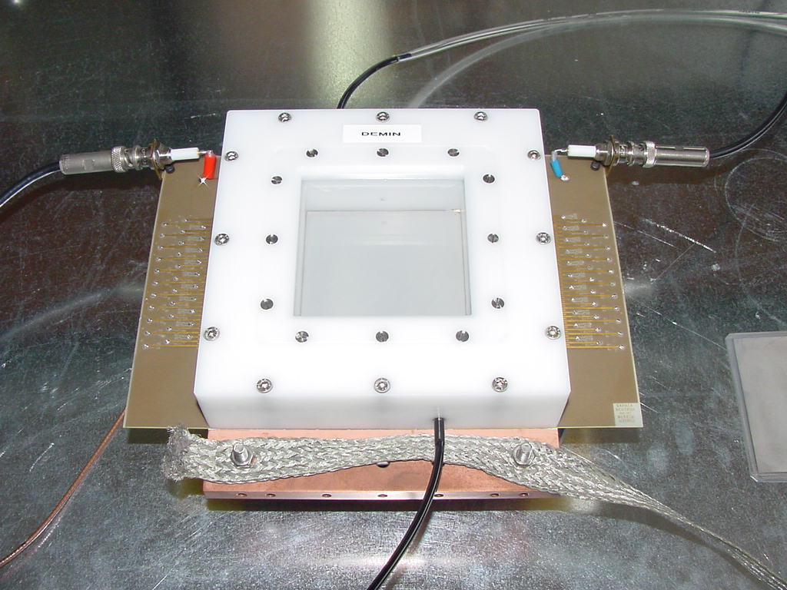
Micromegas Concept for Laser MégaJoule & ICF Facilities
M. Houry et al., NIM,557(2006)648
The γ insensitivity of Micromégas applied to neutron spectroscopy
on Inertial Confinement Fusion experiments
2mm CH₂ converter
Time response < 500 ps
65 strips (1.6 mm pitch)
Gas In
HV1
HV2
Microstrips
Microstrips
Very good γ-rejection
< 15 cm >
Gas Out
Ref: CEA/DIF/DCRE/SDE M. Houry
DEMIN group (CEA/DIF/DCRE and DAPNIA)

Slide 6
The proposed BLM for ESS
Assembly of the 2 detectors:
1st detector (MM + polyethylene) appropriate for high flux - high energy neutrons, coming from the front
  directional
  insensitive to gammas
  high particle fluxes
  Detection times << 1μs
2nd detector(MM + B₄C) capable of monitoring fast neutron fluxes ~ few n · cm⁻² s⁻¹
  minimum E_{n} defined by the absorber
  4π
  adjustable neutron sensitivity
  low gamma sensitivity
  Detection times of ~1 μs possible!!!
Extra option as 1st detector:
MM + thin ²³⁸U layer
  E_{n} threshold ~1 MeV
  Fission fragments ➔ very low gain ➔ completely insensitive to gammas
  Very high radiation environment
Mirobor or other absorber
Polyethylene
MM +
Polyethylene + Al
MM + B₄C
~20 cm
~10 cm

Slide 7
The proposed BLM for ESS
Gas: Helium + quencher (CO₂ )
  High max gain ➔ better stability
  Low sensitivity to gamma & electrons
  Leek tightness more difficult
Gas circulation at low flux
Front-end electronics integrated
Applied voltages ~ 500 V
Possibility of segmentation ➔ multi channel output
  adaption to actual rates
Detector parameters to be optimized according to the expected
particle fluxes and desired performance.
Prototype will be characterized at the facilities:
LINAC4 (CERN)
Birmingham University Irradiation facility
LICORNE (fast neutrons)
Searching for γ irradiation facility
ORPHEE (high thermal neutron flux / aging)
SEDI laboratory (long term stability)
Project started on June 1st 2016. Estimated time for optimization, design, construction, characterization, installation & commissioning: 2.6 years (Commissioning: April 2019). Budget: 1.18 M€.
Mirobor or other absorber
Polyethylene
MM +
Polyethylene + Al
MM + B₄C
~20 cm
~10 cm

Slide 8
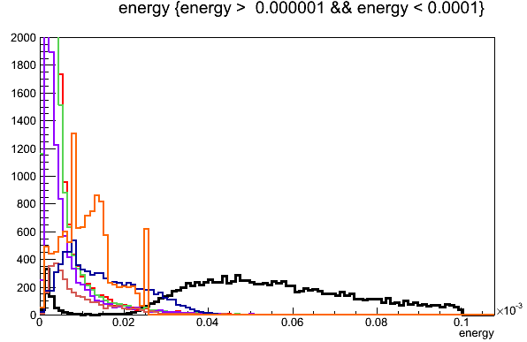
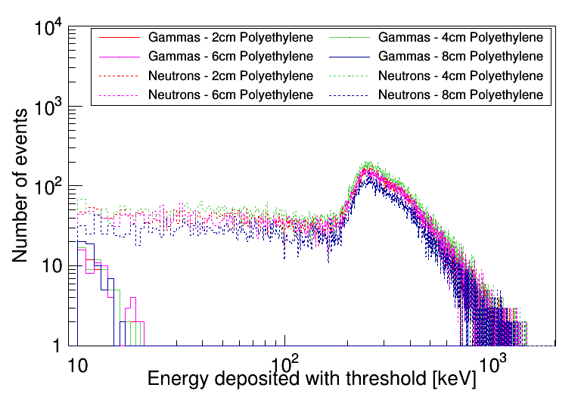
γ - n Discrimination
Discrimination is based on different dE/dX of electrons and ions
Drift gap is small, so only part of the energy is deposited.
Ions will deposit much bigger fraction of their energy compared to electrons
X < 20 keV
γ or X > 20 keV
n,p
¹⁰B(n,α)⁷Li
Photons
2 MeV
1 MeV
500 keV
100 keV
50 keV
25 keV
n,p [10 MeV]

Slide 9
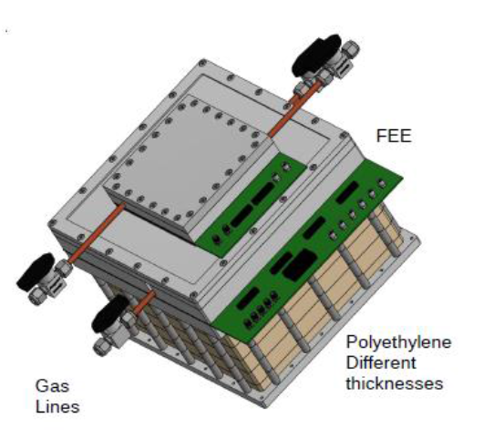
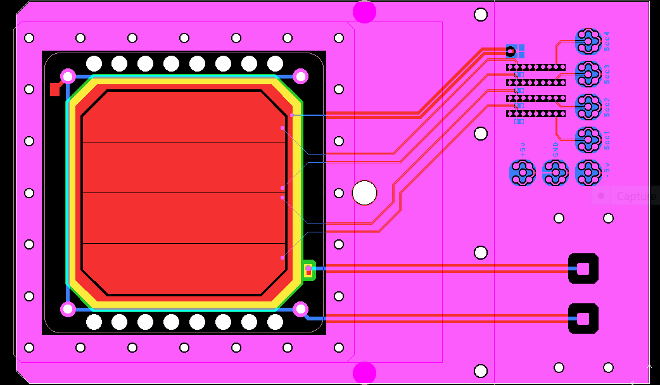
Project overview
  Neutron Beam Loss Monitors System (Detection of fast neutrons with Micromegas detectors)
  Delivery, installation and commissioning of 42 modules by April 2019
  Gas System
  Controls System
  Acquisition
Milestones reached:
  Kick-off meeting → 25/07/2016
  PDR1.1 → 05/12/2016
  PDR1.2 will 10-11th July at Lund
Status
Design of the first prototypes
  Mechanics for 2 fast and 2 slow detectors available
Design of the Micromegas detectors
  First 3 slow detectors arrived in June. FEE integrated to one.
  First 3 fast detectors are expected soon
  First signals acquired with a ²⁵²Cf source
  Tests / characterization at SEDI lab during summer
  First tests at different facilities will start in fall
Design of the FEE &BEE electronics (review during PDR1.2)
Design of the gas system layout (review during PDR1.2)
Design of the acquisition & control system (review during PDR1.2)
First B₄C convertor ready. Order 10 more in Linköping in the coming days
Preparation of polyethylene & thick Mylar convertors ongoing at CEA
LOW voltage
Protection
& Filters
SHV Connectors
HT Filter

Slide 10
Project overview

Slide 11
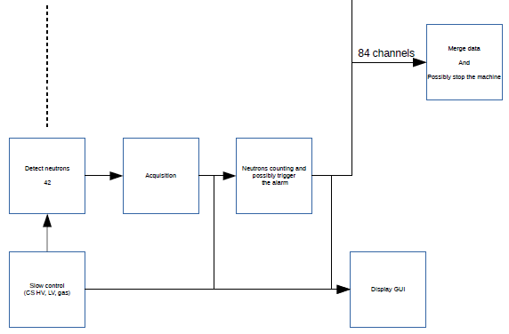
nBLM functional architecture

Slide 12
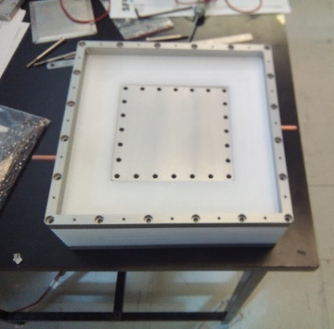
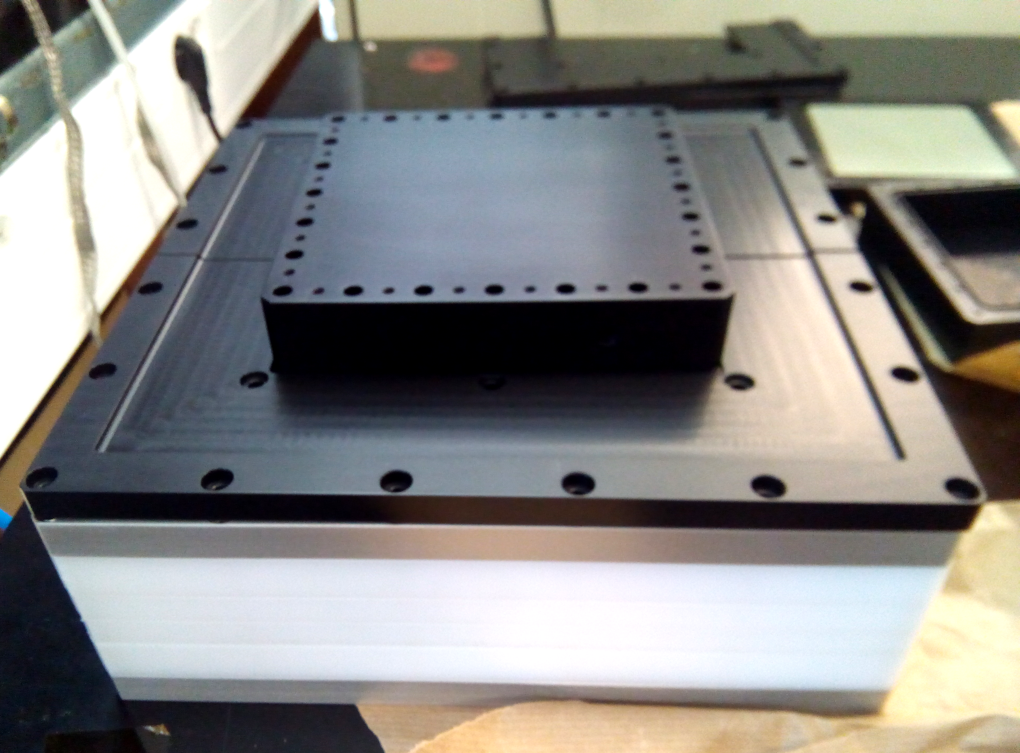
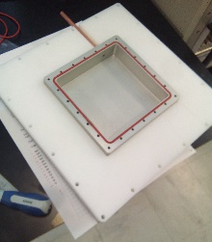

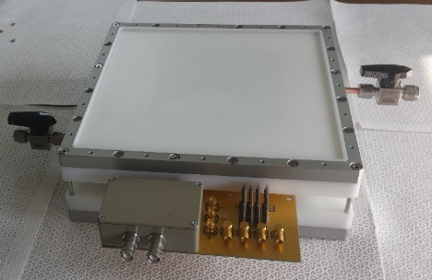
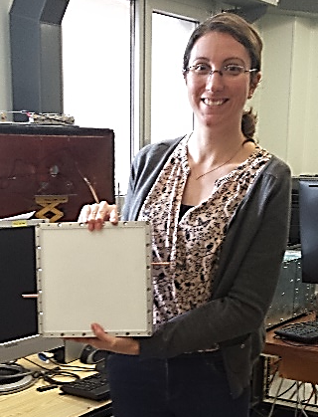
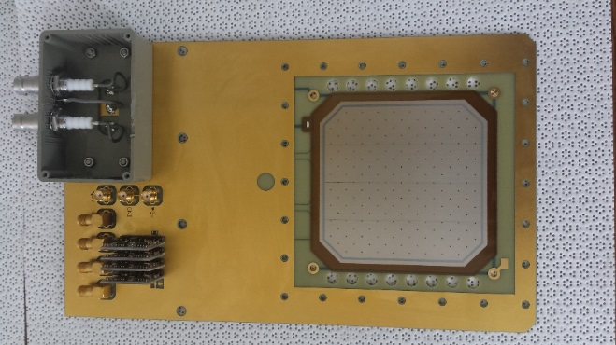
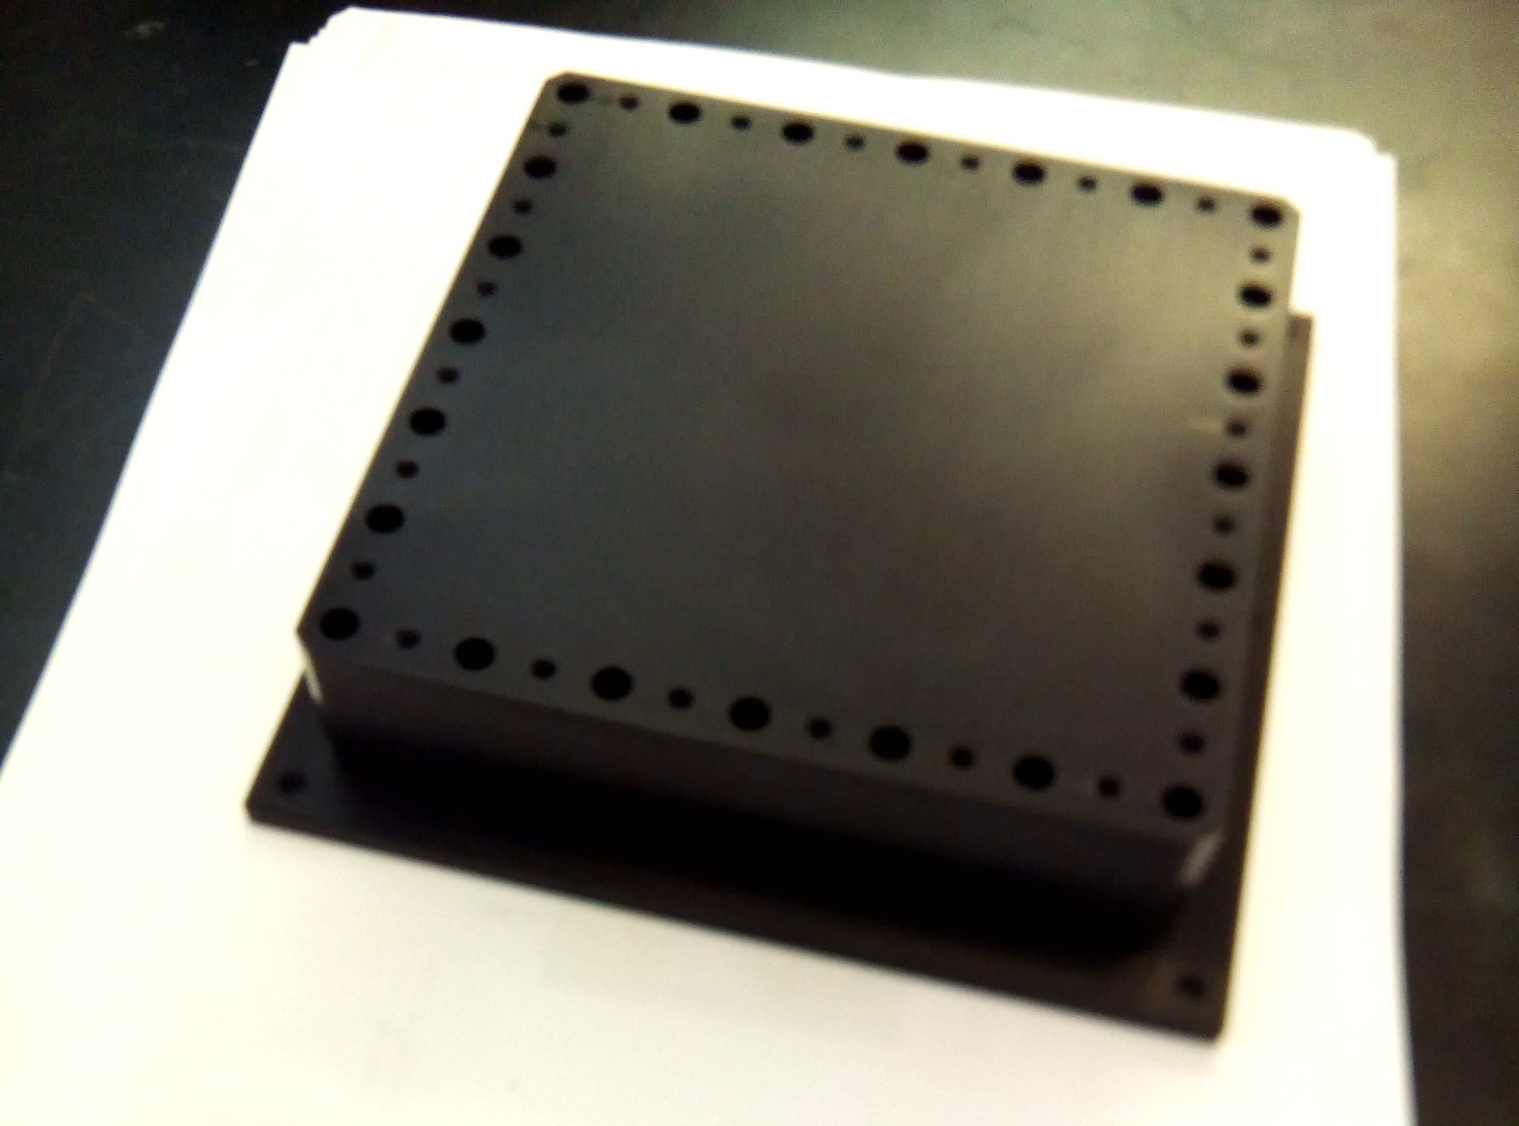

nBLM Detectors
SLOW
FAST
(n, α) ¹⁰B reaction
Detection of fast neutrons after moderation in polyethylene (~4cm)
More efficient, 4π, but slower response
Recoil protons produced by neutrons in polypropylene
High flux high energy n's (>0.1 MeV)
Faster response
Gas chamber
Different thickness of polyethylene can be added
Integrated FEE
Detector size
~30x30x30cm³
~3kg
Easy to transport
See talks by Laura

Slide 13
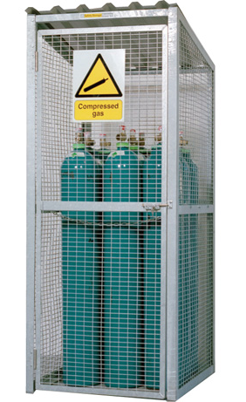
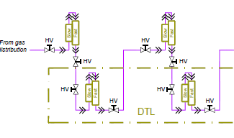
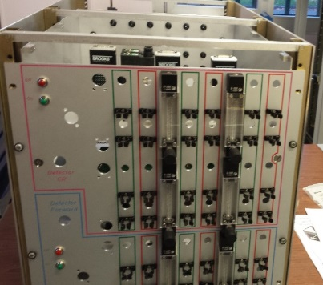
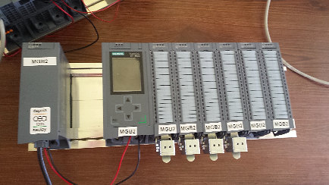
nBLM Gas System
Detectors are designed to operate in semi – sealed mode, however for long term stability some gas recirculation is necessary. The nBLM Gas System:
Provide a constant flaw of 0.2 - 2 l/h of He + 10% CO₂ to 5 independent gas lines
Each line feeds a group of detectors in series
Control / Monitoring of flow IN – flow OUT of each line ➔ assure tightness & gas quality
Warning to EPICs
Gas Distribution (GD)
In
Gas Detectors Line (GDTL)
Gas Storage (GS)
Out
Exhaust
See talks by Laura & Quentin

Slide 14
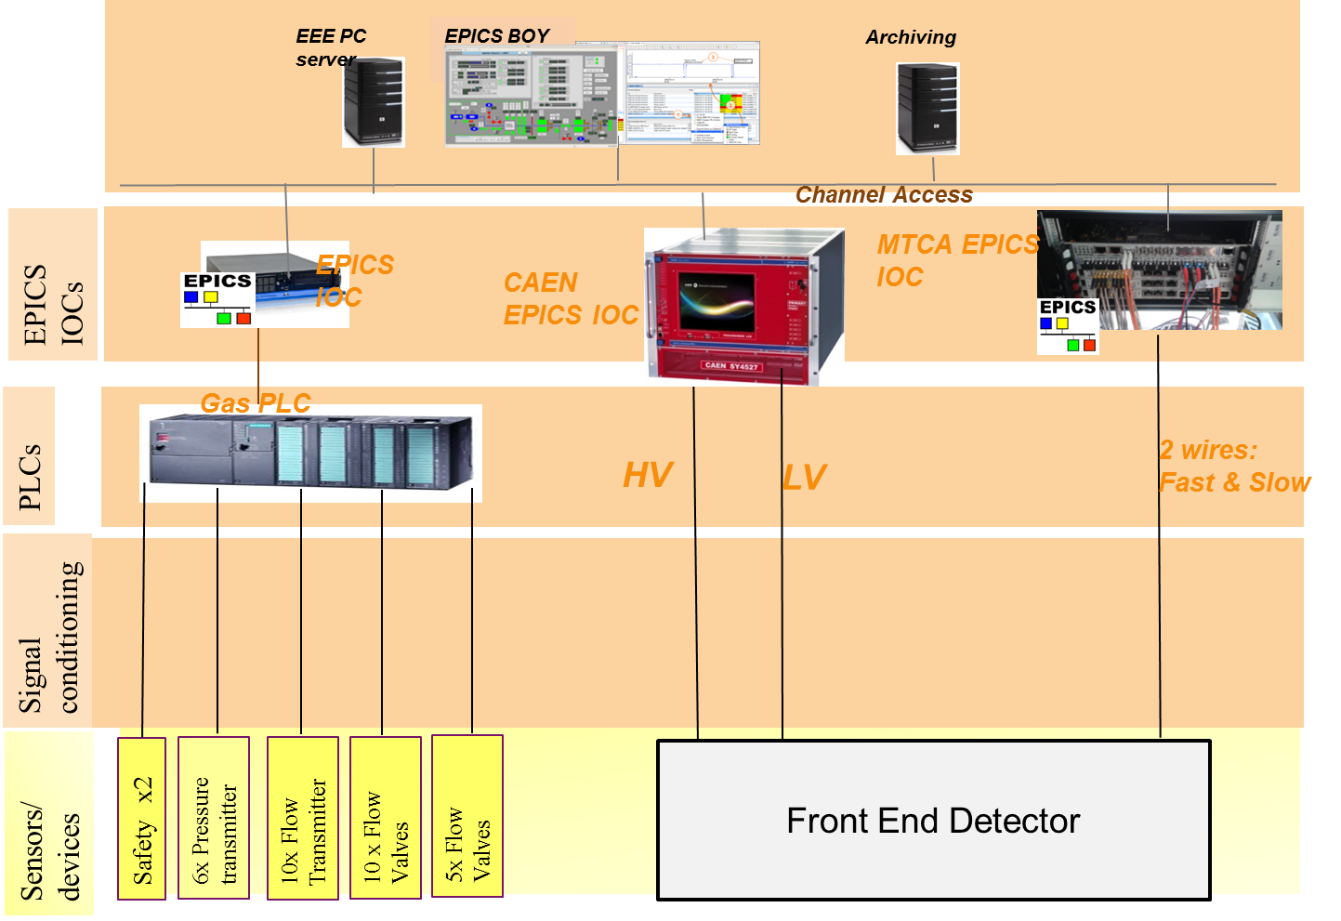
nBLM CONTROL SYSTEM
See talk by Yannick

Slide 15
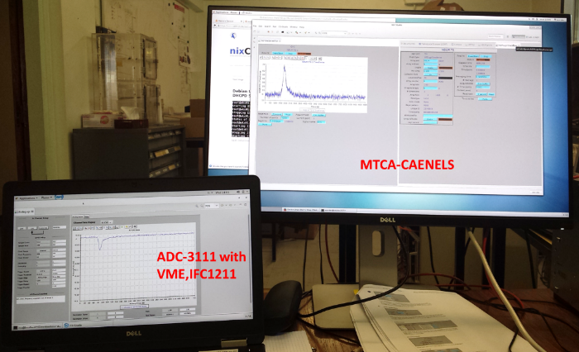
nBLM Acquisition SYSTEM
  Fast acquisition
ICS standardisation for fast acquisition is based on:
μTCA.4
IOxOS CPU IFC_1410
IOxOS ADC_3111 FMC boards.
  FPGA software
The FPGA will have 3main tasks:
Detection of neutrons and counting
Trigger an alarm on the Beam Interlock System if needed
Supply of debug and diagnostic data (neutron rates …)
The FPGA software design and development will be done by ESS ERIC
Requirements will be presented in the document :
“Requirements and functions to be implemented for the nBLM control system” [to be released soon].
See talks by Laura & Yannick

Slide 16
Thank you for your attention
Commissariat à l’énergie atomique et aux énergies alternatives
Centre de Saclay | 91191 Gif-sur-Yvette Cedex
T. +33 (0)1 69 08 76 11 | F. +33 (0)1 69 08 30 24
Etablissement public à caractère industriel et commercial | RCS Paris B 775 685 019

Slide 17
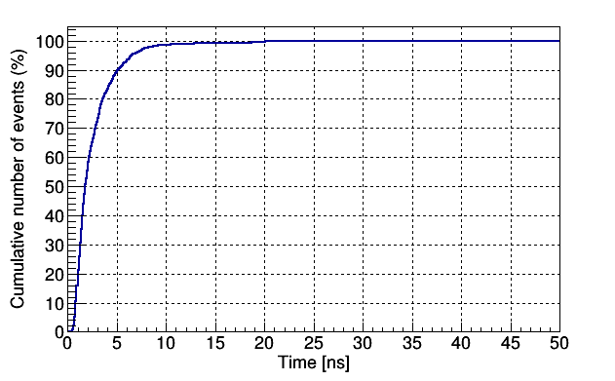
nBLM risks
  As a result of Unknown operational conditions of ESS accelerator
(N1) : Insufficient count rate
  there is a risk that Insufficient count rate for the desired system reaction time,
  resulting in Reduced alarm sensitivity
(N2) : Detectors saturation
  there is a risk that Detectors saturation
  resulting in redesign analysis software
(N3) : Neutron signal difficult to discriminate due to backgrounds
  there is a risk that Neutron signal difficult to discriminate
  resulting in Reduced alarm sensitivity
Mitigation strategy
Tests at LINAC4 and ESS cavities
  Backgrounds
  Response
Versatile design of prototypes
Efficiency can be reduced:
  Reducing the B₄C thickness
  Using natural Boron instead of ¹⁰B
  Detector segmented in 4
From the simulations with scenarios we have so far
Rates of >MHz in µs (slow detector)
in ns (fast detector)

Slide 18


DIAGNOSTICS (mitigation status)
  (N1) Neutron signal difficult to discriminate
  > Prepare the implementation of back-up - to be ready to launch (50%) : Shielding studies. Fissile converter (U238)
Versatile design to test at LINAC 4
(shielding, drift distance, B₄C…)
Segmented anode allows to accommodate for high/slow rates during commissioning at ESS
Accommodate detector for higher rates strategy:
Reducing the B₄C thickness
Using natural Boron instead of ¹⁰B
Detector segmented in 4
Progress | Mitigation status (monitoring)
0% | Not started
25% | Just started
50% | On going
75% | Almost finished
100% | Completed
Klystron fabrication

