Slide 1
icBLM electronics
Clement Derrez
Test Engineer
www.europeanspallationsource.se
10 July, 2017

Slide 2
Outline
Conceptual system design
Detectors
Electronics
  High voltage unit
  Signal acquisition unit
Conclusion & Outlook

Slide 3
Conceptual system design
BLM system: One of the most important diagnostic system of the ESS LINAC.
  Keep the machine safe from beam-induced damage
  Avoid excessive machine activation by providing critical input to the MPS
  → no blind spots & precise loss locations determination
System designed for maximum reliability
  Redundancy
  low latency
Challenges:
  Complicated noise situation. Additionally, noise sources vary depending on the location within the accelerator.
  Cabling: This will be covered by Edvard in the next talk

Slide 4
Conceptual system design
Possibly FE
MPS
Post mortem
Timing
Detectors: ICs
microTCA
Timing receiver
User screens,
Archiver…
HV
FPGA processing,
interfacing
Signal acquisition
EPICS IOC
Tunnel
Gallery
ESS control room

Slide 5
Conceptual system design
Units deployed in the support area fit in a 47U rack
  Specified by BI
  Provided by WP15.
Unit description | Installation area | Comment | Entity
Current readout | Support | FMC or custom acquisition crate | CAENels FMC-PICO or custom acquisition crate (CERN Solution)
High voltage supply | Support | 1 is needed per mTCA chassis | CAENels HV-PANDA.
Timing Receiver | Support | Event receiver for triggers and clock | The unit is provided by ICS.
Power supply | Support | Power supply for mTCA chassis | The unit is provided by ICS.
Central Processing Unit | Support | CPU for mTCA chassis, Intel i7 | The unit is provided by ICS.
Chassis | Support | The microTCA chassis | 3U microTCA crate. The unit is provided by ICS.
MicroTCA Carrier Hub | Support | 1 is needed per mTCA chassis | The unit is provided by ICS.
Rack | Support | Electronics rack | The unit is provided by WP15 and specified by BI.
Rack patch panel | Support | Installed on top of the rack | The patch panel will be designed by WUT
Sensor | Tunnel | Ionization chamber
Beam Line Element Patch Panel | Tunnel
Notes:
How are these units connected together, layout? Next slide

Slide 6
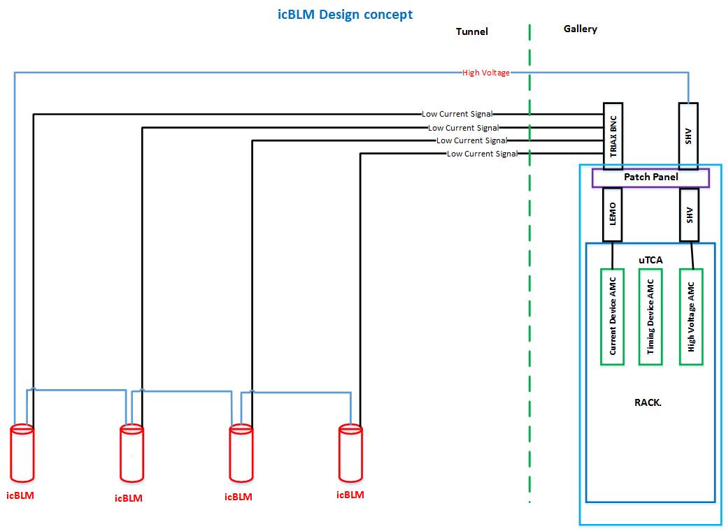
Conceptual system design
Baseline solution, being evaluated:

Slide 7
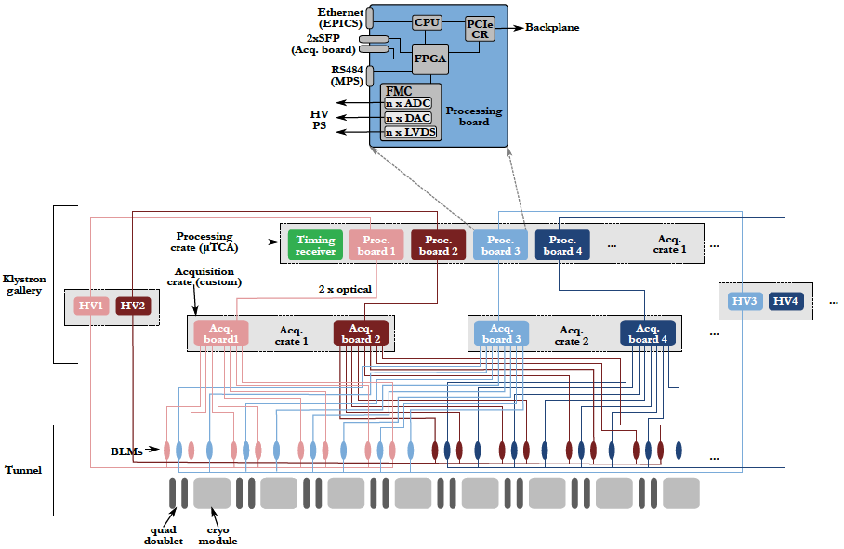
Conceptual system design
Alternative solution: custom acquisition crate
Notes:
In a nutshell: based on a current to frequency converter, optical links out to a processing board in the micro TCA crate.
This is a more “advanced” approach, providing better performance but more complicated to maintain, support has to come from CERN also…

Slide 8
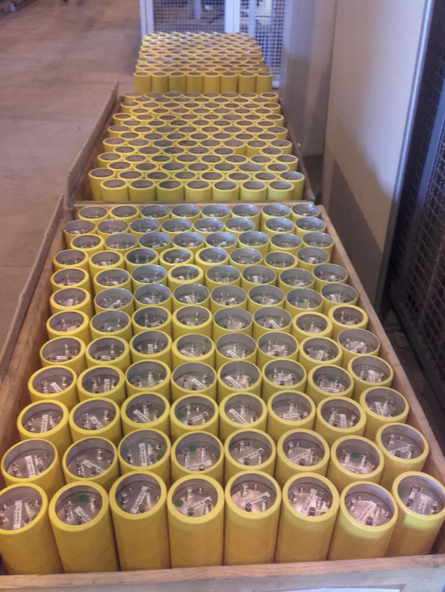
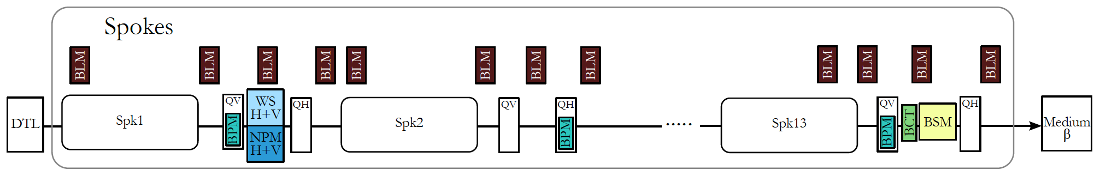
Detectors
Details have been covered in the icBLM detectors talk:
  LHC-type
  Design criteria: signal speed & robustness against ageing
  Operated at 1.5 kV
  Low pass filter at HV input
  285 ionization chambers received at ESS in Jul. 2017

Slide 9
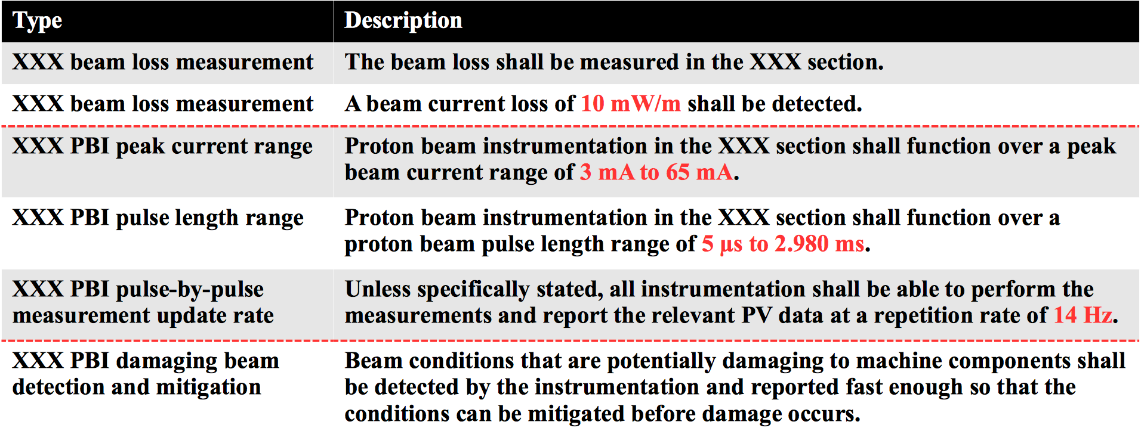
L4 requirements

Slide 10
Electronics: HV unit specifications
High Voltage Supply: Modulation | Self-testing the ion chamber channels by modulating HV bias voltage shall be possible | A pulse or a continuous modulation could be used. This produces a signal by coupling through the capacitance of the ion chamber.
High Voltage Supply: output voltage rating | Positive voltage of at least 3 kV | the use of “positive polarity” will minimize saturation effects under high dose rates
High Voltage Supply: output power | Maximum output power of at least 5 W
High Voltage Supply: output voltage ripple | Output voltage ripple below 4 ppm pk-pk/FS
High Voltage Supply: noise figure | Noise figure shall be compatible with that of the signal acquisition board. This includes temperature induced noise

Slide 11
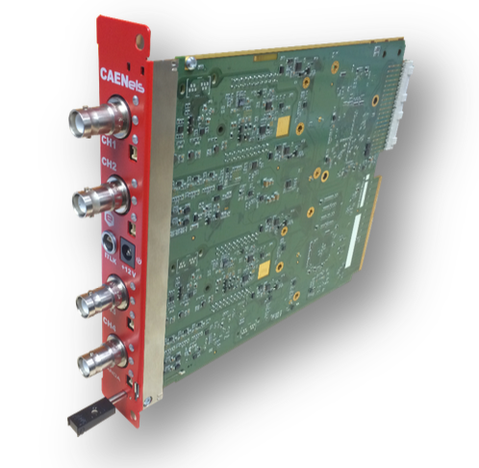
Electronics: HV unit
COTS solution: CAENels HV-PANDA will be evaluated
  Double-width AMC with MTCA.4 Rear I/O
  4 channels rated at 4kV at 7W
  Configurable ramp rate
  Nominal voltage accuracy better than 0.05% FS and a ppm-level peak-to-peak output voltage ripple
  SHV type connectors

Slide 12
Electronics: Signal acquisition unit specifications
Signal acquisition: Dynamic range | Input current dynamic range: 10 nA to 10 mA. | Two separate ranges shall be used: the low end set by the condition that the operators must be able to tune on beam loss measurements down to 10 mW/m, while the high end shall allow recording of total beam loss during faults and machine studies | BLM is required to be able to measure at least 1% of 1W/m loss during normal operation and up to 1% of the total beam loss.
Signal acquisition: Response time | NC LINAC: Calculated melting time values of 3-4 us SC LINAC: 10 us The signal acquisition card shall therefore feature a bandwidth of at least 300 KHz and a minimum sampling rate of 1MSPS | “Particle time” - PT: time between the onset of beam loss (the primary is lost) and the moment particle (primary or secondary) hits the detector. Detection time: time needed for the detector signal to develop and to collect enough hits/current Processing time: from the output of the detector to the BIS output on the FPGA
Signal acquisition: resolution | The signal acquisition card shall have a resolution of at least 20 bits
Signal acquisition: noise figure | The signal acquisition card shall have a typical noise better than 10 nA in its lowest range, including temperature induced noise
Notes:
The response time of the BLM system is a sum of:
“Particle time” - PT: time between the onset of beam loss (the primary is lost) and the moment particle (primary or secondary) hits the detector.
Detection time: time needed for the detector signal to develop and to collect enough hits/current
Processing time: from the output of the detector to the BIS output on the FPGA
In a word: Dynamic range specs:
“BLM is required to be able to measure at least 1% of 1W/m loss during normal. operation and up to 1% of the total beam loss”.
Gave estimation on the ICLBM current range: ~800nA – few mA

Slide 13
Electronics: PICO-8 evaluation
COTS solution: CAENels PICO-8
8-channel 20 bit Bipolar Floating Picoammeter with MTCA.4 REAR I/O
“standard” AMC PICO-8 specs: http://www.caenels.com/products/amc-pico-8/
  Full-scale ranges of 1mA and 1 uA
  Input bandwidth: 10KHz
ESS custom AMC PICO-8: (different input op-amp)
  full-scale ranges of 10 mA and 500 uA
  input bandwidth: 300 kHz

Slide 14
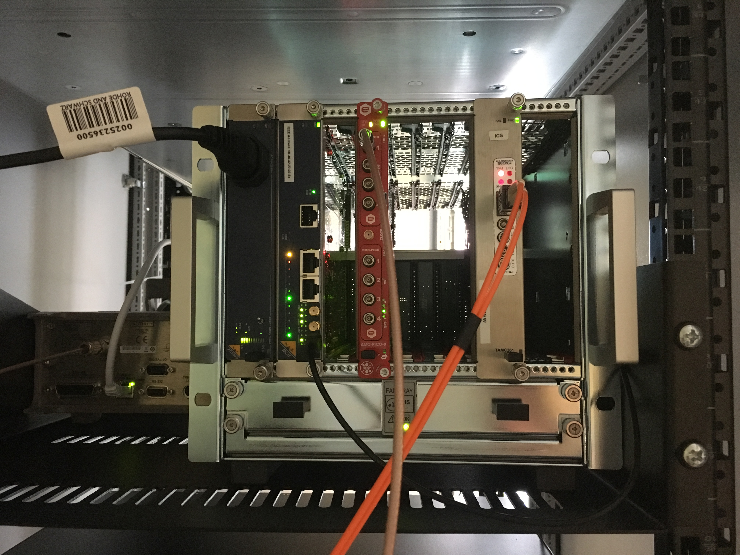
Electronics: PICO-8 evaluation
PICO_8
CAEN DAMC-FMC25
current source Keithley 6221

Slide 15
Electronics: PICO-8 evaluation
Noise levels, as measured by manufacturer vs measured at ESS: (1 $σ$,10000 points @ 1MSPS)
Bandwidth, as measured by manufacturer:
 | CAENels | ESS testbench
10 mA range | 190 nA | 195 nA
500uA range | 10 nA | 10 nA
 | CAENels, 10mA range | CAENels, 500uA range
Ch 0 | 301 kHz | 300 kHz
Ch 1 | 294 kHz | 292 kHz
Ch 2 | 299 kHz | 299 kHz
Ch 3 | 303 kHz | 391 kHz

Slide 16
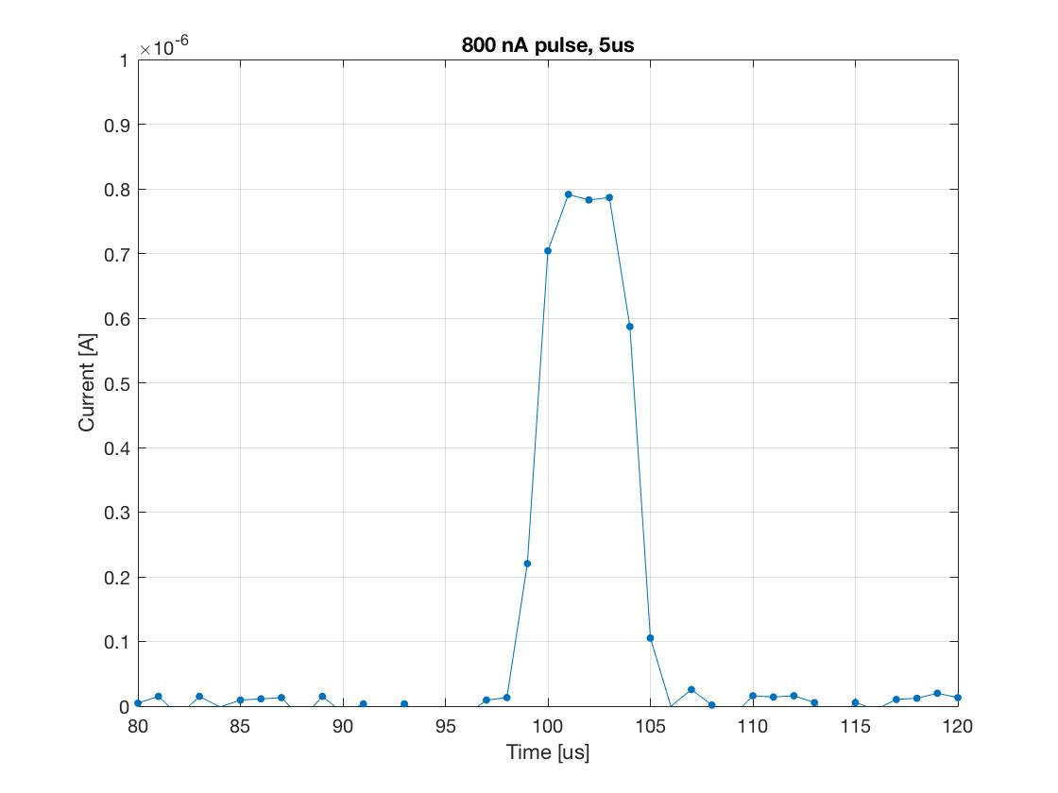
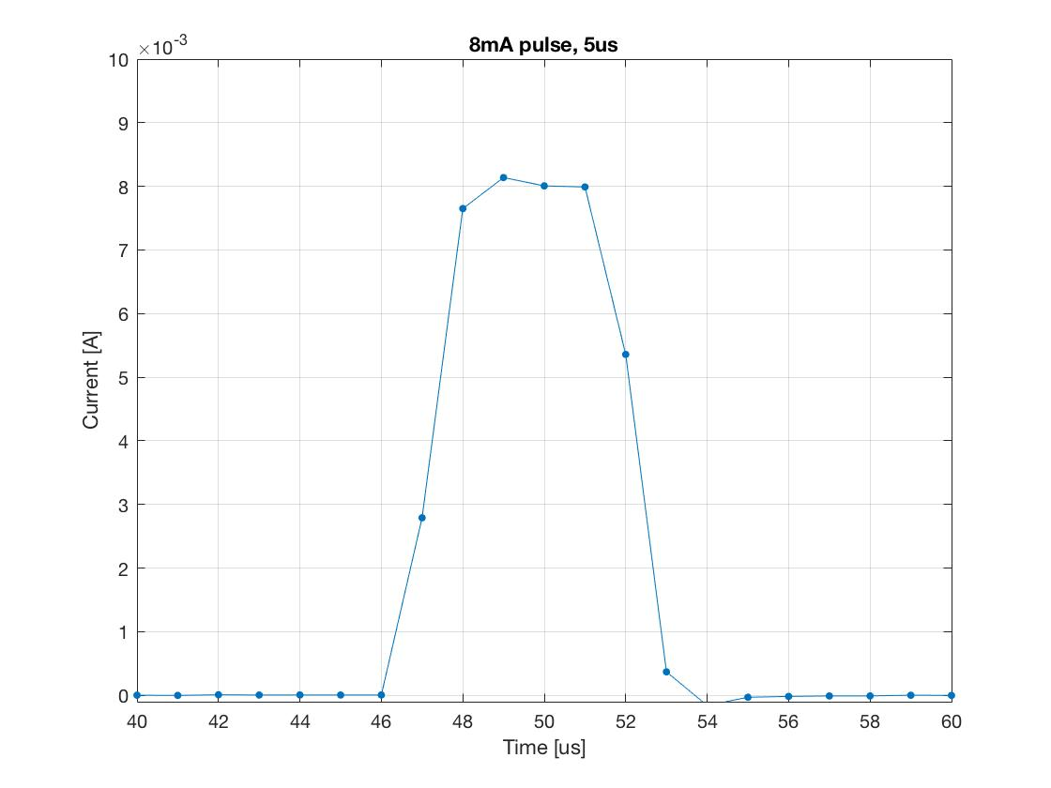
Electronics: PICO-8 evaluation
Shortest pulse:

Slide 17
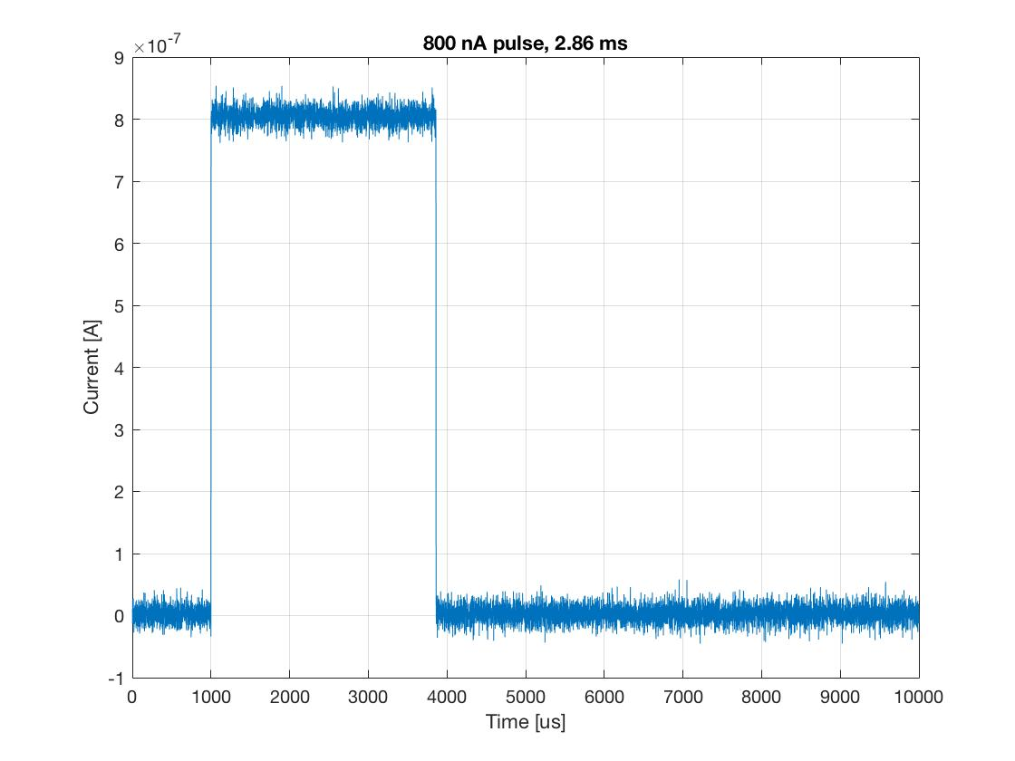
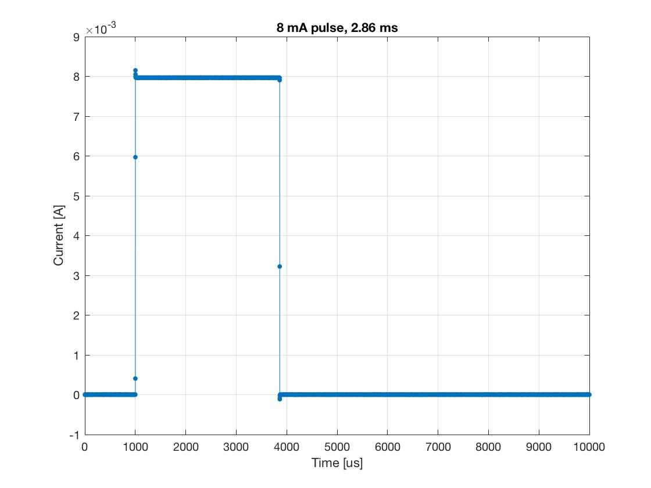
Electronics: PICO-8 evaluation
Longest pulse:

Slide 18
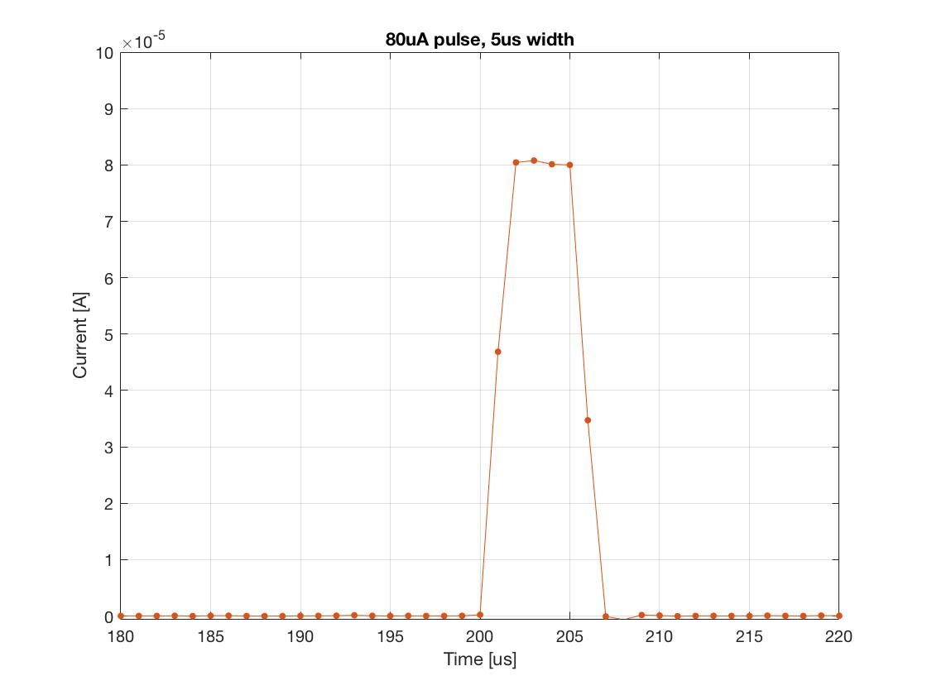
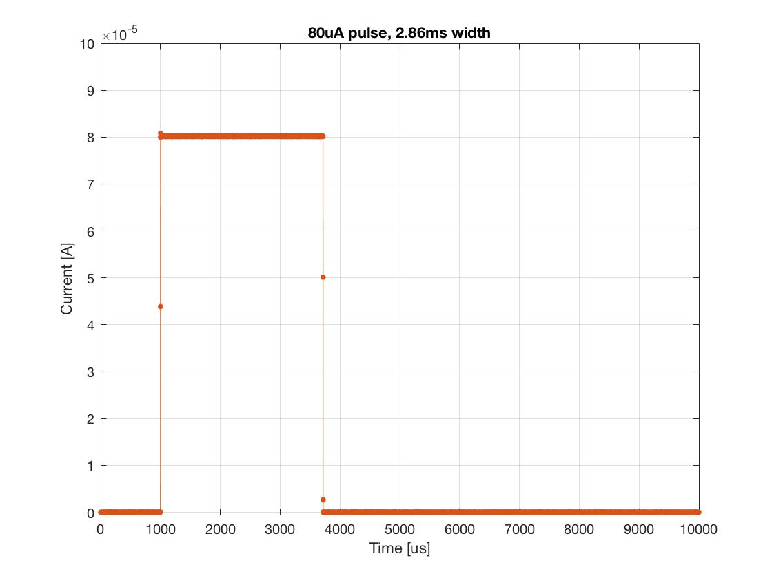
Electronics: PICO-8 evaluation
80 uA pulse amplitude: 1W/m loss during normal operation

Slide 19
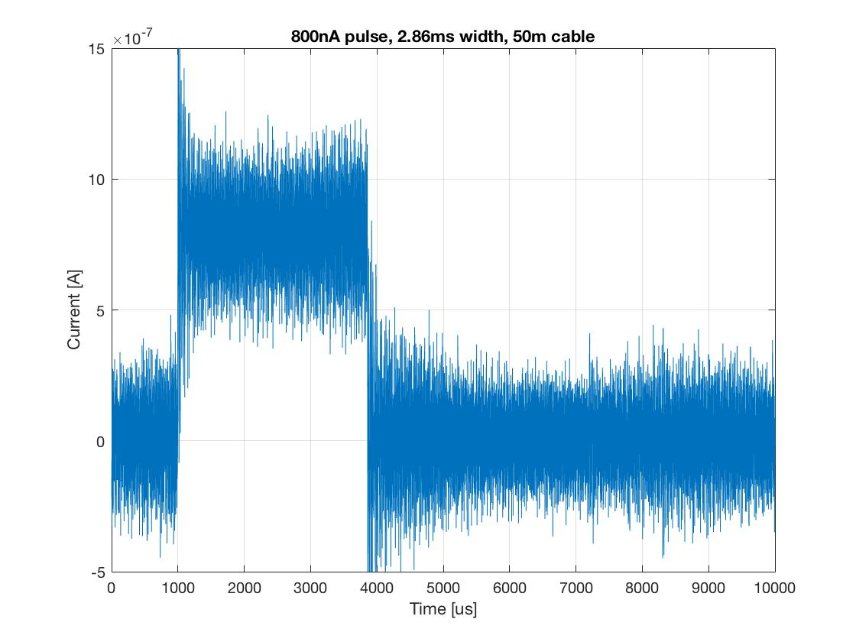
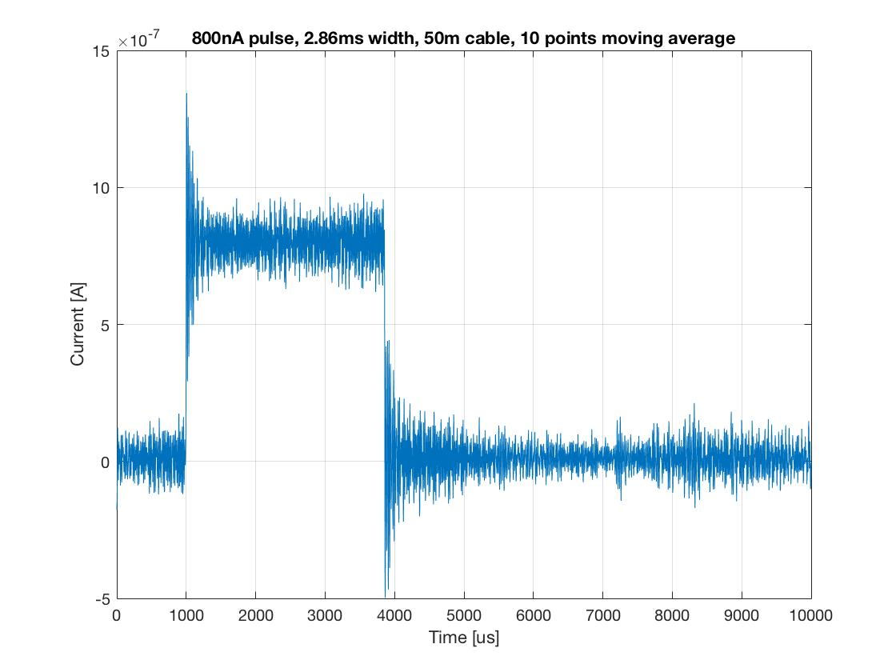
Electronics: PICO-8 evaluation
Worst case: long off the shelf coax cable, moving average:
$σ$ = 150 nA
$σ$ = 50 nA
Notes:
Std(worst): 151nA
Std(10 points moving average): 50nA
Std(100 points moving average): 3.6nA

Slide 20
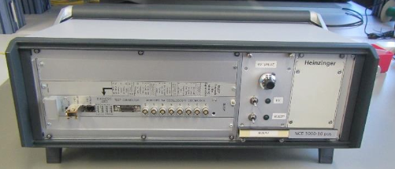
Electronics: signal acquisition unit
Alternative solution: Custom acquisition crate
  CERN BLEDP + processing mezzanine
  Current to frequency converter, fully differential front end
  Measurement of the current input is performed by two different techniques:
    Advanced Current to Frequency Converter (ACFC) used in the range 10pA to 30mA
    Direct ADC acquisition (DADC) used in the range 20.3µA to 200mA
    Transition between ranges managed by an FPGA
    Optical output to post processing unit

Slide 21
Conclusions & Outlook
System design is moving forward quickly. 285 ICs received last week
FRU tests:
  Perform a “long-term” measurement to check for possible drift, on HV and signal acquisition units
  Compare CERN solution evaluation with PICO-8
Software and Firmware

