Slide 1
icBLM
PDR
10/07/2017 Viatcheslav GRISHIN

Slide 2
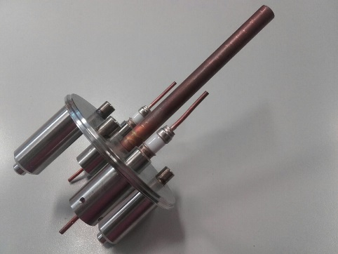
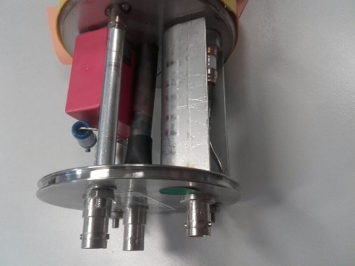
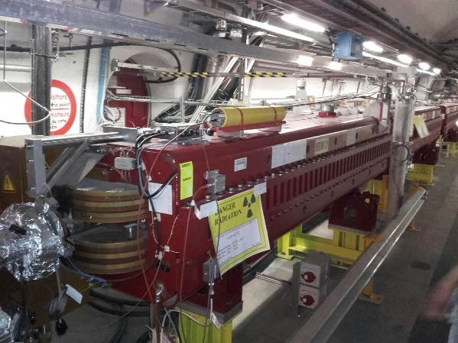
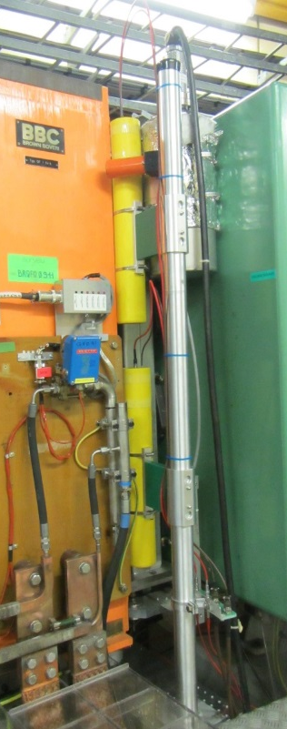
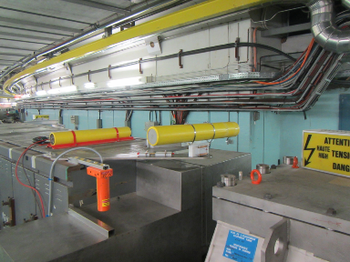
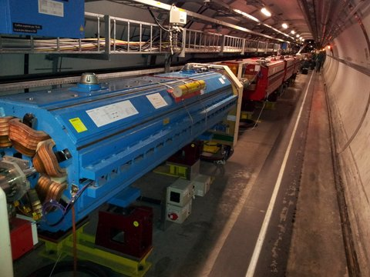
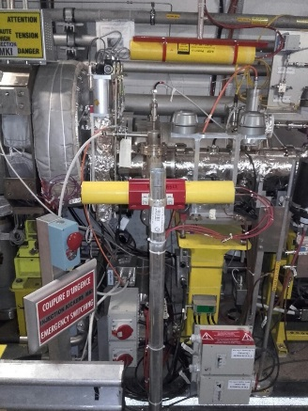
BLM Ionization Chamber
At the beginning of Run 2, BLM LHC system had 3929 monitors
3518 Ionization Chambers (IC), 108 LIC and 191 SEM
LINAC 2 had 5 IC
LINAC 4 installed 24 IC
~100 ICs in PS
BLM PSB system had 32 installed IC and 32FIC.

Slide 3
Design criteria and specification
The design of the LHC type beam loss monitors is based on the experience gained with the SPS BLMs, which have been in operation last 40 years.
Signal speed and robustness against aging were the main design criteria.
Ionization Chamber : parallel aluminum electrode plates separated 0.5 cm ( for ESS 0.54).
The detector is about 50 cm long (electrical and vacuum, active parts) with diameter of 9 cm, sensitive volume of 1.5 liter, insulated.
Each monitor is permanently sealed inside a stainless-steel cylinder. The quality of the welding was a critical aspect during production.
The chambers are filled with Nitrogen at 100 mbar overpressure.
To avoid radiation aging (electronegative gases, organic compounds), up to 2.10⁸ Gy in 20 years, production of the chambers followed strict UHV requirements and strict cleaning procedure.
No gain variations are expected on the LHC BLMs for 20 years of operation.
The chambers are operated at 1.5 kV and are equipped with low pass filter at the high voltage input.
BLMs have been manufactured and tested at the Institute for the High Energy Physics (IHEP), Protvino, Russia, following their development at CERN.
IHEP designed and built the UHV production stand.
Due to the required dynamic range of 10⁷,the leakage current of the monitors has to stay below 2 pA.
Several tests during and after production were performed at IHEP and CERN. And high quality during the whole production period was achieved.

Slide 4
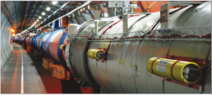
Detector description
61 circular parallel plate Al electrodes
HV = 1500V
1.5 l N₂ gas (1.1 bar pressure)
Sensitivity: 5.26 x 10⁻⁵ C/Gy derived from
ρ(N₂) = 1.2 kg/m³
W = 34.8 MeV (avg energy for ionization)
Dynamic range (10⁷⁾ limited by:
Leakage current (1-2 pA)
Saturation effects (space charge)

Slide 5
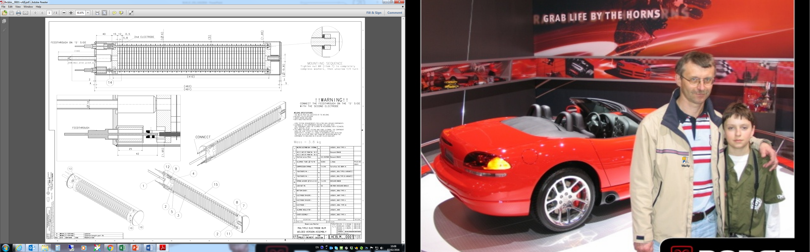
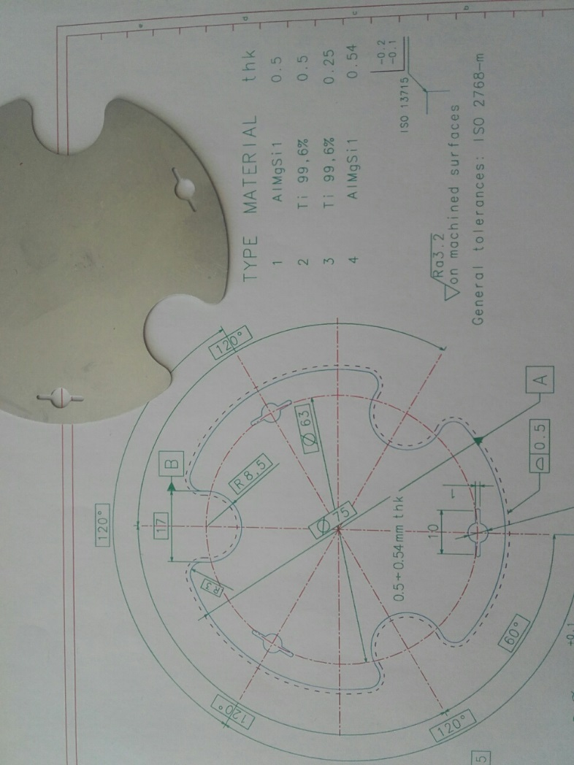

Slide 6
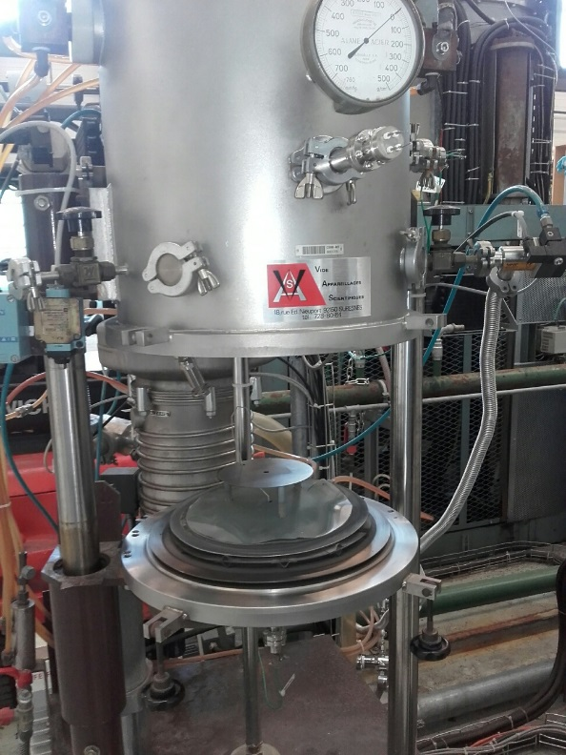
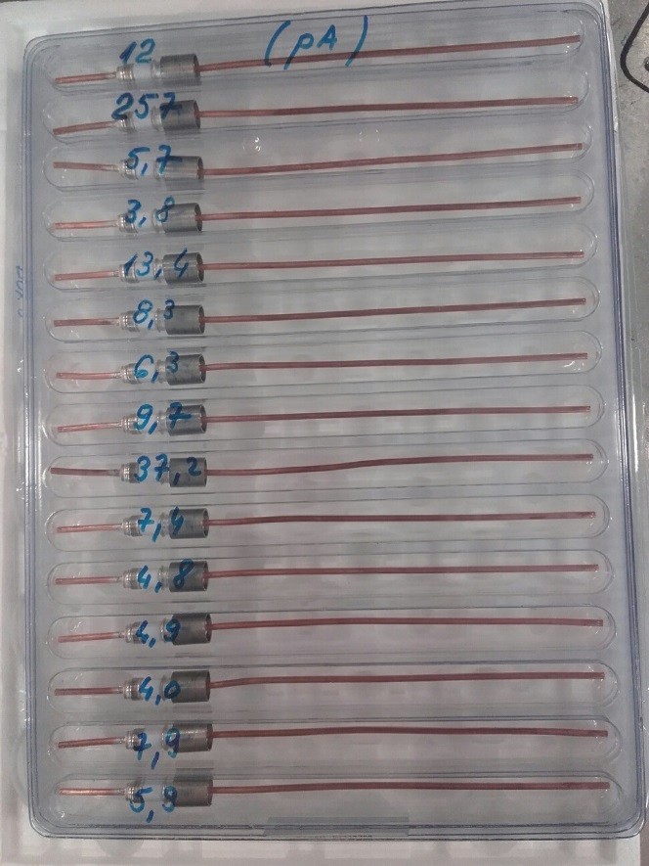
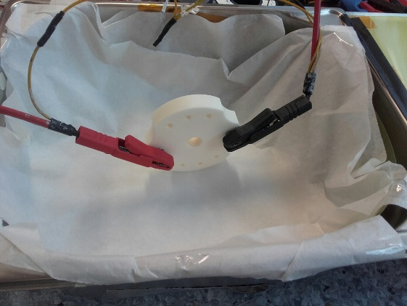
CERN: materials
High voltage 2000 V DC
Quantité | 120 | Pièces
TEST N° 1
Quantité = 120 pièces |  |  |  | Leakage current admis ≤ 2.0 pA |  | Après | 1 minute
 |  | Bonnes |  | 42
 |  | Rebuts |  | 78
TEST N° 2
Quantité = 78 pièces |  |  |  | Leakage current admis ≤ 2.0 pA |  | Après | 1 minutes
 |  | Bonnes |  | 13
 |  | Rebuts |  | 65
TEST N° 3
Quantité = 65 pièces |  |  |  | Leakage current admis ≤ 3.0 pA |  | Après | 2 minutes
 |  | Bonnes |  | 42
 |  | Rebuts |  | 23
RESULTAT FINAL |  | Bonnes |  | 97 | Pièces
 |  | Rebuts |  | 23 | Pièces
Sub system | Company ( 2015) | per chamber | Order
LHCBLM__0001 and LHCBLM__0009
Material: tubes 1.4435 ss 88.9 x 2.0 x 6 mt | Nicormal(Germany) |  | 89 pcs x 6 m
tube inox 316L 483x88.9x2.0 LHCBLM__0040, IC | Morfi ( Greece) | 1 | 850
tube inox 316L 105x88.9x2 LHCBLM__0038 | Morfi ( Greece) | 1 | 850
Ceramics LHCBLM__0005 v.AC, IC | Friatec (Germany) | 2 | 1740
Material AW6082 | Metalvin (Spain) | 6 km
Al electrodes production LHCBLM__0004 0.5X82, IC | ADM (France) | 61 | 53200
electrode spacer LHCBLM__0007 type A | Ruprec(Portugal) | 183 | 160000
electrode spacer LHCBLM__0007 type C | Ruprec(Portugal) | 6 | 5300
bottom cover disk LHCBLM__0006 | Morfi ( Greece) | 1 | 850
bottom cover spacer LHCBLM__0006 | Morfi ( Greece) | 1 | 850
tighteners M4 LHCBLM__0016
type A Var 1 (incl. welded washer) | Morfi ( Greece) | 4 | 3500
type B Var 1 (incl. LHCBLM__0013) | Morfi ( Greece) | 2 | 1800
small items
compressing spring 1.4310 ferroflex | Ferroflex (France) | 1 | 872
alumina tube D15/10, L=25mm | Ceratec ( Netherlands) | 2 | 1743
electrical connections LHCBLM__0036
external plate LHCBLM__0037, manufacture | Morfi ( Greece) | 1 | 850
st steel sheet LHCBLM__0037, manufacture | NCP (Portugal) | 1 | 850
tube AlMgSi hard 4*7 L=60 | Metallica (Swiss) | 3 | 2615
in.steel.thr.rods A4 316 M4 L=85 | Fournisseur EPI (France) | 3 | 2615
BNC HT RRI Polystyrene SHV 5KV | Huber+Suhner (Swiss) | 2 | 1743
BNC 50ohm, connecteur coaxial, femelle,RRI Polystyrene | Huber+Suhner (Swiss) | 1 | 872
soldering lug, M4 | CERN | 1 | 872
soldering lug, BNC | CERN | 1 | 872
wires (L=100, 1.5mm2) | CERN | 0.15 | 130
tinned cupper wires, without insulation, D=0.91mm | CERN | 0.1 | 10
Resistor 10Mohm ,1W | Etronics AG (Swiss) | 1 | 900
Capacitor (0.47uF, 2000V) | WIMA(Germany) | 1 | 900
shrinking tube | CERN | 0.05
03.02.2016, BLM lab (bat 865), Rain outside, pict1
Measurements between to diagonal electrodes
Time of test | to + 15 sec | to + 30 sec | to + 1 min | to + 2 min | to + 3 min
1st batch 2016
Offset of picometer
Signal in pA | -3.7 | -0.4 | 0.0
HV = 1500 V
N° disk
N°1 | 30 | 27.7 | 27.2 | 28.8 | 28.3
N°2 | 63 | 59 | 51 | 42 | 38
N°3 | 58 | 56 | 53 | 48 | 42
N°4 | 85 | 62 | 55 | 38 | 35
N°5 | 1028 | 668 | 357 | 258 | 208
N°6 | 44 | 43 | 43 | 40 | 39
N°7 | 485 | 381 | 322 | 268 | 234
N°8 | 355 | 351 | 342 | 323 | 294
3rd batch 2015
Offset of picometer
Signal in pA | -3.8 | -0.5 | -0.3
HV = 1500 V
N° disk
N°2 | 7.8 | 7.3 | 6.0 | 4.2 | 3.2
N°3 | 14.0 | 9.2 | 6.3 | 4.2 | 2.6
N°4 | 10.7 | 7.6 | 5.5 | 3.7 | 2.8
27.01.2016, Vacuum lab (bat 112) , pict21&22
3rd batch 2015
HV = 1500 V
Signal in pA
N° disk
N°1 | 2.8 | 2.4 | 2.0
N°2 | 3.8 | 3.2 | 1.7
N°3 | 1.0 | 1.7 | 1.3
N°4 | 4.3 | 2.3 | 1.5
electrical connections LHCBLM__0036
external plate LHCBLM__0037, manufacture | Morfi ( Greece) | 1 | 850
st steel sheet LHCBLM__0037, manufacture | NCP (Portugal) | 1 | 850
tube AlMgSi hard 4*7 L=60 | Metallica (Swiss) | 3 | 2615
in.steel.thr.rods A4 316 M4 L=85 | Fournisseur EPI (France) | 3 | 2615
BNC HT RRI Polystyrene SHV 5KV | Huber+Suhner (Swiss) | 2 | 1743
BNC 50ohm, connecteur coaxial, femelle,RRI Polystyrene | Huber+Suhner (Swiss) | 1 | 872
soldering lug, M4 | CERN | 1 | 872
soldering lug, BNC | CERN | 1 | 872
wires (L=100, 1.5mm2) | CERN | 0.15 | 130
tinned cupper wires, without insulation, D=0.91mm | CERN | 0.1 | 10
Resistor 10Mohm ,1W | Etronics AG (Swiss) | 1 | 900
Capacitor (0.47uF, 2000V) | WIMA(Germany) | 1 | 900
shrinking tube | CERN | 0.05 | OK
el+A35:D56 box assembly LHCBLM__0002
cover plate LHCBLM__0003, 316L | Morfi ( Greece) | 1 | 850
feed throughs | Ceramtec (USA) | 2 | 1710
copper tube 10 x 8, L=120mm | CERN | 1 | 900
cover spacer LHCBLM__0008 type A, 316L, IC | Ruprec(Portugal) | 2 | 1800
protection tube LHCBLM__0010, 316L | Morfi ( Greece) | 2 | 850
welded spacer LHCBLM__0035, 304L, IC | Ruprec(Portugal) | 3 | 2700
Screen for cover LHCBLM_0056 | NCP (Portugal) | 1 | 850
Holder on cover LHCBLM_0085 | NCP (Portugal) | 1 | 850
additional jobs (IC)
cleaning and heating of Cu | CERN
additional materials for cleaning and vacuum stand (IC)
NGL | Nyon(Swiss) | 120 kg | 120 kg
TL7-Part#14210 | OERLIKON leibold vacuum | 1 | 1
TL7-Part#14023 | OERLIKON leibold vacuum | 1 | 1
insert Front olifes | CERN | 1100 | 1100
insert Front olifes | CERN | 1100 | 1100
Nuts for sagana | CERN | 50 | 50
Tungsten electrodes "TIG" welding | CERN | 20 | 20
Rub. Karton autocol | CERN | 4 | 4
Gant cuir souple/soudure | CERN | 4 | 4
CERN shipping permission | Tom Wegelius (CERN+Swiss) |  | In progress
Protvino shipping permission | Expert - OK; new IHEP Director - change of doc |  | In progress
Gaine thermo jaune s halogenne | Srati ( France) |  | OK

Slide 7
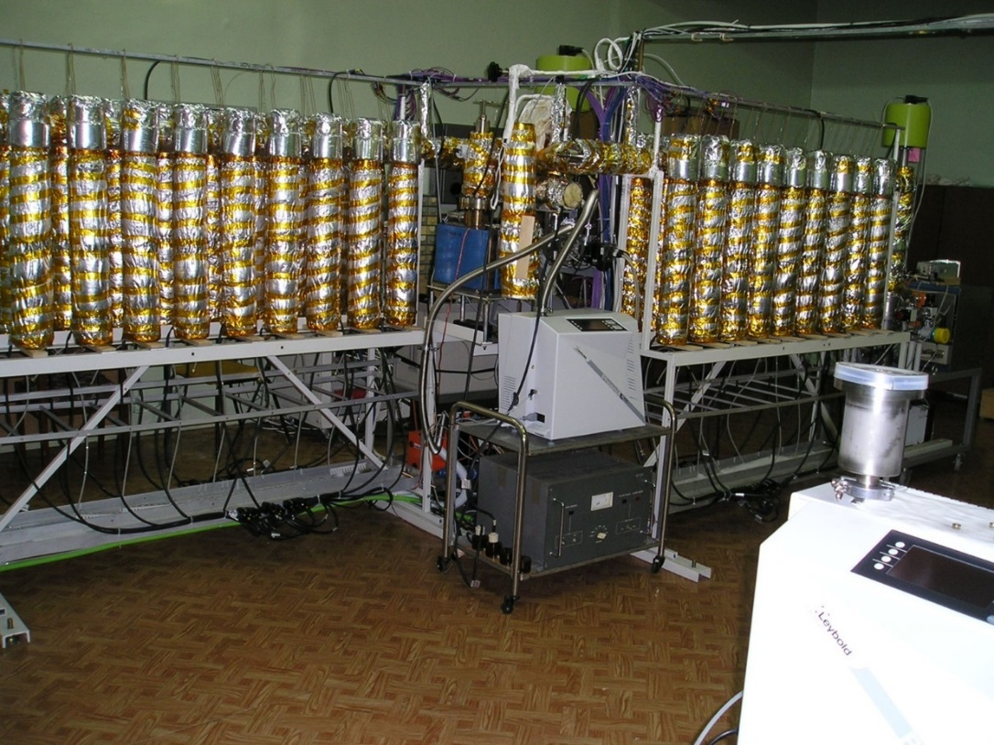
Protvino: vacuum stand
Heating of the chambers started after the pressure had reached 2 ·10−5 mbar. The temperature of the chambers was increased at a rate of 50 ◦C per hour and kept at 220 ◦C for 6 hours. Then, the heating was switched off and at about 100 ◦C and a pressure of 5 - 10·10−6 mbar the ion molecular pump was switched on and kept pumping during 20 hours to further reduce the pressure to a final value of 10−8 mbar before filling. Chambers were filled with 99.999% nitrogen at 1.1 bar at a temperature of 20 ◦C. After pinch-off (annealed Cu-tube) and removal of the chambers from the vacuum stand, the nitrogen is pumped from the stand during one hour (test of the tightness of all pinch-offs remaining on the stand). To control the purity of the nitrogen, the composition and residual gas pressure was measured. Analysis of the residual gas spectrum shows a typical spectrum for this type of vacuum stand and gives evidence of the absence of additional pollution from the nitrogen gas.

Slide 8
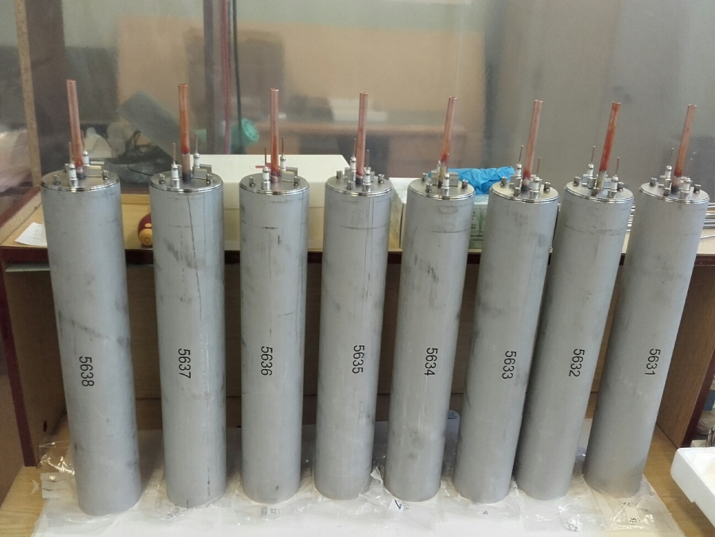
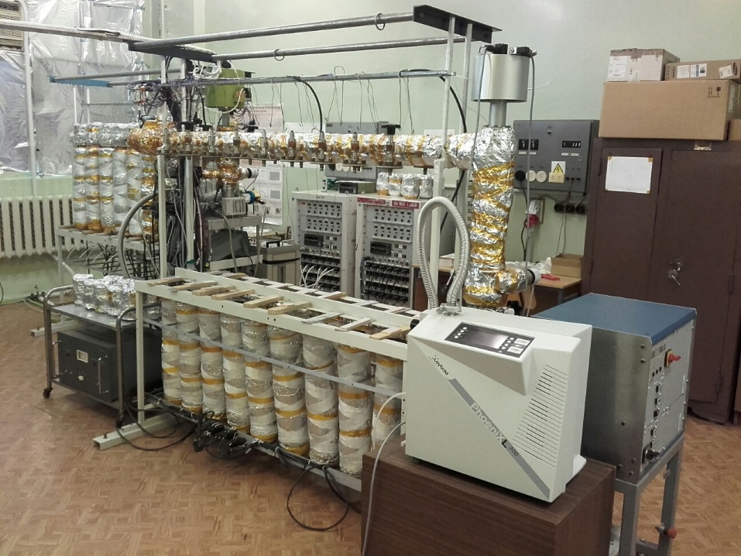
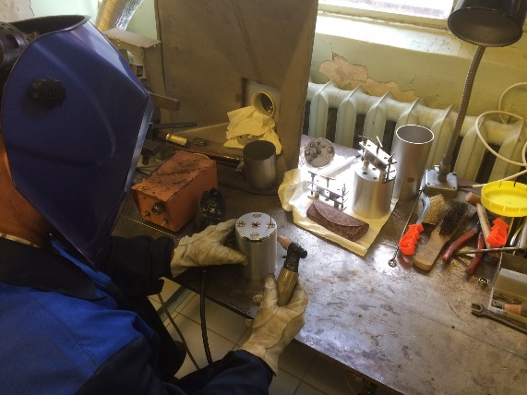
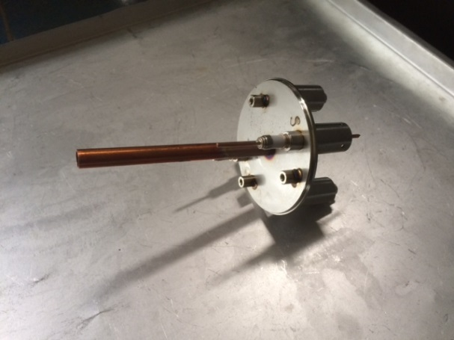
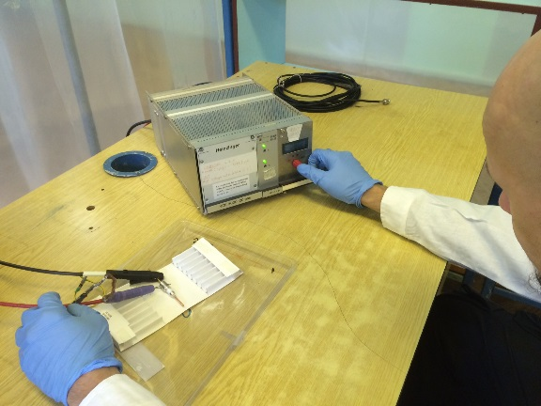
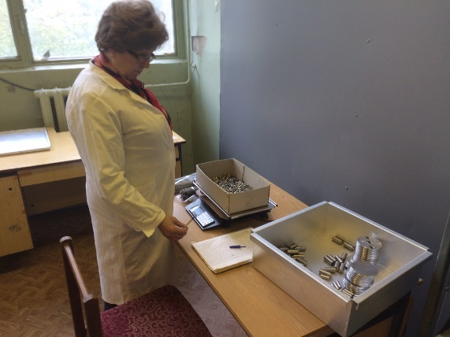
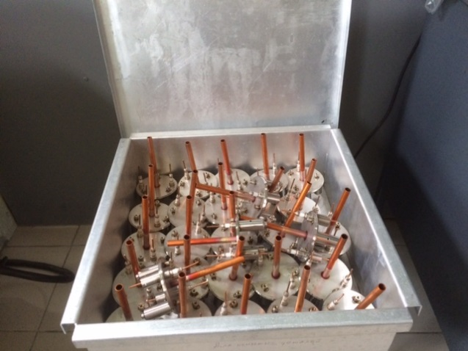
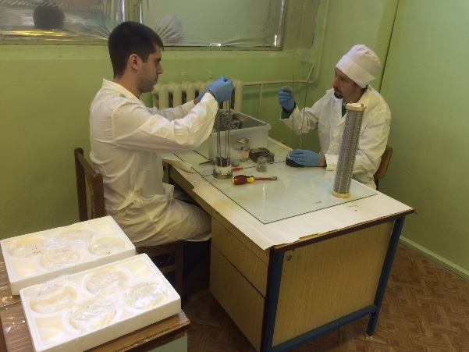
Protvino: Production

Slide 9

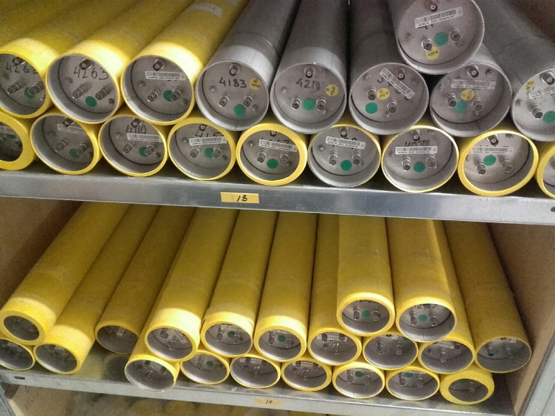
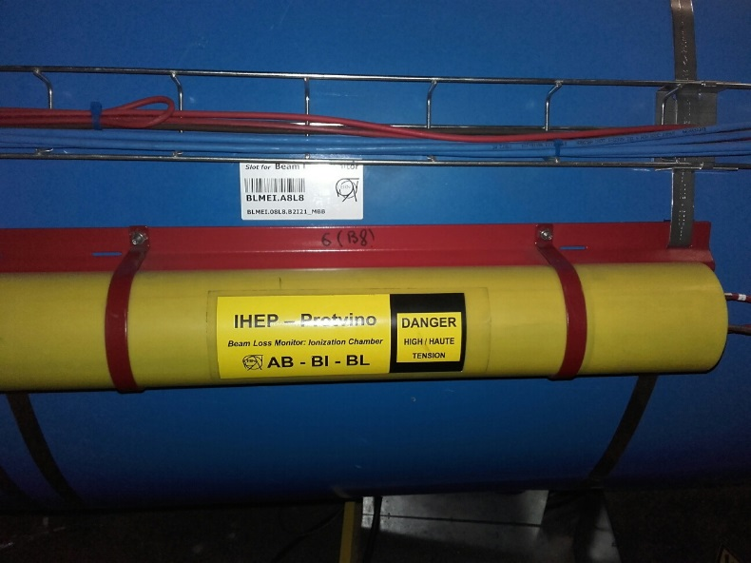
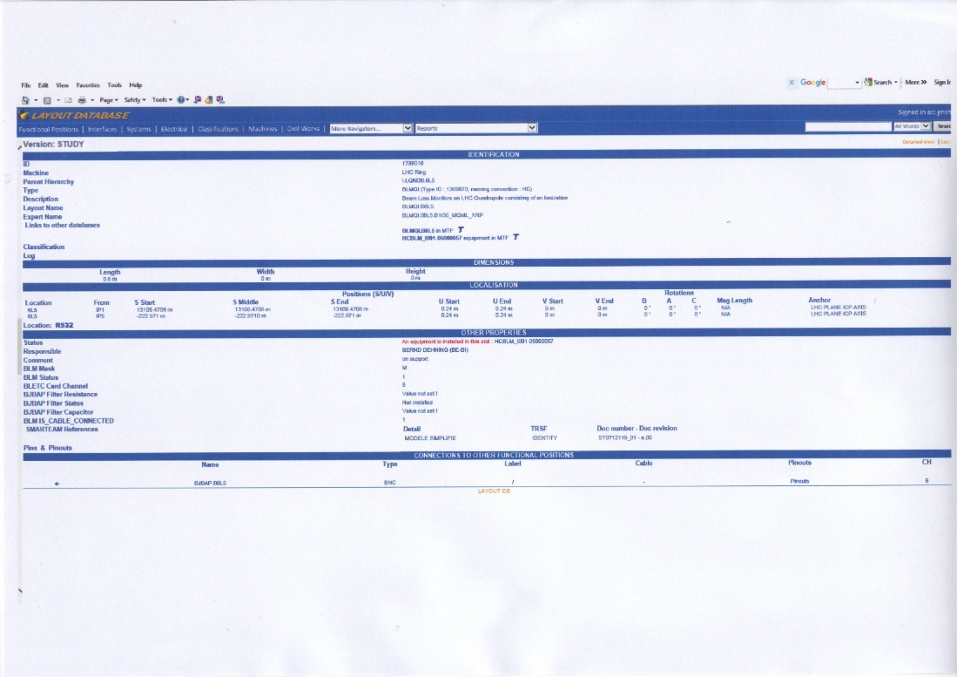
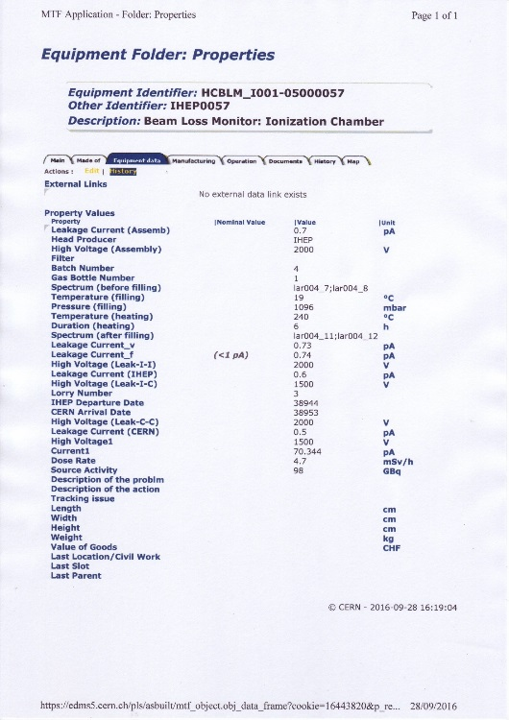
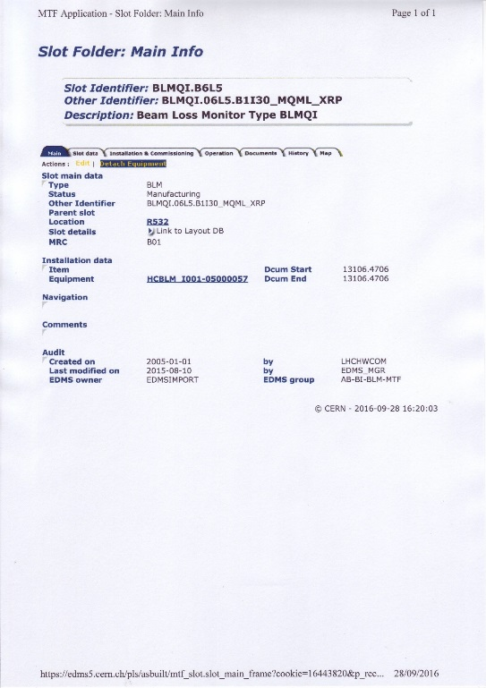
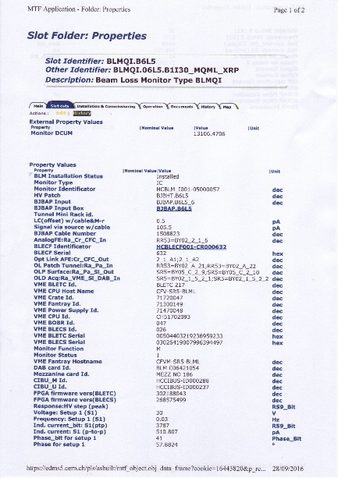
Protvino & CERN: database

Slide 10
Acceptance test at CERN
After transport of the monitors to CERN by lorry, reception tests were performed at CERNs gamma irradiation facility (GIF in 2009 and GIF++ in 2017).
For the IC they consisted of a) leakage current measurements and b) measurements of the signal induced by the radioactive source.
For GIF the 15 monitors were placed in a special support at 1.4 m transverse to the flux of the radioactive source 137 Cs (98 GBq, 4.7 mSv/h), the geometry leading to a difference in flux of +/- 5% between the 15 monitors. T
The measurements are recorded in the MTF equipment database. In 2019 out of 4259 IC arriving at CERN only 20 did not pass the reception tests.
2009 test results

Slide 11
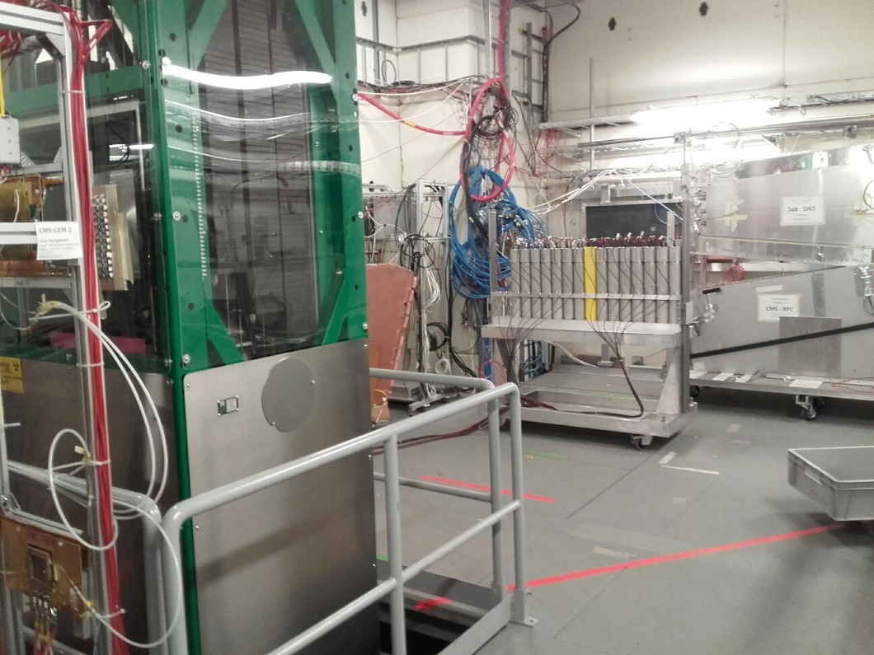
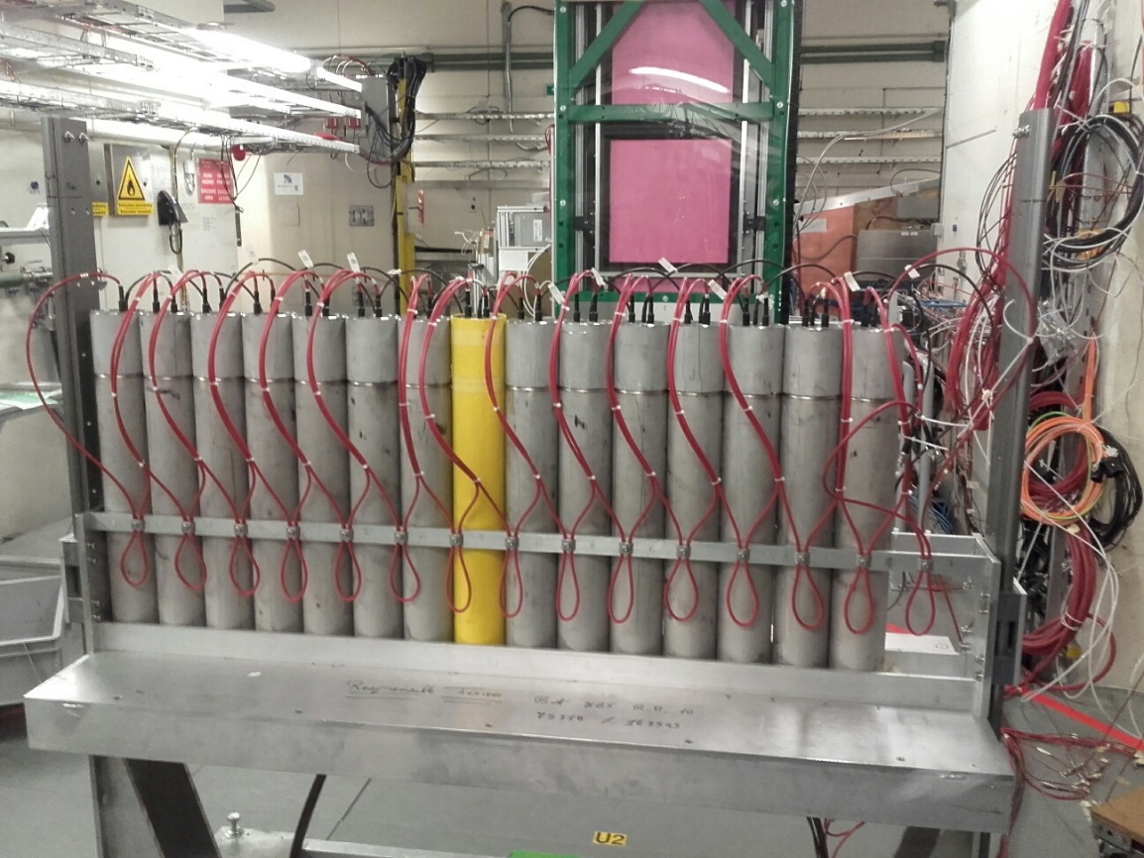
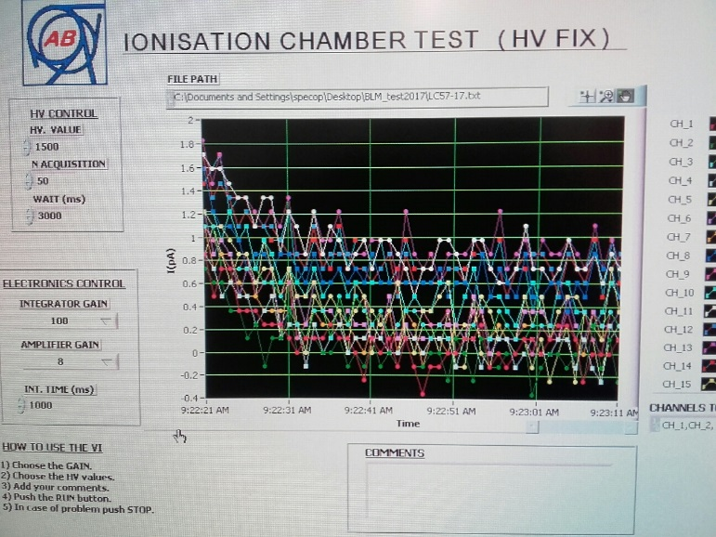
2017 GIF++ CERN acceptance test

Slide 12
830IC:
*8 ICs – well known assembly problems
*822 ICs tested in 59 set-ups
*During all tests one “old” IC was at set up
3 ICs have big Leakage Current (it should be <1.0-1.2 pA)
799 ICs are accepted
+10 ICs will be checked and re-tested

Slide 13
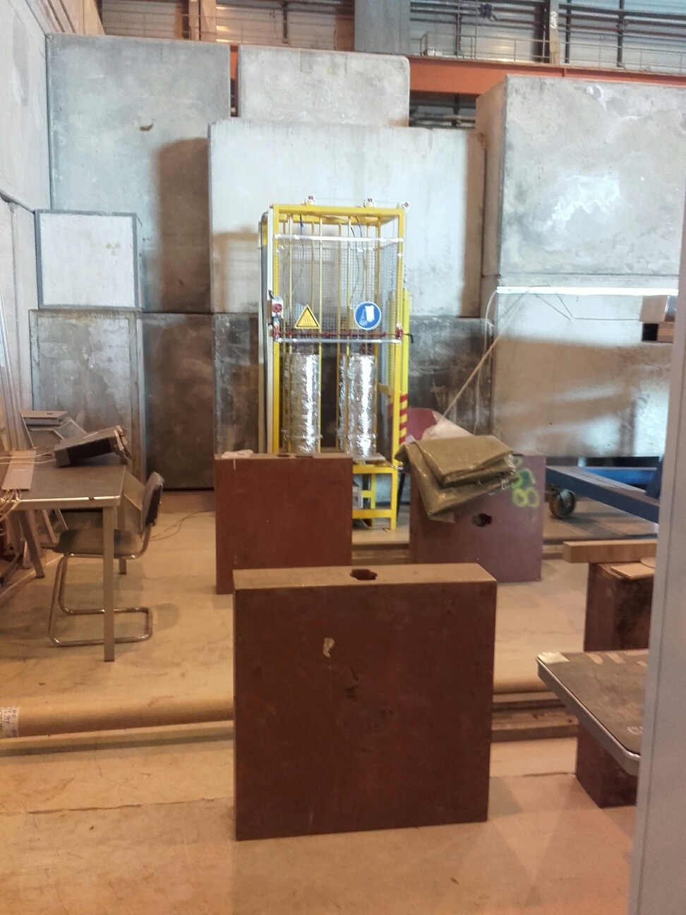
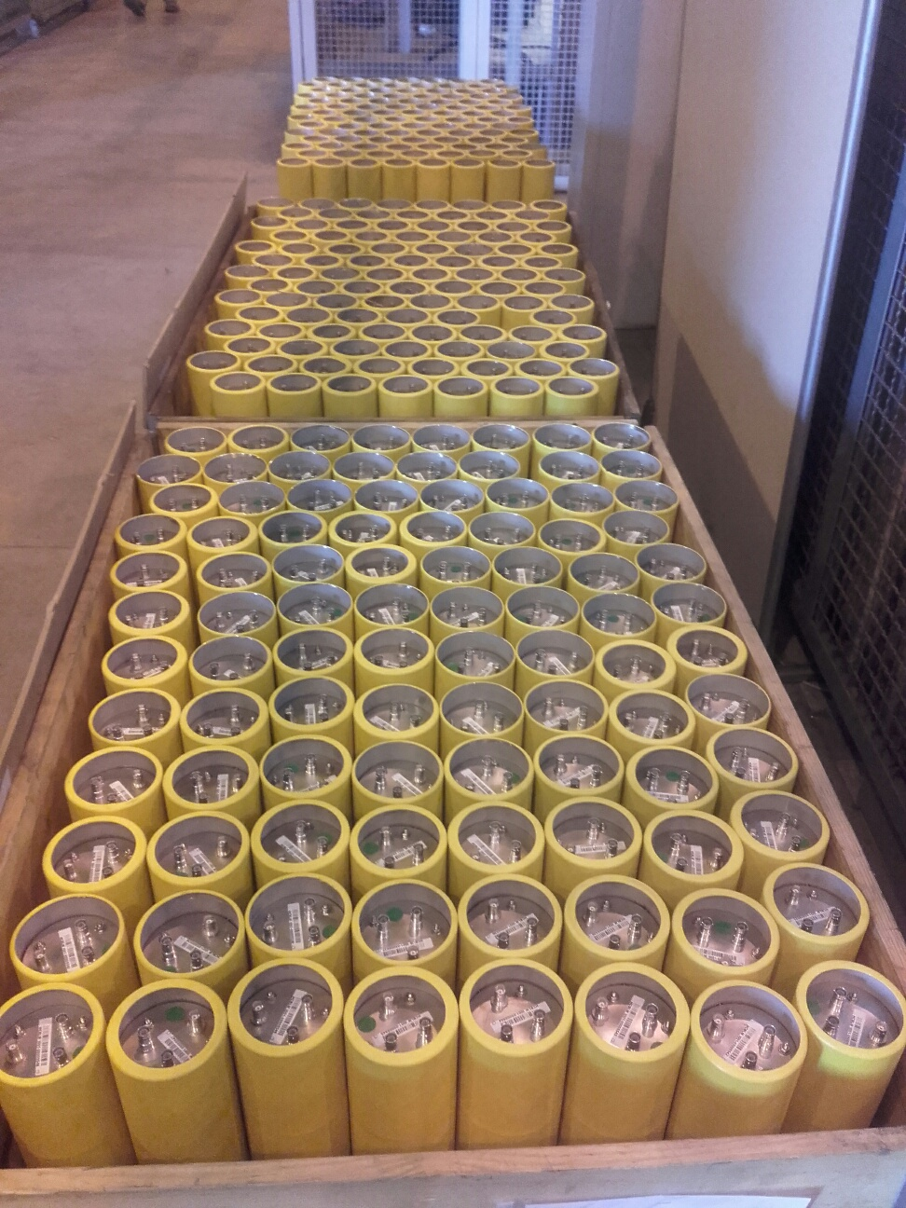
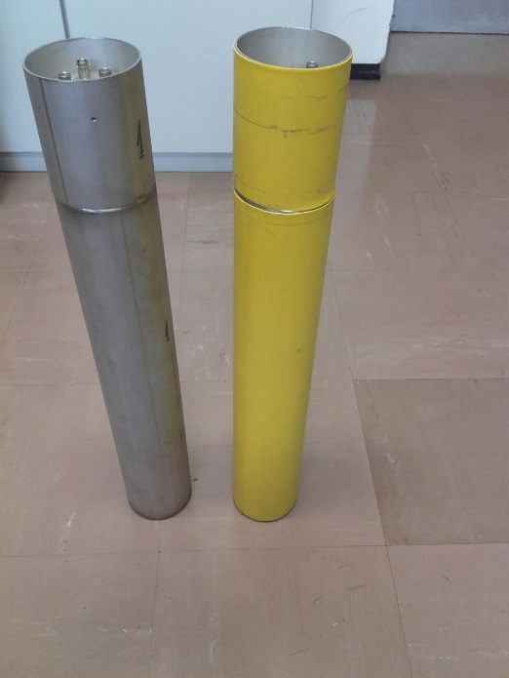
CERN: Insulation and shipping

Slide 14
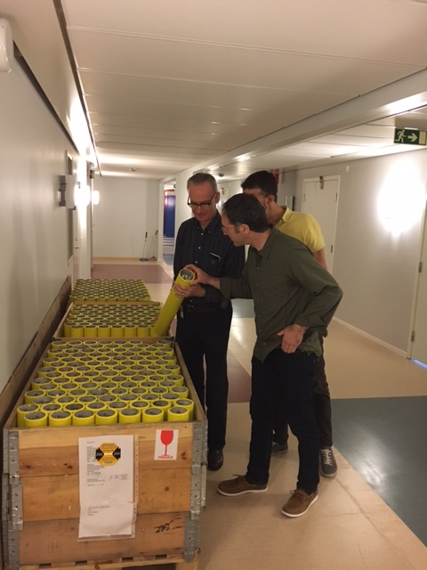
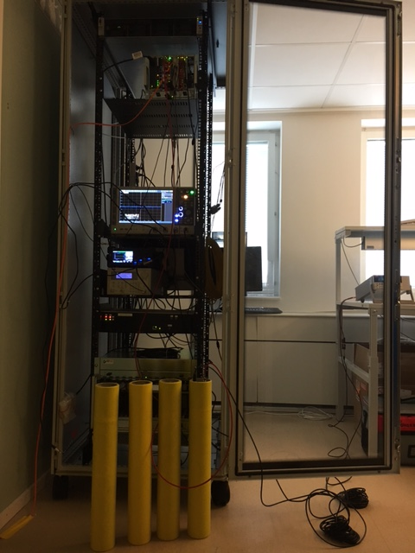
BLM at ESS
3. Radiation source calibration test
1. Arrival and visual inspection
4. Radiation source test (before startup):
Placing a radioactive source (mobile irradiator) on the monitor
and reading the induced signal by icBLM electronics, DB
2. Leakage current test

Slide 15
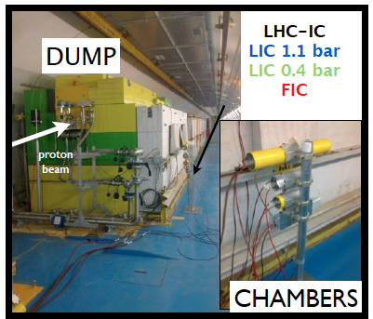
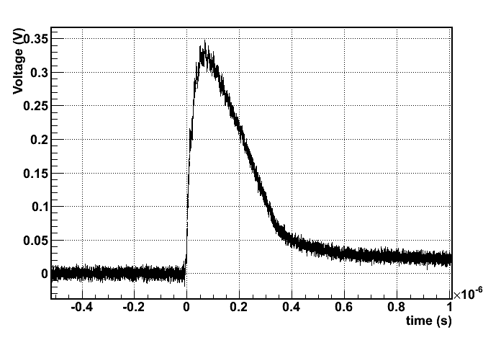
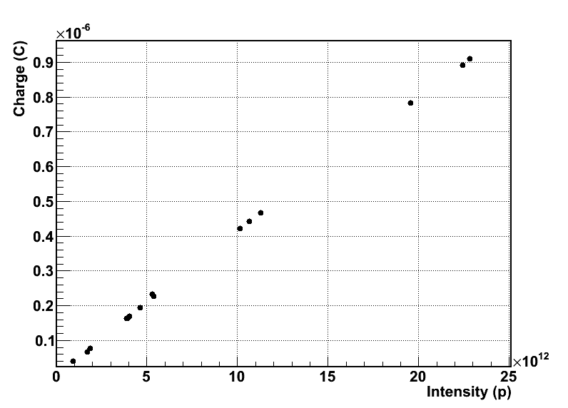
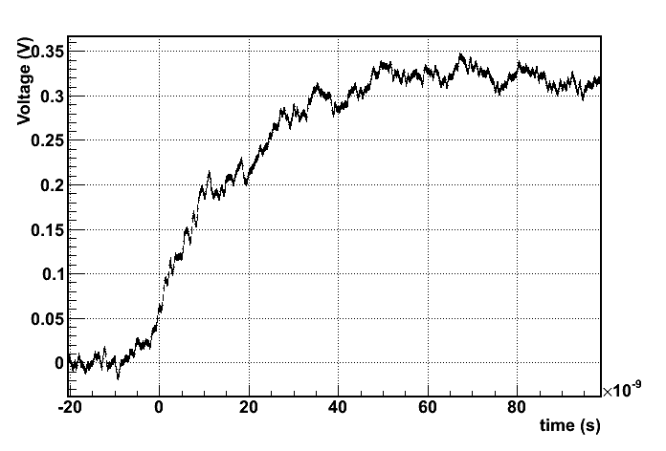
Detector performance at CERN
Electron induced
signal
Response to 1 ns pulsed (mixed radiation field. Protons onto dump)
Raise time/FWHM ~40/200 ns
Total (ion) charge collected in 300us
Response linear with intensity

Slide 16
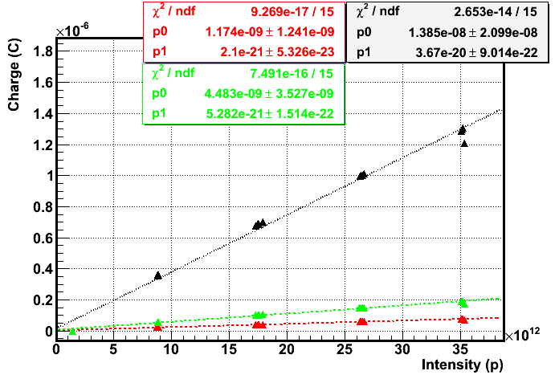
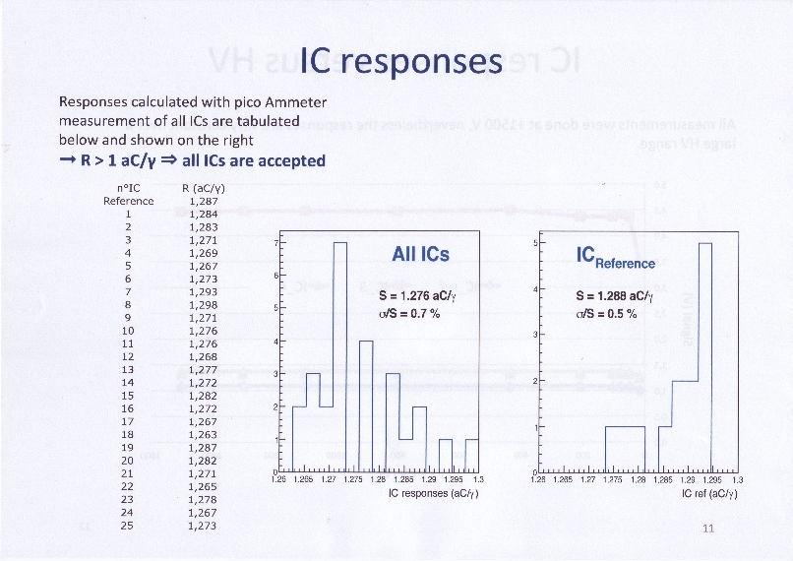
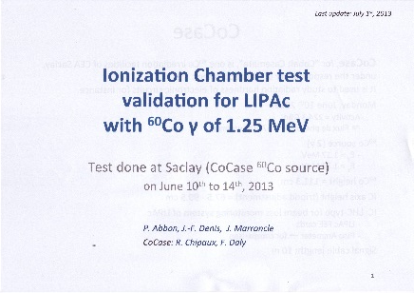
Ionization Chamber: CERN HRM and Saclay’s test
plot of the integrated charge (over 40 us), Sep 2015 at HRM
black = IC, green = FIC, red =LIC

Slide 17
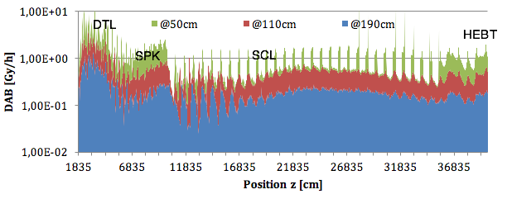
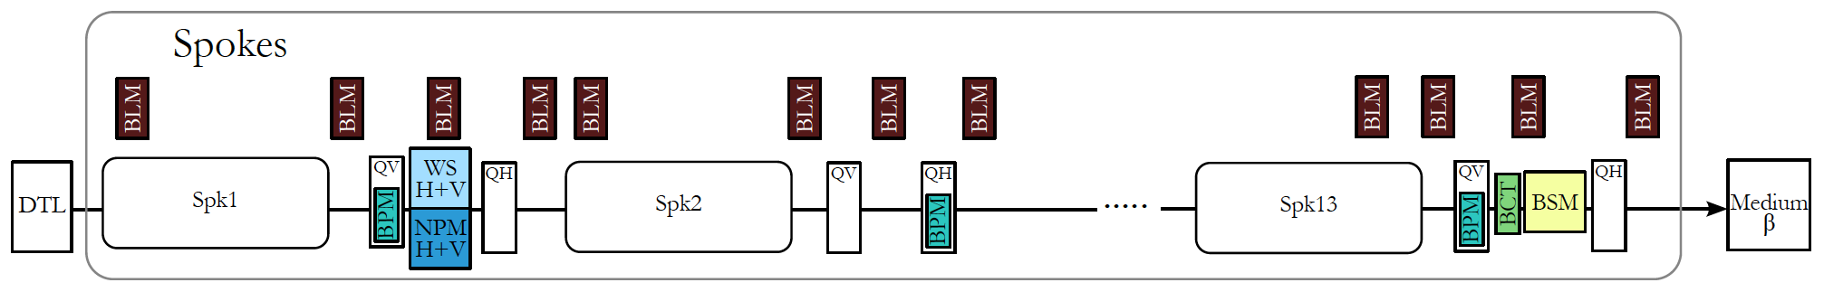
BLM at ESS linac
The number of ionization chambers
deployed per LINAC section is summarized
in the table
icBLM detectors positions are chosen in accordance with maximum beam loss locations,
and to minimize crosstalk. Because the ionization chambers are nearly point detectors,
their location must be chosen to allow full coverage without blind spots.
For diagnostic use, the detector layout should also allow determination of the loss origin Operational
and accidental losses are based on ESS-0044760:
“A guideline to operational and accidental absorbed dose rates in the ESS accelerator tunnel” by Lali Tchelidze.
Detectors will be installed outside cryostats and will have an option as mounting flexibility (mobile monitors).
Normal operational 1 W/m proton beam loss was considered.
This was derived from hands-on maintenance criteria for high intensity proton machines
and was adopted at ESS as a maximum allowable operational beam loss.
The beam loss was simulated as a homogeneous uniform loss around and across the vacuum beam pipe,
with a shallow angle.
Additionally, a full point beam loss was considered for 2 GeV on a vacuum beam pipe
as an accidental beam loss.
LINAC section | Number of ionization chambers | Comment
DTL | 5 | 1 per Tank
Spokes | 52
Medium Beta | 36
High Beta | 84
HEBT | 45 | 3 per q-pair
Dog leg | 21 2 | 3 per q-pair 1 per dipole
A2T | 15
Dump line | 6
Total | 266

Slide 18
ESS SCL – icBLM
Ionization chambers (ICs) developed for LCH BLM – primary BLMs in SCL
Photon background due to the RF cavities must be taken into account when using ICs a linac
  Bckg. mainly due to el. field emission from cavity walls, resulting in bremsstrahlung photons created on cavities/beam pipe materials.
  Levels are difficult to predict numerically – they depend on the quality of cavities, operation conditions and time.
  Energy spectra estimation: photons with energies up to tens of MeV can be expected.
  Plan to asses this experimentally as well.
          BLM tests in Uppsala (September 2017), Steve M.
          Test in Saclay
          Test in Los Alamos (November 2017)
LHC IC sensitivity to photons:
  “cut off” at transversal photon and electron incidence ~2MeV (~30MeV for p and n)
Background sampling and subtraction in the signal processing necessary.

Slide 19
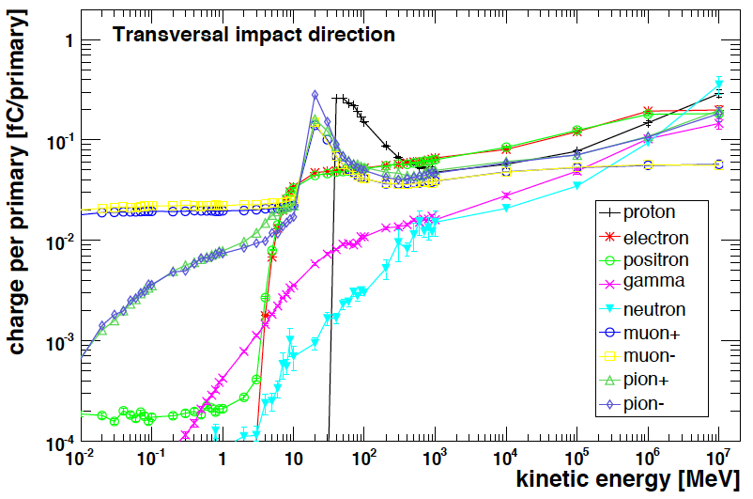
ESS BLM
Name | Description
Leakage current | Less than 1-2 pA
Conversion factor | 5.25 E-5 C/Gy
Energy Cut-off | *Protons, neutrons ~ 30 MeV *Electrons, photons ~ 2 MeV
Electron and Ion drift time | Electrons: 1/e fit of max is ~ 50 ns, all electrons collected is ~300ns Ions: 1/e fit of max is ~ 83 microsec, all ions collected is ~300 microsec
Dynamic range | Chamber’s current is 10⁷, in range ~50 pA to 0.5 mA

