Slide 1
Controls Infrastructure
Timo Korhonen
ICS Chief Engineer
www.europeanspallationsource.se
7 July 2017

Slide 2
Overview
Control system infrastructure components
MTCA base infrastructure
Timing system
Machine Protection System (Annika’s talk)
Digital platform IFC1410, status and support
Interface with Beam Instrumentation
Software services
Summary

Slide 3
Control system infrastructure components
MTCA.4
  Crates, MCH, Cooling Units, PSU
  Platform Management
  Crate variants: 12-slot and 6-slot
I/O and processing
  Digital platforms
Network and servers
  Network hardware in-kind contribution from Norway
Timing System
  EVG, EVR, Distribution System
EPICS and associated software
Configuration management tools

Slide 4
MTCA base infrastructure
Crates in two variants
12-slot, 9U crate
  For (LL)RF systems that can utilize many slots
  Has been in use, stable configuration
6-slot, 3U crate
  For smaller, more distributed systems (saves rack space)
  Backplane issues
    Vendors consider MTCA backplanes as “custom”
    Defined an “ESS-specific” backplane – follows layout of the bigger crate
  Cooling and airflow issues with prototype
    Added one fan to improve airflow
    Front-to-rear cooling is challenging due to small air inlet area
MCH (Micro Channel Hub) standardized on N.A.T.
Power supplies need final definition
  Wiener has good noise performance but issues with size

Slide 5
MTCA Crate variants
3U, 6-slot crate
4 slots with place for rear transition module
CPU, EVR in remaining slots
Primary candidate for the BCM systems
9U, 12-slot crate
12 slots with place for rear transition module
2 MCH slots (redundancy)
4 PSU slots (2 with double width, e.g. WIENER)

Slide 6
Timing system
MRF Event System
  Components defined
  Uses latest design with active delay compensation
    Higher frame rate possible
    Unlimited fan-out depth
    Etc.
  MTCA.4 version with backplane trigger and clock support
    Software support to be finalized
Details of interfacing to BI (and other) systems to be discussed and finalized
  A preliminary, incomplete definition exists (ESS-0088633)

Slide 7
Accelerator sequences
14 Hz <-> 71.4 ms
71.4 ms
71.4 ms
71.4 ms
…
t
Beam Off, t=0+3395 us
Beam On,t=0+535 us
RF Pulse, t=0+530 us
DATA
Modulator, t=0+500 us
Transmit (well) before next cycle
Pre-programmed sequences repeat at 14 Hz
  Sequencer with a RF-synchronous 88 MHz clock (can be changed)
  “programming” can happen in less than a millisecond
“Data”, i.e., beam envelope mode, etc., transmitted in parallel
  Contains “plan” for the next cycle: envelope mode, beam/no beam, pulse counter, rep rate,…
  Mode changes require a handshake with BIS
    When mode change is transmitted, timing does not send beam before MPS/BIS gives OK

Slide 8
Interaction of timing with BLM system
BLMs measure continuously – as far as I have understood
  Interface less critical
  Timestamping for post-mortem, correlations, etc.
Requirements, wishes, etc. welcome
  Radical changes would be hard…

Slide 9
Digital platforms, status and support
IOxOS IFC_1410
  Hardware ready for production
    In-kind partner (PSI) preparing series procurements
  Firmware framework (TOSCA) available
    Supports all available features of the board
      PCIe, DMA engines, interrupts, shared memory, etc.
      Earlier firmware applications (for IFC_1210) ported or in progress
  Software support exists (Linux, EPICS)
    PSI is working on upgraded drivers
      Closing completion
    Linux Yocto
  FMCs:
    ADC3110 (250 MSPS), ADC3112 (1 GSPS), ADC3117 (5 MSPS, 20ch)
    Quad SFP+ FMC, digital I/O,… as required
    PICO-8 to be developed/adapted

Slide 10
Digital platform (IFC/IOxOS) support from PSI
1410/1420 test/devl. environment setup
1410 Prototype tests
Procurement of 1410
1420 prototype tests
Porting FW & SW packages (from IFC1210)
Procurement of 1420 (1411 + DAQ 1430)
Series productions
Maturation support
Integration support
Final reports
In addition: potential in-kind contribution from Poland/Lodz for the (i)BLM project –proposal to be discussed

Slide 11
IFC_1410 board without FMC modules

Slide 12
IFC1410 overview
BIS interface can also be implemented on a Rear Transition Module
FMC slot #1
BIS special
Mezzanine
(backside mounted)
CPU
FPGA
Xilinx
KU040
FMC slot #2

Slide 13
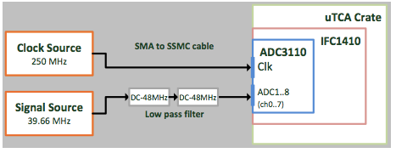
ADC3110 (FMC)
8 channels, 250 MSPS, 16-bit ADC
  Characterized on IFC_1410 by PSI
  250 MHz clock, 39.66 MHz signal
    Noise floor ~120 dBFS, integrated noise floor ~75 dbFS
    SNR ~73 dBFS, SFDR ~85 dBFS, SINAD ~73 dBFS, ENOB 11.8
  Full report available
    Measurements can be repeated at desired frequency

Slide 14
Networks and servers
Network design done
  Technical (aka controls) network backbone
  State-of-the-art performance level
  Hardware in-kind contribution from Norway
  Installation, cabling is underway
    System-level connection details to be defined
Some EPICS IOCs already running on site
  CF systems with PLCs
Temporary control room being equipped
  As well as server infrastructure (also temporary until server room ready)

Slide 15
Software support from ICS
EPICS base infrastructure
  EEE (ESS EPICS Environment) is designed to support
    Distributed development
    Continuous integration, test procedures
    closed loop from development to deployment
  Scripting support (Python)
EPICS (7) services
  Archiving, alarm system, save&restore
  Channel Finder for (flat) namespace management
    Generate higher level abstraction(s) and grouping

Slide 16
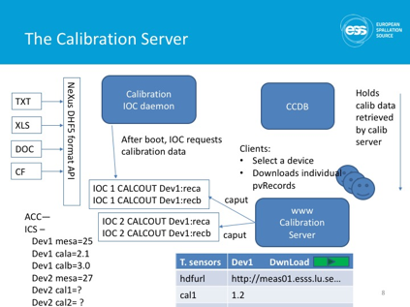
Software support from ICS
Configuration management
  Databases (CableDB, CCDB)
Data management tools
  Calibration data for various devices
  Storage and indexing of measurement results
  Under design, based on use of HDF5 file format

Slide 17

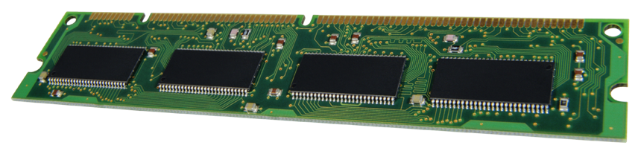
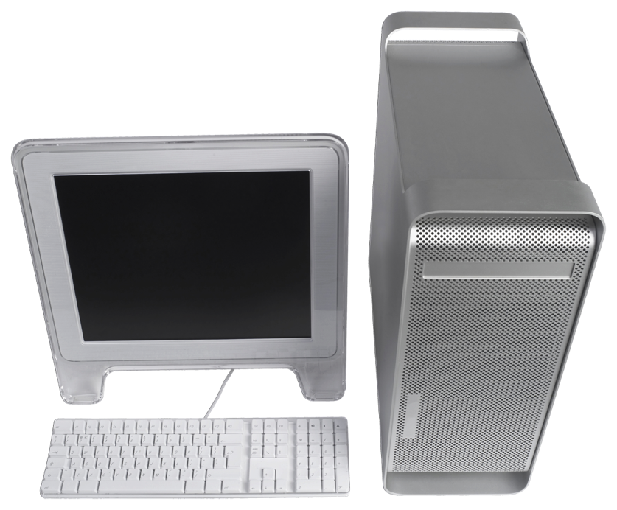
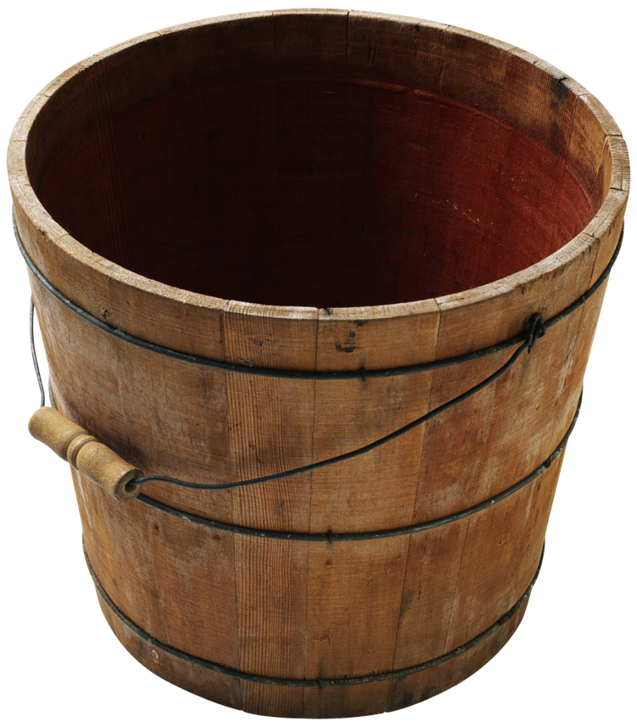

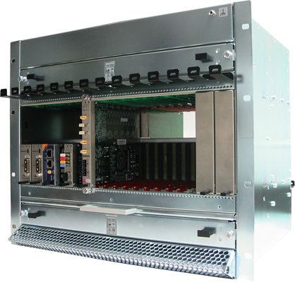
Deployment environment overview
EPICS Base
EPICS modules (community)
EPICS modules (ESS)
Community release
Community (various sources)
ESS internal or in-kind
Download, configure, test, etc.
Develop, configure, test, etc.
Download, configure, test, etc.
CCDB
Compilation, maintenance
Continuous integration, tests, etc.
EPICS core
EPICS modules
(RT)OS image
File system (NFS)
IOC Factory
File system (NFS)
rsync
st.cmd
Synchronization
System integration
Boot

Slide 18
Interface with Beam Instrumentation
From our latest ICD document (should be updated and finalized)
MPS/BIS interface to be finalized
Discussion on data interfaces (EPICS PVs, to beam physics, etc. to be done)
Work on defining requirements for archiving and other services necessary
Data management, calibration, operating procedures to be discussed in detail.

Slide 19
Summary
MTCA base infrastructure defined
  Crates and related components, platform boards, FMCs
Timing system components defined
  Procurement process in preparation
Platform support improving
  IFC (IOxOS) platform support catching up after a slow start
  Potential in-kind support for (i)BLM project from Poland (Lodz)
Control system services defined but more details to be discussed
  Definition of PVs for operation (waveforms, integrated values,…)
  Archiving requirements
  Post-mortem and beam-synchronous data handling
  Calibration requirements
  Etc.

