Slide 1

Control System for 1 nBLM test in Saclay
CEA\DRF\IRFU\SIS | Yannick Mariette
2017/07/10
Notes:
I will mainly talk about the nBLM acquisition CS for one nBLM

Slide 2
Plan
Control system for 1 nBLM test in Saclay
  Control system requirements, interfaces and facilities
  Architecture of a nBLM group
  FPGA considerations
Proposition of the control for all nBLMs
Notes:
Sub-part

Slide 3
Control system Requirements
42 nBLMs will be distributed all along the Linac
Each nBLM contributes to the accelerator safety, the beam tuning and the long term monitoring
Slow control for the HV, LV and gas
Notes:
For the safety it will be alarms connected to the Beam Interlocks System to stop the beam

Slide 4
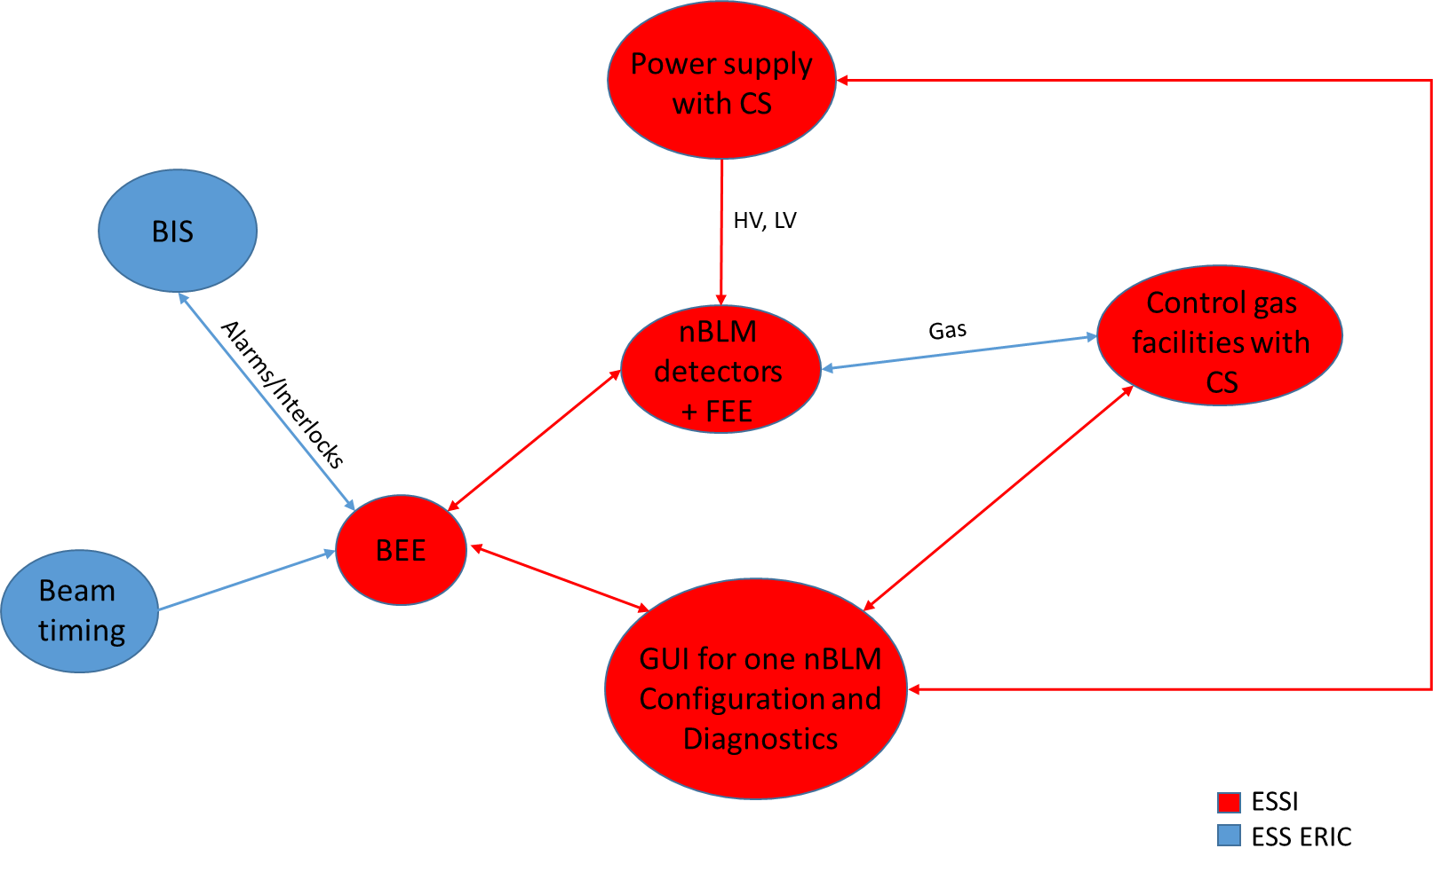
Interface overview
Notes:
nBLM : 2 micromegas detectors : fast and slow
FEE : electronic with preamplifier (need LV)
- BIS and Beam Timing only in ESS site

Slide 5
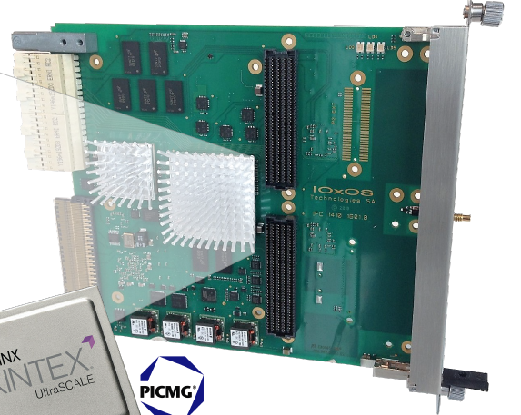
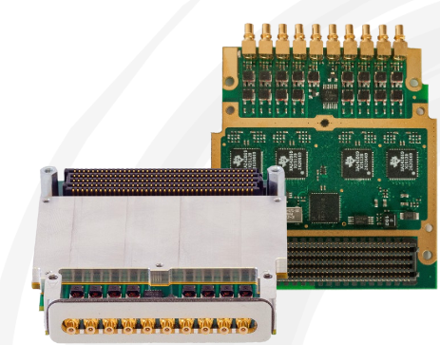
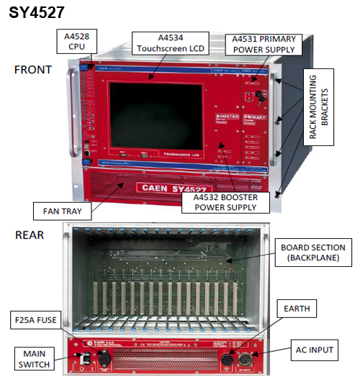
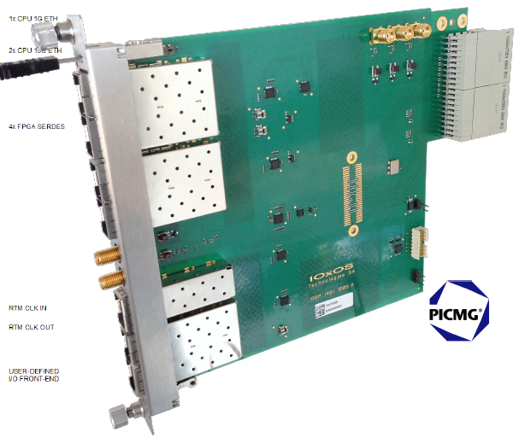
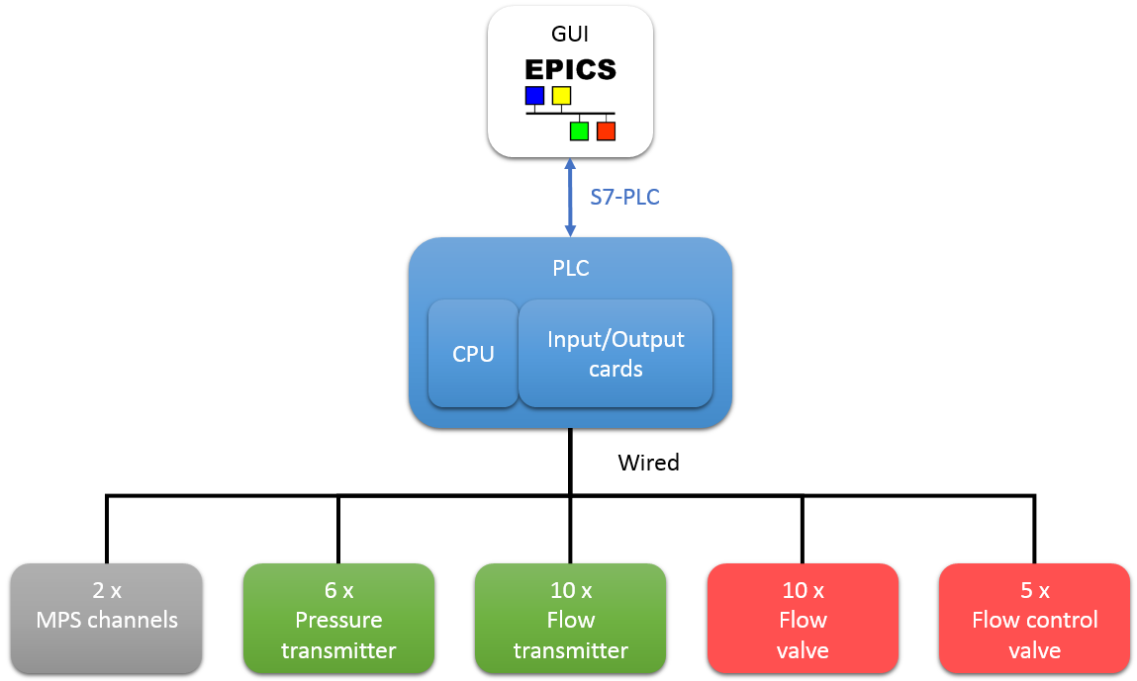
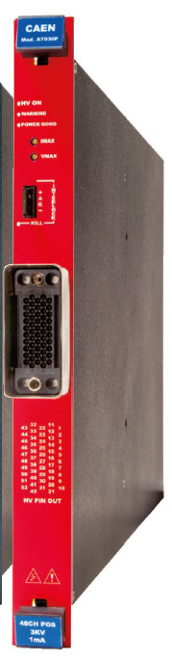

Control system facilities
HV and LV CS facilities
BEE CS facilities
IFC1410
ADC3111
RTM ?
A7030 + A2519
Gas CS
facilities
IOC
Kontron IPC
+
Gas CS facilities
Siemens PLC
Notes:
- SY4527 provides an EPICS service which gives access to PV using the CA protocol
HV : A7030 -> 48 channels
LV : A2419 -> 8 channels
- AMC board IFC1410 on MTCA crate with CPU and Kintex FPGA. 2 FMC slots
ADC3111 -> 8 ADC channels, 250 Mhz
- Kontron Industrial PC + Siemens PLC + Siemens Input/output cards. An EPICS server runs on PLC and communicates with the s7plc driver on the industrial PC

Slide 6
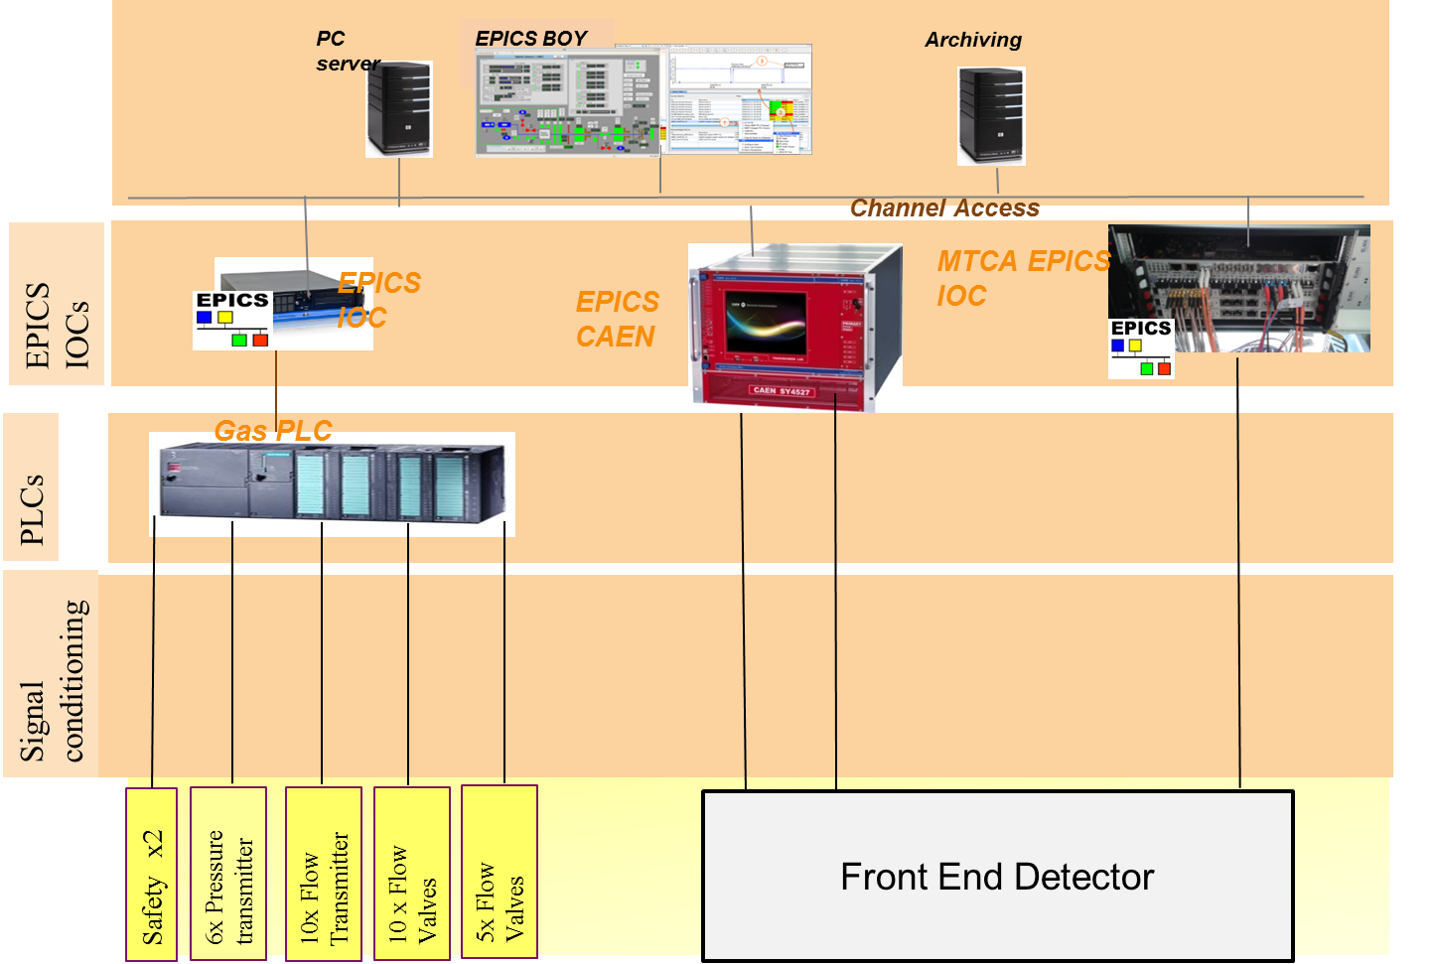
Control system overview for 1 NBLM test in saclay
Notes:
Layers from HW to CS

Slide 7
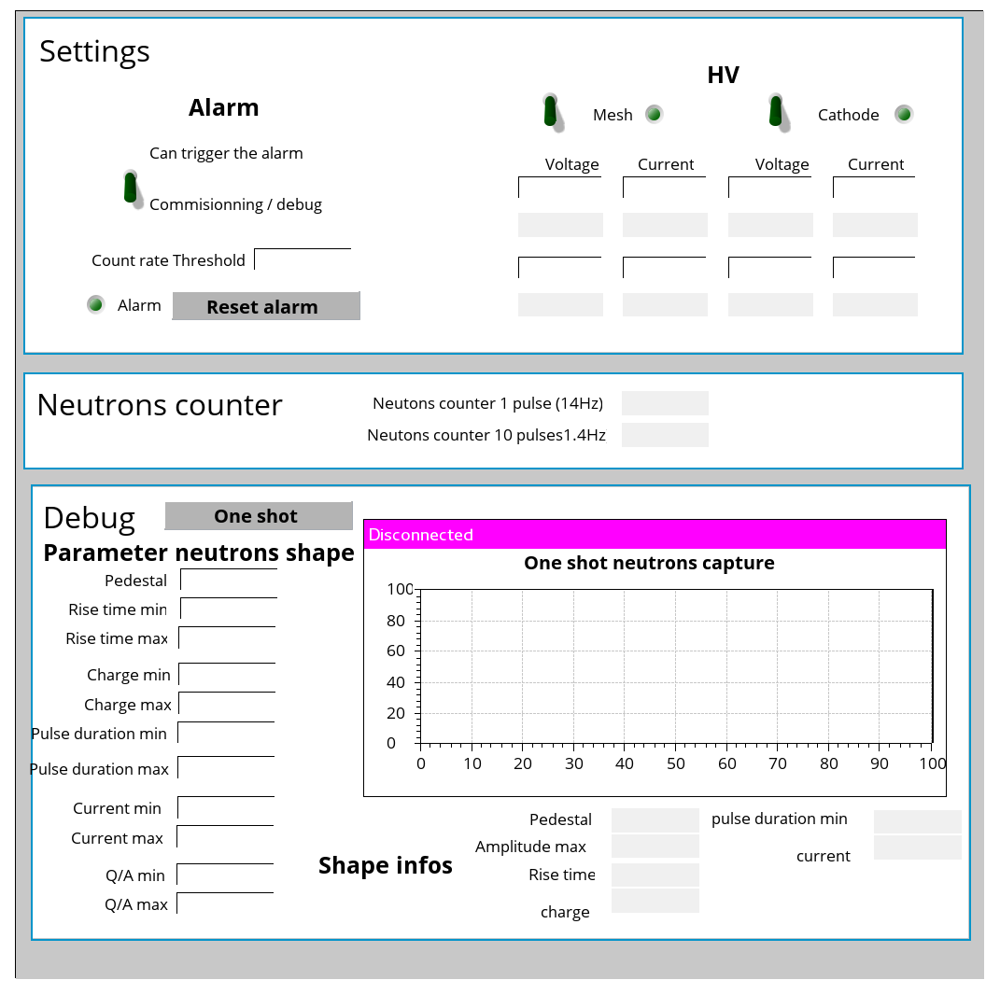
gui for one detector
Notes:
GUI for one detector with the Control and status, with Diagnostics (like neutons count, current…), and Debug (oscilloscope)
The debug will help for the FPGA firmware development.
Data Rise time, charge… are calculated from the one shot raw data

Slide 8
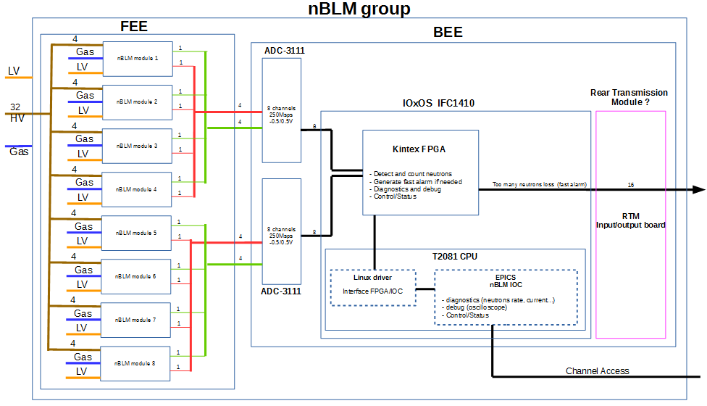
Architecture of a nBLM group control system
Notes:
nBLM group = FEE + BEE
BEE = digitizer
The FPGA development will be done by ESS. The specification comes from CEA in the nBLM Control System Design document. A preliminary version exists and will soon be sent.

Slide 9
FPGA firmware requirements
Detect and count neutrons
Generate fast alarm if needed
Diagnostics (neutons count, current…)
Debug
Control/status
Coincidence between neighbouring detectors
Notes:
The relability of the system will be better with a nBLM coincidence algorithm inside the FPGA.
It could detect false trigger in a nBLM (due to detector malfunction or sparks).
But it is not needed for one nBLM test in Saclay

Slide 10
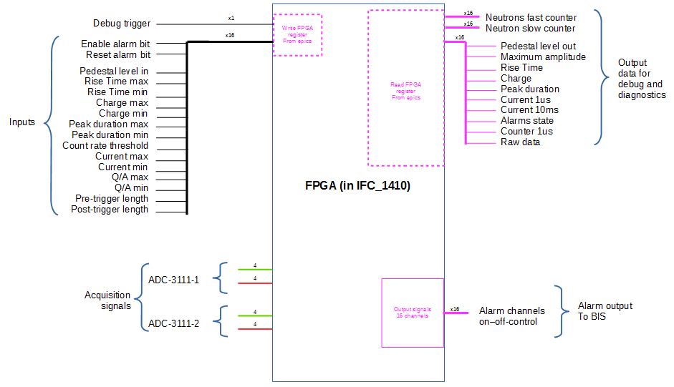
FPGA interface and data
Notes:
16 Acquisitions signals at 250 Mhz
Parameters for neutron peak detection
Diagnostics data
Debug data (raw data on a peak detection trigger + calculated data)
16 Alarm output signals

Slide 11
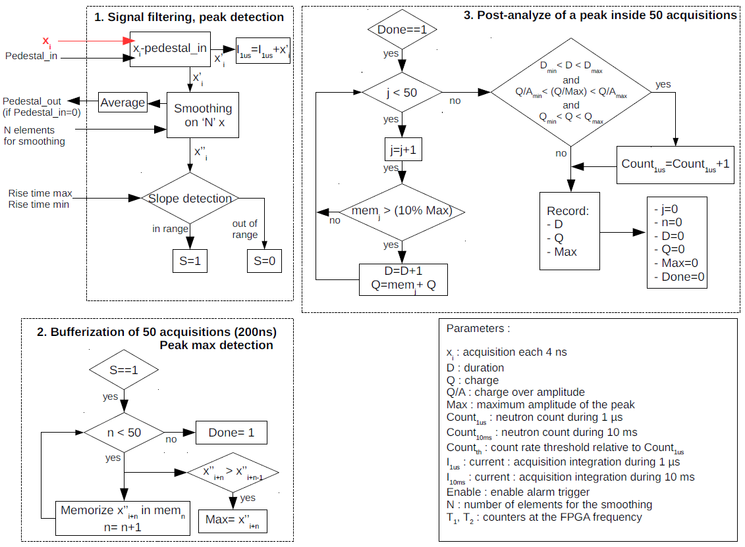
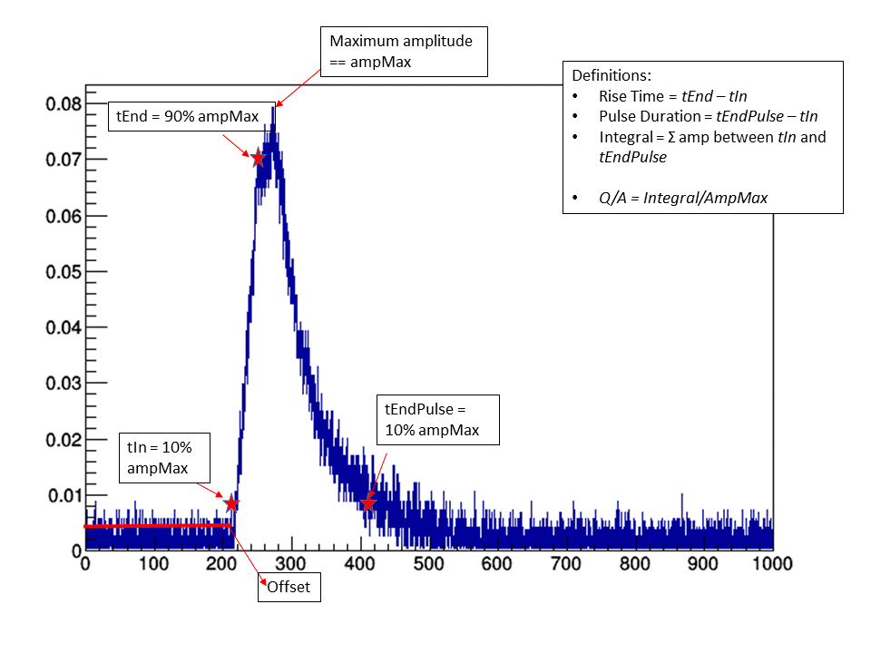
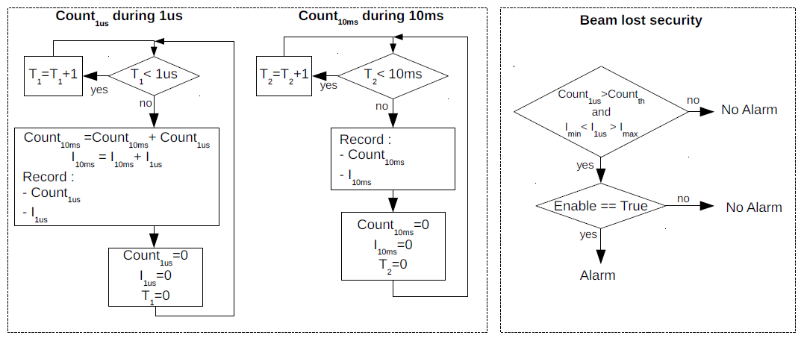
FPGA algorithm for neutron detection
In case of an ideal shape for a neutron signal
Notes:
1, 2 et 3
Peak detection with the slope for example
considering only ideal shapes for neutron signals

Slide 12
Plan
Control system for 1 nBLM test in Saclay
  Control system requirements, interfaces and facilities
  Architecture of a nBLM group
  FPGA considerations
Proposition of the control for all nBLMs

Slide 13
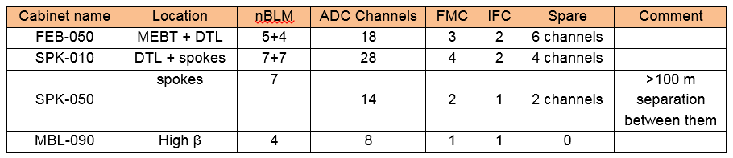
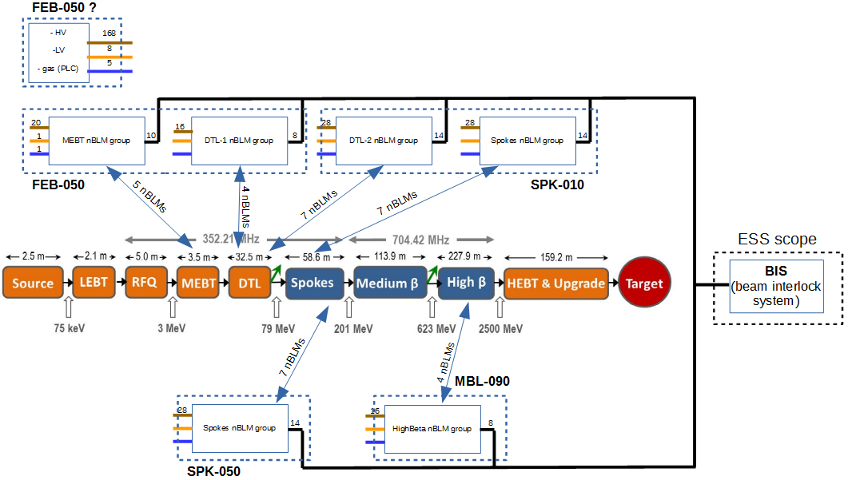
Proposition of the control for all nBLM
Notes:
Proposition of nBLM distribution inside Cabinet
4 available cabinets for 34 nBLM
HV and LV could be in the first cabinet
There are 34 nBLM in the first ESS proposition with defined location. The CEA will provide 42 nBLM with enough FMC and IFC boards .
But it is very important to know the position of other nBLM

Slide 14
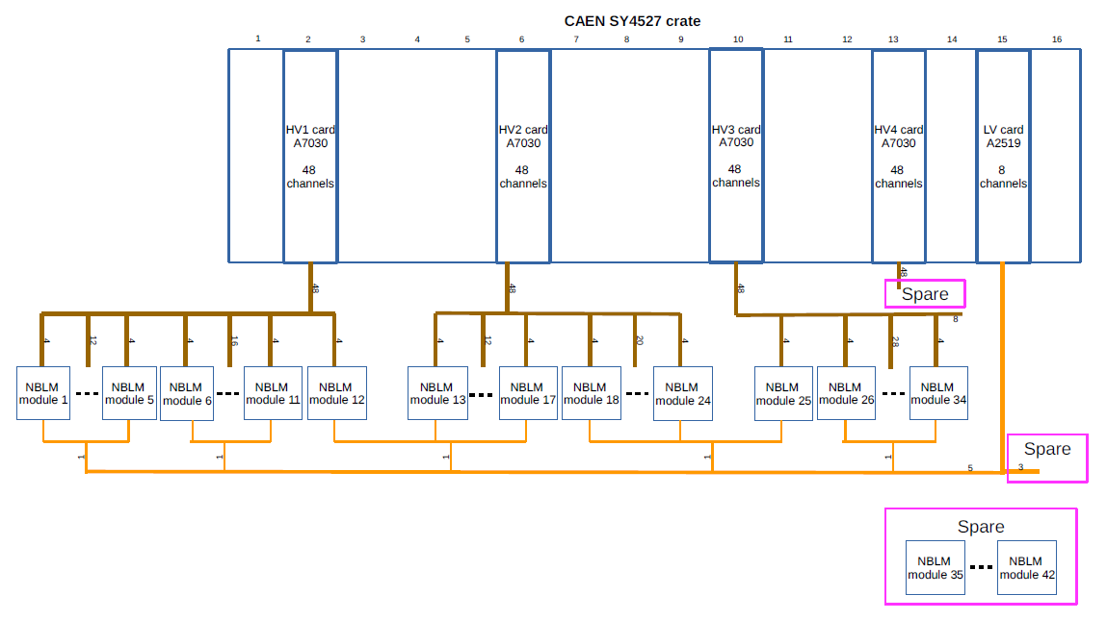
High and low voltages distribution
Notes:
Architecture of the all HV and LV in the CAEN crate
5 HV board and 1 LV boards are enough for 42 nBLM
1 IOC for the SY4527 containing all HV and LV boards

Slide 15
Conclusion and questions
Go on specifications and work on IFC1410 board
We will need a first FPGA firmware version for IOC development and then to tune neutron detection
        Which I/O board for alarms and communication extender for CA ?
        Concerning the future in ESS, still important questions :
        Location of the rest of nBLMs ?
        Beam loss coincidence inside the FPGA or/and inside the BIS. Is it needed ? who does it ?
        Who will do the CS for all nBLMs ?
Notes:
The next step is to go on specification (nBLM Control System Design document) and work on the MTCA IOxOS board.
Pileup treatment…
IOxOS purchase a RTM board RSP_1461 with ethernet (but it is only 11 outputs), FMC board?
Location is important for the facilities and CS architecture

Slide 16
Thank you for your attention

