Slide 1
The Beam Loss Monitoring System and its Integration into the ESS Machine Protection Strategy
Annika Nordt et al.
European Spallation Source ERIC, Lund, Sweden
www.europeanspallationsource.se
PDR BLMs 2017-07-10

Slide 2
Overview
ESS Machine Protection Scope and Concept
How to Address Machine Protection?
Damage Potential of Beam, Beam Losses, Activation Limits
Beam Loss Measurement Strategy at ESS
Dynamic Range and Response Times from MP for BLM System
Environmental Requirements and Other Comments
MP Requirements for BLM System
Interface to Beam Interlock System
Management of Beam Loss Thresholds/ Some ideas
Self Testing Functionality Requirements from MP for the BLM System
Summary

Slide 3
Scope of Machine Protection at ESS
Machine Protection helps in achieving the operational availability requirements for ESS. High availability is achieved through high system reliability, through short preventive and corrective maintenance times and short recovery times after stopping beam operation.
The right strategy to avoid damage leading to long corrective maintenance times, will involve a mix of:
dedicated technical systems stopping operation (not only of beam) to prevent and mitigate damage,
dedicated operational and maintenance procedures to fix things before real damage can occur.
Machine Protection needs to reliably do the following:
protect the “machine” from damage, be it beam-induced or resulting from any other source,
protect the “machine” from unnecessary beam-induced activation.
in accordance with beam and facility related availability requirements.
Machine protection will be implemented in a way to:
minimize unnecessary down-time due to spurious trips,
provide optimal support for failure localization,
support all operational modes of the facility,
support operation in degraded mode.
Notes:
Text according to slide

Slide 4
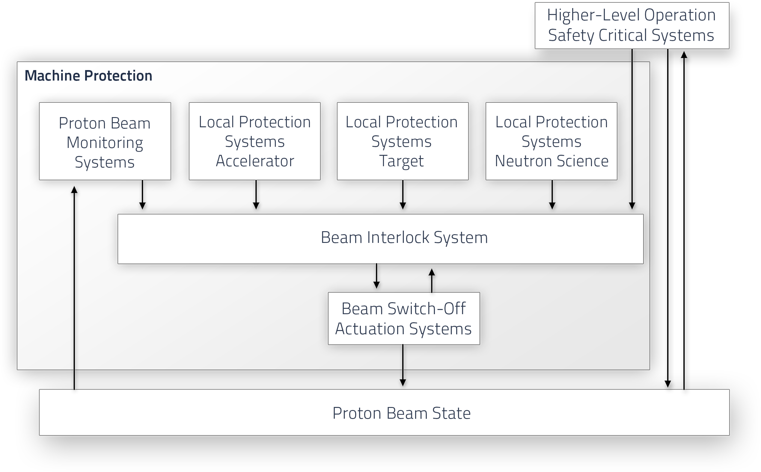
Functional MP Architecture Concept

Slide 5
Proton Beam Monitoring Systems
Proton Beam Monitoring Systems:
The proton-beam monitoring systems detect any off-nominal states of the beam itself that might cause damage to or unnecessary activation of any equipment.
The corresponding protection functions will trigger a stop of beam operation by means of a BEAM-PERMIT signal transmitted to the Beam Interlock System.
Local Protection Systems for Proton Beam Monitoring :
detect off-nominal states that might lead to damage to the beam instrumentation itself,
detect states where the monitoring systems are not ready for beam operation.

Slide 6
Beam Interlock System
The Beam Interlock System evaluates the BEAM-PERMIT signals from all systems.
If required, the Beam Interlock System stops beam operation by triggering a set of actuation systems in a specific sequence, allowing for a painless recovery to normal operation.
The BIS will verify the correct reaction of the actuation systems and, in case beam is not stopped, an emergency sequence disregarding any recovery requirements will be triggered.
After an interlock, beam production will only be allowed to resume once all relevant BEAM-PERMIT input signals are in the expected state and all systems as well as the Beam Interlock System have been actively reset.

Slide 7
How to Address Machine Protection?
What criteria are to be considered when talking about machine protection?
  Damage potential of beam
  Level of expected beam losses (continuous and accidental)
  Delicacy of equipment (failure modes, state of the art, spares, etc)
  Means to inject, stop, or extract beam
  Availability requirements
  Environment: location of equipment (radiation, temperature, humidity)
  Prepare for the unknown, if you operate at unprecedented energy, power etc.

Slide 8
Damage Potential of Beam
Relevant parameters to be considered for heating and possible damage to material:
Momentum of the particle,
Particle type,
Energy stored in the beam,
Beam power,
Beam size,
Beam power/energy density (MJ/mm2, MW/mm2),
Time structure of the beam,
Cooling conditions.
In order to estimate the order of magnitude for possible damage:
i) one MJ can heat and melt about 1.5 kg of copper;
ii) one MJ corresponds to the energy stored in about 0.25 kg of TNT;
iii) one MW during one second corresponds to one MJ

Slide 9
Beam Losses and Machine Protection
Continuous beam losses: inherent during operation of accelerators.
Accidental beam losses: transient losses with time scales from ns to many seconds due to a multitude of failure mechanisms.
‘Machine protection’ protects equipment from damage, activation, downtime due to accidental beam losses. Machine protection includes a large variety of systems.
Example:
For 1 MW, a loss of 1% corresponds to 10 kW, not to be lost along the beam line to avoid activation of material, heating, etc.
Assuming a length of 200 m, these losses would correspond to 50 W/m.
1 W/m is max. acceptable for hands on maintenance (limiting activation levels).

Slide 10
Activation – Hands-On Maintenance
An average beam loss of 1 W/m should be a reasonable limit for hands-on maintenance.
1 W/m corresponds to 6x10⁹ protons/[m•s] of energy 1 GeV (uniformly distributed)
Simulations show the following:
If the irradiation time of a steel beam pipe with 1 W/m beam losses is 100 days and cool down time is 4 hours, then the effective dose rate at 30 cm distance from the beam pipe is about 1 mSv per hour.
Courtesy of N.V. Mokhov and W. Chou, 7th ICFA workshop on High intensity high brightness hadron beams, USA, 1999

Slide 11
Beam-Loss Induced Damage
Equipment operating at high voltage (RFQ, cavities) can be very sensitive to beam losses (surface quality degradation). Then operation at the same voltage is not possible and probability for arcing is increased.
At SNS, errant beam losses led to a degraded superconducting cavity. Beam current monitors (BCMs) measured beam losses of a few μs. After such errant beams, sometimes the cavity gradient needs to be lowered. Conditioning after warm-up helps in most cases, but in one case a cryo-module had to be exchanged.
The energy of beam losses is about 100 J. The damage mechanisms are not fully understood; it is assumed that some beam hitting the cavity desorbs gas or particulates (= small particles) creating an environment for arcing.

Slide 12
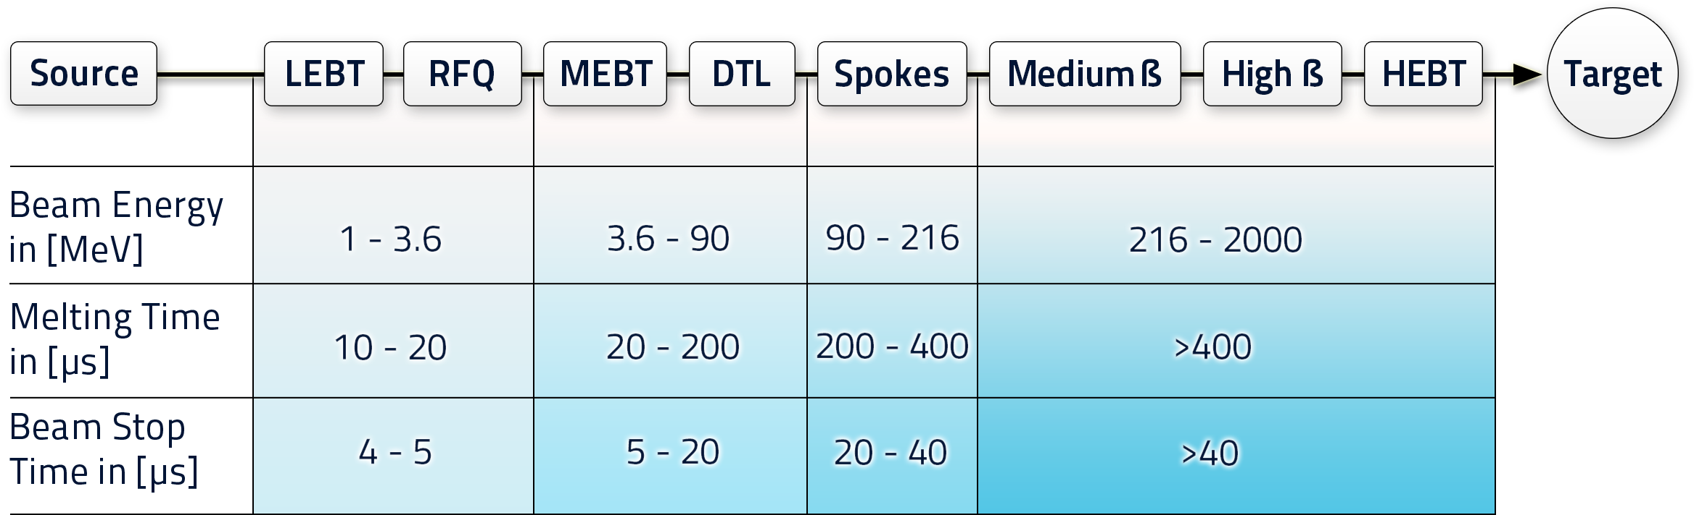
Damage Potential of the ESS Proton Beam
Assumption:
Proton beam impinging perpendicularly on copper or steel (2mm beam size).
Courtesy of L. Tchelidze
From these time scales it is possible to determine the (IC) BLM response time requirements. Fastest reaction time required (≥ 80 MeV): 10 μs (tbc)

Slide 13
Beam Loss Measurement Strategy
To provide the ability of measuring beam losses along the full linac, different systems are required (this is mainly driven by the proton beam energy range at ESS).
Beam losses in the warm linac can be measured by Beam Current Monitors only (proton beam energy of 1 MeV – 30 MeV).
Above a proton energy of 30-80 MeV (DTL), it is possible to use Ionization Chambers as beam loss monitors (in addition to BCMs). BLMs and BCMs are located along the rest of the linac up until and including the target. Also it might be possible to use nBLMs to protect equipment from damage in the warm linac (especially in the DTL).
It is important that ESS finalizes the definition of damage potential of equipment that needs protection; i.e. how much protons can be lost at certain locations in the linac without causing damage in what type of time scales? These two numbers define the dynamic range and response time for the system. This also allows us to understand where we have gaps in beam loss detection ability if any.

Slide 14
Beam Loss Measurement Strategy
The estimated beam losses in p⁺/m/s can be converted into A [the current that is measured by the ionization chambers]. This measured current in [A] can be further converted into [Gy/s].
Currently MP, Beam Physics and BI are working together to define an official beam loss measurement strategy for ESS.
Need to finalize analysis related to beam loss induced damage! This is on going work and will define the PIL and reaction times of the different protection functions that have to be implemented by the beam loss monitoring system.
One open part of the analysis is quench detection. It might be that the BLM system becomes relevant for quench protection of the superconducting cavities (besides the quench detectors implemented by the RF/Cavity systems). Ie as additional layer of protection.

Slide 15
Dynamic Range and Response Times
Need minimum and maximum expected number of lost protons in [p⁺/m/s] that have to be measured by the BLM system.
Based on this we can define (and prioritize) the dynamic range that is required for the system.
In addition we need to understand the time scales during which critical beam losses can occur and which type of damage can occur where (along the linac).
The dynamic range in current and related reaction times are especially important to define the requirements for the electronics that will be used to process the measured current.
The damage potentials in number of lost p⁺/m/s per equipment is needed to set the beam stop thresholds in a reliable way.

Slide 16
Environment of Equipment
Understand where the equipment will be located
Examples:
Avoid electronics in an radiation area (single event upsets)
Avoid high temperatures and high humidity, EMC, EMI
Avoid long cables
Always try to equip with rich diagnostics for efficient failure tracking

Slide 17
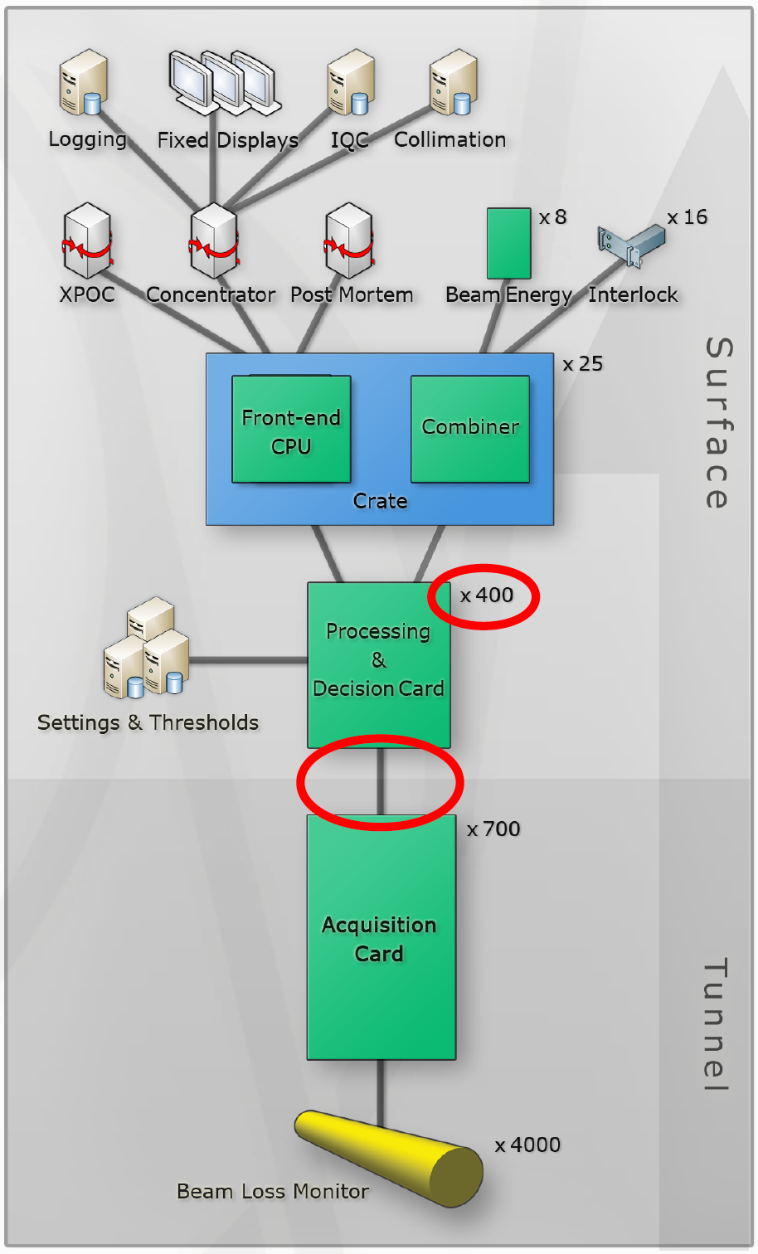
Environment Example: LHC BLM System I
A cyclic redundancy check (CRC) is an error-detecting code commonly used in digital networks and storage devices to detect accidental changes to raw data. Blocks of data entering these systems get a short check value attached, based on the remainder of a polynomial division of their contents.
25.000 data packets/second/link and 1600 links!
Continuous checks on data transmission (FPGA level)
In 14 cases lost packets can induce an LHC beam dump
Automatic offline monitoring and survey on lost packets (check of 12 variables):
  Nr of CRC comparison errors between links,
  Nr of CRC comparison errors on links,
  Nr of lost frames,
  Nr of lost frame IDs.
Correlation with temperature?

Slide 18
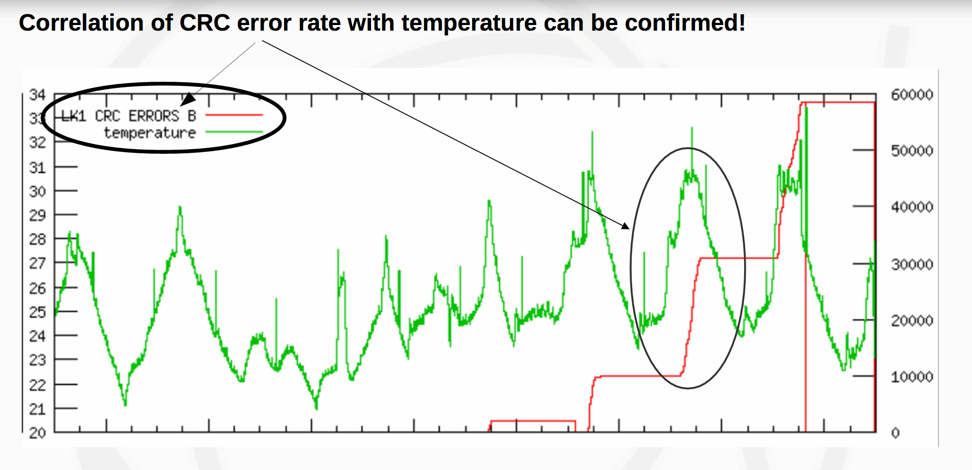
Environment Example: LHC BLM System II

Slide 19
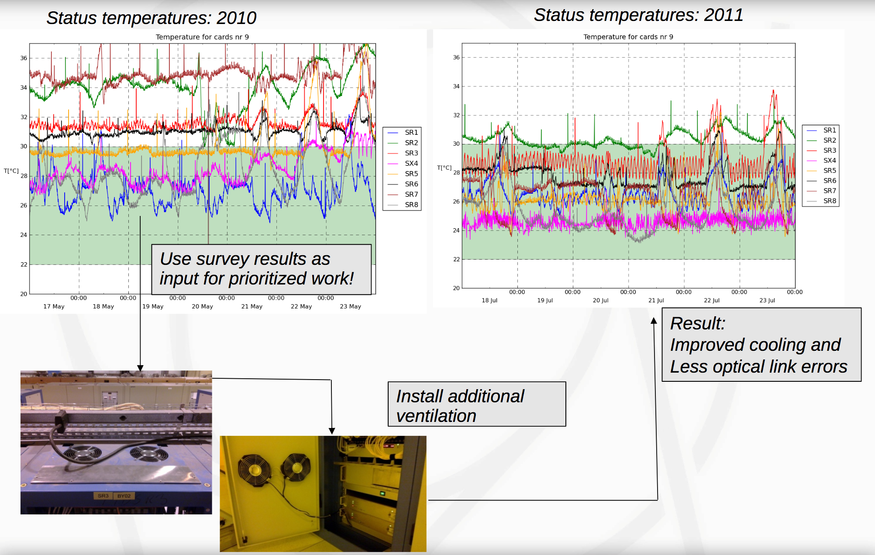
Environment Example: LHC BLM System III

Slide 20
Environment Example: LHC BLM System IV
The key message from this example is:
Equip the system with rich diagnostics, like e.g. with temperature and humidity sensors (here: directly on electronics level)
Archive the data and make it available (in an easy way) for further analysis
Optimize performance by reducing false trips

Slide 21

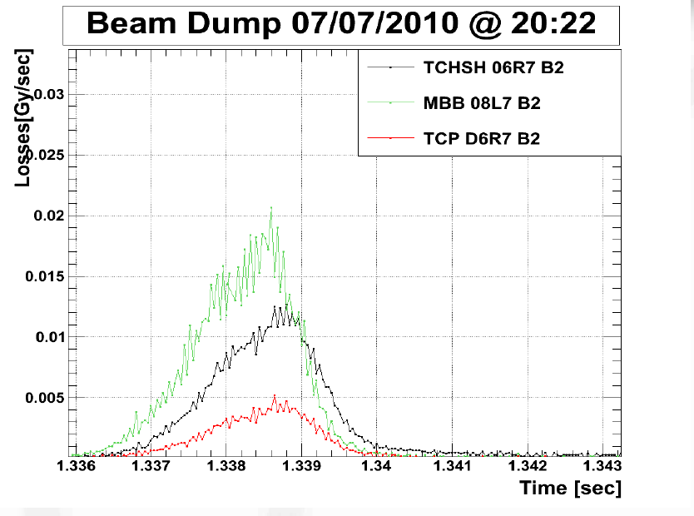
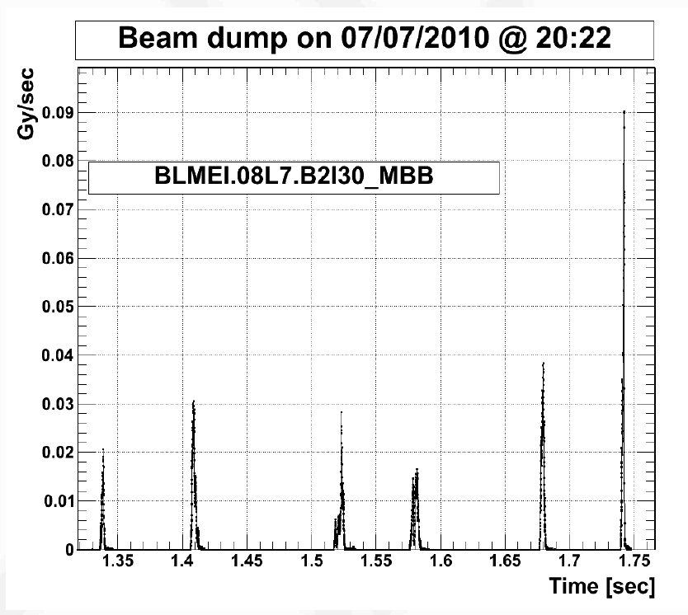
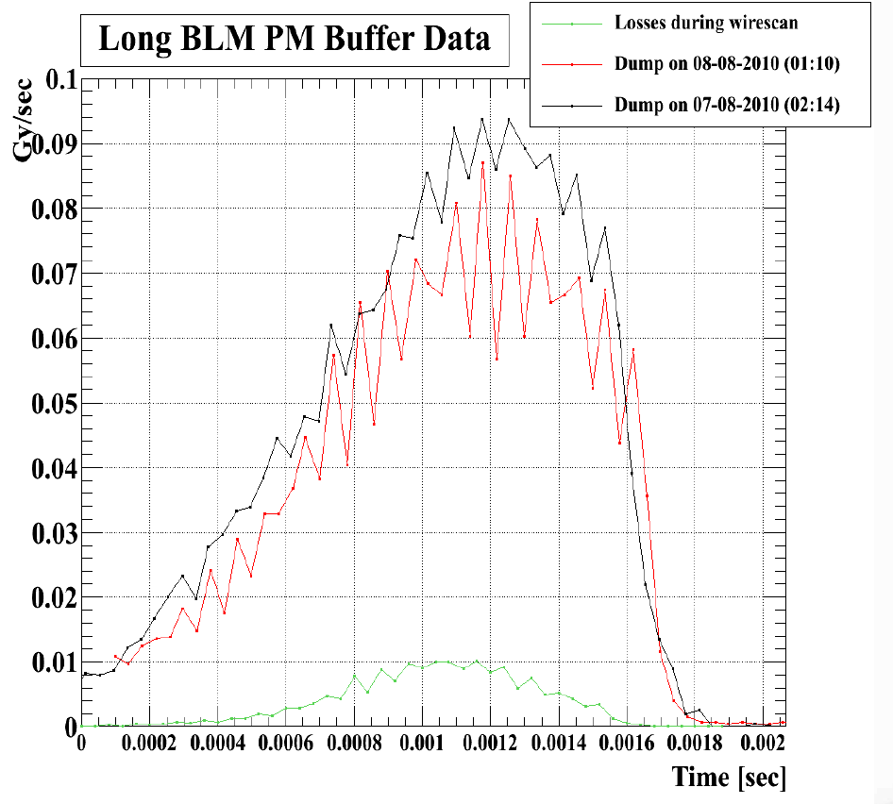
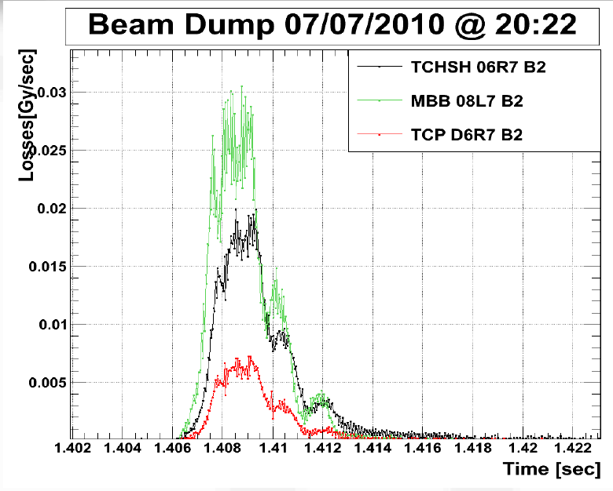
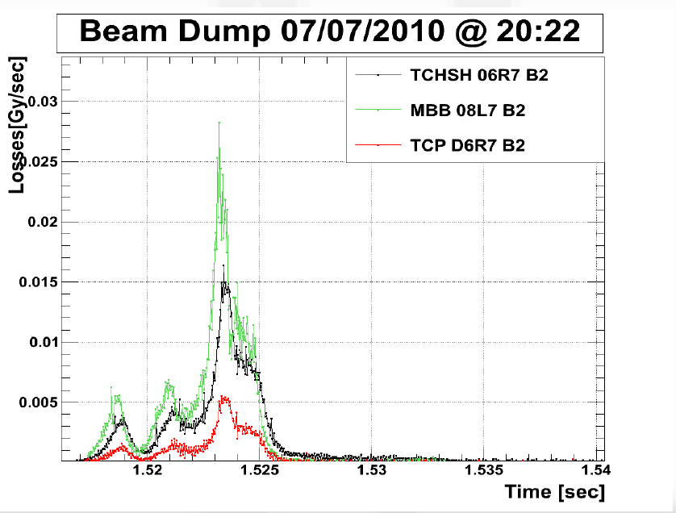
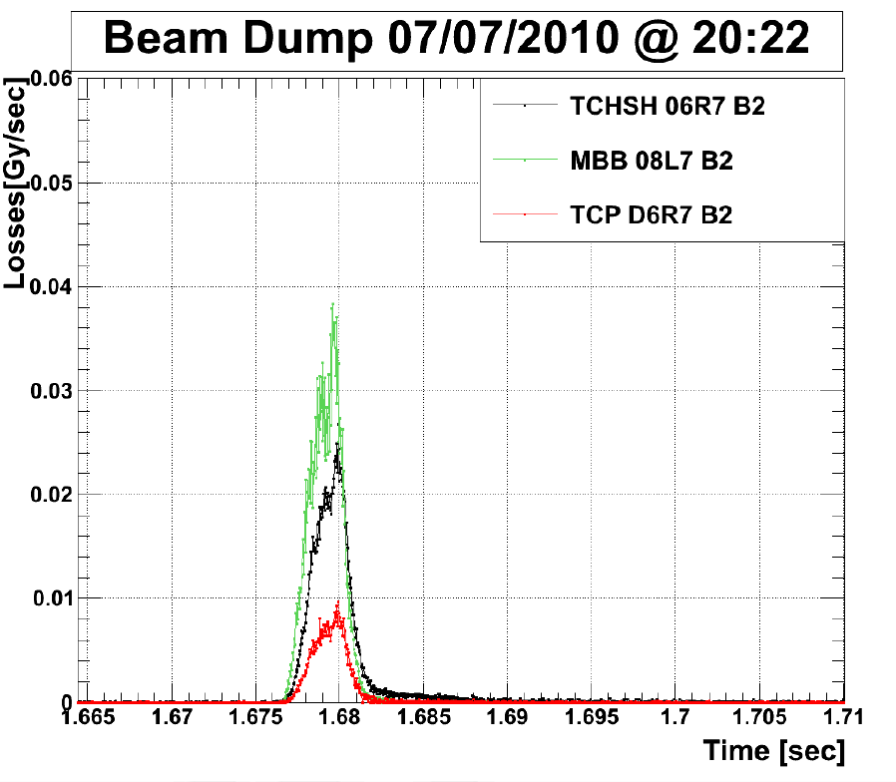
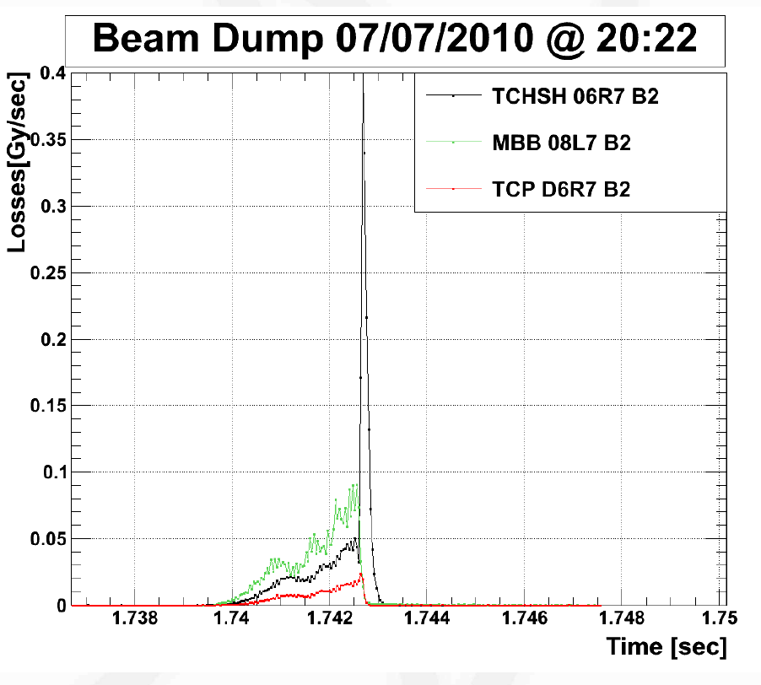
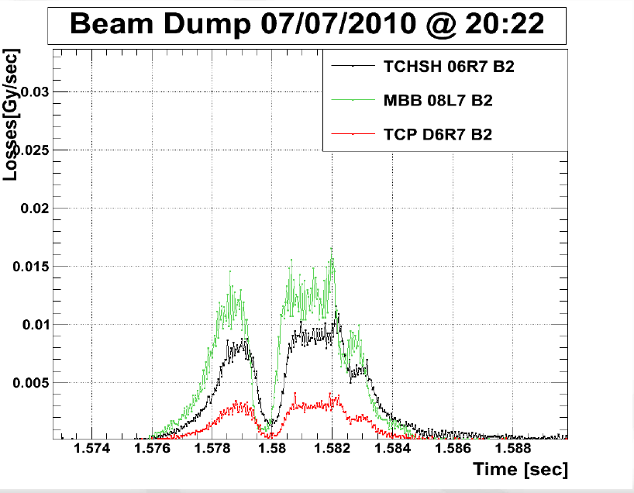
UFOs in LHC
Compare with wire scan losses
ISIS-TS1

Slide 22
How to Foresee the Unforeseeable?
Mission Impossible?
Tough to foresee and prepare for some features, like e.g. the UFOs in LHC
It is certainly very helpful to have highly reliable beam instrumentation systems, with a large dynamic range:
do not focus only on the huge beam loss detection but also allow on detection and analysis of very small beam losses
Archive data with high quality/resolution and allow for quick correlation of different data sets from different systems (synchronized time stamping can be helpful too)
Equip vital systems with a lot of diagnostics and make measurements accessible

Slide 23
General MP Requirements for BLMs
Function | Purpose
BLM Configuration information | Prevent mode confusion
BLM Internal Health information | Allow for beam operation. Be able to detect stuck at OK state for beam loss detection (and other signals)
Beam Loss Detection | Prevent damage and unnecessary activation of equipment due to beam losses
Beam Presence Detection | Validate interlock or escalate to emergency interlock Validate Beam Destination

Slide 24
General MP Requirements for BLMs
Function | Purpose
ALGORITHM | The logic used to detect off nominal states. Off nominal state: a state that can lead to damage or activation of the machine. Example: It shall be possible to change beam loss thresholds. Can be done through EPICS.
LATCH MODE | If the LATCH MODE is YES, the signal shall stay in the NOK state until a RESET command is received. If the LATCH MODE is NO, the signal shall automatically transition from the NOK state to the OK state when no off nominal states are detected.
MP-DATALOG (Archiving) | The BLM System shall have a MP-DATALOG readable by external systems. The time and reason for all off nominal state transitions shall be stored in the MP-DATALOG.
PROTECTION MODE | It shall be possible to set the BEAM LOSS signal status according to ALG, OK or NOK. Where ALG corresponds to the off nominal state detection ALGORITHM, OK to “1” and NOK to “0”. This will be used for testing of the BIS, masking for commissioning or operation in degraded states.

Slide 25
Required Information from BLM System
Required Functions
Beam Loss Detection BLM1 … BLM8
BLM Internal Health information BLM1 … BLM8
Beam Presence Detection BLM1 … BLM8
BLM Proton Beam Mode BLM1 … BLM8
BLM Proton Beam Destination BLM1 … BLM8
Implemented Functions
Beam Permit (Number of lost p⁺) 1/ Processing Board for all connected BLMs
BLM Internal Health 1/ Processing Board for all connected BLMs
Beam Presence (tbd) BLM1 … BLM8
Proton Beam Mode 1/ Processing Board for all connected BLMs
Proton Beam Destination 1/ Processing Board for all connected BLMs
Interface - Signals
Beam_Permit (redundant/tbc)
Beam Presence
BLM Serial Datalink
Important: It is assumed that the baseline for the BLM processing board is IFC 1410.

Slide 26
Beam Loss Threshold Management
To determine the beam stop thresholds, we can use the following formula:
Th(E_{b}, Δt) = Q_{BLM}(E_{b}) x N_{p}(E_{b}, Δt)
Where:
  E_{b} is the energy of the beam,
  Δt is the loss duration,
  Q_{BLM} is the signal observed in a BLM due to a single lost proton, and
  N_{p} is the maximum number of protons that can be lost in the protected element.
Thresholds usually should be set to be a factor 3-10 below the damage potential of the particular equipment that is protected by the BLM.
The work on BLM thresholds is on-going and needs strong collaboration between BI, Beam Physics, MP and operations.

Slide 27
Beam Loss Threshold Management
We can define master thresholds Th(E_{b}, Δt), representing the ultimate level to stop beam operation.
In addition we can provide some flexibility to operations, allowing for immediate beam loss optimization by operations whilst running the machine (ie without intervention by the BLM experts).
The applied thresholds as set on electronics level are then:
th (E_{b}, Δt) = MF x Th(E_{b}, Δt)
Where the Monitor Factor MF can be set to be max 1.0 (typically 0.1)
Master thresholds and Monitor Factors can be set individually for each BLM.
Example of BLM threshold configuration management: https://accelconf.web.cern.ch/accelconf/IPAC2011/papers/wepc170.pdf

Slide 28
Configuration Change Management
It is planned to control the following processes and/or system components (not complete):
Be able to trace back (master) thresholds to documented/approved (by MPC) protection functions, damage events (including information on expected number of lost p⁺ that lead to damage and time scales during the damage can occur)
Document and set (with change control) the master thresholds for the different time scales on paper, on database level, on script level where used for final computation, on application level where used to modify DB settings, on electronics level where used for interfacing the BIS
ID change control and online supervision of each component of the system (chamber, front-end, back-end electronics, interface to the BIS).
ID change control and online supervision of the firmware version of the processing board (back-end)

Slide 29
Self Testing Functionality of the BLM System
Sanity Check: Check the functionality of the chambers, front-end electronics and final processing electronics by modulating a HV signal and comparing the measured gain and phase values per monitor with pre-defined thresholds. Such a test can be done every 24 hours and lasts around 20-30 min, but ensures high reliability of the system. This is in particular important when operating with high power beam. Example: http://iopscience.iop.org/article/10.1088/1748-0221/5/12/C12044/pdf
Connectivity Check: Check whether all monitors are properly connected to the HV supply and whether all cables are still intact. Can be part of the sanity check.
Threshold Check: Check whether there were any unforeseen and/or un-documented/unwanted changes in the master threshold settings.
Early Fault detection analysis: Use diagnostics information from the system to evaluate whether certain links are degrading, whether HV connection of chambers is degrading, etc.

Slide 30
Summary
The BLM system is the backbone for Machine Protection and has very high priority for ESS operation.
A strong collaboration and team work between the different teams from beam instrumentation, controls, hw development, machine protection, RAMI, beam physics, operations is required and needs to be supported as much as possible by the management.
This should include the allocation of more resources to the project, in particular to the icBLM project.
It should be noted once more, that the ESS machine protection strategy cannot be implemented without a well working beam loss monitoring system.

Slide 31
Back Up Slides

Slide 32
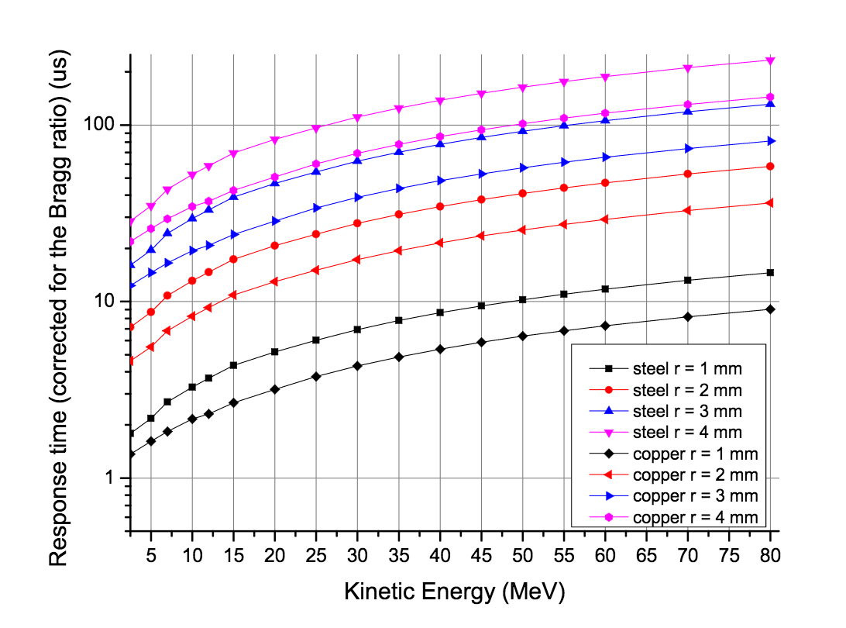
The Time Needed to Melt Copper or Steel
Assuming perpendicular beam impact, 1 mm beam size at 1MeV, then melting WOULD start in 1 μs!
Courtesy of L. Tchelidze, ESS

Slide 33
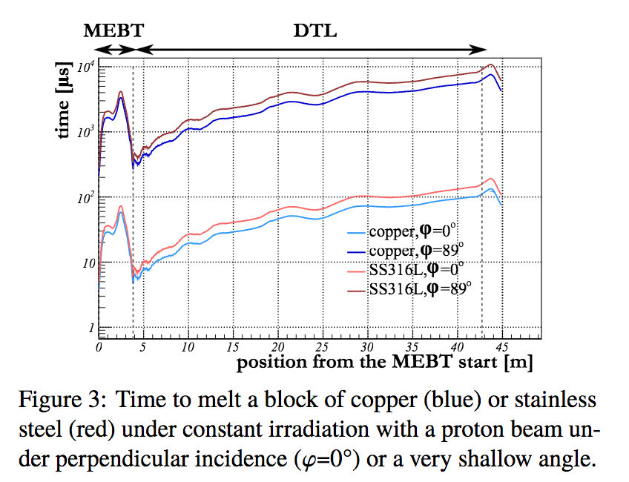
Fast Protection Functions
Simulations have shown that 90° beam impact is possible in the MEBT scrapers.
Fastest reaction time required to stop proton beam is 1-5μs.
This includes detecting, processing and actual stopping of the proton beam.
Courtesy of I. Kittelmann/ HB2016 THAM6Y01

