Slide 1
icBLM quality assurance
Clement Derrez
Test Engineer
www.europeanspallationsource.se
6 July, 2017

Slide 2
Outline
Naming convention
Data management system: Insight
Acceptance tests workflow
Ionization chamber: tests description
After-installation tests
Notes:
Walk through: workflow from acceptances tests to commissonning

Slide 3
Naming convention
Every Field Replaceable Unit (FRU) is named. A FRU can be a simple part or an assembly
  Ex: FEB-050ROW:PBI-PPC-002 for a cabinet cable
Naming convention:
Sec-Sub:Dis-Dev-Idx
  Two major areas of FRU installation slots are identified:
  tunnel: including stub, tunnel wall and gallery wall,
  support: front end building (FEB), klystron gallery, gallery support area (GSA) in A2T
→ System name is not misused!
Notes:
Naming: Section – subsection : Discipline – Device type - Index

Slide 4
Data management system
Data export / import with other software tools
Systems and subsystems tests results coming from different locations (ESS, IK Partner, Industry partners…)
We must be able to trace back acceptance tests results to laboratory measuring devices
We need to be able to prepare an installation batch when an installation slot is ready: need for a dynamic tool
  → Having a reliable Data management system is critical!
Notes:
Illustration: mention a possible issue happening if we want to find out what tests results are affected when a deviation is detected in a lab device calibration.
How can we make sure we’ll be able to store reliably all our systems docs? The answer is using insight.

Slide 5
Data management system: Insight
Ensures traceability between tests and production data, system components and laboratory devices.
Objects’ attributes store all FRU info: responsible, current status (procured, received, RFI…) etc.
Added value, current installation or production progress… can be automatically extracted for each system or FRU
Timeline is managed in Jira, tasks are linked to Insight.
We do not want to replace CHESS!
Insight: PBI shopping list
Component requirements
System FRUs list
Tests report
Test plan
Laboratory devices
Test Design document
JIRA: timeline
Notes:
Add a demo here using Insight??
We can get a quick overview of any project extracted from this system: % of all BPMs in “RFI” state for instance.
Stress that we do not replace CHESS when using Insight! This is a data management tool.

Slide 6
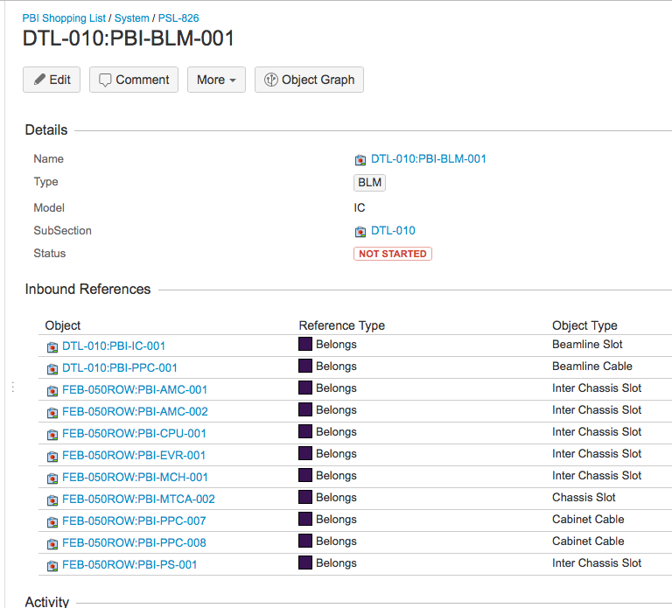
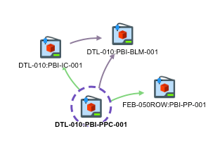
Data management system: Insight
No lost effort, as everything can be scripted to populate external tools and extract any needed information!
Installation batch: installation status easily verified and prepared
Data is uploaded by BD team. Training IK and industrial partners on that is possible.
Notes:
Main additional points to mention: When we prepare a system for installation, we can make sure all components are stored and tested by checking the corresponding installation batch status
Each object share a minimum set of mandatory attributes.
Screenshot: example of a BPM beam line element: a BPM button and its beam line cables are visible here… It is part of this system etc (we can go up to the mTCA objects easily)

Slide 7
Insight: Demo
Ionization chamber reception

Slide 8
Measurements files format
Large amount of measurements parameters: Data logged in HDF5 and uploaded to Insight.
Data files produced at ESS follow a fixed format: Files, groups and datasets mandatory attributes are defined.
Existing data received from IK and industry partners is stored as is for now, adding the needed metadata. Re-formatting to HDF5 is planned for each test results.

Slide 9
Acceptance tests workflow
System tests requirements
Test plan
Test Design Document
testbench implementation
Tests requirements are defined for each subsystem
Design document is validated by system lead: we make sure test requirements are correctly translated
Test coverage is reviewed. Possible risk assessment if we do not reach 100% coverage
Test system implemented in python.
Describes subsystems' test setup and characterization procedures
Tests IDs defined for each measurements
When not COTS: test plan is prepared/discussed and agreed with IK partner
Run tests
Acceptance tests performed in RATS
Data stored in Insight

Slide 10
Where do we store our systems?
RATS preliminary layout
BI area
36 m
87 m

Slide 11
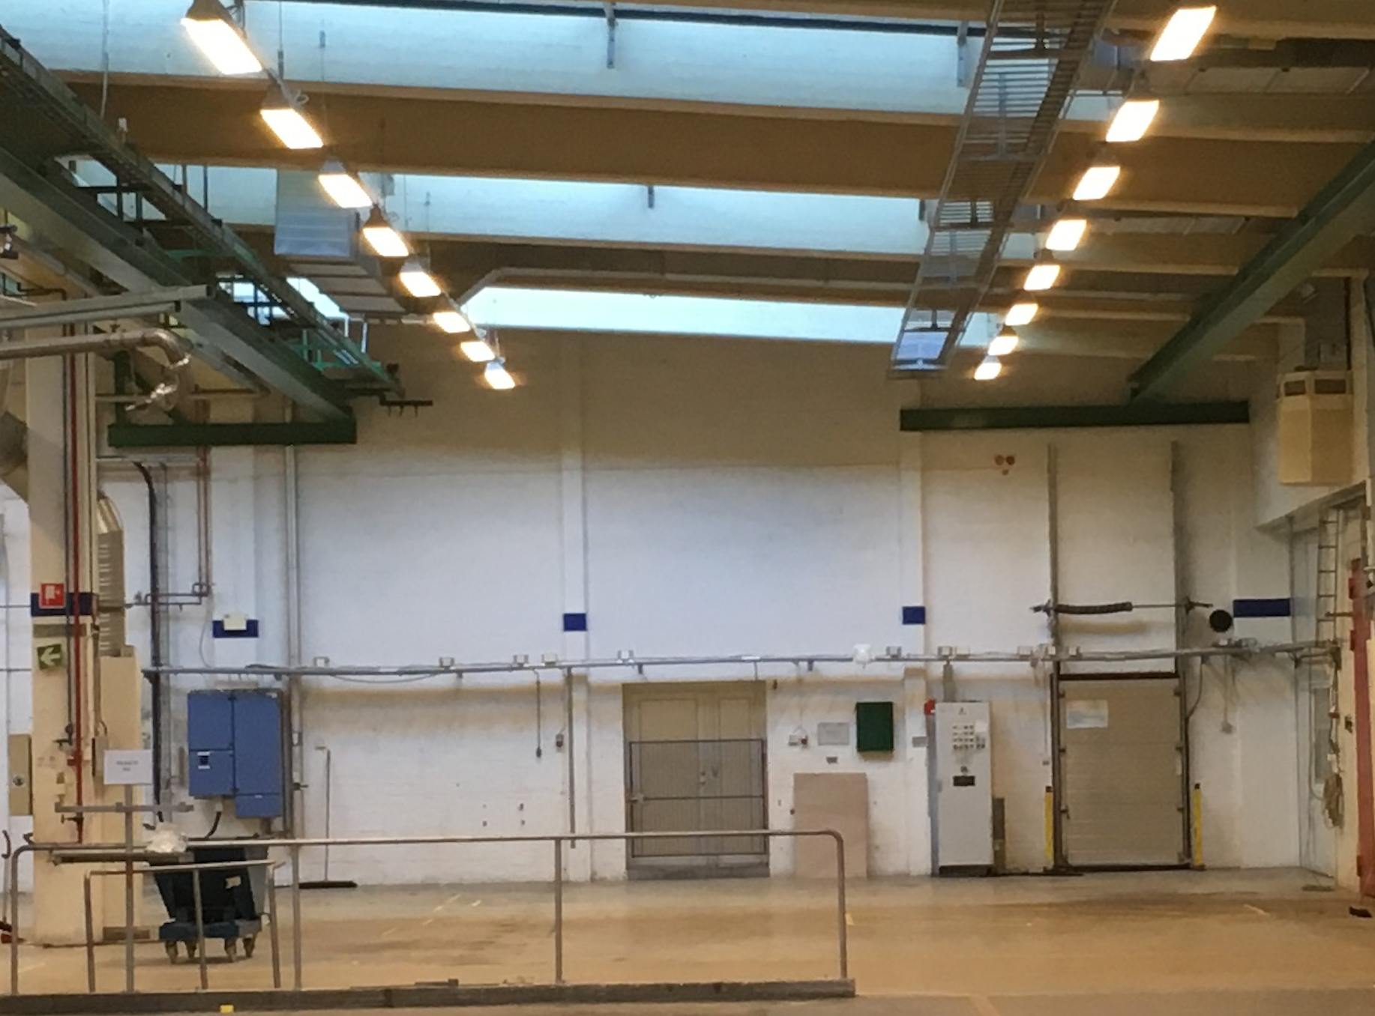
Where do we store our systems?

Slide 12
Acceptance tests workflow
Component received.
Component tested.
RATS: Component stored.
RATS: System assembly and test → RFI
RATS: System stored
Installation slot: System goes to ESS AT site.
  Guideline: Install and test as much as possible, as early as possible
  Learning curve will help us moving faster with installation work after the first systems are processed
Last step: commissioning
Notes:
We focus on having as much automation in our test and tuning stations!
This flow might change depending on if we score some area on site…

Slide 13
icBLM: tests description
 | Detector | Data acquisition units | HV unit | Complete acquisition chain
Functional test | x | x | x | x
Barcode check | x | x | x
Source test | x
Radiation source test (before startup) | x | x | x
Signal offset |  | x | x | x
Beam Inhibit tests |  | x | x | x
Thresholds and channels assignment software checks |  | x | x | x
HV modulation tests |  | x | x | x
Uploaded to database:
CERN production tests results
ESS reception tests results: output of the tests described in the table above

Slide 14
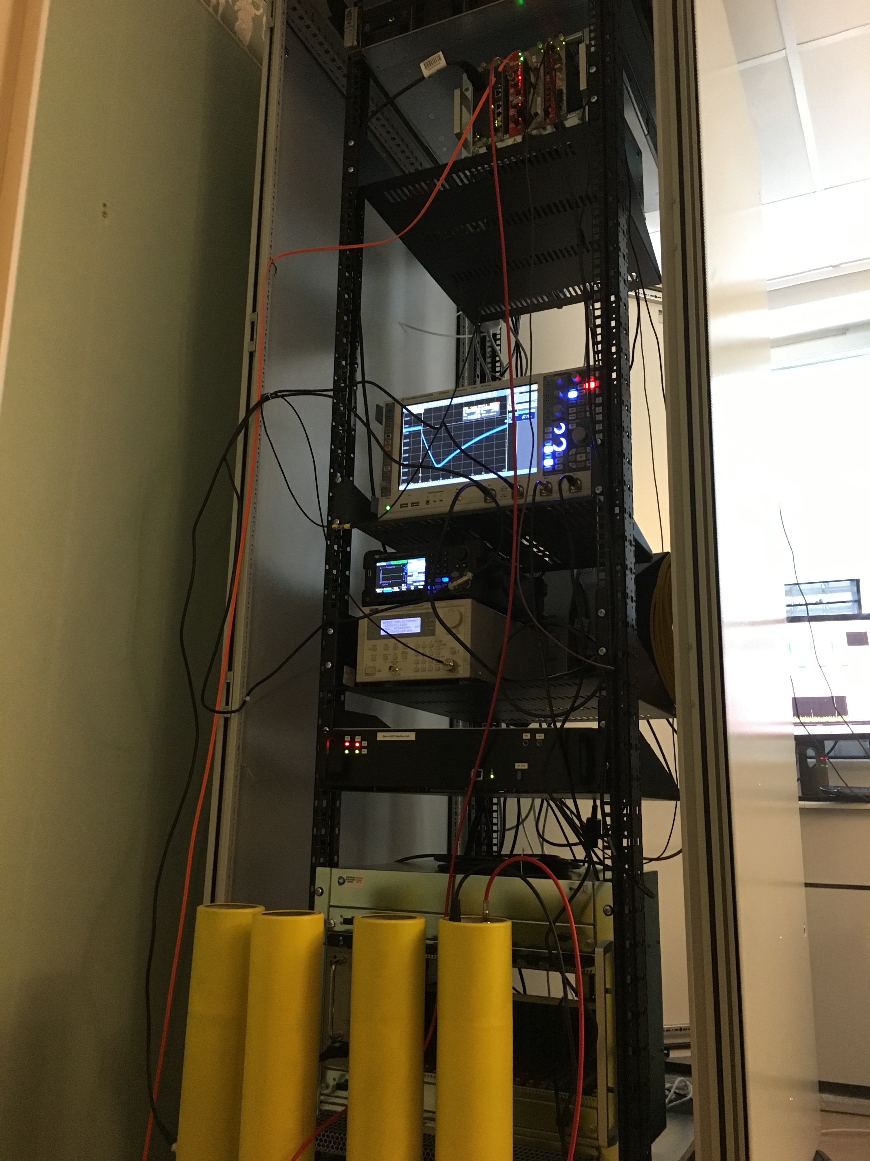
icBLM: tests description
Practical work started on the ionization chambers

Slide 15
After-installation tests sequence
After-installation tests sequence:
  initial first-time commissioning: test_ID
  cold check-out: test_ID
  commissioning with beam: test_ID
  quick self-check: test_ID
Sequential testing is important (tests timestamps are checked automatically). Otherwise the statement: “the instrument is installed and working properly” has less confidence.
During debugging:
  Relevant tests in each architectural layer are repeated until satisfactory results are obtained.
  If the problem is identified and can be isolated within its layer, there is normally no need to repeat all of the tests which are sequentially following. Depending on the situation, some test might become mandatory nevertheless (for instance a software recompilation might entail a standard interface check, and a repaired connector might entail a signal transmission check).

Slide 16
After-installation tests sequence
Cold check out: Testing of the whole instrument on all architectural layers:
  monitor, front-end electronics, cables, mTCA-electronics, timing, data treatment, publishing, network transmission and machine protection interface.
Commissioning with beam: Aims at verifying the correctness of the integration for machine operations.
  Includes initial comparisons and cross-calibrations in order to gain confidence in the instrument. Performance limiting factors are identified.
Quick self test: The self-test procedure includes testing of calibration, machine protection and data transmission.

Slide 17
Thank you!
Questions ?

