Slide 1

Heavy Shutter Concept
Gábor László
03.05.2017

Slide 2
Heavy Shutter Concept
Technical requirements
  Simple maintenance
  Design life >15yrs
  Service interval >5 years
  Reliability >98% (measured over 100 days of beam distribution)
  Designed for 'hands on' serviceable within 30 days of beam off (full power) if service interval <15years.
  Serviceability in-situ strongly preferred.
  The shutter guide should be in a vacuum or inert gas. (Safety/Performance requirement)
  Closing time after close command should be less than 2 minutes. (Sample access requirement)
  Low activation and/or good self-shielding for easier access and maintenance.
  The gap should be minimized between the shutter guide and the neighboring guides. (Scientific requirement)
  The shutter should be able to be connected to the neighboring housings with bellows, but is should be also possible to separate it with beam windows.
  Bunker prefers the Shutter inside the bunker wall, because otherwise it creates restricted area inside the bunker.(Safety requirement)
  The shutter should be able to close automatically in case of loss of power (Safety requirement) /
  PSS interface switch positions should be in a position where easy maintenance can be carried out
https://confluence.esss.lu.se/display/SPD/Stakeholders+and+Requirements

Slide 3
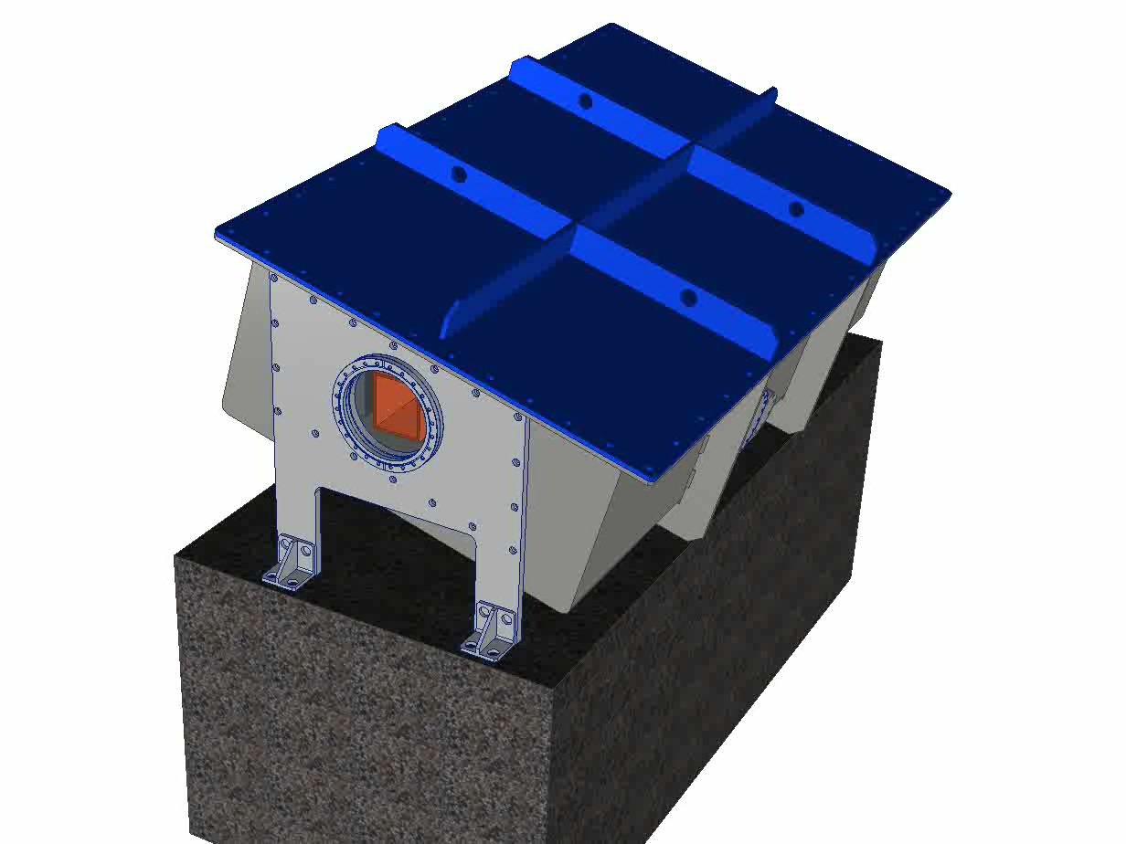
Heavy Shutter Concept

Slide 4
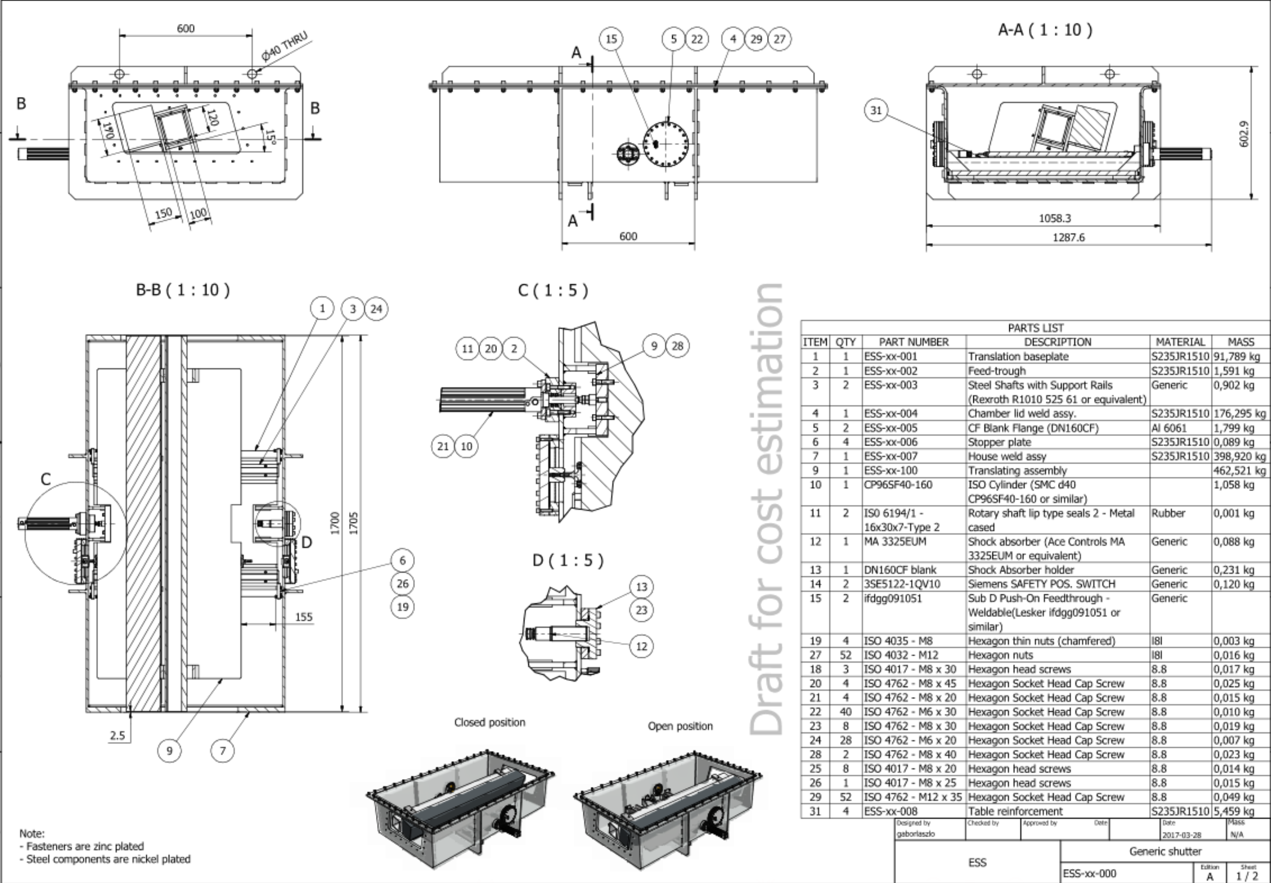
Heavy Shutter Concept
Saint Venant Principle!

Slide 5
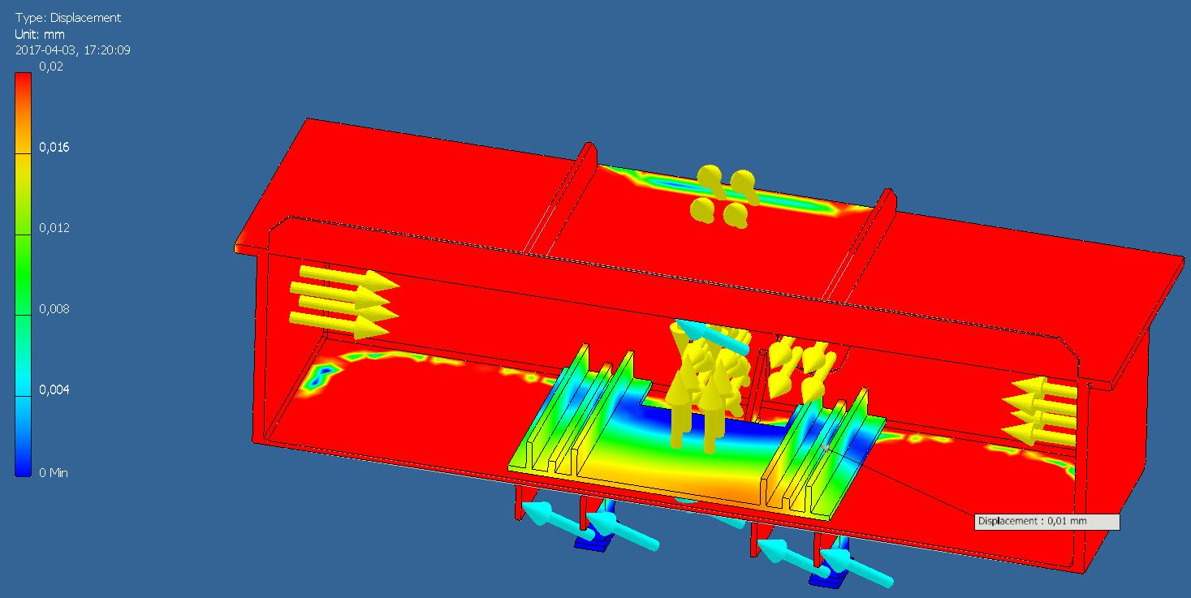
Heavy Shutter Concept

Slide 6
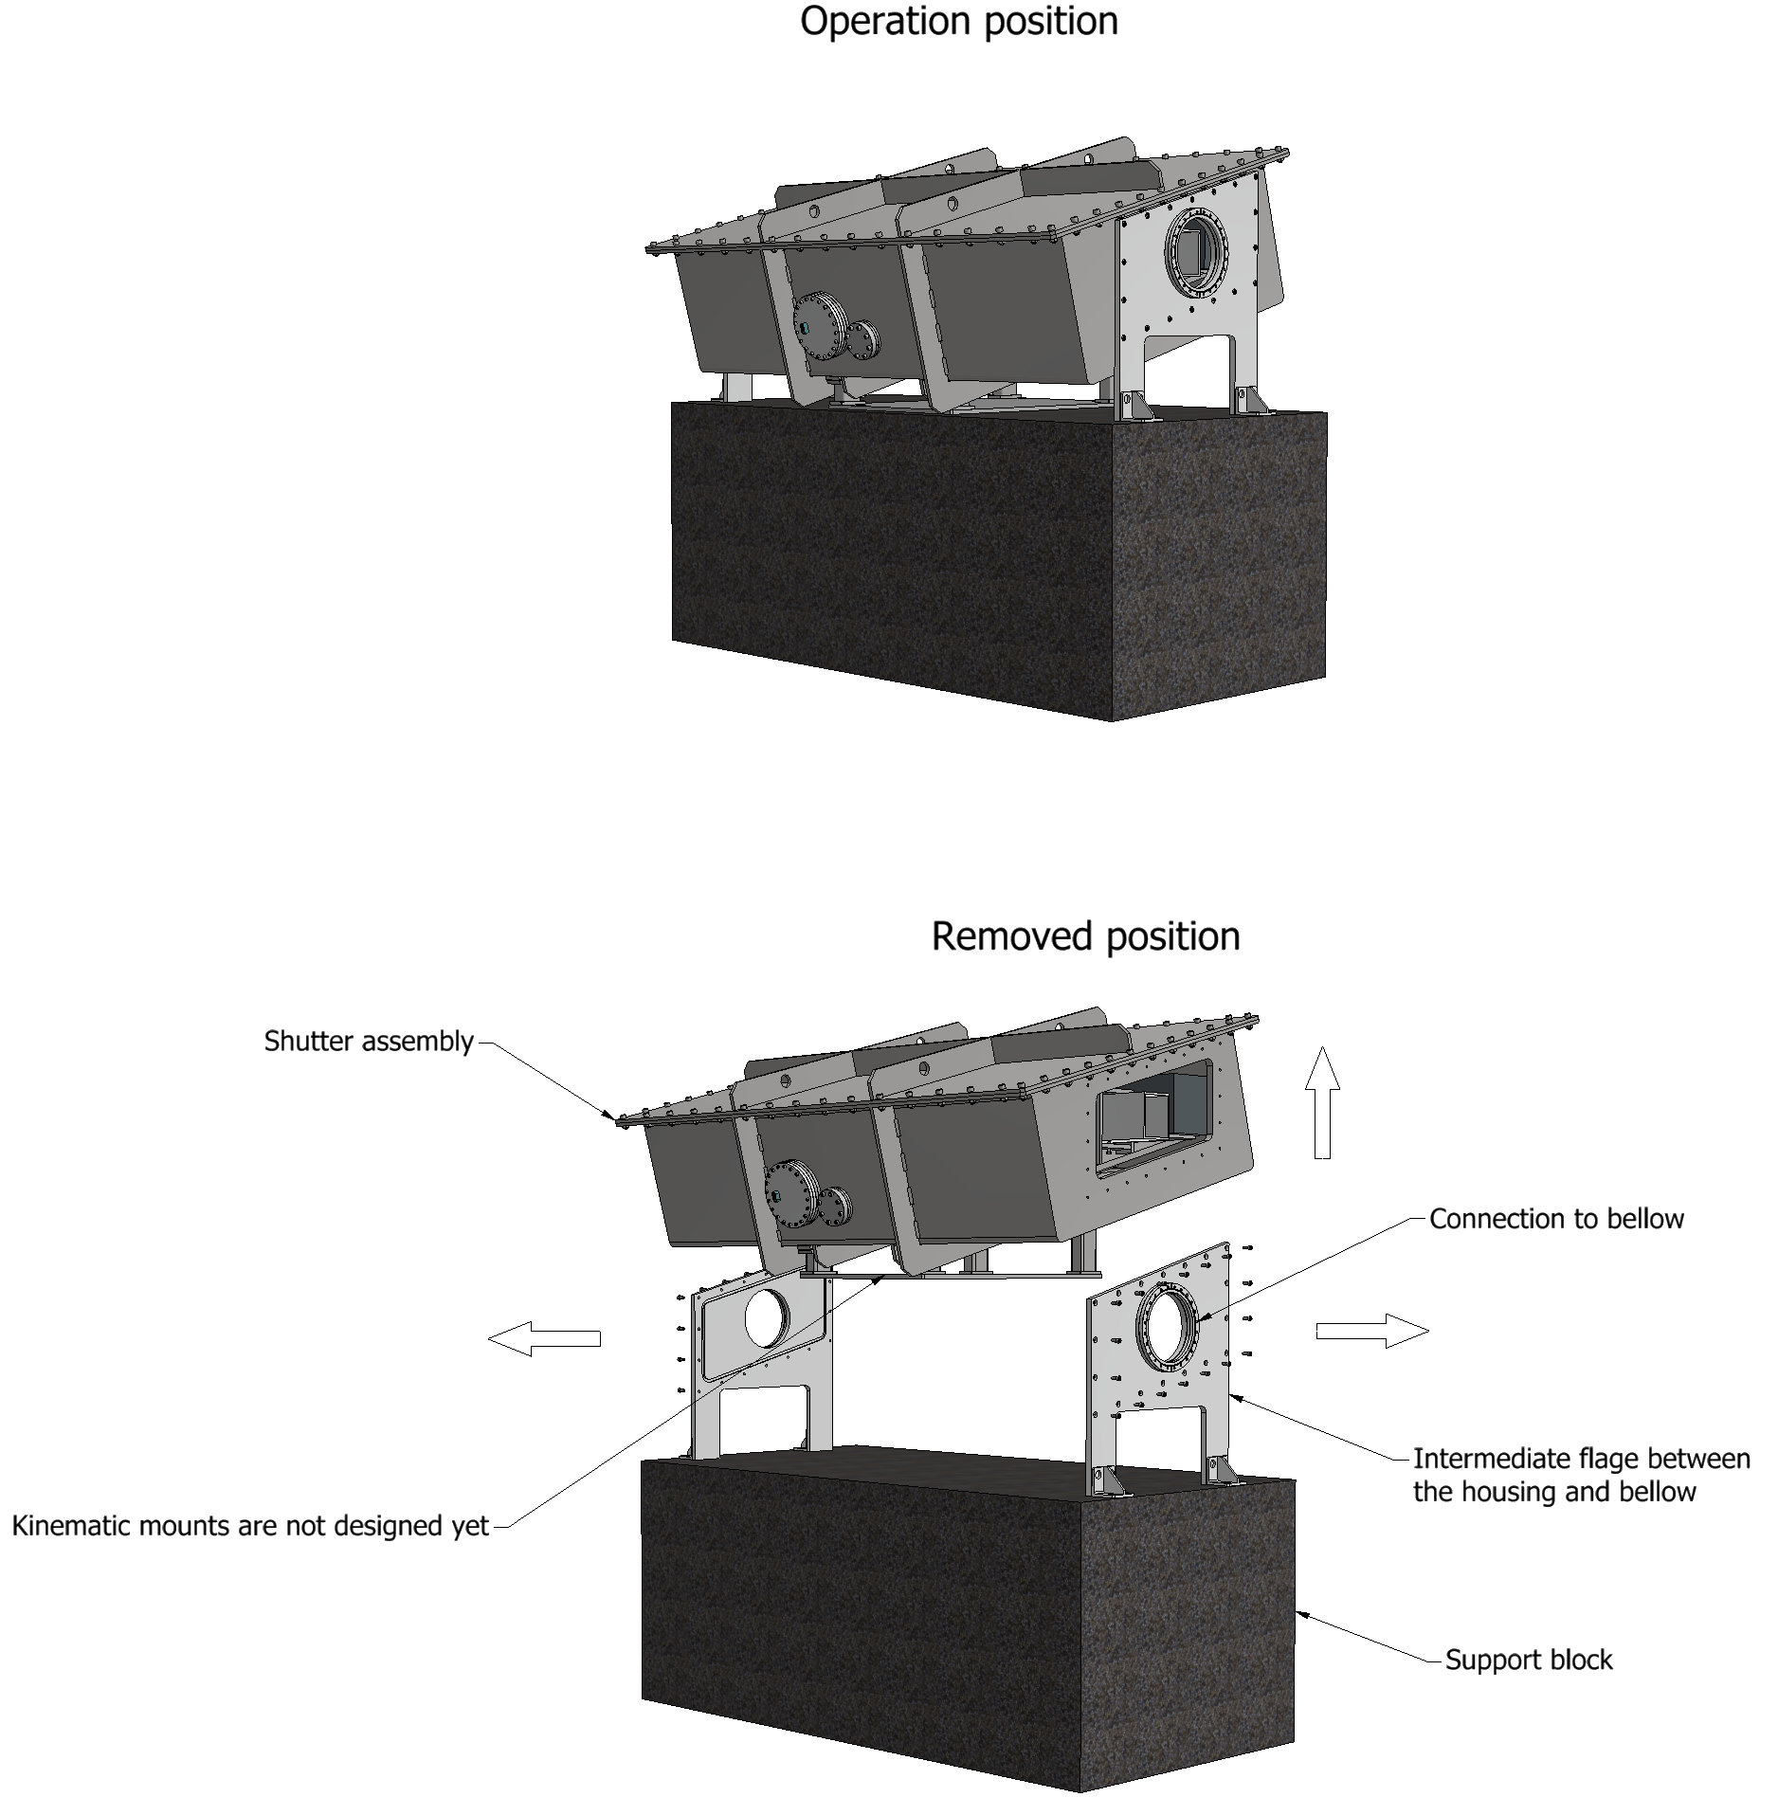
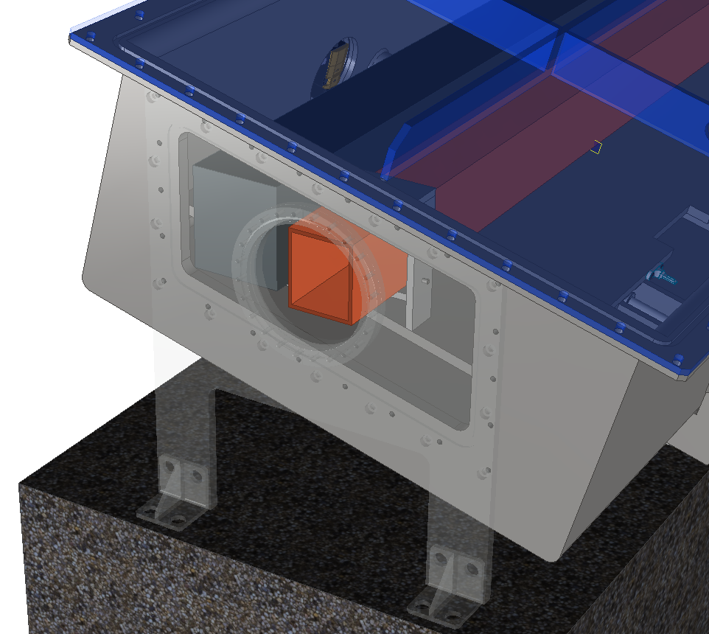
Heavy Shutter Concept

Slide 7
Thank you for your attention!

