Slide 1

Neutron guide Shielding Concept
Gábor László
03.05.2017

Slide 2
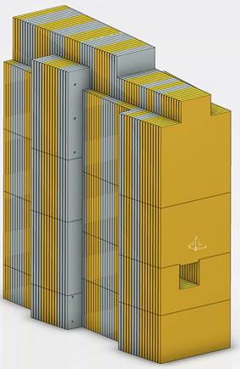
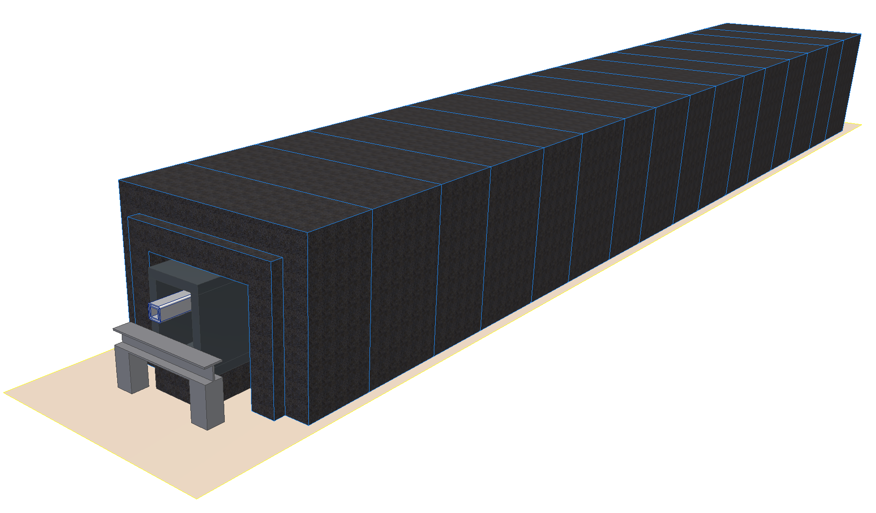
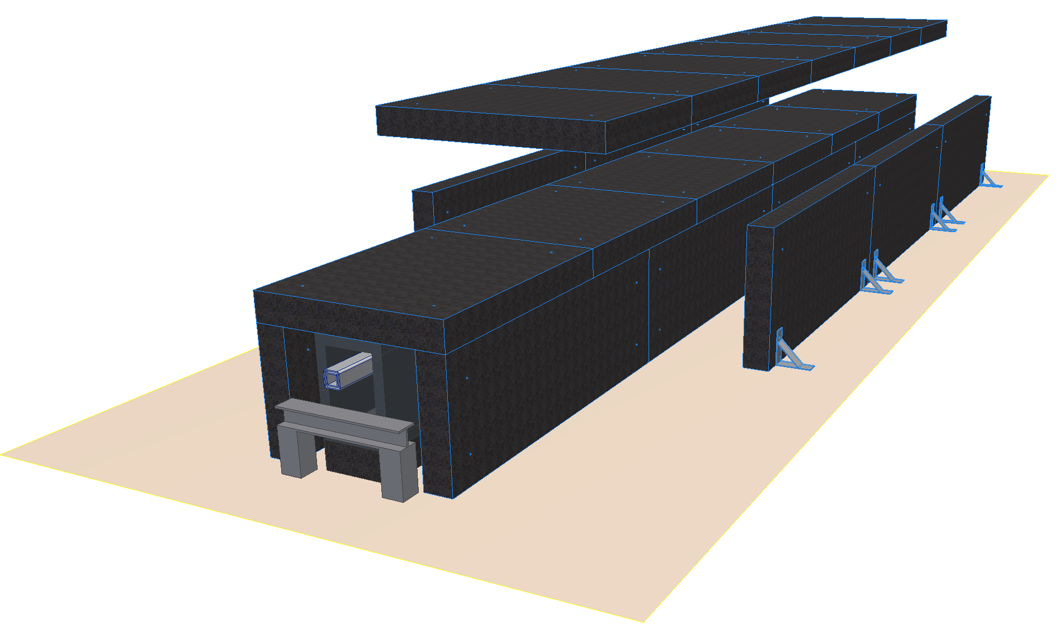
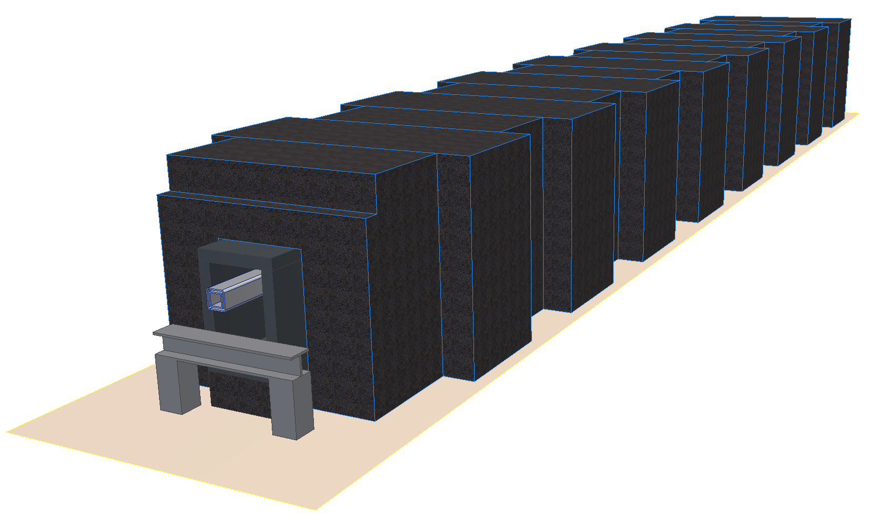
Goal
Choose a preferred design solution!

Slide 3
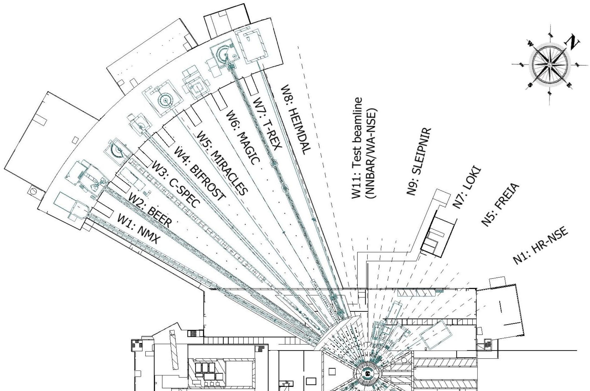
Geometry is affected by the materials

Slide 4
Geometry is affected by the materials
 | Density | Price
Steel | 7 850 kg/m3 | 11 800-15 600 EUR/m3
Lead | 11 340 kg/m3 | 23 800 EUR/m3
Concrete | 2400 kg/m3 | 450-900 EUR/m3
Borated Concrete |  | 800 EUR/m3
Heavy Concrete | 4000 kg/m3 | 1900-2000 Eur/m3
HDPE | 970 kg/m3 | 2910 EUR/m3
Borated HDPE | 1035 kg/m3 | 7245 EUR/m3
https://confluence.esss.lu.se/display/SPD/Instrument+shielding

Slide 5
Concrete or Heavy concrete?
Gamma-rays has the main contribution to the dose level in case if we are out of line of sight.
Most of the gamma is coming from the Ni-Ti SM.
4.4 MeV photons is the average for Ni/Ti
We need roughly two times thicker regular concrete(2.4t/m3) than Heavy concrete (4t/m3).
Regular concrete is more cost effective by 10%-110% in case of simple shapes.

Slide 6
Concepts
NUVIA soulution

Slide 7
Concepts
Manufacturing Cost: 1
Installation Cost/time: 1
Decommissioning cost: 1
Modularity: 2 level of thickness is easily achievable.
(50-75cm or 60-90cm)
Maintenance of components inside: top access by removing three pieces
Average weight of a
component: 3.9t
No seismic requirement in the E buildings only Conventional safety!

Slide 8
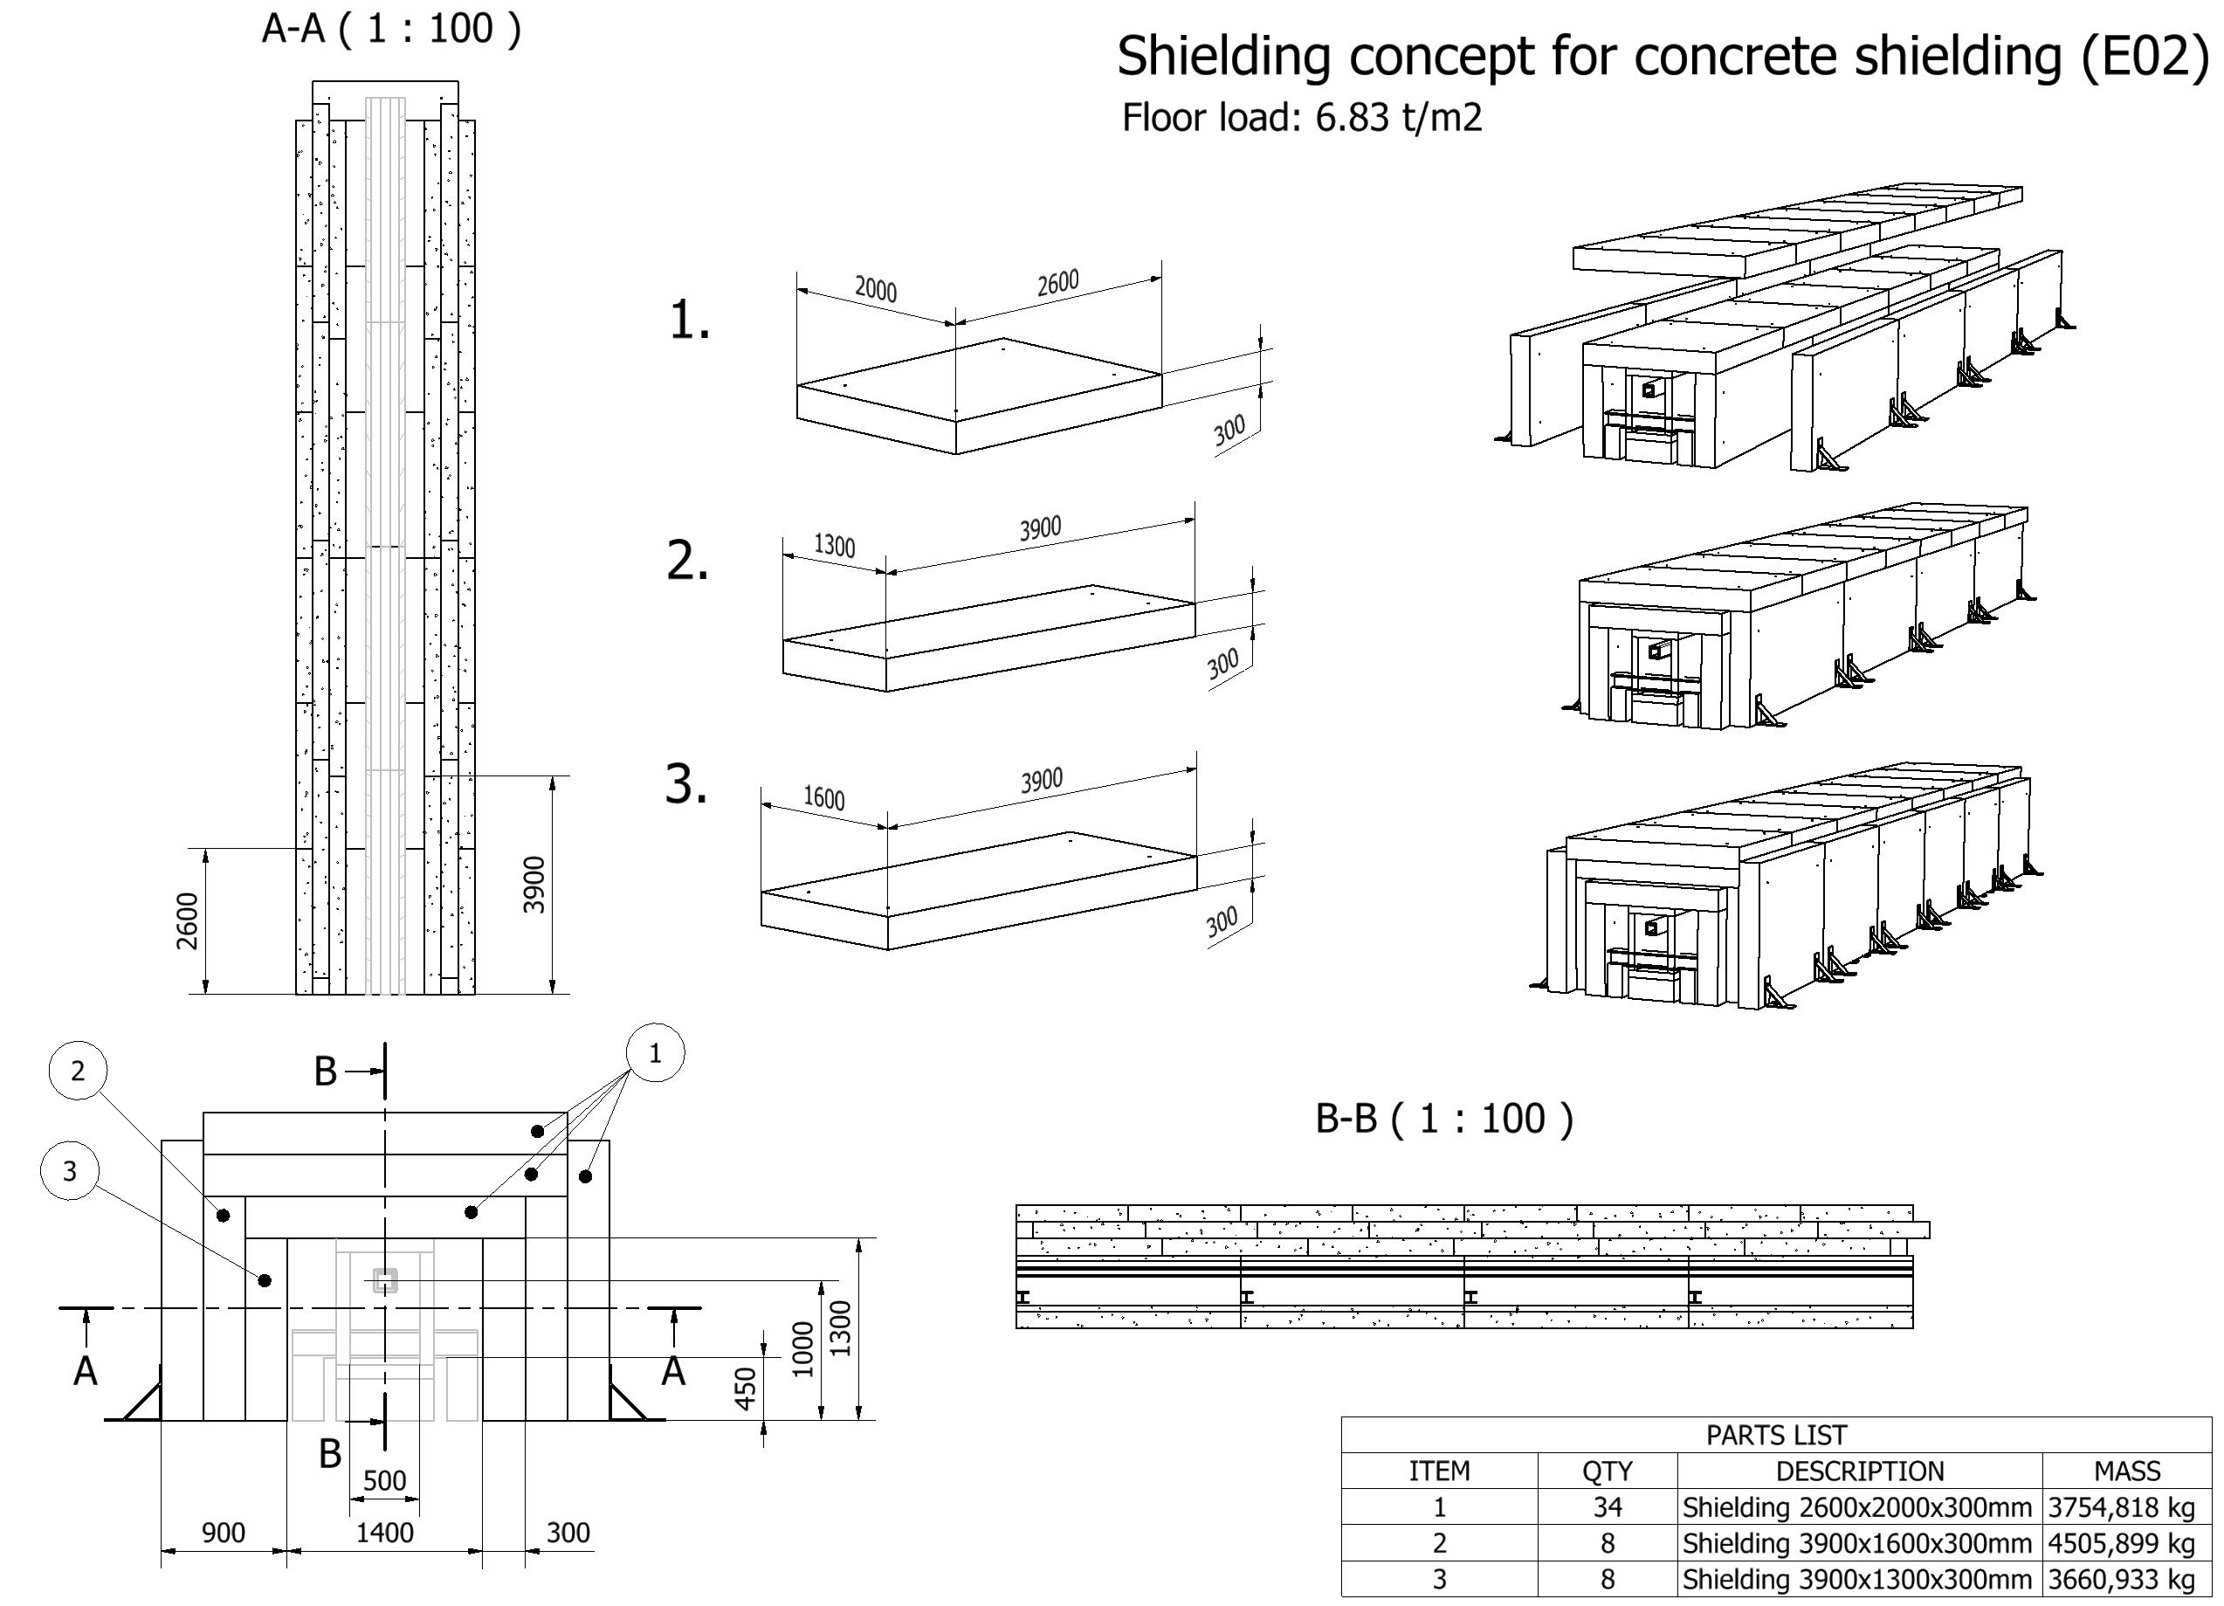
Concepts

Slide 9
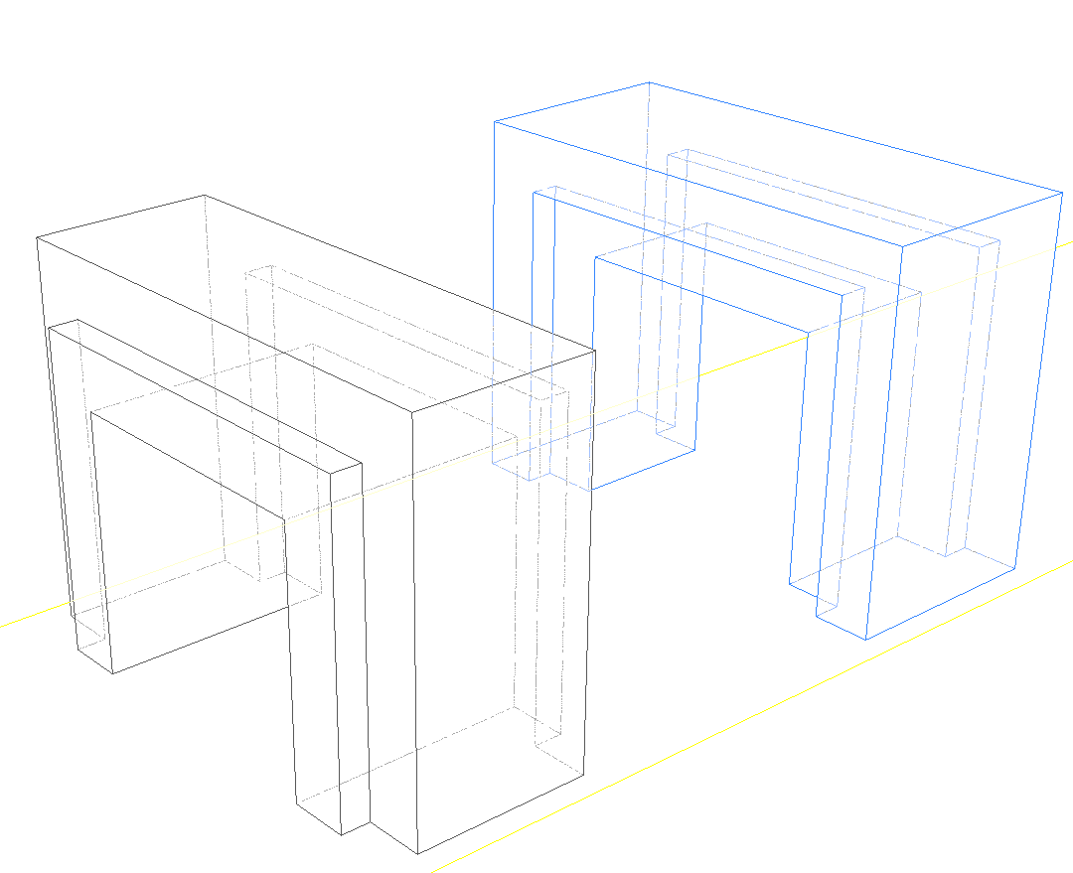
Concepts
Manufacturing Cost: 1.6
Installation Cost/time: 0.7
Decommissioning cost: 1.8
Modularity: Not modular
Maintenance of components inside : full access by removing two pieces
Average weight of a
component: 7.4t
Weight:
0.1 t/m less
Male - Female

Slide 10
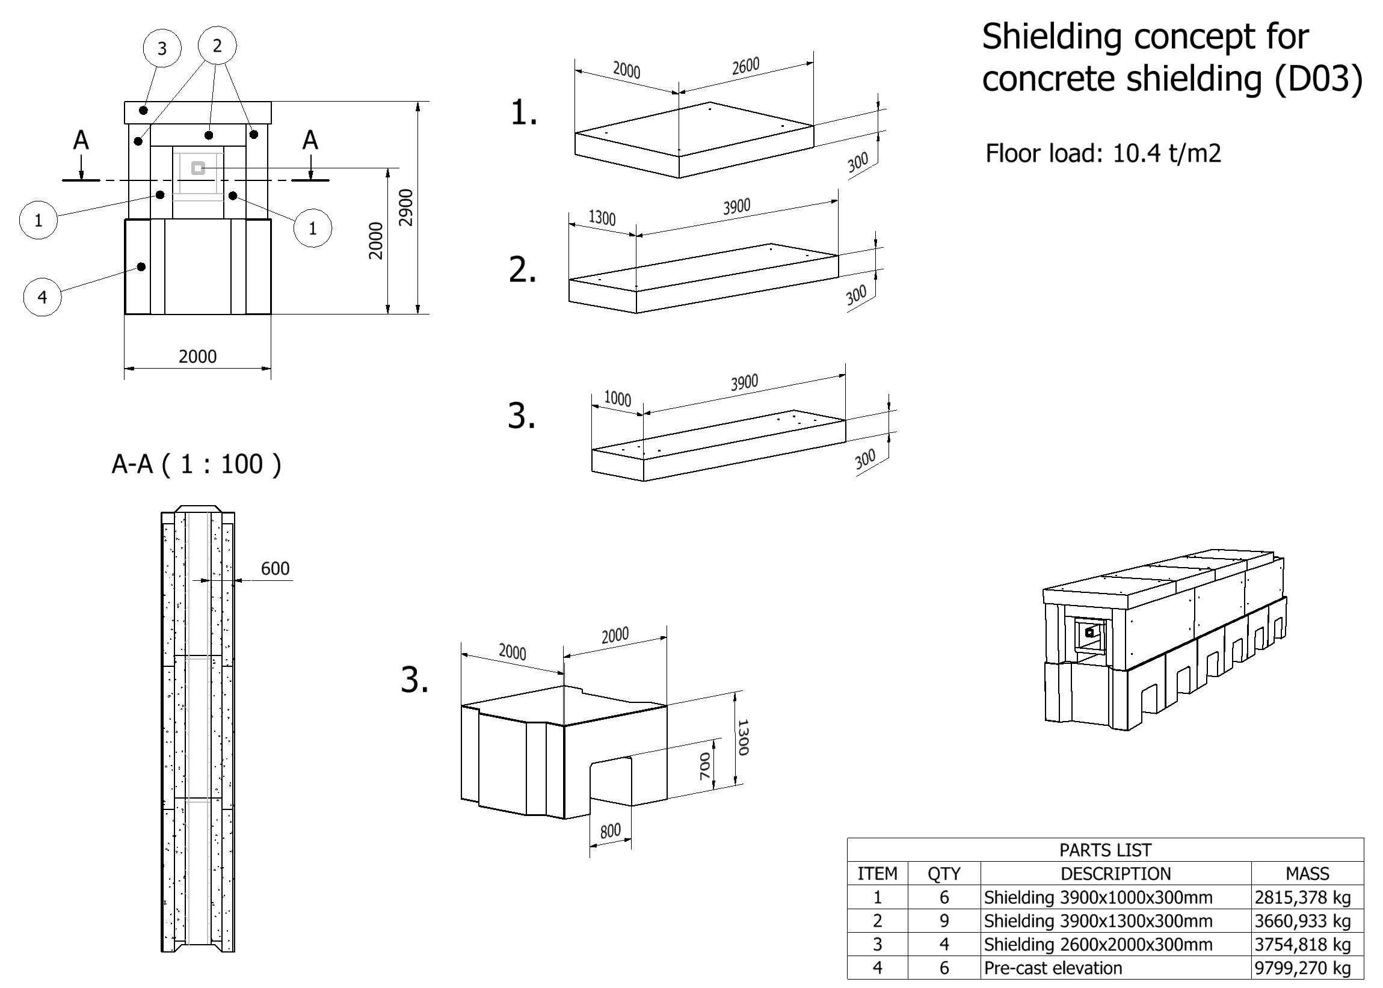
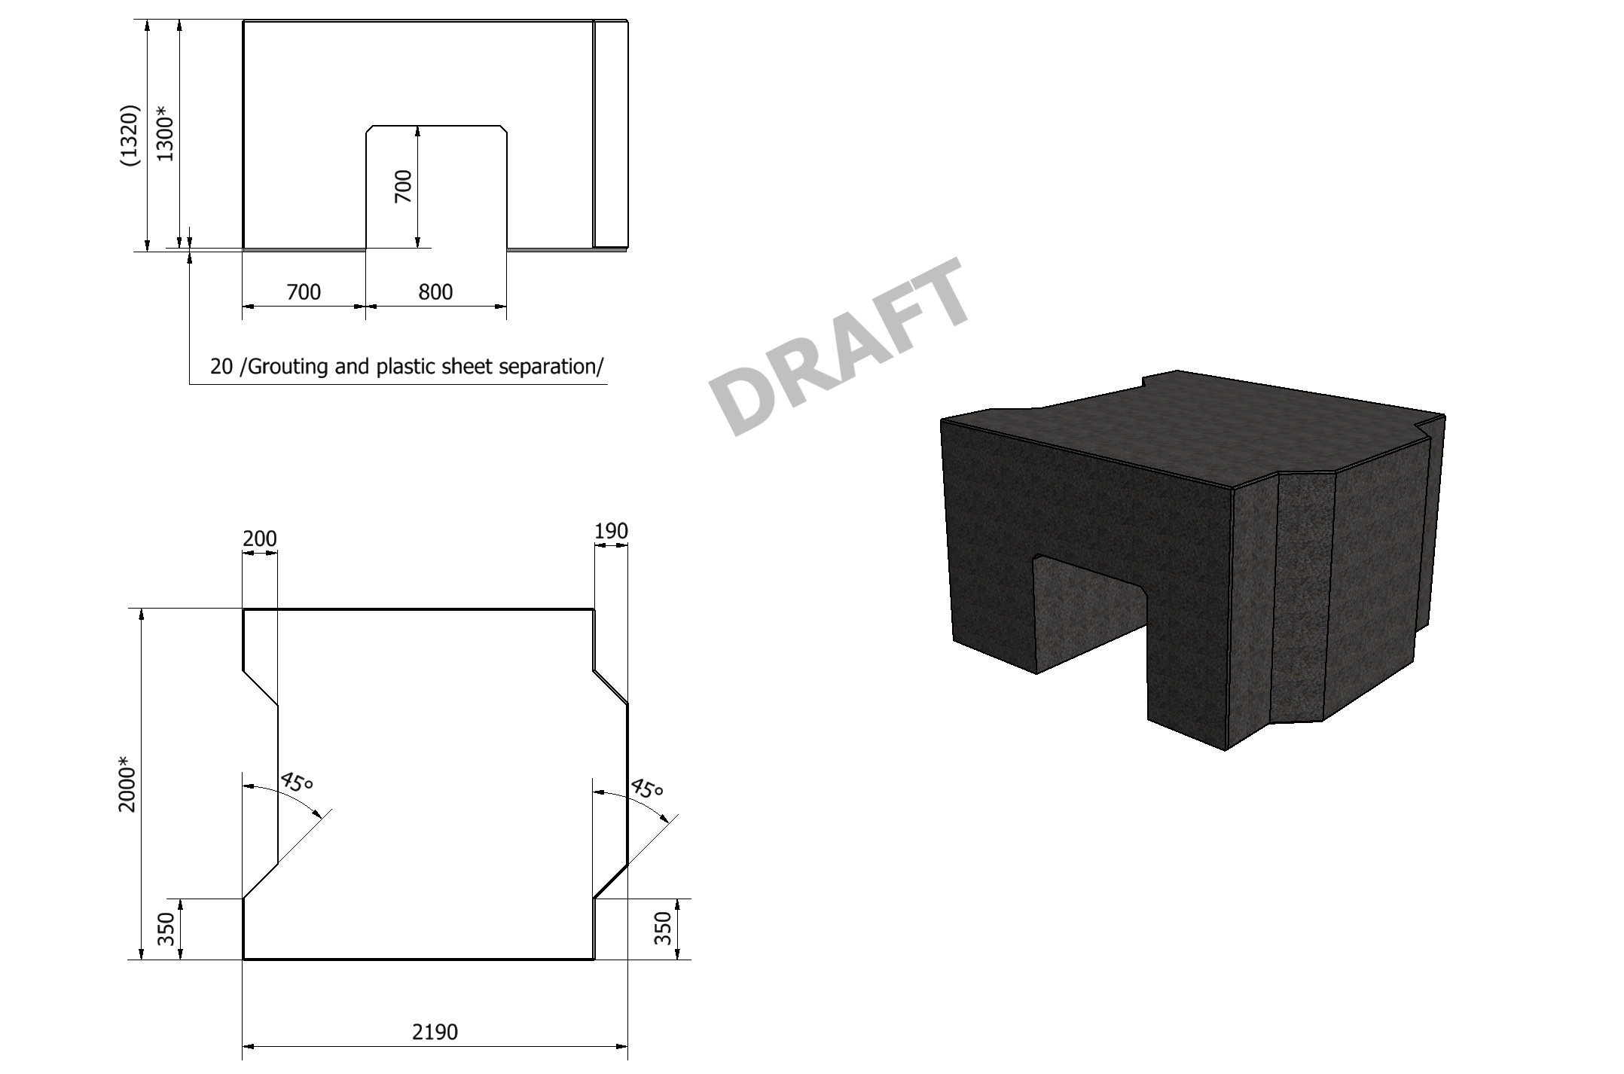
Concept for Elevation in D01-D03

Slide 11
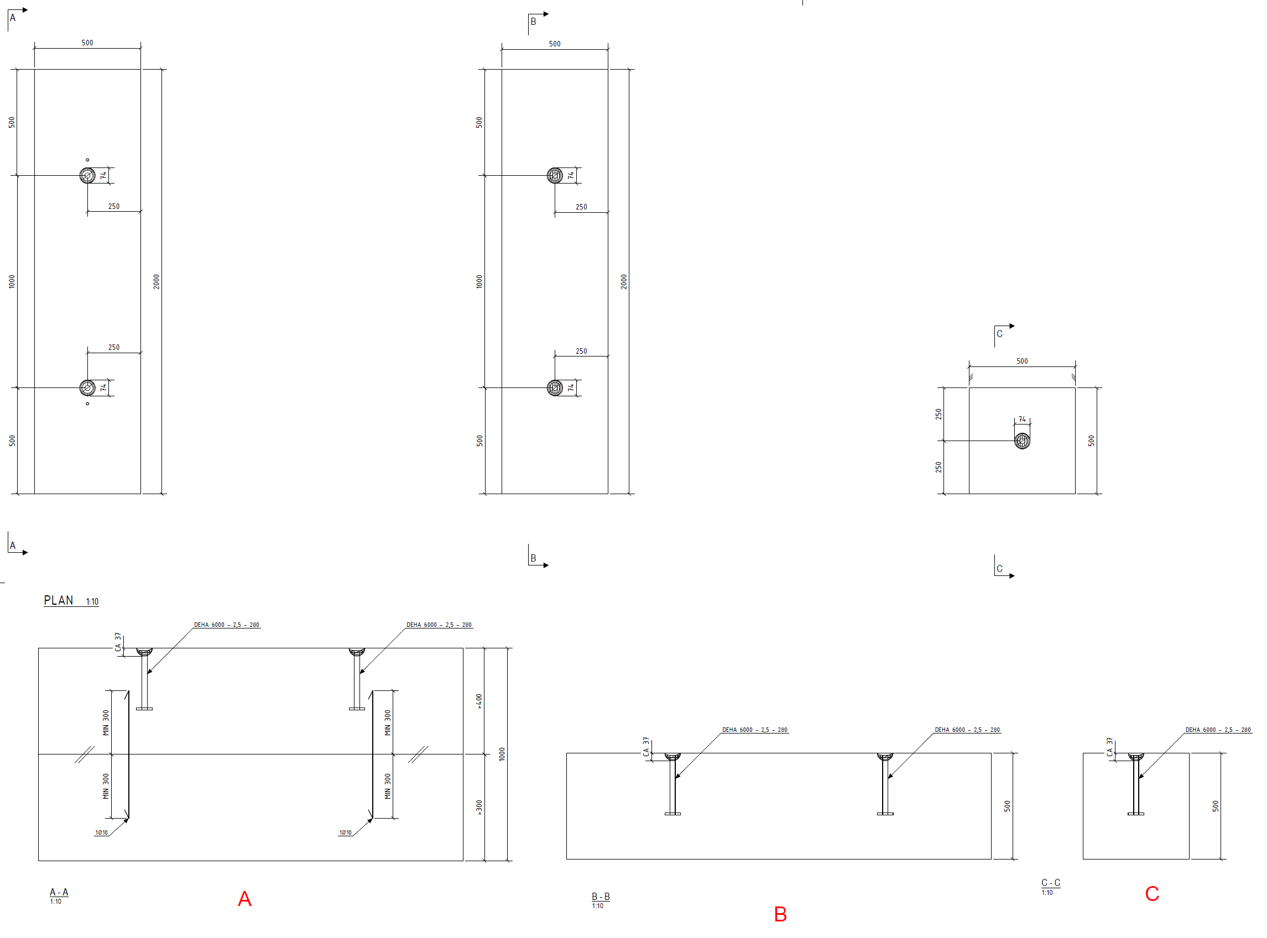
Shielding blocks from leftover concrete
Size:
2000mmx1000mmx500mm
2000mmx500mmx500mm
500mmx500mmx500mm

