Slide 1
Tender scope overview of LOT 1
Piping installation & design of pipe supports
WP16
Water cooling systems
www.europeanspallationsource.se
February 27, 2017

Slide 2
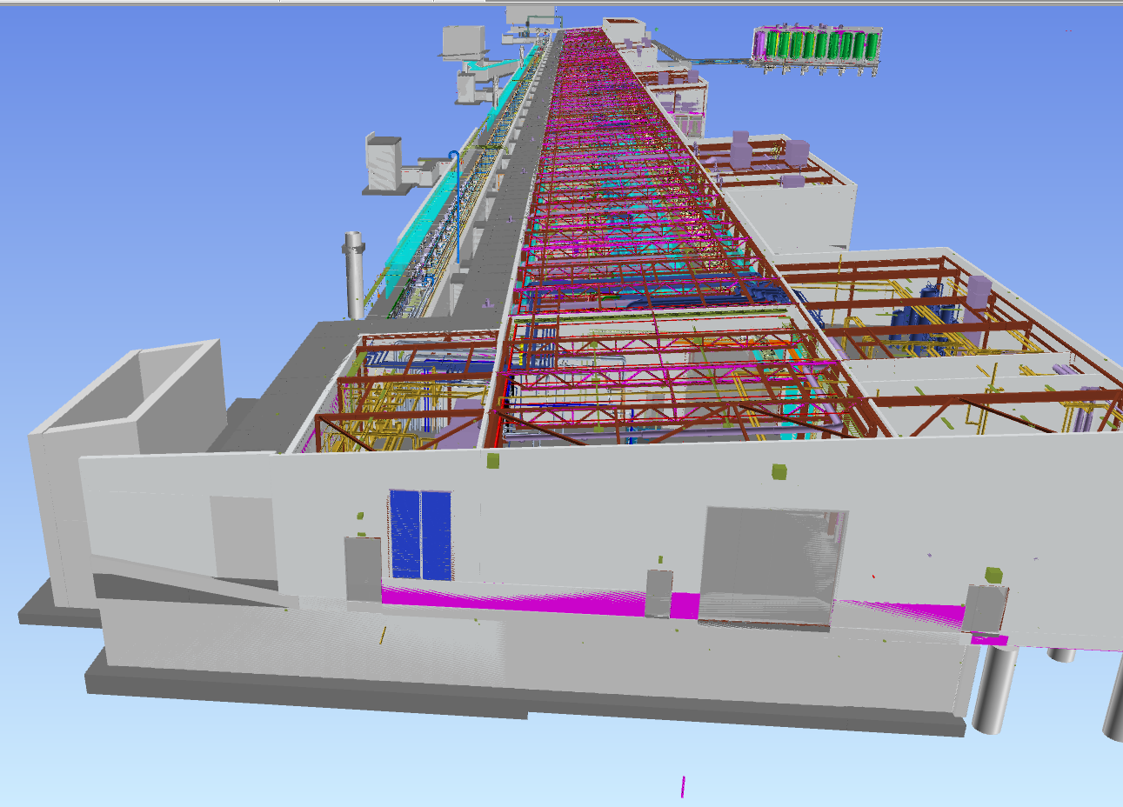
Tender Scope of LOT1
Intention of this document is to use it with the 3D model XML file distributed along with the tender and Isometric drawings for increased understanding of the Tender scope of Lot 1.
Front End Building (FEB) and the Accelerator Tunnel (G01) tender scope LOT1 limits.
  Any information presented in the 3D XML model file is for info only and intended to increase the overall understanding. Detail engineering on mainly some of the pipe supports is still ongoing while tendering.
  The Navisworks file used for the making of some of the screenshots in this document is a subject of regular updates, screenshots may therefore appear outdated at a direct comparison to the 3D XML model file. The 3D XML file in tender version should reflect the actual isometric drawings.
Accelerator tunnel
Level 90
HVAC room
Level 100
FEB
Level 100
FEB
Level 90

Slide 3
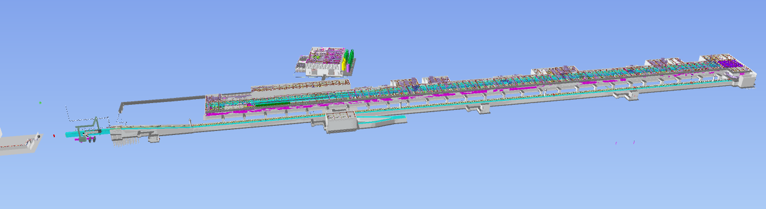
Tender Scope of LOT1
Front End Building (FEB) and the Accelerator Tunnel (G01) tender scope LOT1 building sections overview.
FEB
Level 100
HVAC room
Level 100
FEB
Level 90
Accelerator tunnel
Level 90
Accelerator tunnel
Level 90
Dogleg section

Slide 4
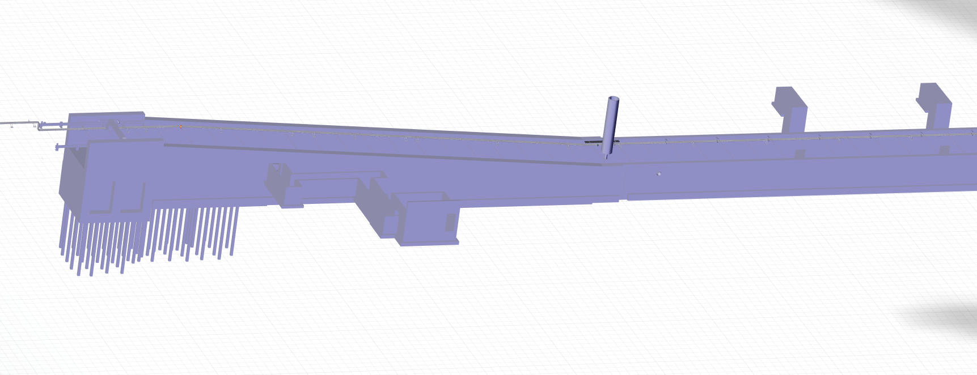
Scope of LOT1
The Accelerator Tunnel (G01) LOT1 scope limit at the dogleg section
Main piping limit of CWS02
ESS.ACC.E02.E02.WP0002
ESS.ACC.E02.E02.WP0004
LOT 1 limit at flanges

Slide 5
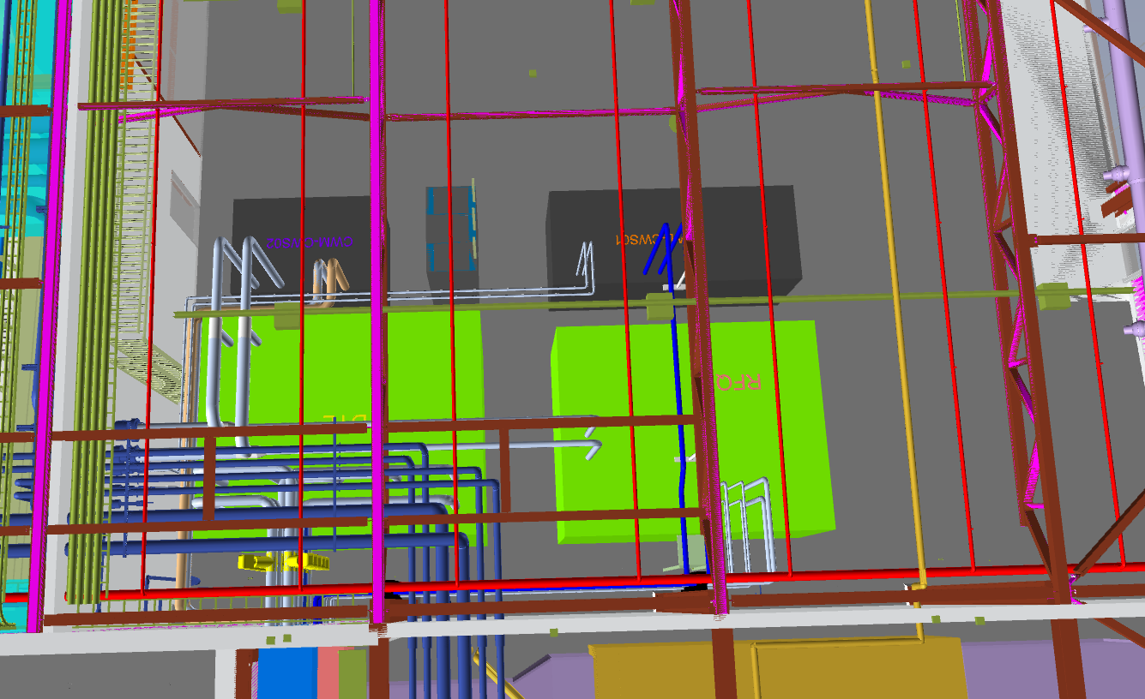
Scope of LOT1
Piping to and from the cooling skids in the FEB level 100 for the
  CWS01 /ESS.ACC.E02.E01,
  CWS02 /ESS.ACC.E02.E02,
  CWS03 (RFQ) /ESS.ACC.E02.E03
  CWS04 (DTL) /ESS.ACC.E02.E04
Current Pipe supports for FEB level 100 are conceptual only.
CWS02 skid delimiter
ESS.ACC.E02.E02
CWS01 skid delimiter
ESS.ACC.E02.E01
DTL Skid delimiter
ESS.ACC.E02.E04
RFQ skid delimiter
ESS.ACC.E02.E04

Slide 6
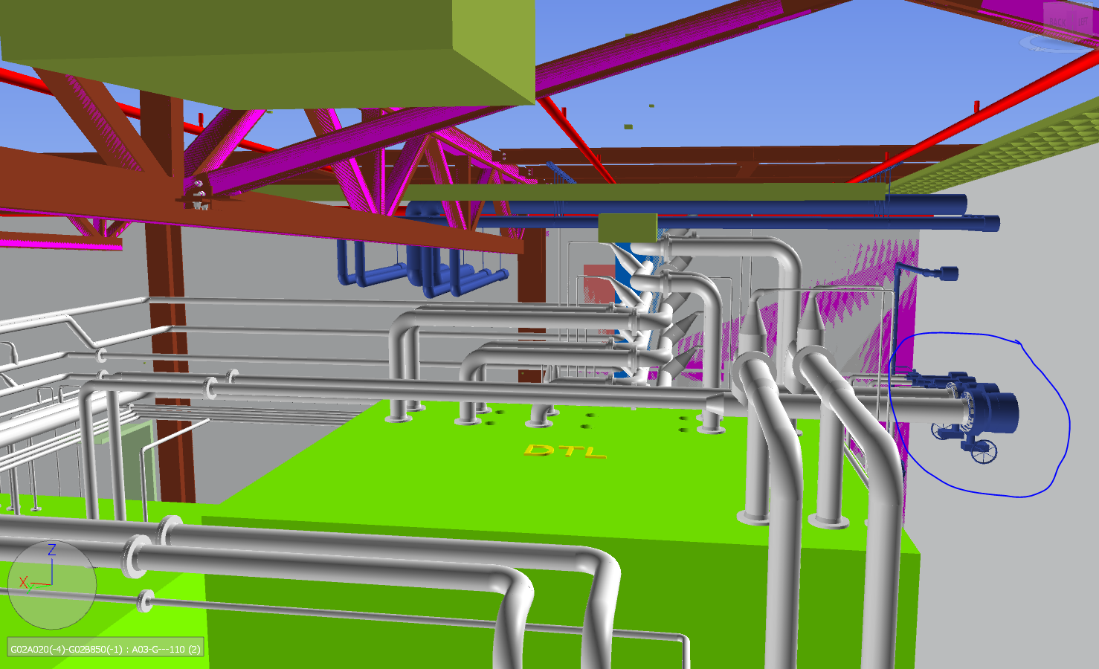
Scope of LOT1
LOT 1 limit to/from external piping in FEB level 100, system limit for ESS.ACC.E02.
Lot1 External Delimiter to/from ESS.ACC.E02

Slide 7
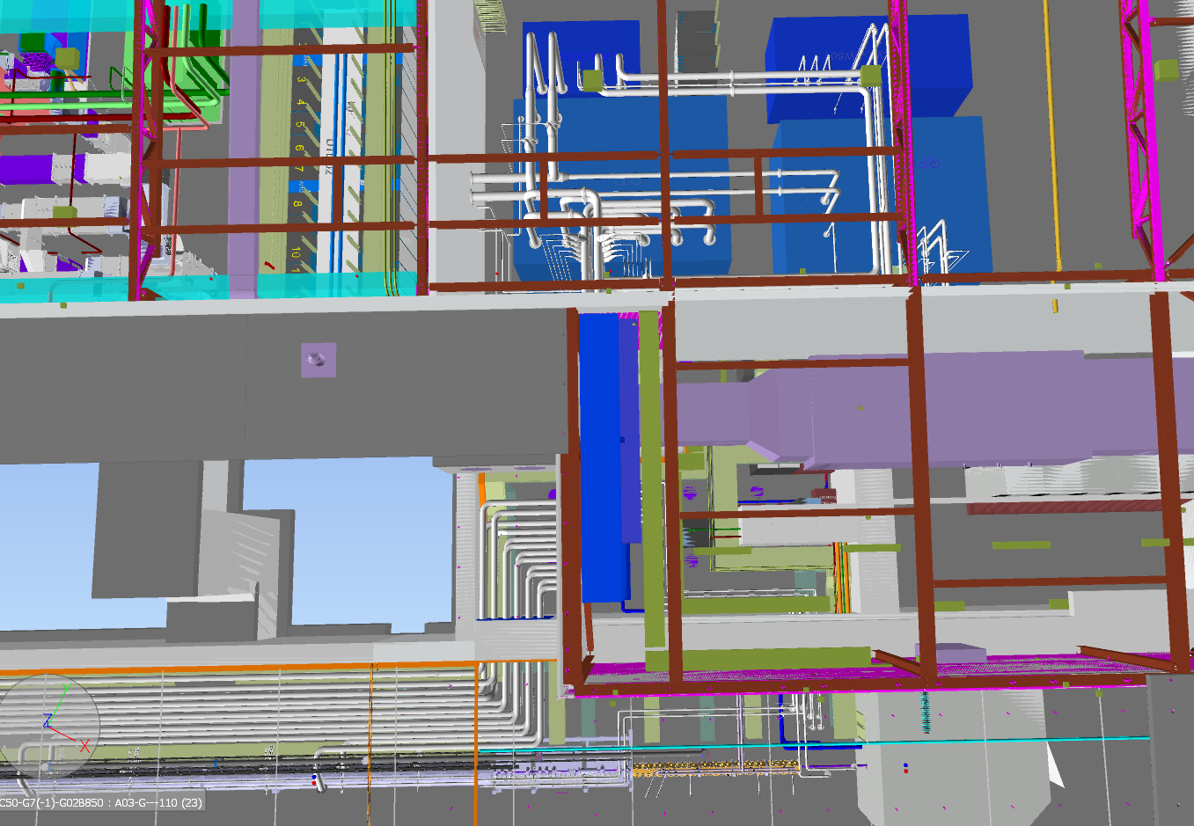
Scope of LOT1
Piping overview to and from the cooling skids of the CWS01 -ESS.ACC.E02.E01, CWS02 -ESS.ACC.E02.E02, CWS03 -ESS.ACC.E02.E03), and CWS04 -ESS.ACC.E02.E04.
ESS.ACC.E02.WP0001-WP005
ESS.ACC.E02.E02.WP0001 ESS.ACC.E02.E02.WP0003
ESS.ACC.E02.E04.WP0001-WP0010
Piping to/from ESS.ACC.E02.E01.xx
ESS.ACC.E02.E03.xx

Slide 8
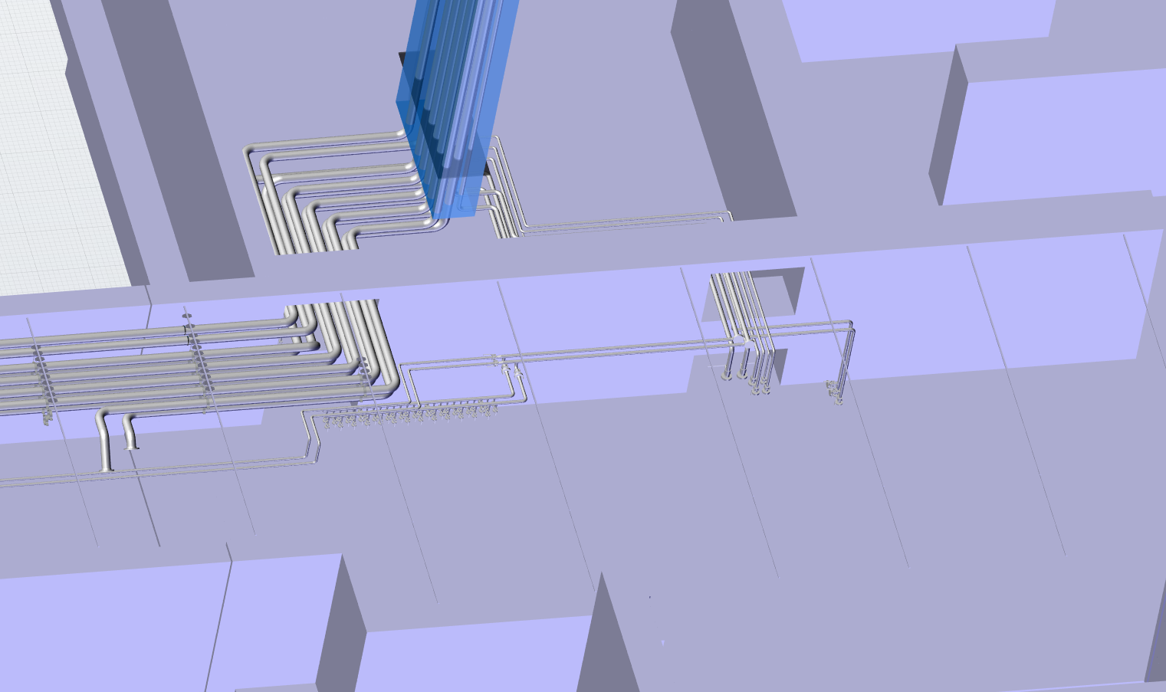
Scope of LOT1
Piping overview to and from the cooling skids of the CWS01 -ESS.ACC.E02.E01, CWS02 -ESS.ACC.E02.E02, CWS03 -ESS.ACC.E02.E03), and CWS04 -ESS.ACC.E02.E04.
ESS.ACC.E02.E02.WP0001 ESS.ACC.E02.E02.WP0003
Piping to/from ESS.ACC.E02.E01.xx
ESS.ACC.E02.E03.xx
LOT 1 limit
ESS.ACC.E02.E04.WP0001-WP0010

Slide 9
Pipe supports contractors scope
WP16
Water cooling systems
www.europeanspallationsource.se
February 27, 2017

Slide 10
Scope of LOT1
Screen dumps presenting Front End Building (FEB) and the Accelerator Tunnel (G01) LOT1 pipe support scope limits
Any information is presented for info only. Engineering is partly ongoing and finalized only after final piping and pipe support structural analyze report is completed by ESS at CDR.
Pipe support design engineering scope of contractor is to model and draught the design on drawings with included BOM according to ESS directions.
See pipe support list for known pipe supports. Type 1, Type 2 and Type 3 pipe supports expected to be as is except for minor modifications.
Also included for contractor is to design, costumize and model any by ESS additionaly required pipe supports necessary and any modifications to the presented supports. This includes two pipe support pillars in the HVAC room level 100 and three pipe support plate designs on wall and floor penetrations.
Important pre-condition on design of any pipe support in the accelerator tunnel G01 is that no drilling or anchoring is allowed on wall and ceiling. Precasted, every 3m, Hilti HAC-41 channels to be used instead of drilling.

Slide 11
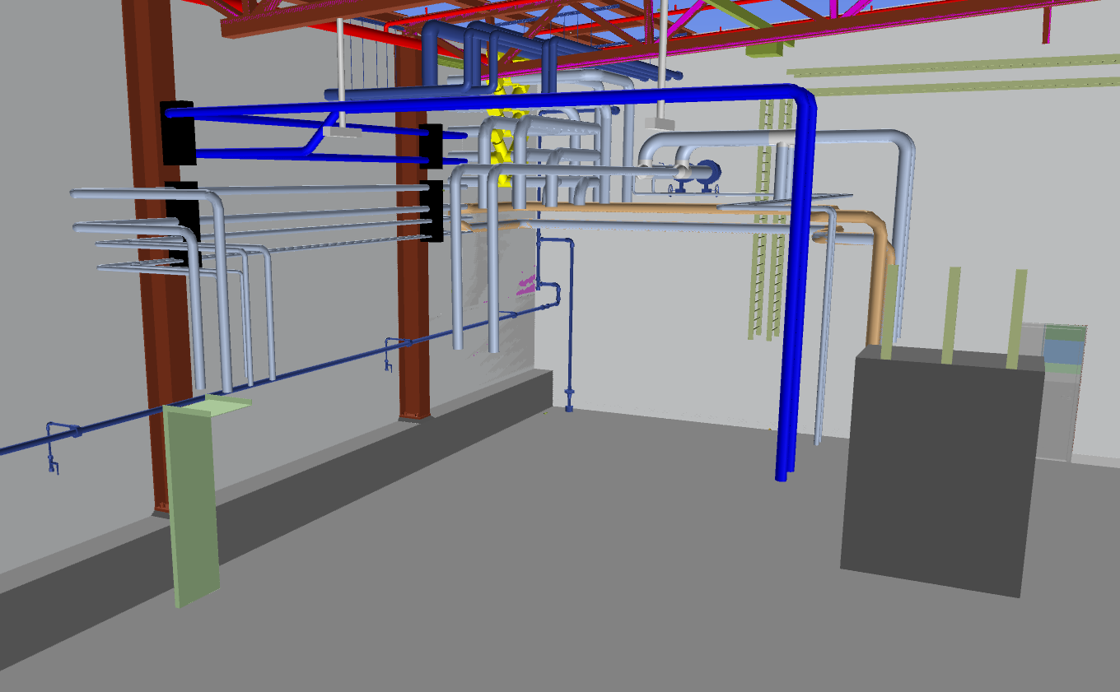
Scope of LOT1
Firewall entry from HVAC room to FEB at level 100.
Pipe supports on building pillars to be designed, preferably by Hilti system parts alt Stauff. Bolting instead of welding preferred to pillars.
Pillars are Firewall painted. If welding is deemed required then any painting affected by welding on building pillars are to be refurbished according to firewall painting requirements.
Pipe supports from roof trusses to be designed preferably by Hilti system parts. Customized bracket for Hilti MI system parts with correct angle towards roof trusses can be made available for purchase from Hilti, estimated lead time 5 weeks.

Slide 12
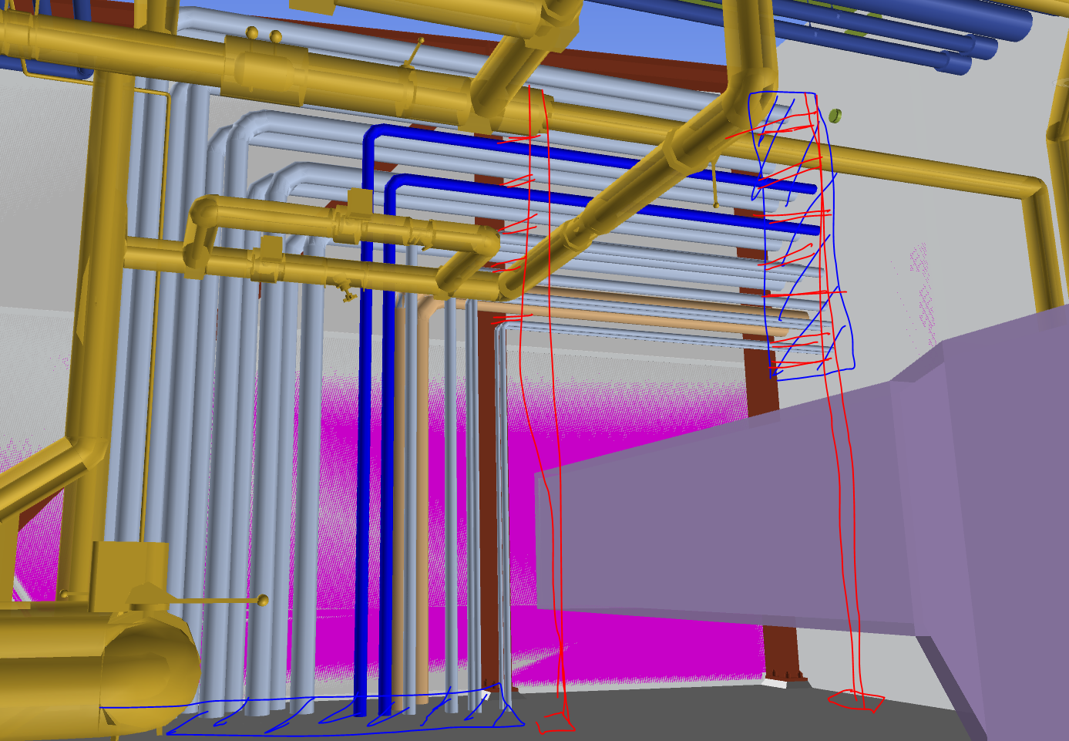
Scope of LOT1
Red sketched lines; pipe supports to be designed at HVAC room FEB level 100 by contractor in agreement with ESS.
Any painting affected by welding on the building pillars are to be refurbished according to firewall painting requirements.
Blue hatched area on wall is a firewall entry area for piping and an ESS scope.
Blue area on floor is pipe support including firewall entry to FEB level 90. Firewall details are an ESS scope, pipe support to be designed and draughted by contractor in agreement with ESS.
Current conceptual design is a 30mm plate with holes and a clamp or similar on the pipes. Stop brackets welded on pipes might show required. Firewall solution must be taken into account for the final design. Firewall solution is ESS scope but ongoing engineering at time of tender.

Slide 13
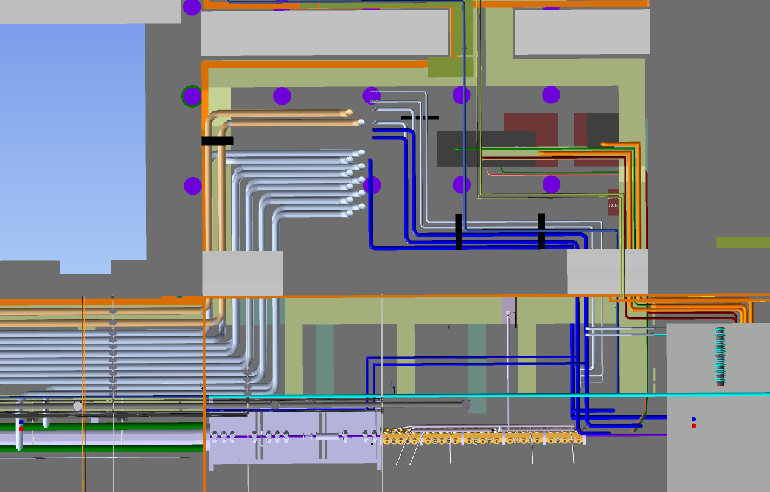
Scope of LOT1
Piping to and from the cooling skids of the CWS01, CWS02, CWS03 and CWS04 in the Front End Building (FEB) level 90 beneath the HVAC room.
Only pipe support details and installation is scope of contractor. Firewall and Radiological wall engineering details and installation is ESS scope of work.
Pipe support designs for penetrations and in the FEB level 90 and the tunnel side of FEB Level 90 to be made in agreement with ESS.
See 3D XML model for updated piping of this area.
Pipe supports to be designed
Pipe support at Firewall EI60 & radiological wall
Pipe support at firewall EI60 & radiological wall
Pipe supports to be designed
DTL manifolds
MEBT section
RFQ section
LEBT &Ion section

Slide 14
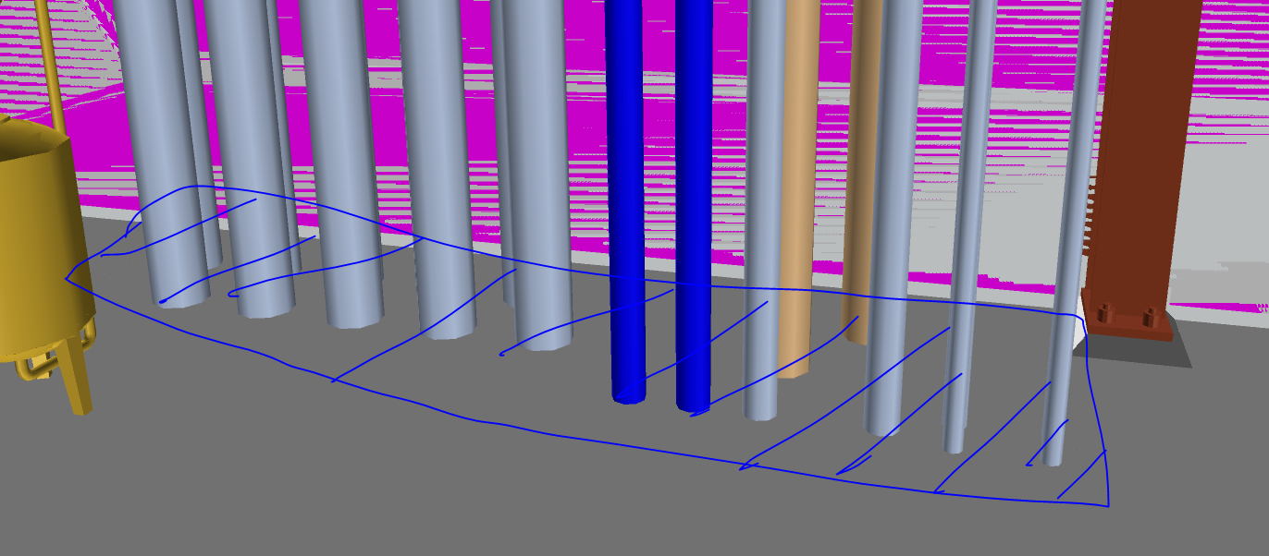
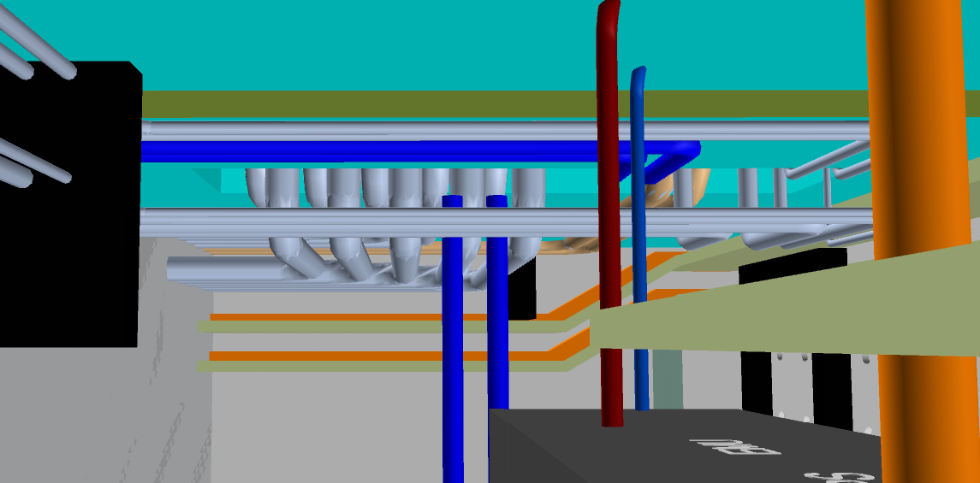
Scope of LOT1
Vertical piping through (Firewall EI60) floor through HVAC room from/to FEB level 90 room to be final modeled and draughted by contractor in agreement with ESS.
Firewall installation is not part of contractors scope.

Slide 15
Scope of LOT1
Any required horizontal piping supports at FEB level 90 to be modeled and draughted by contractor in agreement with ESS.

Slide 16
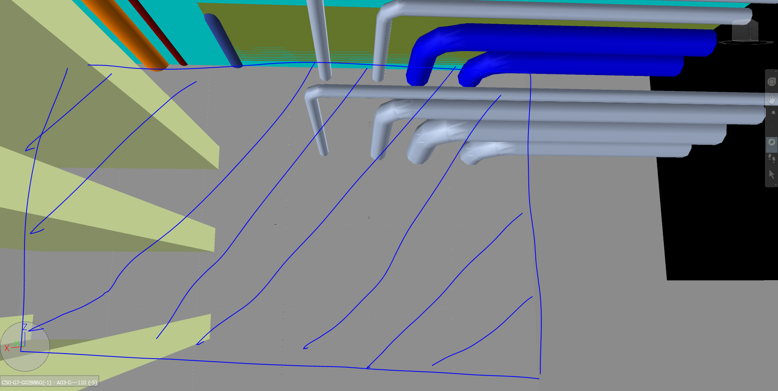
Scope of LOT1
Horizontal piping supports through Radiological walls through to the Accelerator tunnel to be final modeled and draughted by contractor in agreement with ESS.

Slide 17
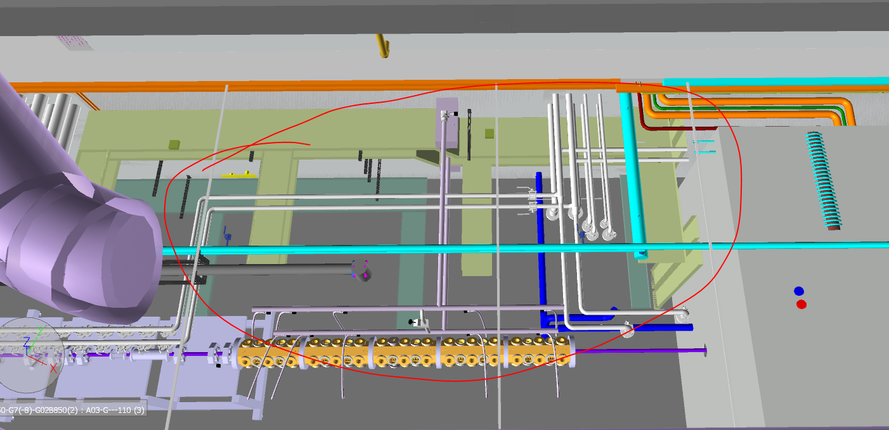
Scope of LOT1
Any required Pipe supports at Accelerator Tunnel level 90 system for piping to be designed and draughted by contractor in agreement with ESS.
See 3D XML file for updated piping of this area.

Slide 18
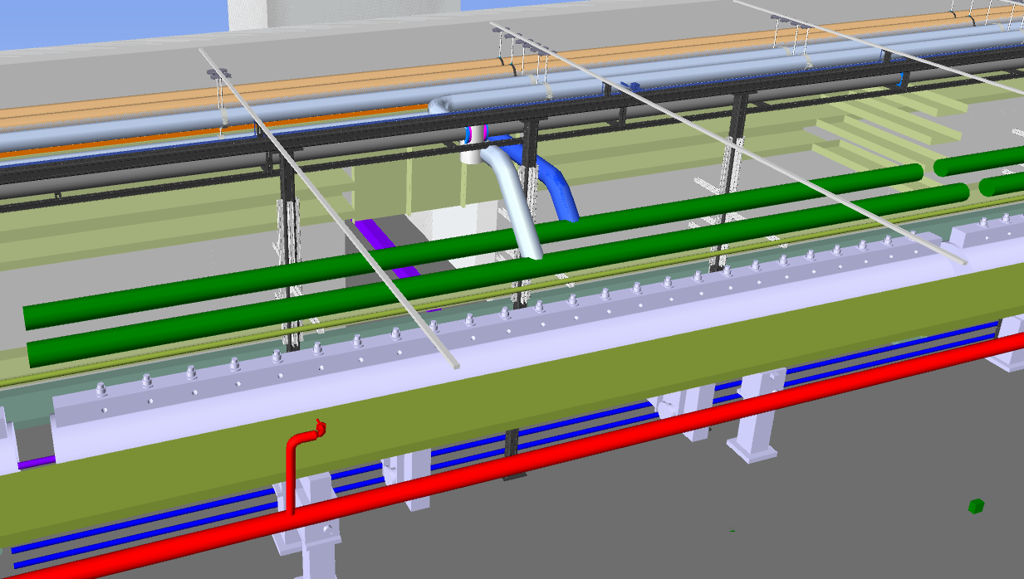
Scope of LOT1
Typical support for the DTL manifolds, (5 sections of green coloured manifold pipes)
Basic design is made of 3 Hilti pillars each on a total of five DTL tanks. Support to be designed and draughted by contractor in agreement with ESS. DTL Manifolds will not be present, only ESS.ACC.E02.E01.WP0005 and ESS.ACC.E02.E01.WP0006 to be supported at this stage.
See 3D XML file for updated piping showing flange connections at this area.

Slide 19
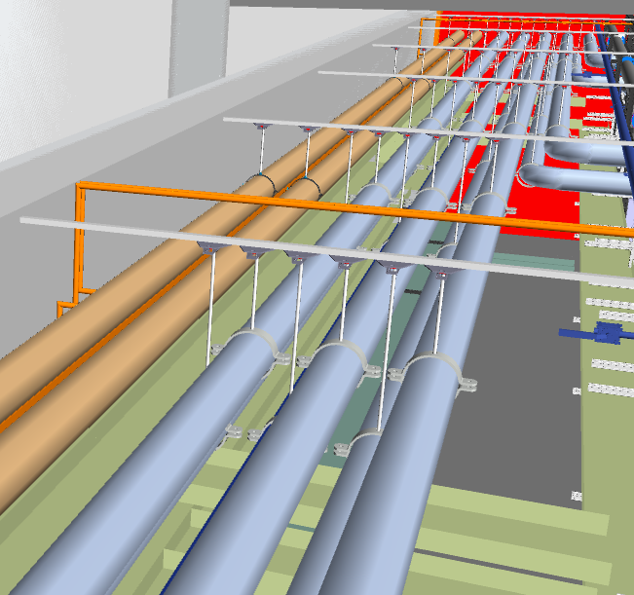
Scope of LOT1
Typical pipe support for the CWS02 beige colored pipes, and CWS04 (DTL) grey coloured pipes. TYPE 1 support consists of Hilti system details.

Slide 20
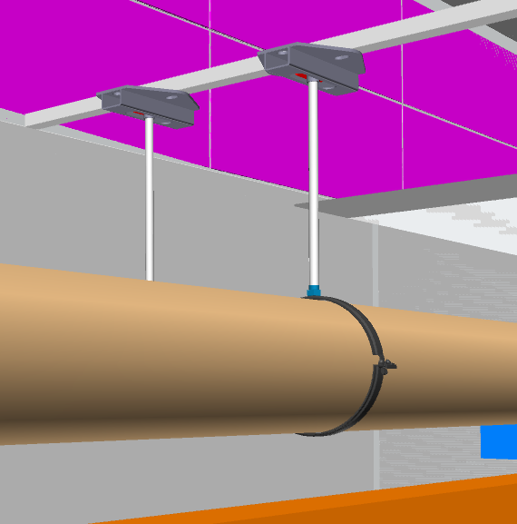
Scope of LOT1
Typical pipe support design of the Magnet piping DN150 and DN100. See support list for TYPE1.
Design made of Hilti system details.
NB! Hilti system rails available each 3 meter on ceiling and wall throughout the accelerator tunnel.
  Bolting/anchoring to the building not allowed except on floor. Bolt type and positions if required at all on the floor to be approved by ESS.

Slide 21
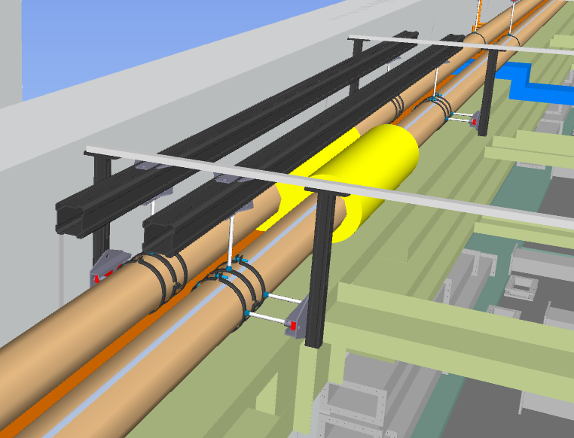
Scope of LOT1
Compensators and typical support structure for the Magnet main pipings. See Support list for TYPE 2.
Design of support consists of Hilti system parts.

Slide 22
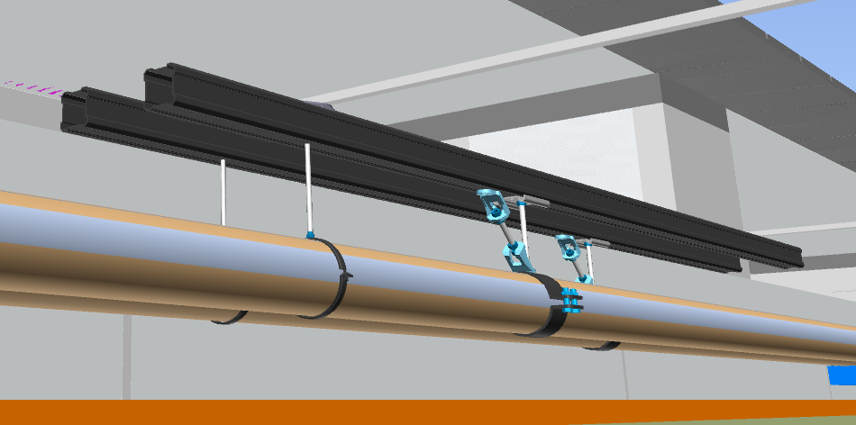
Scope of LOT1
Typical fix support structure for the Magnet main pipings, design of Hilti system details. See support list for TYPE 3.

