Slide 1
CDS-EL and CDS-LTS2
Project Quality Plan
TRR1
Agnieszka Piotrowska
Wrocław, 2017-06-28

Slide 2
Introduction
Wroclaw University of Science and Technology
public academic school

Slide 3
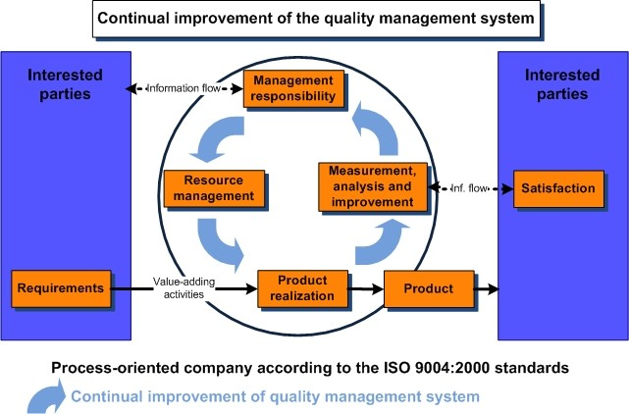
Introduction
Wroclaw University of Science and Technology
public academic school
quality managment system can’t be confirmed
by standards e.g ISO 9000

Slide 4
Introduction
Wroclaw University of Science and Technology
public academic school
quality managment system can’t be confirmed
by standards e.g ISO 9000
PROJECT QUALITY PLAN

Slide 5
Collaboration structure

Slide 6
Cycle of project execution

Slide 7
Map of responsibility

Slide 8
Map of responsibility

Slide 9
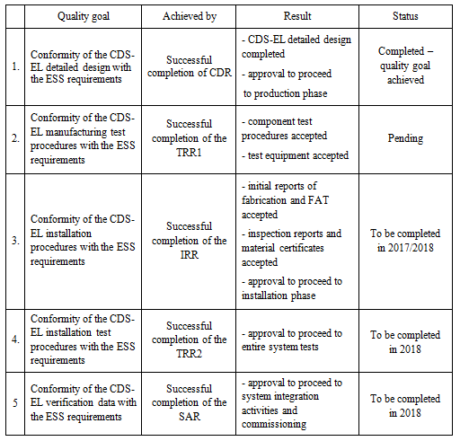
CDS-EL Quality goals

Slide 10
CDS-EL PQP document
Management responsibilities within quality plan
General strategy for the collaboration and responsibilities between ESS, WUST and contractor(s)
Control of records within this quality plan
Resources
Materials – updated (pressure equipment directive 2014/68/EC, vacuum vessels SS1.4301 with EN 10204 3.1 certification)
Human resources – updated (Adam Ratajczak)

Slide 11
CDS-EL PQP document
Infrastructure and work environment – updated (manufacturer selection – basic information concerning the public tender )
WUST contractor(s) – basic info concerning selected manufacturer incl. certificates added
Requirements
Customer communication
Design and development process
Purchasing
Production and service provision

Slide 12
CDS-EL PQP document
Identification and traceability
Transport and storage of product – updated (transport by the sub-contractor of KrioSystem, basic requirements)
Control of nonconforming product
Monitoring and measurement
Audits
Implementation and revision of the quality plan

Slide 13
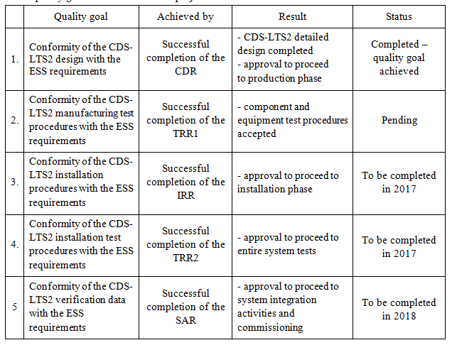
CDS-LTS2 Quality goals

Slide 14
CDS-LTS2 PQP document
Materials – updated (pressure equipment directive 2014/68/EC, vacuum vessels SS1.4301 with EN 10204 3.1 certification)
Human resources – updated (Adam Ratajczak)
Infrastructure and work environment – updated (manufacturer selection – basic information concerning public tender)
WUST contractor(s) – basic info concerning selected manufacturer incl. certificates added
Revision of the quality plan – updated (input data for PQP 2 - PQP5 drafts)

