Slide 1

Wroclaw 28.06.2017
ESS – CDS-EL and CDS-LTS2
Activities and procedures for dimension control works
Maciej Matkowski
Project Manager
maciej.matkowski@kriosystem.co.pl
CRYOGENICS IS OUR PASSION
www.kriosystem.com.pl

Slide 2
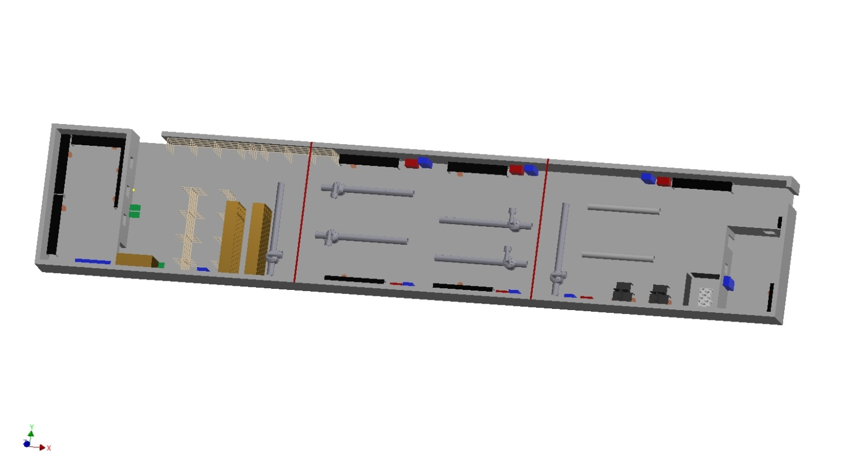
Works area
CRYOGENICS IS OUR PASSION
www.kriosystem.com.pl

Slide 3
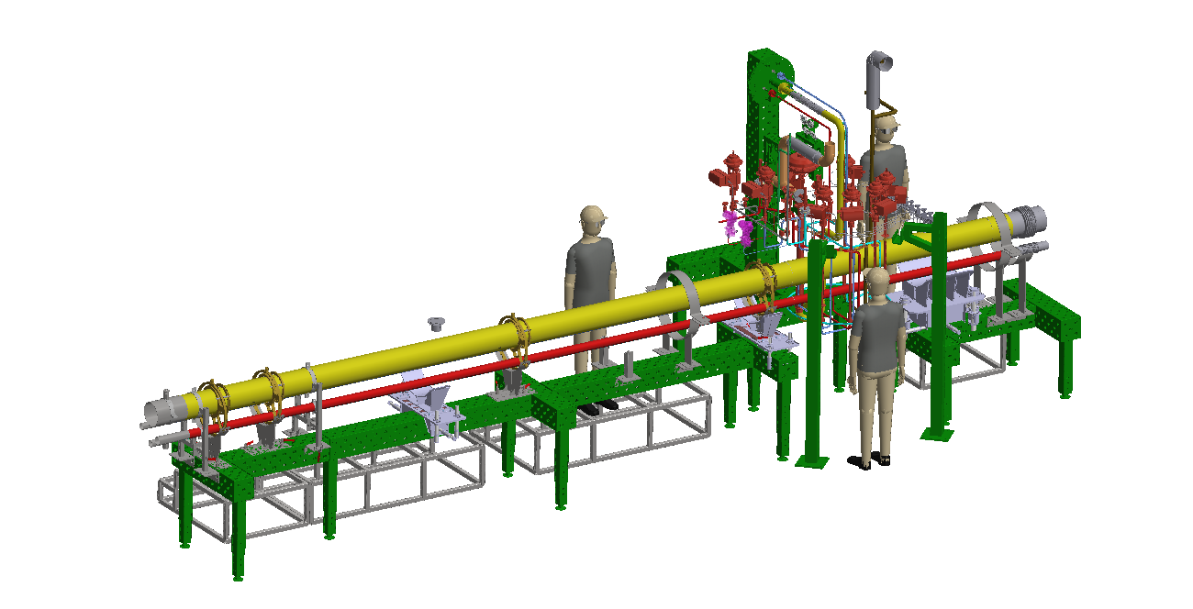
Assembly stand
CRYOGENICS IS OUR PASSION
www.kriosystem.com.pl

Slide 4
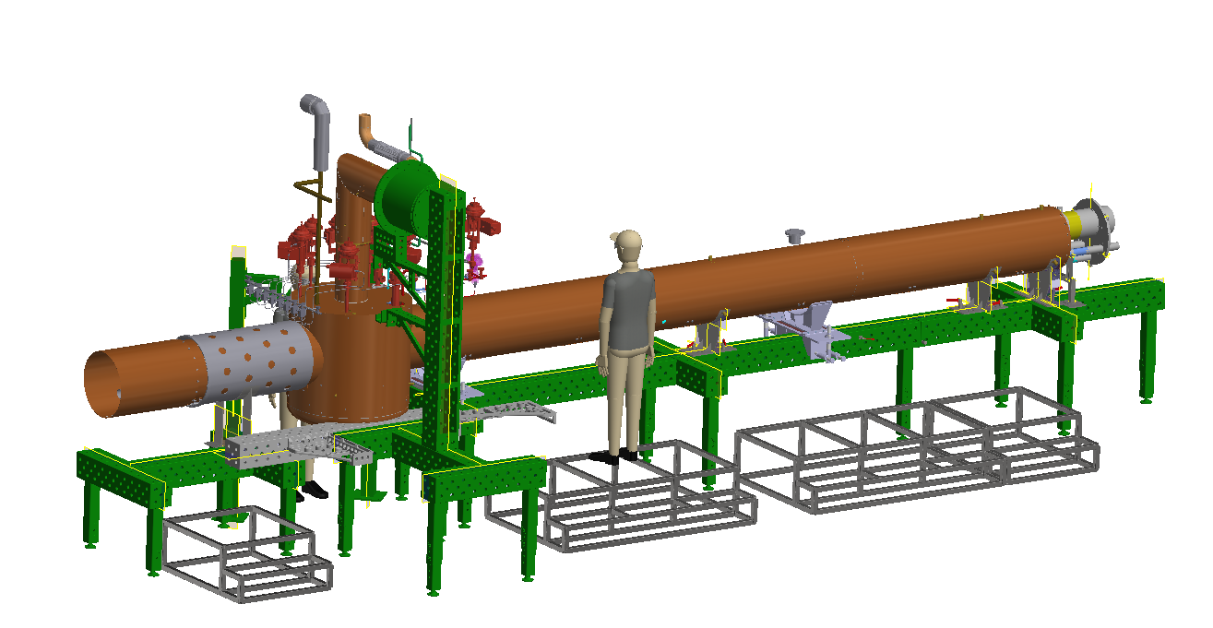
Assembly stand
CRYOGENICS IS OUR PASSION
www.kriosystem.com.pl

Slide 5
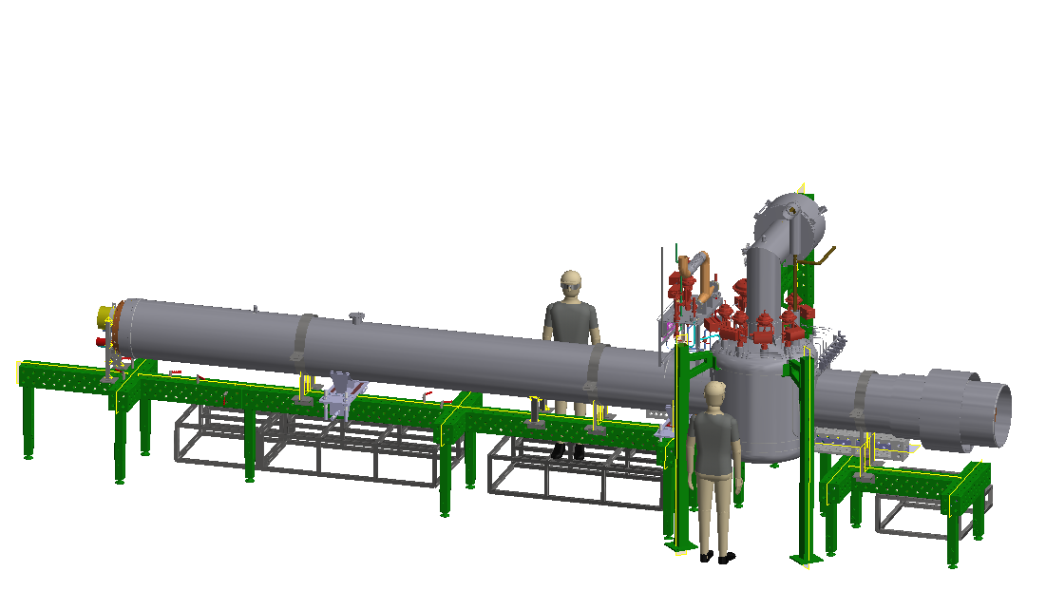
Assembly stand
CRYOGENICS IS OUR PASSION
www.kriosystem.com.pl

Slide 6
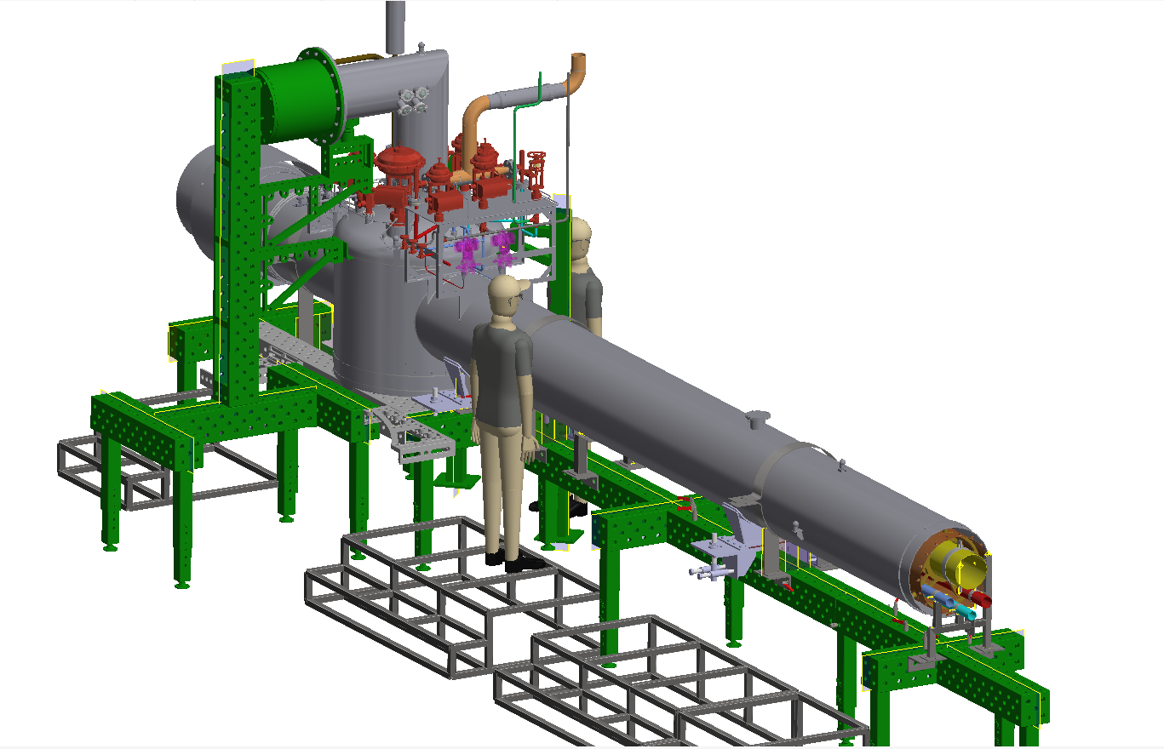
Assembly stand
CRYOGENICS IS OUR PASSION
www.kriosystem.com.pl

Slide 7
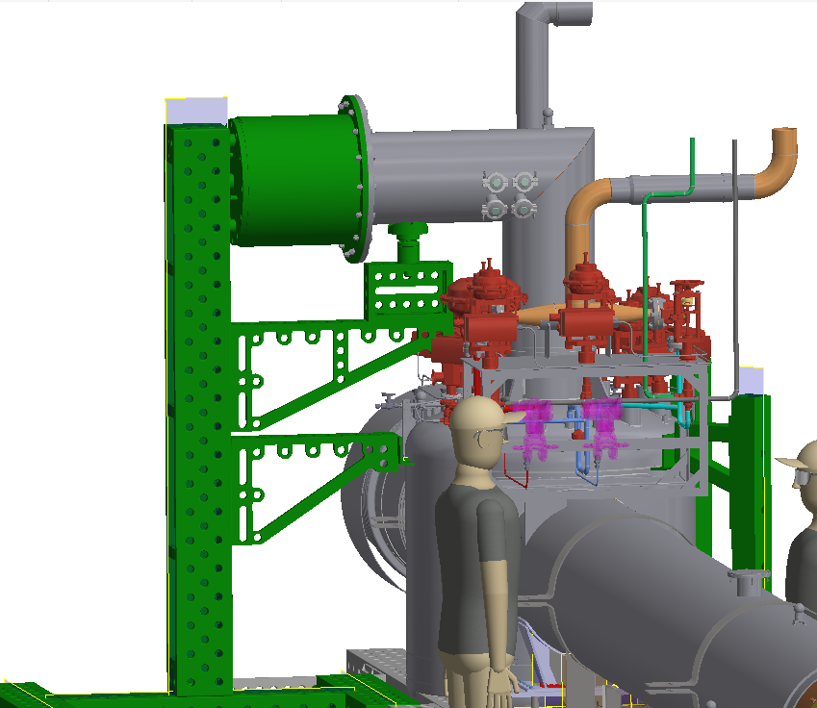
Assembly stand
CRYOGENICS IS OUR PASSION
www.kriosystem.com.pl

