Slide 1

Wroclaw 28.06.2017
ESS – CDS-EL and CDS-LTS2
Equipment for helium leak test
Maciej Matkowski
Project Manager
maciej.matkowski@kriosystem.co.pl
CRYOGENICS IS OUR PASSION
www.kriosystem.com.pl

Slide 2
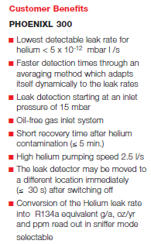
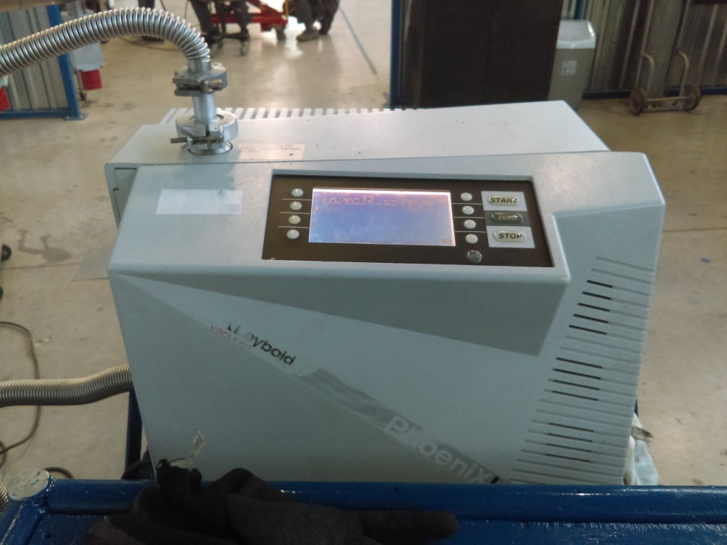
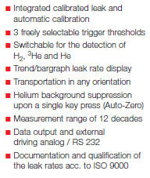
Helium Leak Detector
CRYOGENICS IS OUR PASSION
www.kriosystem.com.pl

Slide 3
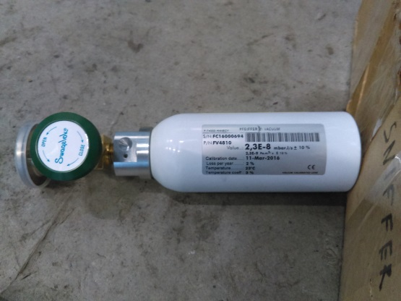
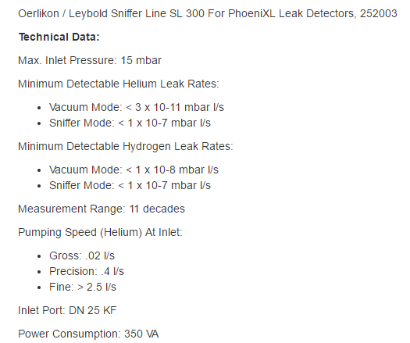
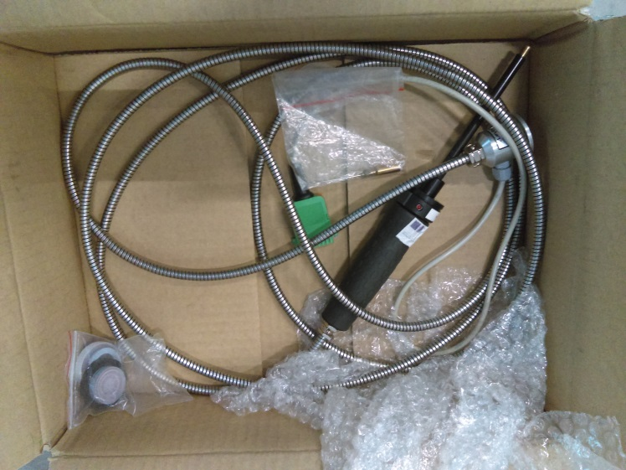
Helium Leak Detector - accessories
CRYOGENICS IS OUR PASSION
www.kriosystem.com.pl

Slide 4
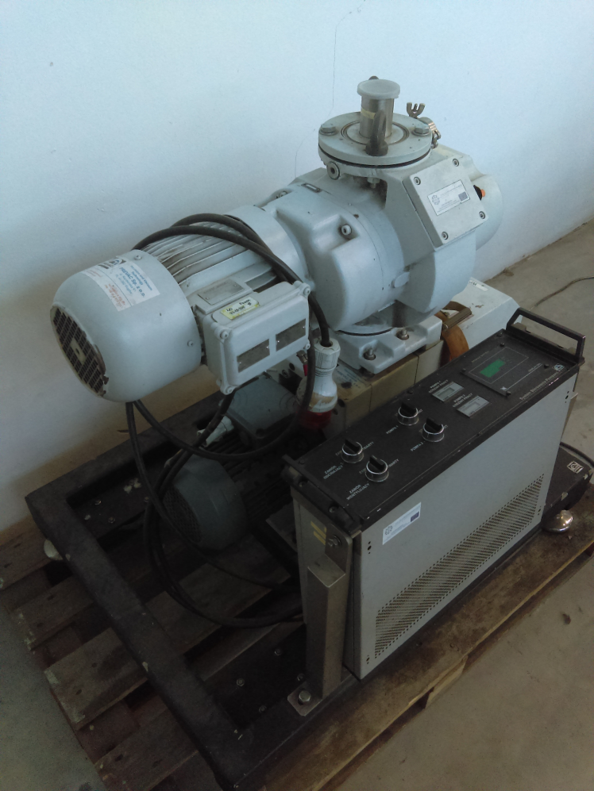
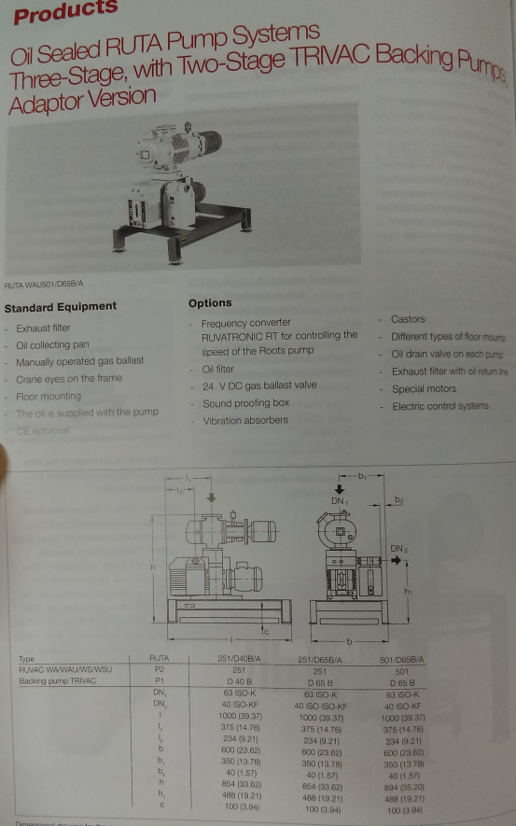
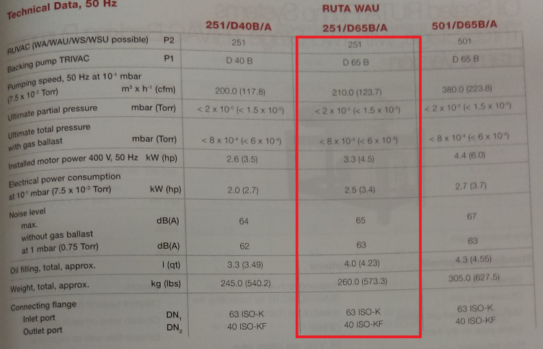
Roots Vacuum Pump
CRYOGENICS IS OUR PASSION
www.kriosystem.com.pl

Slide 5
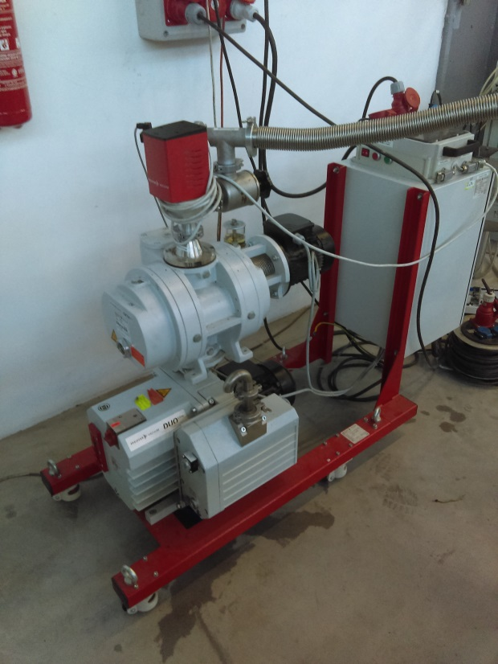
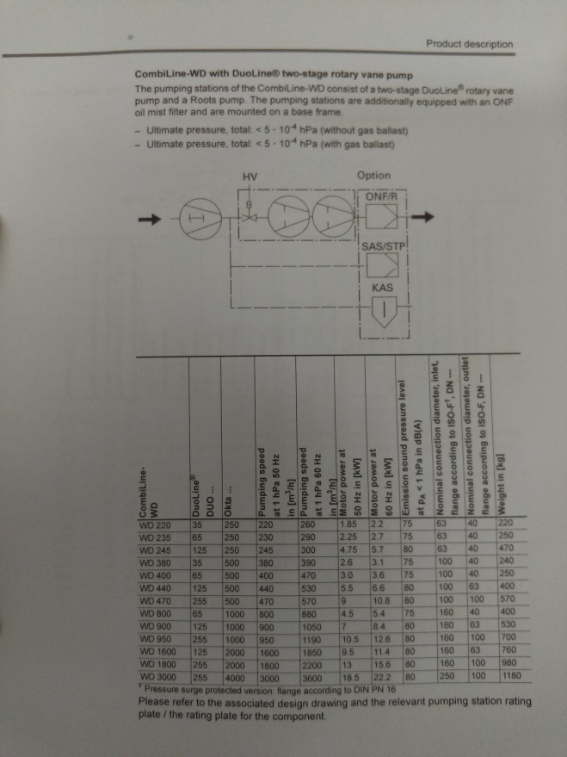
Roots Vacuum Pump
CRYOGENICS IS OUR PASSION
www.kriosystem.com.pl

Slide 6

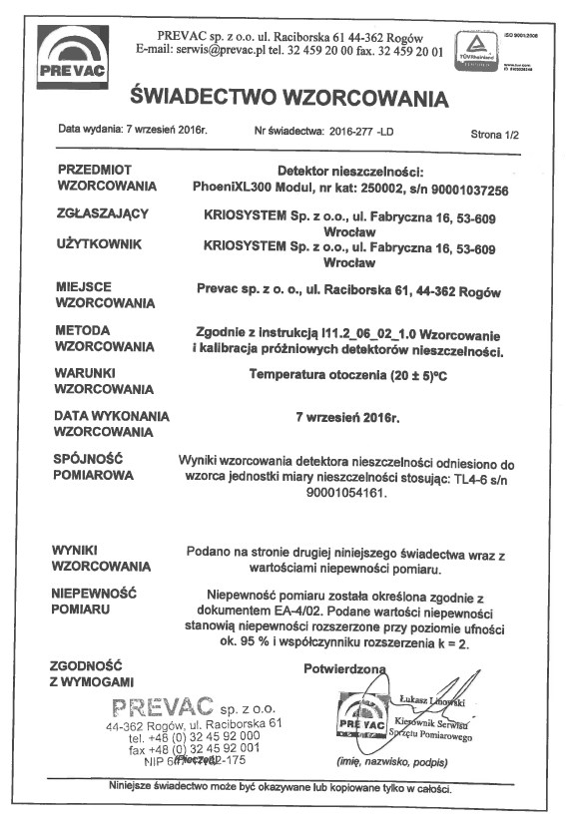
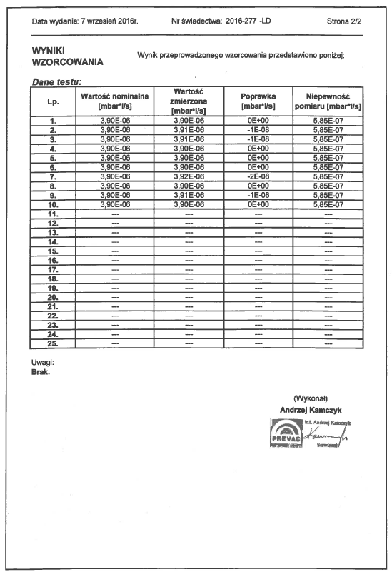
Responsible Person – eng. Tomasz Borek
Calibration certificate
CRYOGENICS IS OUR PASSION
www.kriosystem.com.pl

