Slide 1

Wroclaw 28.06.2017
ESS – CDS-EL and CDS-LTS2 – Verification Plans
Maciej Matkowski
Project Manager
maciej.matkowski@kriosystem.co.pl
CRYOGENICS IS OUR PASSION
www.kriosystem.com.pl

Slide 2
Fabrication and factory acceptance test plan
Production tests
Final factory tests
CRYOGENICS IS OUR PASSION
www.kriosystem.com.pl

Slide 3
Production tests
  Tests of trade items
  Tests of pre-assembly elements
  Tests of process pipes after whole assembly of process pipes and valves
  Tests after installation of Temperature Sensors and MLI wrapping on process pipes
  Tests after instalation of radiation shield
  Tests after vacuum jacket installation
CRYOGENICS IS OUR PASSION
www.kriosystem.com.pl

Slide 4
Tests of trade items
In this stage we will tests trade items like:
bellows,
flexible hoses,
cryogenic control valve bodies
Prepared tests:
LIN tests
Leak tests
CRYOGENICS IS OUR PASSION
www.kriosystem.com.pl

Slide 5
Tests of trade items – LIN Tests
To verify of trade items before installing them on the installation they have to be 3 times thermal shocking by liquid nitrogen. The test will be perform by manufacture personel. To perform that test they have to be putted in to a vessel with nitrogen for few minutes (liquid have to stop boiled) then carry out from vessel to reach an ambient temperature.
CRYOGENICS IS OUR PASSION
www.kriosystem.com.pl

Slide 6
Tests of trade items – Leak Tests
To verify of trade items after thermal shocking and before installing them on the installation they have to be checked by helium leak detector. To preform that test one side of the item has to be connected to a helium leak detector and other sides has to be blinded. Then in the item shell be evacuated at least to a pressure of 5⋅10⁻³ mbar. During these tests all the components etc. shall be sprayed from outside with helium. The single leak rate from outside to the item shall not exceed 1⋅10⁻¹⁰ mbar⋅l/s. This test will be done by test engineer – Tomasz Borek, by using helium leak dectector PHIOENIXL 300.
CRYOGENICS IS OUR PASSION
www.kriosystem.com.pl

Slide 7
  Tests of pre-assembly elements
bending and welding elements of process pipes (insides of Valve Boxes)
Prepared tests:
VT
X-Ray
Dimensional verification
CRYOGENICS IS OUR PASSION
www.kriosystem.com.pl

Slide 8
  Tests of pre-assembly elements - VT
All welds shall be tested and inspected in accordance with EN 13480-5. Tests and inspections of welds shall include reviews of welding documents, inspections before welding, testing and inspections during welding as well as inspections after welding.
Visual examination shall be performed according to ISO 17637. The quality level and acceptance criteria of weld imperfections shall be level B for process pipes, level C for vacuum jacket and radiation shield of ISO 5817.
The test will be perform by manufacture qualified personel, which are cerftified to visual control of welds VT2 (Maciej Matkowski, Konrad Zawada).
Weld | Phase | Visual examination
Process pipe welds | Fabrication | 100%
External envelope welds | Fabrication | 100%
CRYOGENICS IS OUR PASSION
www.kriosystem.com.pl

Slide 9
  Tests of pre-assembly elements – X-Ray
All welds shall be tested and inspected in accordance with EN 13480-5. Tests and inspections of welds shall include reviews of welding documents, inspections before welding, testing and inspections during welding as well as inspections after welding.
The execution of X-ray examinations of welds, assessment of X-ray films and preparation of the related documentation shall be based on EN 13480-5. In case of non-conformities, the X-ray examinations shall be extended according to standard statistical quality assurance procedures. The test will be done by subcontractor (for example Solver Sp. z o.o.) who has accreditation of the Technical Inspection Authority.
Radiographic tests shall be performed according to ISO 17636. The quality level shall meet ISO 5817 level B requirements. The acceptance criteria for the weld imperfections shall comply with EN 12517.
Weld | Phase | Radiographic test
Process pipe welds | Fabrication | 100%
External envelope welds | Fabrication | 10%
CRYOGENICS IS OUR PASSION
www.kriosystem.com.pl

Slide 10
Tests of pre-assembly elements – Dimensional verification
The relevant dimensions of the Valve Box LTS2 elements shall be verified after assembly work at the manufacturer’s premises by the manufactuer qualified personel. The measurement equipment for test: tape meter, calipper, protractor, etc. As examples, relevant dimensions are the valve box sizes, the orthogonality of the jumper connection interface flange and the lengths and diameters of the process lines and outer vacuum jacket sections. All dimensions shall comply with the values given in the final manufacturing and assembly drawings.
Tolerances are specified on the drawings and in the specification.
For welding works – ISO 13920 – class C and G.
Dimensions without tolerance – ISO 2768 – class m and K.
CRYOGENICS IS OUR PASSION
www.kriosystem.com.pl

Slide 11
  Tests of process pipes after whole assembly of process pipes and valves
VT – 100% of welds
X-Ray – 100% of welds
Pressure Tests
Rough leak test of Process Pipes
Dimensional verification
CRYOGENICS IS OUR PASSION
www.kriosystem.com.pl

Slide 12
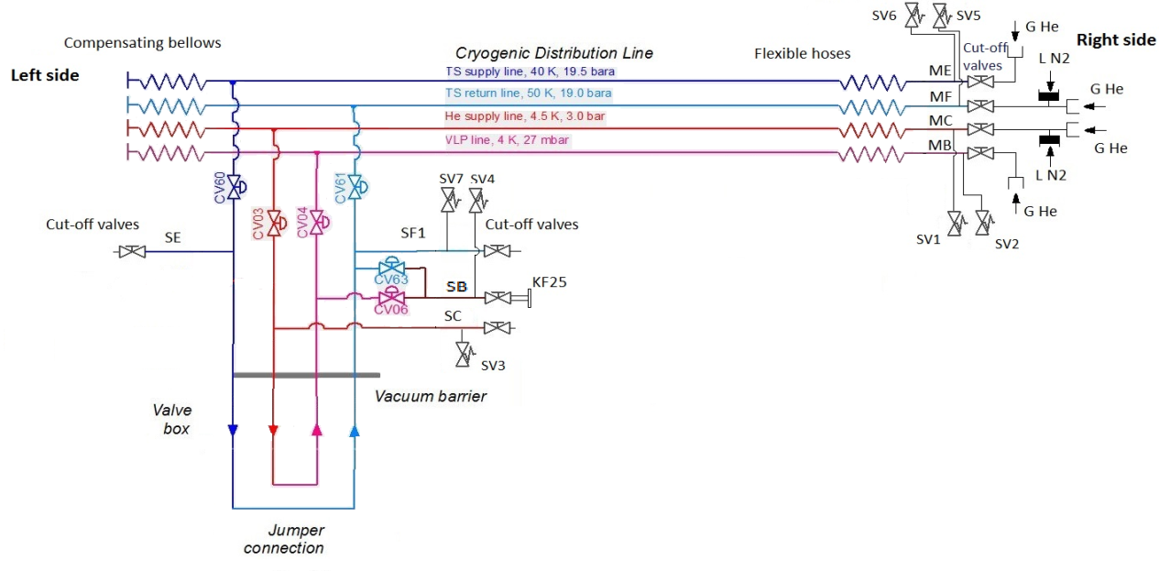
  Tests of process pipes after whole assembly of process pipes and valves - Pressure Tests
CRYOGENICS IS OUR PASSION
www.kriosystem.com.pl

Slide 13
  Tests of process pipes after whole assembly of process pipes and valves – rough leak test
After each pressure test the pressure in the process pipes shall be reduced to the design pressure. Then, all welding seams shall be controlled individually for substantial leaks. For this purpose the welding seams shall be covered hermetically from outside with plastic foil and submitted to a sampling probe test. Gluing of the foil directly onto the welding seams is not allowed since the glue might block the leak.
The single leak rate from outside to a vacuum vessel shall not exceed 1⋅10⁻⁹ mbar⋅l/sec. The single leak rate from the pressure bearing components (welds, valves, etc.) shall not exceed 1⋅10⁻⁹ mbar⋅l/sec at the design pressure and at both room and operating temperatures. Under operating conditions, the measured integral helium leak rate into the insulation vacuum shall not exceed 5⋅10⁻⁷ mbar⋅l/sec. The single leak rate from pressure bearing components (welds, valves, etc.) to the outside shall be smaller than 1⋅10⁻⁷ mbar⋅l/sec. This test will be done by test engineer – Tomasz Borek, by using helium leak dectector PHIOENIXL 300.
CRYOGENICS IS OUR PASSION
www.kriosystem.com.pl

Slide 14
  Tests after installation of Temperature Sensors and MLI wrapping on process pipes
Testing the temperature sensors
Visual control of MLI
Dimensional verification of TS positions
CRYOGENICS IS OUR PASSION
www.kriosystem.com.pl

Slide 15
  Tests after installation of Temperature Sensors and MLI wrapping on process pipes - Testing the temperature sensors
The functioning of temperature sensors shall be controlled before and after each important fabrication and assembly step (such as thermal shocks, application of MLI, etc.). The tests shall include verification of the leakage current to the ground and measurements of the resistance between each pair of connecting wires. This test will be done by test engineer – Tomasz Borek, by using multimeter UNI-T M890C+.
Sensor and Leadwire Testing
To avoid installation of broken sensors or lead-wires the sensor with the leadwires installed must be tested prior to installation. The test must be performed with an adequate ohm-meter using a four-wire RTD configuration.
For testing, the sensor must be smoothly warmed e.g. by applying a warm air stream.
The test must be repeated after full installation.
No faulty sensors or leadwires are allowed.
All testing must be recorded within a dedicated protocol.
CRYOGENICS IS OUR PASSION
www.kriosystem.com.pl

Slide 16
  Tests after installation of Temperature Sensors and MLI wrapping on process pipes - Visual control of MLI
After application of the MLI, a careful inspection must ensure that the MLI has been applied according to the best possible protection from heat radiation and the lowest possible heat transfer. Control should be recorded. Following criteria has to be applied:
all metal surfaces has to be covered with MLI
singularities like connection of two sheets of MLI, endings etc. has to be made by avoiding connection of low temperature layers with warm temperature layers
the density of the layers should be between 1-2 layers per mm
MLI has to be clean, dry and protected from dirty/wet atmosphere
CRYOGENICS IS OUR PASSION
www.kriosystem.com.pl

Slide 17
  Tests after instalation of radiation shield
Visual control of MLI
Dimensional verification
CRYOGENICS IS OUR PASSION
www.kriosystem.com.pl

Slide 18
  Tests after vacuum jacket installation
VT – 100% of welds
X-Ray – 10% of welds
Dimensional control
CRYOGENICS IS OUR PASSION
www.kriosystem.com.pl

Slide 19
Final factory tests
Dimensional verification
vacuum vessel leak tight test
thermal shocking
pressure / helium leak tests of process pipes
valves seat leak tight test
valve functioning control
testing the temperatures sensors
fiducial control
CRYOGENICS IS OUR PASSION
www.kriosystem.com.pl

Slide 20
Final factory tests - vacuum vessel leak tight test
Preparation:
The test box on the jumper connection shall not be installed.
The all cut-off valves installed on process pipes shall be closed.
The vacuum jacket shall be evacuated to a pressure of 5·10⁻³ mbar and all internal process lines shall be evacuated to a reasonably low pressure.
Test:
The following elements shall be sprayed with gaseous He in the following sequence:
Each element welded to the vacuum vessel (process pipes terminals, valves, vacuum flanges).
All connections of process pipes and vacuum barriers on the jumper connection.
The connection between the CDL vacuum vessel and Valve Box vacuum vessel.
Each weld seams of the vacuum vessel jumper connection, starting from the top of the jumper connection.
The weld between the vacuum vessel torispherical bottom and the vacuum vessel jumper connection.
Weld connection between the torispherical bottom cylindrical part and Valve Box cylindrical part.
Weld connection between the Valve Box cylindrical parts.
Weld connection between the Valve Box cylindrical part and torispherical bottom cylindrical part.
Note!: The single leak rate from outside to a vacuum vessel shall not exceed
1⋅10⁻⁹ mbar⋅l/s, leak detection sensitivity shall be not higher than 1·10⁻¹¹ mbar·/s.
CRYOGENICS IS OUR PASSION
www.kriosystem.com.pl

Slide 21
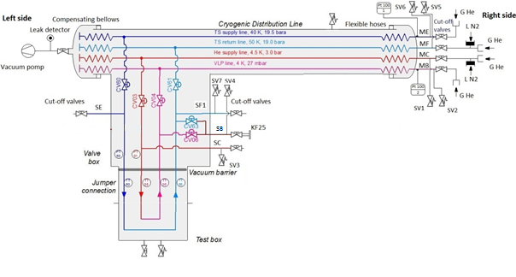
Final factory tests - thermal shocking
CRYOGENICS IS OUR PASSION
www.kriosystem.com.pl

Slide 22
Final factory tests - pressure / helium leak tests of process pipes
Preparation:
The vacuum vessel on the jumper connection shall be closed by vacuum end cap equipped with safety valve and pumping port KF 40, vacuum pump and leak detector must be connected to the pumping port, the vacuum in the end cap must be at least 5·10⁻³ mbar.
All cryogenic valves shall be closed.
Vacuum valve on the pumping port ISO-K 100 shall be opened.
All cut-off valves shall be closed.
Note:
During the pressure tests, the pressure in the process lines shall be gradually increased to a value of 50 % of the required test pressure. Thereafter the pressure shall be increased in steps of approximately 10 % of the required test pressure until the test pressure is reached.
During the pressure tests, the pressure in the process lines shall be gradually increased to a value 2 barg using GHe, then to further increase the pressure GN₂ can be used.
CRYOGENICS IS OUR PASSION
www.kriosystem.com.pl

Slide 23
Final factory tests - valves seat leak tight test
Preparation:
The helium recovery side line 2 – SR2 (DN25) ( installed on the valve box) shall be ended with KF25 vacuum flange, if necessary the cut-off valve should be removed.
The third vacuum pump and third leak detector shall be connected to KF25 vacuum flange on SR2.
CV03, CV04, CV60, CV61 should be closed.
CV06 and CV63 valves shall be opened.
The vacuum in the process pipes shall be created. If it possible, the vacuum should be better than 5·10⁻³ mbar.
Valve seat lea tight test have to be performed with operating pressure.
Observe the leak detector connected to the line. The helium leakage rate across the valve seat must not exceed 1·10⁻⁴ mbar·l/s
After the test the line shall be disconnected and GHe shall be relieved from line - to atmosphere.
CRYOGENICS IS OUR PASSION
www.kriosystem.com.pl

Slide 24
Final factory tests - valve functioning control
All valves shall be actuated along their full stroke repeatedly. The valves shall move softly within the whole range of mechanical operation, without any visible, audible or otherwise noticeable signs of jerks.
Leak Test of Valve Seats contains Valve Functioning Control Test.
CRYOGENICS IS OUR PASSION
www.kriosystem.com.pl

Slide 25
Final factory tests - fiducial control
For Fiducial Control Test we use ATOS optical scanning system.
The scanning process would take place in two steps usind two systems: TRITOP and ATOS Core.
The portable TRITOP system measures coordinates of three-dimensional objects quickly and precisely. The measuring object is recorded with a high-resolution digital camera. The images are automatically evaluated on a notebook using the TRITOP software. With mathematical adjustment computation, a precise model automatically calculated from ray intersection, camera positions, lens distortions and object coordinates. Based on this model and on the digital images, the user performs the actual measurement directly on the notebook screen.
CRYOGENICS IS OUR PASSION
www.kriosystem.com.pl

