Slide 1
Motion Control on ESS Test Beam Line
PDR 23rd May 2017
Viktor Heirich, Thomas Gahl
Disclaimer: These slides are supposed to be used for an ESS internal seminar series for educational purposes only!
Notes:
Hi, I am Viktor Heirich, an electrical engineer seconded from Wigner, Hungary. Currently I am working in Thomas’ group. Now I am going to speak about the motion control on the Test Beamline.

Slide 2
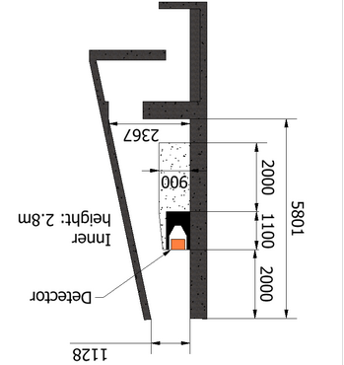
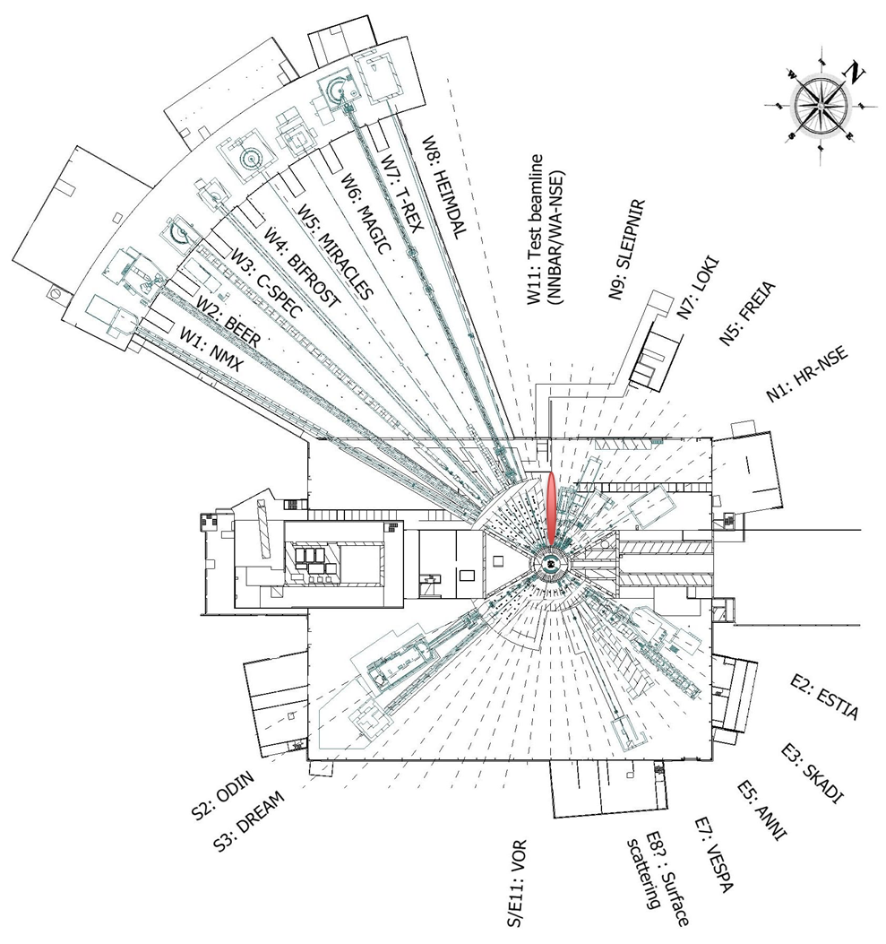
Test Beam Line @ ESS - layout
n
bunker wall
Notes:
On the right you can see the location of the beamline, which is the W11 beam port and a draft of the cave layout. But because we have already talked enough about it I will skip this and jump to the next slide.

Slide 3
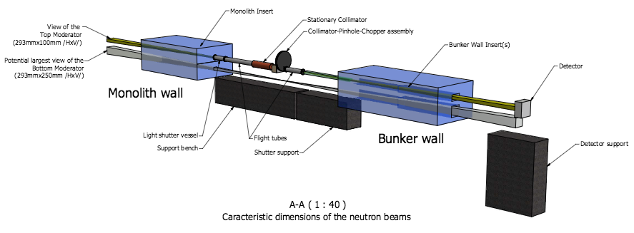
Test Beam Line @ ESS - layout
Notes:
On the top we can see a simplified drawing of the beamline with the neutrons coming from the left and the monolith and the bunker walls represented by the two blue cubes.
On the bottom drawing I have marked with green the locations of the moving components which shall be controlled by us. There are two major assemblies inside the bunker (nominally the pinhole assembly and the heavy shutter) and two outside the bunker in the cave (the sample stage and the detector)

Slide 4
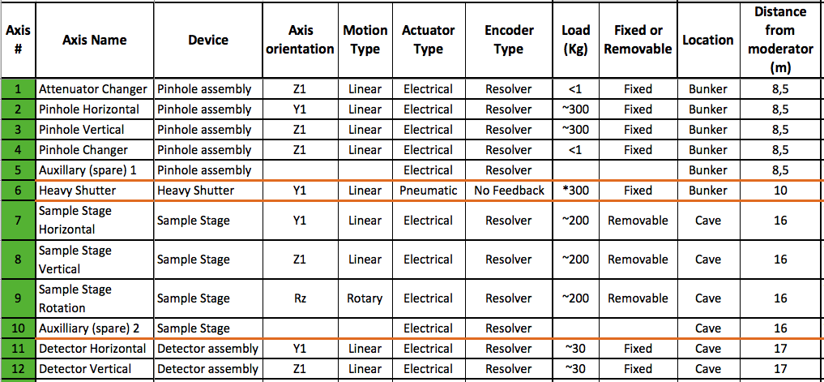
Test beam line – table of motion
Notes:
This is an extract of our so called table of motion, which contains every important property of each axis. I have filled it with the already known data.
On the pinhole assembly we have:
Attenuator changer, this axis moves vertically
Pinhole assembly horizontal movement,
Pinhole assembly vertical movement,
Pinhole changer, which moves vertically too
and one undefined axis for spare.
These axes move linearly, and are electrically driven. Because of the high radiation inside the bunker we have to use resolvers as feedback devices. The attenuator changer and the pinhole changer are light components, but the other two are really heavy. Of course all of these axes are fixed. And they are in a circa 8.5m distance from the moderator.
Next we have the heavy shutter, which is still inside the bunker and move almost horizontally. It is a pneumatically actuated linear axis without an encoder.
In the cave we have the sample stage, which has 3 main axis and one for spare.

Slide 5
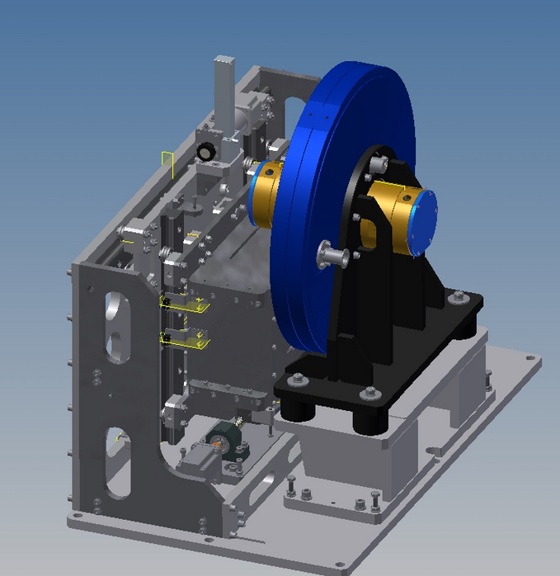
MCA components I – Pinhole collimator I (2Ax)
2 Axes
1. Attenuator changer Z
4. Pinhole changer Y
4.
1.

Slide 6
MCA components II – Pinhole collimator (2Ax)
2+1 Axes
2. Translation Y
3. Translation Z
5. Aux 1
3.
2.

Slide 7
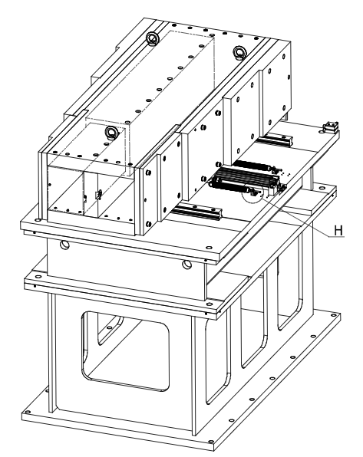
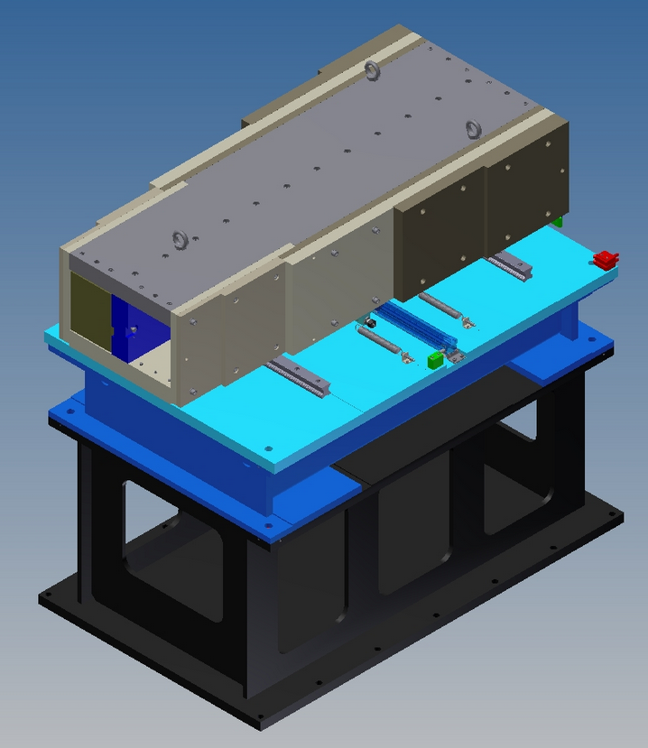
MCA components III – Heavy shutter (1Ax)
1 Axis
6. shutter translation
6.

Slide 8
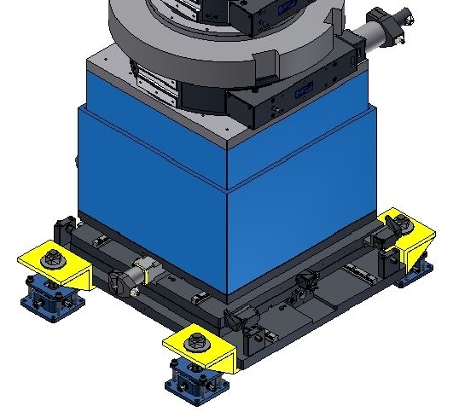
MCA components IV – Sample stage (3 Ax)
9.
3+1 Axes
7. Translation Y
8. Translation Z
9. Rotation Rz
10. Aux 2
8.
7.

Slide 9
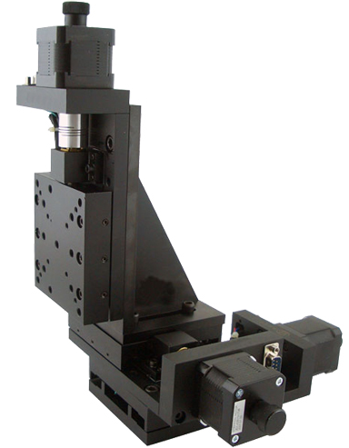
MCA components V – Detector positioner (2 Ax)
2 Axes
11. Translation Y
12. Translation Z
12.
11.

Slide 10
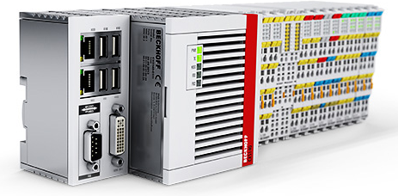
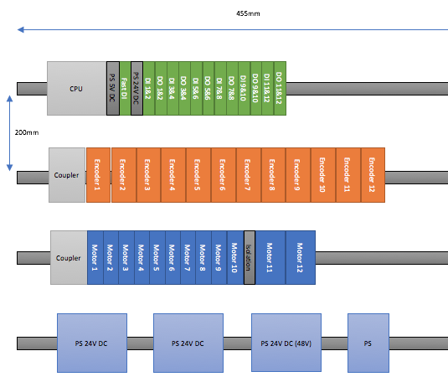
beam line – MCA control system
MCA needs to control:
9 + 2 stepper motors
1 pneumatic actuator
9 + 2 resolver
2 certified limit switches (PSS)
10 +2 radiation proof limit switches
4 radiation proof home switches
10 + 2 standard(?) limit switches
Connection to PSS for shutter control
Solution:
Beckhoff EtherCAT system with TwinCAT software
Standardised 12axes setup for DIN rail cabinets
Notes:
For summary I have collected al the motion control related parts. So will need to control 9+2 stepper motors, one pneumatic actuator. We will have 9+2 resolver for each axis.
For the heavy shutter we need 2 certified limit switches for PSS, On the axes inside the bunker we need 10+2 radiation proof limit switches and 4 radiation proof home switches. This is a question of the accuracy of the limit switches. For the axes in the cave we need an other 10+2 limit switches. It is again a question if these switches need to be radiation proof or not.
The control system shall have connection to PSS for the shutter control.
Our solutions:
This perfectly fits into our standardised 12 axes setup for DIN rail cabinets using Beckhoff EtherCAT system with TwinCAT software.
On the left you can see our preliminary design for the cabinet. The rails are represented with gray, The CPU is on the top with the digital input and output modules. On the second rail are the encoder modules. Under that the modules for the motors. And finally the power supplies on the bottom.

